Slide 1

Mineral Fibers in the Lung:
Toxicology of Asbestos
and other Elongate Mineral fibers
Christopher P. Weis, Ph.D., DABT.
Principal and Science Director
Weis Toxicology, LLC
Bethesda, Maryland
Notes:
1
Introduction:
I’m Chris Weis, Toxicologist and Senior Science Advisor and CEO of Weis Toxicology, LLC in Bethesda, MD. I want to thank FDA for inviting us to join the IWGACP and NIEHS looks forward to continuing our liaison with FDA on today’s topic.
Over the next few minutes, I’d like to give you some background regarding our thoughts about Elongate Mineral Particles. Then, I’d like to take you on a trip deep into the lung where much of the biological damage due to EMP exposures occurs. Finally, I’ll provide some data from my experience and others that demonstrates the need for much better information about EMP exposures.

Slide 2
Background
“Asbestos” and elongate mineral particles (EMP) can cause cancers and non-cancer health effects.
Most occupational exposures to “asbestos” are to chrysotile; amphibole asbestos is a naturally occurring contaminant in talc, vermiculite, taconite and contaminated soils.
EMPs initiate inflammatory responses in relation to their length.
Short fibers are very common in EMP populations and data show that fibers below the resolution of light microscopy contribute to disease.
2
Notes:
I’ll just read this slide to you so that the general points I’d like to convey to you are clear.

Slide 3
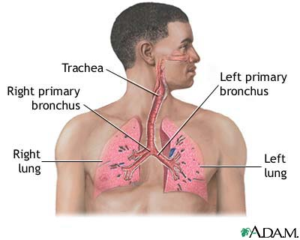
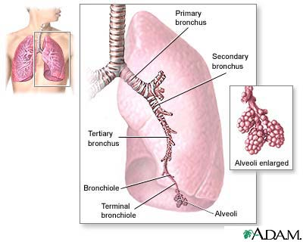

Basic Respiratory Anatomy
Images developed under contract to the National Institutes of Health
3
Notes:
Asbestos in the Lung:
Once inhaled, exposure to asbestos is, in large part, driven by the anatomy of the lung. Fibrous particulates enter the lung through the trachea on laminar air flow. The length to width ratio (Aspect Ratio) of the fibers determines their aerodynamic characteristics as they ‘fly’ through the passageways of the primary, secondary and tertiary branches of the lung bronchioles. This is one reason why measurement of fiber size is so important to the pathophysiology of EMP exposure.
Particles that impact on the surface of the upper reaches of the respiratory tract prior to reaching the alveoli of the lung can be removed by the cilia (little hairs) on the surface of the trachia or bronchioles. However, at the level of the terminal bronchioles and alveoli of the lung, there are no cilia to assist in removing the particulate. The lung must rely on macrophage (scavenger) cells to remove the particles to the lymph system where they are eventually excreted into the urine.
Only particles of sufficiently small size are removed by the macrophage system.
1. Permitted Use. User has a nonexclusive, nontransferable, limited, revocable right to use the Website solely for User’s personal educational, informational, and entertainment use. User will not use the Website for any other purpose, including any commercial purpose, without the Company’s express prior written consent. For example, User will not and will not authorize any other party to (i) Co-brand the Website or portion thereof, or (ii) frame the Website or portion thereof (whereby the Website or portion thereof will appear on the same screen with a portion of another website). "Co-branding" means to display a name, logo, trademark, or other means of attribution or identification of any party in such a manner reasonably likely to give a User the impression that such other party has the right to display, publish, or distribute the Website or content accessible within the Website (the "Content"). User agrees to cooperate with the Company in causing any unauthorized Co-branding, framing or linking to immediately cease.

Slide 4
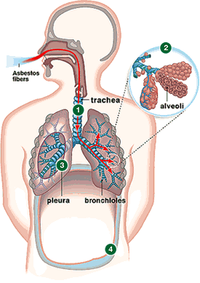
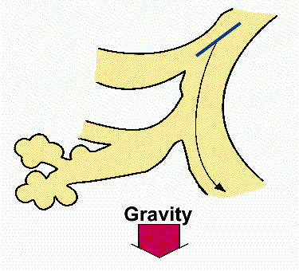
Fiber Deposition in the Lung
4
Notes:
This cartoon depicts an Elongate Mineral Fiber (EMP). Note that the characteristics of the fiber as well as the lung. Fibers that impact deeper in the lung must either remain in the lung or be actively removed by

Slide 5
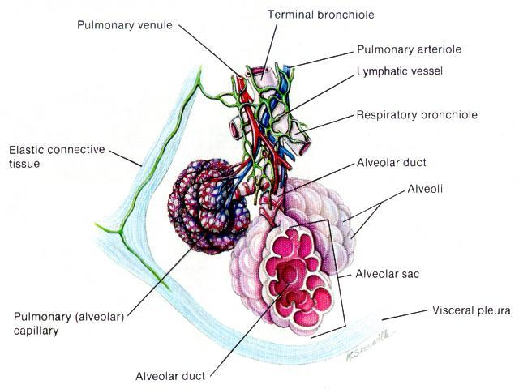
Anatomy of the bronchiolar alveolus clusters
5

Slide 6
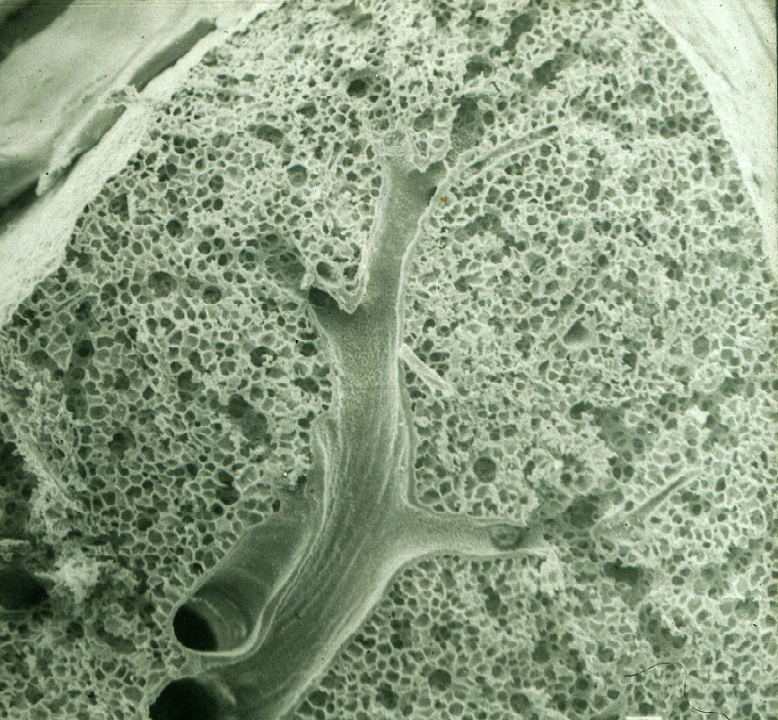
Photo Credit: Dr. Arnold Brody

Slide 7
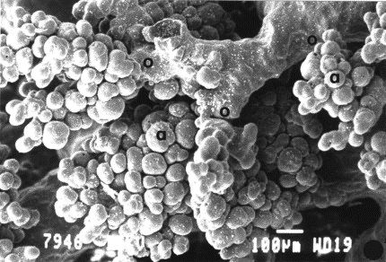
Bronchiole Alveolar Structure
Maina & van Gils (2001) Comp. Biochem and Physiol. 130(4)781-798.
6

Slide 8
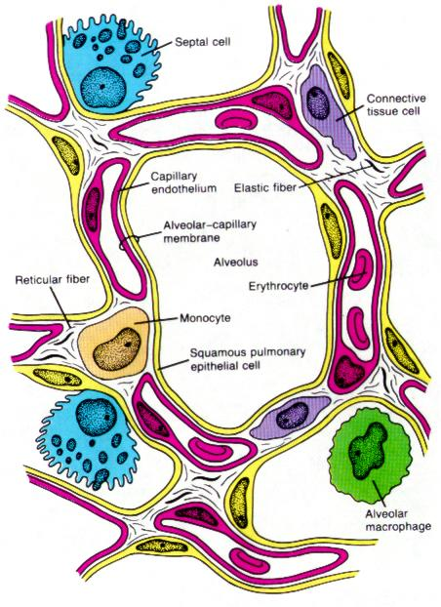
Gas exchange in the lung
Blood volume
in capillary space
Is about 70 mL.
The alveolar-
capillary membrane
is just 0.2 microns
thick!
Blood flow through
the lung is about
5L/min.
7

Slide 9

Pulmonary Alveolar Macrophage:
searching for foreign material
SciencePhotoLibrary.com – Dennis Kunkel, with permission (756696).
8

Slide 10
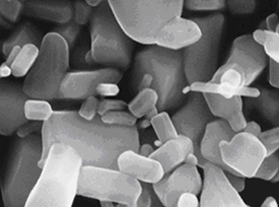
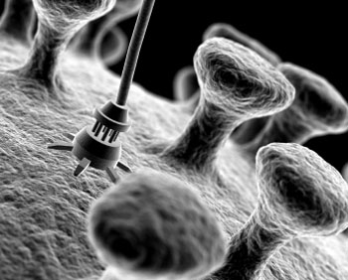
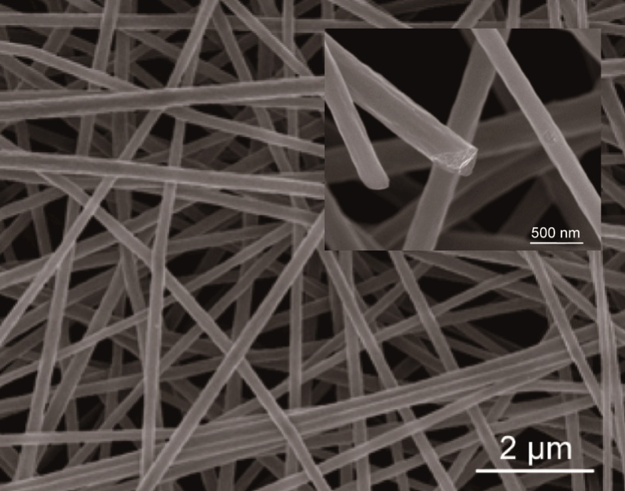
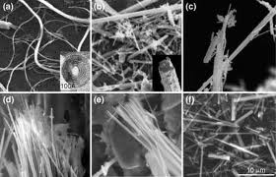
9

Slide 11
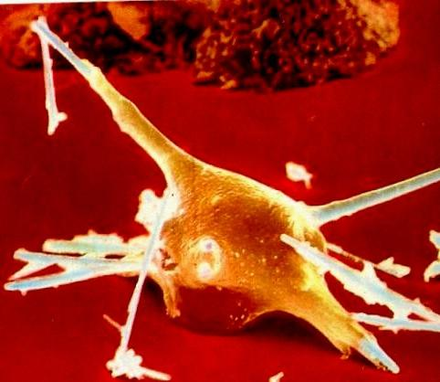
Frustrated phagocytosis of asbestos fibers
A Pulmonary Alveolar Macrophage cell (PAM) attempts to engulf and ingest several elongate mineral particles (EMP)
Incomplete ingestion of bio-persistent particles can lead to release of pyrogens, (e.g. IL-2b) proteolytic enzymes, and ROS from the ‘frustrated’ PAM
Frustrated PAM circulate through the blood to other tissues carrying EMP with them.
10

Slide 12
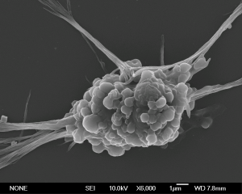
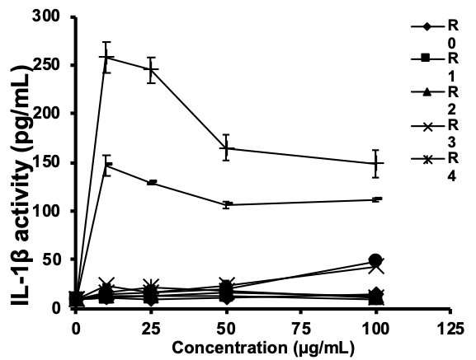
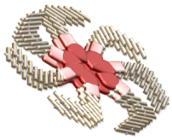
Frustrated phagocytes release pyrogenic cytokines
that can cause inflammation
THP-1 phagocyte cells
Exposed to EMP <2um
AR 6:1
Macrophage
lysosome
AR 7:1
NALP3
IL-1β
AR 0-5:1
pro-IL-1β
IL-1β
N
Inflammasome activation
Ji, Xia, Wang, Nel, Zink ACS Nano 2012
11

Slide 13
Asbestos-Related Lung Diseases
Pleural Effusions
Pleural Plaques and Diffuse Pleural Thickening
Pulmonary Fibrosis
Malignant Mesothelioma
Bronchogenic Carcinoma
12
Notes:
Pleural Effusions
Earliest and most common effect, seen 10-20 years after even minimal exposure.
Pleural Plaques and Diffuse Pleural Thickening
Pleural fibrosis containing many asbestos fibers, inflammation.
Pulmonary Fibrosis
Bilateral interstitial fibrosis, frequently associated with diffuse pleural thickening; development requires higher doses of asbestos penetrating deep into lung and phagocytosis of fibers by macrophages, stimulating fibroblasts to deposit connective tissue.
Malignant Mesothelioma
Usually arises in the pleura and peritoneum, but sometimes pericardium, larynx, kidney.
Strongly associated with cumulative burden of asbestos exposure; latency 35-40 years.
Aggressive: most die within 1 year of diagnosis.
Bronchogenic Carcinoma
Develops in 20-25% of asbestos workers, usually after 10-30 years latency; prognosis poor.
Amphiboles are 10-50x more potent than chrysotile as inducer.
Smoking coupled with asbestos exposure may double the risk.

Slide 14
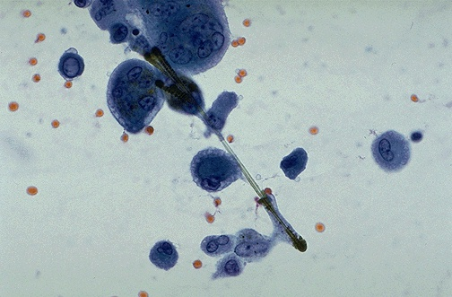
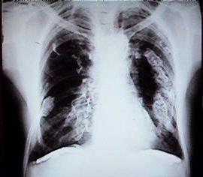
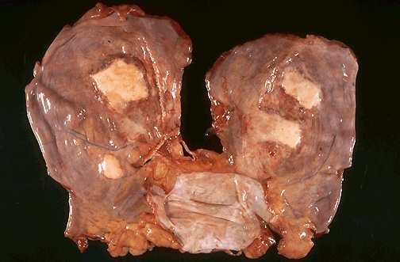
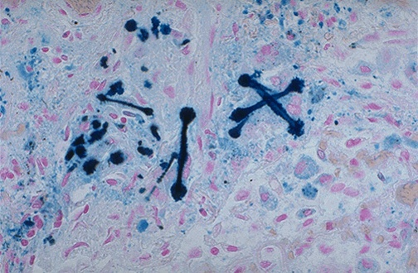
Microscopic and macroscopic lung abnormalities caused by durable fibers
Radiograph of
Pleural plaques
‘mineral bodies’
Anatomy of
Pleural plaques
‘ferruginous bodies’
Attribution: Med. Digital Library. Univ. of Michigan
13

Slide 15
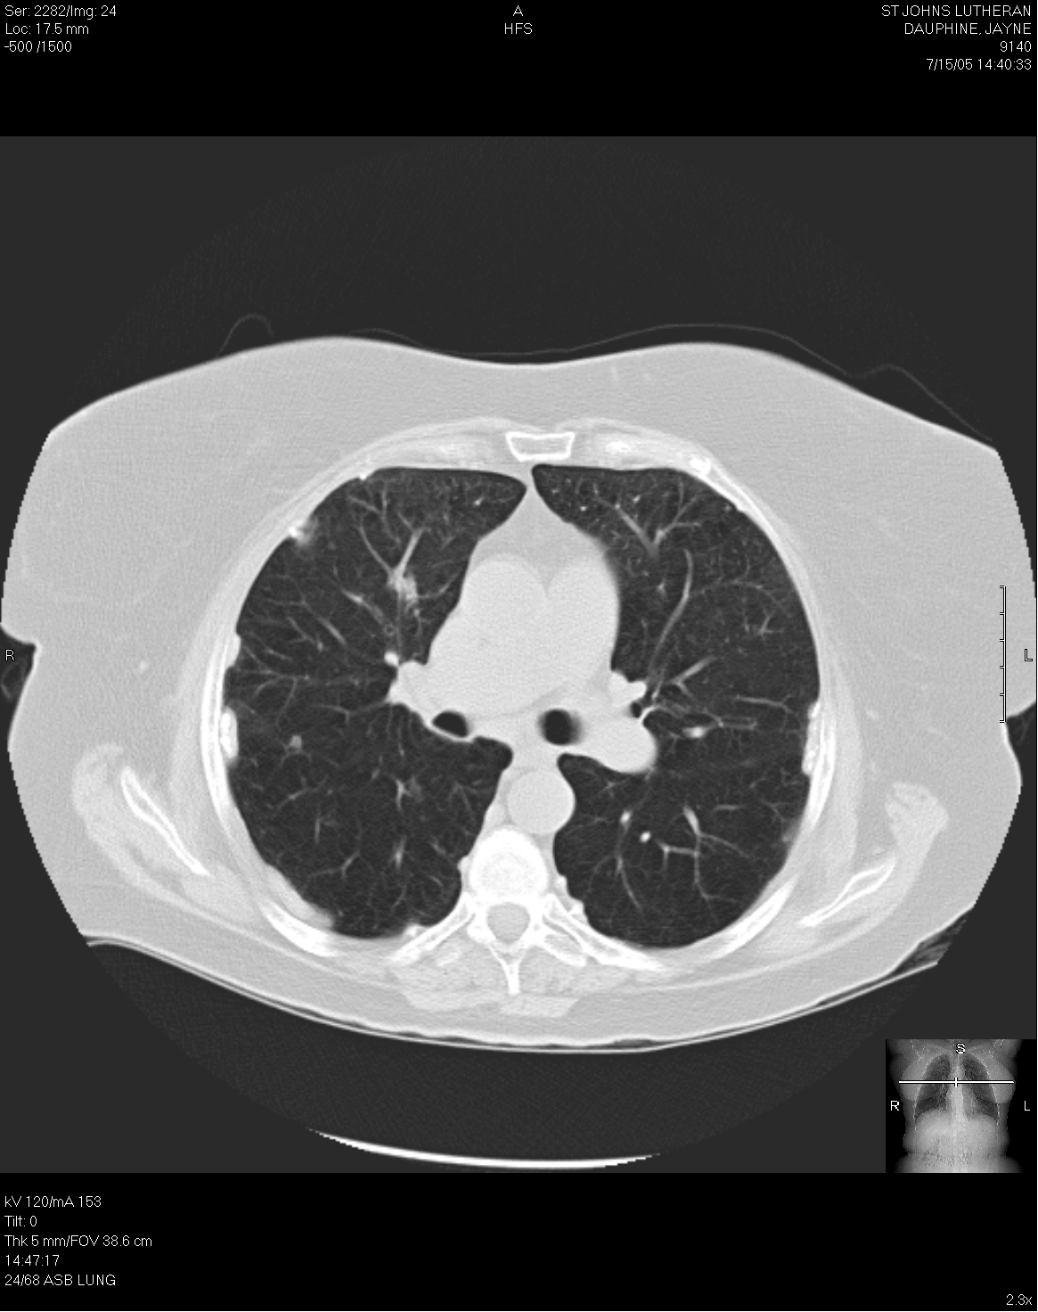
HRCT Image of Localized Pleural Thickening.
Courtesy of the Center for Asbestos-Related Disease. Libby, MT
14

Slide 16
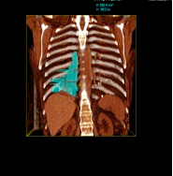
High Resolution Computed Tomography (HRCT) of a pleural plaque
HRCT scan of a 45 Y.O. female with secondary (take home) exposure to nano particle taconite dust in the Upper Peninsula of Michigan.
Harbut et al. (2009) Int J Occup Environ Health 15(3):269-273.
15
Notes:
Calcifications along the anterior right pleural plaques are increasing as well as the thickness of the pleural plaques; peripheral interstitial pulmonary fibrosis has remained essentially unchanged; fibrosis predominates along the mid and lower lung zones; pericardial thickening and partially calcified plaques are identified along the anterior left lateral aspect of the heart.

Slide 17
Mechanisms of Pathogenesis by Inhaled Mineral Dusts
Mineral particles accumulate in lung
Macrophages engulf trapped particulates; travel to lymphatic system
Many particles activate an inflammatory response,
Disease typically develops over a long period of time
16
Notes:
Mineral particles accumulate in lung
Smallest particles travel deepest
Clearance from lower airways, if it happens, takes decades
~20 yrs for amphiboles, ~ 10 yrs for chrysotile
Macrophages engulf trapped particulates; travel to lymphatic system
Long fibers -> ‘frustrated phagocytosis’, ‘asbestos bodies’
Many particles activate an inflammatory response, initiating collagen deposition (granulomas), scarring, fibrosis, interstitial lung disease, mutation
Disease typically develops over a long period of time

Slide 18

Elongate mineral particles from Western Montana
Attribution:
17
Notes:
A bundle of Libby Amphibole fibers (tremolite-actinolite-winchite) observed in a residential soil sample recorded as non-detect using bulk analysis by polarized light microscopy (SOP EPA 9002).

Slide 19
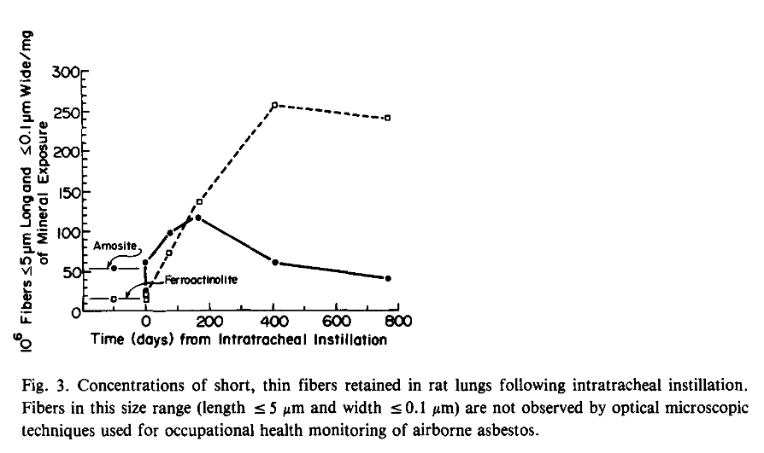
Fibers can disaggregate in vivo following exposure.
Cook, P.M., L.D. Palekar, and D.L. Coffin, Interpretation of the carcinogenicity of amosite asbestos and ferroactinolite on the basis of retained fiber dose and characteristics in vivo. Toxicol Lett, 1982. 13(3-4): p. 151-8.
18
Notes:
Fiber bundles can disaggregate

Slide 20
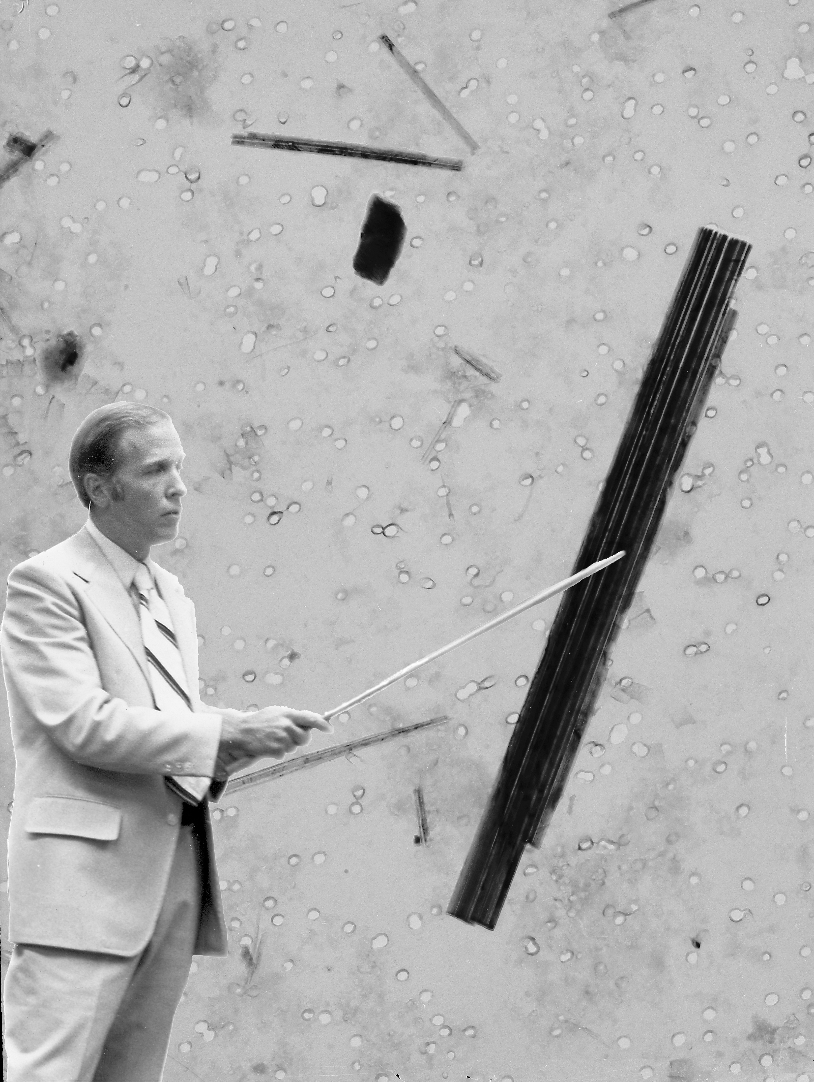
Eureka!
ferroactinolite fibers were dissolving and splitting longitudinally while residing in rat lung tissues over time.
Courtesy of the late Dr. Phil Cook
19

Slide 21
20

Slide 22
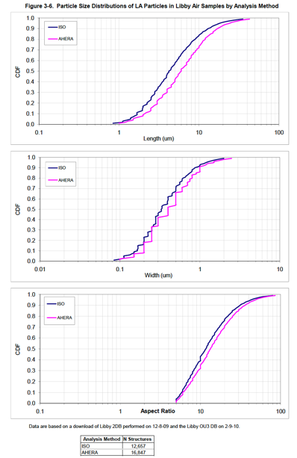
EMP size distributions of airborne fibers
collected in Libby, MT
EPA, U.S., Particle size distribution data for Libby Amphibole structures observed in air at the Libby Asbestos Superfund site. . 2010: Denver, CO
18
Notes:
EMP size distributions from airborne samples collected by EPA in Libby, MT. Note that more half of the particles are shorter than the commonly employed < 5 microns. (N=12,657 airborne fibers)
EPA, U.S., Particle size distribution data for Libby Amphibole structures observed in air at the Libby Asbestos Superfund site. . 2010: Denver, CO

Slide 23
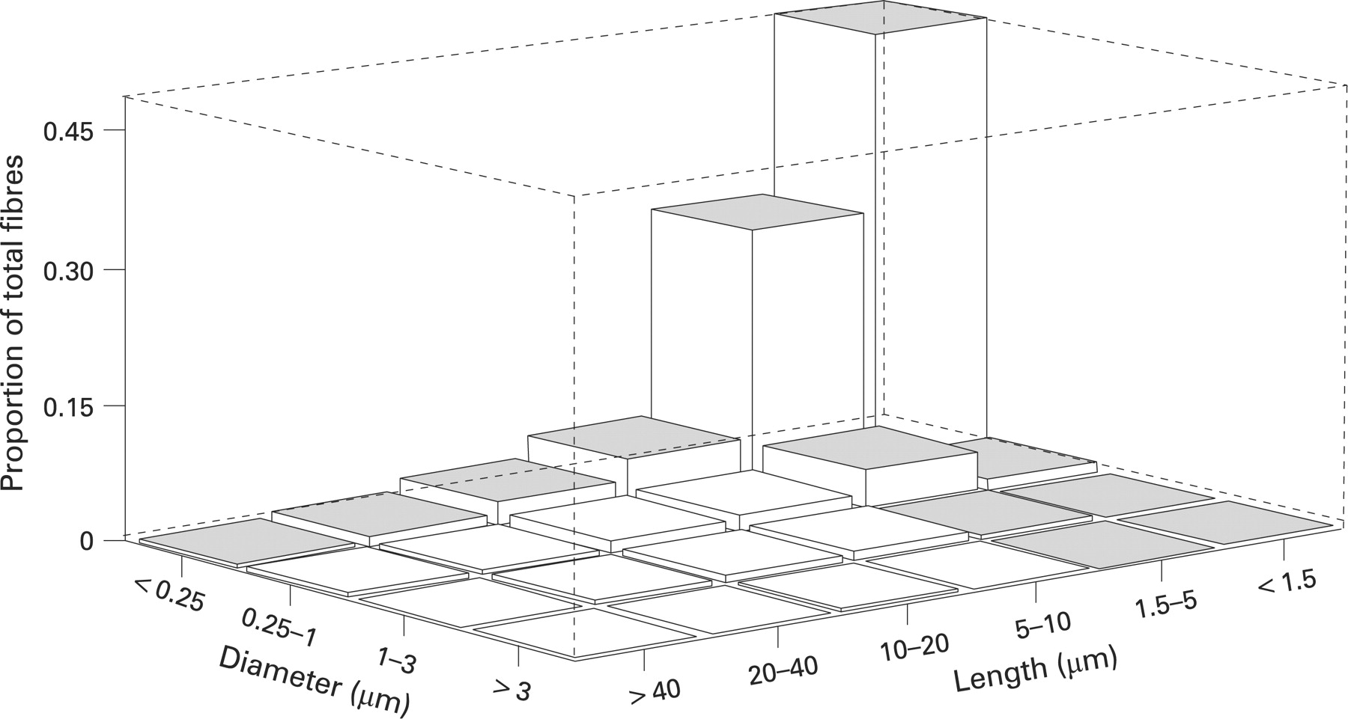
Size–based RfCs: a good idea?
“Fibres shorter than 5 μm have traditionally not been counted by methods used for regulatory standards for asbestos because these methods were developed to provide a reproducible index of fibre exposure.
The findings from our analysis show that cumulative exposures to all fibre size indices, including fibres <5 μm in length, were highly statistically significant predictors of lung cancer or asbestosis mortality.”
Stayner et al. (2008) Occ. Env. Med 65(9):613
21
Notes:
Results: TEM-based cumulative exposure estimates were found to provide stronger predictions of asbestosis and lung cancer mortality than PCM-based estimates. Cumulative exposures based on individual fibre size-specific categories were all found to be highly statistically significant predictors of lung cancer and asbestosis. Both lung cancer and asbestosis were most strongly associated with exposure to thin fibres (<0.25 μm). Longer (>10 μm) fibres were found to be the strongest predictors of lung cancer, but an inconsistent pattern with fibre length was observed for asbestosis. Cumulative exposures were highly correlated across all fibre size categories in this cohort (0.28–0.99, p values <0.001), which complicates the interpretation of the study findings.
Conclusions: Asbestos fibre dimension appears to be an important determinant of respiratory disease risk. Current PCM-based methods may underestimate asbestos exposures to the thinnest fibres, which were the strongest predictor of lung cancer or asbestosis mortality in this study. Additional studies are needed of other asbestos cohorts to further elucidate the role of fibre dimension and type.
http://dx.doi.org/10.1136/oem.2007.035584
Short fibres
Fibres shorter than 5 μm have traditionally not been counted by methods used for regulatory standards for asbestos because these methods were developed to provide a reproducible index of fibre exposure. The findings from our analysis show that cumulative exposures to all fibre size indices, including fibres ⩽5 μm in length, were highly statistically significant predictors of lung cancer or asbestosis mortality. However, because of the correlations in these fibre size distributions, it is not possible to clearly distinguish between a biological basis for a specific fibre dimension (eg, ⩽5 μm) versus a simple association with exposures to the longer fibres in this facility. The models comparing the shorter (⩽5 μm) and longer (>5 μm) fibres did not completely resolve this question. That is, for asbestosis cumulative exposure to fibres ⩽5 μm in length provided a slightly better fit to the data than did fibres >5 μm, while for lung cancer, cumulative exposure to fibres >5 μm provided a slightly better fit (in univariate analyses). Multivariate models containing cumulative exposure indices for both fibre dimensions (⩽5 μm and >5 μm in length) did not significantly improve the fit of either lung cancer or asbestosis models over those containing a single parameter for fibre length. In contrast, other findings in this study did provide support for a role of increasing fibre length (especially >10 μm) in predicting lung cancer mortality, while a trend with fibre length was not as apparent for asbestosis.

Slide 24





Size Distribution of Tremolite Particles in Two Cosmetic Products Tested for FDA
22

Slide 25
EMP Characteristics of importance to health
Length and width (all)
Persistence in biological tissue
Surface area
Mineral type and habit
Surface reactivity
Surface charge (Zeta potential)
23

