Slide 1
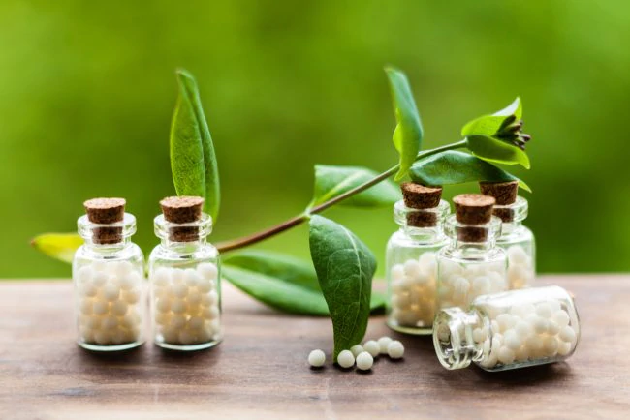

Slide 2
Homeopathic Treatment of Brain Injury:
Stimulating Self Healing to Improve Outcomes
Sarah Paton, ND
Naturopathic Doctor
Virtual Brain Injury & Stroke Conference
May 13, 2021

Slide 3
Professional Experience
Licensed Naturopathic doctor
  Family medicine practice in Portland since 2008
Faculty + Curriculum Development
    University of Southern Maine, College of Nursing’s Holistic Health Program
    Baylight Center for Homeopathy
Past President
  Maine Association of Naturopathic Doctors

Slide 4
Naturopathic doctor training includes:
Nutrition - including supplementation and IV therapy
Herbal medicine
Homeopathic medicine
Physical adjustments like chiropractic
Lifestyle counseling
Physical exam, labs/imaging, minor surgery

Slide 5
Goals today are to provide you with:
Clear understanding of homeopathic medicine and how it can support patients healing and recovery
Give you some basic medicines for patients to try on their own if they wish
Know when referral for homeopathic medicine is appropriate
Inspire you with some case studies showing effectiveness of homeopathic medicine

Slide 6
Outline
Introduction and History of Homeopathic Medicine
Homeopathic Medicine in Practice
Production of Homeopathic Medications
Homeopathic Treatment of Brain Injury with most commonly indicated medications.
Evaluating Treatment with Homeopathic Medicine
Inspiring Case Studies

Slide 7
Introduction to Homeopathic Medicine

Slide 8
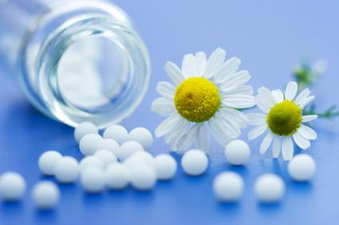
What is homeopathy?
A 200 year-old system of medicine using highly diluted form of a natural substances to stimulate body’s healing mechanism

Slide 9
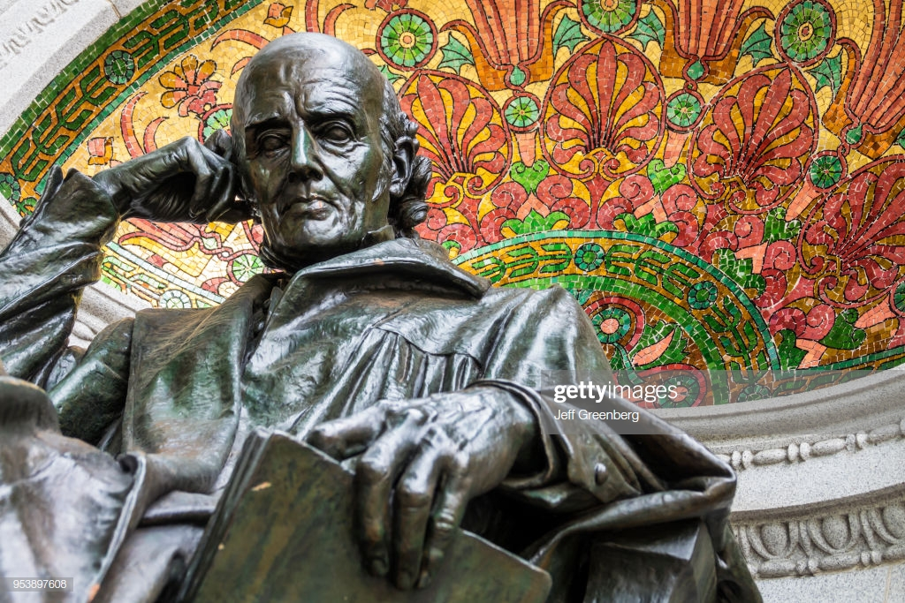
Discovery of homeopathy
Samuel Hahnemann (1755-1843) - German physician
Saw Cinchona bark toxicity was similar to symptoms of malaria.
He took it himself and started diluting it so as not to poison himself and got same anti-malarial effect.

Slide 10
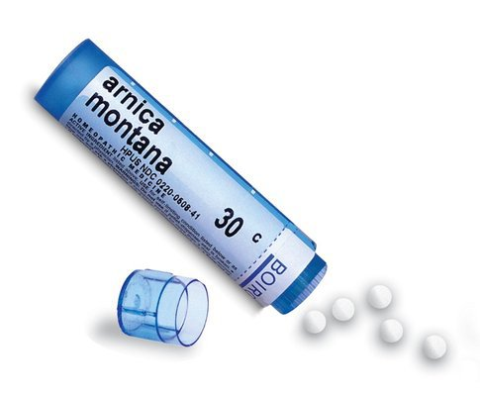
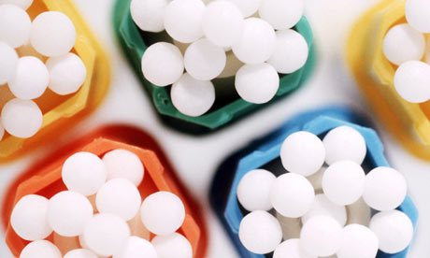
What is a homeopathic “remedy”
Medication made from minerals, plants or animal products

Slide 11
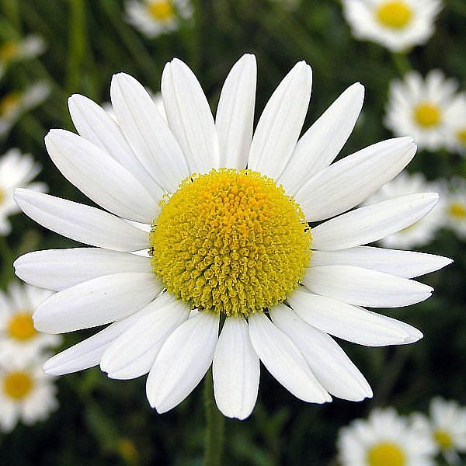
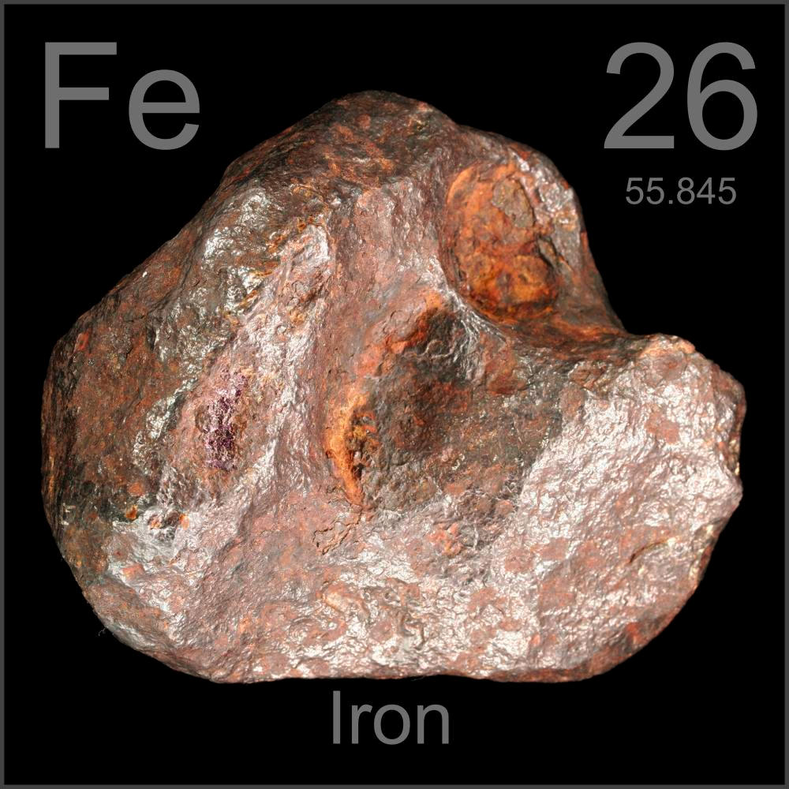
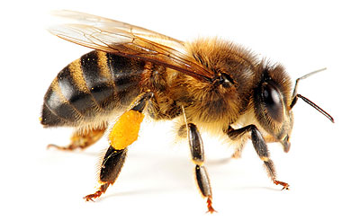
What are remedies made from?

Slide 12
Who uses homeopathy?
Every year, 6 million Americans use homeopathy. (1,2)
Worldwide, over 200 million people employ homeopathic medicine. (3)
Homeopathy is included in the national health systems of a number of countries including Brazil, Chile, India, Mexico, Pakistan, Switzerland, Cuba, United Kingdom.(4)
Black LI, et al. Use of Complementary Health Approaches Among Children Aged 4–17 Years in the United States: National Health Interview Survey, 2007–2012. National Health Statistics Reports, 2015; 78: February
Clarke TC, et al. Trends in the Use of Complementary Health Approaches Among Adults: United States, 2002–2012. National Health Statistics Reports, 2015; 79: February
Prasad R. Homoeopathy booming in India. Lancet, 2007; 370:1679-80
Homeopathic medicinal products. Commission report to the European Parliament and the Council on the application of Directives 92/73 and 92/74

Slide 13
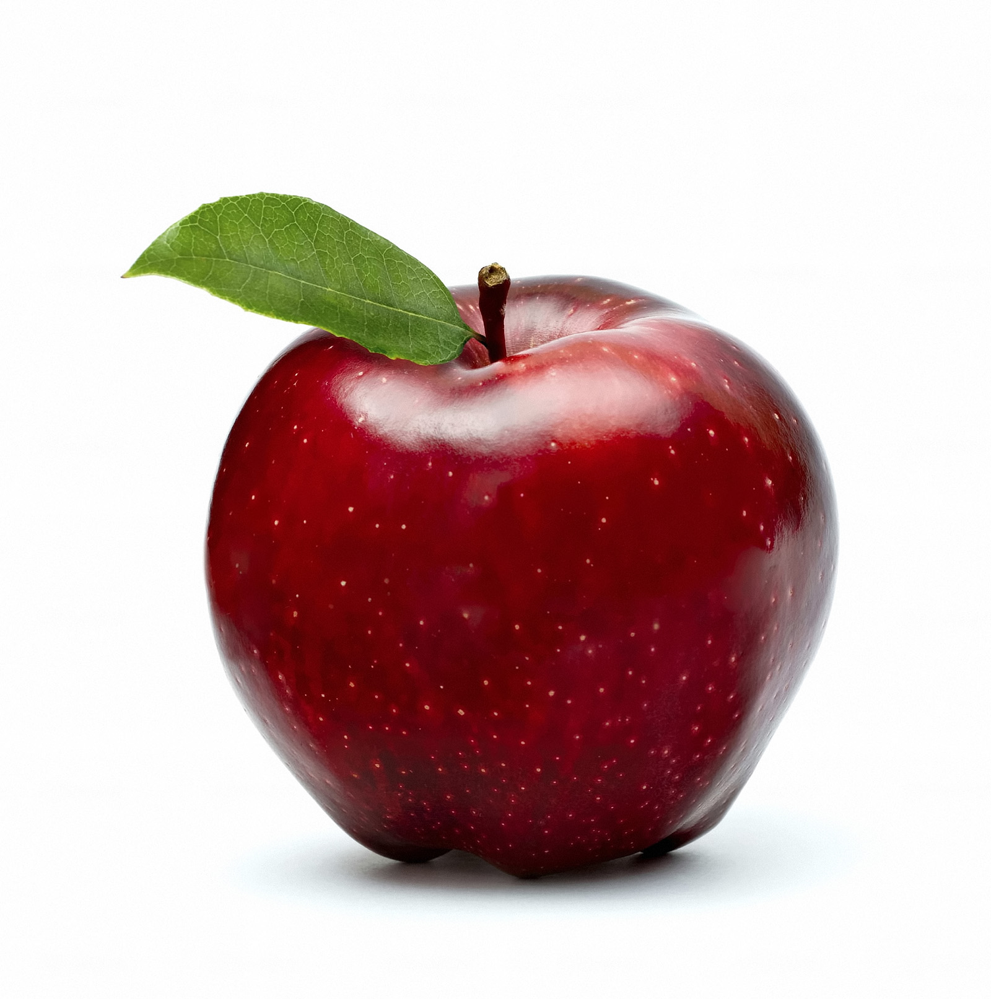
How does it work?
Employs natural principle observed in living systems called the Law of Similars.
“Like Cures Like”
Substance that produces symptoms in healthy subject will cure same symptoms when given to sick person.

Slide 14
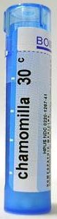
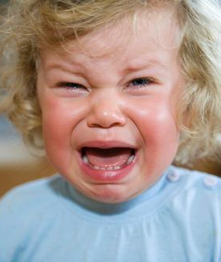
Example of Law of Similars
In healthy subjects Chamomilla CAUSES:
  Irritability, tantrums, sensitivity to pain
In unhealthy subjects, Chamomilla CURES those same symptoms.
  For teething toddlers at naptime!

Slide 15
Homeopathic Medicine in Practice

Slide 16
How do we tell what each remedy should be given for?
By homeopathic drug trials called “provings”
  4,000-5,000 substances have been tested for their medicinal effects, in past 200 years.
Each remedy causes a characteristic group of short-term side effects when given to healthy people.

Slide 17
The homeopathic process
A homeopath will ask you to describe your symptoms and history in detail.
  They will give you a remedy at the time or will take time to research and select your remedy.
You come back in 4-6 weeks for follow up

Slide 18
What information is needed?
An OVERVIEW of the whole person
  Not just the main complaint
Useful information is unique to the individual
  Time of day complaints are better or worse
    Headache worse at 9pm
  Triggers for problems or what makes them better
    Dizziness that comes on after getting angry.
  What exactly does the pain feel like?
    Feels like a knife stabbing into my left temple!

Slide 19
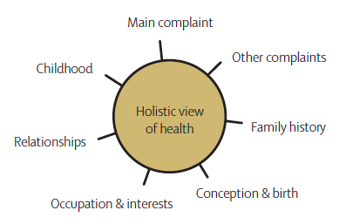
Medical + personal history are important

Slide 20
Activity
Mini case taking demonstration for gathering history:
Who has a complaint they’d be willing to discuss?

Slide 21
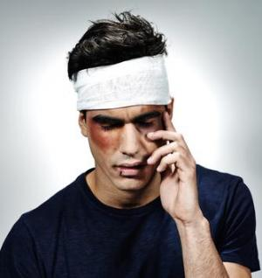
Homeopathic medicine for acute injury
For acute injuries with symptoms lasting less than 6 weeks, patients can use homeopathic medication in addition to their conventional treatment.
If symptoms aren’t resolving, see a trained homeopath.

Slide 22
Acute dosing protocol
Dosages are taken orally, typically 3 pellets dissolved under the tongue.
They can be taken up to 3x/day and then less often as long as improvement is continuing.
Topical homeopathic creams are available and work well for bruising, pain, and swelling after injury.

Slide 23
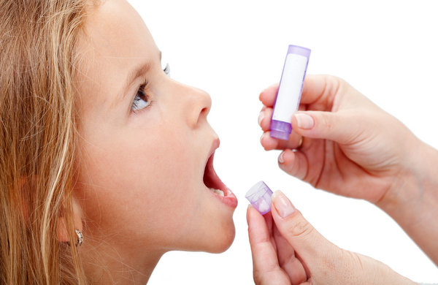
How remedies are dosed
One dose is 3 pellets
  Dissolved under tongue
  No food or drink 15 minutes before or after dosing
To start treatment:
  Take 3 pellets at bedtime + 3 pellets the next morning within 12 hours.
  Those 6 pills will act for 4-6 weeks IF you avoid coffee, mint, and prescription medications.
  If you are on those, see next slide.

Slide 24
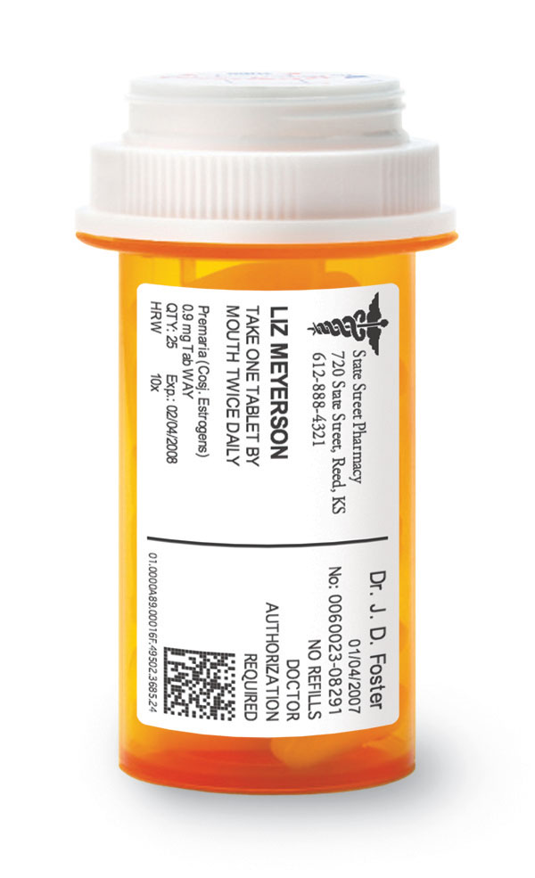
If taking other prescriptions, dose daily
After the first two doses of 30C, take a lower daily dose of the same remedy.
  This means 1 pellet of 6C nightly at bedtime for the next 4-6 weeks.
Wait the full 4-6 weeks to see what action the remedy will have.

Slide 25
After 4-6 weeks, then what?
If symptoms are still improved, don’t redose unless they come back.
  If you are doing well, you don’t redose with 30C.
Can be normal to need repeated doses monthly for 3-6 months or more.
  Eventually you won’t need to redose and your symptoms will not come back.

Slide 26
Production of Homeopathic Medication

Slide 27
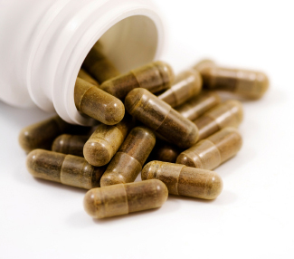
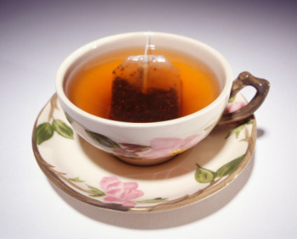
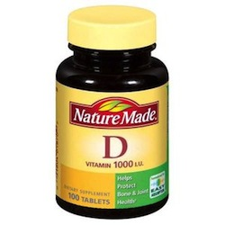
How are homeopathic remedies different from herbs + supplements?

Slide 28
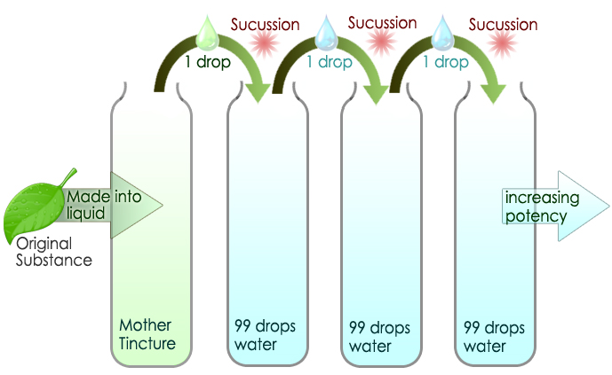
How are homeopathic remedies made?

Slide 29
What’s in a homeopathic remedy?
Single remedies
  Most professionals prescribe just one substance at a time, not a mixture of different substances.
Combination remedies
  Contain more than one type of homeopathic remedy.
  The tend not to be curative but can alleviate symptoms.

Slide 30

Is homeopathic medicine safe?
Yes, because highly diluted, there’s no interaction with prescription medications, herbs or supplements.
Safe to use with other treatments, but acupuncture may interrupt the action of the remedy so redose after each treatment.

Slide 31
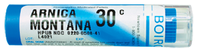
Remedies come in different strengths
Potencies are the numbers next to the remedy name of the bottle:
  Ex, Arnica 30C
From lower to higher strength:
  6C - used daily if on meds or using coffee/mint
  30C - good to start treatment
  200C - if 30C stops working
  1M - if 200C stops working

Slide 32
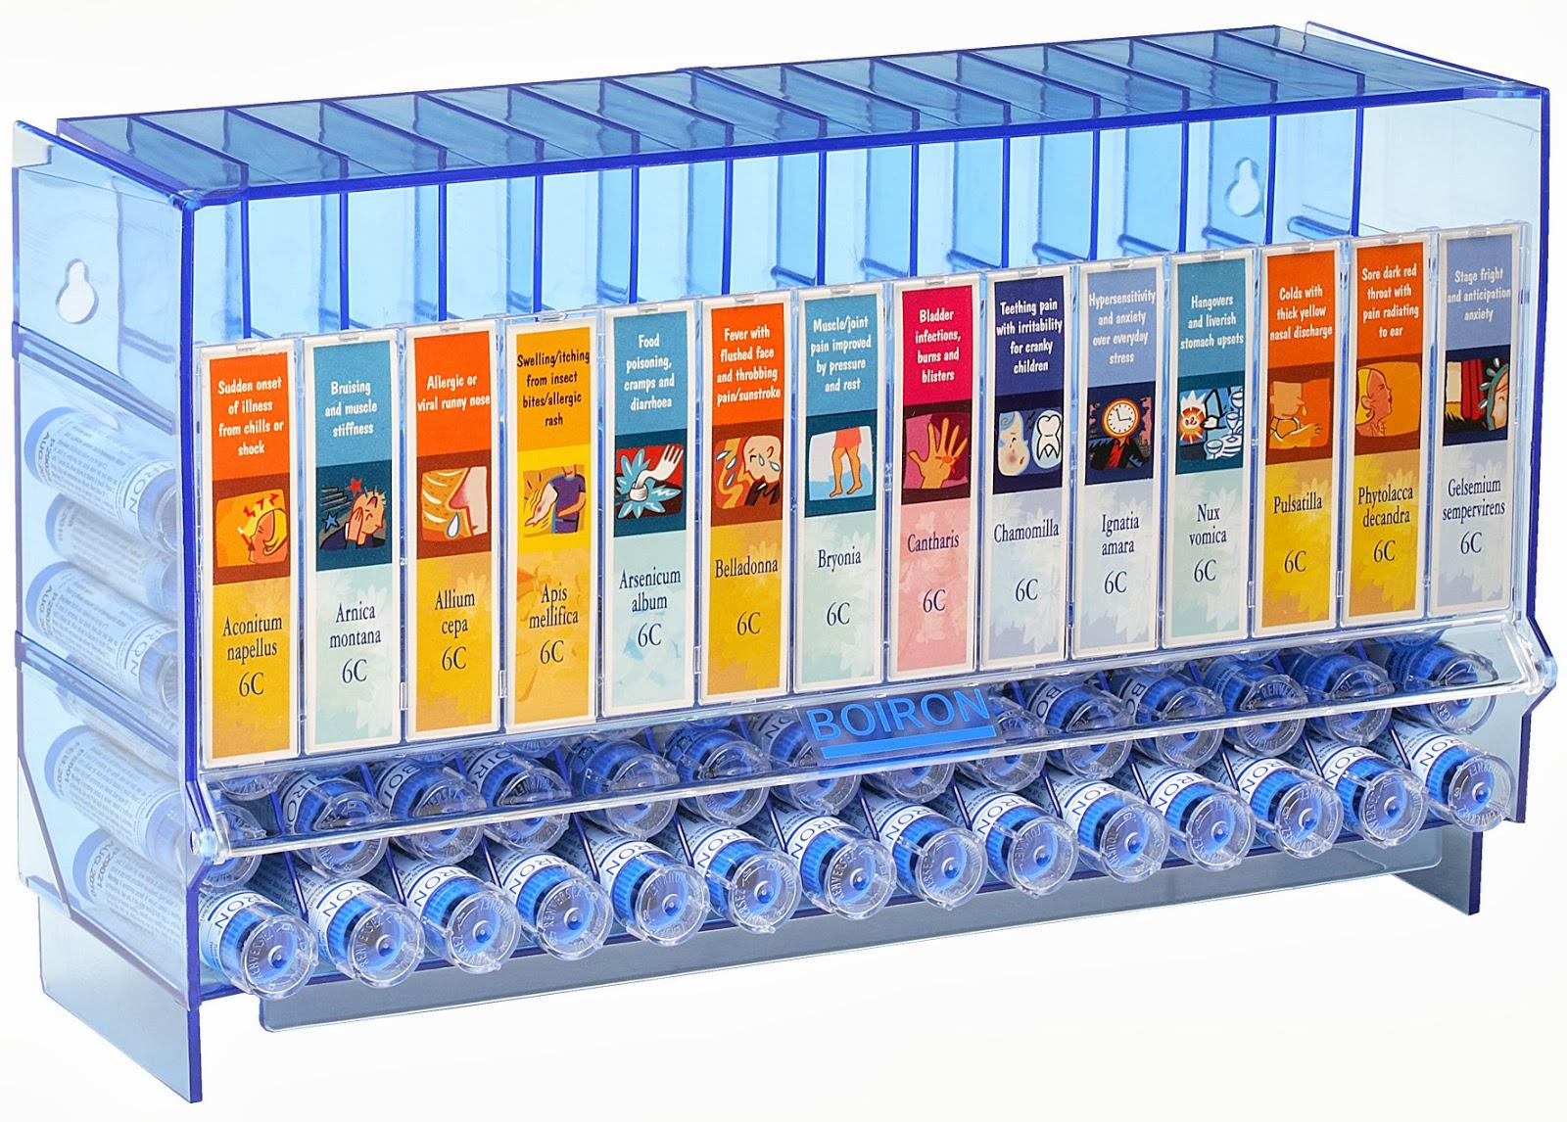
Access to homeopathic medication
Most homeopathic medicines are available over-the-counter at health food stores or homeopathic pharmacies.
The “potency” or strength used for many injuries is 30C.
  Ex: “Arnica montana 30C”
Cost is about $8 for 30 doses.

Slide 33
Buying At-Home Kits:
Single remedies can be found on Amazon
Helios Pharmacy in London is excellent for kits
  https://www.helios.co.uk/shop/basic-36-kit
  $50 for 20-30 remedies
Hahnemann Labs in California
  Is excellent for single remedies, not so great for home kits.
  $10 for single remedies
  http://www.hahnemannlabs.com/

Slide 34
Scientific research supporting homeopathic medicine
Studies showing efficacy of homeopathic medicine in treatment of traumatic brain injury, trauma, emergency medicine.
  J Head Trauma Rehabil. 1999 Dec;14(6):521-42. Homeopathic treatment of mild traumatic brain injury: A randomized, double-blind, placebo-controlled clinical trial. Chapman EH1, Weintraub RJ, Milburn MA, Pirozzi TO, Woo E.
  Complement Ther Med. 2008 Feb;16(1):22-7. doi: 10.1016/j.ctim.2007.04.004. Epub 2007 Jul 12. The role of a homoeopathic preparation compared with conventional therapy in the treatment of injuries: an observational cohort study. Schneider C1, Schneider B, Hanisch J, van Haselen R.
  Wien Med Wochenschr. 2005 Nov;155(21-22):491-7. Homeopathy in emergency medicine. Oberbaum M1, Singer SR, Friehs H, Frass M.
A great resource for cutting edge research in the UK
  https://www.hri-research.org/hri-research/how-do-homeopathic-medicines-work/

Slide 35
Research
J Head Trauma Rehabil. 1999 Dec;14(6):521-42. Homeopathic treatment of mild traumatic brain injury: A randomized, double-blind, placebo-controlled clinical trial. Chapman EH1, Weintraub RJ, Milburn MA, Pirozzi TO, Woo E.
  Randomized, double-blind, placebo-controlled trial of 60 patients using homeopathic remedies vs placebo. Results indicate a significant improvement from the homeopathic treatment versus the control and translate into clinically significant outcomes for mild traumatic brain injury.

Slide 36
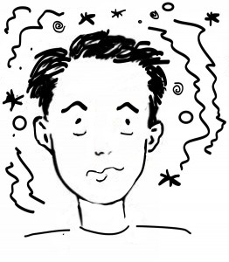
Brain-injury related conditions homeopathic remedies can help
Headache
Vertigo or dizziness
Confusion + brain fog
Difficult concentration
Memory problems
Cognitive + visual processing deficits
Depression

Slide 37
Most common homeopathic medications for Traumatic Brain Injury
Arnica montana
Cicuta
Helleborus
Natrum sulphuricum
Hypericum
Belladonna
Aconite
Bryonia
Pulsatilla
Gelsemium

Slide 38
Homeopathic medications and their symptoms
Each medication has a “symptom picture” which means a common group of issues that the remedy treats.
When the remedy symptom picture is matched to the patient’s symptoms, the symptoms go away.

Slide 39

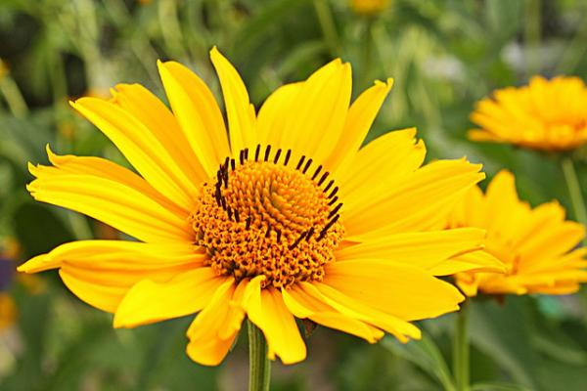
“Arnica montana” medication
Made from flower Wolf’s bane or Mountain Arnica

Slide 40
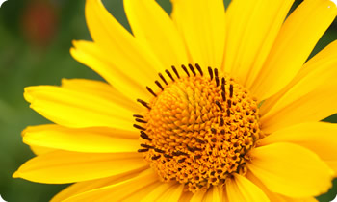
“Arnica montana” medication
Source material: Wolf’s Daisy flower
Top trauma and injury remedy
Bruised, sore achy feeling
Reduces pain and swelling and decreases healing time
For the injured person who thinks they are fine, even when obviously hurt.

Slide 41
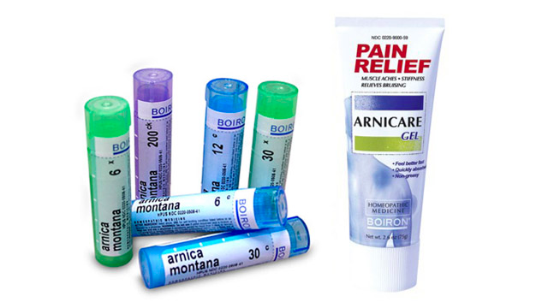
Most popular homeopathic medication worldwide: Oral pellet form and topical gels widely available
Notes:
Topical not at curative as oral pills.

Slide 42
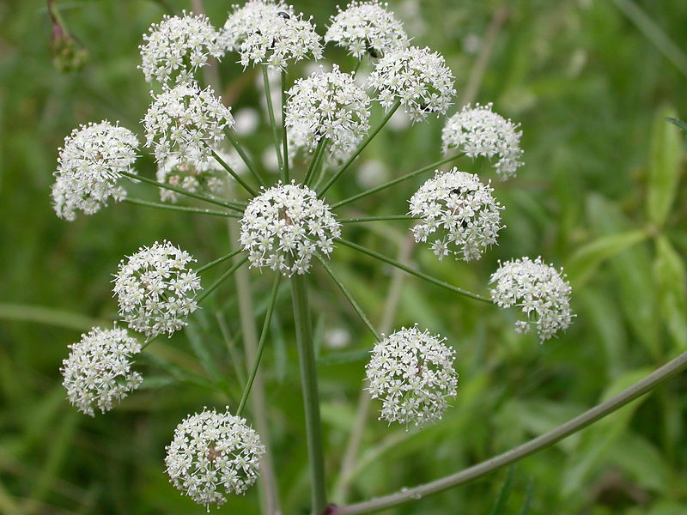
“Cicuta virosa” medication
Source material: Water Hemlock plant
Mental dullness, childish behavior
Brain fog, difficulty thinking, memory deficits
Used for concussion, epilepsy, and developmental disorders

Slide 43
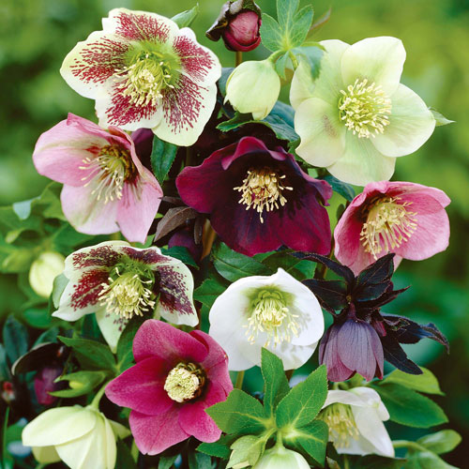
“Helleborus” medication
Source material: Christmas Rose plant
Obtunded after head injury
Takes long time to speak and answer questions
Wrinkled forehead like they are trying hard to think
Blank expression

Slide 44
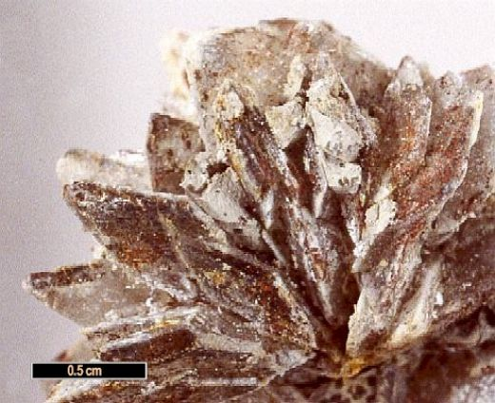
“Natrum sulphuricum” medication
Source material: sodium sulphate mineral salt
Personality changes following brain injury, lasting years.
Irritability, confusion, anger.
Depression and suicidality.

Slide 45
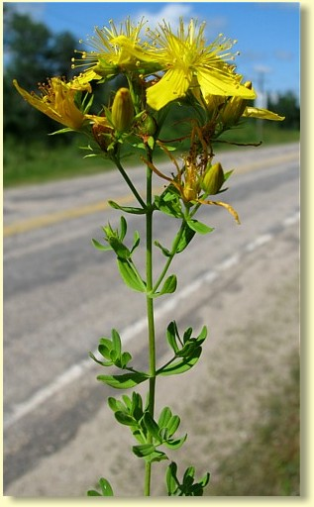
“Hypericum” medication
Source material: St. John’s Wort plant
Damage to brain/spinal cord or other nerve-rich areas like fingers/toes.
Violent shooting, lightning-like pains that radiate from injured part.
Very effective for phantom limb pain, reflex sympathetic dystrophy or complex regional pain syndrome.

Slide 46
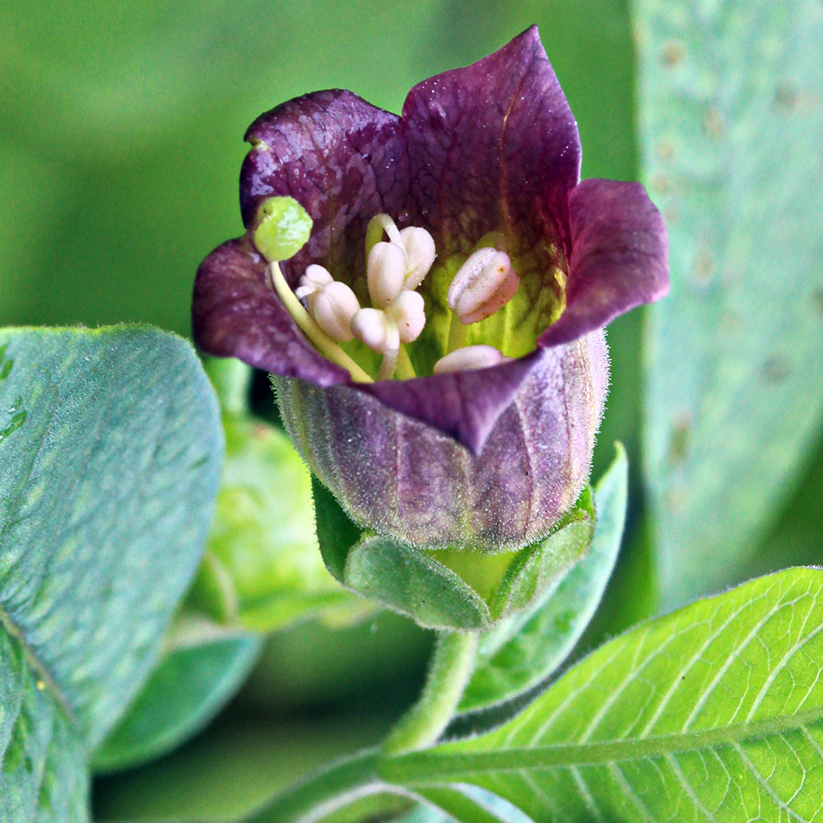
“Belladonna” medication
Source material: Deadly nightshade plant
Violent, throbbing migraines worse lying down, better sitting up.
Fullness and congestion in head.
Raging, manic, hot-headed literally and figuratively.

Slide 47
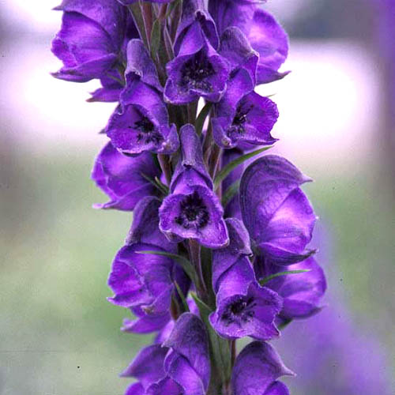
“Aconite” medication
Source material: Monkshood plant
State of shock and fear after accident or trauma
Feel disconnected from their body
Fear of death with restlessness
Worse at night 12-2am

Slide 48
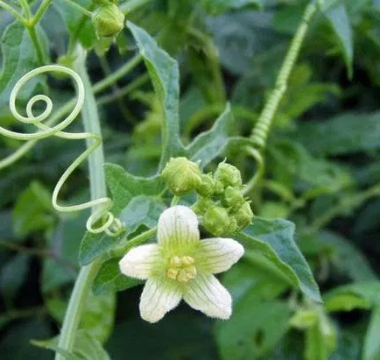
“Bryonia” medication
Source material: White bryony plant
Pain after injuries which are better from holding still, like broken ribs
Grumpy and irritable
Want to be left alone because hate being touched/moved

Slide 49
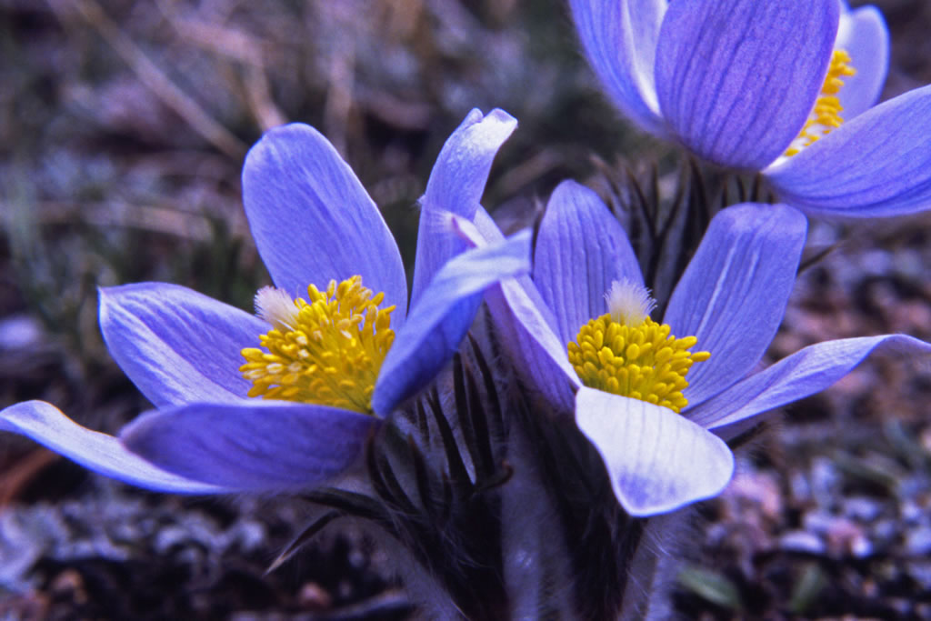
“Pulsatilla” medication
Source material: Pasqueflower plant
Uncontrollably weepy, like constant PMS after trauma/injury.
Very changeable moods.
Clingy and needy.
Better outside in open air.

Slide 50
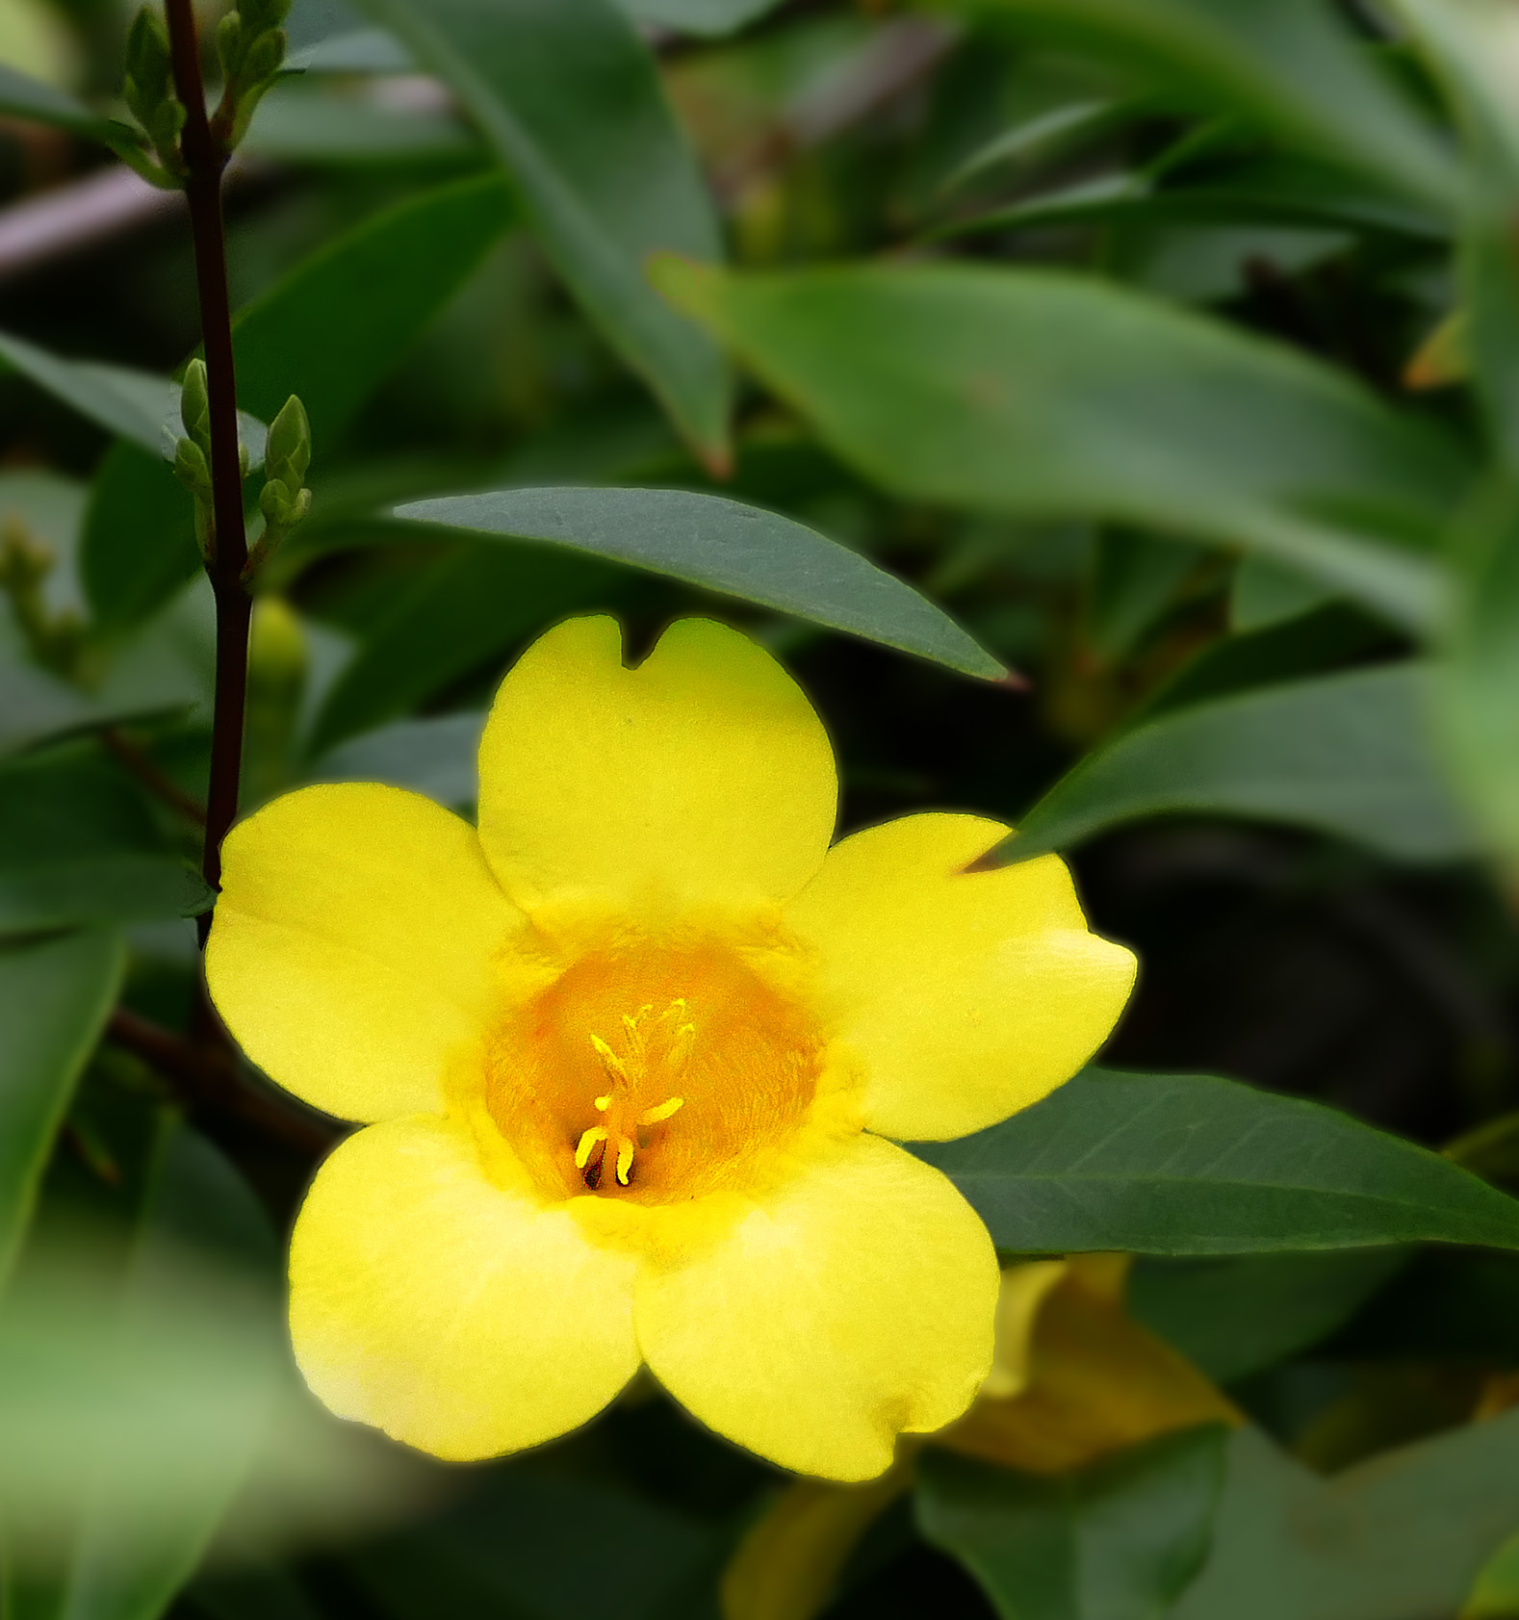
“Gelsemium” medication
Source material: Yellow jessamine plant
Dizzy, drowsy, dull
Heavy head and weakness
So tired, eyes are half-open
Vertigo and lack of coordination

Slide 51
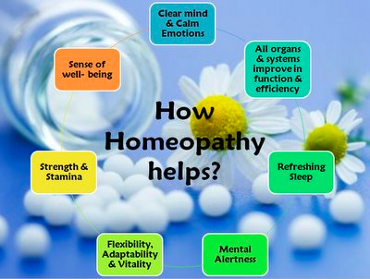
Holistic effect of homeopathic remedies

Slide 52
Common signs and symptoms that a remedy is acting effectively
Gradual improvement over 4-6 weeks
Aggravation of symptoms within 24-48 hours
Return of old symptoms
Follow predictable pattern of improvement
Complaint returns if treatment is antidoted

Slide 53
Patterns of improvement in healing process
Can see a predictable pattern of healing called Laws of Cure
  From most to least important organs
  From top to bottom of body
  From inside to outside of body
  In reverse order of how complaints developed - more recent ailments return first, older ones later

Slide 54
Brainstorm list of conditions
Most important to least important organs/parts:
Spirit/mind
Brain/heart/lungs/kidneys
Stomach/intestines
Bones
Joints
Skin

Slide 55
Evaluating Treatment with
Homeopathic Medicine
Activity:
Interactive Quiz Game testing understanding of healing process and prognosis of cure as reaction to homeopathic medicine.

Slide 56

Things that stop a remedy from working
Coffee
  In food or drinks, even decaf. Caffeine is ok to have.
Mint
  In toothpaste, mouthwash, gum, body care products
  Same for things with very powerful smells like tea tree oil, camphor, Tiger Balm
Dental work
  Drilling + xrays
Extreme stress
  A car accident, shock, grief

Slide 57
Is homeopathy safe to use with other treatments?
Yes
  Because highly dilute there’s no risk for interaction with medications, herbs or supplements.
Ok to use with other forms of treatment, but acupuncture may interfere with action of the remedy.
  Remedy may need to be redosed after acupuncture treatments.

Slide 58
Homeopathic training + licensure
Doctors who practice homeopathy:
  Medical doctors, Chiropractors, Osteopaths, Naturopathic doctors
Homeopathic practitioners who aren’t otherwise licensed are often certified.
  National certification exam for homeopathy (CHC) ensures excellent level of training.
  Ask practitioners if they have this.

Slide 59
Insurance coverage
Depending on the doctor, coverage may be available.
Homeopathic practitioners, without other licensure, are not eligible for insurance coverage.

Slide 60
Where to find homeopathic treatment
New Hampshire Association of Naturopathic Doctors
  www.nhand.org
Maine Association of Naturopathic Doctors
  www.MAND.org
Maine Association of Homeopaths
  www.homeopathyinmaine.com
American Association of Naturopathic Physicians
  www.naturopathic.org

Slide 61
Inspiring Case Studies

Slide 62
Case History #1
60 year old male
  Presents with atrial fibrillation hasn’t responded to ablation
  On metoprolol, statin, aspirin, prilosec
  History of multiple concussions from sports as kid
Rx: Natrum sulphuricum 30C

Slide 63
Case #1 Outcome
Within 4 weeks, atrial fibrillation went away, headaches returned for a period.
  With a few more doses of remedy at monthly intervals, patient able to discontinue all medications and headaches resolve.
Case stable x 3 years with no recurrence of symptoms.

Slide 64
Case History #2
22 year old male
Presents for brain fog, difficulty concentrating + joint pains
  History of closed head injury from fall at 2 years old.
Yawns a lot (head injury related symptom)
Rx: Natrum sulphuricum 30C

Slide 65
Case #2 Outcome
Over 6 month period used increasing potencies of the same remedy
  Brain fog resolves, mood improves, makes major life changes for the better.
  Dizziness returns for a while and then resolves.
  Joint pains resolve.

Slide 66
Case History #3
20 year old female athlete
Presents with confusion, stomach pain, painful periods, numbness in extremities.
  History of multiple head injuries + concussions
  Can’t collect her thoughts, do math, do logical problem solving
Rx: Natrum sulphuricum 1M

Slide 67
Case #3 Outcome
3 weeks following remedy, feels good.
Thinking is clearer and easier
  Able to see patterns easily during problem solving, do math well again.
Periods + migraines worsened, then improved.
Stomach pain not as severe as before.
Case stable x 6 years.

Slide 68
Case History #4
17 year old female
Low speed car accident caused mild concussion
Presents with depression, irritability, difficulty concentrating, headaches
Rx: Natrum sulphuricum 200C

Slide 69
Case #4 Outcome
Symptoms begin to improve within 1 week.
  Another head injury during sports causes return of all previous symptoms.
  Rx: Arnica 30C for few days, then back to Natrum sulphuricum 200C as needed for any return of symptoms.
Case stable x 1.5 years with no headaches, depression or cognitive difficulties

Slide 70
Case History #5
10 year old male
Depression, difficulty in school, asthma, dizziness, stomach problems.
History of minor head injury while biking
Rx: Natrum sulphuricum 1M

Slide 71
Case #5 Outcome
Mental/emotional symptoms improve.
Return of asthma for a while, then resolved.
Remedy repeated 3-4 times over 2 years.
Case stable x 3 years.

Slide 72
Case History #6
14 year-old boy sustained a closed head injury falling from a tree: diagnosed with subdural hematoma
Developed difficulty speaking and thinking, slow to answer
Depression, generalized weakness and chronic dry cough
Remedy: Helleborus niger 30c

Slide 73
Case #6 Outcome
Restoration of speech, memory and cognitive function over several months
Energy level increases and depression dissipates
Cough stops almost immediately
Condition stable x 5 years

Slide 74
Case History #7
50 year old man impaled by a metal bar which embedded in brain
Marked personality change with childish behavior and emotional outbursts
Wants to be alone
Frequent hiccoughs
Remedy: Cicuta virosa 30c

Slide 75
Case #7 Outcome
Within a month, experienced steady and consistent improvement.
Cognitive abilities and emotional responses restored to almost pre-injury state.
Condition stable x 8 years.

Slide 76
Thank you for attending.
Feel free to reach out
if you have any questions!
Sarah Paton, ND - Naturopathic Doctor
194 Danforth St, #3 Portland, ME 04102
DrSarahPaton.com - (207) 200-5155

