Slide 1

Advances in Pediatric Hearing Assessment with the Auditory Brainstem Response (ABR)
James W. Hall III, PhD
Professor
Osborne College of Audiology
Salus University
Extraordinary Professor
University of Pretoria South Africa
jwhall3phd@gmail.com www.audiologyworld.net

Slide 2
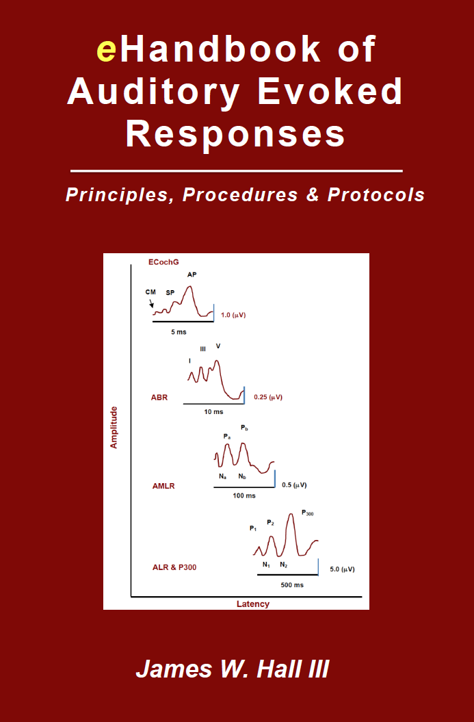
Advances in Pediatric Hearing Assessment with the Auditory Brainstem Response (ABR)
Review of ABR anatomy and physiology … the ABR is NOT a test of hearing
Pediatric applications of ABR measurement
Four advances in pediatric hearing assessment with ABR
  Chirp stimuli (click and tone burst)
  The B-81 oscillator for bone conduction ABR measurement
  Options for un-sedated ABR measurement
  Efficient ABR measurement in < 30 minutes
Kindle Direct Publishing (www.amazon.com) 2015

Slide 3
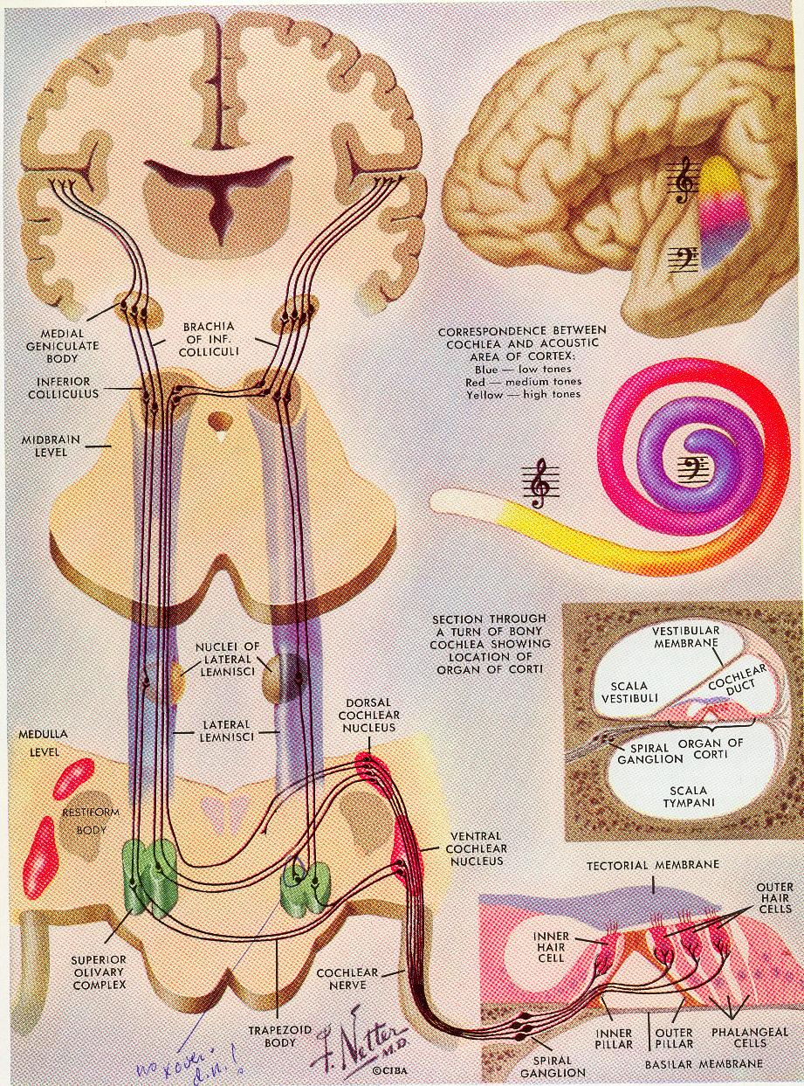
Advances in Pediatric Hearing Assessment
with the Auditory Brainstem Response
ABR is Generated by Axons … Not Nuclei

Slide 4
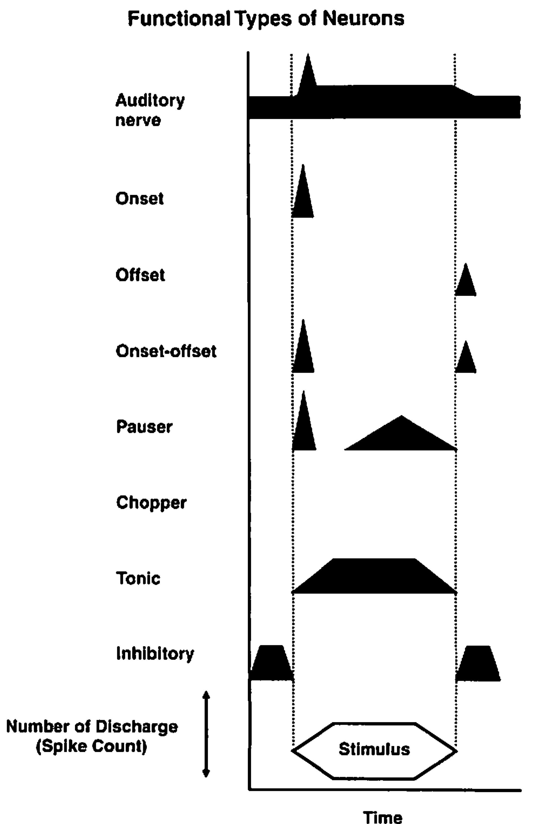
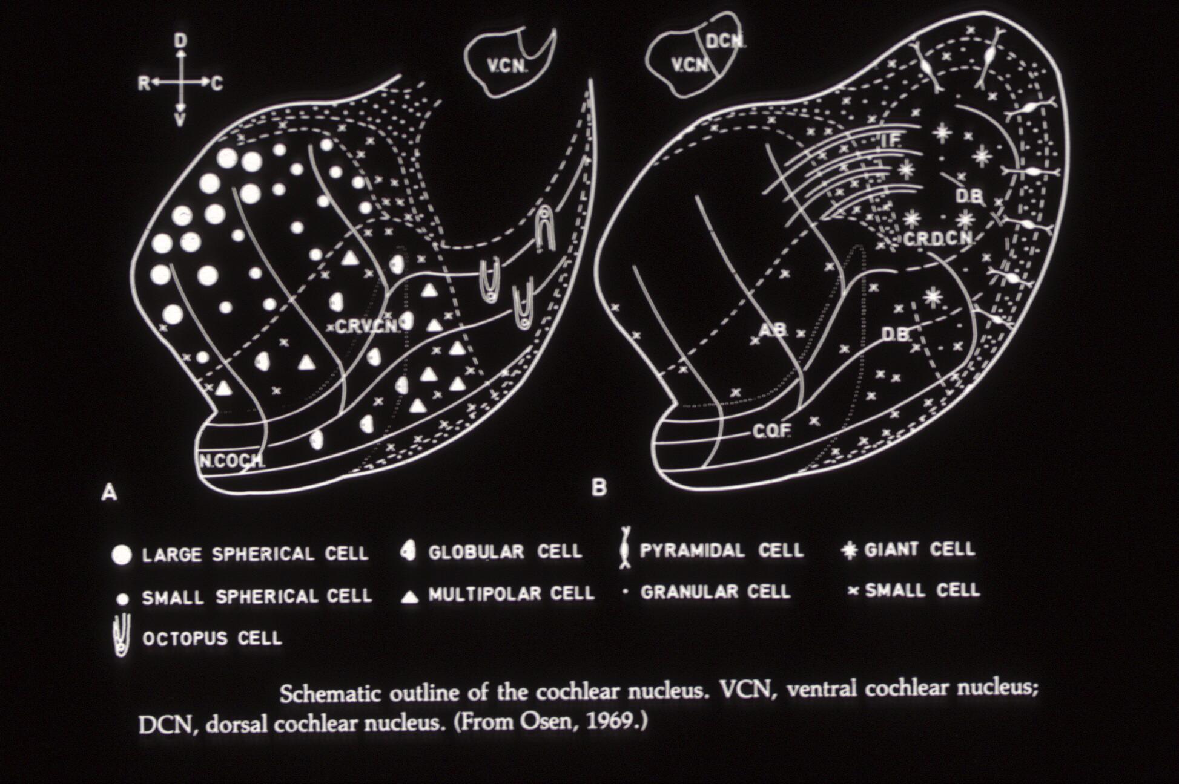
Advances in Pediatric Hearing Assessment
with the Auditory Brainstem Response
ABR is Generated by Onset Neurons (Octopus Cells)

Slide 5
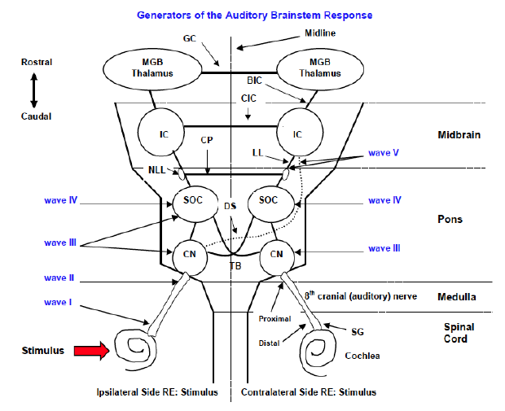
Advances in Pediatric Hearing Assessment
with the Auditory Brainstem Response
Generators of ABR Waves
Wave I is generated on the side of the stimulus (ipsilateral)
Wave III is generated by ipsilateral and midline pathways
Wave V is generated by contralateral pathways

Slide 6
Advances in Pediatric Hearing Assessment with the Auditory Brainstem Response
The ABR is Not a Test of “Hearing”
Generated by axons, not nuclei
Click evoked ABR is generated only by “onset” neurons
Highly dependent on synchronous firing of these neurons
Does not assess structures rostral to brainstem (e.g., thalamus and auditory cortex)
Can be recorded from persons who are:
  Comatose
  Sedated
  Anesthetized persons
Usually elicited with simple non-speech signals

Slide 7
Advances in Pediatric Hearing Assessment with the Auditory Brainstem Response
How is “Hearing” Assessed in Children
Behavioral Audiometry (if feasible)
Otoacoustic Emissions (OAEs)
Aural Immittance Measurements
  Tympanometry and Wideband Reflectance/Absorbance
  Acoustic Reflexes (ipsi- and contralateral conditions)
Auditory Brainstem Response (ABR)
  Click, Tone Burst and Chirp Stimulation
  Speech stimuli (e.g., da or ga)
Auditory Steady State Response (ASSR)
Electrocochleography (ECochG)
Cortical Auditory Evoked Responses

Slide 8
Advances in Pediatric Hearing Assessment with the Auditory Brainstem Response (ABR)
Review of ABR anatomy and physiology … the ABR is NOT a test of hearing
Pediatric applications of ABR measurement
Four advances in pediatric hearing assessment with ABR
  Chirp stimuli (click and tone burst)
  The B-81 oscillator for bone conduction ABR measurement
  Options for un-sedated ABR measurement
  Efficient ABR measurement in < 30 minutes
Kindle Direct Publishing (www.amazon.com) 2015

Slide 9

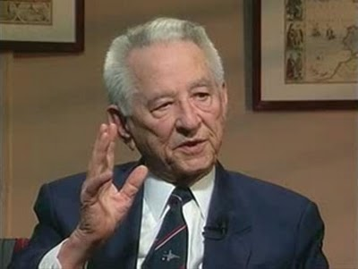
Advances in Pediatric Hearing Assessment
with the Auditory Brainstem Response
> 50 Years of Clinical Experience with ABR
Jewett D and Williston J. Auditory evoked far fields averaged from the scalp of humans. Brain 4: 681-696, 1971.

Slide 10
Advances in Pediatric Hearing Assessment
with the Auditory Brainstem Response
> 50 Years of Clinical Experience with ABR

Slide 11
Advances in Pediatric Hearing Assessment with the Auditory Brainstem Response
Pediatric Applications of ABR (> 3000 publications)
Infant hearing screening (automated ABR)
Differential diagnosis of childhood hearing loss
  Sensory hearing loss
  Conductive hearing loss
  Neural auditory dysfunction
  Auditory neuropathy spectrum disorder (ANSD)
Frequency-specific estimation of auditory thresholds (an electrophysiologic audiogram)
Monitoring auditory function to document effective management
Confirmation of normal hearing thresholds in suspected false hearing loss
Objective assessment of auditory processing disorder

Slide 12
Advances in Pediatric Hearing Assessment with the Auditory Brainstem Response (ABR)
Review of ABR anatomy and physiology … the ABR is NOT a test of hearing
Pediatric applications of ABR measurement
Four advances in pediatric hearing assessment with ABR
  Chirp stimuli (click and tone burst)
  The B-81 oscillator for bone conduction ABR measurement
  Options for un-sedated ABR measurement
  Efficient ABR measurement in < 30 minutes
Kindle Direct Publishing (www.amazon.com) 2015

Slide 13
Advances in Pediatric Hearing Assessment with the Auditory Brainstem Response
Evidence Based ABR Protocol: Stimulus Parameters
Parameter Selection Comment
Transducer Insert earphone A dozen good reasons; BC also O.K.
Type Click or tone bursts Both are essential; Chirps are available
Polarity Rarefaction Larger amplitude; change as indicated
Rate > 20/sec Faster rate saves time
Intensity dB nHL Verify stimulus intensity
Repetitions Variable Whatever is needed for good SNR
Masking Rarely needed Only if ABR is abnormal and no wave I
Mode Monaural Provides ear-specific information

Slide 14
Advances in Pediatric Hearing Assessment with the Auditory Brainstem Response
Evidence Based ABR Protocol: Acquisition Parameters
Parameter Selection Comment
Electrodes
Noninverting Fz High forehead preferred to vertex
Inverting Ai Ipsilateral earlobe, not mastoid
Ground Fpz Low forehead for common electrode
Filters (HP) 30 Hz Especially in infants
(LP) 3000 Hz 1500 Hz O.K. if high frequency artifact
Notch None Removes critical low frequency energy
Amplification 100,000 Or sensitivity of +/- 25 or 50 μV
Analysis time 15 ms Encompasses ABR in all cases
Pre-stim baseline - 1 ms Information on response quality
Sweeps (# stimuli) Variable Whatever yields adequate SNR (3:1)

Slide 15
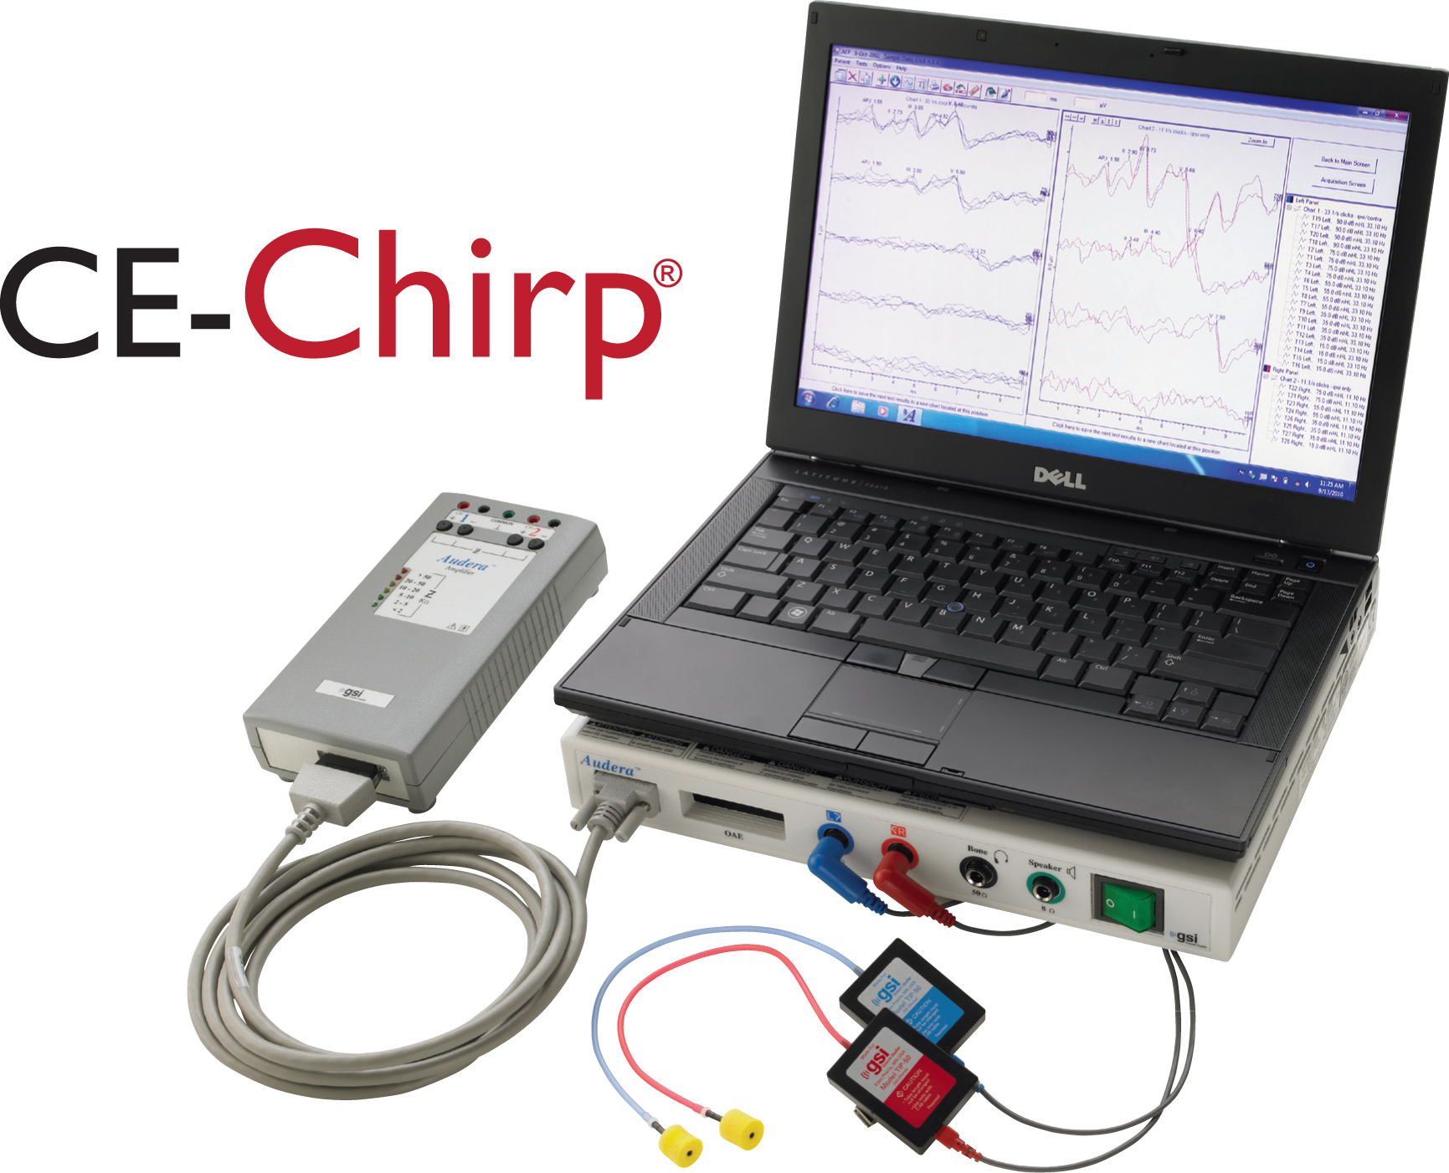
Advances in Pediatric Hearing Assessment with the Auditory Brainstem Response
Broad Band and Narrow Band Chirp Stimuli

Slide 16
Advances in Pediatric Hearing Assessment
with the Auditory Brainstem Response
Broad Band and Narrow Band Chirp Stimuli
Low Frequencies
High Frequencies

Slide 17
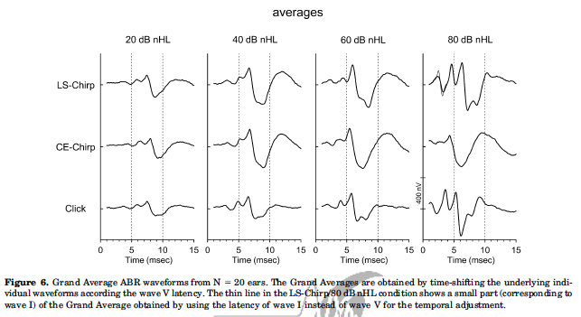
Advances in Pediatric Hearing Assessment with the Auditory Brainstem Response
Efficient Pediatric ABR Measurement
Larger amplitudes for wave I and V (up to twice as large)
More confident identification of ABR
Detection of clear ABR restless children
Possibility of more accurate ABR threshold estimation
Quicker ABR test time (larger ABR increases SNR)

Slide 18
Advances in Pediatric Hearing Assessment with the Auditory Brainstem Response (ABR)
Review of ABR anatomy and physiology … the ABR is NOT a test of hearing
Pediatric applications of ABR measurement
Four advances in pediatric hearing assessment with ABR
  Chirp stimuli (click and tone burst)
  B-81 oscillator for bone conduction ABR measurement
  Options for un-sedated ABR measurement
  Efficient ABR measurement in < 30 minutes
Kindle Direct Publishing (www.amazon.com) 2015

Slide 19
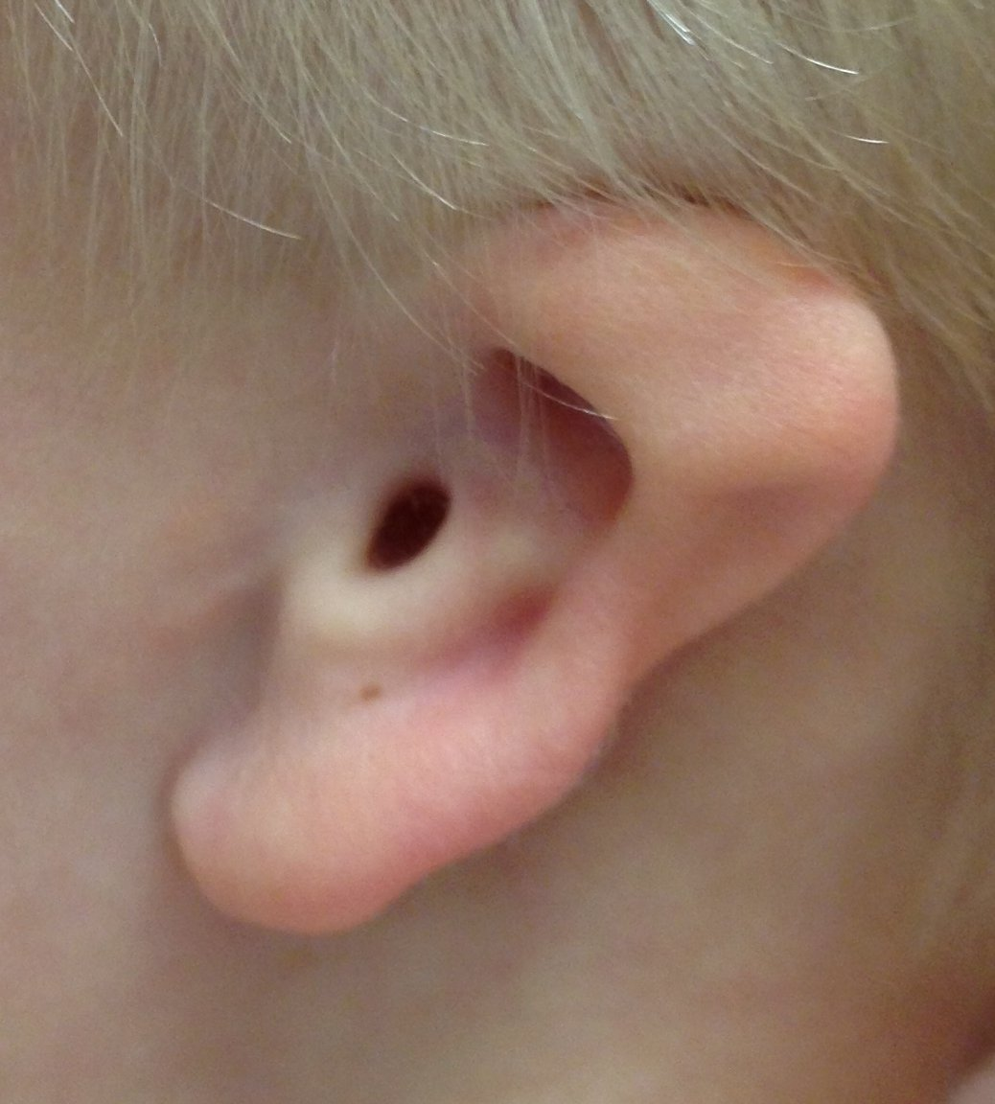
Advances in Pediatric Hearing Assessment with the Auditory Brainstem Response
Clinical Indications for Bone Conduction ABR
Craniofacial anomalies associated with middle ear dysfunction
Syndrome associated with conductive hearing loss
History of middle ear disease
Abnormal tympanometry findings
Abnormal delay in wave I latency for air conduction ABR
Before and/or after surgical management for middle ear disease

Slide 20
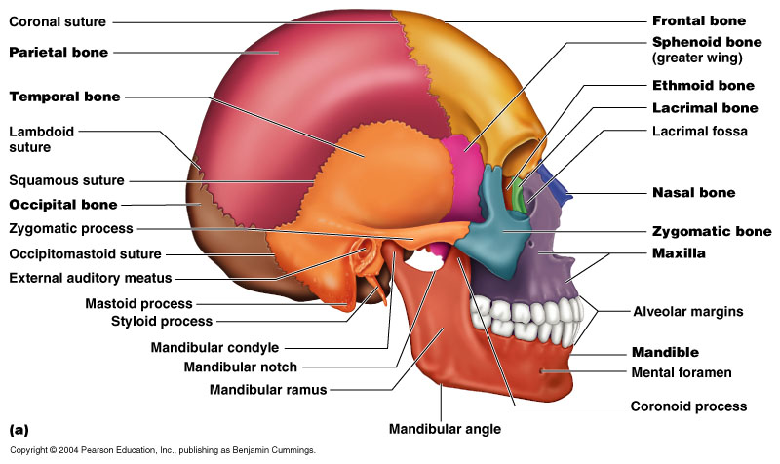
Advances in Pediatric Hearing Assessment with the Auditory Brainstem Response
A Newer Bone Oscillator Design

Slide 21

Advances in Pediatric Hearing Assessment with the Auditory Brainstem Response
A Newer Bone Oscillator Design
Slightly Greater Output
Lower Harmonic Distortion

Slide 22
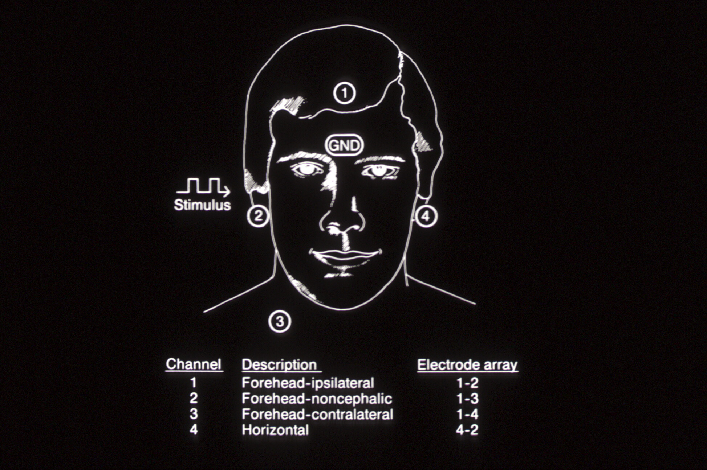
Advances in Pediatric Hearing Assessment
with the Auditory Brainstem Response
Ipsilateral Wave I Verifies Ear-Specific Findings
Ipsi Channel
Wave I
Contra Channel
No Wave I

Slide 23
Advances in Pediatric Hearing Assessment
with the Auditory Brainstem Response
Estimation of Air-Bone Gap with ABR
Air conduction
Bone conduction
8
35 dB
Wave V Latency in msec
6
4
0
20
40
60
80
100
Click Intensity in dB nHL

Slide 24
Advances in Pediatric Hearing Assessment with the Auditory Brainstem Response
Reasons for Only Using Click Stimuli for Bone Conduction ABR
Test time is unacceptably lengthy with addition of tone burst bone conduction recordings
Confident identification of ABR is more likely with click versus tone burst stimulation
Provides the information that is needed for management decisions, i.e., referral to otolaryngology for medical or surgical intervention

Slide 25
Advances in Pediatric Hearing Assessment with the Auditory Brainstem Response (ABR)
Review of ABR anatomy and physiology … the ABR is NOT a test of hearing
Pediatric applications of ABR measurement
Four advances in pediatric hearing assessment with ABR
  Chirp stimuli (click and tone burst)
  The B-81 oscillator for bone conduction ABR measurement
  Options for un-sedated ABR measurement
  Efficient ABR measurement in < 30 minutes
Kindle Direct Publishing (www.amazon.com) 2015

Slide 26
Advances in Pediatric Hearing Assessment with the Auditory Brainstem Response
ABR Measurement: Detecting a Signal (ABR) within Electrical “Noise”
500
250
125
60
30
0
ECG
EOG (ENG)
60 Hz
Power line noise
Rectified RF noise
EEG sleep
µV
EMG
EEG awake
ABR
Amplitude 0.1 – 1 μV
Frequencies 30 – 3000 Hz
0 10 20 40 80 100 250 500 1000 2000 4000 Hz

Slide 27
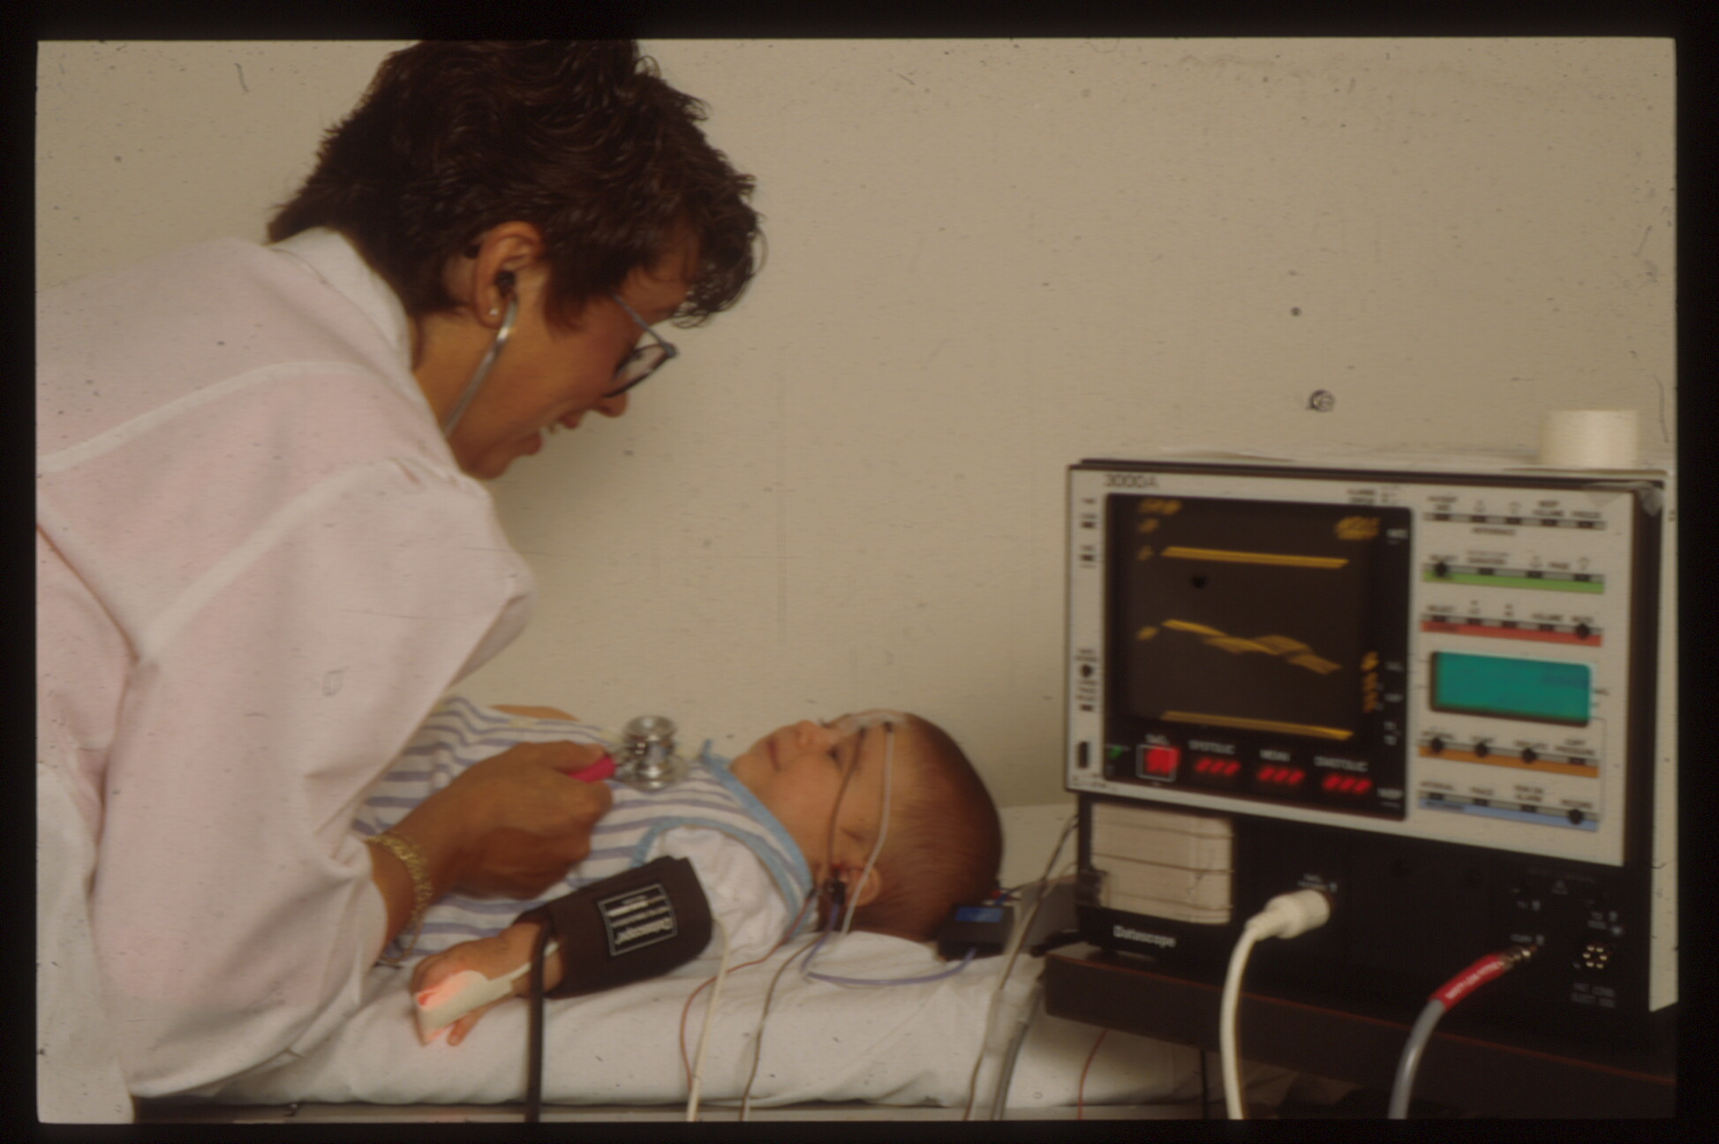
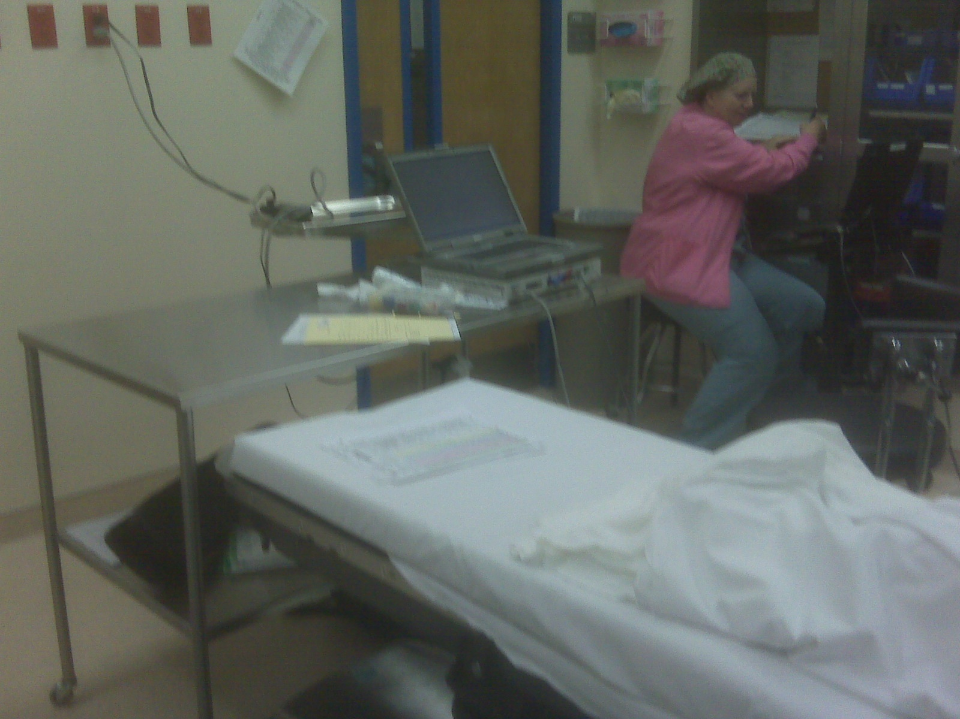
Advances in Pediatric Hearing Assessment
with the Auditory Brainstem Response
The Goal = A Sleeping and Quiet Child

Slide 28
Advances in Pediatric Hearing Assessment with the Auditory Brainstem Response
Un-Sedated (Natural Sleep) ABR Measurement is Feasible
Detailed instructions for parents/caregivers
Atypically late bedtime for the child
Two adults transport the child to the clinic
ABR is scheduled early in the morning
Preparation for ABR begins immediately upon patient arrival at the clinic
Make the child as comfortable as possible
Record the ABR after feeding in a dark and quiet room

Slide 29
Advances in Pediatric Hearing Assessment with the Auditory Brainstem Response
Comfortable Options for Pediatric ABR Measurement
For Mother & Child

Slide 30
Advances in Pediatric Hearing Assessment with the Auditory Brainstem Response
Melatonin as a Sleep Aid
Hormone naturally produced by pineal gland
Controls circadian rhythm
Inhibited by light
Enhanced by darkness
Strong antioxidant activity
Exogenous melatonin causes rapid induction of sleep without sedation
Peak serum concentration reached in about 60 minutes
Concentration declines within 4 hours

Slide 31
Advances in Pediatric Hearing Assessment with the Audito ry Brainstem Response
Melatonin is Used to Induce Sleep in Medicine
Management of a variety of diseases and disordera
Management of bothersome tinnitus
Complimentary use during anesthesia
Imaging studies
  CT scans
  Magnetic resonance imaging (MRI)
Electrophysiological studies
  EEG studies
  Sensory evoked responses … including ABR

Slide 32
Advances in Pediatric Hearing Assessment with the Auditory Brainstem Response
Melatonin in Pediatric ABR Measurement
Schmidt et al. Melatonin is a useful alternative to sedation in children undergoing brainstem audiometry with an age dependent success rate: A field report of 250 investigations. Neuropediatrics 38: 2-4, 2007.
Guerlain et al (2016). Efficiency of melatonin as compared to pentobarbital for audiometry brainstem response in children with associated disorders. American Journal of Audiology, 25, 206-210, 2016
Casteil et al (2017). Study of the efficacy of melatonin for auditory brainstem response (ABR) testing in children. Eur Ann Otorhinolaryngol Head Neck Dis, pii: S1879-7296(17)30075-3. doi: 10.1016/j.anorl.2017.03.006. [Epub ahead of print]

Slide 33
Advances in Pediatric Hearing Assessment with the Auditory Brainstem Response
Melatonin in Pediatric ABR Measurement

Slide 34
Advances in Pediatric Hearing Assessment with the Auditory Brainstem Response (ABR)
Review of ABR anatomy and physiology … the ABR is NOT a test of hearing
Pediatric applications of ABR measurement
Four advances in pediatric hearing assessment with ABR
  Chirp stimuli (click and tone burst)
  The B-81 oscillator for bone conduction ABR measurement
  Options for un-sedated ABR measurement
  Efficient ABR measurement in < 30 minutes
Kindle Direct Publishing (www.amazon.com) 2015

Slide 35
Advances in Pediatric Hearing Assessment with the Auditory Brainstem Response (ABR)
Rationale for Efficient ABR Assessment
ABR assessment includes multiple stimulus conditions for two ears
  Air conduction clicks
  Bone conduction clicks (as needed)
  Multiple tone burst frequencies (3 or 4 per ear)
ABR measurement with natural sleep is feasible if the total test time is < 30 minutes
Sedation or anesthesia is typically not required
ABR assessment can be performed in the audiology clinic rather than a remote location (e.g., hospital clinic or operating room)
All necessary information can be obtained in one test session
  More convenient for family
  Timely test results for more prompt management

Slide 36
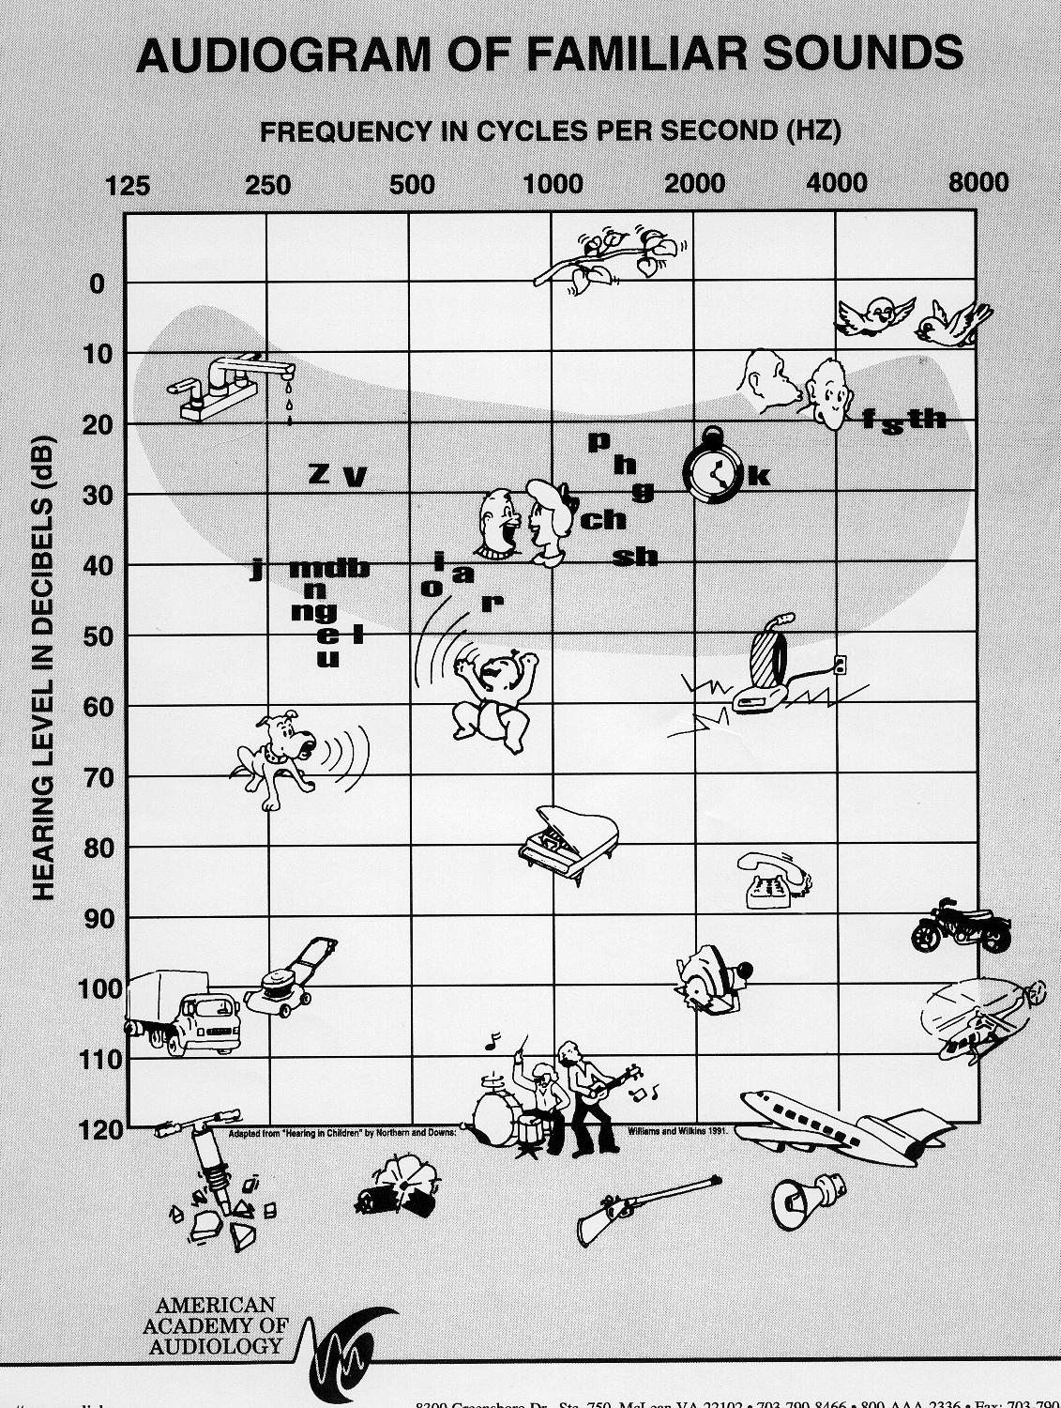
Advances in Pediatric Hearing Assessment
with the Auditory Brainstem Response
Frequency-Specific Estimation of Auditory Thresholds

Slide 37
Advances in Pediatric Hearing Assessment with the Auditory Brainstem Response (ABR)
How to Complete an ABR Assessment in < 30 Minutes
Develop an ABR test strategy in advance based on available information
Take all possible steps to enhance a sleep state
Use chirp stimuli
Use fast stimulus presentation rates
  Click stimuli: ~ 21.1/sec
  Tone burst stimuli: ~ 37.7/sec
Discontinue the averaging process when SNR reaches 3:1 (ABR amplitude is three times higher than background activity)
Replicate ABR waveforms only for the initial high intensity level and the estimated threshold level
Decrease stimulus intensity in 40 dB steps if ABR appears normal at a high intensity level
Notes:
Ta

Slide 38
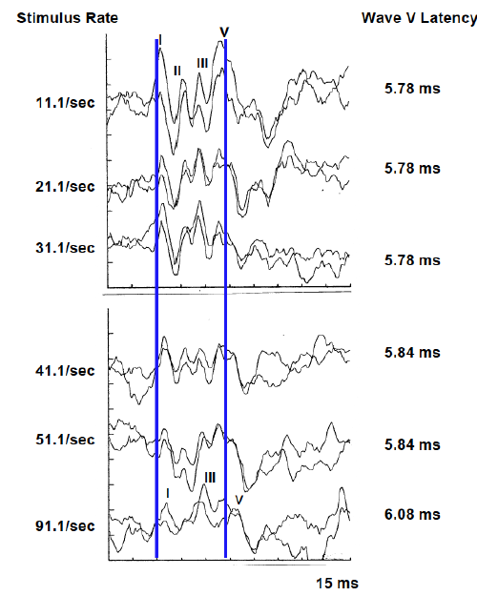
Evidence-Based ABR Protocol for Infant Hearing Assessment
What is the Optimal Stimulus Presentation Rate?
Run Your ABR at the Stimulus Speed Limit
General Guideline: Fastest rate that still produces an optimal response
Click stimulus: 21.1/sec
  Extensive normative data for latency
  Slow enough to identify wave I
  Fast enough for rapid data collection
  Odd number not in sync with 50 Hz or 60 Hz current
Tone burst stimulus: 37.7/sec
  Quicker test time
  Not interested in wave I
  No negative impact of rate increase on waveform morphology

Slide 39
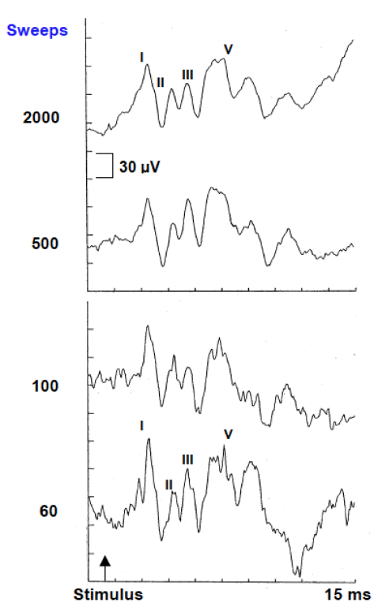
The Optimal Number of Stimuli (Signal Averages) … Just Enough
The Number That Produces an ABR to Noise Ratio (SNR) of 3:1
Signal-to-noise ratio (SNR) =
Signal Amplitude X Number of Averages
_______________________________
Noise Amplitude
where Signal = ABR and
Noise = any electrical activity that is NOT ABR
Adequate SNR = 3
(ABR wave V is 3 times larger than residual background noise)

Slide 40
The Optimal Number of Stimuli (Signal Averages)
(British NHS Guidelines, 2013)

Slide 41


Advances in Pediatric Hearing Assessment with the Auditory Brainstem Response (ABR)

