Slide 1

Assessment and Management of Children with
Decreased Sound Tolerance and Tinnitus
James W. Hall III, PhD
Professor
Salus University and University of Hawaii
Extraordinary Professor
University of Pretoria South Africa
jwhall3phd@gmail.com www.audiologyworld.net

Slide 2

Assessment and Management of Children with
Decreased Sound Tolerance and Tinnitus
Disorders of Decreased Sound Tolerance
  Differentiation and Definitions
  Risk Factors and Etiologies
  Mechanisms and Physiology
  Assessment
  Management options
Tinnitus
  Definition
  Risk Factors and Etiologies
  Mechanisms and Physiology
  Assessment
  Management options

Slide 3
Disorders of Decreased Sound Tolerance
Suggested Reading
Hyperacusis
Loudness recruitment
Phonophobia
Misophonia

Slide 4
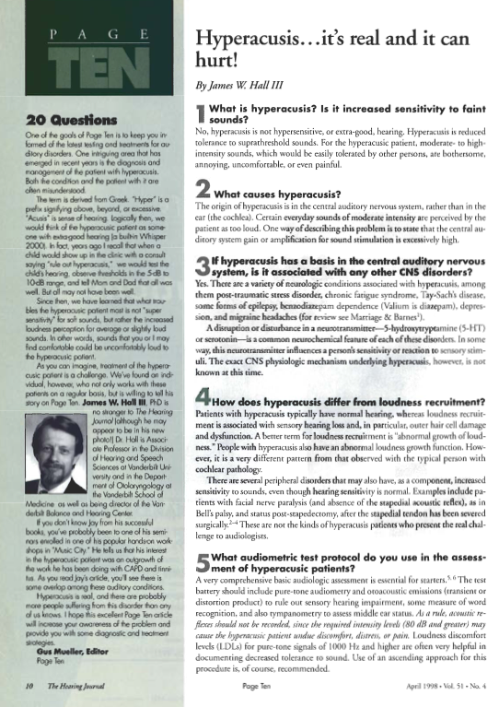
Disorders of Decreased Sound Tolerance
Additional Readings

Slide 5
Disorders of Decreased Sound Tolerance
Increasing Number of Publications on Hyperacusis
Baguley and Hoare, 2018

Slide 6
Disorders of Decreased Sound Tolerance
Definition
“Consistently exaggerated or inappropriate responses or complaints of uncomfortable loudness to sounds that are neither intrinsically threatening nor uncomfortably loud to a typical person” (Klein et al. Hyperacusis and otitis media in individuals with Williams syndrome. JSHD 55: 1990)
“Unusual intolerance to ordinary environmental sounds” (Vernon. Pathophysiology of tinnitus: a special case -- hyperacusis and a proposed treatment. Am J Otol 8: 1987)
“Experience of inordinate loudness of sound that most people tolerate well, associated with a component of distress … this experience has a physiologic basis … but it also has a psychological component.” (Baguley & Andersson, 2007)

Slide 7
Disorders of Decreased Sound Tolerance
Terminology
Hyperacusis
  Abnormally strong reactions (intolerance) occurring within the central auditory pathways with exposure to moderate levels of sounds
  Hearing sensitivity is typically normal
  Otoacoustic emissions (OAEs) are typically normal
  Lack of contralateral suppression of OAEs
  Reduced LDLs
  Estimated prevalence of 3 to 17% (Rosing et al, 2016)
Loudness recruitment
  Abnormal growth of loudness
  Sensory (outer hair cell) hearing loss (peripheral)
  OAEs are abnormal
  Reduced LDLs

Slide 8
Disorders of Decreased Sound Tolerance
Terminology
Phonophobia
  Fear of sound
  Anticipatory, anxious, and sometimes different reaction to specific sounds, e.g.,
    Vacuum cleaner Siren
    Telephone ringing Hair dryer
    Crying child Barking dog
  Reaction and avoidance to sounds involves learning and conditioning
  Consistently related to intensity of sound
  Intact peripheral and efferent auditory systems
  Enhanced connections between the auditory cortical regions and the limbic and autonomic nervous system regions

Slide 9
Disorders of Decreased Sound Tolerance Terminology
Misophonia
  Dislike or hatred of sound
  Usually for very specific sounds
  Sometimes referred to as “Selective Sound Sensitivity Syndrome” (SSSS or 4S)
  Irritation and dislike of specific soft sounds
  Most common sounds, produced by family members, e.g.,
    Eating
    Smacking lips
    Breathing
    Speech sounds

Slide 10
Disorders of Decreased Sound Tolerance
Two Reviews of Misophonia

Slide 11
Differentiation Among Disorders of Decreased Sound Tolerance
Misophonia
(Adapted from Siepsiak & Dragan, 2019)
Jastreboff first described misophonia (and coined term) in 2002
Marsha Johnson in 1990 observed Selective Sound Sensitivity Syndrome (4S)
General characteristics
  Somatic response in addition to strong emotional response, e.g.,
    Pressure in chest, arms, head, whole body
    Increased heart rate and body temperature
    Breathing difficulty
    Physical pain
  Desire to “violate” the source of the sound, e.g.,
    “I hate this person”
    Verbal and physical outbursts
  Prevalence
    3% of tinnitus and hyperacusis population (Jastreboff & Jastreboff, 2014)
    Up to 20% of selected college student populations

Slide 12
Differentiation Among Disorders of Decreased Sound Tolerance
Misophonia
(Adapted from Siepsiak & Dragan, 2019)
Comorbid and co-existing disorders
  Not correlated to hearing loss or status
  Not an intolerance to loud sounds or noise
  May be related to obsessive-compulsive disorder spectrum and/or depression and PTSD
  Debate about which sounds are involved in misophonia
Mechanisms are unknown
  Possible genetic factor
  Possible central auditory nervous system dysfunction (auditory ERP findings)
Management … there is no research evidence in support of any management technique or protocol, but a team approach is appropriate
  Audiologists
  Psychologists
  Psychiatrists

Slide 13

A Good Resource on Hyperacusis and
Decreased Sound Tolerance
David Baguley, PhD

Slide 14
Comprehensive Current Reviews of Hyperacusis in Children

Slide 15
Assessment and Management of Children with
Decreased Sound Tolerance and Tinnitus
Disorders of Decreased Sound Tolerance
  Differentiation and Definitions
  Risk Factors and Etiologies
  Mechanisms and Physiology
  Assessment
  Management options
Tinnitus
  Definition
  Risk Factors and Etiologies
  Mechanisms and Physiology
  Assessment
  Management options

Slide 16
Hyperacusis
A Symptom Associated with Varied Clinical Entities
Neurological Disorders and Diseases
Depression
Migraine
Chronic fatigue syndrome
Post-traumatic stress disorder
Tay Sach’s disease
Ramsay-Hunt syndrome
Multiple sclerosis
Middle cerebral artery aneurysm
Complex regional pain syndrome related dystonia

Slide 17
Hyperacusis is a Symptom Associated
with Varied Clinical Entities
Otologic Disorders
Tinnitus
Acoustic trauma
Auto-immune disorders
Post otologic surgery
  Ventilation tubes
  Otosclerosis
  Tympanoplasty
Genetic predisposition (family trait)
Auditory processing disorders (APD)
Drugs. e.g.,
  Effexor Prozac
  Remeron Tegretol
  Zoloft

Slide 18
Hyperacusis
A Symptom Associated with Varied Clinical Entities
Other Comorbid Disorders and Diseases
William’s syndrome (96% according to Levitin et al, 2005)
Autism spectrum disorder (27% according to Levitin et al, 2005)
Attention deficit hyperactivity disorder (ADHD)
Epilepsy
Migraine
Lyme disease
Facial paralysis
Pyrodoxine deficiency
Benzodiazepine dependency
Down syndrome (7% according to Levitin et al, 2005)

Slide 19
Hyperacusis
A Symptom Associated with Varied Clinical Entities
Williams Syndrome
Rare neurodevelopment disorder (10,000 to 20,000 annually)
“Elfin” appearance
Very good speech and communication skills
Good long-term memory
Highly social and outgoing
Genetic origin: 25 genes deleted from chromosome 7
Medical problems and characteristics, e.g.,
  Teeth wide and with wider spacing
  Heart defects and blood vessel narrowing
  Connective tissue abnormalities
  High calcium levels in blood
  Developmental delays

Slide 20
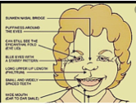

Hyperacusis
A Symptom Associated with Varied Clinical Entities
Williams Syndrome

Slide 21
Disorders of Decreased Sound Tolerance Terminology
Physical Sensations and Reactions
Reported by Patients with Hyperacusis
(Potgieter et al, 2020)
Physical sensations
  Physical discomfort
  Pain, especially head and ears
  Nausea and stomach pain
  Headache
  Sweaty palms, shaking, palpitations
Reactions
  Covering ears
  Fear
  Crying
  Screaming
  Running away
  Verbally abusive

Slide 22
Disorders of Decreased Sound Tolerance Terminology
“Coping Behaviors When Exposed to Troublesome Sound”
(Potgieter et al, 2020)
Avoidance
  Noisy corridors in school
  Noisy cafeterias
  Public toilets with noisy hand dryers
  Sitting in the back of music class
  Spending recess in the library
  Arrival in classroom after other students are seated
Wearing ear protection
  Earplugs
  Sound canceling earmuffs

Slide 23
Disorders of Decreased Sound Tolerance Terminology
Sounds Most Bothersome for Patients with Hyperacusis
Shrill sounds
Power saw
Telephone ringing
Alarms
Vacuum cleaner
Hair dryer
Sirens (e.g., ambulance)
Children crying and screaming
Plates clanking

Slide 24
Hyperacusis:
Reactions when being exposed to annoying sounds (N = 1157)
(Andersson et al, 2002)
How do you feel when you are being exposed to disturbing sounds?
        % N
Tense 10 119
Angry 12 141
Irritated 75 862
Afraid 1 16
Poor concentration 41 479
Pain 5 57

Slide 25
Assessment and Management of Children with
Decreased Sound Tolerance and Tinnitus
Disorders of Decreased Sound Tolerance
  Differentiation and Definitions
  Risk Factors and Etiologies
  Mechanisms and Physiology
  Assessment
  Management options
Tinnitus
  Definition
  Risk Factors and Etiologies
  Mechanisms and Physiology
  Assessment
  Management options

Slide 26
Definition of Hyperacusis and Importance of Patient History
Possible Hyperacusis Mechanisms
Imbalance of neuro-chemical seratonin (5 HT), involved in stimulus reactivity and perception of sensory information in brain
Release of neuro-transmitter glutamate with stress, anxiety, or fatigue,
Defective efferent (descending or inhibitory) auditory system
Increased “central gain” in auditory system
Activation of limbic system (amygdala) involved in fear conditioning
Neural spread from auditory system (e.g., lateral lemniscus or thalamus to central trigeminal pathways) … explanation for perception of pain response to sound
Point prevalence may be as high as 8 to 9% (e.g., Andersson et al. Hypersensitivity to sound (hyperacusis): a prevalence study conducted via the internet and post. Int J Audiology 41: 2002.

Slide 27
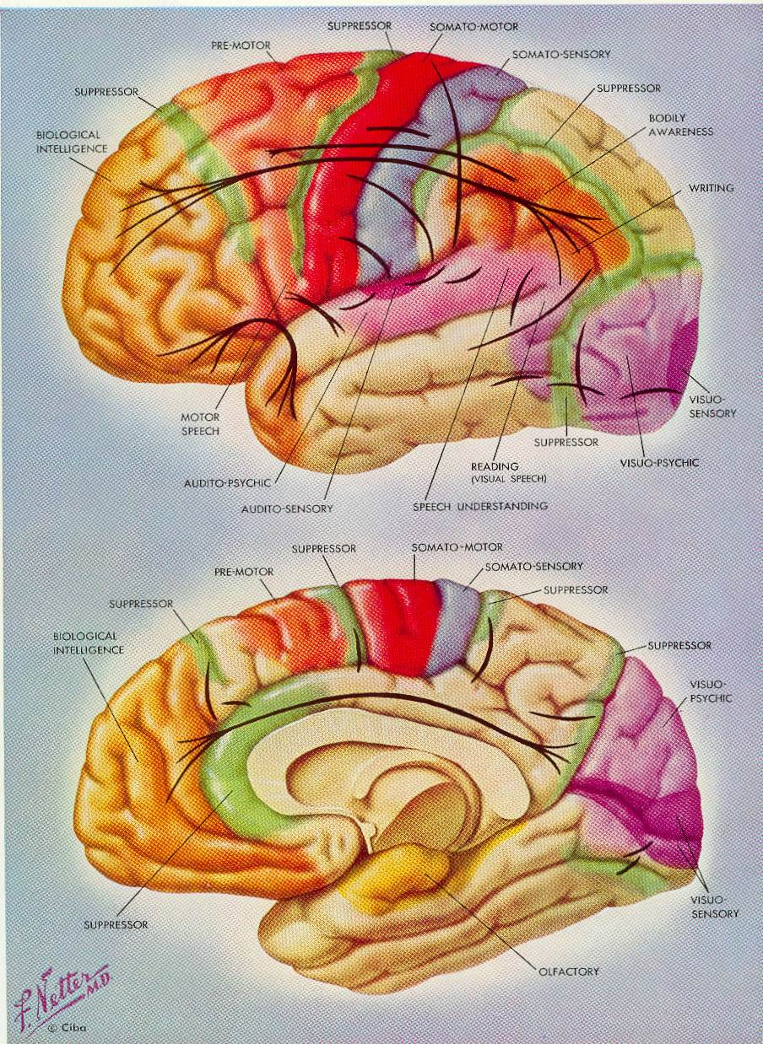
Definition of Hyperacusis and Importance of Patient History Hyperacusis Mechanisms
Increased central gain
Likely auditory efferent system involvement
Interaction between auditory cortex and
  Limbic system
  Autonomic nervous system
  Pain centers
Multiple etiologies
Audiologists can offer management options

Slide 28
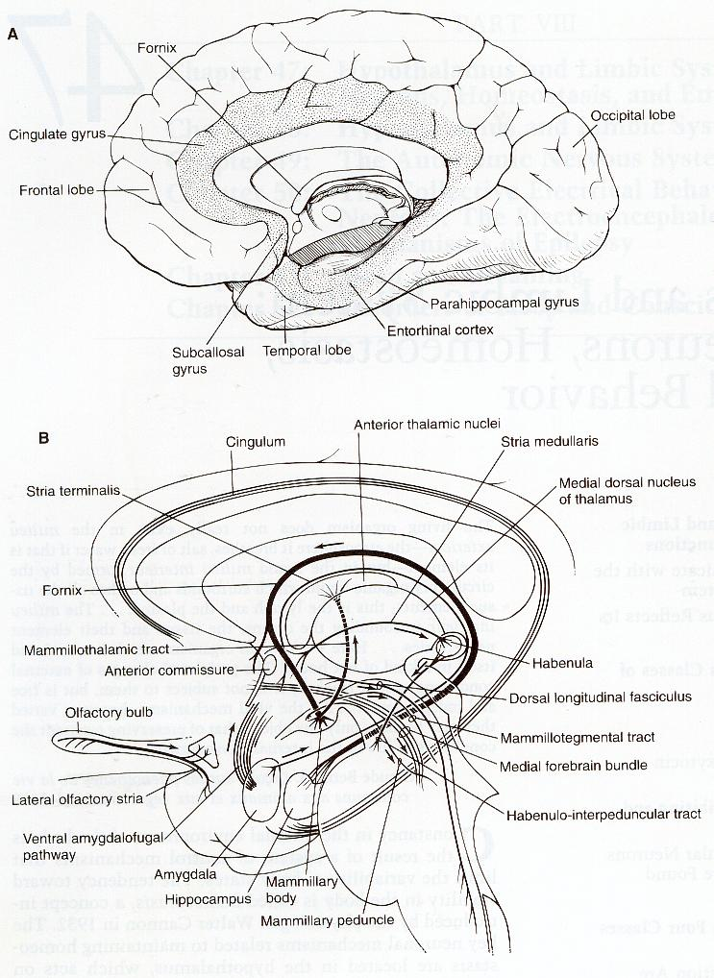
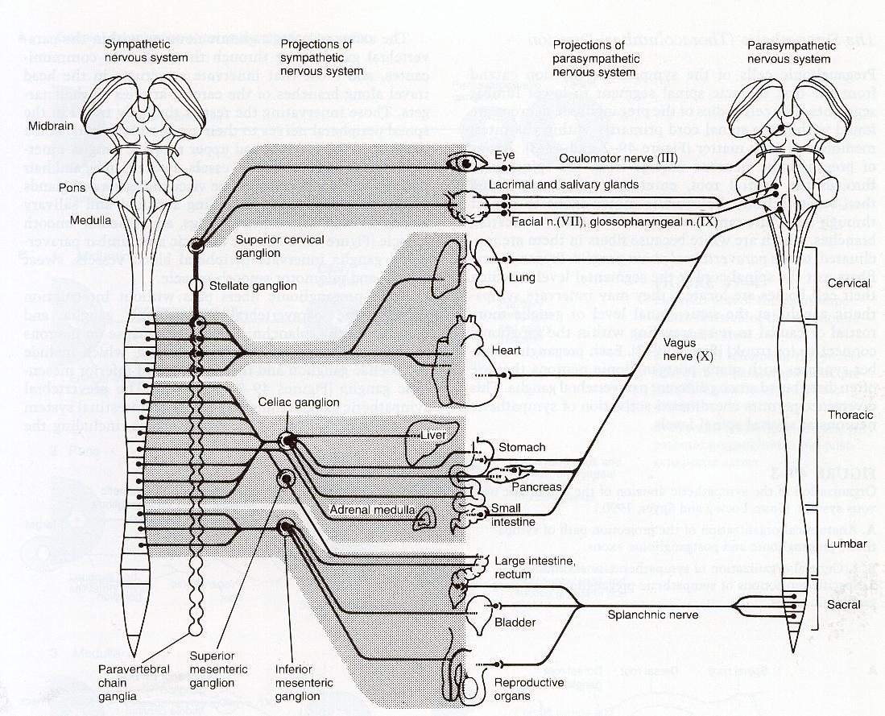
Disorders of Decreased Sound Tolerance
Mechanisms and Physiology
Limbic System
(mediating emotional response)
Autonomic Nervous System
(mediating the brain’s response to “danger sounds”

Slide 29
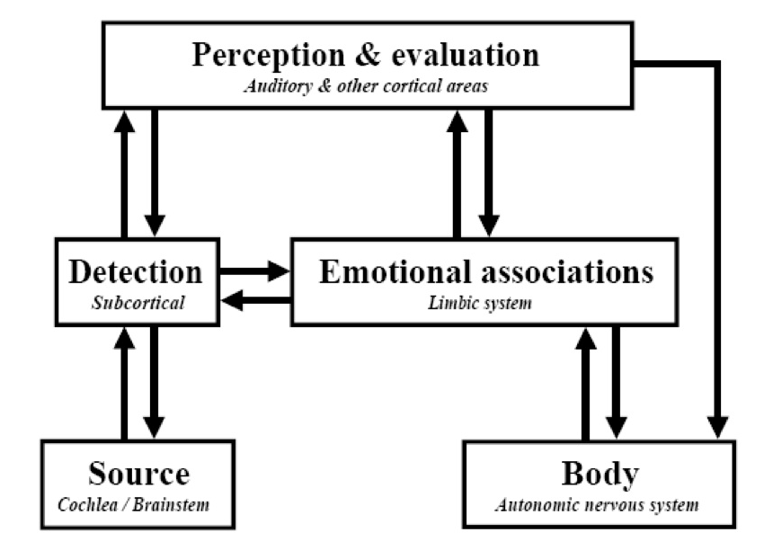

Neurophysiological Model for Hyperacusis
(Pawel Jastreboff)

Slide 30
Assessment and Management of Children with
Decreased Sound Tolerance and Tinnitus
Disorders of Decreased Sound Tolerance
  Differentiation and Definitions
  Risk Factors and Etiologies
  Mechanisms and Physiology
  Assessment
  Management options
Tinnitus
  Definition
  Risk Factors and Etiologies
  Mechanisms and Physiology
  Assessment
  Management options

Slide 31
Assessment (and Management) of Hyperacusis and Disorders of Sound Tolerance in Children
A Team Approach
Audiologist
  Assessment and management of children with decreased sound tolerance is within our scope of practice
  Up-to-date knowledge is important
  Credentials should include post-graduate training (like this lecture)
  Knowledge and skills in counseling is critical
  Professional confidence and compassion is essential
Primary care physicians, including pediatricians
  Audiologist must educate PCPs about hyperacusis
  PCPs must refer to audiologists all patients with decreased tolerance to sound

Slide 32
Assessment (and Management) of Hyperacusis and Disorders of Sound Tolerance in Children
A Team Approach
Otolaryngologist
  Preferably an otologist or neurotologist
Occupational therapist
  Knowledge and skills in decreased sound tolerance and sensory integration disorder
Neurologist
  Knowledge of hyperacusis as symptom of CNS diseases
Psychologist
  Important for patients with suspected misophonia
  Management with cognitive behavioral therapy (CPT)
Psychiatrist

Slide 33
Assessment of Hyperacusis and Disorders of Sound Tolerance in Children
Test Battery for Audiological Assessment (< 30 minutes)
General information
  Briefly explain test process
  Inform patient that a test can be terminated if sounds are perceived as too loud
  Stress the importance of completing the assessment
Acoustic immittance measurement
  Tympanometry
  No acoustic reflexes!
Distortion product otoacoustic emissions (DPOAEs)
  Frequencies from 500 to 8000 or 10,000 Hz
  6 or 8 frequencies per octave
  65/55 intensity levels

Slide 34
Assessment and Management of Hyperacusis and Disorders of Sound Tolerance
Test Battery for Audiological Assessment (< 30 minutes)
Pure tone audiometry
  Thresholds measured to as low as – 10 dB HL
  Inter-octaves > 2000 Hz
  High frequency thresholds up to 20,000 Hz
  Bone conduction only as indicated
Speech audiometry
  Speech reception threshold testing not necessary
  Measure word recognition at a comfortable level
  NU-6 lists with most difficult words ranked from 1 – 25
  Stop word recognition test if score is 100% after first 10 words
Loudness discomfort levels (LDLs)
    Pure tones
    Speech

Slide 35
Assessment and Management of Children with
Decreased Sound Tolerance and Tinnitus
Disorders of Decreased Sound Tolerance
  Differentiation and Definitions
  Risk Factors and Etiologies
  Mechanisms and Physiology
  Assessment
  Management options
Tinnitus
  Definition
  Risk Factors and Etiologies
  Mechanisms and Physiology
  Assessment
  Management options

Slide 36
Management of Children with Decreased Sound Tolerance
Patient and Family Counseling and Education
“Knowledge is power.”
(Nam et ipsa scientia potestas est.)
Francis Bacon
(1561-1626)
Meditationes Sacrae [1597]

Slide 37
Management of Children with Decreased Sound Tolerance
Misophonia
There is no research evidence in support of any management technique or protocol, but a team approach is appropriate.
Refer children to a child psychologist who has experience with and/or knowledge of misophonia

Slide 38
Primary Management Options for Hyperacusis
Desensitization to Bothersome Sounds
Identify and list bothersome or fearful sounds
Provide parents or caregivers with suggestions for home management, e.g., honest discussions with child about bothersome sounds
Record the actual bothersome sounds or download examples from the internet for desensitization program
  Under supervision, the child replays the sounds daily
  Devote approximately 10 minutes per day to desensitization
  Discuss the sounds with the child
  Child progressively replays the sounds at higher intensity levels
Avoid silence
  Environmental sound therapy (e.g., sound machine, sound pillow)
  Daily use of personal audio player for music (child chooses)
  No earplugs unless indicated by child’s behavior and/or dangerous noise levels
  Then, use musician earplugs or Doc’s Pro Plugs (for children)

Slide 39
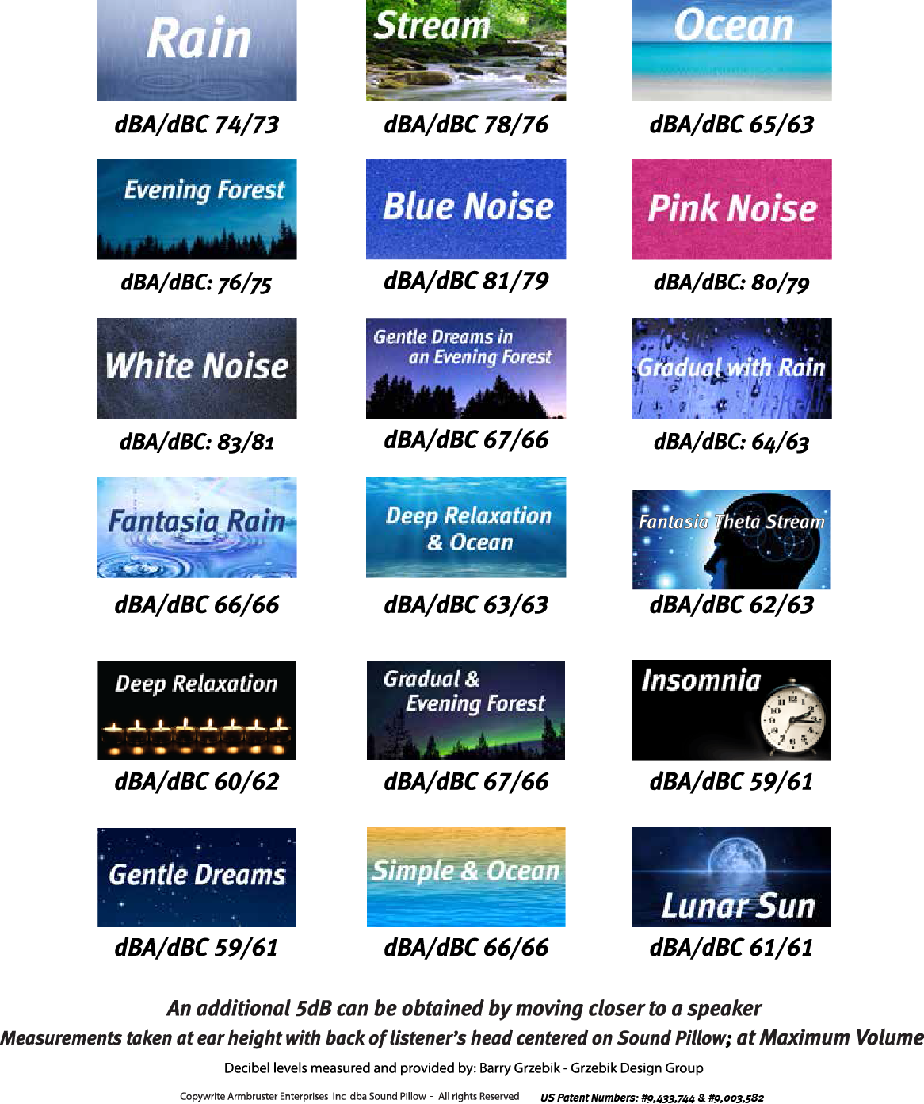
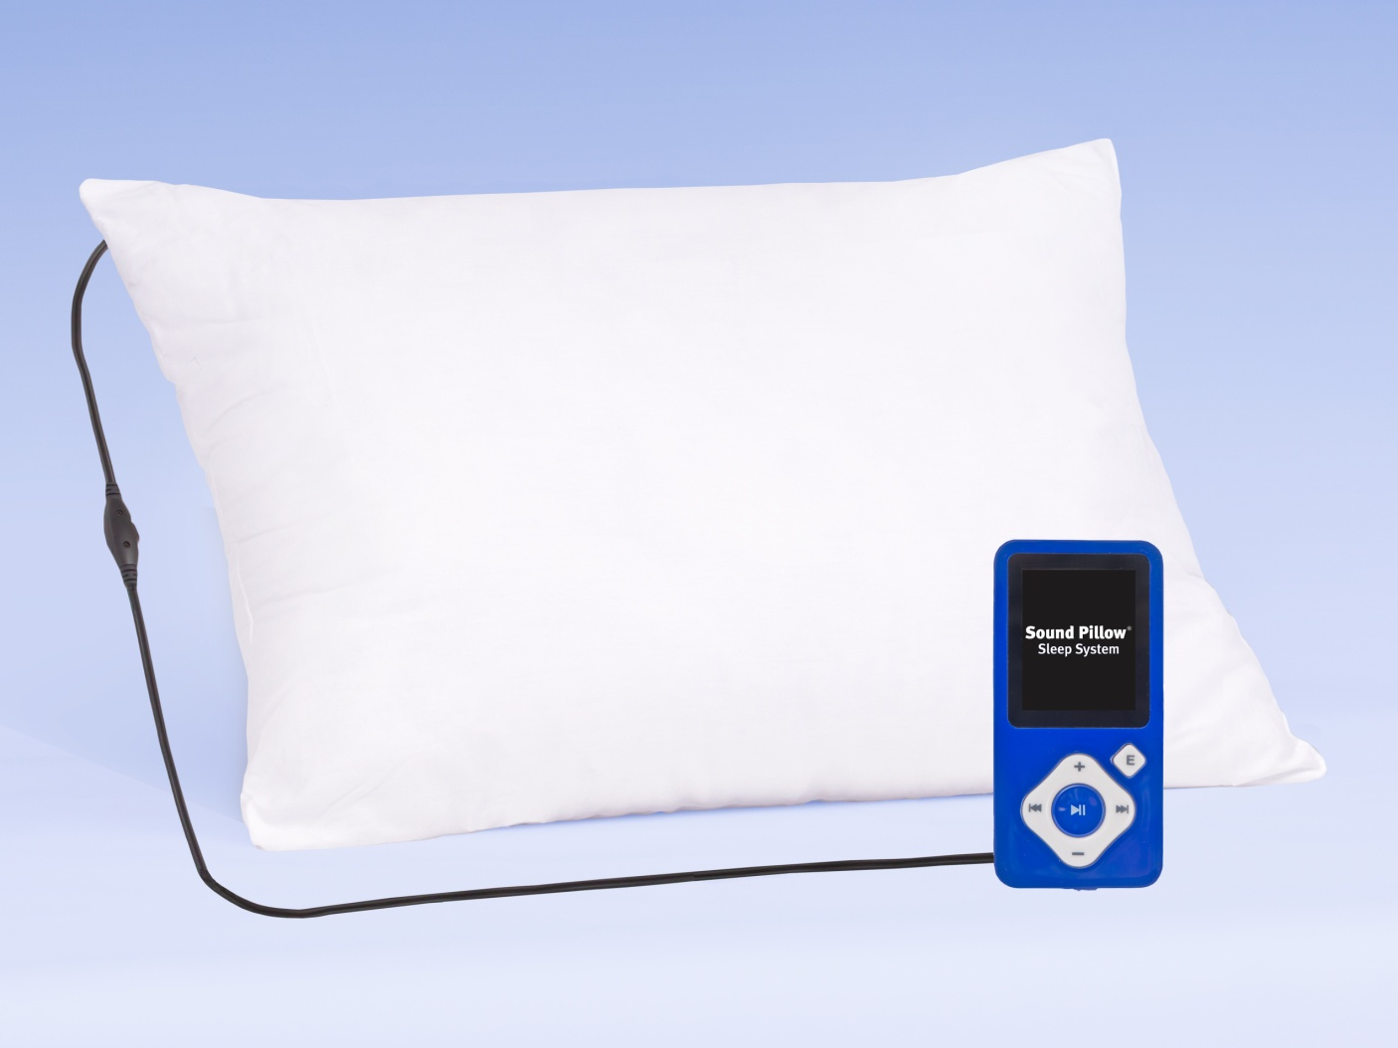
Sound Pillow® Sleep System
R. Scott Armbruster, President (www.SoundPillow.com)

Slide 40
Other Management Options for
Selected Patients with Hyperacusis
Explain to patient or parent extended management options
Retraining therapy (TRT) … more details in tinnitus review
  Directive counseling
  Sound generator use
    Ear level
    Desktop device
    Smart phone app
Neuromonics Tinnitus Treatment
Referral to other professionals as indicated
  Occupational therapist (OT)
  Neurologist
  Otolaryngologist
  Psychologist or psychiatrist

Slide 41
Hyperacusis
Evidence in Support of Management with TRT
Bartnik, Fabijanska & Rogowski (1999)
  Over two-thirds of hypercusis patients showed improvement with TRT
Gold, Frederick & Formby (1999)
  Increased LDLs and dynamic ranges for 123 adults with hyperacusis
  Sound therapy did not eliminate patient concerns about hyperacusis
Wolk & Seefeld (1999)
  Positive outcomes with TRT for 23 subjects with troublesome hyperacusis
  Defined by LDLs, dynamic ranges, and subjective descriptions

Slide 42
Hyperacusis
Evidence in Support of Management with TRT
Jastreboff and Hazell (2004)
  Summarized existing published and unpublished research
  Patients with hyperacusis and tinnitus showed greater benefit from TRT than patients with tinnitus only
  “A significant improvement in hyperacusis patients with TRT has already been reported”, however …
  No strong clinical evidence for this conclusion was cited from peer-reviewed publications (mostly tinnitus conferences)

Slide 43
Hyperacusis
Evidence in Support of Management with TRT
Formby et al (2008)
  Randomized, double-blind, placebo-controlled clinical trial of efficacy of TRT
  Treatment included counseling and sound therapy with noise generators (NG)
  Treatment administered for > 5 months
  Subjects assigned randomly to four treatment groups
    Full treatment, both counseling and NGs
    Counseling and placebo NGs
    NGs without counseling
    Placebo NGs without counseling.
  Over 80% of subjects assigned full treatment group achieved significant benefit
  Most subjects assigned to partial treatment group did not benefit from treatment

Slide 44
Hyperacusis
Additional Recent Review References
Madeira, Montmirail, Decat, Gersdorff (2007) Belgium
  TRT investigation
  24 patients with hyperacusis (out of 46 with tinnitus)
  Sound therapy for minimally 8 hours per day
  Outcome (based on “subjective testimony”)
    Hyperacusis with or without tinnitus, i.e., PJ category 3 (N = 16): 88.5% improved
    Hyperacusis with or without tinnitus exacerbated by noise, i.e., PJ category 4 (N = 8): 75% improved
Noreña AJ, Chery-Croze S (2007) France
  Treatment was enriched sound environment
  Sound therapy administered for less than one month
  Stimuli initially considered “too loud” were perceived as comfortable with > 2 weeks of sound enrichment

Slide 45
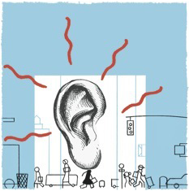
Assessment and Management of Children with
Decreased Sound Tolerance and Tinnitus
Disorders of Decreased Sound Tolerance
  Differentiation and Definitions
  Risk Factors and Etiologies
  Mechanisms and Physiology
  Assessment
  Management options
Tinnitus
  Definition
  Risk Factors and Etiologies
  Mechanisms and Physiology
  Assessment
  Management options

Slide 46
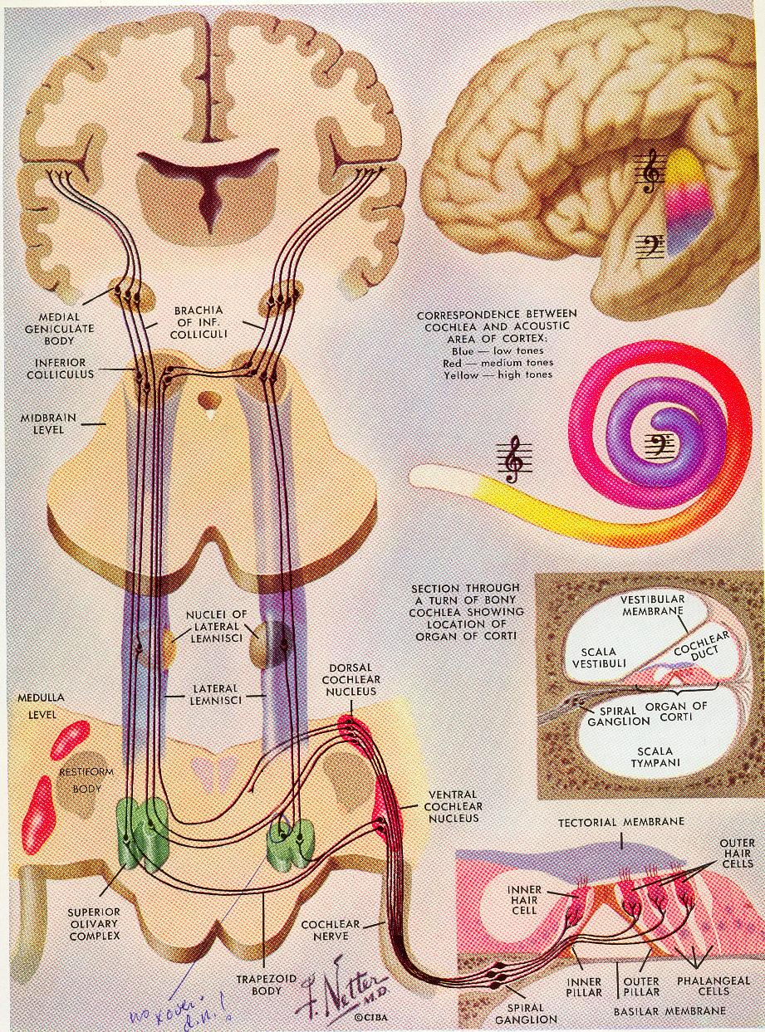
Assessment and Management of Children with
Decreased Sound Tolerance and Tinnitus
Definition of Tinnitus
Tinnitus is a phantom auditory perception i.e., the perception of a sound in the absence of an external sound signal.
Tinnitus is real! It’s not imagined or “just in your head”.
Tinnitus is a symptom … not a disease.

Slide 47
Tinnitus Assessment and Management is Primary Care Audiology
Tinnitus Sound Has No Diagnostic Importance
Description of Types of Tinnitus for >100 adult patients
ringing = 47 clicking = 2
crickets = 21 frying sound = 2
high-pitch tone = 17 mid-pitch tone = 1
hissing = 13 screeching = 1
humming =13 whizzing = 1
roaring = 6 fizzing = 1
static noise = 5 siren = 1
buzzing = 4 crackling = 1
pulsing = 4 running water = 1
Notes:
Spankovich in Orange

Slide 48
Assessment and Management of Children with Tinnitus
Determining Prevalence
Challenging with young children
Children like to please adults … question must be asked very carefully
Children can be inconsistent in their responses
Children have their own vocabulary, e.g., “ocean sound”
What is the definition for a “child”?
Wide range of reported prevalence (Rosing et al, 2016)
  5 to 46% in general population
  24 to 62% in children with hearing impairment

Slide 49
Assessment and Management of Children with Tinnitus
Common Adult Characteristics … Not All Apply in Children
Very tired, slowed down, fatigue
Persistently sad mood
Patient does not enjoy things the way he/she used to
Restless or irritable
Difficulty concentrating
Sleeping problems
Persistent headaches, stomach aches, or chronic pain
Nervousness
Excessive crying
Hopelessness, e.g., life is not worth living
Absence of pleasures or joys
Reduced quality of life

Slide 50
Assessment and Management of Children with
Decreased Sound Tolerance and Tinnitus
Disorders of Decreased Sound Tolerance
  Differentiation and Definitions
  Risk Factors and Etiologies
  Mechanisms and Physiology
  Assessment
  Management options
Tinnitus
  Definition
  Risk Factors and Etiologies
  Mechanisms and Physiology
  Assessment
  Management options

Slide 51
Assessment and Management of Children with Tinnitus
Risk Factors
Prevalence in Sound Induced Auditory Dysfunction Among US Youth
Niskar, Kiesak, Holmes, Estban, Rubin & Brody (2001). Estimated prevalence of noise-induced hearing threshold shifts among children 6 to 19 years of age: The Third National Health and Nutrition Examination Survey, 1988-1994, United States. Pediatrics, 108, 40-43
Agrawal, Platz & Niparko (2008). Prevalence of hearing loss and differences by demographic characteristics among US adults. Arch Intern Med, 168, 1522-1530
Shargorodsky et al (2010). Change in prevalence of hearing loss in US adolescents. JAMA, 304, 772-778
Henderson, Testa & Hartnick (2011). Prevalence of noise-induced hearing-threshold shifts and hearing loss among US youth. Pediatrics, 127,

Slide 52
Increased Prevalence of Hearing Loss Among US Youth
Shargorodsky et al (2010). Change in prevalence of hearing loss in US adolescents. JAMA, 304, 772-778

Slide 53

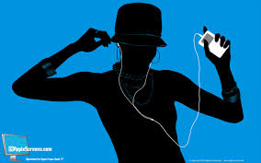
Assessment and Management of Children with Tinnitus
Risk Factors
Increased Concern About Personal Audio Players Since 2007

Slide 54
Assessment and Management of Children with Tinnitus
Risk Factors
Concern About Personal Audio Players Since 2007

Slide 55

Assessment and Management of Children with Tinnitus
The Dangerous Decibels Program www.dangerousdecibels.org
“Jolene”
The Dangerous Decibels
Manniken

Slide 56
Martin WH, Griest SE, Sobel JL & Howarth LC (2013). Randomized trial of four noise-induced hearing loss and tinnitus prevention interventions for children. Int J Audiology, 52, S41-S49
WHO estimates that North American children are exposed to more noise at school than workers from an 8-hour day at a factors
97% of children in 3rd grade are exposed to hazardous noise levels
30% of children said they have participated in noise activities
Only 5.5% ever use ear protection at the time
94% of youth (adolescents) use personal music players
28% use personal music players at levels putting them at risk

Slide 57
Martin WH, Griest SE, Sobel JL & Howarth LC (2013). Randomized trial of four noise-induced hearing loss and tinnitus prevention interventions for children. Int J Audiology, 52, S41-S49
1120 4th grade students in Oregon and southwest Washington
Randomized into 5 groups based on mode of education
  Classroom participation by high school students presenting Dangerous Decibels Program (DDP)
  Health professional educators presenting DDP
  On-site museum experience involving an exhibition on NIHL and tinnitus prevention
  Internet based virtual museum experience
  No intervention comparison group matched for age, gender, and ethnicity
.

Slide 58
Martin WH, Griest SE, Sobel JL & Howarth LC (2013). Randomized trial of four noise-induced hearing loss and tinnitus prevention interventions for children. Int J Audiology, 52, S41-S49
Interventions
  Activities were based on health communication theory principles
  Dangerous Decibels Classroom Program
    A 45-minute, interactive presentation with demonstrations and images
    Students participate in one or more hands-on activities
Three educational messages
  Sources of dangerous sounds
  Consequences of exposure to dangerous sounds
  Methods for protection from dangerous sounds
.

Slide 59
Martin WH, Griest SE, Sobel JL & Howarth LC (2013). Randomized trial of four noise-induced hearing loss and tinnitus prevention interventions for children. Int J Audiology, 52, S41-S49
Physics of sound
Normal auditory function
Pathophysiology
Consequences of noise exposure
Recommended exposure limits
Hearing protective strategies
Peer-pressure issues related to use of hearing protection

Slide 60
Martin WH, Griest SE, Sobel JL & Howarth LC (2013). Randomized trial of four noise-induced hearing loss and tinnitus prevention interventions for children. Int J Audiology, 52, S41-S49

Slide 61
Martin WH, Griest SE, Sobel JL & Howarth LC (2013). Randomized trial of four noise-induced hearing loss and tinnitus prevention interventions for children. Int J Audiology, 52, S41-S49

Slide 62
Martin WH, Griest SE, Sobel JL & Howarth LC (2013). Randomized trial of four noise-induced hearing loss and tinnitus prevention interventions for children. Int J Audiology, 52, S41-S49

Slide 63
Martin WH, Griest SE, Sobel JL & Howarth LC (2013). Randomized trial of four noise-induced hearing loss and tinnitus prevention interventions for children. Int J Audiology, 52, S41-S49

Slide 64
Martin WH, Griest SE, Sobel JL & Howarth LC (2013). Randomized trial of four noise-induced hearing loss and tinnitus prevention interventions for children. Int J Audiology, 52, S41-S49
Conclusions
  Classroom educational program presented by school nurses or high school students was most effective
  “The highly visible museum exhibition, while disappointing in terms of its effectiveness as a stand-alone program, has great potential to directly, albeit minimally, influence large numbers of the public in a cost-effective manner.”
  Internet-based interventions may serve multiple roles
    Introduce the topic of hearing health to young people
    Serve in limited capacity as primary educational tool
    Serve as an adjunct to a classroom program
.

Slide 65
Assessment and Management of Children with
Decreased Sound Tolerance and Tinnitus
Disorders of Decreased Sound Tolerance
  Differentiation and Definitions
  Risk Factors and Etiologies
  Mechanisms and Physiology
  Assessment
  Management options
Tinnitus
  Definition
  Risk Factors and Etiologies
  Mechanisms and Physiology
  Assessment
  Management options

Slide 66
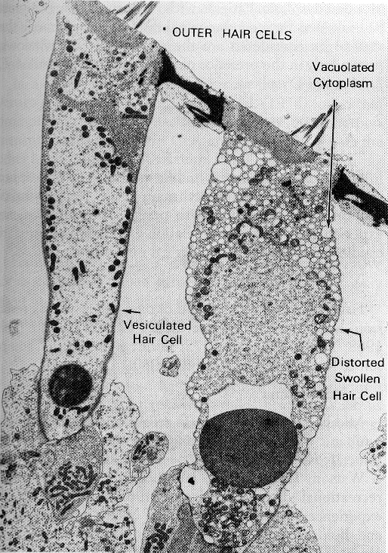
Assessment and Management of Children with Tinnitus
Causes and Mechanisms of Tinnitus (1)
Tinnitus typically has a cochlear origin
  Outer hair cell and sometimes inner hair cell damage
  Discordant Damage Theory: Imbalance between outer hair cell and inner hair cell function
  Reduced innervation of 8th nerve fibers
  Hyperexcitability of neural activity
Notes:
Spankovich

Slide 67
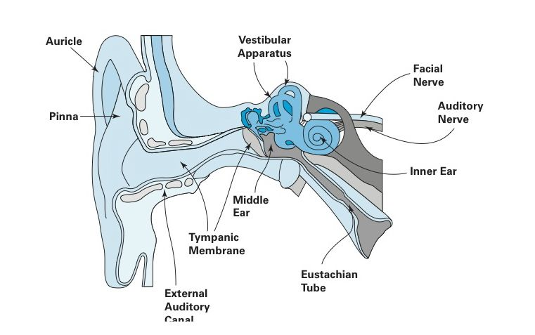
Assessment and Management of Children with Tinnitus
Causes and Mechanisms of Tinnitus
Secondary 8th nerve dysfunction
  Peripheral de-afferentation in auditory nerve
  Loss of input to tonic inhibitory systems
  Release of excessive excitatory neurotransmitter (glutamate)
  Over-expression of synaptic receptor function
Influence of middle ear disorders
  Increases tinnitus loudness because external everyday sounds do not “mask” tinnitus as much
  Medically manage middle ear disorders and related problems (e.g., allergies, sinusitis)

Slide 68
Assessment and Management of Children with Tinnitus
Ryan & Bauer (2016). Neuroscience of Tinnitus.
Neuroimaging Clin N Am, 26 (2), 187-196
Tinnitus is a spectrum-based percept
Most commonly a consequence of changes in auditory and non-auditory neural networks following damage to the cochlea.
Homeostatic compensatory mechanisms occur after hearing loss.
These mechanisms alter the balance of excitatory and inhibitory neurotransmitters.
Some people with tinnitus are disturbed by this subjective sensation.
When auditory network dysfunction is coupled with limbic-gating dysfunction, an otherwise meaningless auditory percept such as tinnitus may acquire negative emotional features.

Slide 69
Assessment and Management of Children with Tinnitus
Causes and Mechanisms of Tinnitus
Auditory brainstem, thalamus and cortex in the CNS
  Perception of sound
  Reorganization of neuronal activity
  Release of excessive amounts of excitatory neurotransmitter glutamate
  Over-expression of synaptic receptors type NMDA (N-Methyl D-Aspartate)
  Somatosensory system integration and
Non-traditional auditory regions
  Limbic system activation
  Autonomic nervous system activation
  Pre-frontal cortex, default mode networks, striatal gating. thalamocortical dysrhythmia, etc.

Slide 70
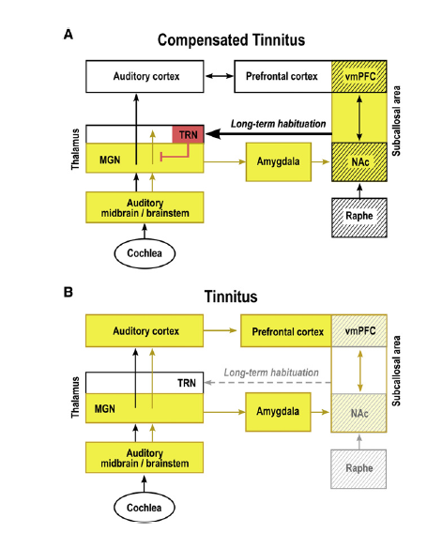
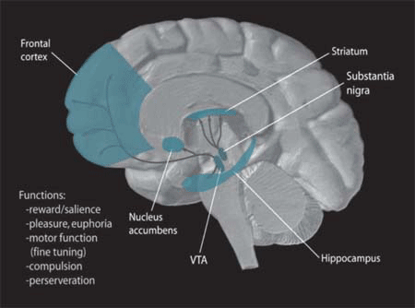
Tinnitus Mechanisms and Physiology
Gating Pathways
Hinkley et al. 2015
The Gating of Tinnitus
Rauschecker et al. 2010
Notes:
Spankovich

Slide 71
Assessment and Management of Children with
Decreased Sound Tolerance and Tinnitus
Disorders of Decreased Sound Tolerance
  Differentiation and Definitions
  Risk Factors and Etiologies
  Mechanisms and Physiology
  Assessment
  Management options
Tinnitus
  Definition
  Risk Factors and Etiologies
  Mechanisms and Physiology
  Assessment
  Management options

Slide 72
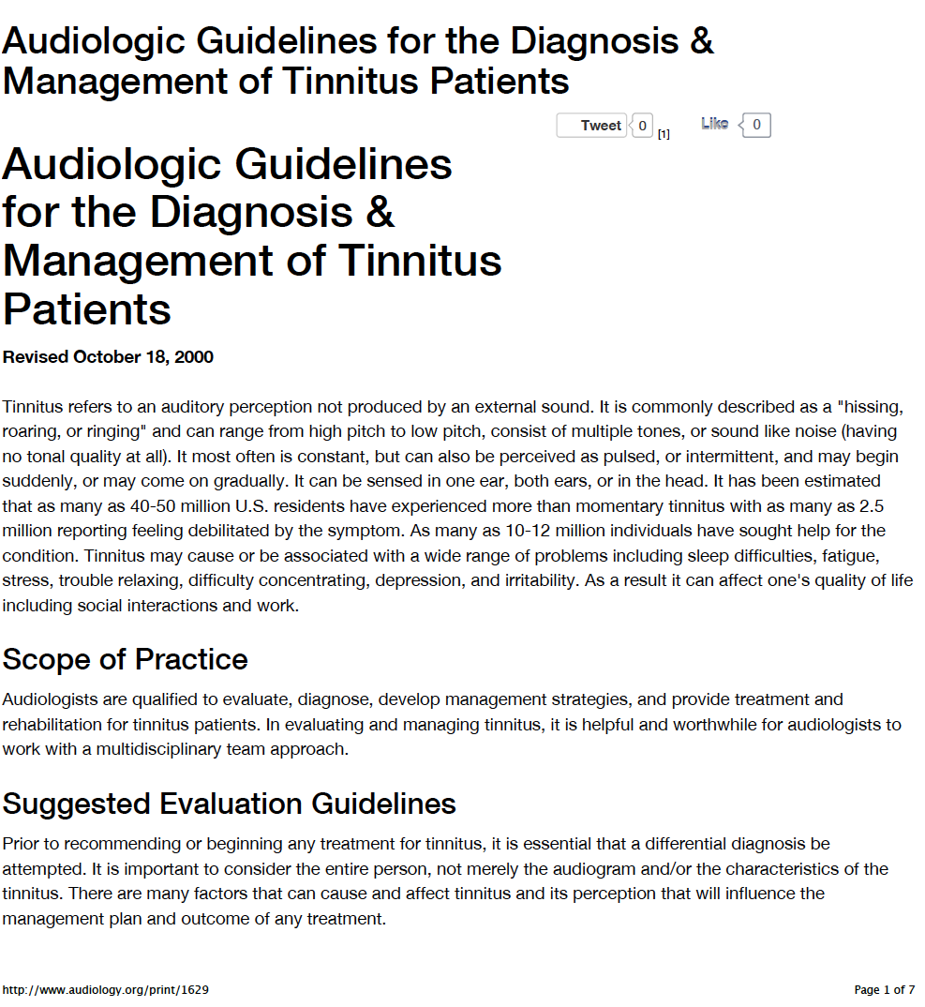
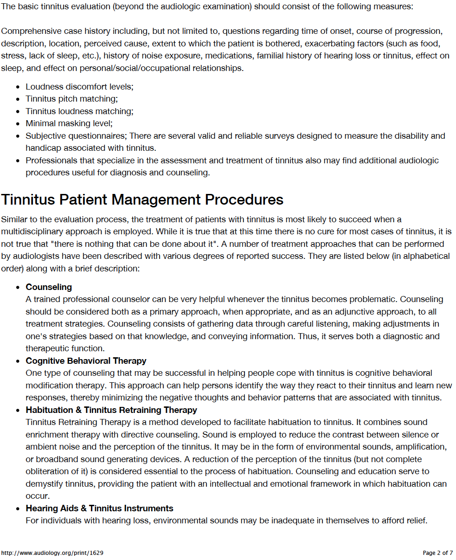
American Academy of Audiology (AAA)
Clinical Practice Guidelines … Written for Adults
(www.audiology.org)

Slide 73
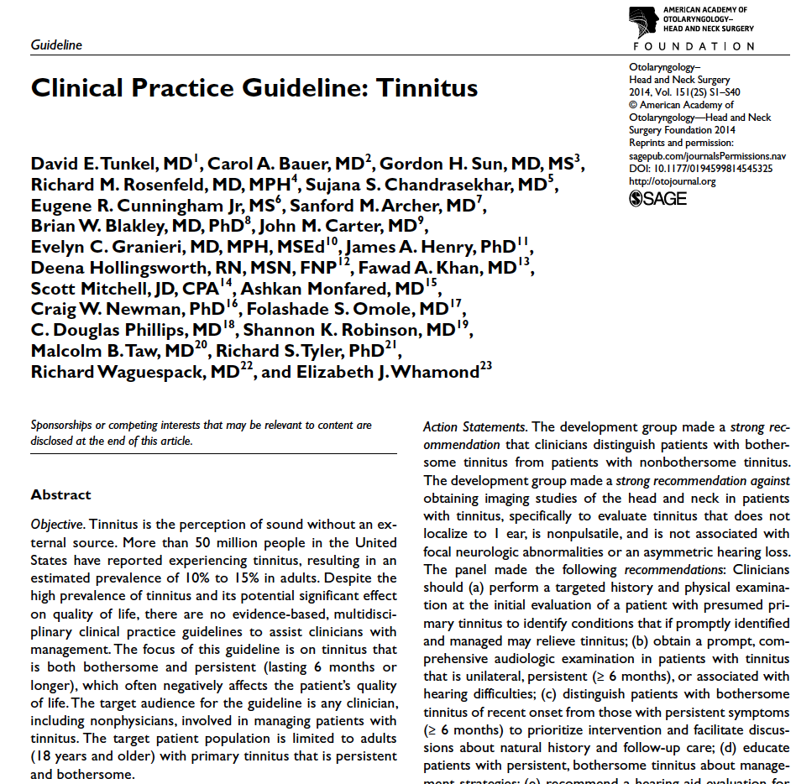
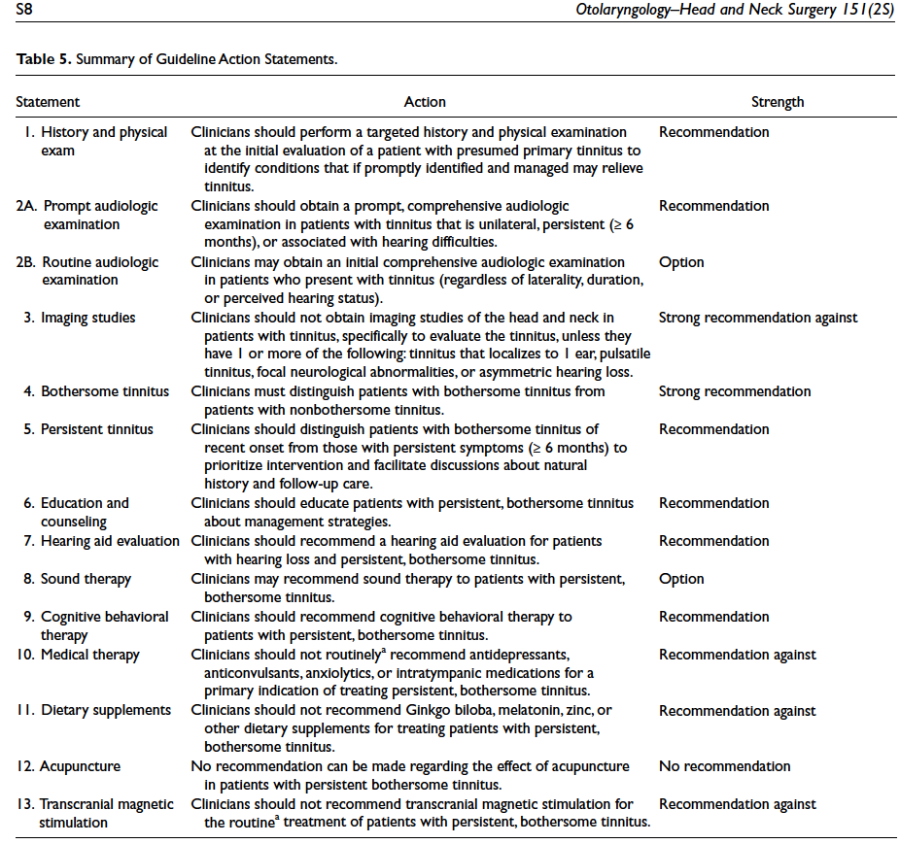
American Academy of Otolaryngology-Head & Neck Surgery
Clinical Practice Guidelines … Written for Adults

Slide 74
Special Tinnitus History or Questionnaire
(Available Upon Request … jwhall3phd@gmail.com)
Parent of child completes a history before tinnitus consultation or audiologist and parent complete the history at the initial appointment
Total of 27 questions with space for patient comments
Questions facilitate probing of important information, e.g.,
  Onset of tinnitus
  Nature of tinnitus
    Type of sound
    Laterality
    Volume (loudness)
    Constancy
  Prior health care consultation and treatment
  Percentage of waking hours aware of tinnitus

Slide 75
Special Tinnitus History or Questionnaire
(Available Upon Request … jwhall3phd@gmail.com)
Tinnitus interference or prevention of daily activities, e.g.,
  Concentration
  Falling and staying asleep
  Social events
  School
  Quiet activities like reading
Depression
Medications
Rank concern about
  Tinnitus
  Hyperacusis
  Hearing loss

Slide 76
Assessment and Management of Children with Tinnitus
Diagnostic Hearing Assessment (< 30 minutes)
Otoscopy
Immittance measurement
  Tympanometry
  No acoustic reflexes for most tinnitus patients (> 50% also complain of hyperacusis)
  Pulsatile Tinnitus
    Reflex decay at 35 dB HL and look at admittance
Distortion product otoacoustic emissions (DPOAE)*
  Frequencies from 500 to 8000 or 10,000 Hz
  6 or 8 frequencies per octave
  65/55 intensity levels
  Ask patient to raise hand if they hear the tinnitus pitch
  * Not noted in AAOHNS guidelines but very important

Slide 77
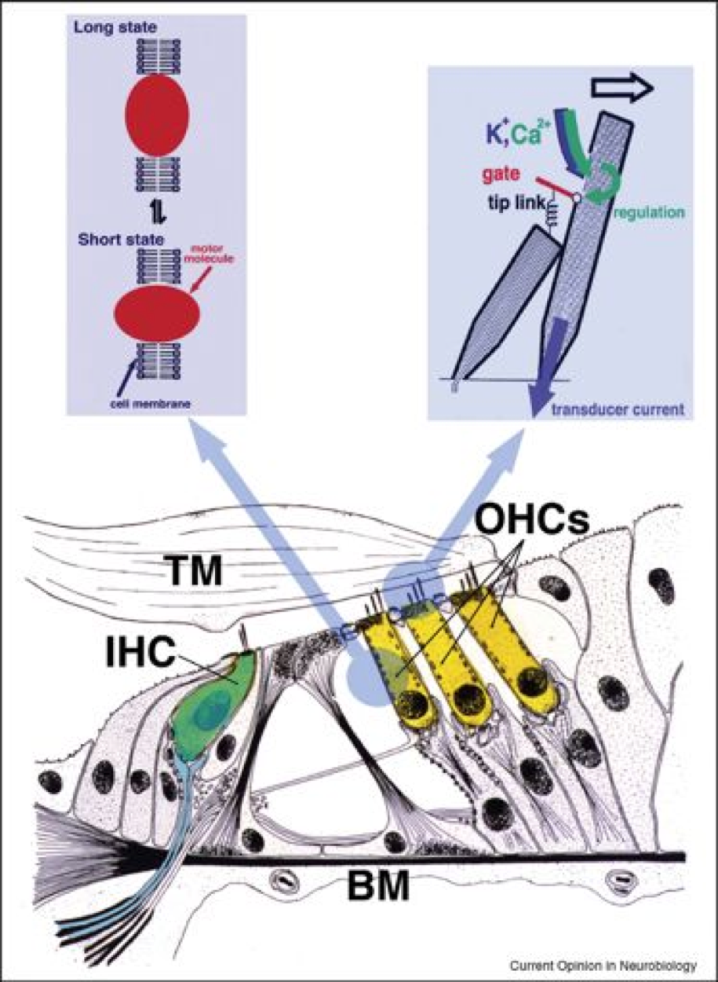
DPOAEs are Invaluable in the Assessment and Management of Tinnitus in Children

Slide 78
Tinnitus Assessment of Cochlear Function:
DPOAEs versus Audiogram (adult data)
(Hall, 1999; Dhar & Hall, 2018)
80
audio
60
% Normal Findings
40
OAE
20
1K
2K
4K
8K

Slide 79
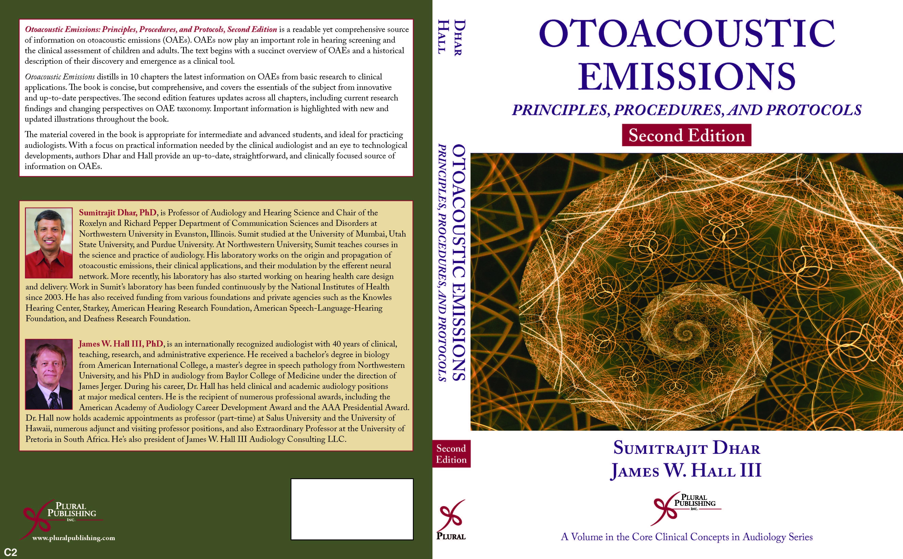
DPOAEs are Invaluable in the Assessment
and Management of Tinnitus

Slide 80
Assessment and Management of Children with Tinnitus
Diagnostic Hearing Assessment (< 30 minutes)
Pure tone audiometry
  Inter-octaves > 2000 Hz
  High frequency thresholds as indicated
  Bone conduction only as indicated
  Consider testing above 8000 Hz
Speech audiometry
  Word recognition performance at a comfortable level
  NU-6 lists with most difficult words ranked from 1 – 25
  Speech perception in noise as indicated

Slide 81
Assessment and Management of Children with Tinnitus
Tinnitus Psychoacoustic Assessment (< 30 minutes)
Threshold for white noise (broad band noise)
  To determine minimal detection level of background sound
  Useful in counseling patient regarding sound enrichment
  Threshold agrees with best pure tone hearing at any frequency (not necessary an audiometric frequency)
Estimate tinnitus pitch
  Only approximation with audiometer frequencies
  More precise estimation with DPOAE frequencies
  May require high frequency audiometer and earphones
  Creative combination of pure tone + narrow band noise may simulate “cricket” type tinnitus

Slide 82
Assessment and Management of Children with Tinnitus
Tinnitus Psychoacoustic Assessment (< 30 minutes)
Estimate tinnitus “loudness”
  At the tinnitus pitch in 1 or 2 dB steps
  Almost always at < +10 dB SL
  Sometimes as low as 0 or 1 dB SL
Determine minimum masking level for tinnitus
  Often less than 30 dB
  Assess “residual inhibition” following masking
  Finding useful in counseling patient about sound enrichment
Measure loudness discomfort levels (LDLs)
  Only if patient haa hyperacusis
  For tones and speech sounds

Slide 83
Assessment and Management of Children with Tinnitus
Tinnitus Psychoacoustic Assessment (< 30 minutes)

Slide 84
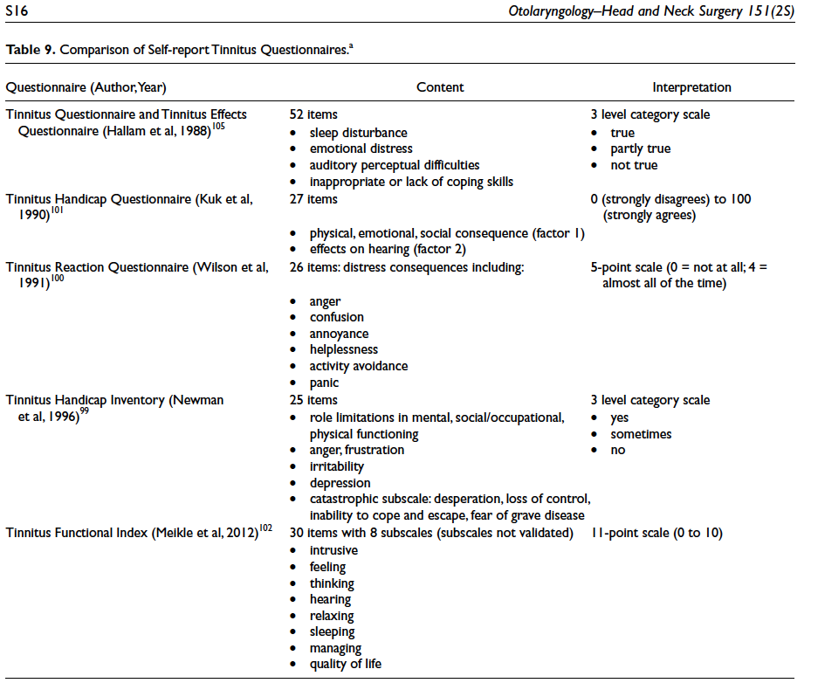
Assessment and Management of Children with Tinnitus
Validated Inventories for Adults … Not Important for Children
(from AAOHNS Guidelines)

Slide 85
Assessment and Management of Children with
Decreased Sound Tolerance and Tinnitus
Disorders of Decreased Sound Tolerance
  Differentiation and Definitions
  Risk Factors and Etiologies
  Mechanisms and Physiology
  Assessment
  Management options
Tinnitus
  Definition
  Risk Factors and Etiologies
  Mechanisms and Physiology
  Assessment
  Management options

Slide 86
Tinnitus Patient and Family
Counseling and Education
“Knowledge is power.”
(Nam et ipsa scientia potestas est.)
Francis Bacon
(1561-1626)
Meditationes Sacrae [1597]

Slide 87
Assessment and Management of Children with Tinnitus
General Management Approaches
In depth “directive” counseling by audiologist experienced with tinnitus with parental support… demystify patient’s tinnitus
Written accurate information for parents of patient
Melatonin (in the evening before going to bed) if disruption of sleep is a major problem
Sound enrichment
  Environmental sound device
  www.soundtherapy.com
  Sound pillow
Amplification if at all indicated (natural sound therapy)
  Hearing aid (open fit hearing aids are especially useful)
  Combination hearing aid/sound generator

Slide 88
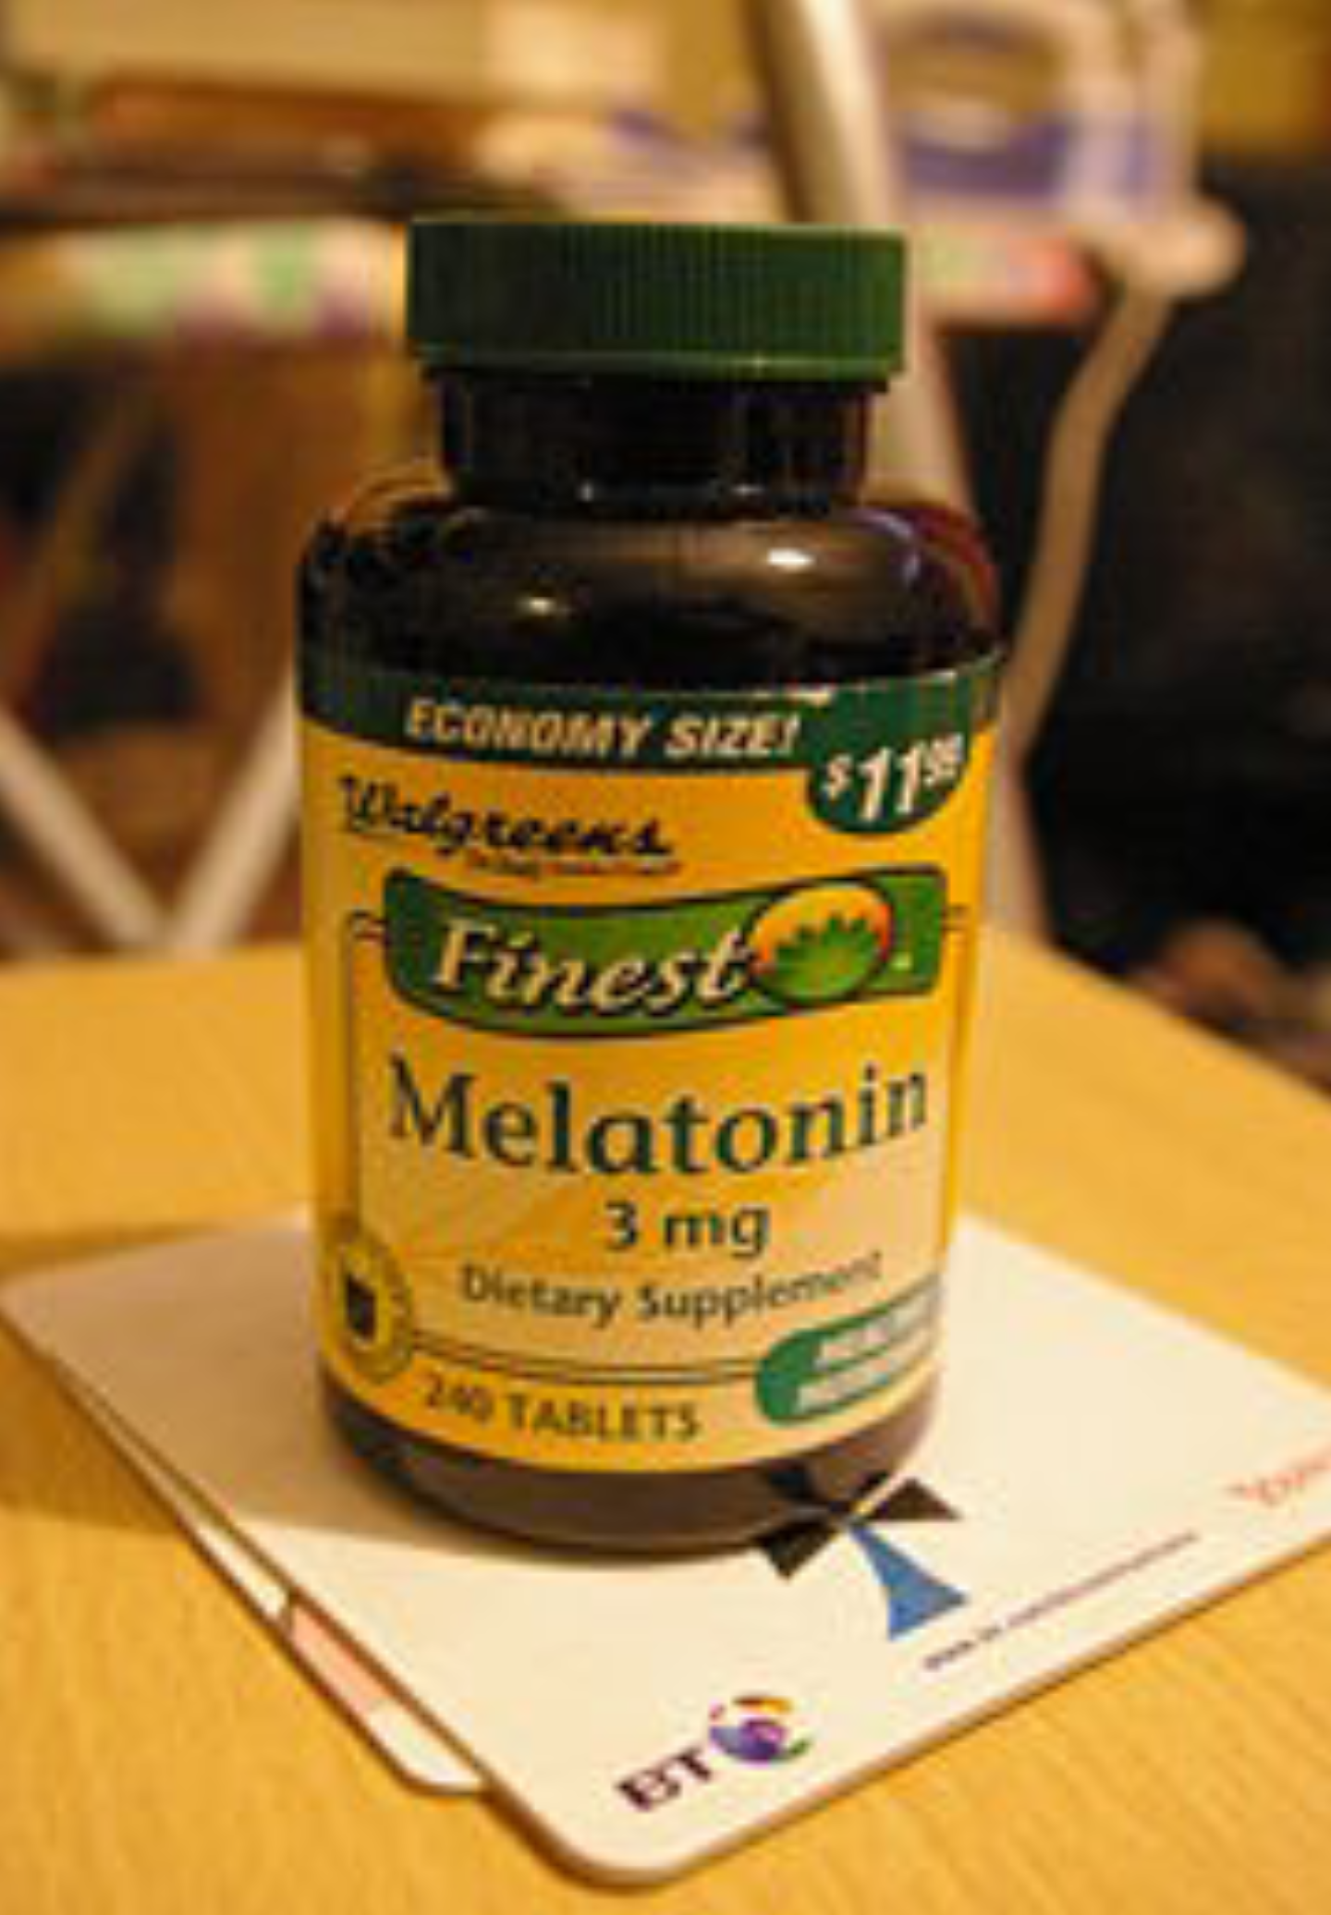
Assessment and Management of Children with Tinnitus
Melatonin in the Management of Tinnitus
Piccirillo JF. Melatonin. Prog Brain Res. 2007;166:331-3.
Melatonin is a neurohormone that is secreted by the pineal gland and known to impact the sleep-wake cycle. Melatonin is regarded to be a safe and natural sleep aid. Since many people with tinnitus suffer sleep disturbance, melatonin has been studied as a therapeutic agent for tinnitus. A review of the literature suggests that melatonin has a beneficial effect on tinnitus, especially for patients with sleep disturbance, but it does not seem to modify the strength or frequency of the tinnitus.

Slide 89
Assessment and Management of Children with Tinnitus
Melatonin in the Management of Tinnitus
Hosseinzadeh et al (2019). Molecular aspects of melatonin treatment in tinnitus: A review. Current Drug Targets, 20, 11112-1128
  Protection against cochlear damage
  Minimizes perception of bothersome tinnitus
  Should be considered as a treatment option
Miroddi et al (2015). Clinical pharmacology of melatonin in the treatment of tinnitus: A review. European J Clin Pharmacol, 71, 263-270
  Melanonin improves sleep in patients with tinnitus
  Mixed findings for treatment of tinnitus with melatonin due to bias in studies
  Remember … placebo effect is your friend in clinical management
Merrick et al (2014). Does melatonin have therapeutic use in tinnitus? South Med J, 107, 362-366
  Minimum risk of toxicity
  Low cost and minimum adverse effects
  Recommend melatonin for patients with bothersome tinnitus

Slide 90
Sound Pillow® Sleep System
R. Scott Armbruster, President (www.SoundPillow.com)

Slide 91
Counseling Patients and Parents of Patients
The Placebo Effect is Your Friend
Tinnitus Research
  Placebo effect is a very clear factor in outcome
  Accounts for up to 40% of apparent benefit from “treatment”
  Control (non-treatment) group is essential in tinnitus research
Clinical Service
  Placebo effect can contribute significantly to improved patient outcome
  Placebo effect is enhanced by:
    Perceived and actual expertise of the audiologist
    Good bedside manner
    Confident and compassionate interactions with patient

Slide 92
Benefit of Directive Counseling in Tinnitus in Adults:
Tinnitus Handicap Inventory Scores Before versus 6 Months After Counseling and Environmental Sound Therapy (Hall, 1999)
20
Pre
15
Post
Total Score
10
5
Functional
Items
Emotional
Items
Catastrophic
Items

Slide 93
Tinnitus is A Symptom of Various Diseases And Pathologies:
Refer Out to Eliminate Doubt!
Otologic disorders such as:
  Noise-induced cochlear dysfunction
  Otitis media
  Other middle ear disorders
  Temporal mandibular joint (TMJ) disorders
Other disorders such as:
  Head injury
  Inflammatory disorders
  Metabolic disorders
  Neurologic disorders

Slide 94
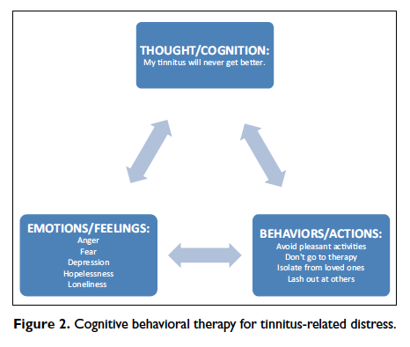
Assessment and Management of Children with Tinnitus
Cognitive Behavioral Therapy or CBT
(from AAOHNS Guidelines)

Slide 95
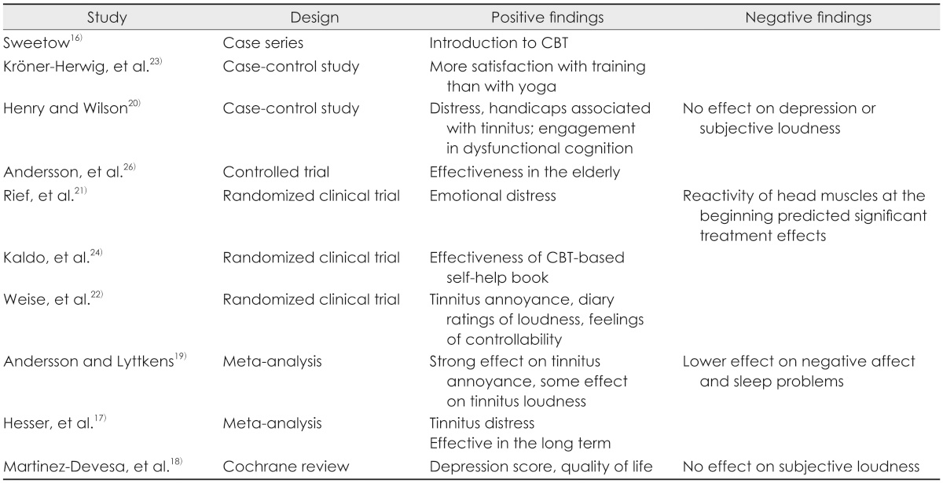
Assessment and Management of Children with Tinnitus Cognitive Behavioral Therapy (CBT)

Slide 96
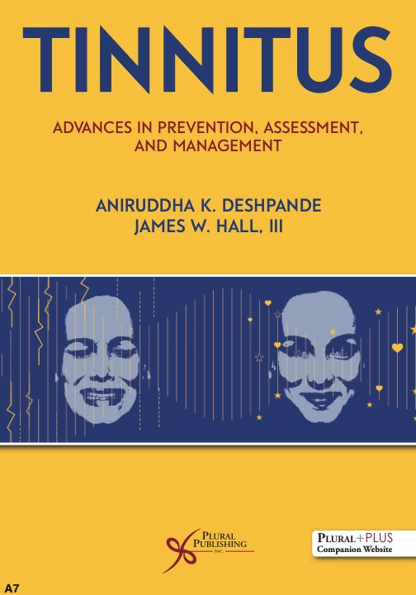
Assessment and Management of Children with
Decreased Sound Tolerance and Tinnitus
New Tinnitus Reference (Spring 2022)
Mechanisms of Noise/Music Induced Tinnitus
Genetic Advancements in Tinnitus Prevention
Technological Advancements in Tinnitus Prevention
Importance of Patient History: Risk Factors for Bothersome Tinnitus
Clinical Test Protocol for Tinnitus Assessment
App-Based Tinnitus Assessment
Diagnostic Advances in Tinnitus
Values-Led Care in Tinnitus
Self-Directed Tinnitus Therapy: At Home Therapy Options
Role of Amplification in Tinnitus Management
Audiologist-Assisted CBT for Tinnitus
Cutting-Edge Approaches in Tinnitus Management
Hyperacusis and Other Disorders of Decreased Sound Tolerance
Health Determinants of Tinnitus
Supplements for Tinnitus
Complementary and Alternative Medicine
Role of Social Media in Tinnitus and Hyperacusis
Tele-audiology and Tinnitus Management

Slide 97


Assessment and Management of Children with
Decreased Sound Tolerance and Tinnitus

