Slide 1

Fuel in a bowl
Power Bowls 101
ENERGIZING
NOURISHING
BALANCED
By: Shannon Adcock
Family and Consumer Science Agent
Harnett County Cooperative Extension
SATISFYING
COLORFUL

Slide 2
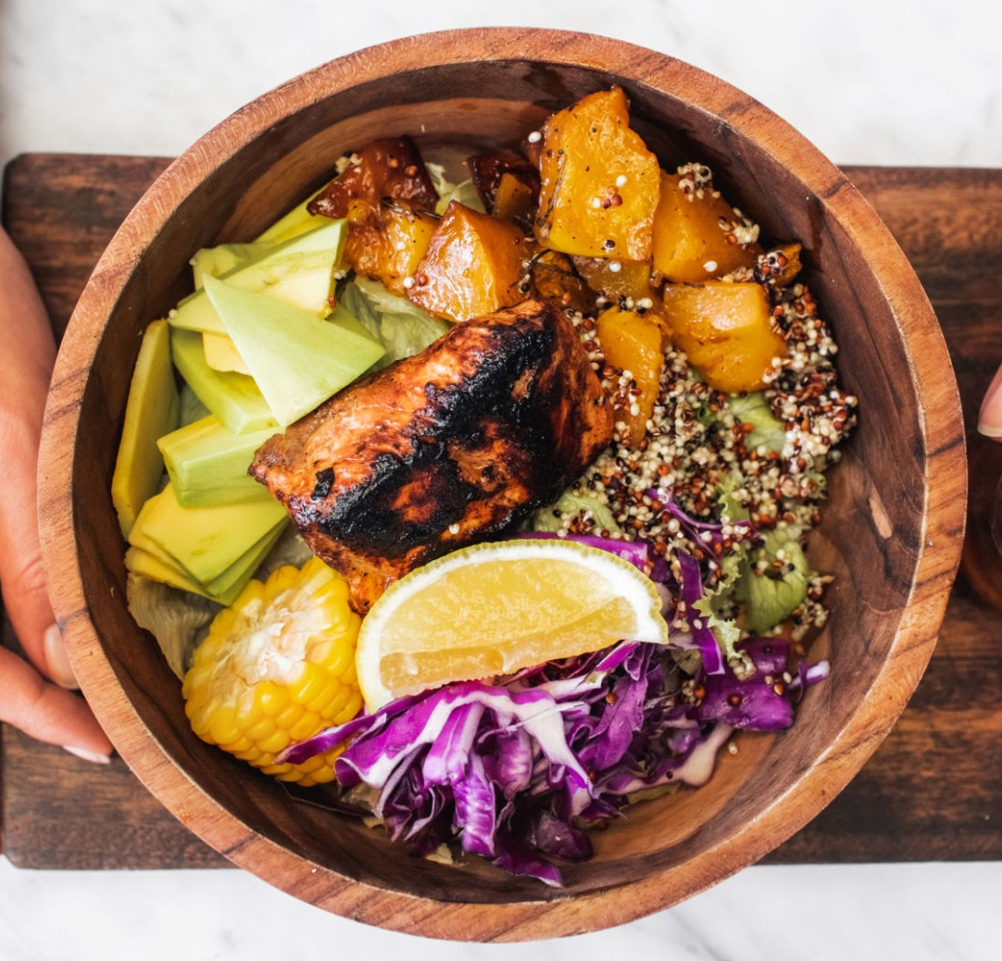
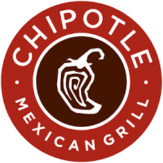


What is a Power Bowl?
A power bowl is a balanced, all-in-one meal made of grains or greens, protein, vegetables, and healthy fats designed to keep you full and energized.
Several restaurant chains have gotten in on the Power Bowl craze.

Slide 3
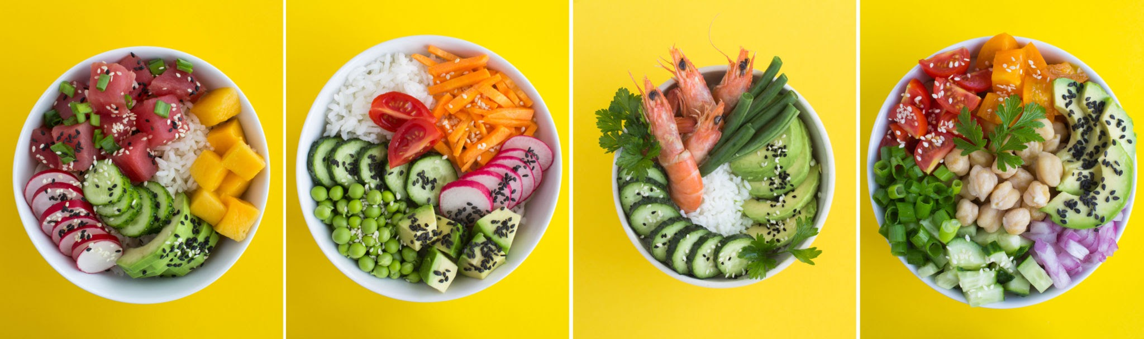
More about Power Bowls . . .
WHO are they for?
WHAT is it exactly?
WHEN should I eat one?
WHERE did they come from?
WHY are they healthy?
Busy professionals who want fast, balanced meals
Fitness enthusiasts building muscle or improving recovery
Students on a budget
Families trying to eat healthier
A power bowl is a balanced, all-in-one meal built in layers:
Base
Protein
Vegetables
Healthy fats
Flavor boost
Lunch to avoid the 3pm crash
Post-workout for muscle repair
Meal prep for the week
Dinner when you want something filling but not heavy
While the “power bowl”name is modern, the structure mirrors traditional meals worldwide:
Mediterranean grain plates
Hawaiian poke bowls
Japanese donburi
Middle Eastern mezze platters
Protein helps you feel full longer and reduces hunger later in the day.
Fiber supports gut health, blood sugar control, and heart health.
Diets rich in vegetables and whole grains are linked to lower risk of chronic disease.

Slide 4
Build your bowl !
1: Base
Whole grains like quinoa or brown rice
Greens like spinach or kale
2: Protein
Chicken, tofu, beans, salmon, eggs,
edamame, chicken sausage
3: Vegetables
Aim for color variety
Different colors mean different antioxidants and micronutrients, which support immune health and gut health.
SATISFYING
4: Healthy Fats
Help you feel full longer and help your body absorb vitamins. Try:
Avocado, hummus, nuts, seeds, olive oil
CREAMINESS
C R U N C H
5: Flavor Boost
Try fresh herbs, vinegars, citrus juice, soy sauce, sriracha, honey or maple drizzle
VARIETY
VIBRANT

Slide 5
Power Bowl flavor profiles
Southwest: Quinoa, grilled chicken, black beans, corn, roast sweet potato, tomatoes, sour cream
Thai: Rice noodles, shrimp/ tofu, bean sprouts, carrots, peanut sauce
Mediterranean: Orzo pasta, canned fish, green beans, artichoke hearts, tomatoes, olives, feta, balsamic dressing
Mexican: Rice, black beans, pico de gallo, avocado/guacamole, tomato, radishes, cilantro
Japanese: Soba noodles, edamame, green onions, mushrooms, cucumber, sesame seeds, fried egg
Italian: Farro, cannellini beans, tomatoes, roasted eggplant/zucchini, halloumi cheese, pine nuts, pesto
Moroccan: Couscous, chickpeas, chicken, greens, pita chips, harissa yogurt
Indian: Basmati rice, dal, cauliflower, slivered almonds, tahini, yogurt

Slide 6

Time saving hacks
Use Pre-cooked Grains: Look for 90-second microwaveable rice or quinoa pouches. They can be eaten cold or at room temperature.
Use Canned Protein: Canned tuna, salmon, chickpeas, and black beans are an important part of no-cook dinners.
Use an Instant Marinade: A simple mixture of lemon juice, olive oil, salt, and pepper works as a dressing for almost any combination.
Keep it Crunchy: Simply add nuts (walnuts, almonds) or seeds (pumpkin, sesame) for extra texture and healthy fats.

Slide 7
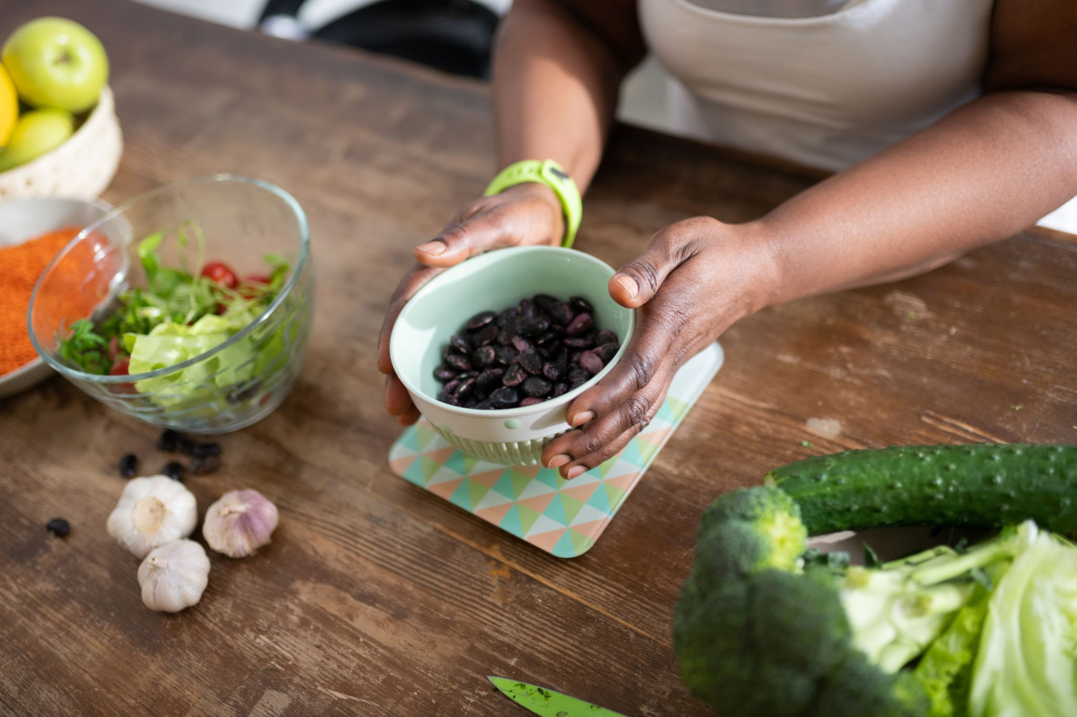
It’s time to create your very own Power Bowl!
ENERGIZING
NOURISHING
BALANCED
SATISFYING
COLORFUL

