Slide 1
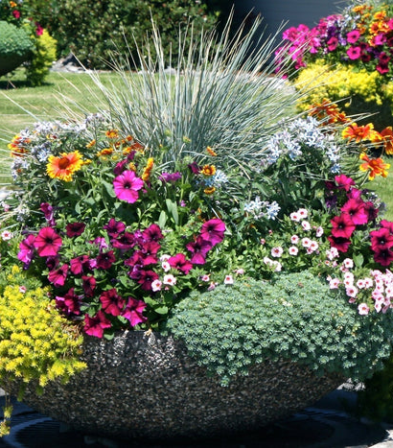

Container Gardening: Thriller-Filler-Spiller Technique
4.21.2026 by Kathy Parker
Anderson Creek Garden Club

Slide 2

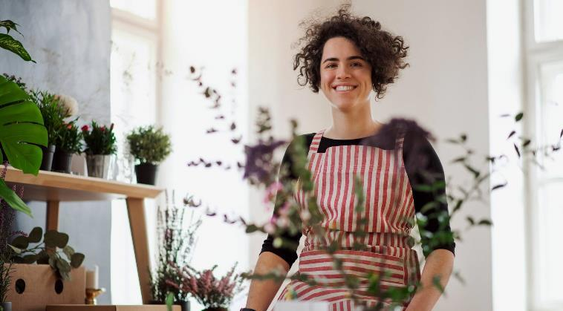
Agenda
The Concept
Soil Components
Cultural Conditions
Plant Selection
Hands-on Steps
Aftercare

Slide 3
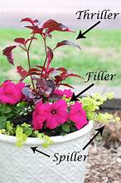

The Concept
Thriller- Tall, upright, eye-catching, drama, and focal point
Center or back
Filler- Medium height, mounding, fullness, structure, and texture
Surrounds thriller
Spiller- Trailing, softness and cascading
Edges of container
Design Layout

Slide 4
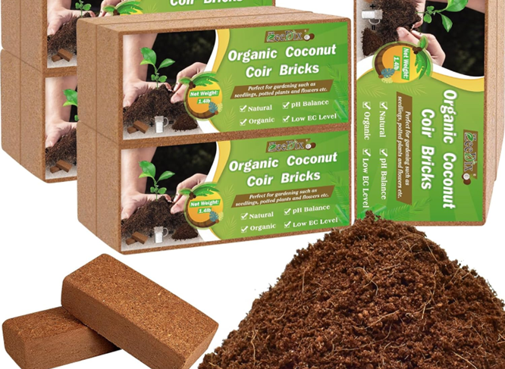
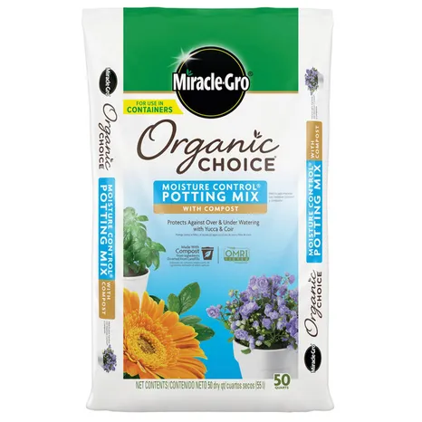
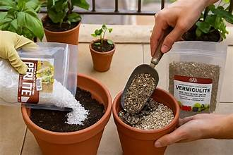
Use soilless substrates Well-draining potting mix
DO NOT USE GARDEN SOIL
Compost –nutrients 20%
Coconut Coir- moisture 60%
Perlite(drains moisture)
Vermiculate(holds moisture)- drainage 20%
https://www.urbanplant.in/

Slide 5
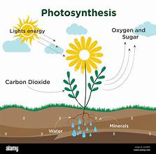
Cultural Conditions
Same Light & Water Needs
Sunlight
Water
Plant Selection NC State Plant Toolbox
Match plants to light conditions:
Full Sun: 6+ hours
Part Sun: 3-6 hours
Shade: <3 hours
DESIGN BASED ON WHERE THE CONTAINER WILL SIT
Containers dry out quickly
Summer-daily checks
Spring- 2-3x week
Water when top 1-2 inches are dry
Ensure drainage holes
WATER DEEPLY, NOT LIGHTLY
Go to Find a plant
Filter: USDA Plant Hardiness Zone -8
Landscape Location-Container Use
Light- Sun/Shade
Confirm Plant Hight before buying

Slide 6
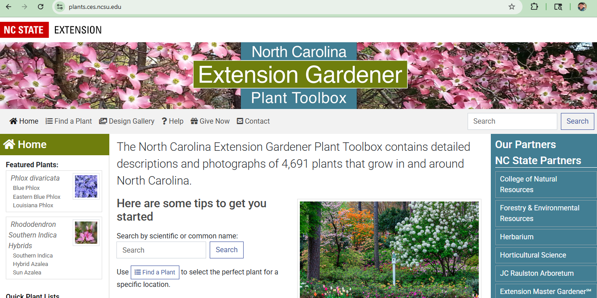
NC State Extension Gardener Plant Toolbox

Slide 7

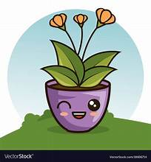

Hands-on Steps
Add soil halfway and slow-release fertilizer
Loosen roots gently
Place thriller first
Add fillers
Place spiller near edge
Backfill and top dress with mulch
Water
Label plant name and sun needs

Slide 8
Plant with similar sun and water requirements that we have with us today.
Full Sun
Full/Part Sun
Part Sun
Bunny tail grass
Sedum
Portulaca
Agastache
Bunny tail grass
Geranium
Celosia
Ageratum
Sweet potato vine
Marigold
Snapdragon
Nasturtium
Purple fountain Grass
Coleus
Begonia
Creeping Jenny

Slide 9
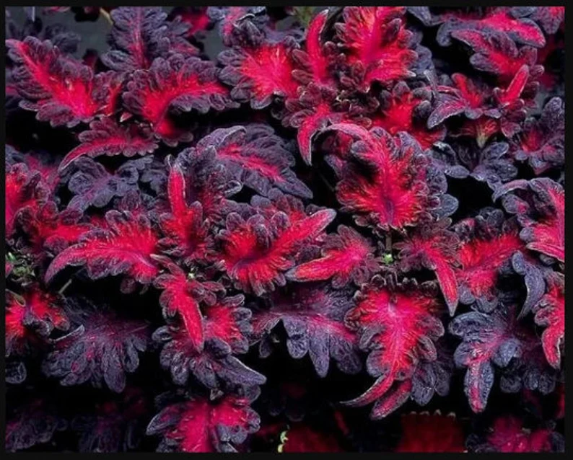
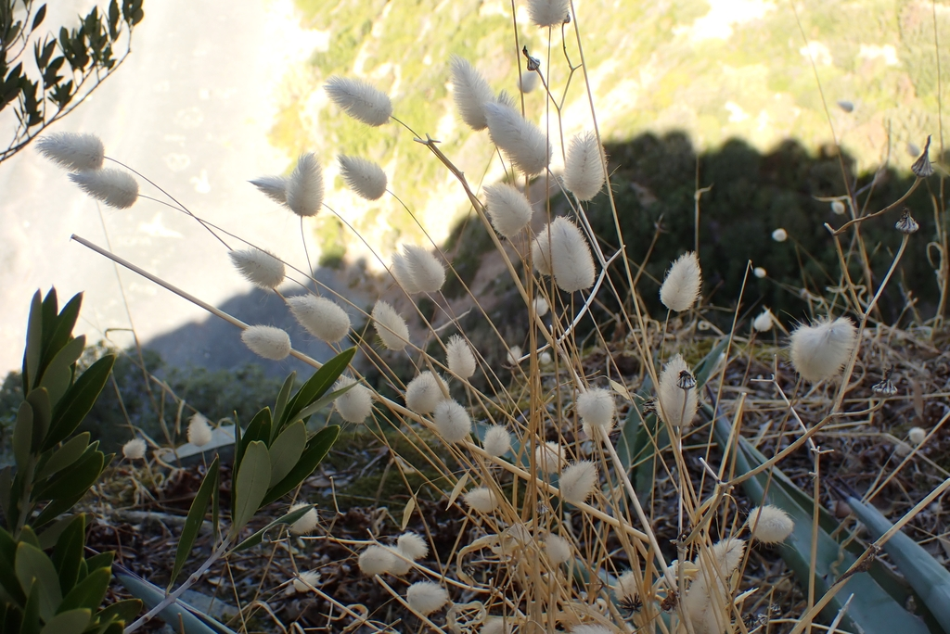
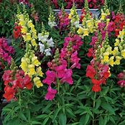
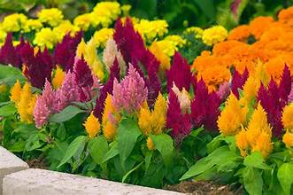
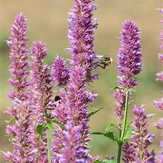
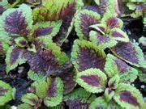
Plant Options
Bunny tail grass
Thriller
Coleus- Black Dragon
Coleus
Begonia
Bunny tail grass
Fountain grass
Snapdragon
Celosia
Agastache
Snapdragon-Candy Tops
Celosia- Kimono Mix
Coleus- Lord Voldemort
Agastache- Arcado Pink

Slide 10
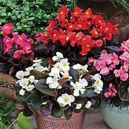
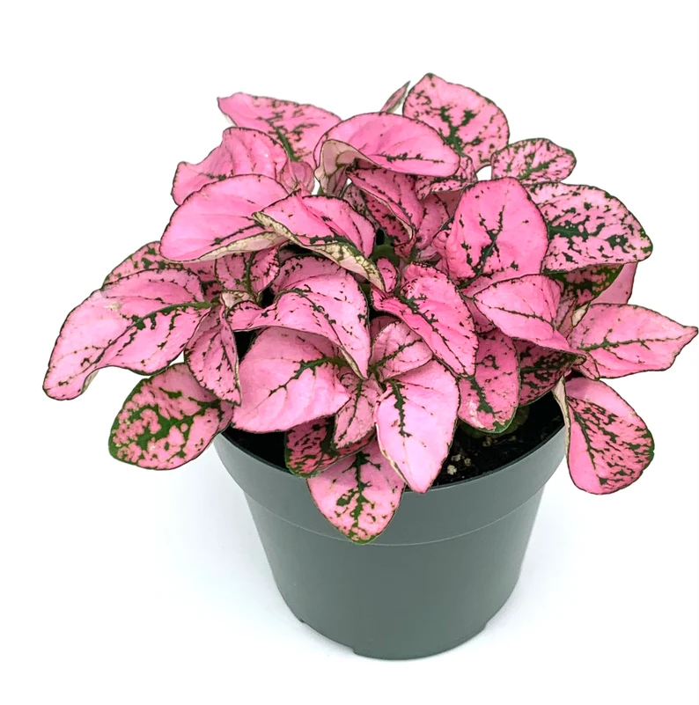
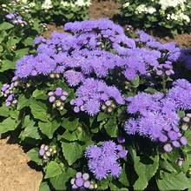
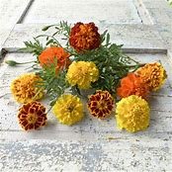
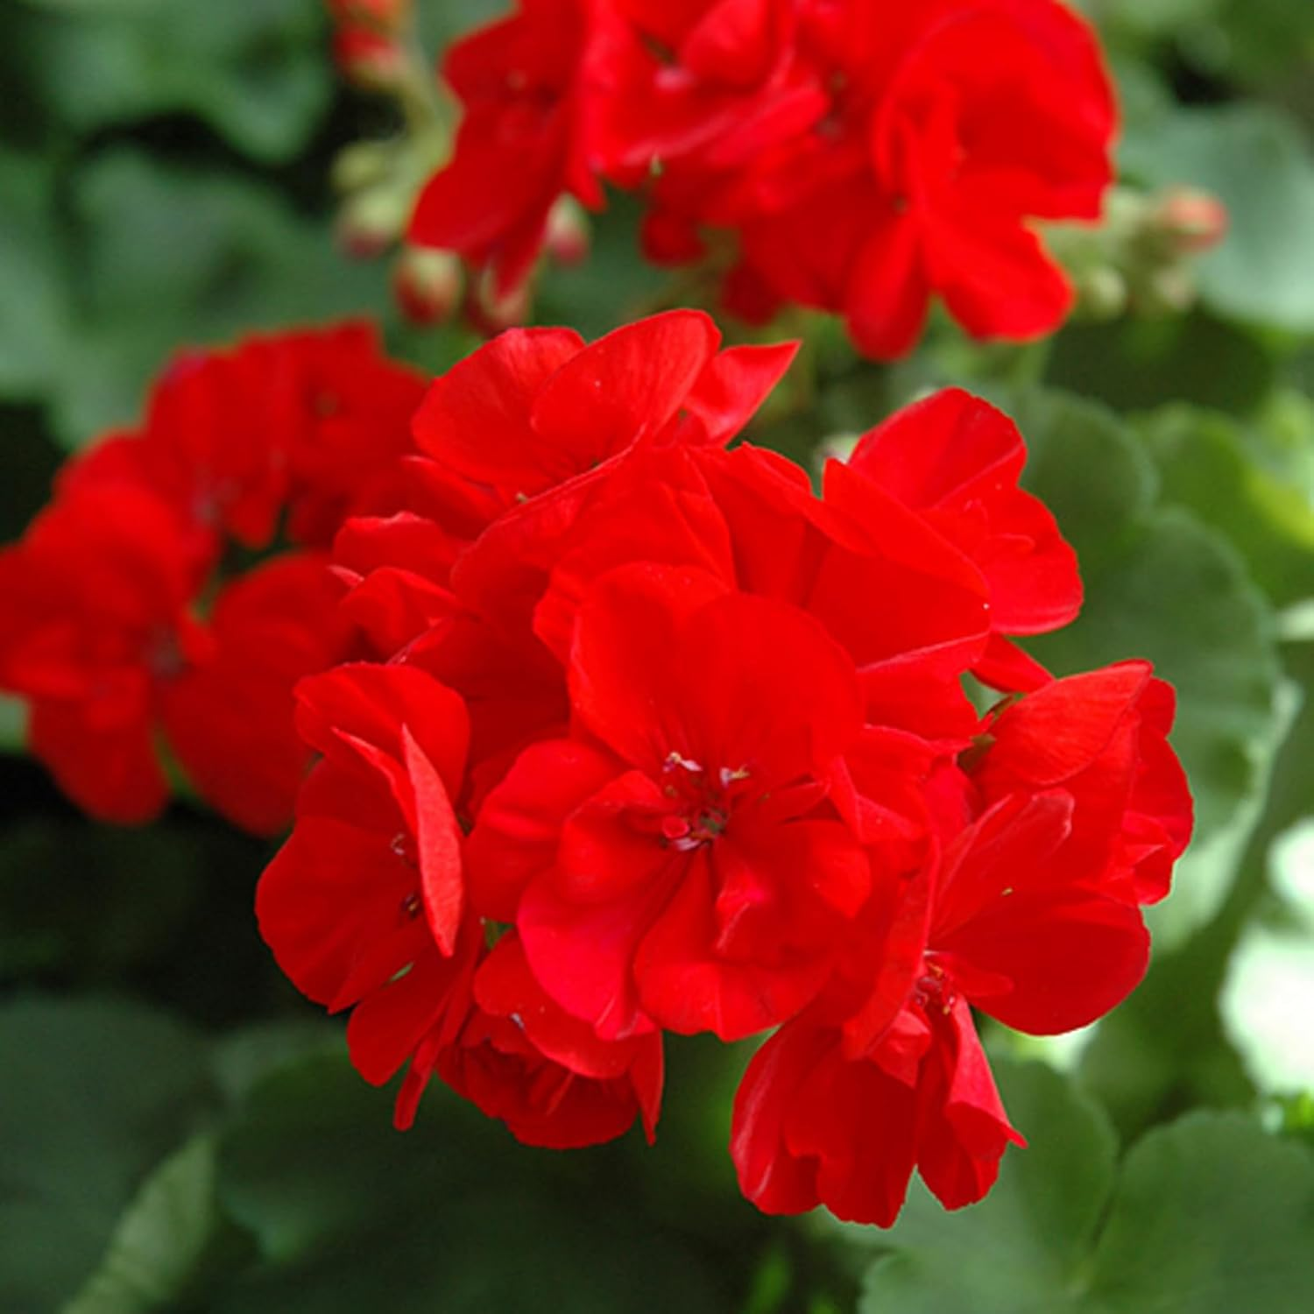
Plant Options
Filler
Begonia- Bada Bing Mix
Hypoestes-Splash Select Rose
Lantana
Verbena
Salvia
Zinnia
Begonia
Marigold
Ageratum
Geranium
Hypoestes
Ageratum-Aloha Blue
Marigold- Bonanza Mix
Geranium- Bright Red

Slide 11
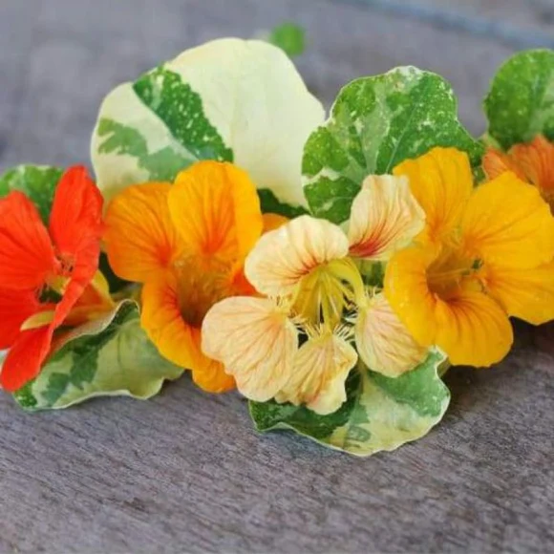
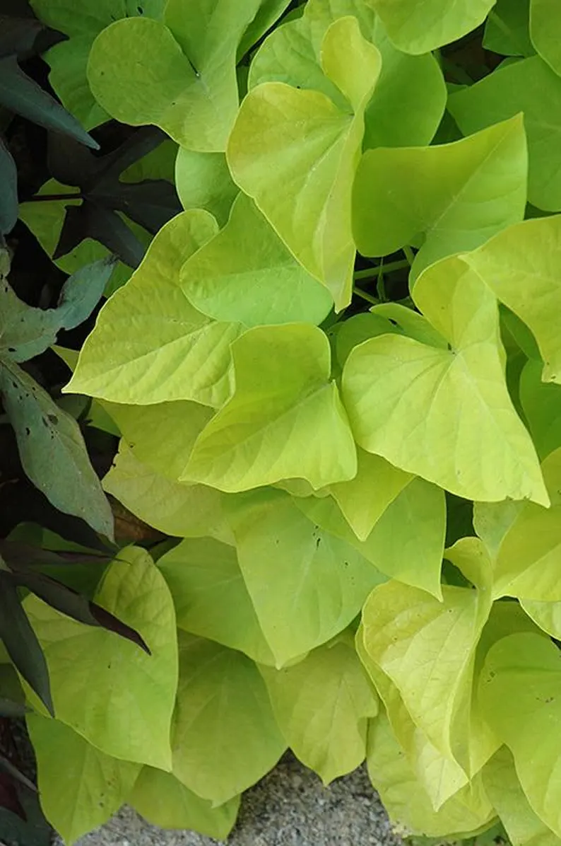
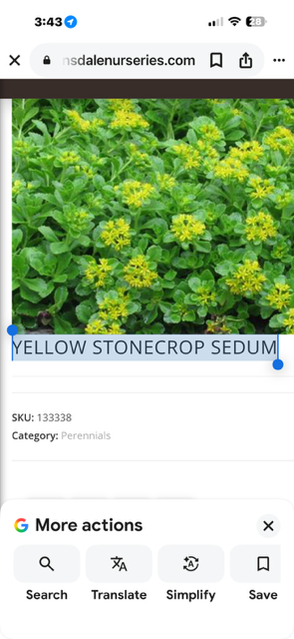
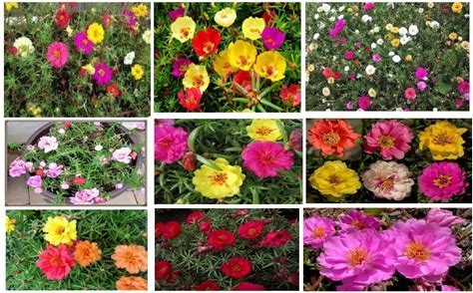
Plant Options
Spiller
Nasturtium-Alaska Mix
Sweet potato vine
Trailing petunia
Nasturtium
Sedum
Portulaca
Ipomoea Sweet Potato Margarita
Portulaca- Mixed

Slide 12
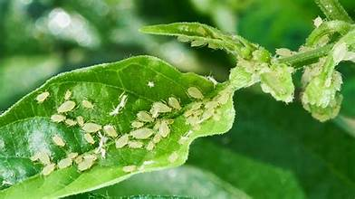
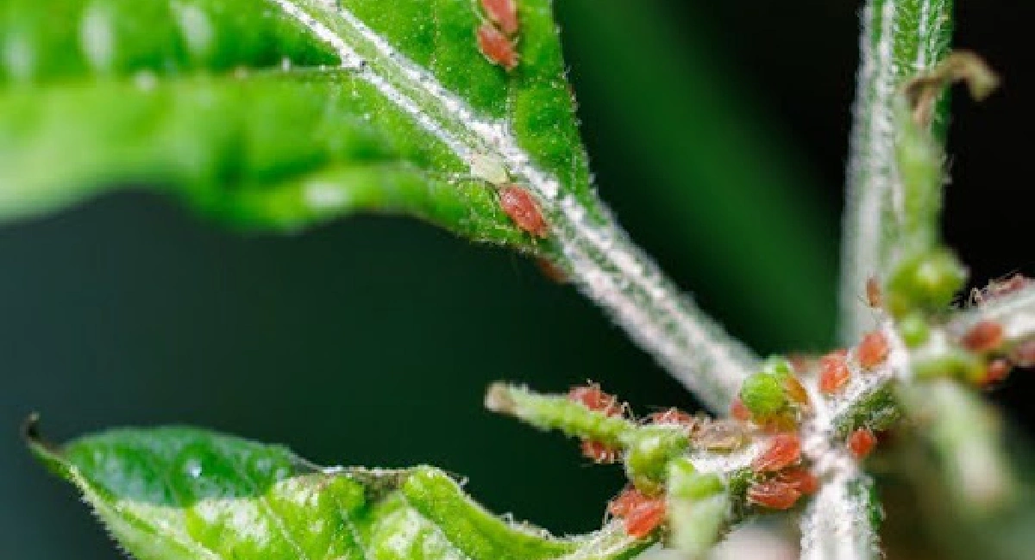
Aftercare
Check soil for water needs (usually needs H2O daily in summer)
Use balanced 10-10-10 liquid fertilizer every 2-3 weeks
Nitrogen(growth), Phosphorus(flowers/roots), Potassium(overall health)
Deadhead flowers
Prune and trim leggy growth
Watch for pests (esp. aphids & mites)
Rotate container weekly
Refresh or replace seasonally
Afternoon shade helps during 95°F+ days

Slide 13
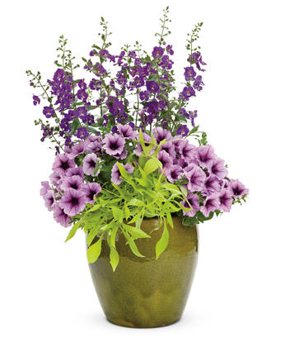
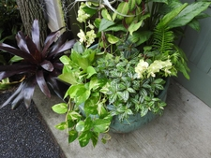
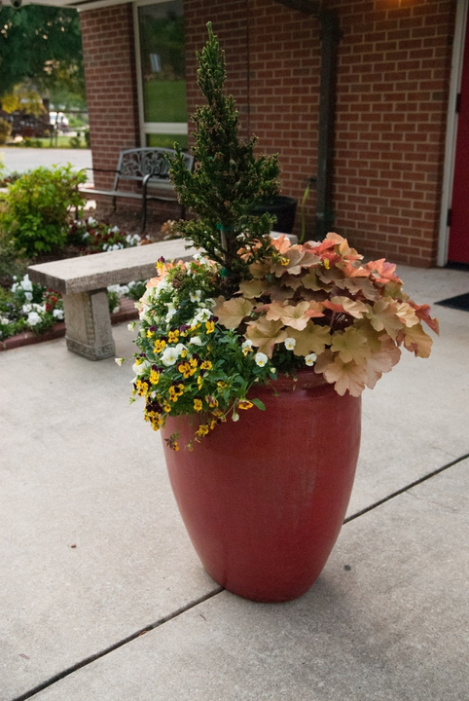
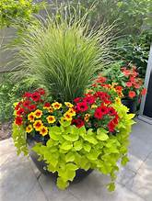
Inspiration
Great Combinations
Sun
Thriller: Celosia or Ageratum
Filler- Marigold or Geranium
Spiller: Portulaca or sweet potato vine
Part Sun/Shade
Thriller” Coleus
Filler: Begonia or Ageratum
Spiller: Nasturtium or Sweet potato vine

Slide 14
Resources
https://plants.ces.ncsu.edu/
https://www.provenwinners.com/Container-Design
Mays, D., K. Richter, L.K. Bradley, J. Sherk, M. Kistler, and J. Neal. 2022. Plants Grown in Containers, Chapter 18. In: Moore, K.A., and L.K. Bradley (eds). North Carolina Extension Gardener Handbook, 2nd ed. NC State Extension, Raleigh, NC. http://content.ces.ncsu.edu/18-plants-grown-in-containers

