Slide 1
Welcome
Anderson Creek Garden Club
April 21st, 2026

Slide 2
Agenda`
Opening Ceremony
Pledge of Allegiance
Purpose
Introduction of Board
Member Introductions
Business
Program “Tour, Power Bowls, Thrillers”
Business Meeting
Approval of minutes
Financial report, Treasurer,
Budget Approval 2026-27
Membership Drive report
Slate of Officers Approval 2026-27
Gold Star project
Calendar of Upcoming events
Program
Introduction Justin Burkhead-Garden Tours
Introduction Shannon Adcock, Power Bowls
Introduction Kathy Parker-Thrillers, Fillers, Spillers
Q & A
Reminders
Adjourn
Notes:
t

Slide 3
Opening Ceremony
Official Collect
The Garden Club of North Carolina, Inc
Our Heavenly Father, who dost feed the birds and clothe the flowers and who knoweth and careth for every need of us, Thy children, so enlighten our minds to use wisely all the gifts of Thy Mighty Hand that we, being imbued with Thy Holy Spirit, may work so Thy will that those who come after may mark their path by our footsteps.
For all the beauty of the earth, Father, in Heaven, we thank Thee.
For our families, our friends, our free and beautiful country, Father in Heaven, we thank Thee.
We beseech Thee of Thy great goodness and tender mercy to forgive our sins and grant that we work together in fellowship, we may draw closer to Thee, Almighty God, in whose name we pray.
Amen
Mary Rehder Gerdes

Slide 4
Overview of Our Purpose
The purpose of this club shall be: to stimulate interest in horticulture, gardens, youth gardening, and flower arranging; to encourage and improve civic planning; to cooperate in the protection of wildlife, wild flowers, and native plants; and to support the projects of the Garden Club of North Carolina, Inc. and National Garden Clubs, Inc.

Slide 5
Members Roundtable
Introductions

Slide 6
Let‘s put the fun and strategy in 2026-27

Slide 7
Business Meeting
Minutes Approval
Treasurer Report, Alexis & Sherry
Membership Drive 39 members sent out this month

Slide 8
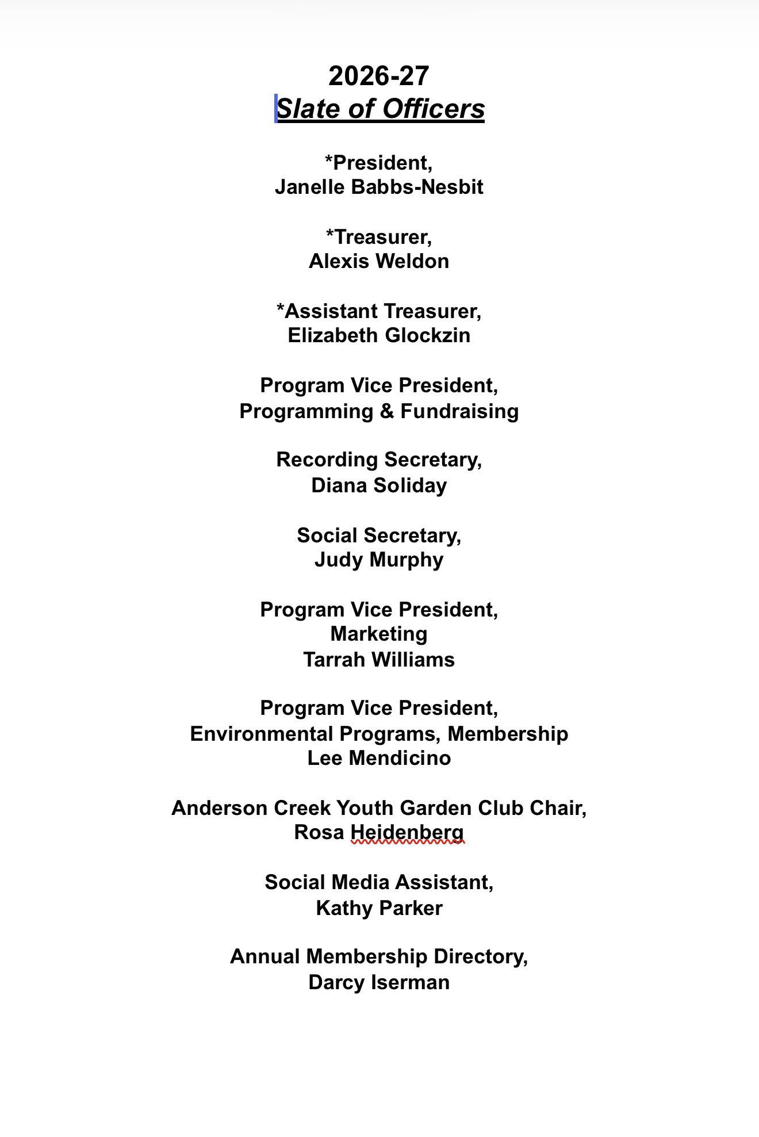

Slide 9
Finance Report

Slide 10
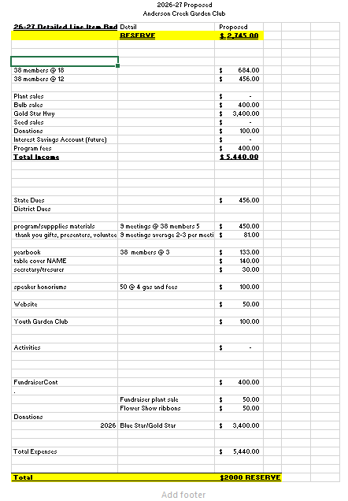
Proposed 26-27 Budget

Slide 11

NEW MEMBERS
ALWAYS WELCOME

Slide 12
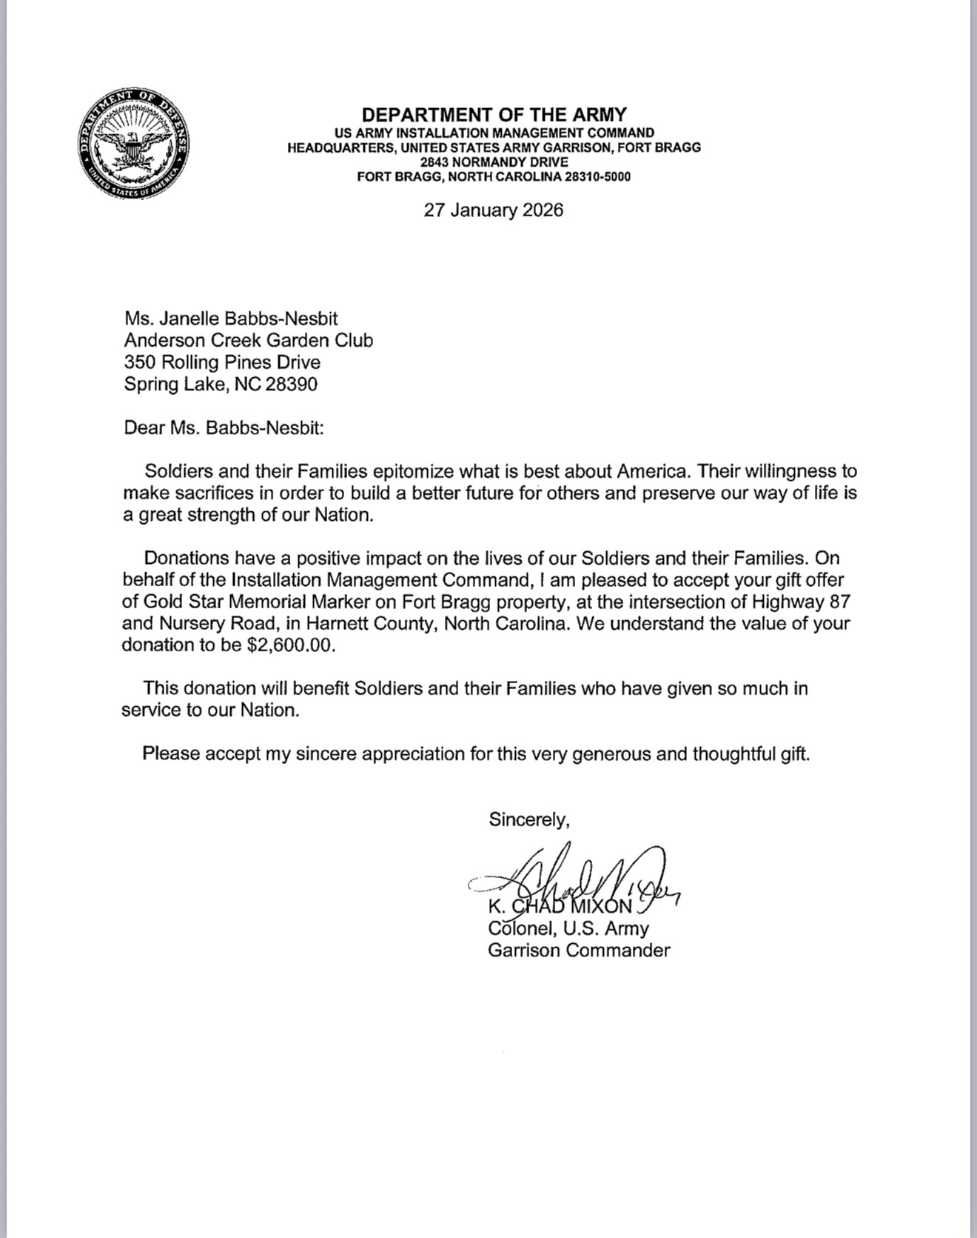
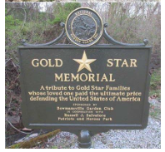
Gold Star Memorial Progress

Slide 13
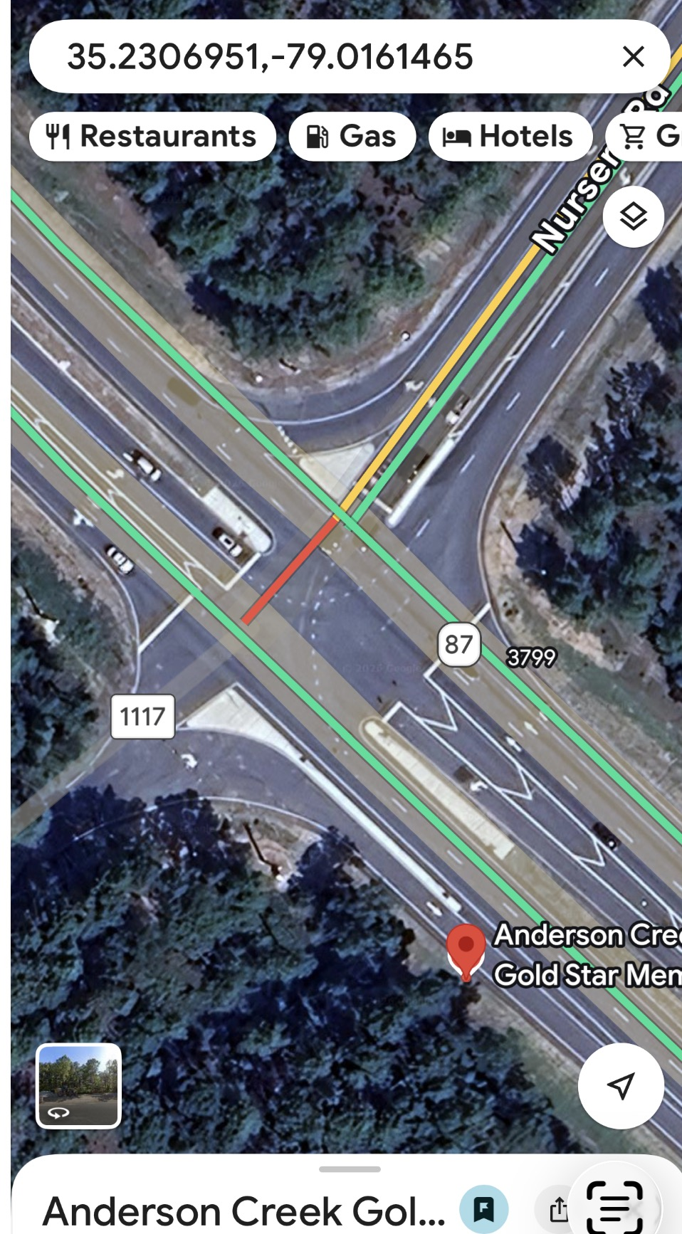
Gold Star Location
Nursery Rd, SR 1117 & Hwy 87

Slide 14
The Year Ahead In PROGRESS
Strategic Plan
Save the dates:
June 6th- ACGC EOY celebration & garden tours (proposed) time evening
Summer Brew & Blooms 3rd Thursdays 11:30-1 @ Bunkers

Slide 15
Business members Meeting
Save the Dates
  GCNC Annual Convention & Meeting, MAY 17-18, 2026 Hilton Garden Inn Greensboro-"Growing Together Communication - Collaboration - Education“
  National Garden Club Annual Conference- May 4, 5, and 6, 2026-St. Louis, Missouri
  Youth Garden Club, application is in! Rosa Heidenberg is our chair
  Gold Star Highway Project---Next step –site selection, fundraising $3500 GOAL

Slide 16

The Garden Club of North Carolina
State Meeting

Slide 17
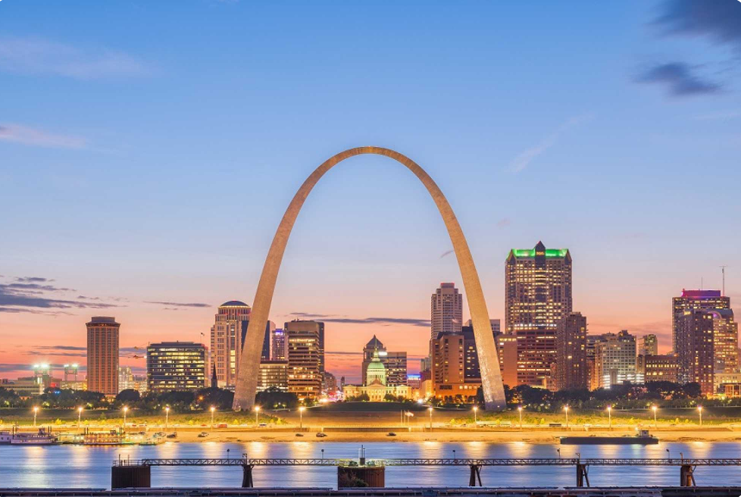
NGC Convention
St. Louis, MO May 4 - 6 2026
2026 Convention
St. Louis, MO--May 4 - 6 2026
Overview
2026 National Convention May 4 – May 6, 2026
"Meet Me in St. Louis, Where the River Bends and The Arch Reaches the Sky!"
Registration Now Open: CLICK HERE TO REGISTER!
$100 Late Fee for Registrations After March 31, 2026
Deadline for All Registrations: April 14, 2026
REGISTRATION POLICY
Walk-in registrations will not be accepted.
Registrations are NON-REFUNDABLE after April 14, 2026.
LATE FEE: All registrations submitted after March 31, 2026 will require an additional $100.00 late fee.
No registrations will be accepted after the deadline of April 14, 2026.
HOTEL INFORMATION
Please reserve your accommodations directly with the Hilton St. Louis at the Ballpark using the link below:
https://book.passkey.com/e/51176836
Room Rate: $189.00 per night (single or double occupancy)
Total with taxes & fees: $224.76 per night
Self-Parking: $35.00 per day (in-and-out privileges)
Valet Parking: $50.00 per day
Hotel Reservation Deadline: April 14, 2026
Notes:
q

Slide 18

2026 SOUTH ATLANTIC REGION CONVENTION
March 21-22, 2026
“A Garden for All”
Convention – South Atlantic Region
Workshops
Workshop 1 Garden Therapy Sheila Rose
Content: The workshop will cover the history, models of garden therapy, and share personal
experiences. Attendees will participate in a garden therapy exercise and bring home ideas for
garden club activities.
Workshop 2 Make A Wreath Gary Harrison
Content: Join Gary as he teaches us the art of spring wreath design. Provided will be silk flowers,
wreaths, ribbons and knowledge. Please bring a hot glue gun, scissors and wire cutters. The wreath
will be the highlight of your front door for years to come. The cost of the workshop is $50.
Workshop 3 Grow with Social Media Brandi Ross
Content: Brandi will share her passion of building community using social media with an emphasis
on Facebook. She also plans to offer some tips to help increase club membership and strengthen
community support. Gardening is her passion, teaching others is her mission.
SAR Convention Schedule Friday,
March 20, 2026 – SAR Convention 8:00-5:00 ………………………………………….…
Registration 9:00-10:00…………………………………………....
SAR Finance Committee 10:00-11:00………………………………………..…
SAR Exec Committee 11:15-12:15…………………………………………..
SAR Lunch* No Speaker Not in package 12:30-1:30 ……………………………………..…….
SAR BOD Meeting 2:30-4:30 ……………………………………........…
Tea at Parkersburg Art Center (PAC) 6:00-7:00 ……………………………………….……
Cocktails – Cash Bar 7:00-10:00 ……………………………………..…….
Dinner A Red White Blue Birthday Speaker - Becky Park – Col. Bradley
Saturday, March 21, 2026 – SAR Convention 8:00-5:00 ……………………………………………
Registration 9:00-5:00..…………………………………...…........
Boutique/Vendors 8:00-9:00 ……………………………………………
Breakfast 9:00-11:00……………………………………………
SAR General Session 11:30-1:30……………………………………………
SAR Award Lunch Speaker - Tara Ranson –
Membership 1:45-2:30 ……………………………………………
Workshop 1 2:30-3:15 ……………………………………………
Workshop 2 3:30-4:15 ……………………………………………
Workshop 3 6:00-7:00 ………….…………………………………
Cocktails – Cash Bar 7:00-10:00…………………………………..………..
Vintage Design Dinner Speaker -Adam Dotson
Please complete form; make checks payable to “SAR” and mail to: Ernie Simien 5229 Staunton Ave SE Charleston, WV 25304
Email: e_simien@hotmail.com
Phone: 713-582-7935
Postmarked by February 27, 2026 for on time registration.
No late registration!
Hotel Registration All hotel registrations should be made directly with The Blennerhassett Hotel by calling 304-422-3131 or on the website https://booktheb.com/ and by using the WV Garden Club Reservation Group ID 69793. Room Rates: Double - $140, Traditional King - $150, Deluxe King - $160, Superior King $170, Junior Suite - $220 Hotel reservations must be made by Friday, February 20, 2026 to obtain these rates.

Slide 19

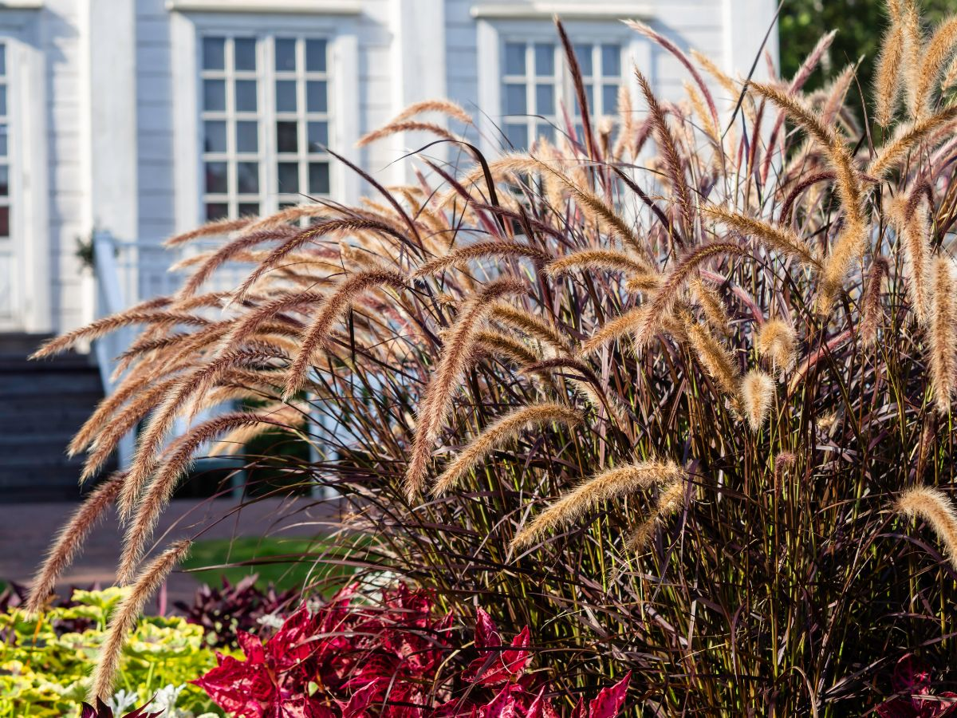
Join us for the 1st
Anderson Creek Garden Club
Garden Tours
June 6th
^{Hours TBD}

Slide 20

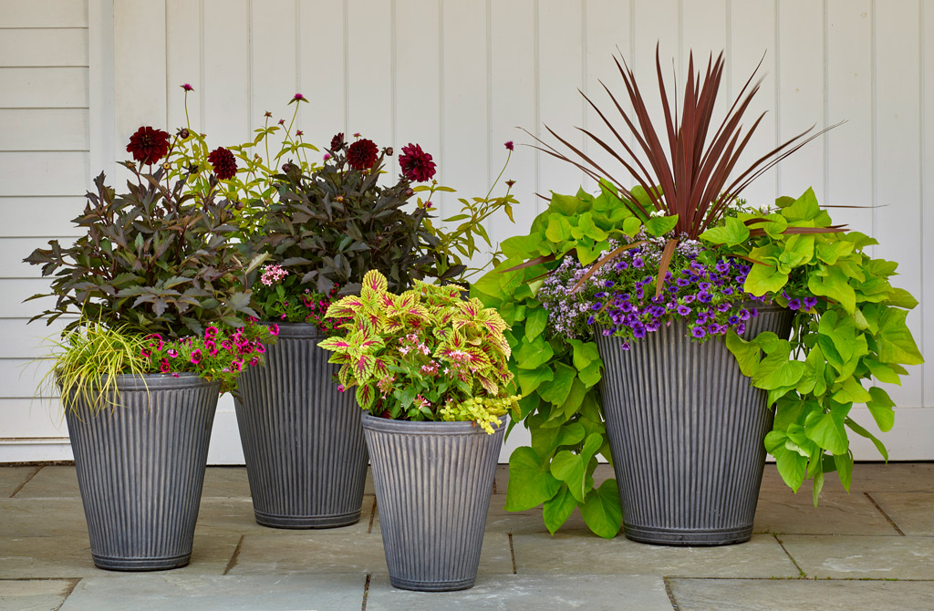
Container Creations and Culinary Sensations
Flower Power and Flavor!
Two workshops combine the focus on flowers and edible plants, encouraging attendees to enhance both aesthetics and flavor in their gardens
Garden Tours by Justin Burkhead-Extension Agent Horticulture and Agriculture
Taste the Garden-- Emphasize the Garden-Fresh Power Bowls and the connection between gardening and healthy eating!
Power Bowl class provided by Shannon Adcock Extension Family and Consumer Sciences
Thrillers, Fillers, Spillers by Kathy Parker
Flower containers, potting soil, amendments, and plants will be provided. The cost for all is $20

Slide 21
General Program Resource Links
https://harnett.ces.ncsu.edu/horticulture-resources/
https://harnett.ces.ncsu.edu/categories/lawn-garden/extension-master-gardener-volunteers/
https://extensiongardener.ces.ncsu.edu/extension-gardener-handbook/
Herbaceous Ornamentals | NC State Extension Publications
Ensuring Long-Term Viability of your Forest Resources
Find a Plant | North Carolina Extension Gardener Plant Toolbox
Carvers Creek State Park: Home | NC State Parks
Andersoncreekgardenclub.org

Slide 22

QR Code for Plant NCSU Plant Tool Box

Slide 23
Meeting Questions
  Q & A Session

Slide 24
Closing Remarks Adjournment
  May 4-7 National Garden Club Convention
  May 17-18, Greensboro, NC, 101st NCGC Convention
  June 6th Anderson Creek Garden Club, Garden Tours
  July 11th Roadside Clean-up 10 am Patriot Hall
  **2026 -27 Youth involvement, Prek, Western Harnett FFA, Anderson Creek Charter & Day Care
  ** Gold Star fundraising memorial announcement coming soon

Slide 25
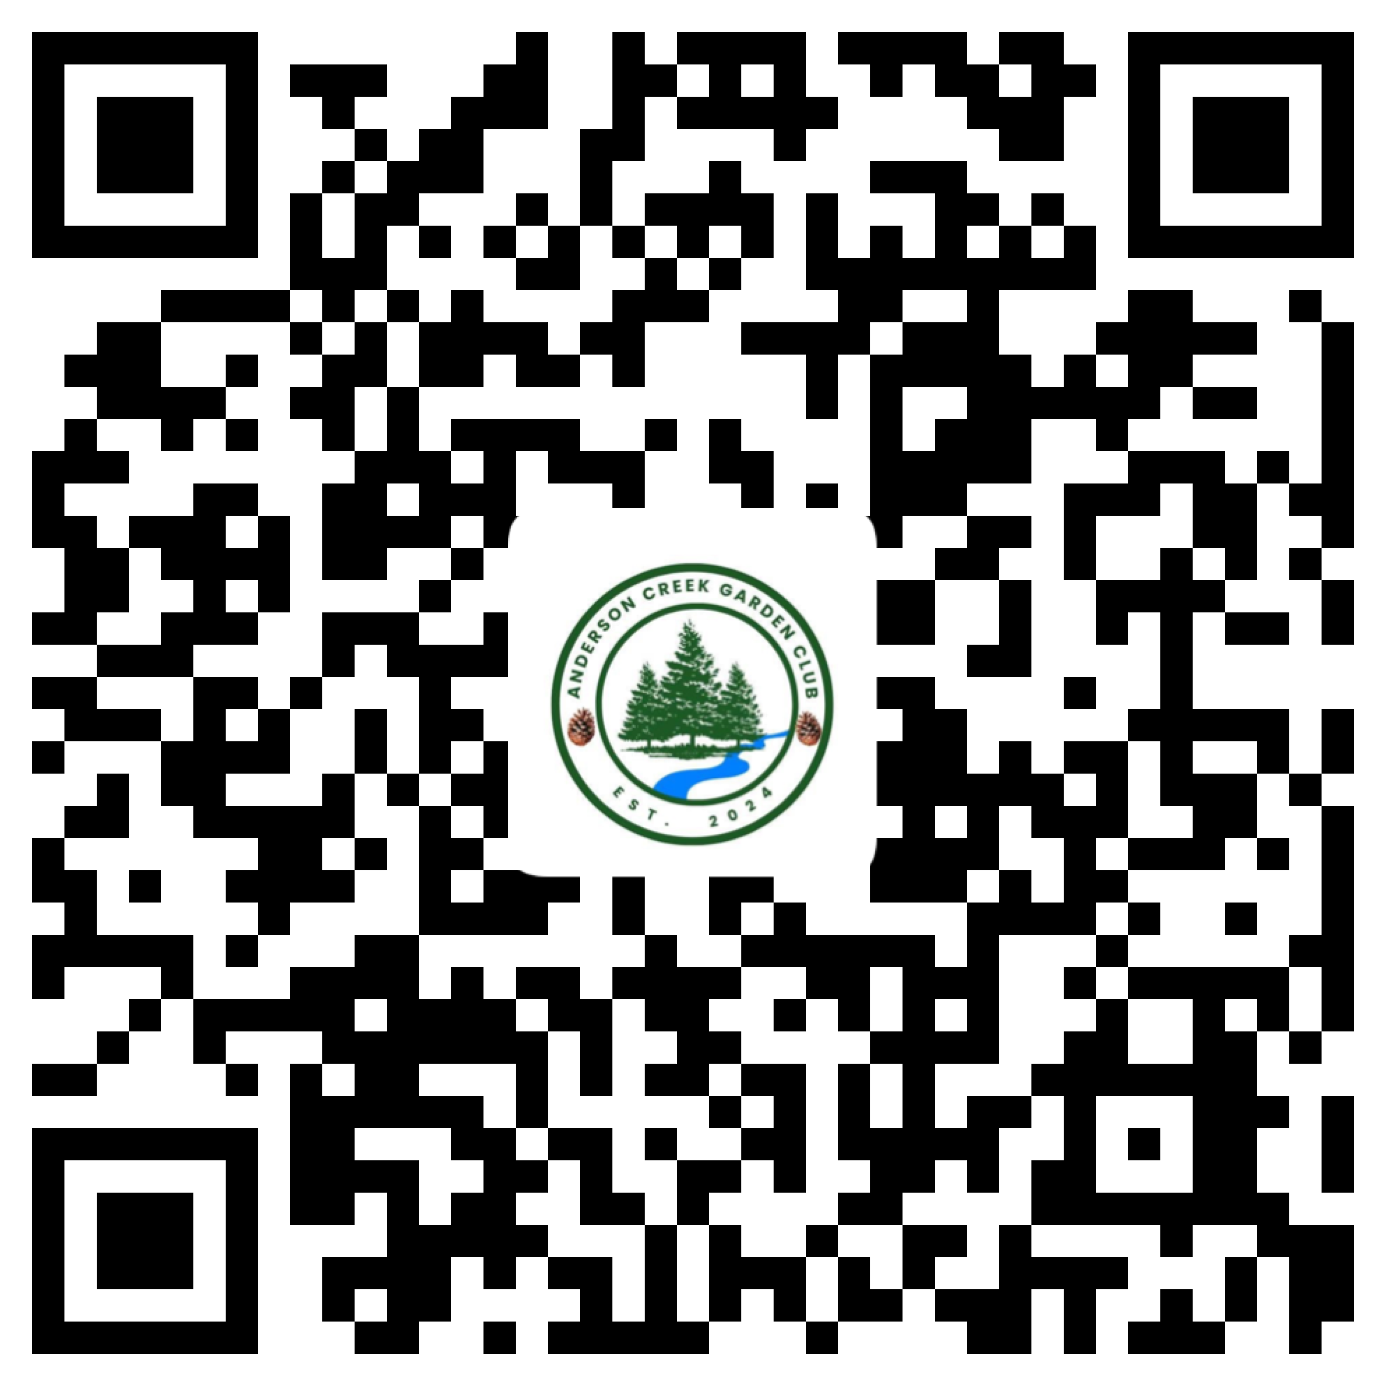
QR Code for ACGC Facebook Page
https://www.facebook.com/share/1ELzoXjKhD/?mibextid=wwXIfr
  Facebook, follow us #Andersoncreekgardenclub
https://www.facebook.com/share/1ELzoXjKhD/?mibextid=wwXIfr

Slide 26

Website
Source: Anderson Creek Garden Club
https://andersoncreekgardenclub.org/
Membership application is on site
ACGC membership application

