Slide 1

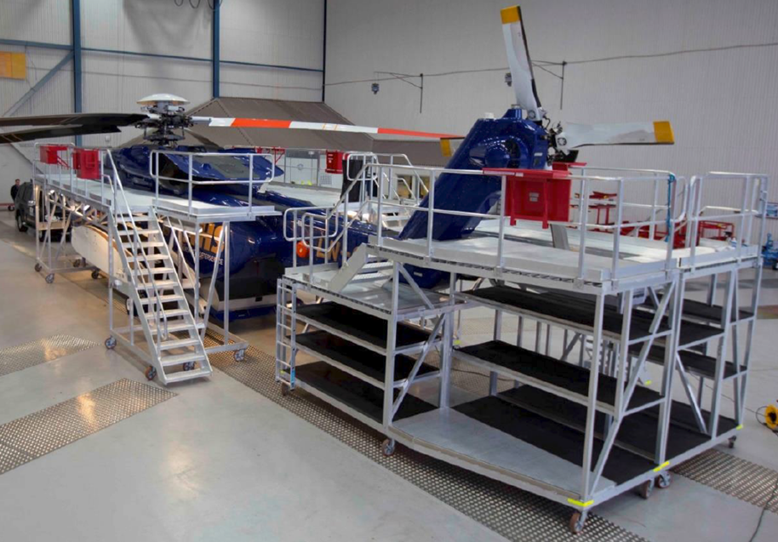
11730 S. Sam Houston Pkwy W. Houston, Texas 77031, USA
Email: Info@PTHoldingsusa.com
Website: www.PTHoldingsusa.com
PT HOLDINGS USA Inc.
Tell: Fax:
281-983-9988
281-983-9989
Aluminum Inspection platforms
Inspection platforms custom designed for your needs.
Made from lightweight Aluminum with adjustable heights.
Multiple levels accommodated to reach all areas required.
Guardrail protected with adjustable options for maximum adaptability.
Ideal and suitable for use on many aviation and transportation applications: Helicopters, airplanes, tankers, rail cars, buses, engines and all commercial vehicles.
Step surfaces and platform surfaces are made with permeable anti-skid profiling in high strength / weight ratio aluminum.
The stepped platforms are custom made for your application and design inputs are welcome to ensure satisfaction with your particular specifications.

Slide 2
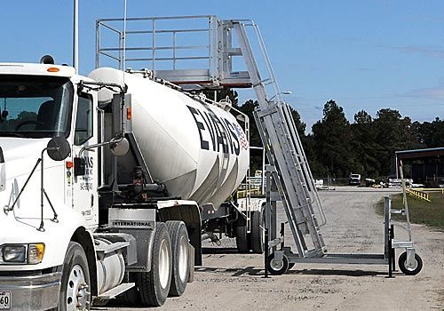
Mobile Access platform and Ladder
Maintenance steps.
Made from lightweight Aluminum with adjustable heights. Suitable for a wide range of tankers and vehicles to ease access and perform maintenance tasks. The maintenance steps are easily adjustable, wheeled into place and locked into position. Platforms are guardrail protected with optional swing-out safety gates, Stabilizer jacks, (retractable), ensure levelling, stability and ease of use. Step surfaces and platform surfaces are made with corrugated anti-skid profiling and permeable to water.
The stepped platforms are custom made for your application and design inputs are welcome to ensure satisfaction with your particular specifications.

Slide 3
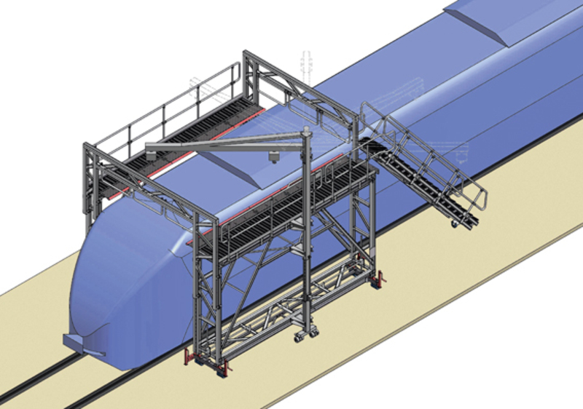
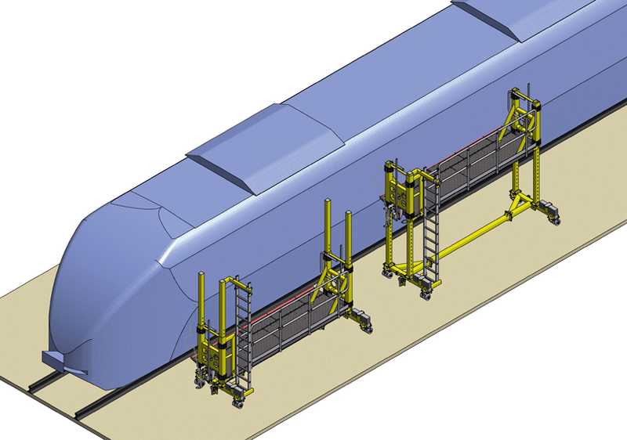
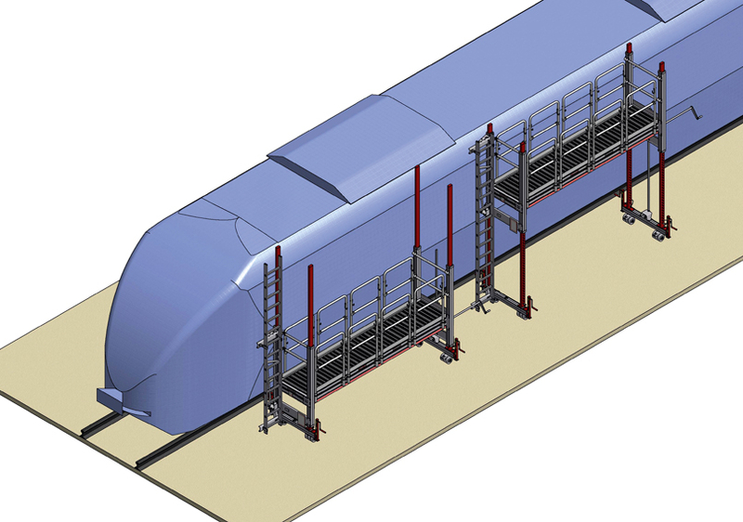
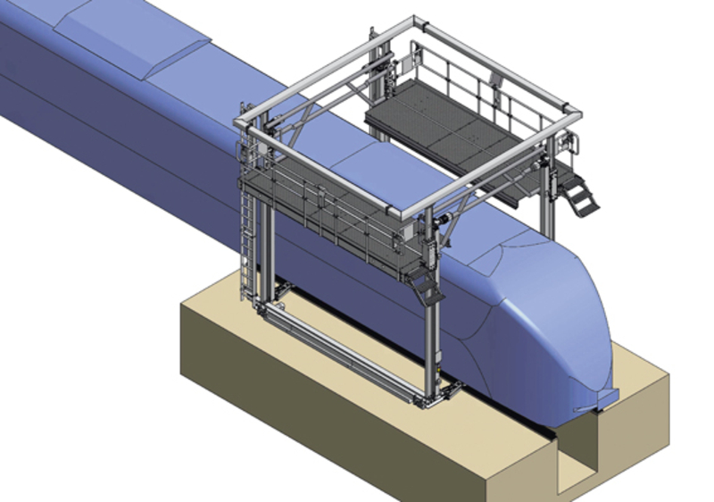
Mobile Access platform and Ladder
Rail Front Access Platforms
Customized to suit trains optimally to suit all access requirements from sides and top. Rubber bumpers fixed to the platform for soft contact stability to the train.
3D design, stress and safety analysis is done and approved before final manufacture. Designed for single person moving then locking into place with deployed jacks.
Made from Aluminum alloy with high strength / light weight ratio combined with corrosion resistance and long service life.

Slide 4
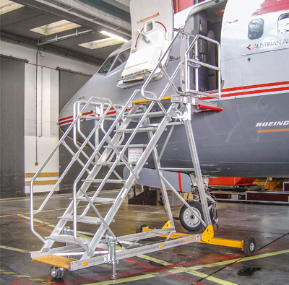
Mobile Access platform and Ladder
Passenger and Cargo Front Access Platforms
Aircraft cargo door access platform is the access to cargo cabin during assembly and maintenance of aircraft. Tailored to suit your aircraft, equipped with bumper rubbers to approach the aircraft to protect from collision. Modular design connected with SS bolting for ease of construction. Designed for ease of positioning by a single person, wheeled into place and locked in position. Made of aluminum alloy giving it strength, light weight and maintenance-free.

Slide 5
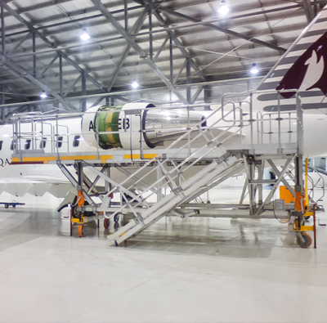
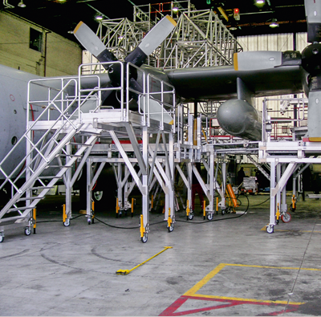
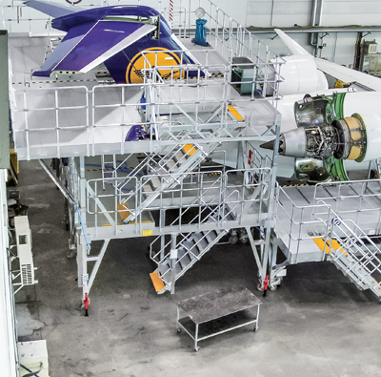
Mobile Access platform and Ladder
Aircraft Maintenance Platforms
Customized to suit your aircraft perfectly.
Designed to include docking system for nose, wings, fuselage and tail.
Made from Aluminum alloy with high strength / light weight ratio combined with corrosion resistance and long service life. Custom designs ensure your industrial needs are met according to specific application

Slide 6
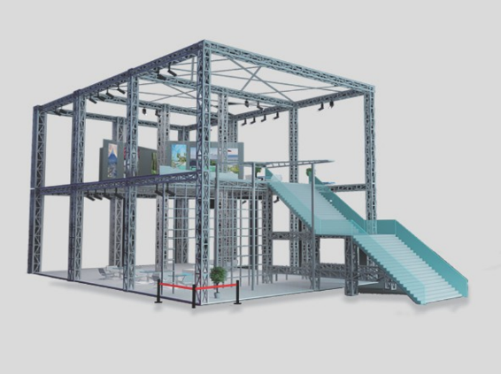
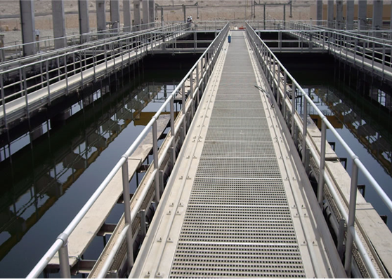
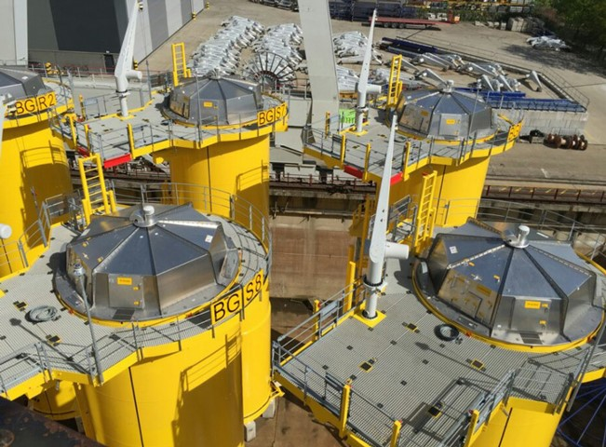
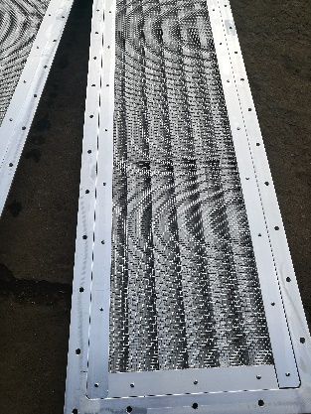
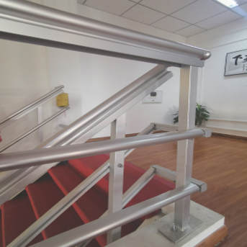
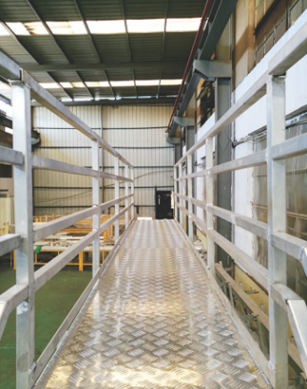
Access Platform, Walkways and Ladders
Custom suppliers in the USA for Aluminum Products
PT Holdings USA Inc. is dedicated to the supply of aluminum Helicopter landing pad (Helipad), Aircraft maintenance platforms, aluminum walkways , stairs, railings ,platforms , louvers and other aluminum customized products , structure design and manufacturing.
Our specialist suppliers have dedicated manufacturing facilities with a production area of 1,000 square meters equipped with laser cutting machines, bending machines, rolling machines, CNC drilling machines, automatic sawing machine and TIG / MIG aluminum welding machines.
Certification includes ISO 3834-2 Welding System Certification, EN287 Welder Certification, and CWI Certification, ISO 9001, ISO 14001, GB/T28001, OSHAS 18001
If you need a quote or pricing based on your specific request we are here to assist you by phone or e-mail. We produce our own approval drawings or we could use yours depending on the job.
Please don’t hesitate to contact us for more information pertaining to any of your applications.
PT HOLDINGS USA Inc.
11730 S. Sam Houston Pkwy W. Houston, Texas 77031, USA
Tell: Fax:
281-983-9988
281-983-9989
Email: Info@PTHoldingsusa.com
Website: www.PTHoldingsusa.com

