Slide 1
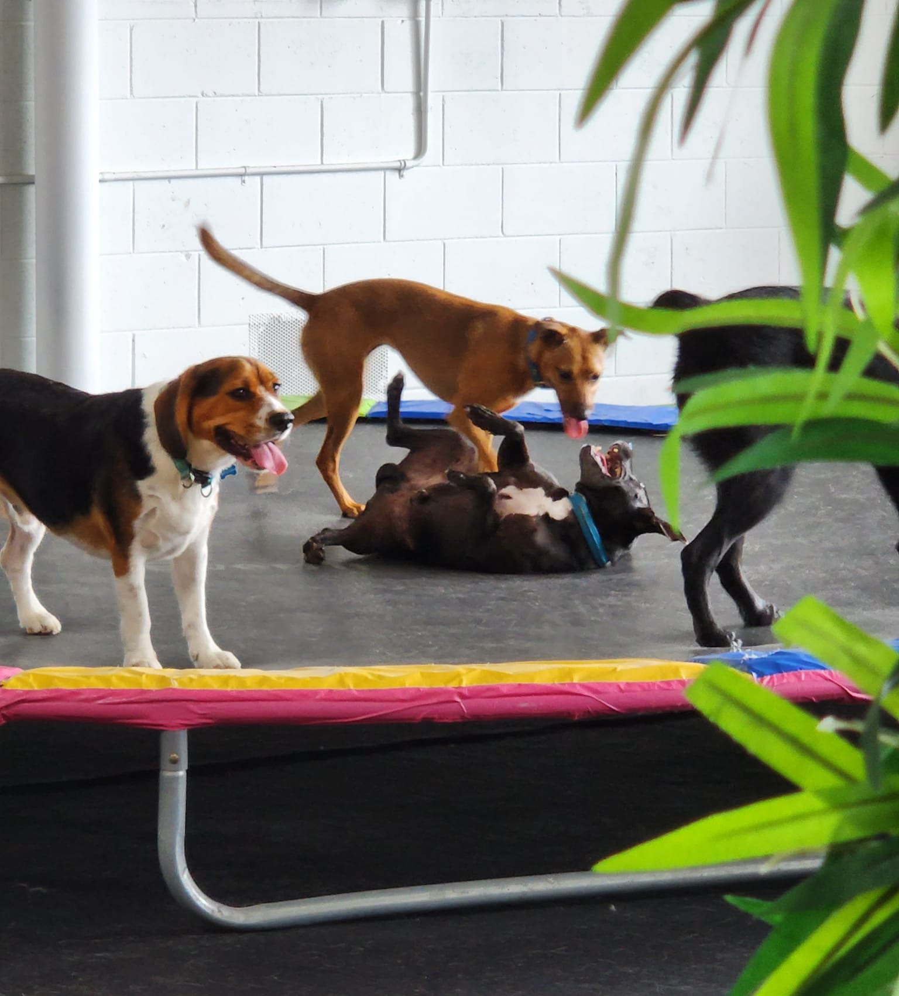
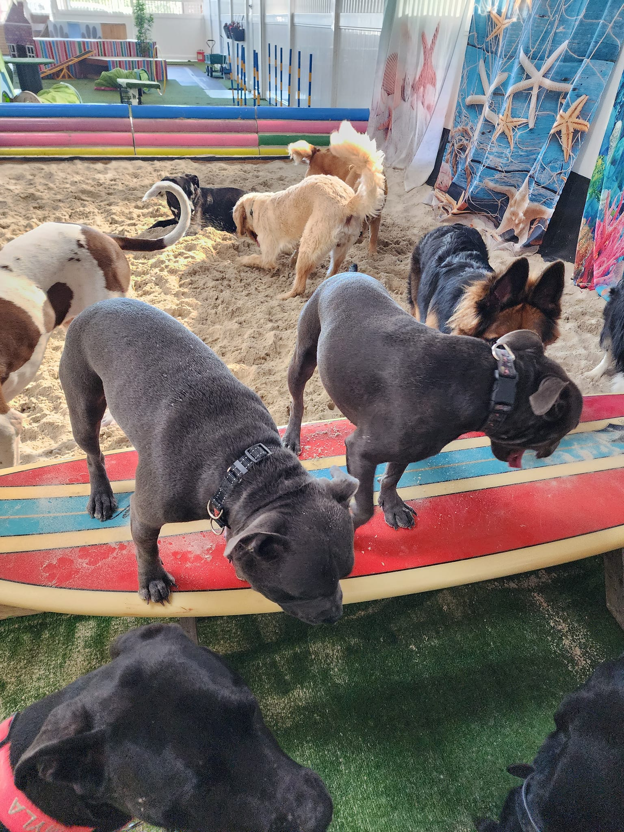
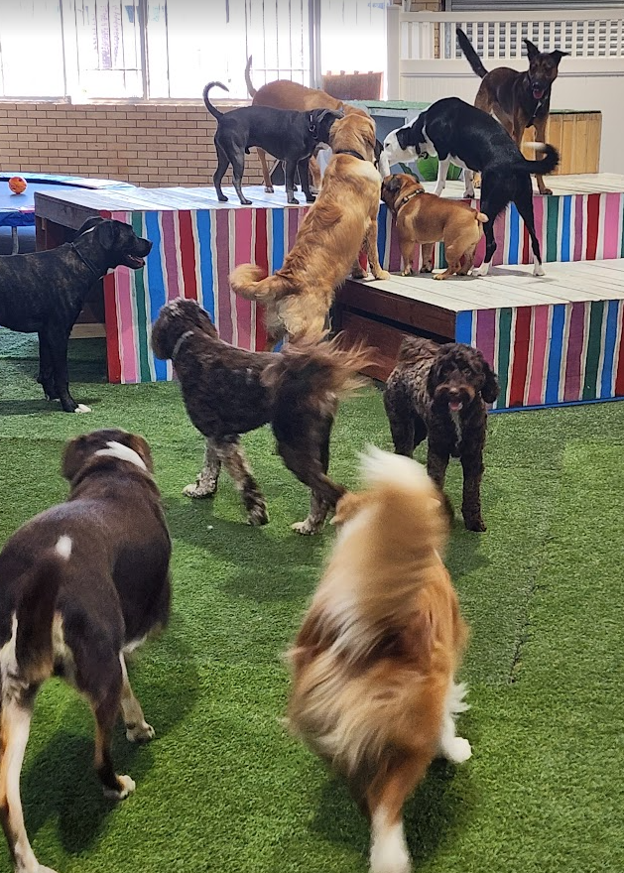
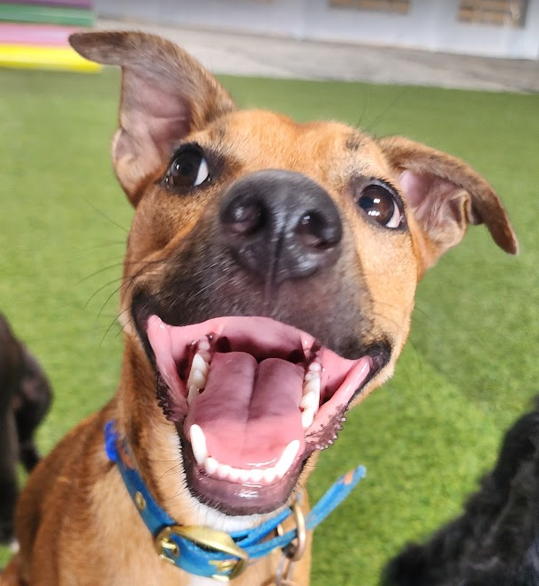

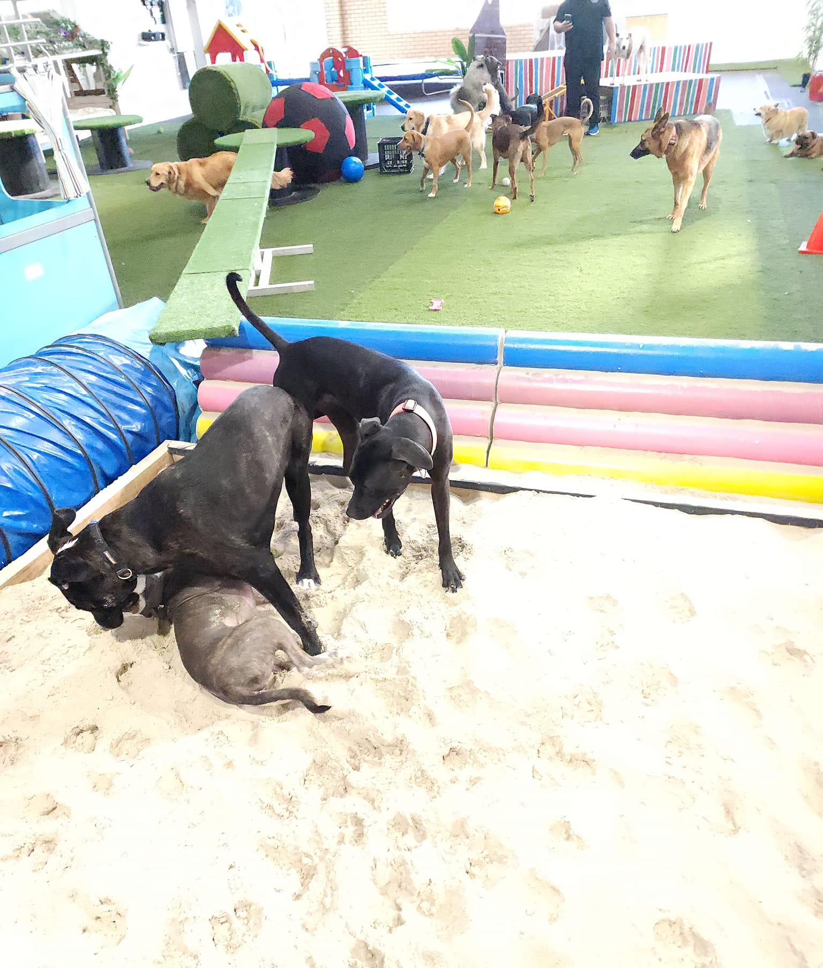


Where dogs come to Play, Stay and Grow!
Open Mon-Fri 7am to 6:30pm
Located 14 Rowland Street Slacks Creek
https://www.facebook.com/PawxPawCentre
pawxpaw.com.au
Doggy Daycare
Prosprectus
Winner 2024 Local
Business Awards for outstanding
Pet Care

Slide 2
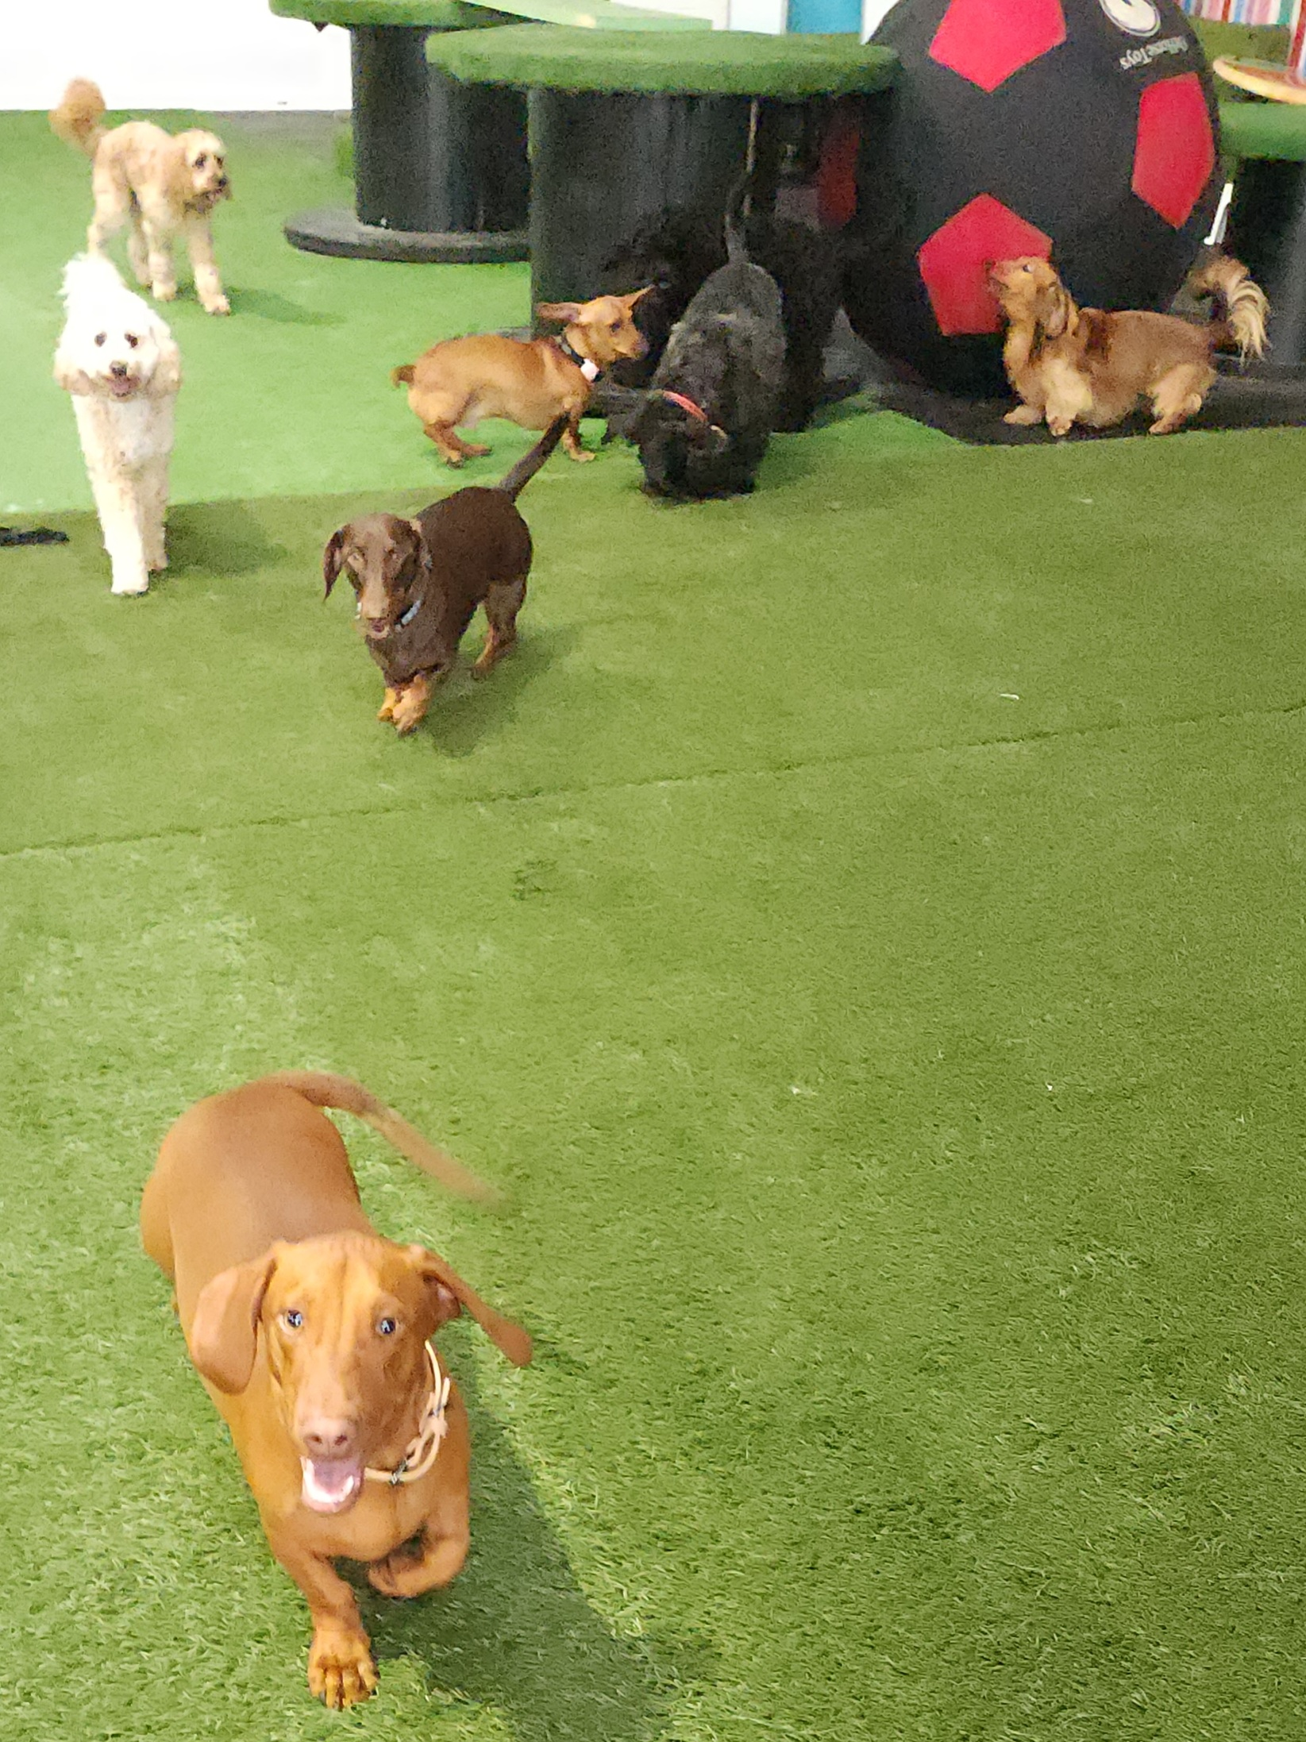
Fully Licenced Council Approved
Member of Pet Industry Association of Australia
Largest indoor daycare centre in Logan City Council
All dogs vaccinated C5
Puppies accepted once fully vaccinated with C5
Dogs 9 months of age must be desexed
All dog's temperament assessed
Free Assessment *Conditions Apply
Structured Daycare includes Play, Nap, Games and Basic Training
Beach Area, Agility and Obstacles including Slide, Dog Trampoline, Ramps and Climbing obstacles
Themed annual events
Grassed Play Area
Photos loaded daily to our Pawrents Group
Casual rates and Package options available
Additional Services
Doggy Birthday Pawties
Daycare Training Packages Available
Private Dog Training Sessions
Registration Process-
Go to our website and register your details and your dog’s details.
Upload your dog’s current vaccination status to your profile.
Then it’s over to us to site your vaccination and place it in your dog’s status, (this normally takes around 24 hours if the information is up to date.)
We contact you to discuss your registration.
Once deemed suitable an assessment is booked for your dog.

Slide 3
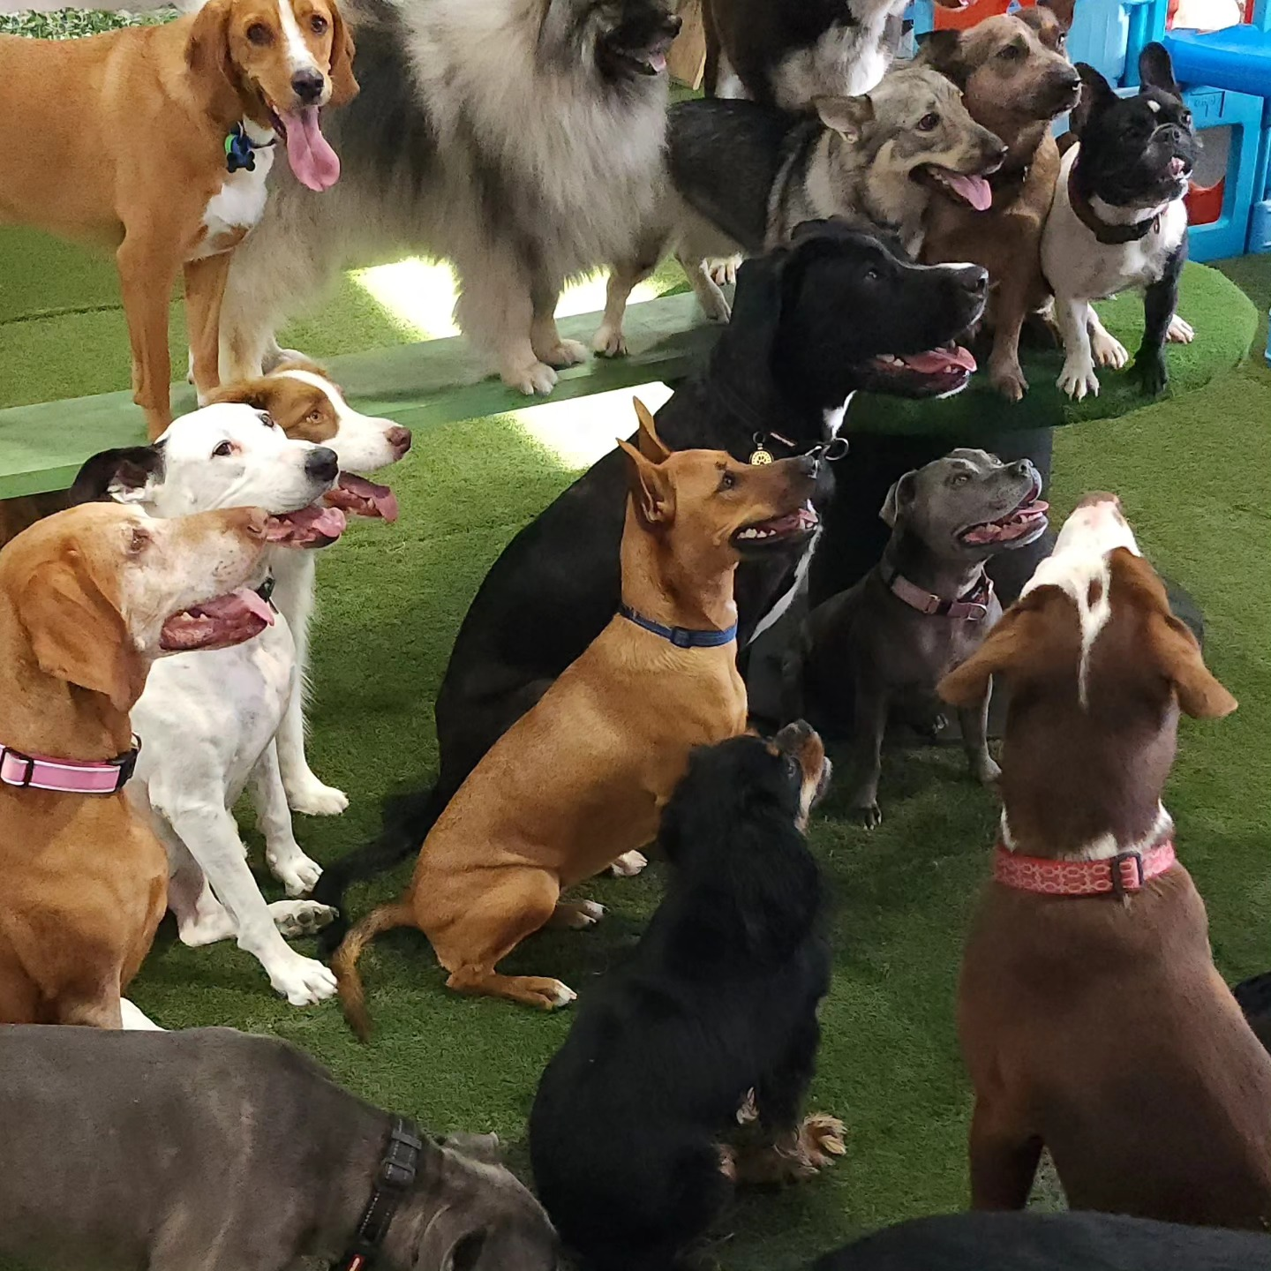

Slide 4
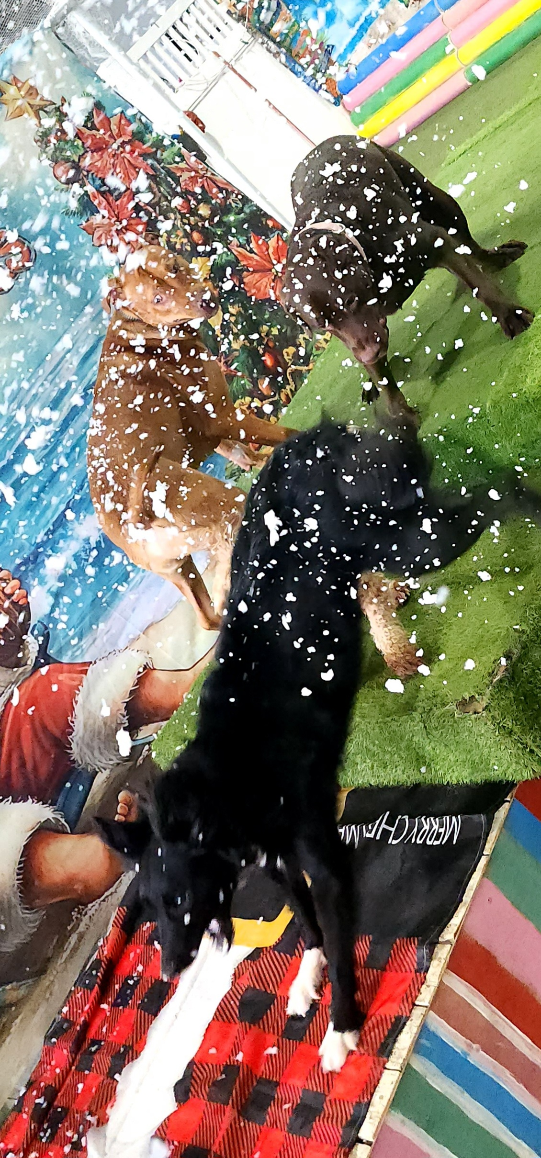
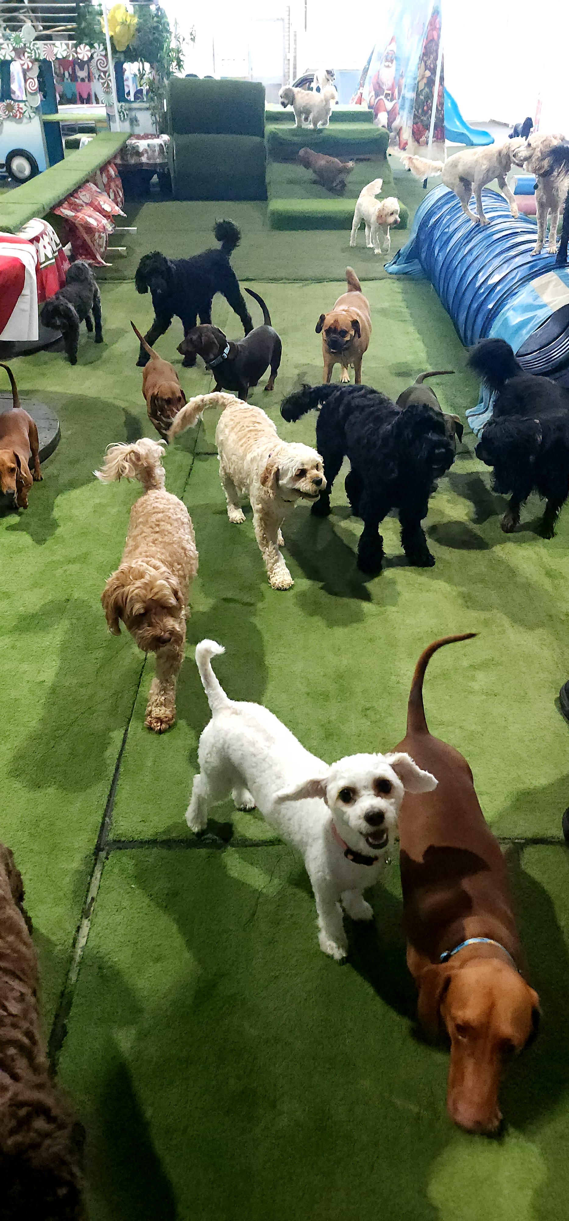

Slide 5
A Few Reviews
This daycare is amazing! So much love shown to the dogs, different activities each day to stimulate them, my boy comes home happy and exhausted after his day. If I could give more than 5 stars I would ❤️
Best decision we made was bringing our Border Collie puppy here for socialisation & because he was reacting to cars, a previous trainer had made things worse & we didn’t know what to do next. Brooke booked him in & after only a few weeks there was a massive change, he’s much happier, no biting, jumping on furniture & he listens to us, Angie worked her magic & explained our homework so we could continue what she had started, he’s more social @ the dog park, recall is going amazingly, we have a different puppy. You can tell Angie, Brooke & the team love their job & dogs and put so much care & attention into each dog to make sure they get the best experience ever & it shows. Our puppy cries as soon as we pull up, he can’t wait to get in & play with his friends & take part in the different programmes during the day, different things to eat & lots of photos so you can see what they’ve been up. Amazing place, amazing people & best doggy daycare ever.
We took our dogs for 'socialisation' while we went to work, but our dogs got so much more than that!!! With a specialized program during the day, we have noticed a MASSIVE improvement in both our dogs...
When our puppy was going through some teething issues, the team guided us with tips and tricks to support us and we are forever grateful.
We feel like part of a family here... the dogs are SO happy on daycare mornings!
For more reviews click here

