Slide 1
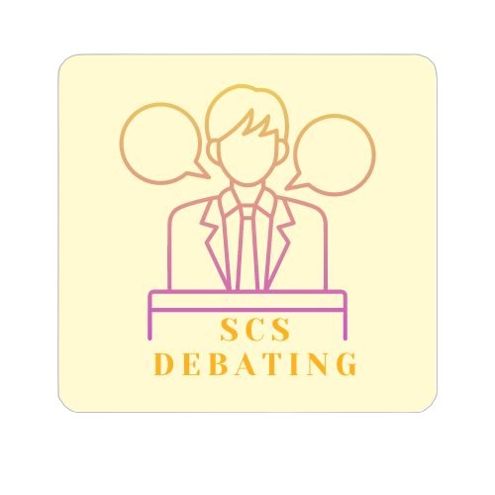
Debating Basics for Beginners
Sunshine Coast Schools Debating Competition 2026
www.scsdebating.com.au
Presented By:
Meg Dunstan

Slide 2
Debating Basics
What Is Debating?
The Basics
A structured, formal discussion between two opposing sides working to build the most persuasive case.

Slide 3
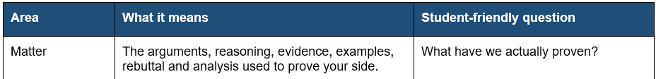
The Three Core Areas: Matter
page 3
Answers the key question: "What have we actually proven?"
Why Matter Matters Most

Slide 4
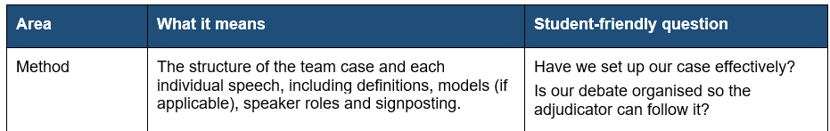
The Three Core Areas: Method
page 3
Setting up the case
Clear organisation helps judges and opponents follow the debate easily.

Slide 5
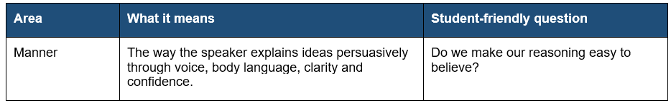
The Three Core Areas: Manner
page 3
Persuasive speaking
Vary your volume, pace, and emphasis. Use natural gestures that match your points.

Slide 6

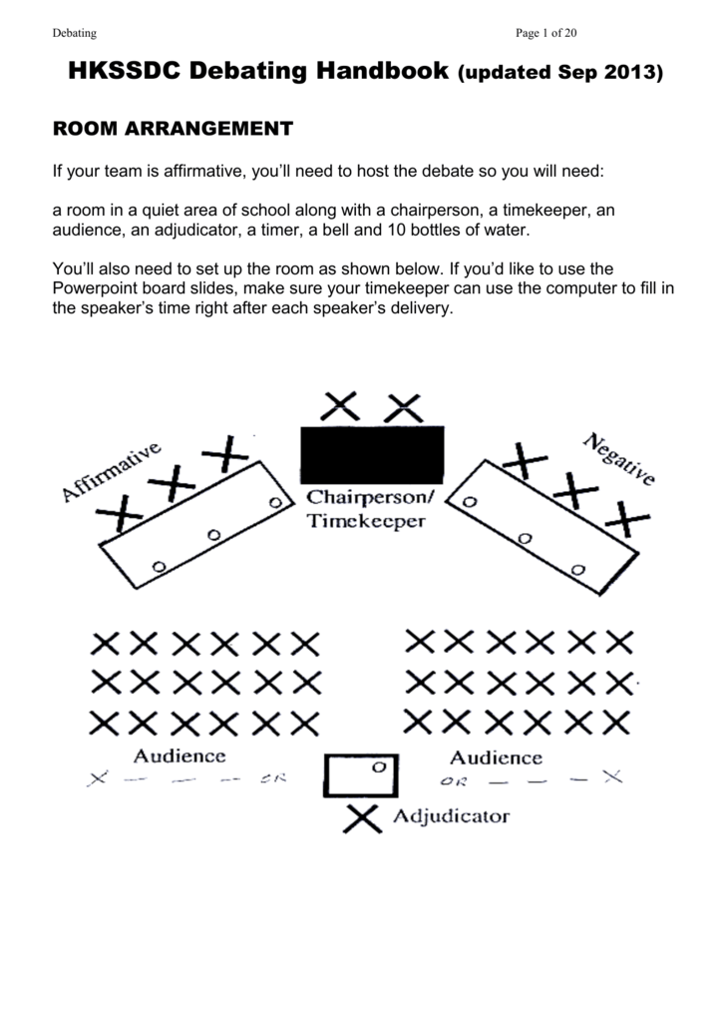

Slide 7
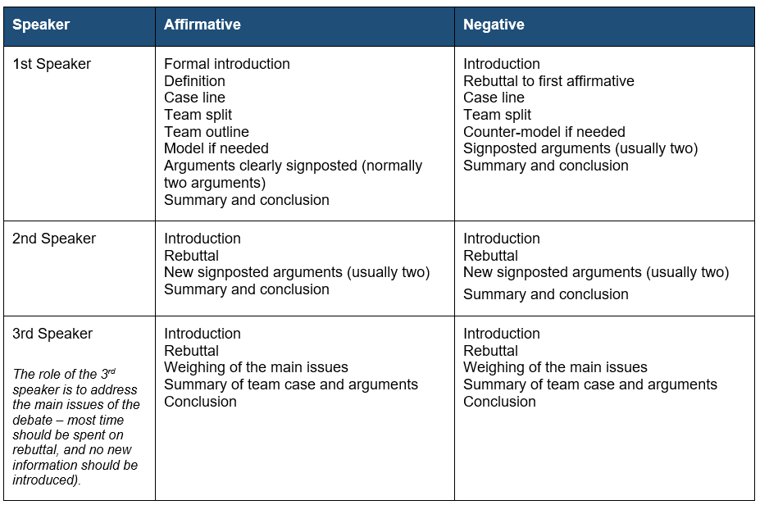
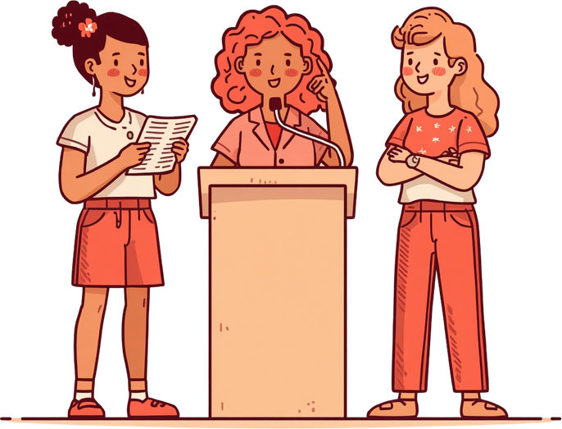
Speaker Roles
(page 6)

Slide 8
What Is Debating?
The Basics
A structured, formal discussion between two opposing sides working to build the most persuasive case.

Slide 9
Method is the organisation of the debate. It is the first thing your team should sort out in the prep room because it determines what the debate is really about, what your team has to prove and how each speaker will contribute.
Before writing speeches, you should agree on:
What type of debate is this?
What do the key words in the topic mean?
What does our side need to prove to win?
Who is affected, and what is the real problem?
What are the two or three main issues the debate will come down to?
STAGE 1
METHOD
(or setup)
Page 4

Slide 10
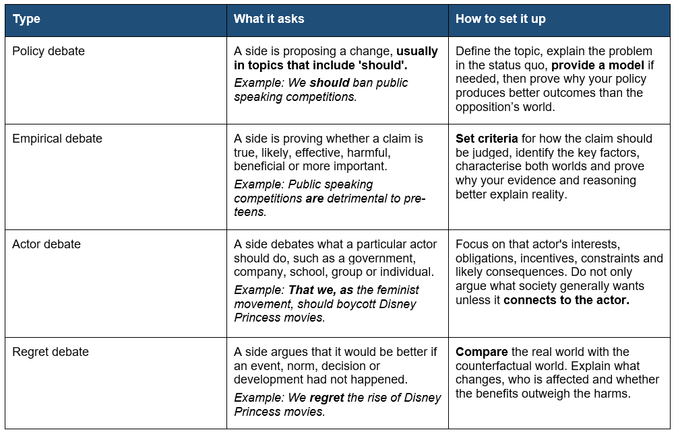
Type of topic directs next steps
Types of debates (page 4)
Different topic types require different setups. A common mistake is preparing every debate as though it is a simple 'for or against' topic. Good teams identify the debate type and then choose the correct method

Slide 11
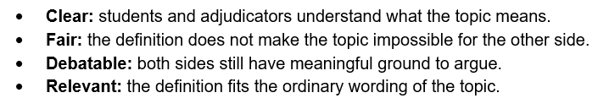
Definitions
Page 5
Why Define?
Definitions set the scope of the debate for all involved.
Clarity Creates Common Ground.
Definitions need to be:

Slide 12
Models and Criteria (page 5)
SHOULD DEBATES need a… | EMPIRICAL DEBATES need…
Model | Criteria
Use a model when your side is proposing a concrete change. Example: 'That we should ban smoking' requires details about who bans it, what is banned, how the ban is enforced, and what support exists for smokers. | Use criteria when the topic is asking for a judgement. Example: 'That social media has done more harm than good' may be judged by scale of harm, depth of harm, vulnerable stakeholders and long-term outcomes.
A model should be simple enough to explain in a debate. Do not spend half the speech on tiny administrative details. Offer reasoning as to why this model would lead to better outcomes. | Criteria should be justified. Do not just say 'health matters most'; explain why health should be the most important way to judge the topic. Criteria should be simple (usually a word or two) and should be limited in number.

Slide 13
Characterisation (page 5)
Characterisation is the team's description of the world of the debate. It explains the problem, the stakeholders, the forces at work and the key opposing factors. Strong characterisation helps the adjudicator understand why the debate matters.
Problem: What is happening now? Why is it harmful, unfair, ineffective or contested?
Stakeholders: Who is affected? Which stakeholders are vulnerable, powerful, ignored or responsible?
Mechanisms: How does your side cause the outcome you claim?
Opposing forces: What incentives, barriers or trade-offs will the opposition point to?
Issue focus: What are the two or three questions the debate will actually come down to?

Slide 14
Practice Topic 1
Establish your setup
That we should ban zoos
The first five prep-room questions
What type of debate is this? (debate type)
What do the key words in the topic mean? (definitions)
What does our side need to prove to win?
Who is affected, and what is the real problem?
What are the two or three main issues the debate will come down to?

Slide 15
AS A TEAM you have now set up your case
Next step?
Time to turn to arguments for each individual speaker.

Slide 16
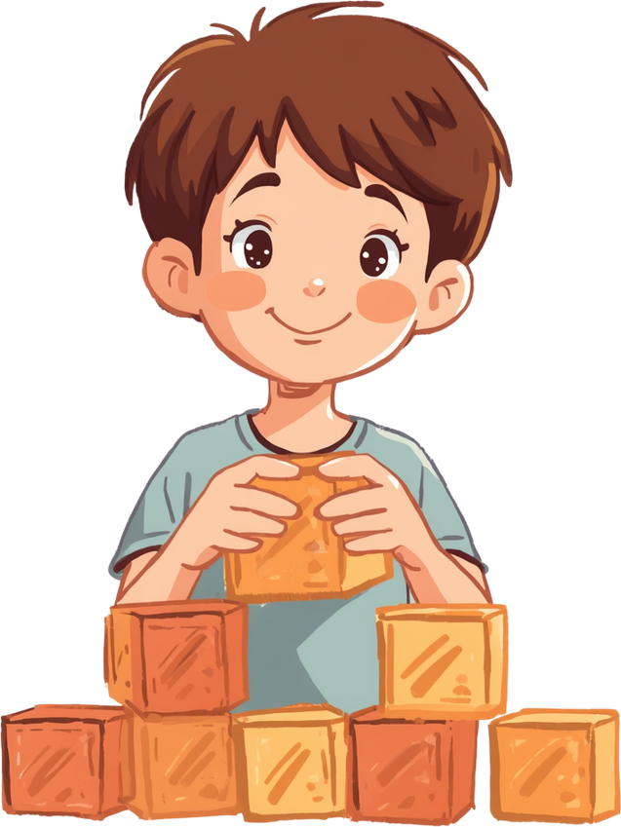
Point
State the argument clearly
Explain
Arguments
Page 7
Explain the logic behind the claim. Consider practical or principled arguments
Evidence or example
This should come from your knowledge or experience. Make reasoning concrete with evidence or examples.
Think of each argument amongst your team as a building block. Your goal is to build strong blocks in your case.
THEN your goal is to knock down the blocks that the opposition have built.
Mechanism
Explains how the claimed outcome actually occurs.
Impact
Explains why the argument matters.
Link
Connects the argument back to the topic and case line.

Slide 17
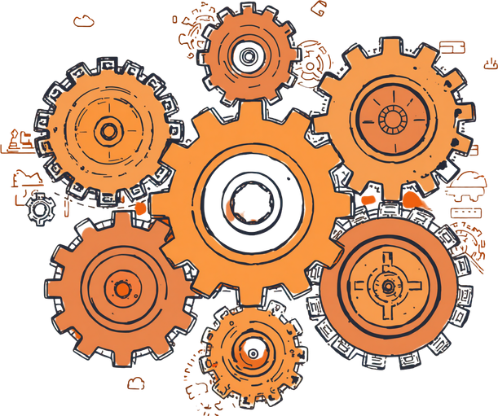
Types of Arguments
(Page 8)
Principled/Moral
Practical/Mechanised
Focus on values, rights, duties and moral responsibilities. They ask what is right, fair, just or legitimate.
Common clashes: freedom of speech vs harm prevention; privacy vs safety; rehabilitation vs punishment; individual choice vs state protection.
Structure: explain the principle, show where else we defend it, apply it to this debate, explain why it is inherently important, and show how the opposition violates it.
Focus on consequences, incentives, mechanisms and outcomes. They ask what works, what changes and who is affected.
Common clashes: effectiveness, cost, unintended consequences, enforcement, stakeholder behaviour and realistic outcomes.
Structure: identify the status quo problem, explain your objective, show mechanisms, prove outcomes, impact why those outcomes matter.

Slide 18
Strong arguments vs assertions
Weak assertion | Stronger argument
Banning fast food is good because fast food is unhealthy. | Banning fast food improves public health because fast food is cheap, heavily marketed and often addictive. Removing easy access would reduce the frequency with which people consume high-fat, high-salt meals. This matters because the health harms are large in scale and depth: they affect many families and contribute to long-term illness.
Zoos are bad because animals are sad. | Zoos restrict animal liberty and create unnatural conditions. Even when physical care is adequate, animals lose the ability to hunt, migrate, form natural social groups and live according to their instincts. This matters because the debate is not only about whether animals survive, but whether humans have the right to confine animals for education or entertainment.

Slide 19
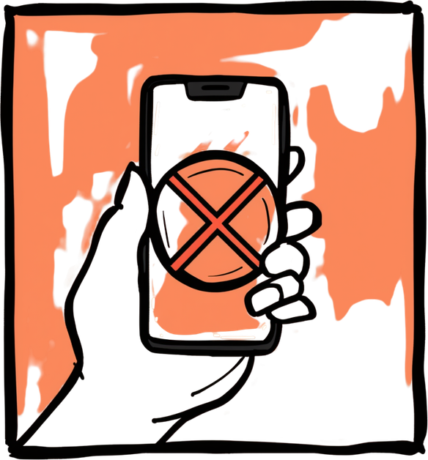
Practice Topic 2
Create an argument
That all schools should ban mobile phones.
State the point in one sentence.
Explain the problem or principle behind the point.
Explain the mechanism: how does this actually work?
Use a relevant example or likely real-world scenario.
Impact it: explain scale, depth, stakeholder vulnerability and long-term outcomes.
Link it back to the topic and your team's case line.

Slide 20
A simple rebuttal structure
They say: state the opposition's argument fairly.
But: identify the flaw, missing mechanism, weak assumption, unfair framing or trade-off.
Because: explain the reasoning behind your response.
Our side: compare with your team's argument or world.
Therefore: explain what the adjudicator should conclude about the issue.
Rebuttal
Rebuttal must engage with the issues
Good rebuttal does not just say, 'They are wrong.' It identifies the opposition's strongest claim, explains why it fails, compares it with your side and shows what this means for the debate.

Slide 21
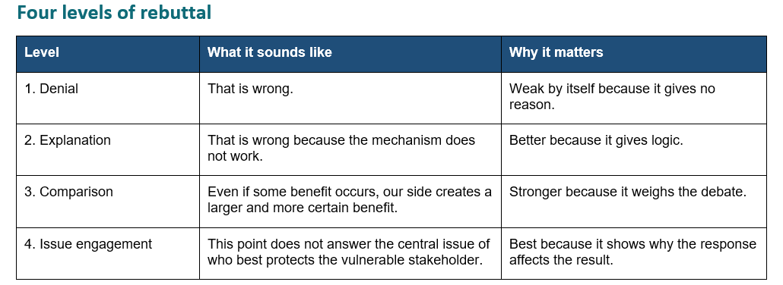

Slide 22
Practice Topic 3
Develop rebuttal (if you were on the negative)
That we regret the popularity of Disney movies.
The popularity of Disney movies leads to many stories around the world becoming too similar. When one company is so dominant in movies for kids and families, it shapes what people expect to see, often focusing on the same types of characters, messages, and storylines. This means audiences don’t get as much chance to see different cultures, ideas, and unique stories, and other movie makers are less willing to take risks because they want to copy what is already successful. This happens because Disney has a lot of money and influence, so their movies are shown in more cinemas, promoted heavily, and supported by toys and merchandise, making them even more popular. As a result, other studios often copy Disney’s style, and audiences get used to that same type of story. For example, many animated movies today include songs, simple moral lessons, and predictable endings, while smaller films from other countries or independent creators often don’t get shown widely, so fewer people see them. This affects millions of children around the world, who are still learning about the world and are more easily influenced by what they watch. It can lead to fewer different voices and stories being heard, and over time can make movies less creative and less diverse. Therefore, we regret the popularity of Disney movies because their dominance limits creativity and reduces the variety of stories people get to experience.

Slide 23
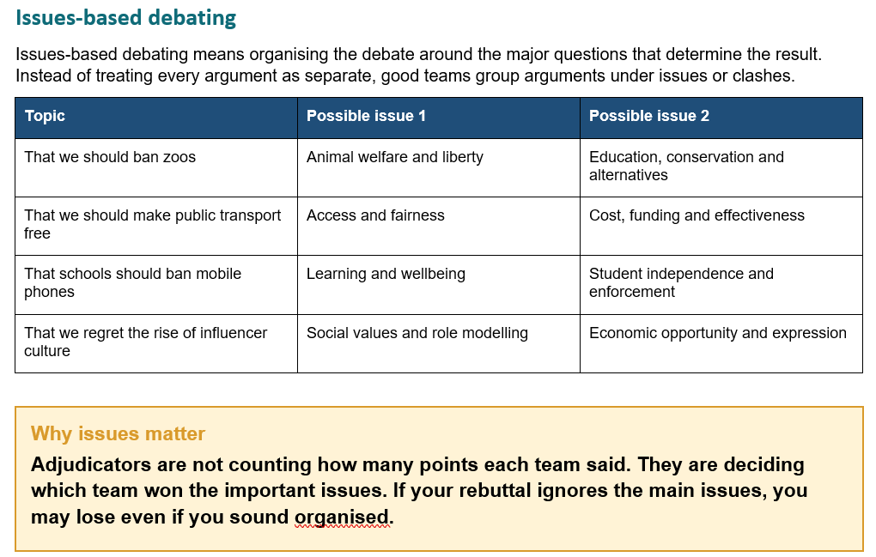

Slide 24
www.scsdebating.com.au
Thank You!
Questions?
Contact us: admin@scsdebating.com.au

