Slide 1
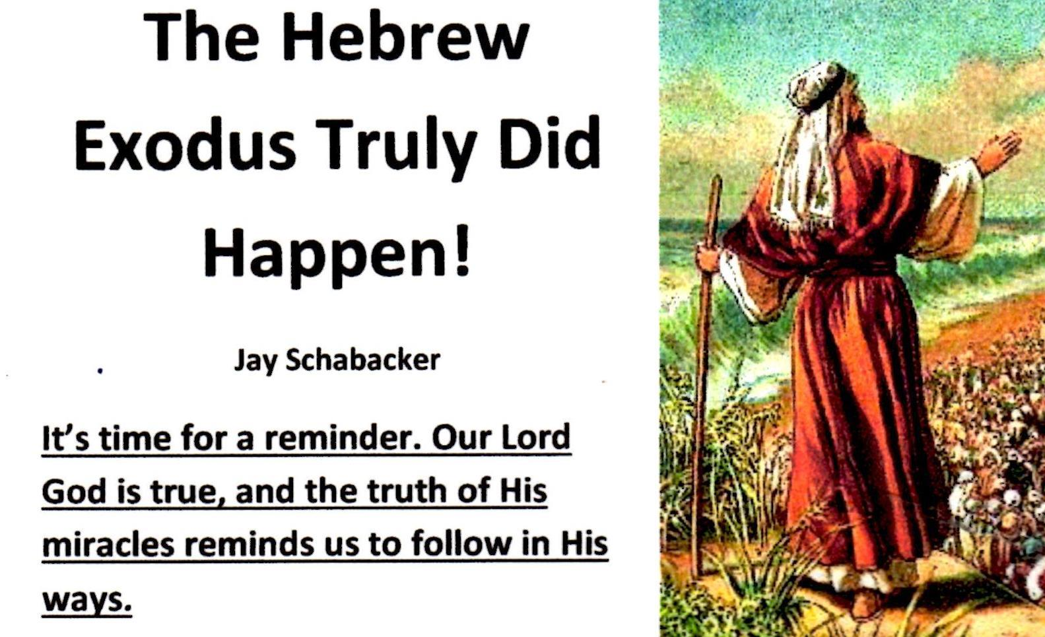

Slide 2
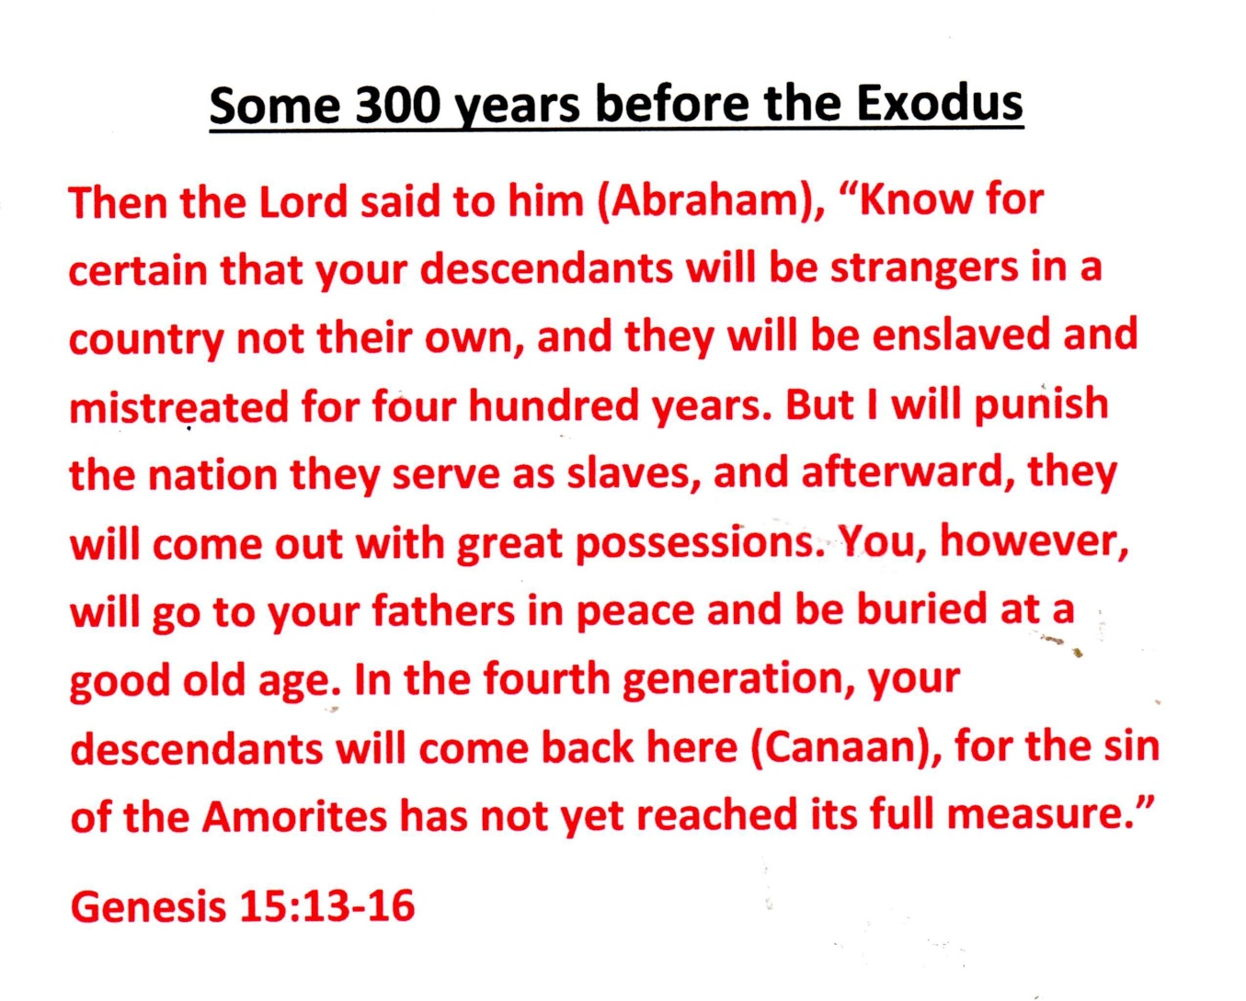
It Was God’s Plan!

Slide 3
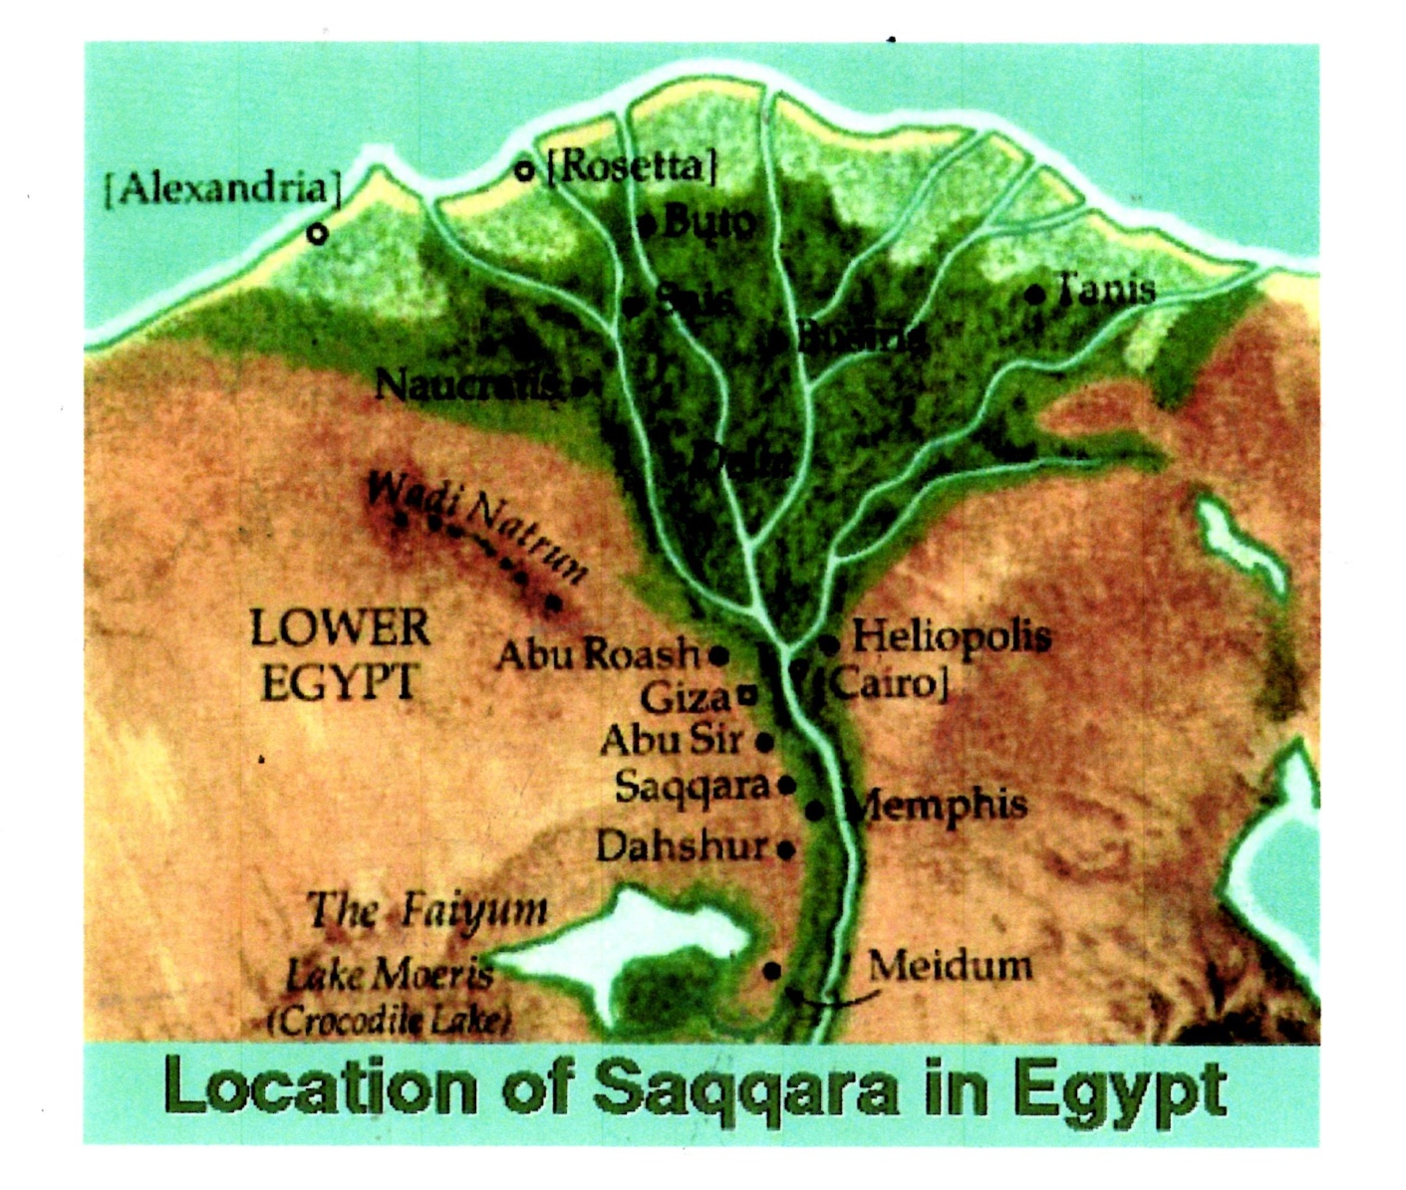
“Strangers in a country not their own.”

Slide 4
The Date of the Exodus
The Bible says, In the four hundredth and eightieth year after the Israelites came out of Egypt, in the fourth year of Solomon’s reign - I Kings 6:1. Then, the fourth year of Solomon’s rein, 966 BC, was the same as 480 years after the Israelite Exodus. So, the Israelites came out of Egypt 966BC minus 480 years earlier. Thus, the Exodus was 966 BC plus 480 years earlier or 966 + 480 or equal to 1446BC.

Slide 5
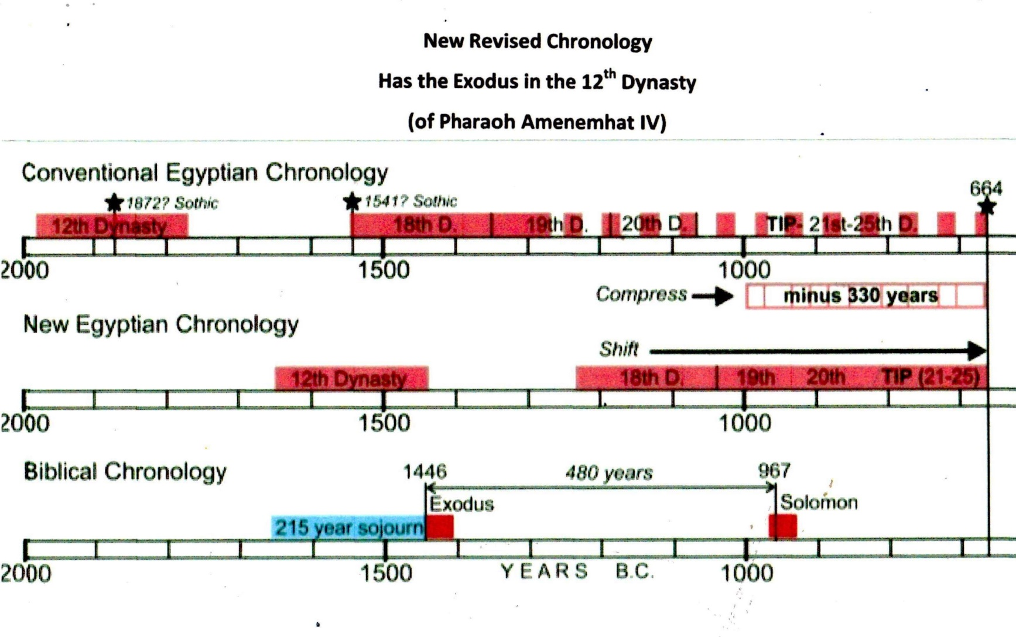
1446 BC the date of the Exodus

Slide 6
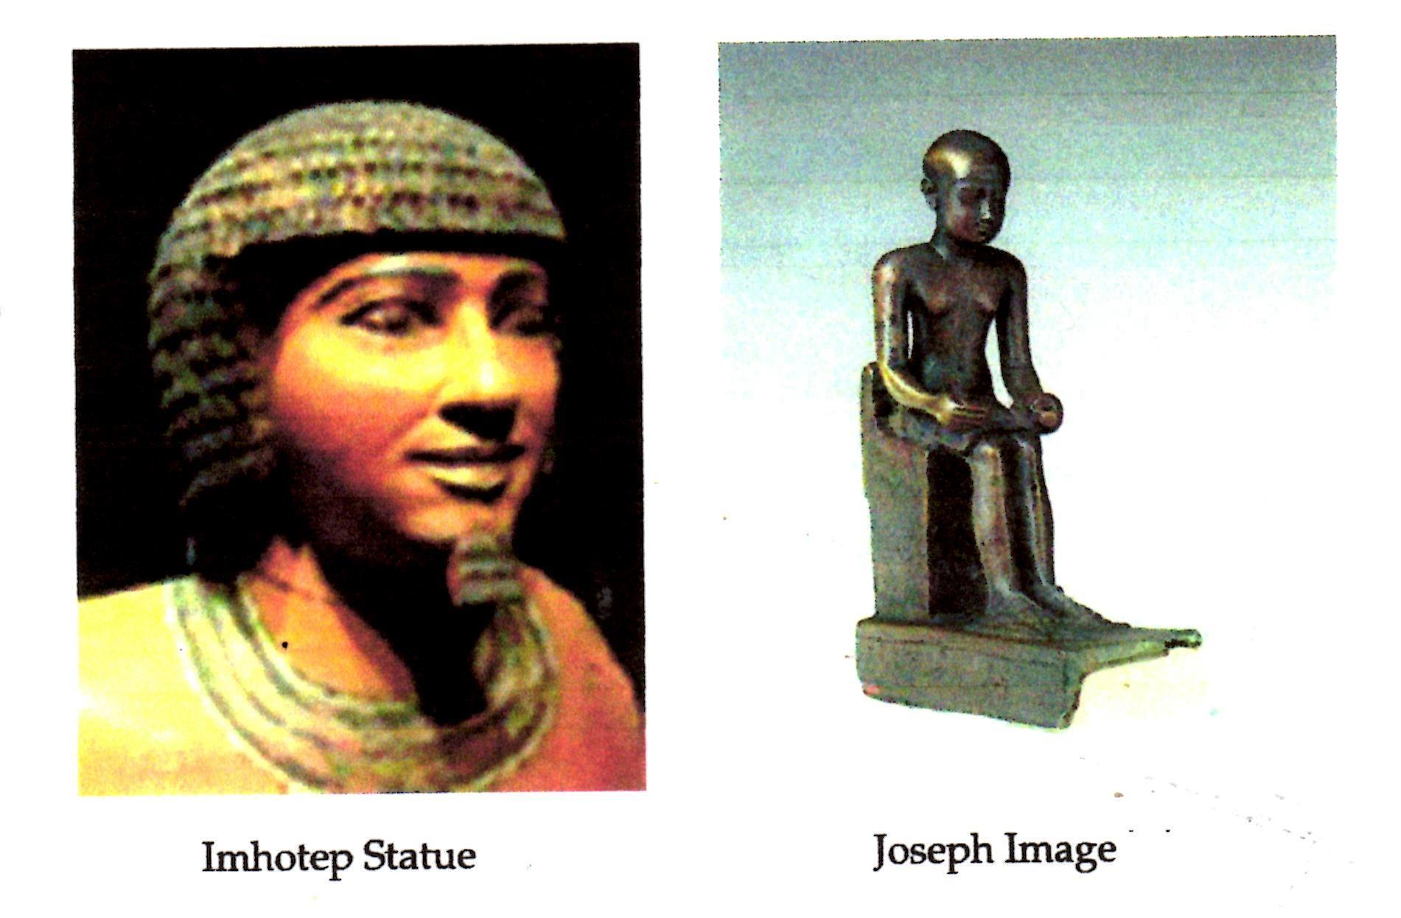
Imhotep was Joseph

Slide 7
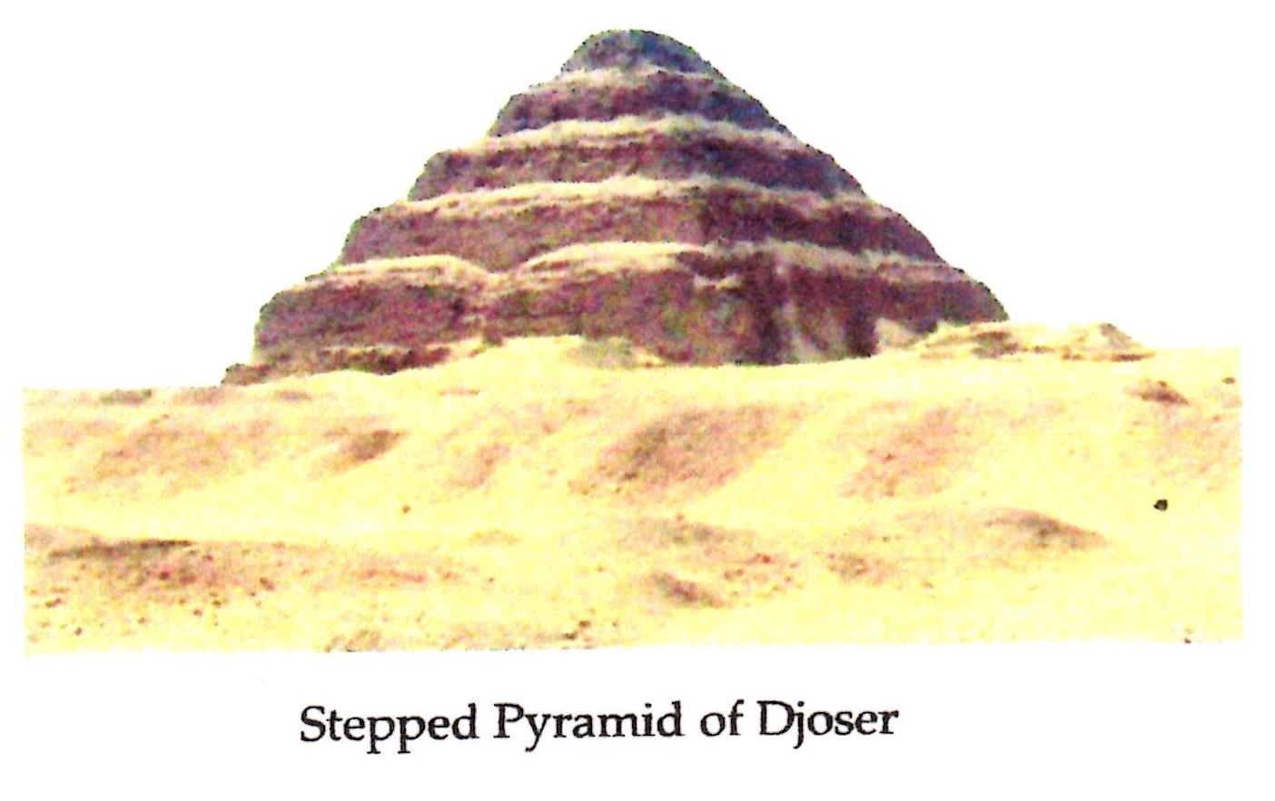
Imhotep/Joseph helped Pharaoh Djoser build the Stepped Pyramid

Slide 8
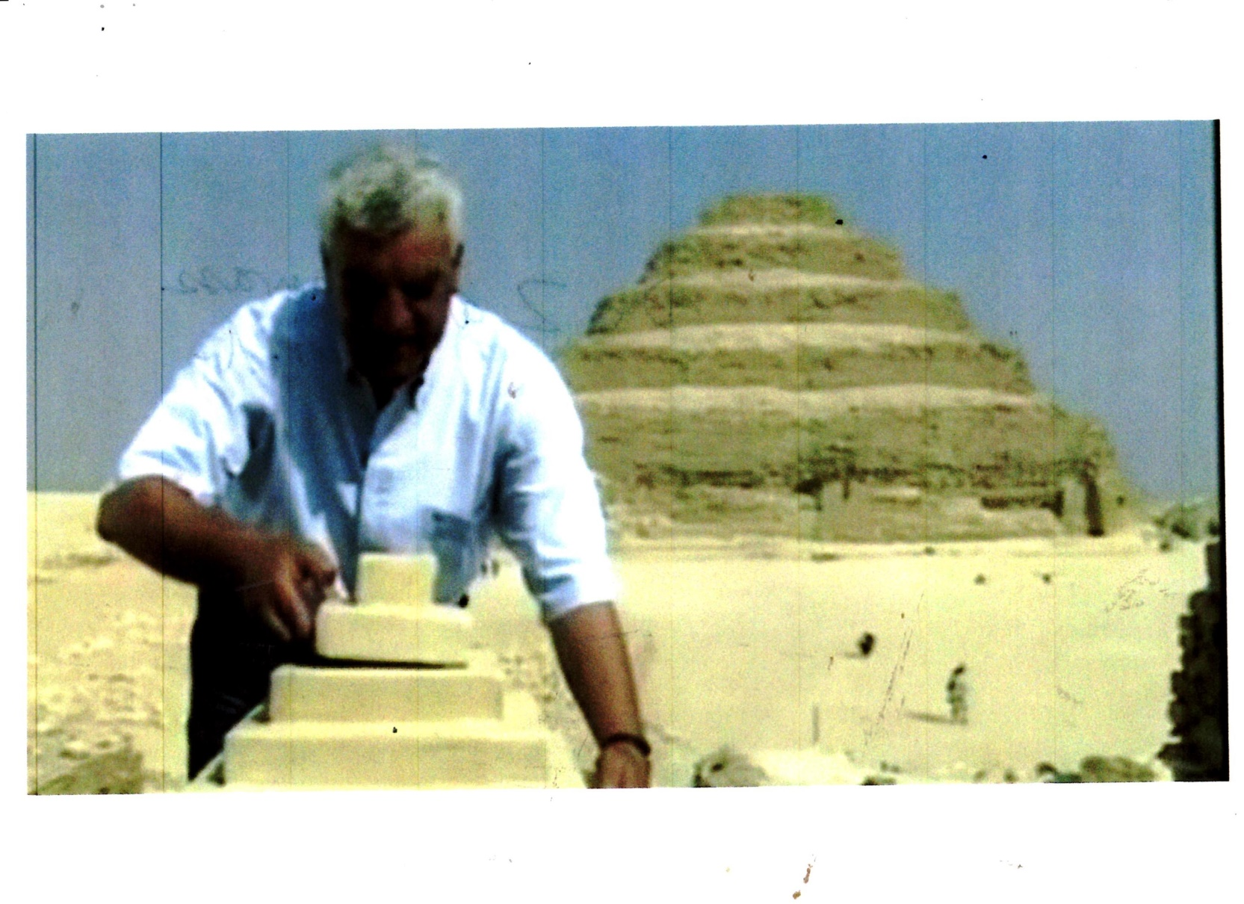
Dr. Zahi Hawass renowned Egyptologist studied the Stepped Pyramid and Grain storage

Slide 9
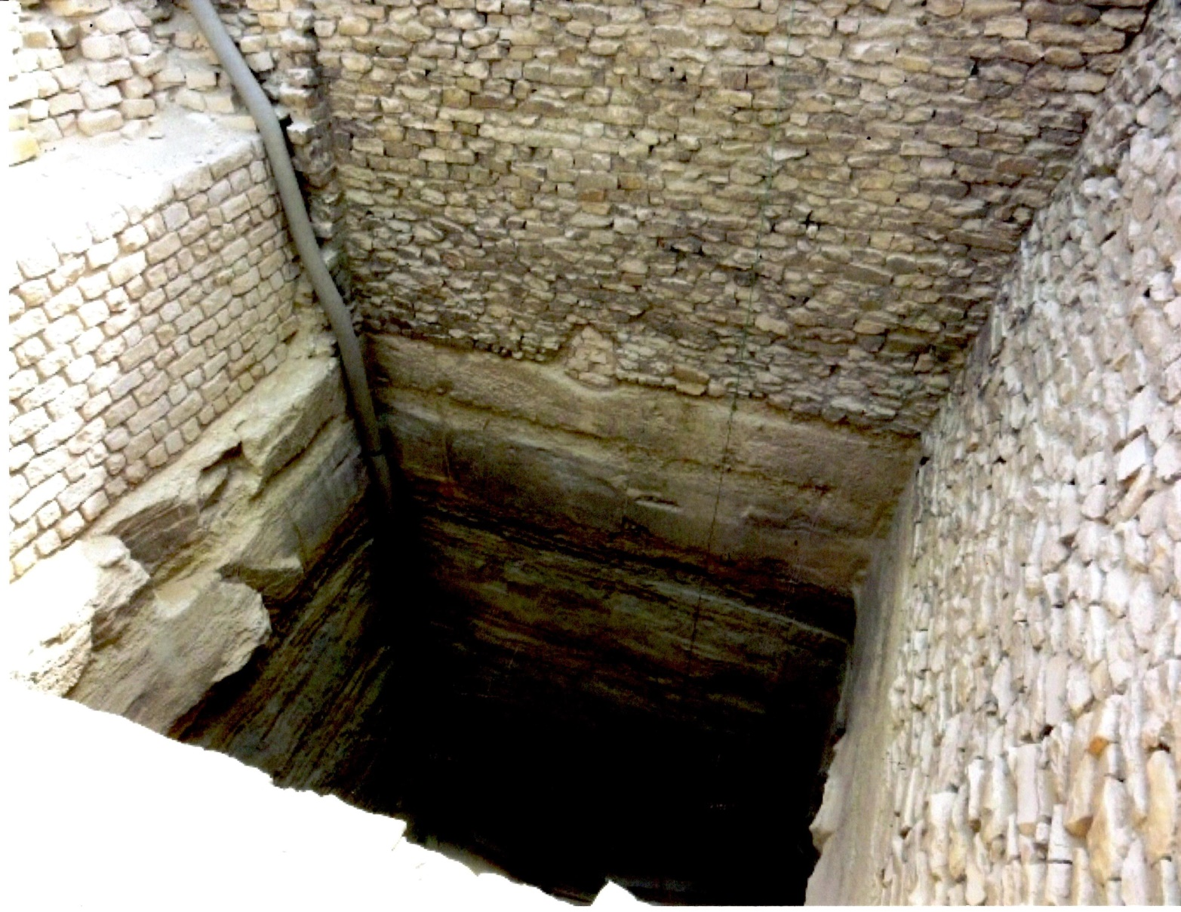
Joseph designed the grain silos

Slide 10
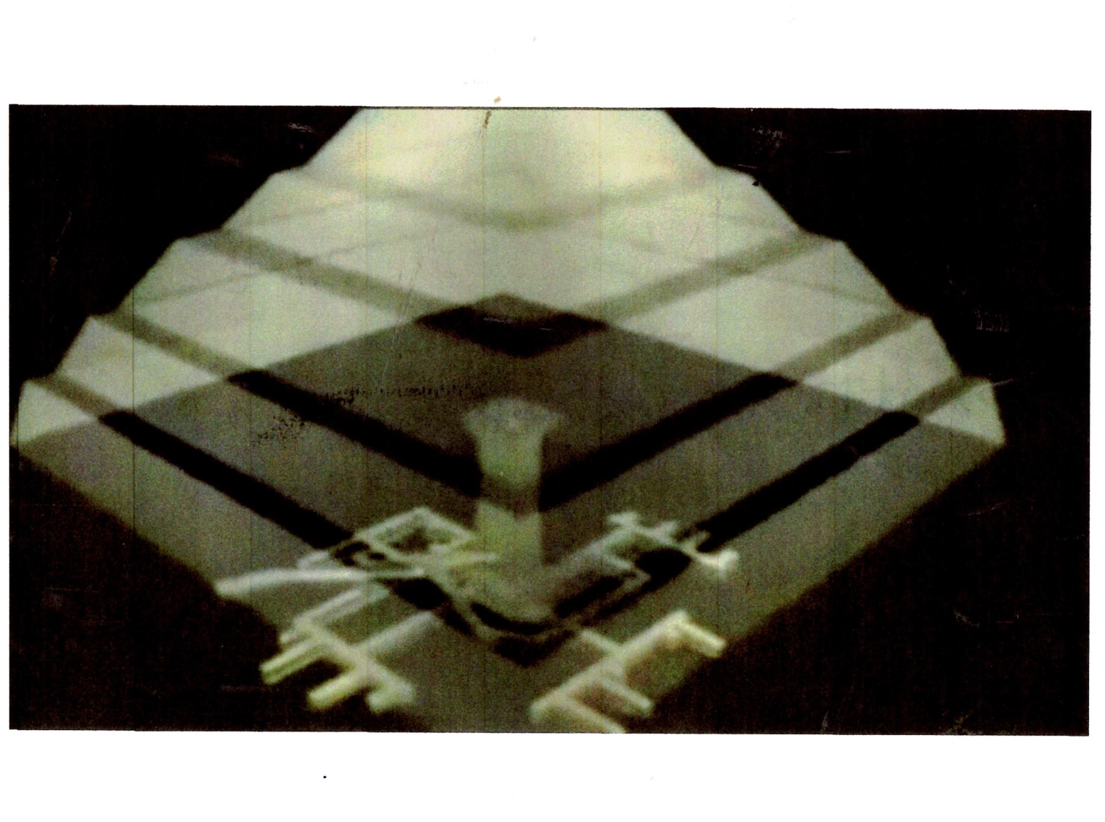
Stepped Pyramid was later built above the grain storage shafts and pits

Slide 11
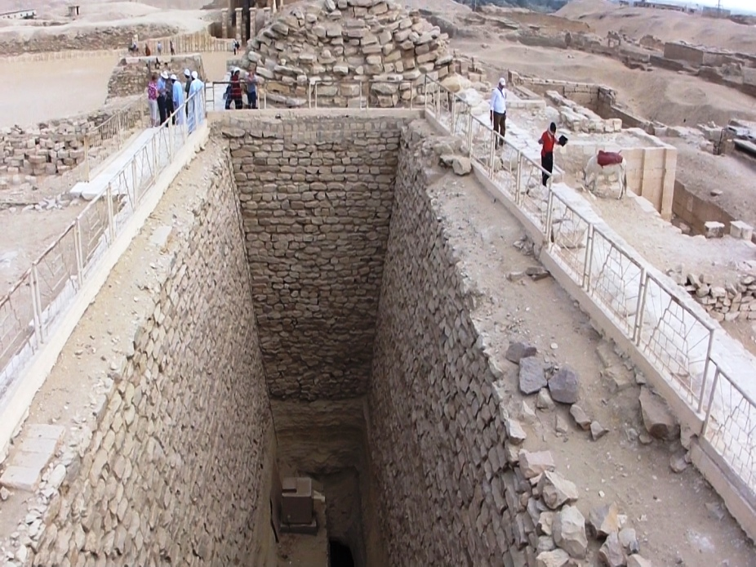
People indicate the huge size of just one grain shaft and storage pit

Slide 12
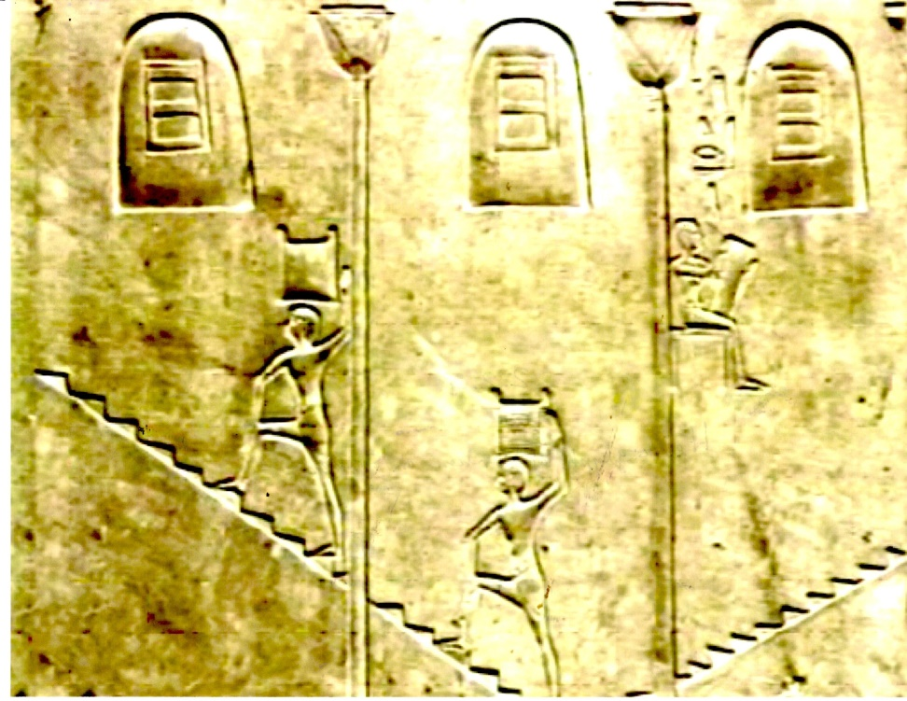
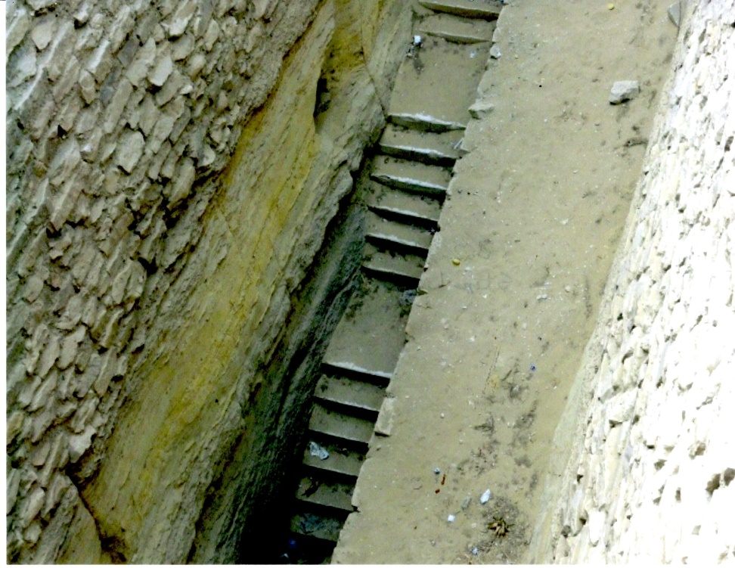
Hieroglyphs show workers on steps carrying grain and, indeed, steps have recently been uncovered!

Slide 13
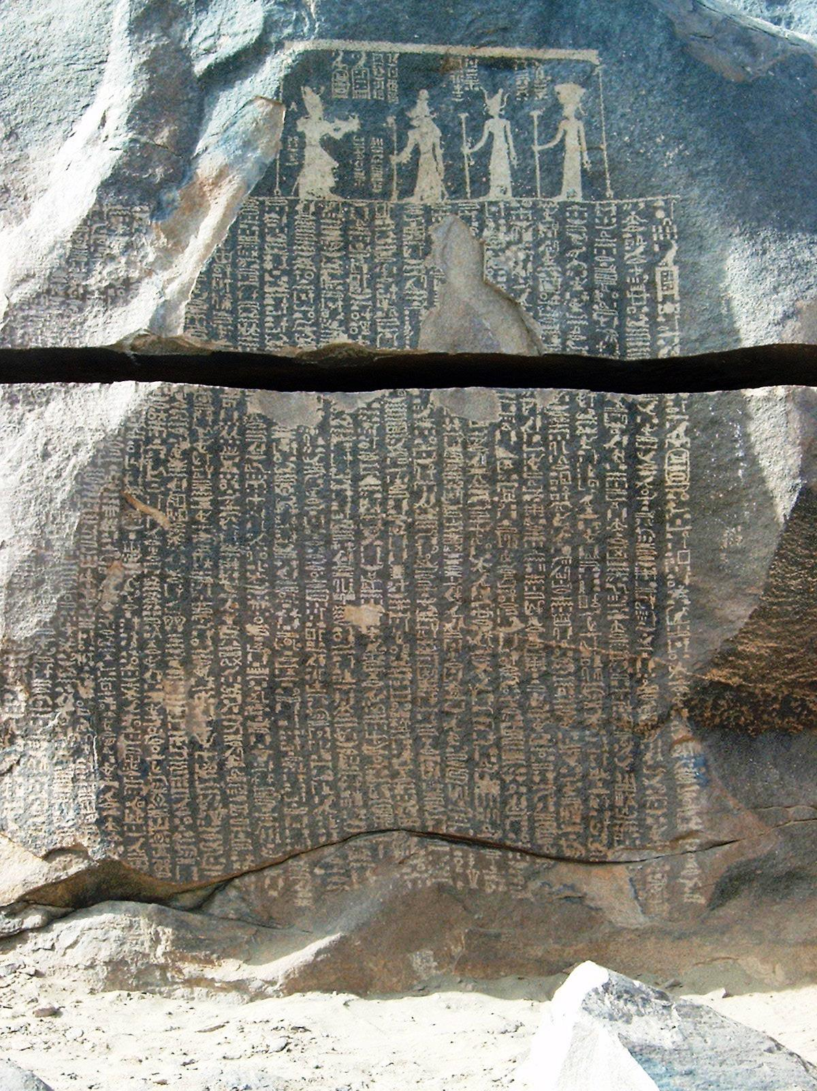
Famine Stelle
On the island of Sihiel, near the first cataract of the Nile, is a great stone (The Famine Stele) with inscriptions on it which mentions Joseph. The inscription states ‘seven meagre years and seven rich years’. “Pharaoh Djoser asks Joseph to help him with the coming seven years of famine.”

Slide 15
“They will be enslaved and mistreated”
Then a new king that did not know Joseph came to power in Egypt. Exodus 1:8
So they set slave masters over them to oppress them with forced labor. Exodus 1:11
Then Pharaoh gave this order to all his people: “Every boy that is born you must throw into the Nile, but let every girl live.” Exodus 1:22

Slide 16
Graves of young boys killed by Pharaoh have been unearthed at Avaris, Egypt
At about 1530 BC, at the Israelit’es Avaris, the remains of numerous tiny graves were found - innocent victims of a vicious slaughter.
While children’s graves normally make up a quarter of all graves, here at Avaris, they represent about two thirds of all deaths! Furthermore, for every five adult female burials, they found only three adult males. The males died earlier as infants.
The graphs show it on the next slide.

Slide 17
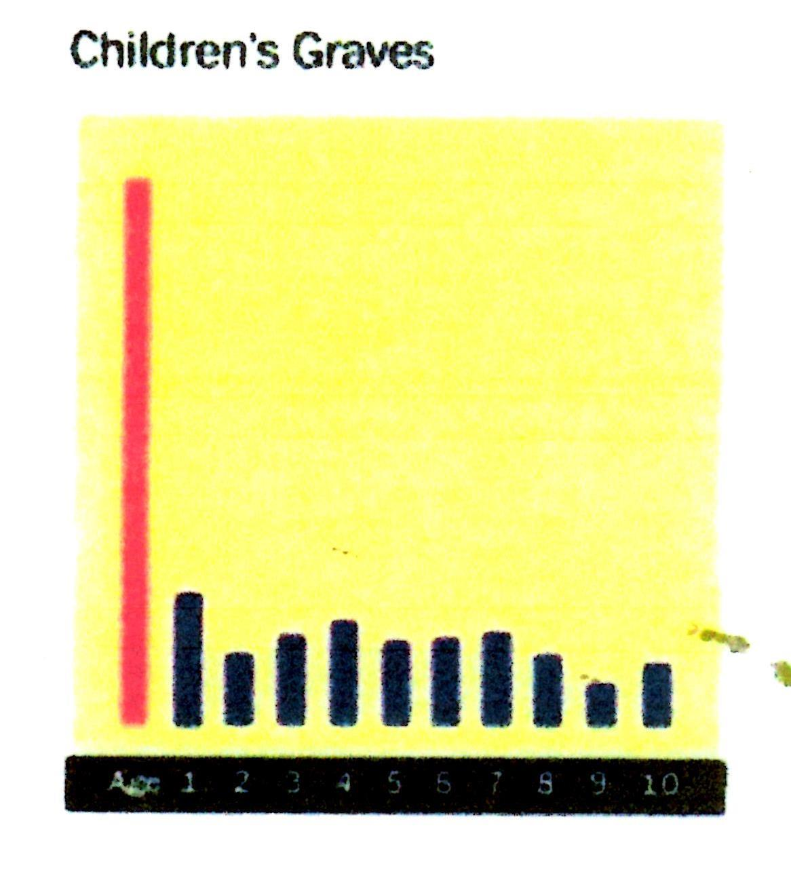
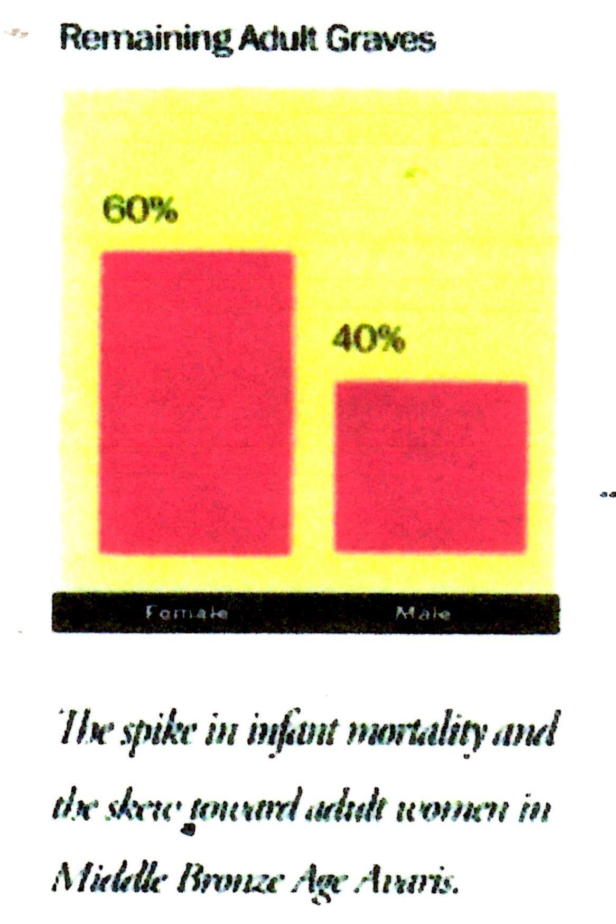
Graves of young boys unearthed

Slide 18
Who was the Pharaoh of the Exodus?
The 12th Dynasty was noted as having all the Pharaoh’s burial sites well known, except for one, that of the 7th Pharaoh, Amenemhat IV.
“The tomb of Amenemhat IV has not been identified.” He was the one who drowned in the Red Sea.
The next Dynasty, the 13th, was much weaker, because of the plagues, and the kings rarely ruled beyond a couple of years.

Slide 19
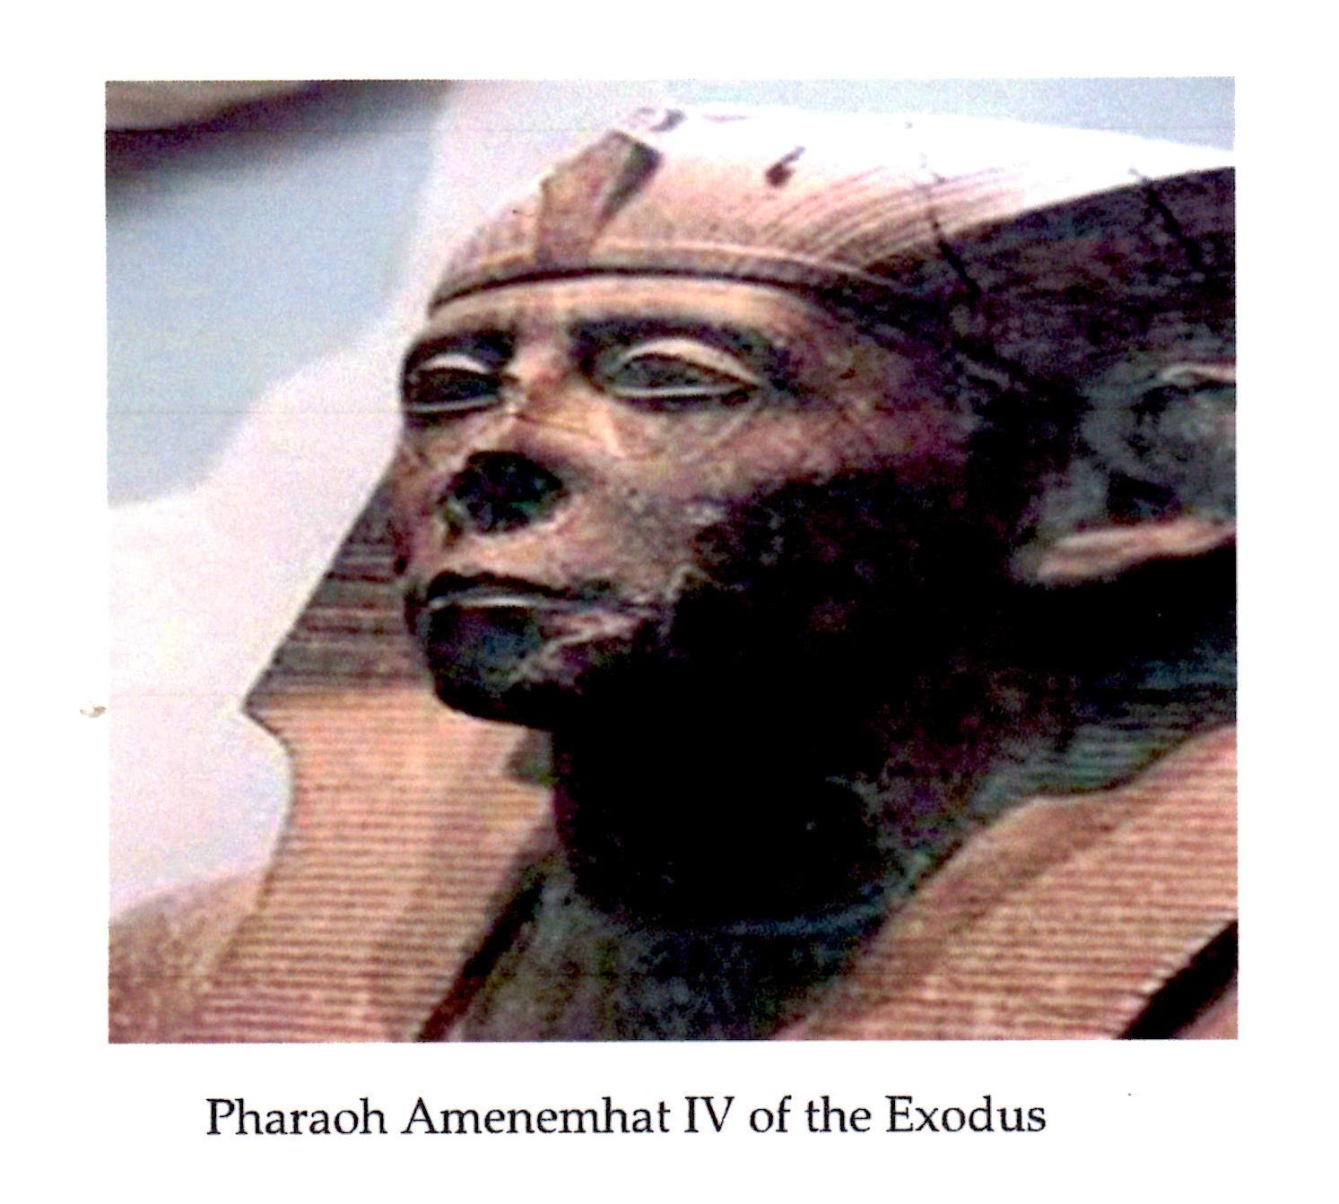
Amenemhat IV of the Exodus

Slide 20
“I will punish the nation they serve as slaves.”
Then the Lord said to Moses, “See, I have made you like God to Pharaoh. . . I will multiply my miraculous signs and wonders in Egypt, he will not listen to you. Then I will lay my hand on Egypt and with mighty acts of judgement I will bring out my divisions, my people the Israelites. And the Egyptians will know that I am the Lord when I stretch out my hand on Egypt and bring the Israelites out.” Ex. 7:1-5.

Slide 21
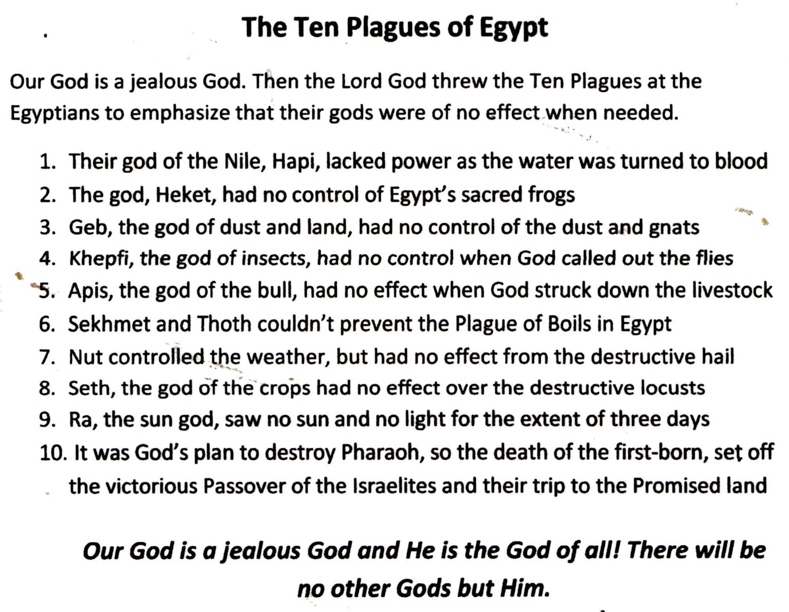

Slide 22
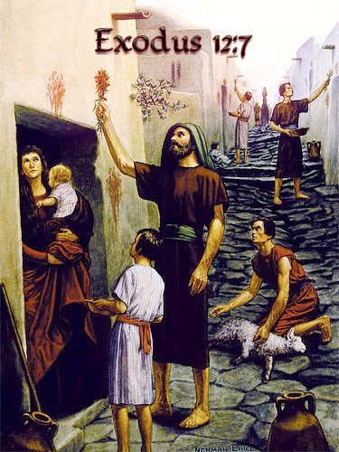
Exodus 12:7 and 12:11
Then they are to take some blood and put it on the sides and the tops of the doorframes of the houses where they ate the lambs. Exodus 12:7
This is how you are to eat it: with your cloak tucked into your belt, your sandals on your feet and your staff in your hand. Eat it in haste; it is the Lord’s Passover. Exodus 12:11

Slide 23
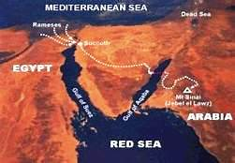
“They will come out with great possessions”
The Israelites did as Moses instructed and asked the Egyptians for articles of silver and clothing. The Lord had made the Egyptians favorably disposed. Exodus 12:35-36.

Slide 24
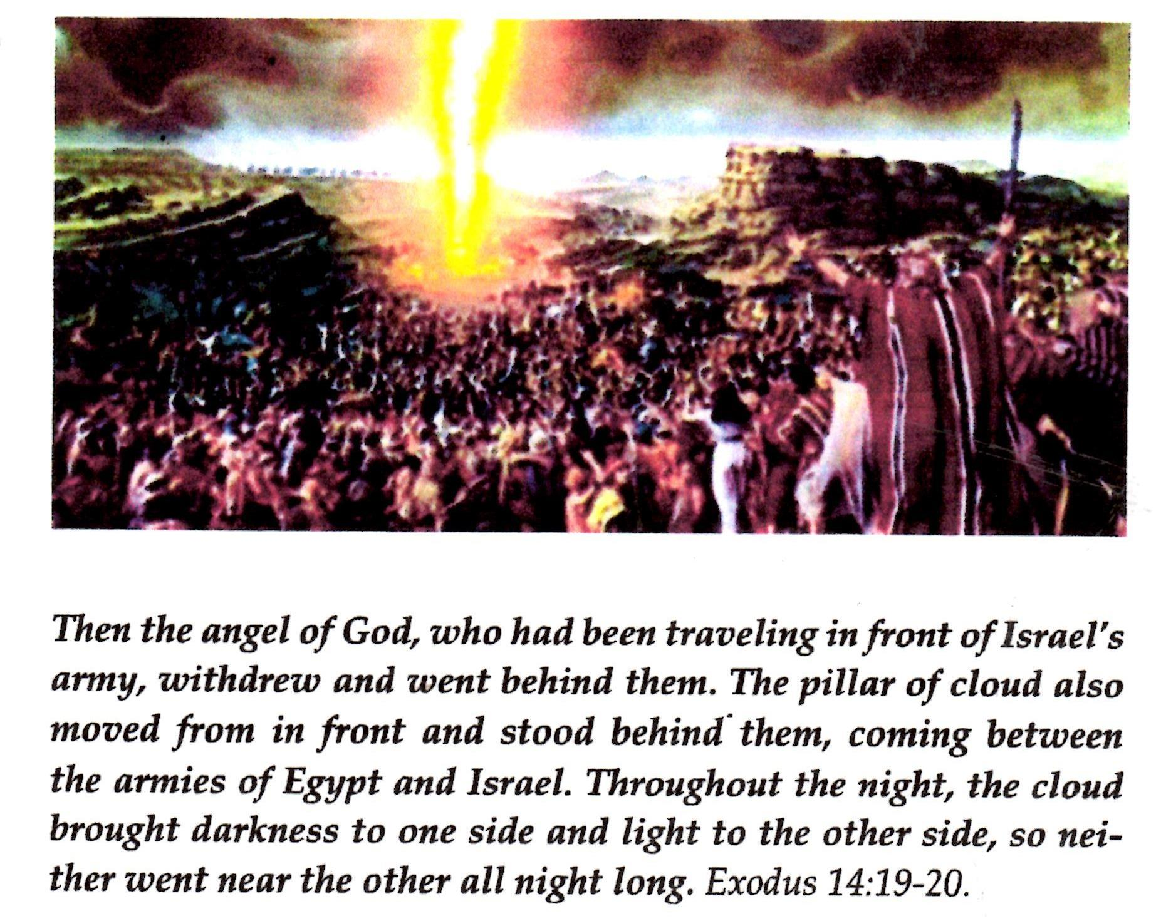

Slide 25
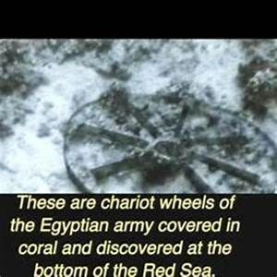
Chariot Wheels in the Red Sea
There have been numerous photos taken of chariot wheels and even human bones at the bottom of the Red Sea at the Israelite crossing at the Gulf of Agaba.

Slide 26
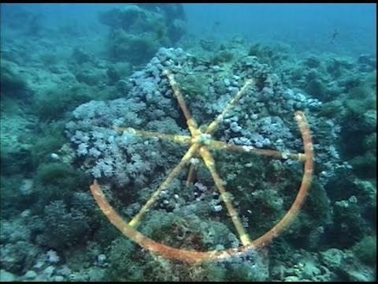

Slide 27
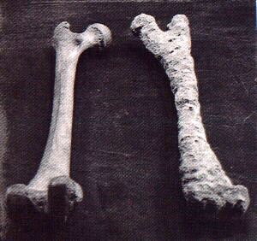

Slide 28
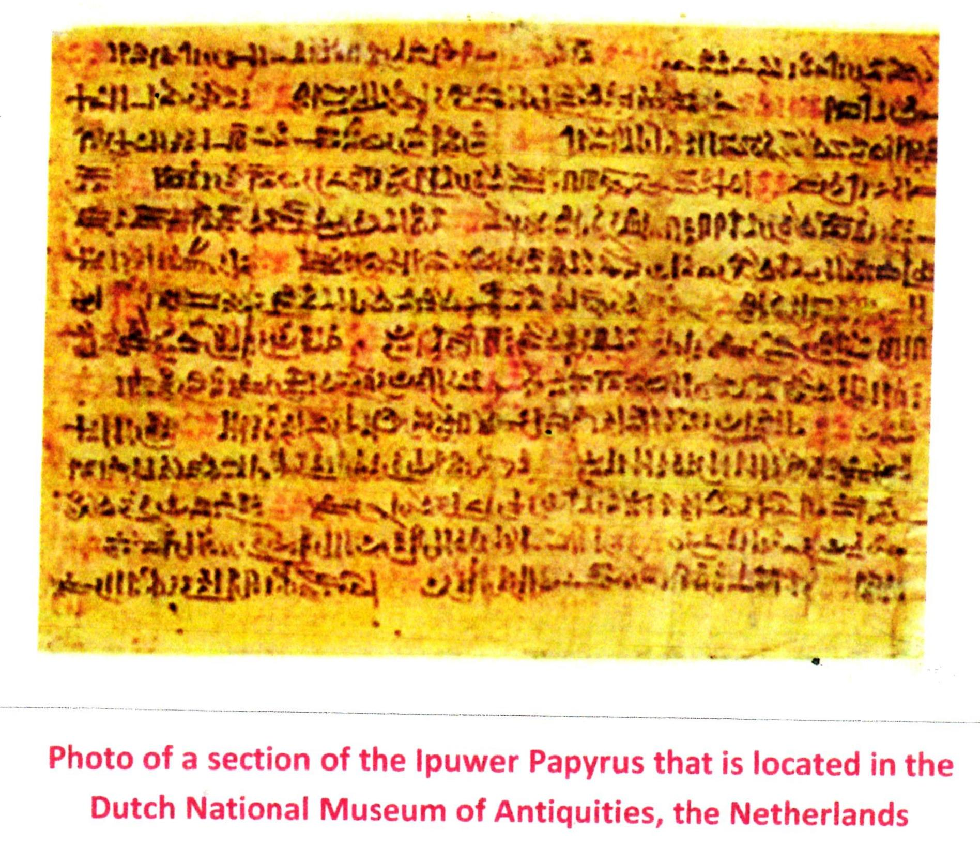
A Major Discovery – The Ipuwer Papyrus

Slide 29
The Egyptian Ipuwer Papyrus
The Ipuwer Papyrus was written at the end of the 12th Dynasty. It is largely a conversation, in poem form, by an Egyptian called Ipuwer, who is talking to someone called ‘The Lord of all.’ It refers to the complete collapse of Egypt at the end of the Old Kingdom because of God’s Ten Plagues and the Exodus. Some of the text refers to ‘the river is blood,’ ‘groaning is through the land,’ and ‘All is ruin.’

Slide 30
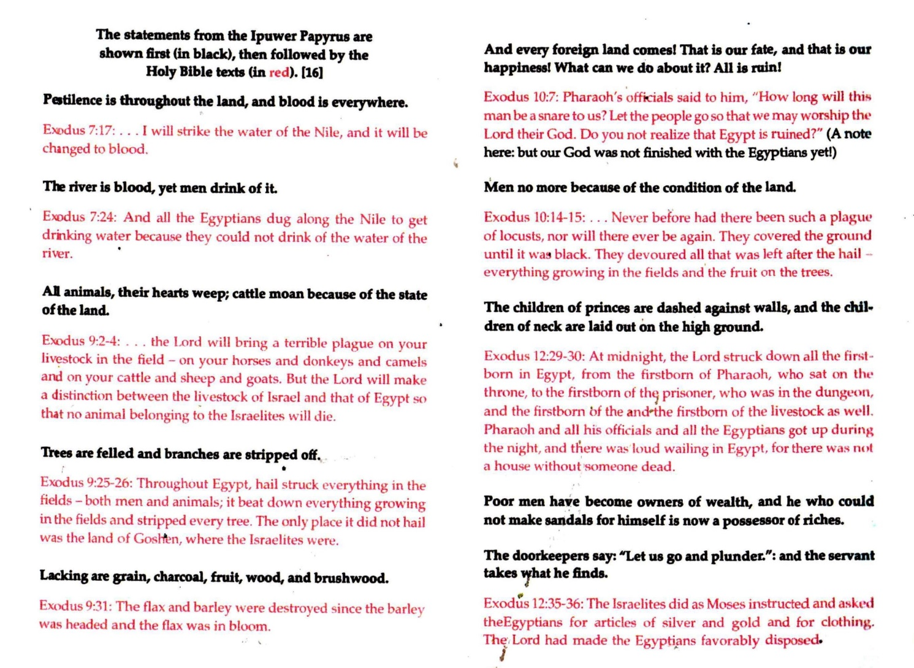

Slide 31
Conclusion – The Five Facts
Archaeologists unearthed numerous grain storage silos built by Joseph for the Pharaoh
Archaeologists have found graves of Hebrew boys (and not girls) who died as infants
The Pharaoh of the Exodus was Amenemhat IV who drowned in the Red Sea
Egyptian chariot wheel found in the Red Sea
Egyptian Ipuwer Papyrus declares ‘All is ruin.’

Slide 32
Epilogue:
The Song of Moses and Miriam
Then Moses and the Israelites sang this song to the Lord: “I will sing to the Lord, for he is highly exalted. The horse and the rider he has hurled into the sea. The Lord is my strength and my song; he has become my salvation. He is my God, and I will praise him, my father’s God, and I will exalt.” Exodus 15:1-2

