Slide 1
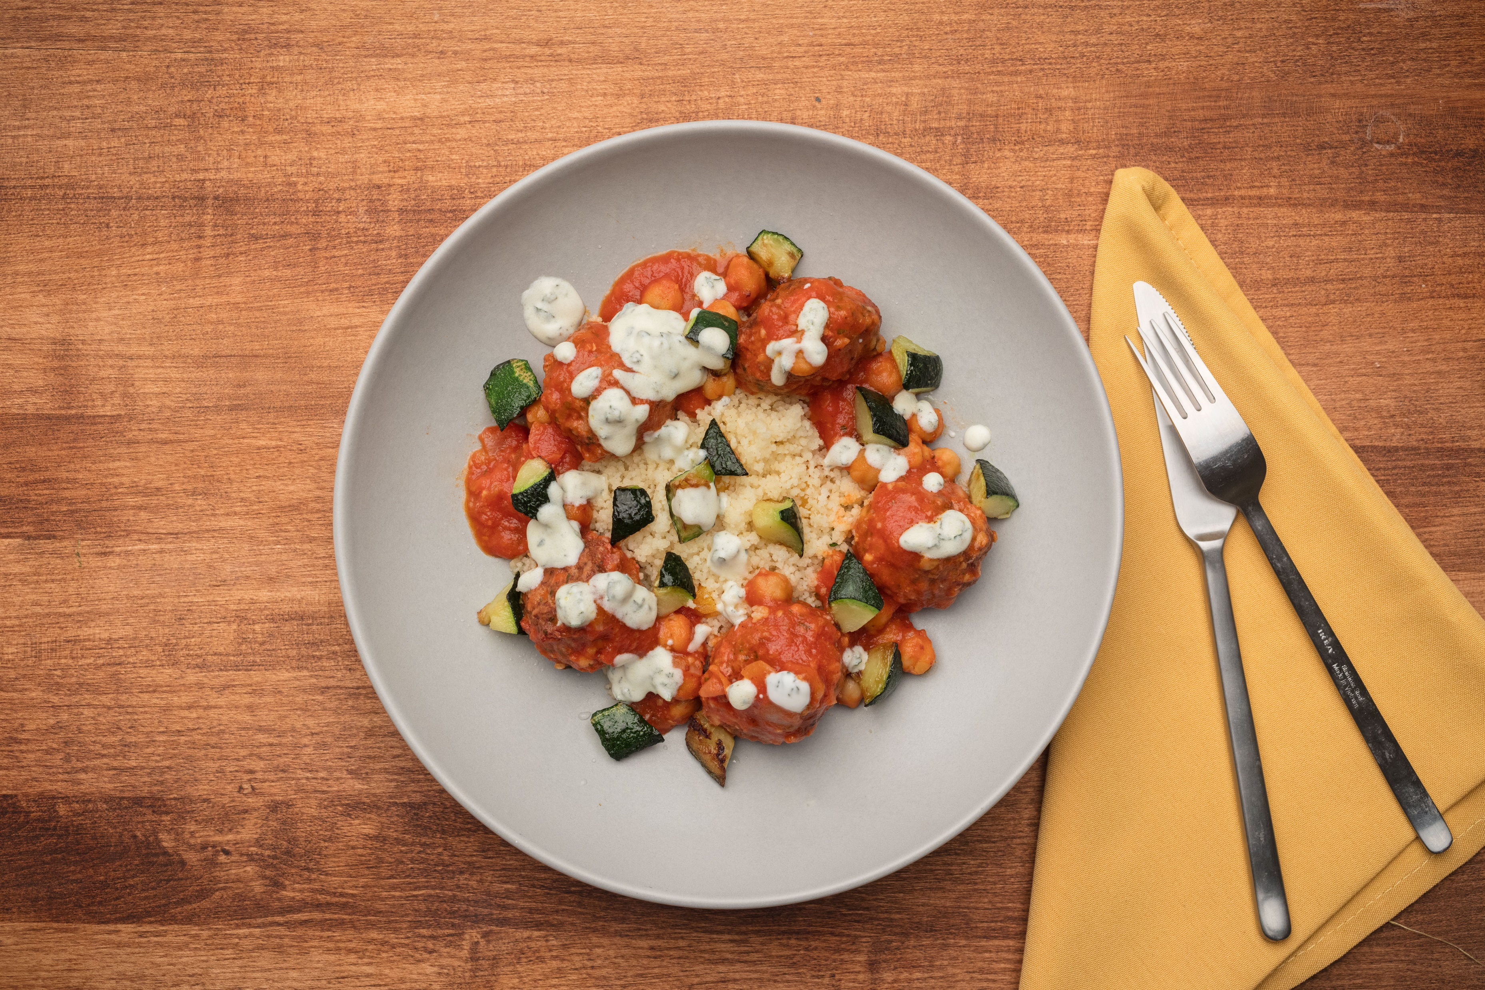
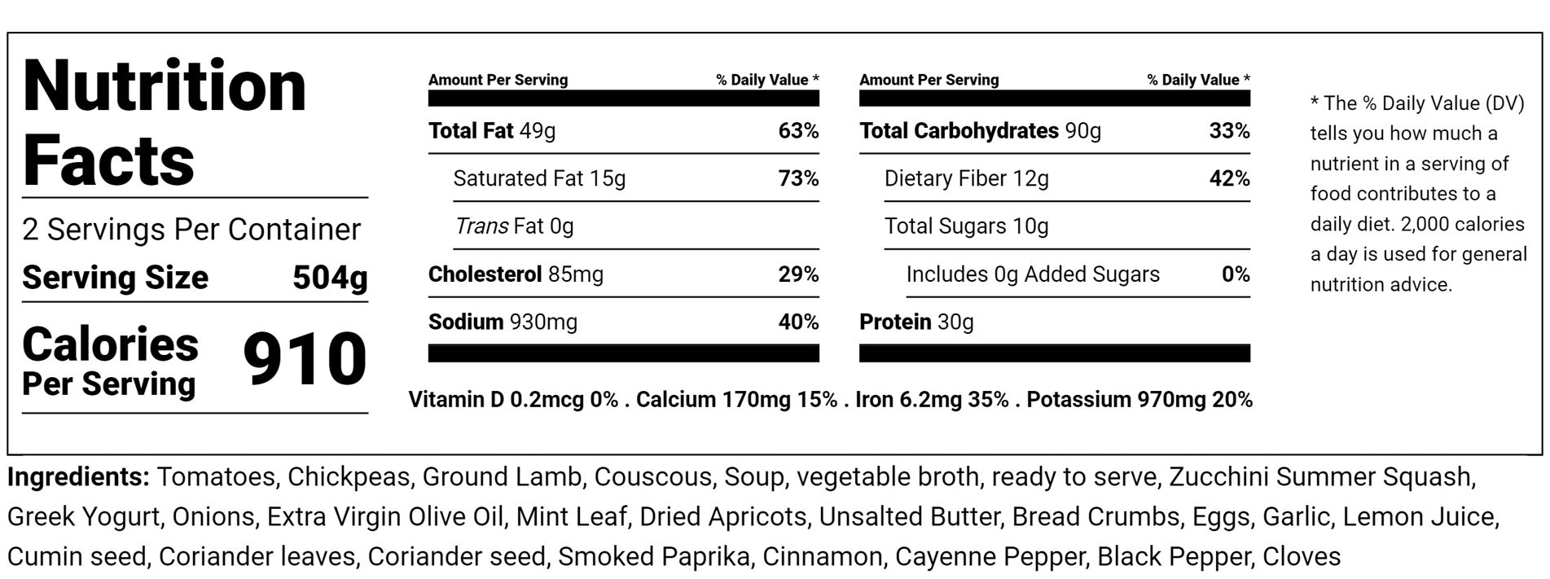
Moroccan Lamb Meatballs
In a Spicy Tomato Sauce with Herbed Couscous & Vegetables
OUR BEVERAGE RECOMMENDATION
We recommend mellow aged reds like Rioja reservas or similar oak-aged Spanish reds, inexpensive southern Italian reds such as Nero d’Avola, Negroamaro and Aglianico, Lebanese reds or of course reds from Morocco itself. Also pairs well with our very own Cleaver IPA.
Chef’s Lesson: Moroccan Tajine
Moroccan tajine dishes are slow-cooked savory stews, typically made with sliced meat, poultry or fish together with vegetables, fruit, spices and nuts. The domed or cone-shaped lid of the tajine pot traps steam and returns the condensed liquid to the pot resulting in a minimal amount of water being needed to cook the meats and vegetables.
Moroccan Lamb Meatballs, Spicy Chickpea-Tomato Sauce,
Herbed Couscous & Vegetables
WHAT’S INCLUDED
WHAT ELSE YOU NEED
Spicy Chickpea-Tomato Sauce
Lamb Meatballs
Couscous
Dried Apricots
Butter
Olive Oil
Zucchini
Yogurt Sauce
Parsley
1 Small saucepan
1 Medium saucepan with tight fitting lid
1 Small Sauté Pan
1 Cup Water plus 2 tablespoons
MeezBox Foods
1946 Campus Drive
Hyde Park, NY 12538
www.meezboxfoods.com

Slide 2
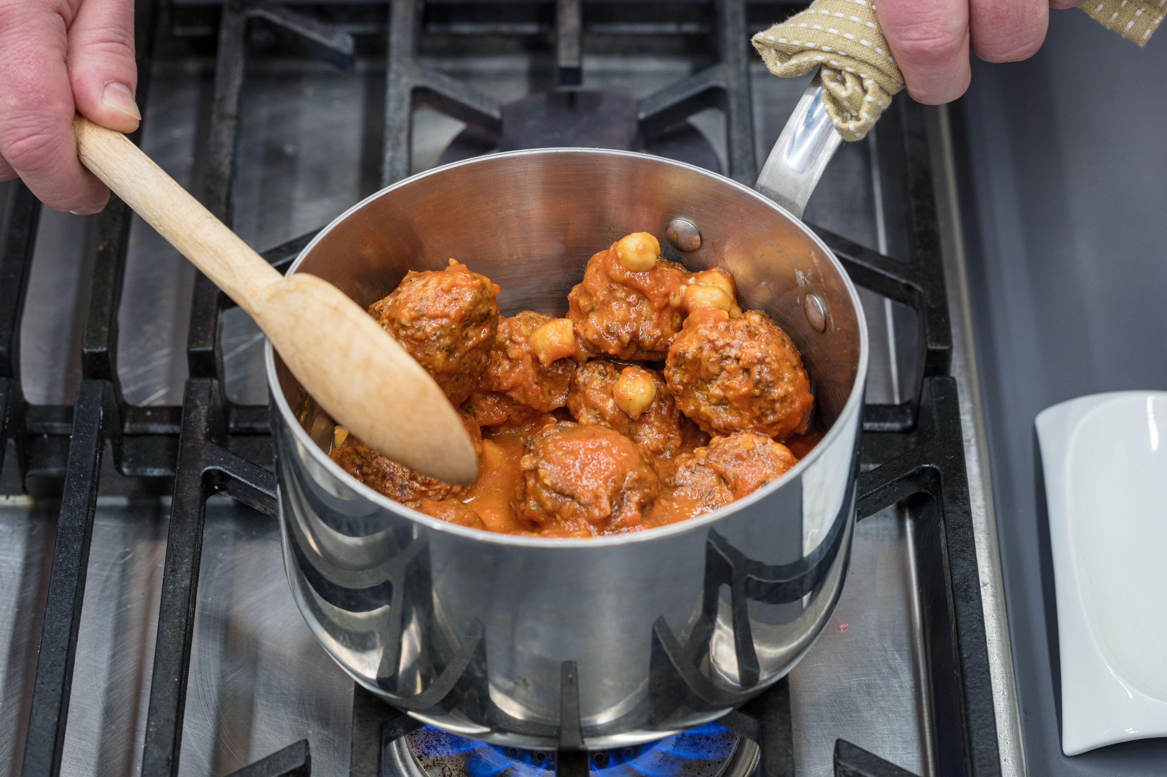
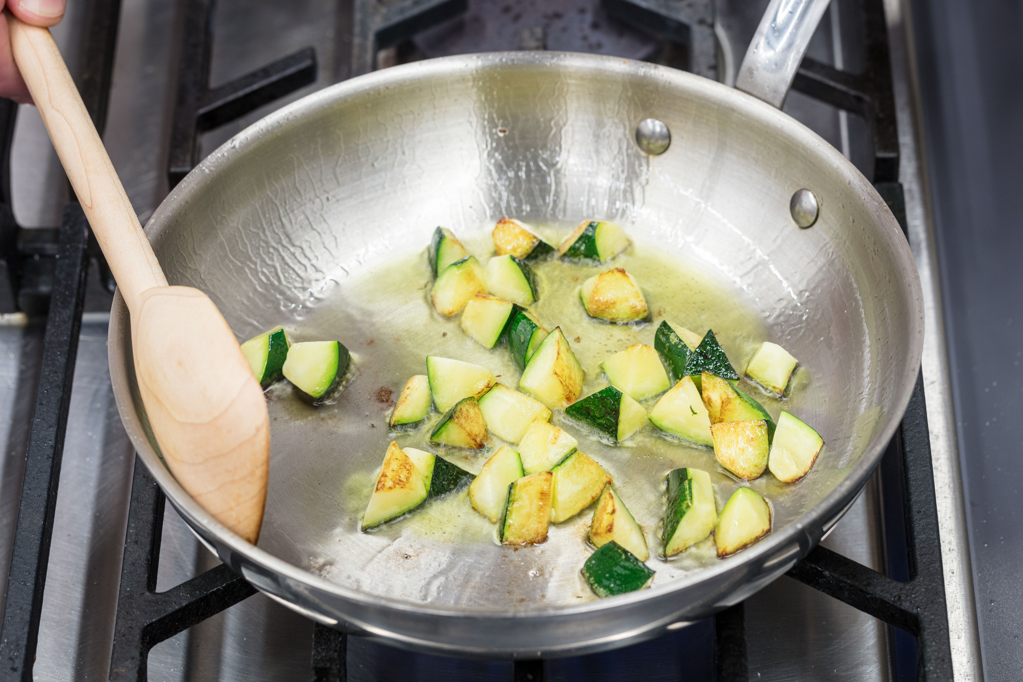
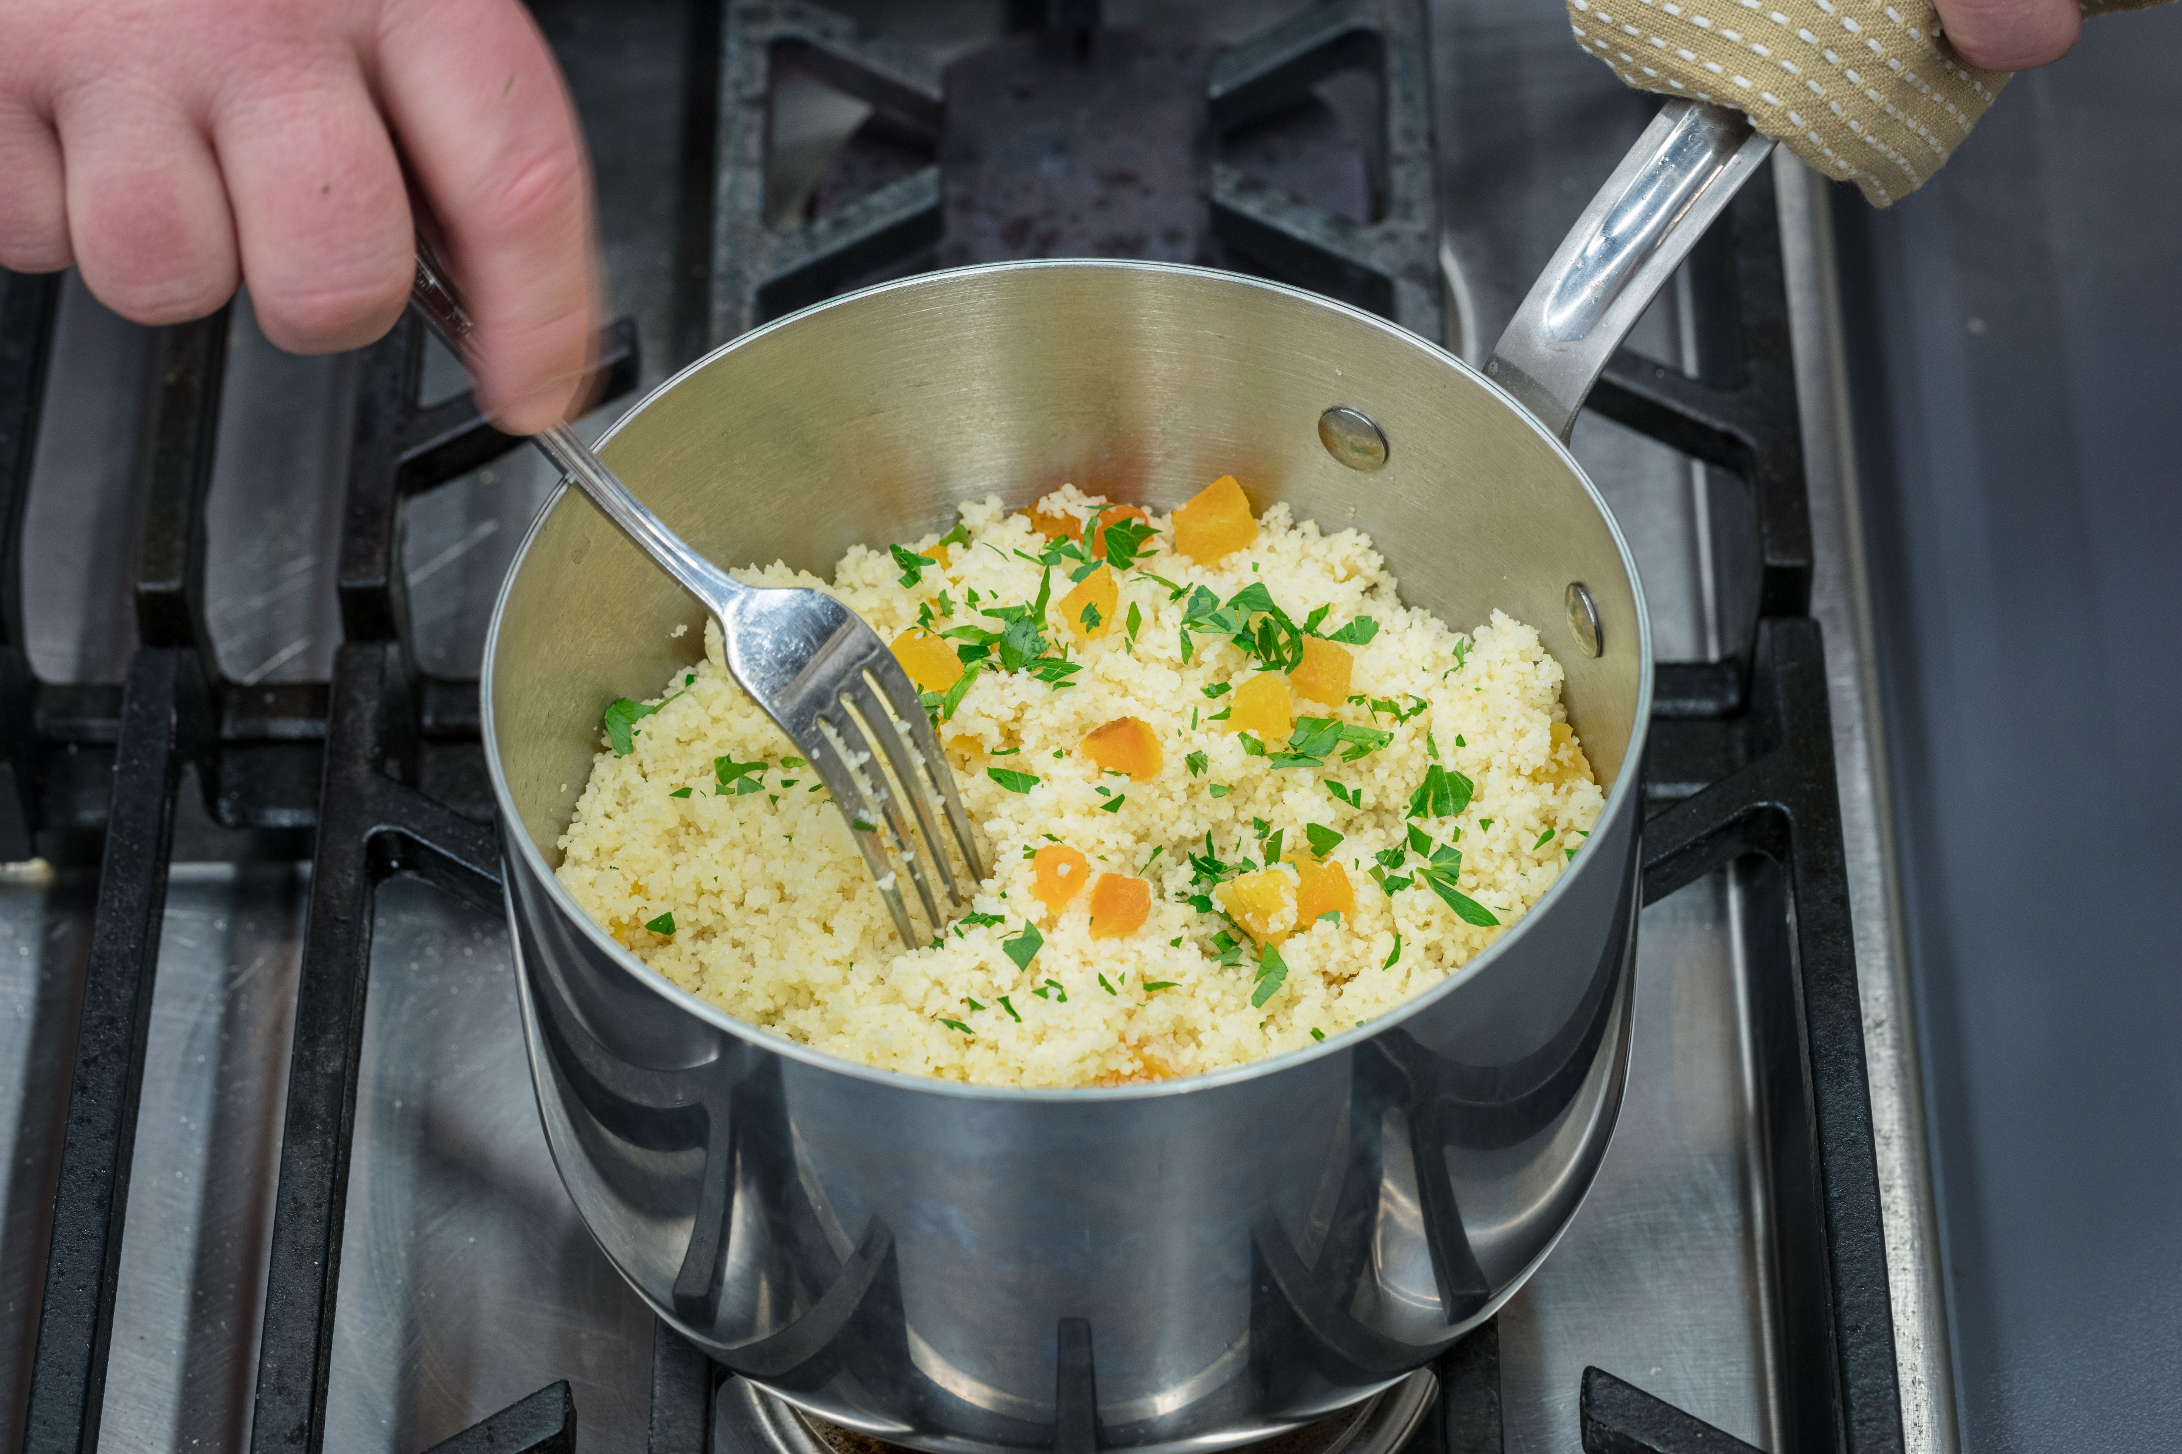
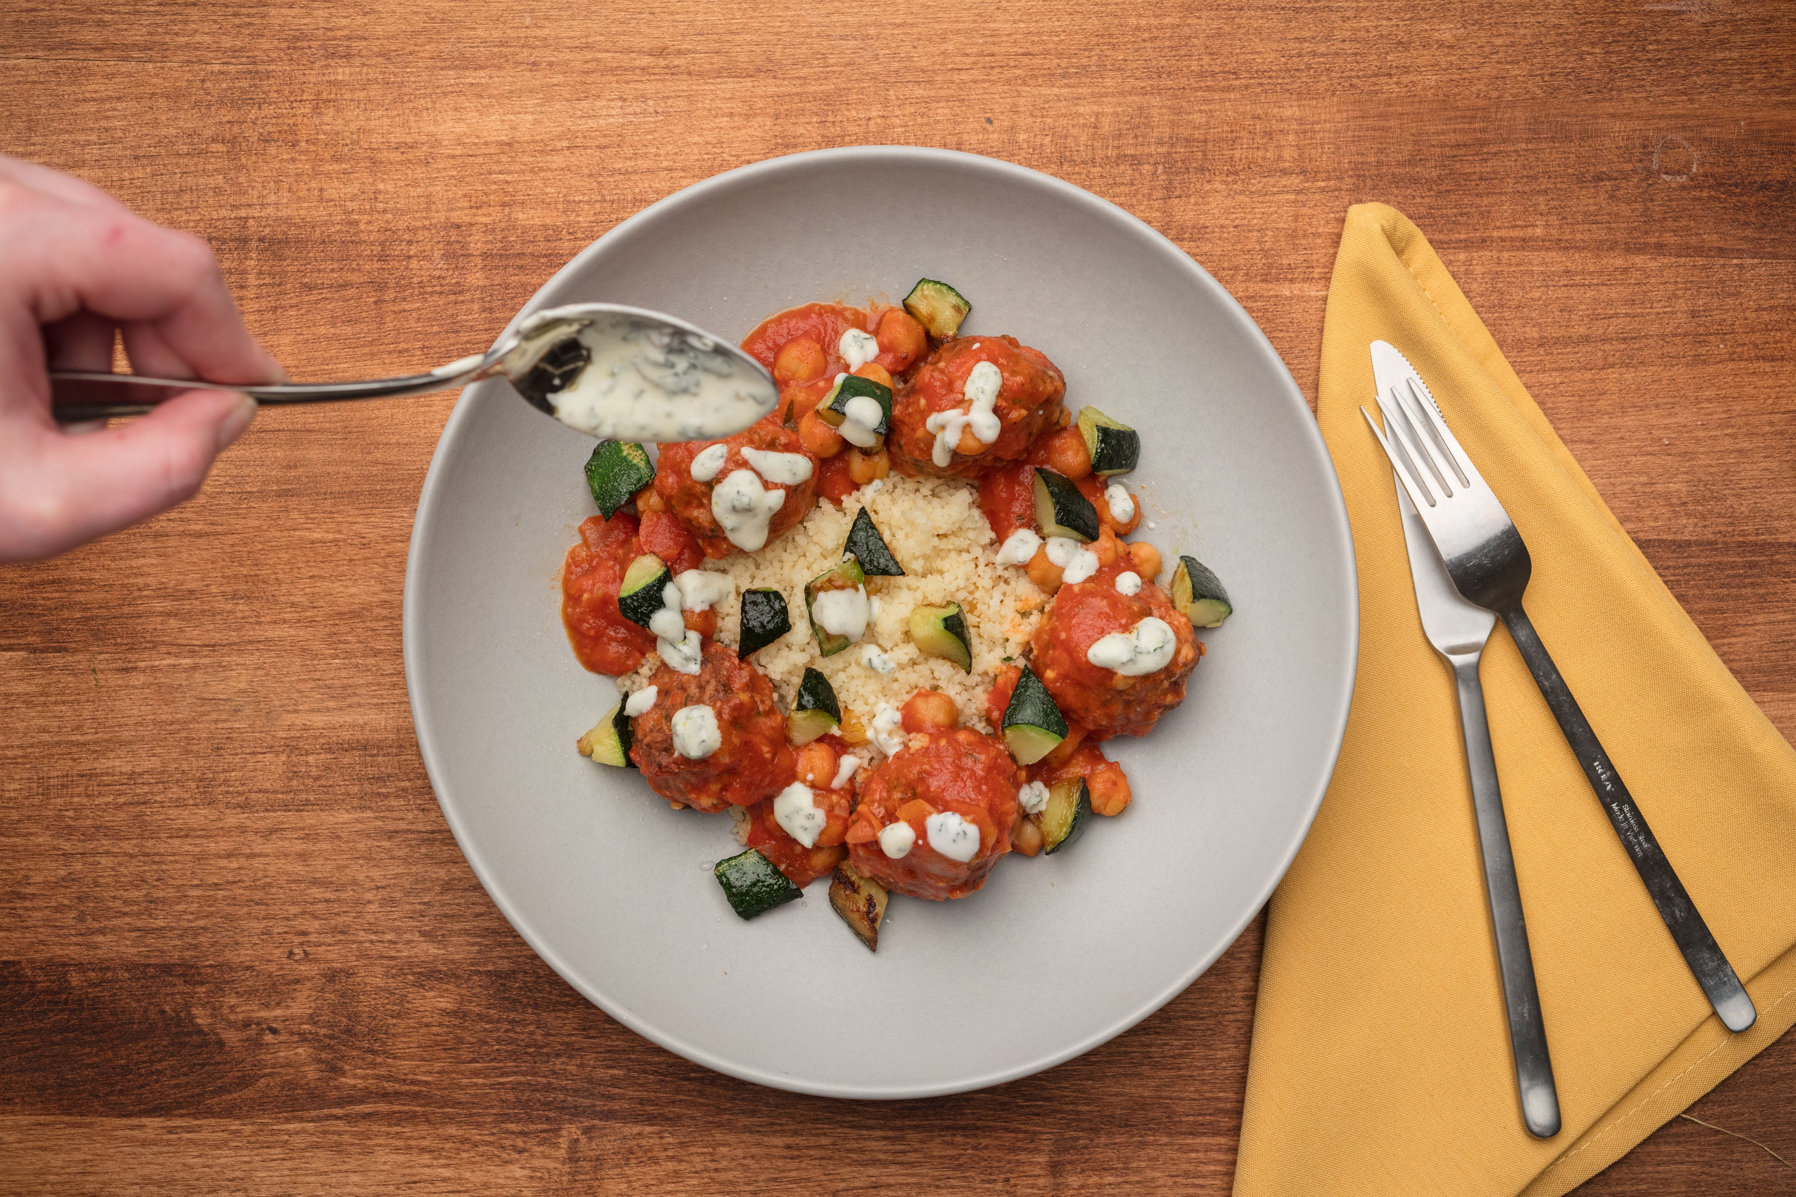
INSTRUCTIONS
STEP 1
STEP 3
Heat the spicy chickpea-tomato sauce and lamb meatballs in a small sauce pot over medium-high heat for approximately 5 minutes. Turn heat to low and hold until ready to plate.
Preheat sauté pan over medium-high heat. Add olive oil and zucchini. Sauté until golden brown. Season to taste.
STEP 2
STEP 4
In a medium saucepan, bring water, butter and oil to a boil. Stir in the couscous, dried apricots & parsley, cover tightly with a lid, and remove from heat. Let couscous steam for 5 minutes. Use fork to fluff and break up
any clumps. Season to taste
with salt and pepper.
Place couscous mixture in the center of the plate. Spoon the lamb meatballs & chickpea-tomato sauce on top. Garnish with sauteed zucchini & yogurt sauce. Enjoy!
Scan this QR code to learn more about meezbox mealkits

