Slide 1
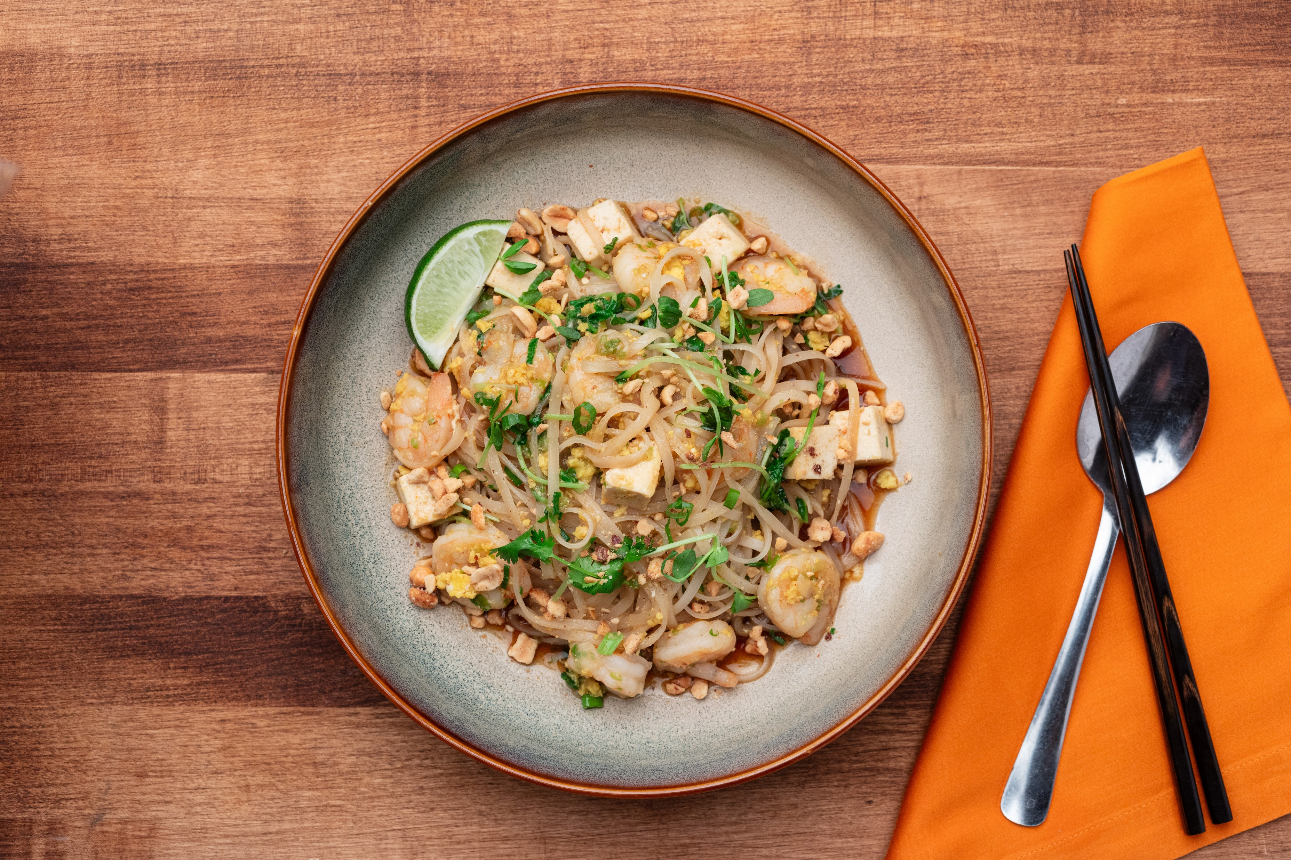
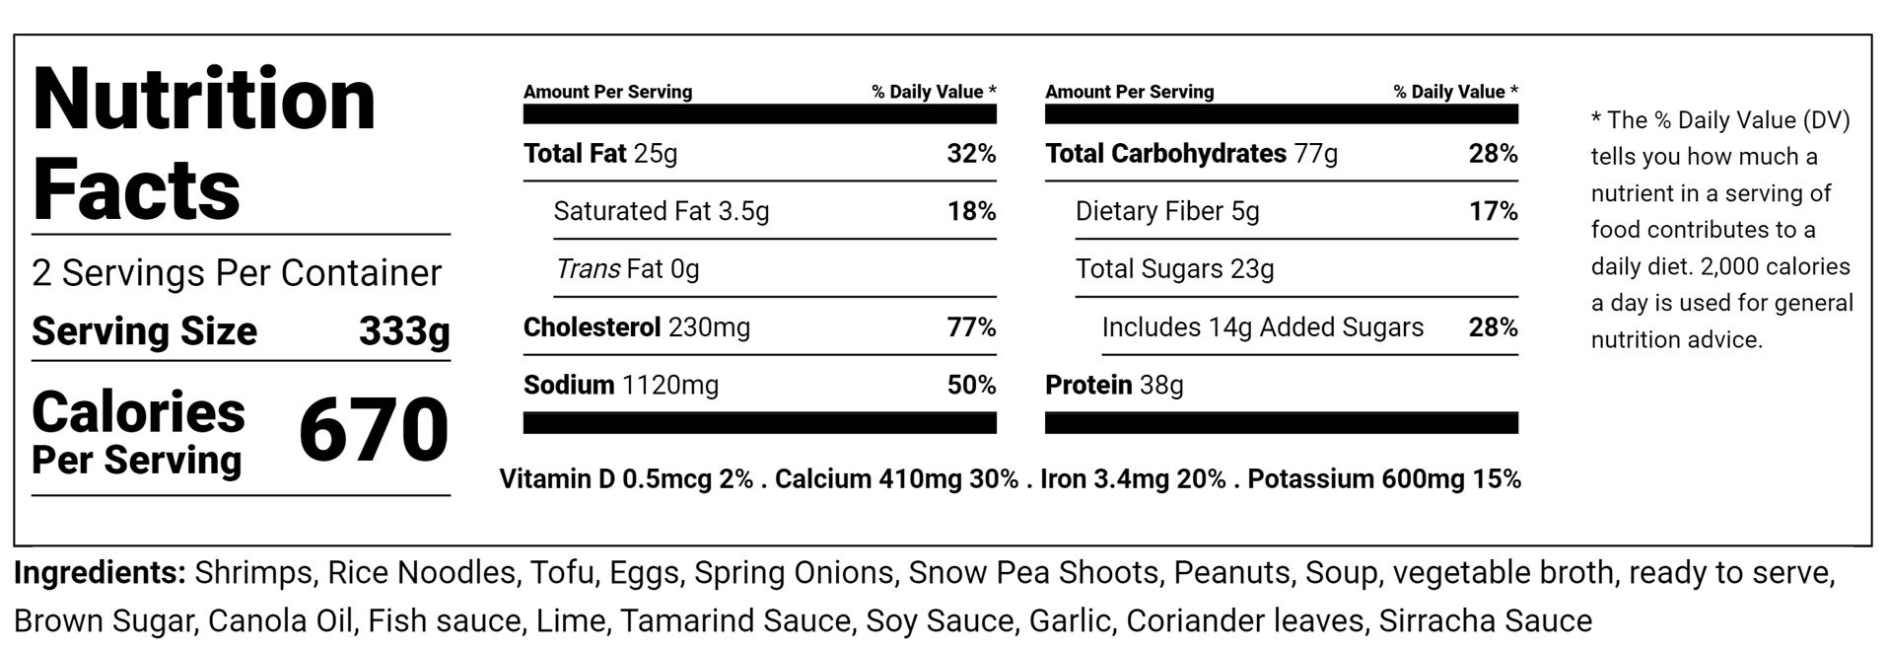
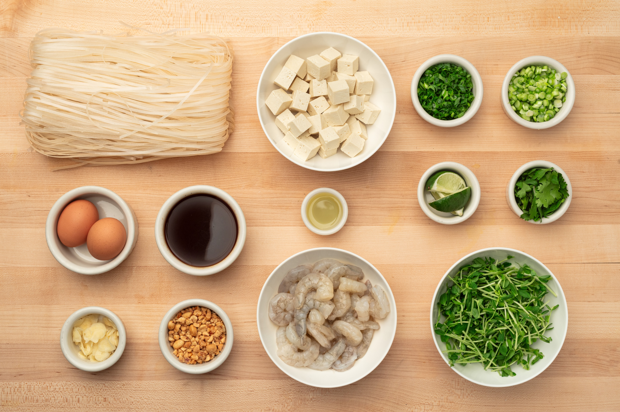
Shrimp Pad Thai
Rice Noodles, Tofu, Pea Shoots, Scallions,
Eggs, Cilantro, Peanuts, Lime
OUR BEVERAGE RECOMMENDATION
Light, crisp white wines with a bit of sweetness, like an off-dry Riesling or a dry German Riesling with high acidity and citrus notes can cut through the dish’s richness. Another good option would be a Napa Valley Sauvignon Blanc, a dry Rose from Provence or a Vouvray. Our very own CIA PRB Pilsner would also pair well with this dish.
Chef’s Lesson: Pad Thai
Pad Thai, a dish that has become synonymous with Thailand’s culinary identity, is a stir-fried noodle dish often served as street food and at casual local eateries. It was born out of necessity during World War II when Thailand faced rice shortages. To reduce domestic rice consumption, the government promoted eating noodles instead.
Shrimp Pad Thai
WHAT’S INCLUDED
WHAT ELSE YOU NEED
Shrimp
Canola Oil
Garlic
Scallion Whites
Whole Eggs
Scallion Greens
1 Large Bowl
1 Large Skillet or Wok
MeezBox Foods
1946 Campus Drive
Hyde Park, NY 12538
www.meezboxfoods.com
Snow Pea Shoots
Tofu
Pad Thai Sauce *contains fish
Rice Noodles
Cilantro
Peanuts
Lime Wedges

Slide 2
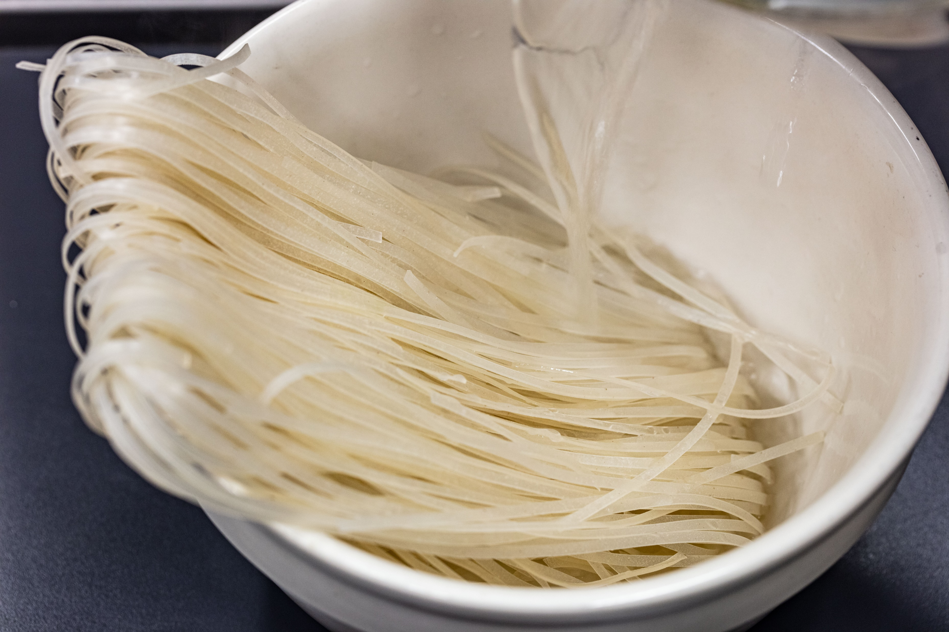
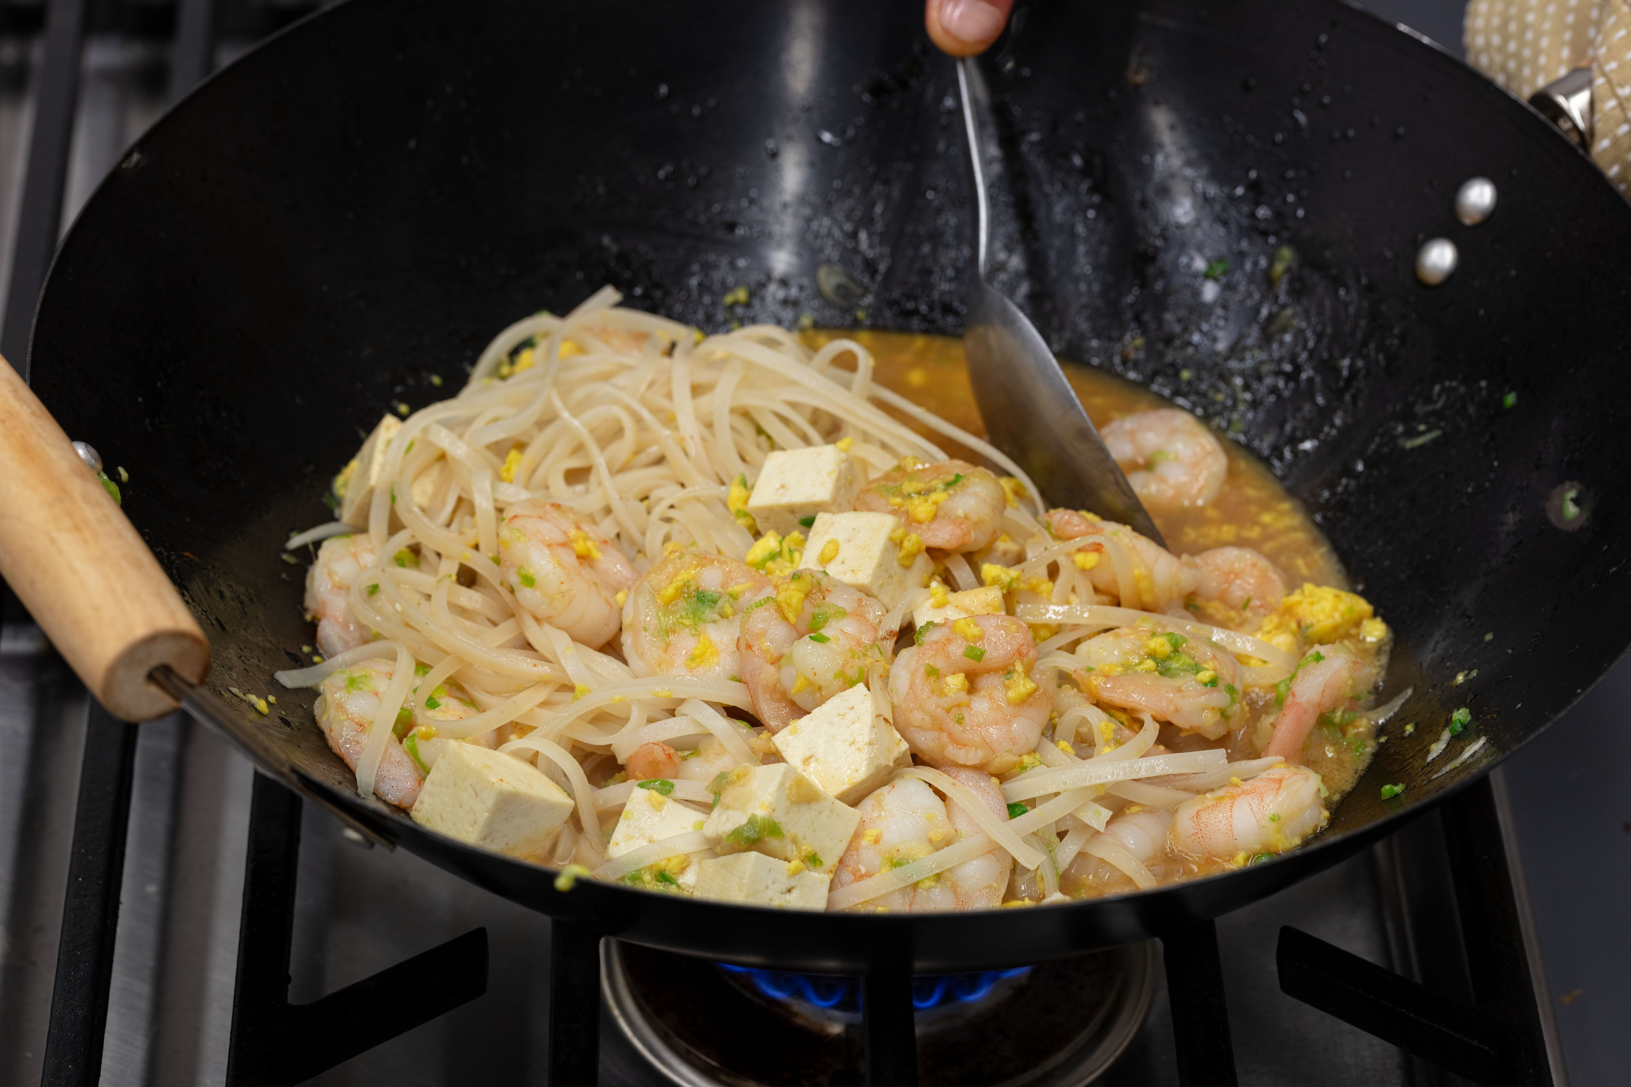
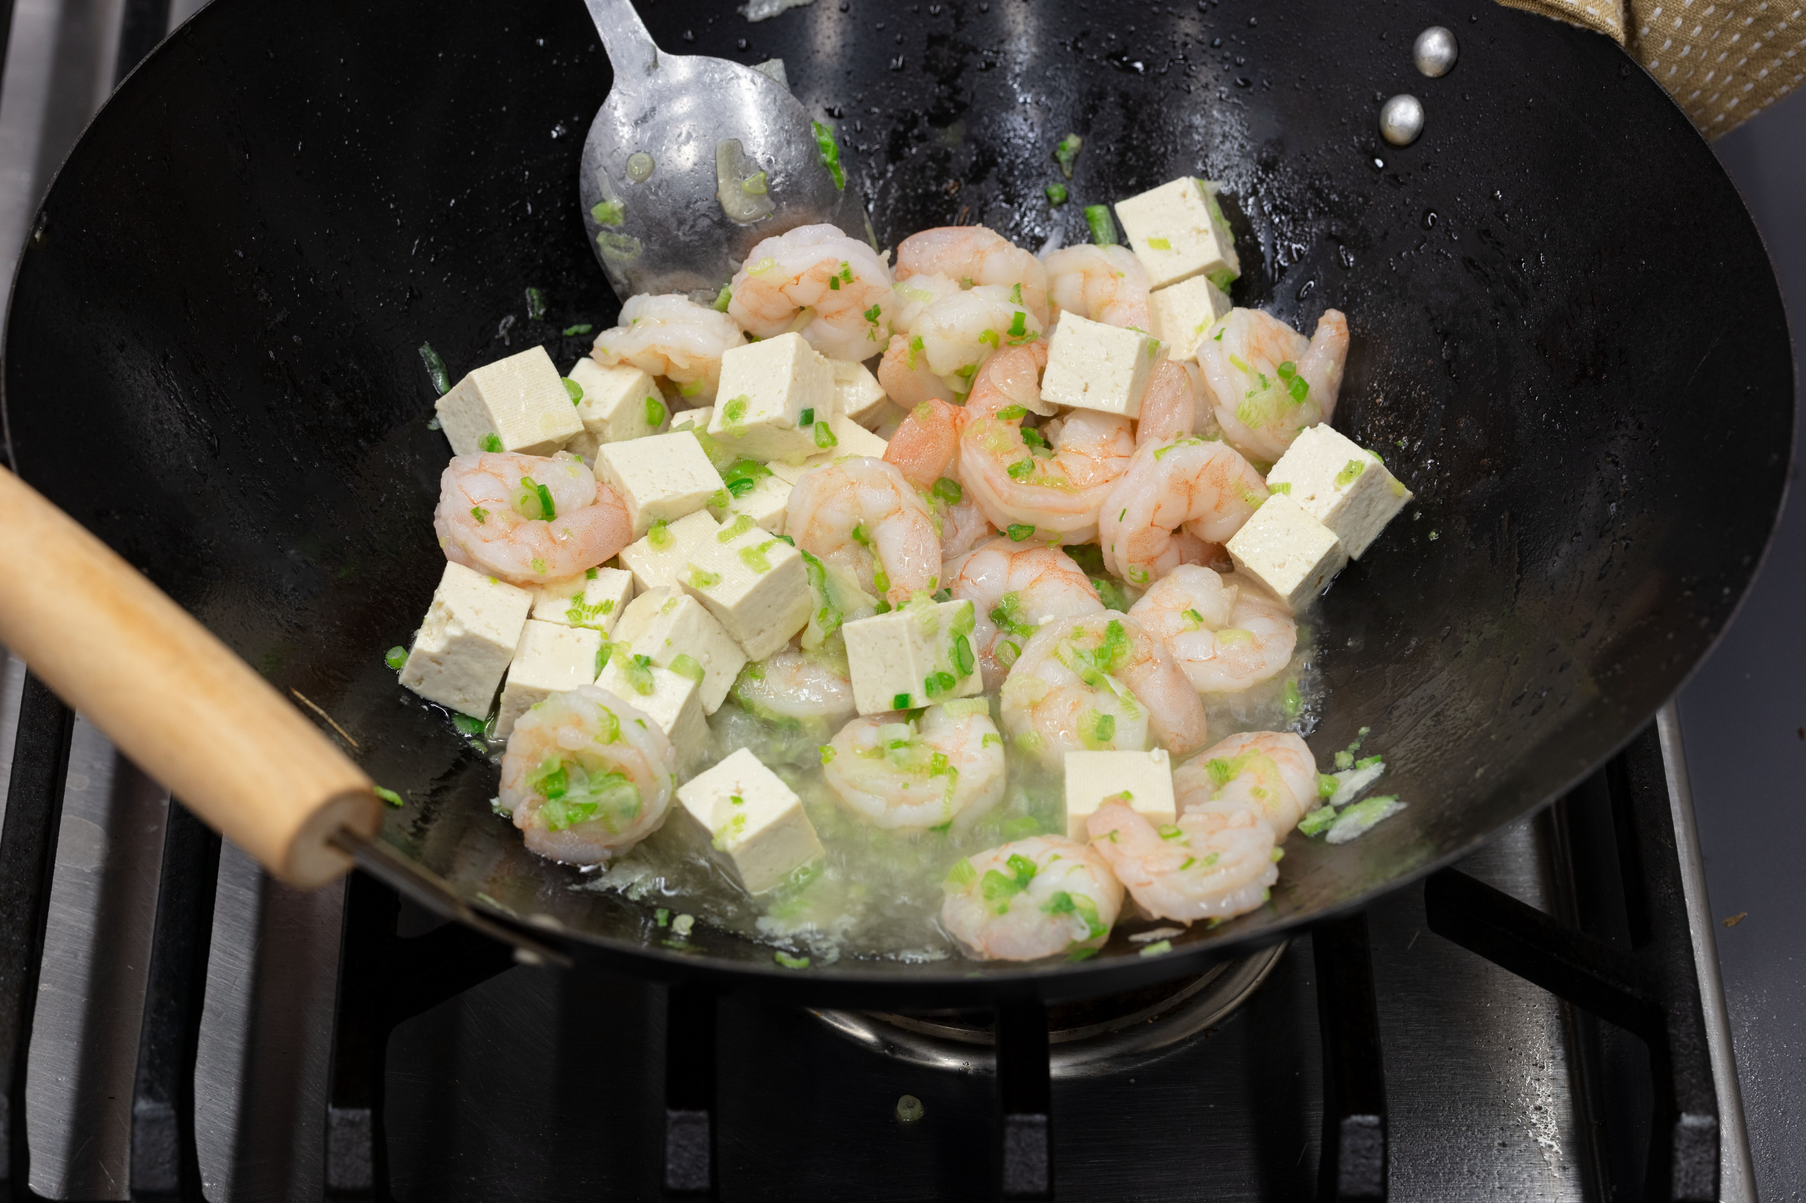
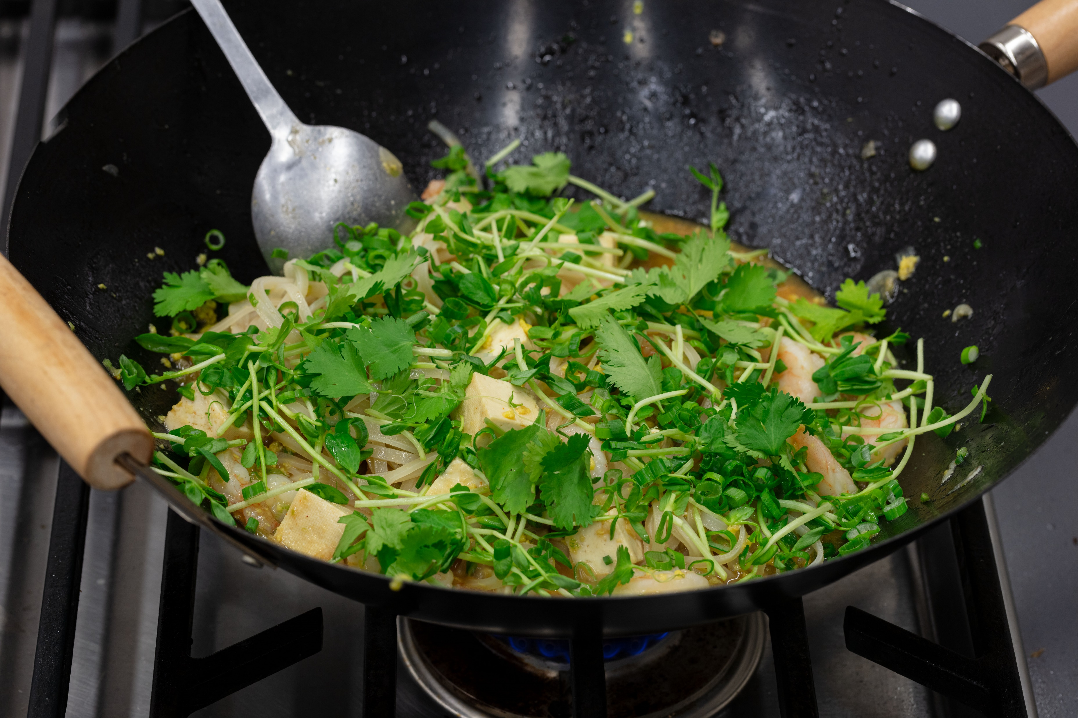
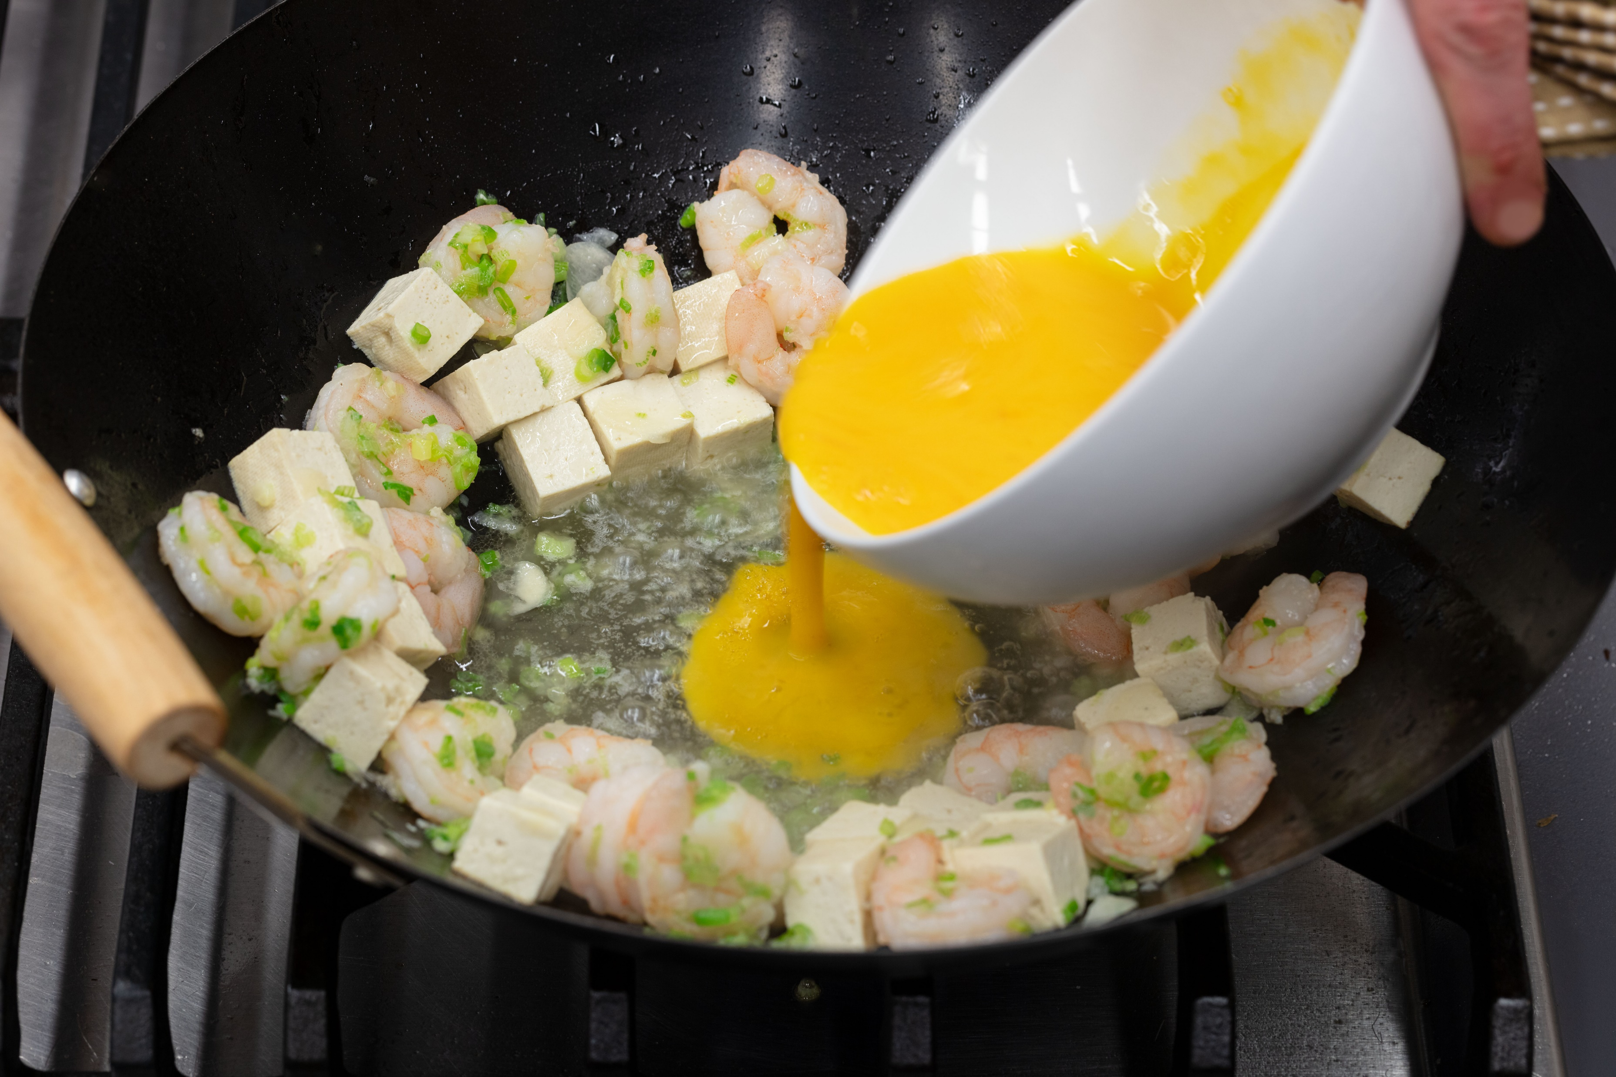
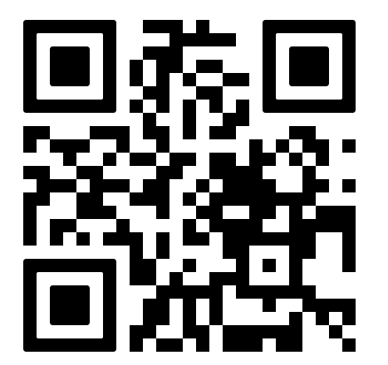
INSTRUCTIONS
STEP 1
STEP 4
Prepare the noodles: Place dry
noodles in a large bowl and cover with
hot tap water or water that comes to a
simmer. Let soak while preparing
the rest of the dish.
Add pad thai sauce and noodles.
Lightly toss to combine.
STEP 2
STEP 5
Heat canola oil in large skillet or wok. Add scallion whites, garlic & shrimp. Stir fry for 3-4 minutes or until shrimp are light pink. Add tofu to warm through.
Fold in scallion greens, pea shoots
and cilantro.
STEP 3
STEP 6
Push the contents of the pan to one
side and add the eggs (whisk with fork
before adding). Scramble the eggs
until firm.
To plate, pile noodles on 2 plates or
in two bowls. Garnish with chopped
peanuts, serve with lime wedge.
Scan this QR code to learn more about meezbox mealkits

