Slide 1

Children's Use of AI Chatbots
Key Statistics and Insights
Based on UK Research by Internet Matters (2025)

Slide 2
About This Study
Study Details
 Title: "Me, myself and AI: Understanding and safeguarding children's use of AI chatbots"
 Publisher: Internet Matters (UK organization focused on children's online safety)
⬧ Publication Date: July 2025
 Geographic Scope: United Kingdom
Methodology
 Survey Sample: 1,000 UK children aged 9-17 and 2,000 parents of children aged 3-17
 Focus Groups: 4 focus groups with 27 children aged 13-17
 User Testing: Conducted across ChatGPT, Snapchat's My AI, and Character.ai
 Expert Interviews: 4 interviews with AI sector experts
Citation: Internet Matters. (2025). Me, myself and AI: Understanding and safeguarding children's use of AI chatbots. United Kingdom.

Slide 3
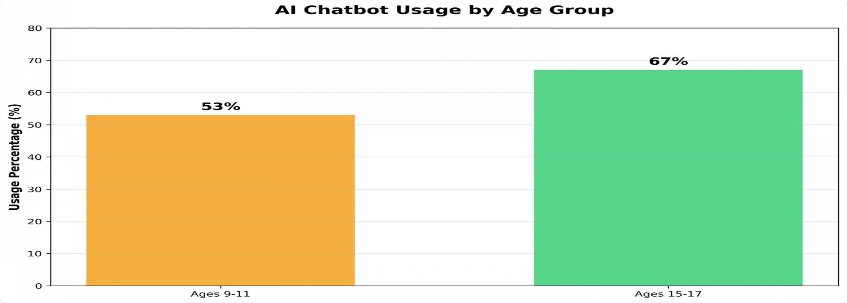
AI Chatbot Usage Overview
64% of UK children aged 9-17 have used an AI chatbot
80% of children who use AI chatbots do so on a weekly basis
2x increase in ChatGPT usage among UK children in just 18 months (23% → 43%)
71% of vulnerable children use AI chatbots compared to 62% of non-vulnerable children

Slide 4
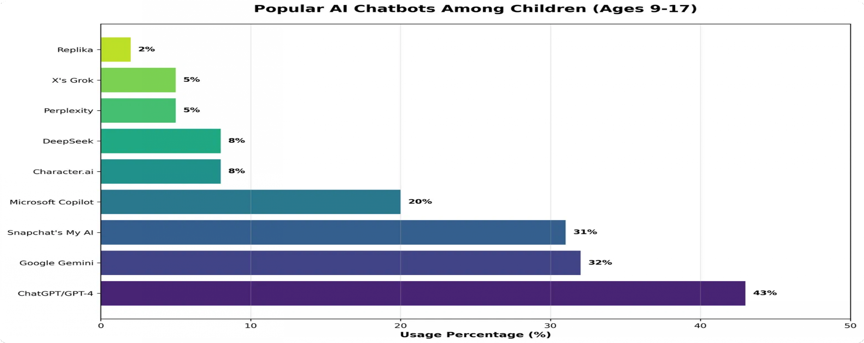
Most Popular AI Platforms
Key Insights
ChatGPT leads with 43% usage among UK children, followed by Google Gemini (32%) and Snapchat's My AI (31%)
Platforms integrated into existing apps (like Snapchat) show high adoption rates among British youth
Companion-style AI chatbots (Character.ai, Replika) are used by smaller but significant percentages of UK children
Every UK child surveyed had heard of or used at least one major AI chatbot
Source: Internet Matters (2025). Me, myself and AI: Understanding and safeguarding children's use of AI chatbots. UK.

Slide 5
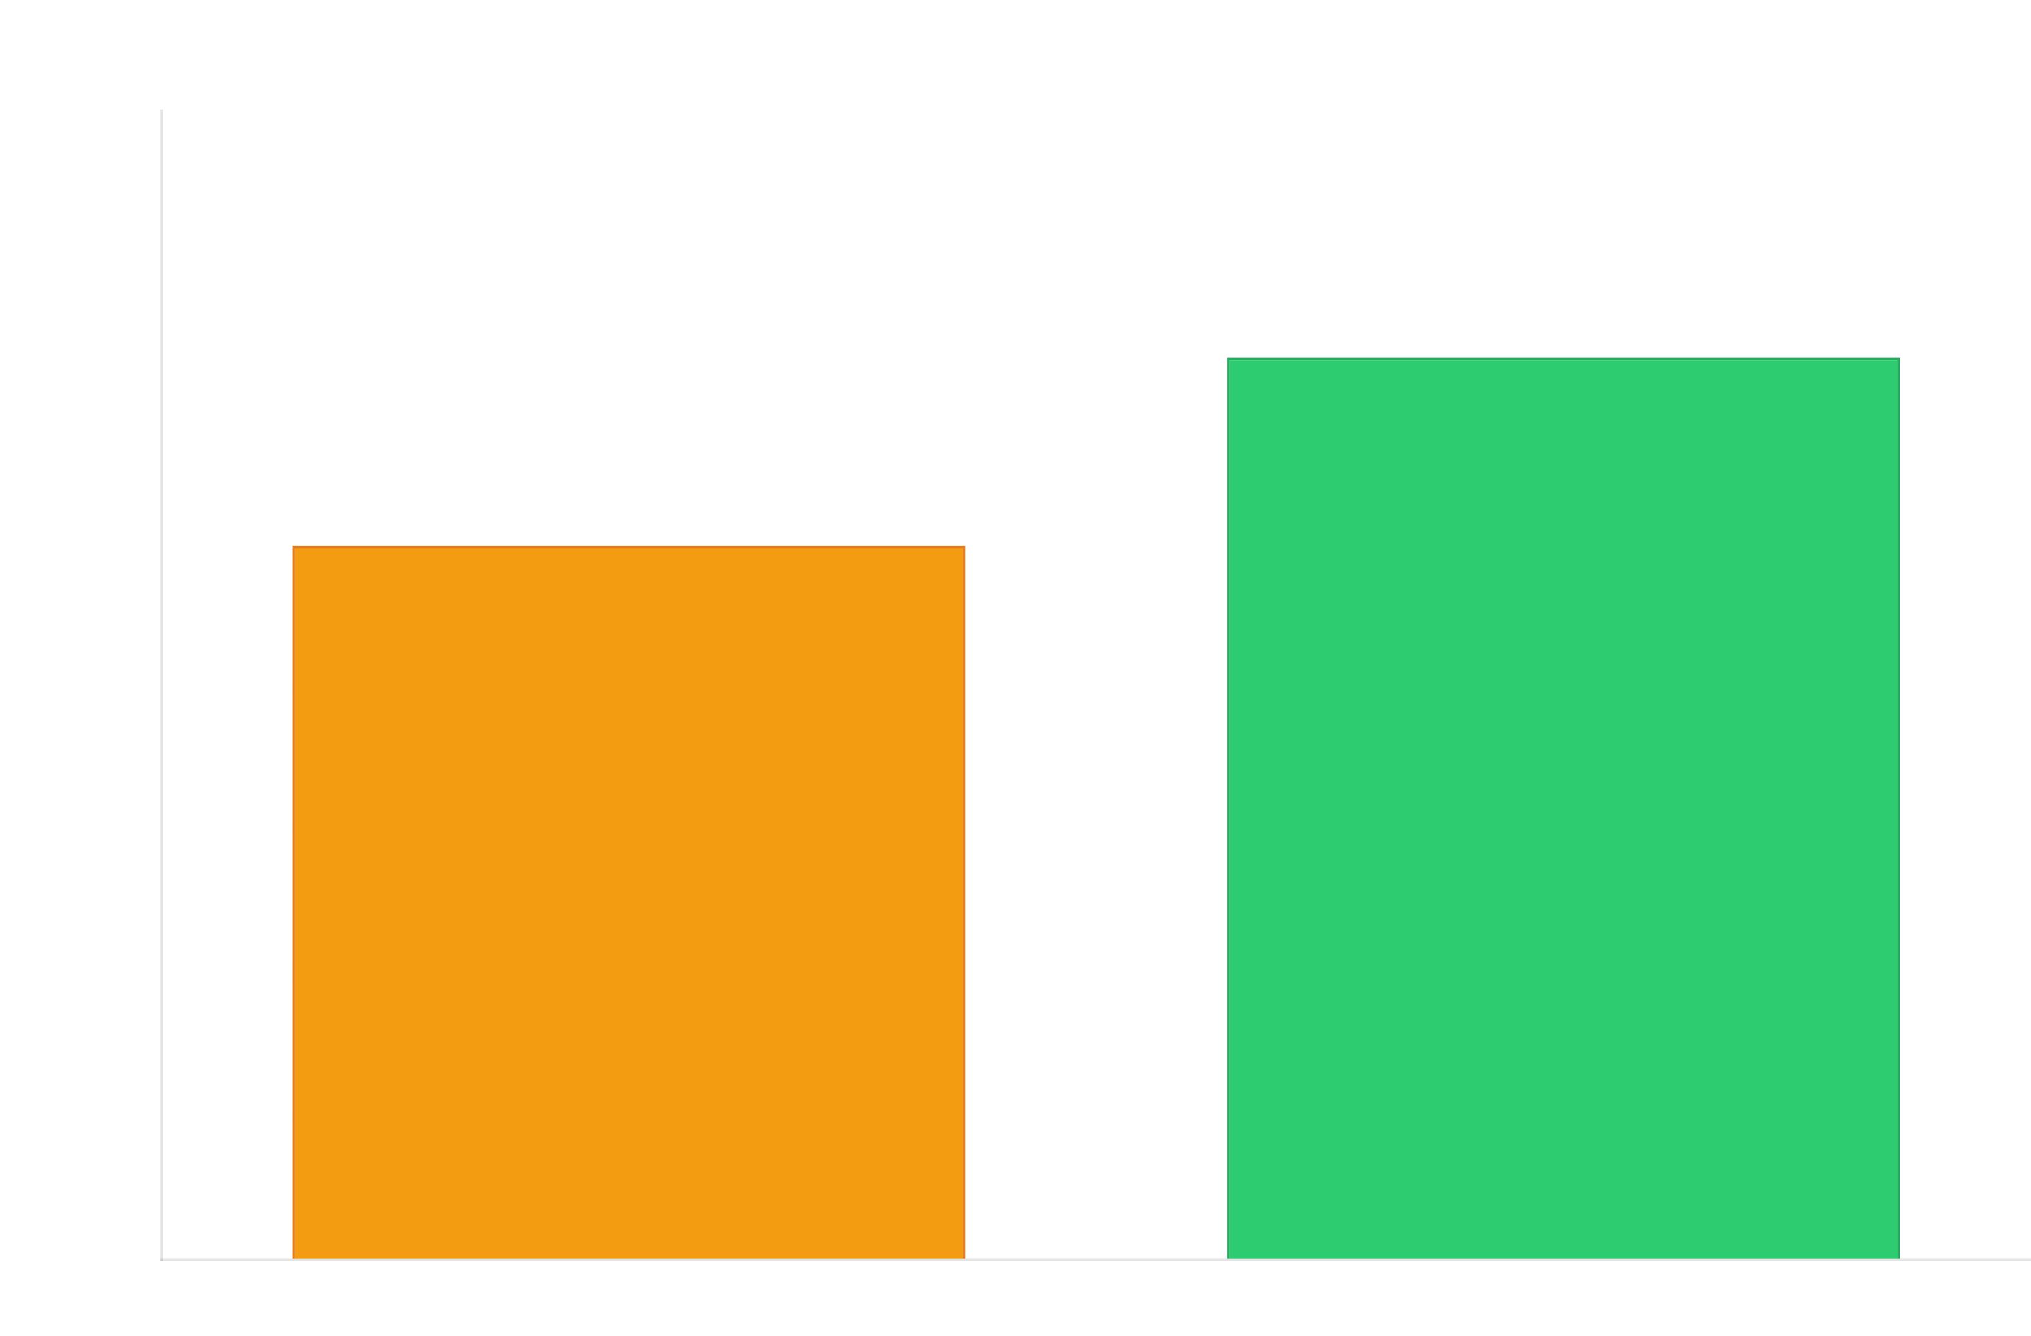
Usage by Age Group
Age Differences
53% of UK children aged 9-11 use AI chatbots
67% of UK teenagers aged 15-17 use AI chatbots
47% of UK teens (15-17) use AI chatbots specifically for schoolwork
69% of UK teens (13-17) report learning something new from AI chatbots

Slide 6
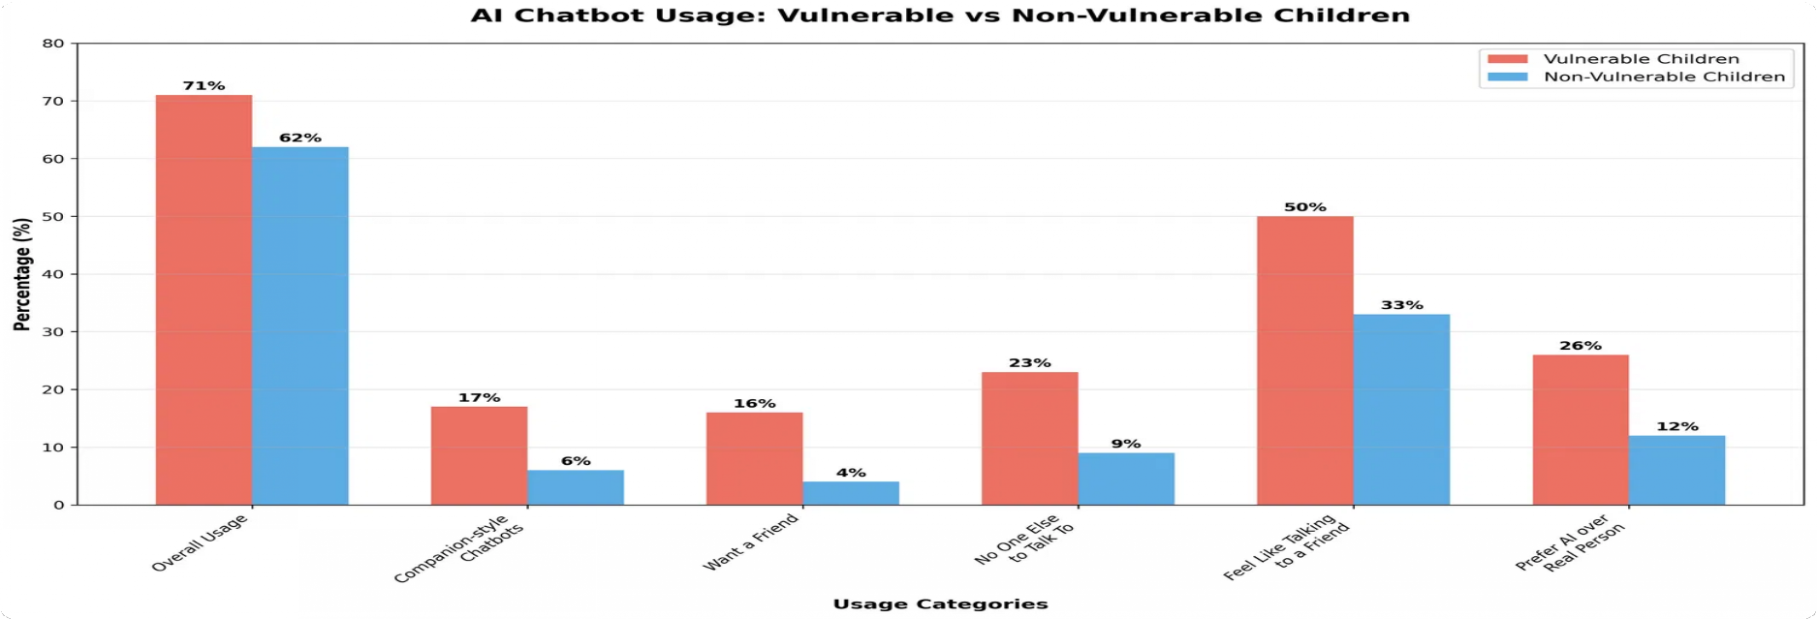
Vulnerable vs. Non-Vulnerable Children
Key Findings
71% of vulnerable UK children use AI chatbots compared to 62% of non-vulnerable peers
Vulnerable children are 3x more likely to use companion-style AI chatbots like Character.ai and Replika
50% of vulnerable children feel AI chatbots are like talking to a friend (vs. 33% of non-vulnerable)
23% of vulnerable children use AI chatbots because they have no one else to talk to (vs. 9% of non- vulnerable)
Source: Internet Matters (2025). Me, myself and AI: Understanding and safeguarding children's use of AI chatbots. UK.

Slide 7
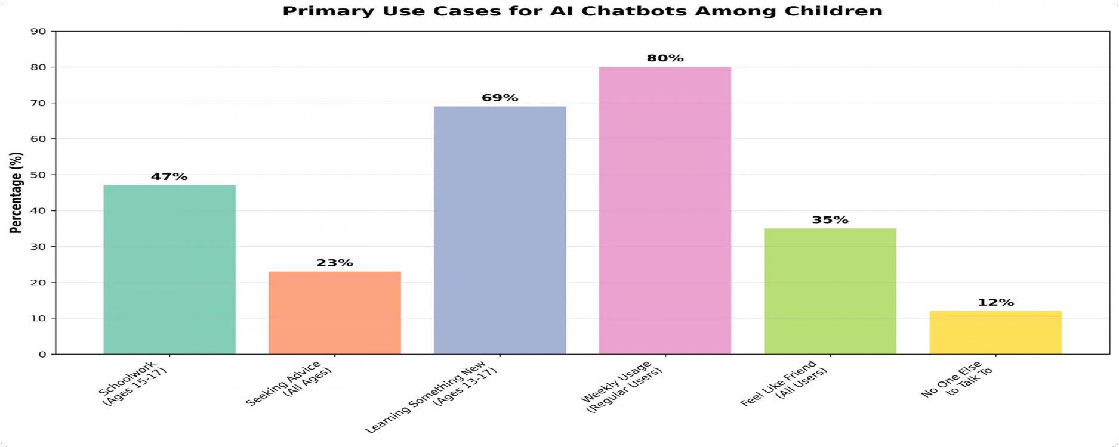
Primary Use Cases
How UK Children Use AI
47% of UK teens (15-17) use AI chatbots for schoolwork and homework assistance
69% of UK teens (13-17) report learning something new from AI chatbots
23% of UK children have used AI chatbots to seek advice on personal matters
12% use AI chatbots because they have no one else to talk to, rising to 23% among vulnerable children

Slide 8
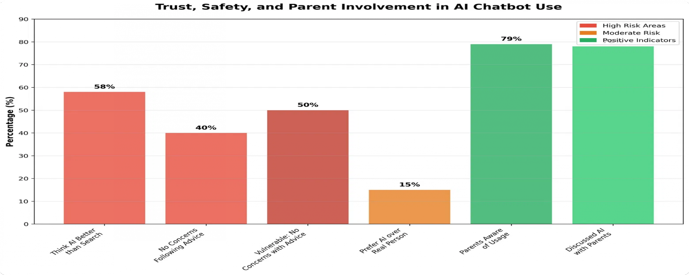
Trust and Safety Concerns
Key Concerns
58% of UK children think AI chatbots are better than searching for information themselves
40% of UK children have no concerns about following advice from AI chatbots
50% of vulnerable UK children have no concerns about following AI advice
15% would rather talk to an AI chatbot than a real person, rising to 26% among vulnerable children

Slide 9
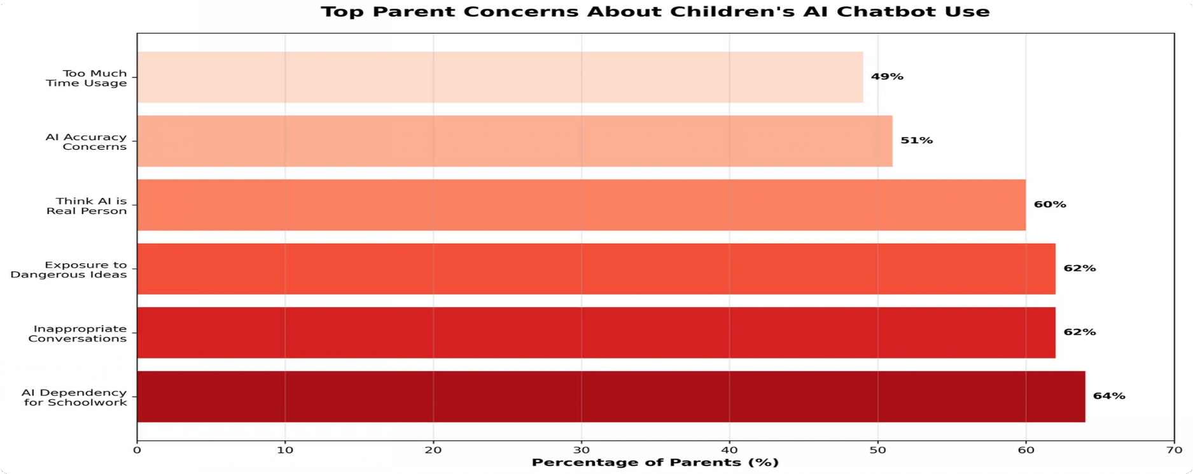
Parent Awareness and Concerns
Key Insights
78% of UK children have discussed AI with their parents, showing high general awareness
Despite 62% of UK parents being concerned about AI accuracy, only 34% discuss how to judge AI truthfulness
Many UK children report having greater AI awareness than their parents, sometimes helping parents use the technology
UK parents need more guidance on how to have specific, targeted conversations about AI safety
Source: Internet Matters (2025). Me, myself and AI: Understanding and safeguarding children's use of AI chatbots. UK.

Slide 10
Key Takeaways
64% of UK children aged 9-17 use AI chatbots, with usage growing rapidly and increasing
 with age
Vulnerable children in the UK are more likely to use AI chatbots for emotional support and
 companionship, with higher trust in AI advice
Many UK children have high trust in AI chatbots, with 40% having no concerns about
⚠ following AI advice
Despite high parent awareness (78%), there's a gap in specific guidance about AI safety
 and critical evaluation
There's an urgent need for AI literacy education in the UK to help children navigate these
 tools safely and effectively
Presented by AILiteracy.biz - The Place to Learn Artificial Intelligence
Source: Internet Matters (2025). Me, myself and AI: Understanding and safeguarding children's use of AI chatbots. UK.

