Slide 1

Q4 Meeting
December 6, 2024

Slide 2

Agenda
  8:30: Doors Open / Networking
  8:45: President’s Comments Announcements & Election Results - Jess Walpole
  9-10: Cyber Reserve – Ryan Patrick & Phillip Ruzicho
  10-10:45: FBI Update - Special Agent Sean Thomas Moore
  11-12 CMMC Panel Discussion - Kevin Baker, Jack Nichelson, Shawn Newman, Clarke Cummings

Slide 3
Survey Results from Registration
What topics you would like to see at future InfraGard Meetings:
Results Summary: Top Topics
Cybersecurity
  Artificial Intelligence in Cybersecurity
  Incident Response & Threat Intelligence
  Sector-Specific Cybersecurity
  Physical Security
  Critical Infrastructure - Utilities & Energy
  Current Trends & Emerging Threats
  CMMC & Compliance

Slide 4

InfraGard Insights - Survey
We’re now seeking your feedback to improve our support for protecting critical infrastructure & enhancing community resilience. Your input will help shape our programs to better meet your priorities. Please take a few minutes to complete the survey using the QR code below.

Slide 5

Give the Gift of Learning This Holiday Season!
HOLIDAY SUPER BUNDLE
Limited Time Only Through 12/31/24
Treat yourself or a colleague to the Holiday Super Bundle from National Infrastructure Security & Resilience U!
Featuring more than 80 webinars, workshops and courses for one low price.
nisru.org/holiday
Topics include cybersecurity, risk management, physical security, homeland security, insider threats, terrorism,
open-source intelligence and much more.
$105 for Patriots Circle Members (30% discount)
$120 InfraGard Members (20% discount)
$150 Non-Members

Slide 6

Support & Participation in Fundraising Campaigns
As we conclude another successful year, we seek your support and participation in our fundraising campaign.
Your involvement is vital to funding programs that benefit the IMAs, including the annual Congress, the R.I.S.E. leadership development program, and various educational and training initiatives.
We kindly request your assistance in sharing our campaign on your personal social media accounts using the provided posts below. By supporting our campaign, you play a crucial role in strengthening our nation's security. Every share and donation, no matter the size, makes a significant impact.
Join me in strengthening our nation's security:
https://www.infragardnational.org/infragard-patriots-circle/

Slide 7
Election Results
Our Chapter has 525 members of which 13% elected to vote for the new Board Member.
Congratulations to Ryan Anschutz for being elected to the board!!!
New Advisory Members:
Lane Campbell
Kim Chuchalovckah
Krysta Dodd
Daro Gerovac
Ganpat “Gunner” Wagh

Slide 8
Mark your Calendar - 2025 Events
March TBD - FBI Overview Briefing @ Eaton
April 15th - Computing Machinery High School Programing Contest @ Baldwin Wallace
May 2nd - SPRING SUMMIT @Galaxy in Wadsworth
May 22nd - Critical Infrastructure Modernization Conference (CIM) @MAPS https://criticalops.com/cim-2025-registration/

Slide 9
Cyber Reserve

Slide 10

The Ohio Cyber Reserve
‘Building a More Cyber Secure Ohio’
OhCR – Assist, Educate and Respond
December 6, 2024

Slide 11
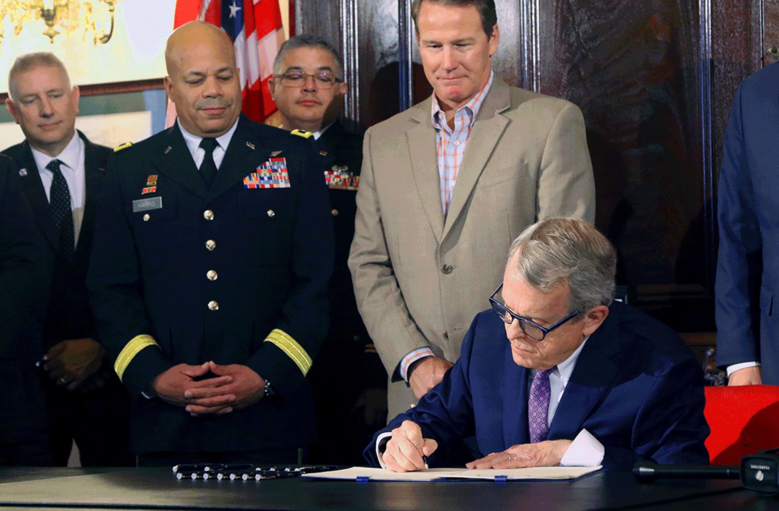
The Ohio Cyber Reserve (OhCR)
The Ohio Cyber Reserve is a volunteer force under the command of the adjutant general. OhCR teams of trained civilians will be available for the governor to assist eligible municipalities with cybersecurity vulnerabilities and provide recommendations to reduce cyber threats. OhCR volunteers will also provide workforce development to train the cyber talent of the future and assist STEM teachers by providing mentors for high school cyber clubs.
Ohio Gov. Mike DeWine signed legislation Oct. 25, 2019, forming the Ohio Cyber Reserve.
The Ohio Cyber Reserve (OhCR)
‘Building a More Cyber Secure Ohio’

Slide 12
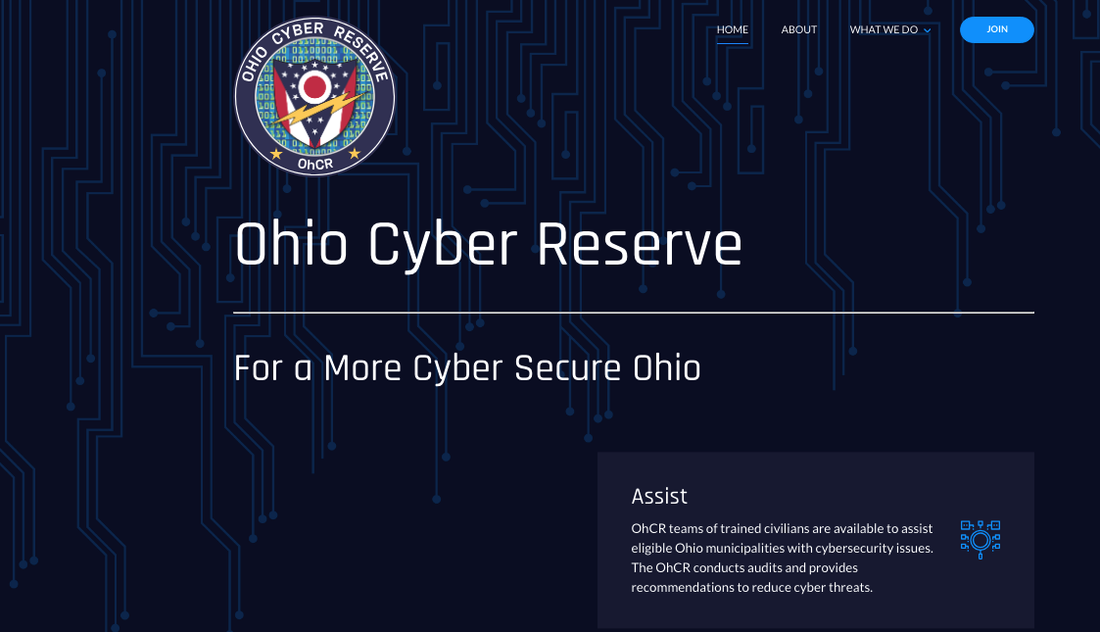
The OhCR Mission
ASSIST: The OhCR Assist Mission works with Ohio municipalities to familiarize and meet the guidelines found in NIST 800-53, Security and Privacy Controls for Information Systems and Organizations. We do this by bringing in a group of our members to audit your processes and procedures to help walk through the controls and identify areas for improvement while getting your organization on the path to data security compliance.
EDUCATE: The Education Working Group mission is to build public interest in cybersecurity, encourage Ohio citizens with the technical interest to pursue educational pathways growing Ohio’s cyber and technical workforce. To that end, we will focus on mentorship and educational efforts for K-12 students in alignment with Regional Programming Centers (RPCs) in the areas in which they operate.
RESPOND: Organizations that find they need assistance with their response to a cyber incident or even to just report a cyber incident has occurred should call the Statewide Terrorism Analysis and Crime Center (STACC) in accordance with the Cyber Incident Plan.

Slide 13
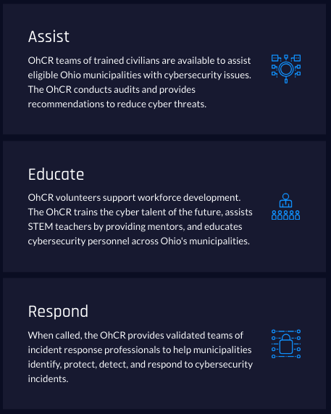
What Do We Do
OhCR Personnel
Cleveland, Columbus, Cincinnati Regions
Missions
  Assist
    Assessment
    POAAM Support
    Vulnerability Assessment
  Educate
  Incident Response
The Ohio Cyber Reserve (OhCR)
‘Building a More Cyber Secure Ohio’

Slide 14
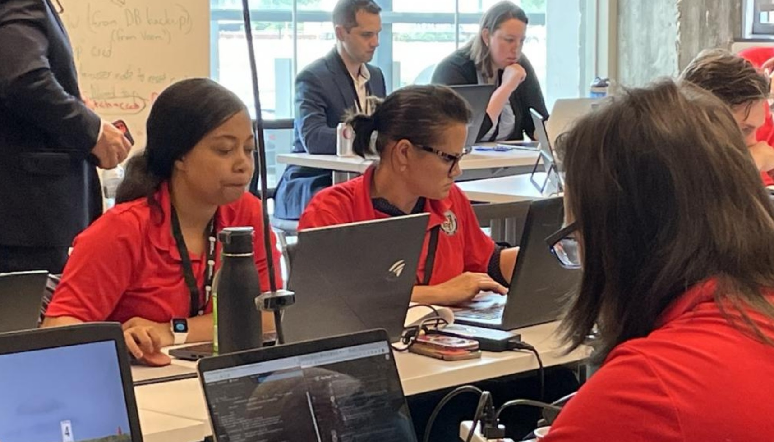
OhCR Personnel Requirements
The requirements to join the Ohio Cyber Reserve are the following:
4 years employed in a cyber security position that requires work role certification
Takes both an OhCR and SANS cybersecurity examination
Reviewed by a 5 person OhCR member panel
Members are citizens of the State of Ohio and the United States of America
Receive an initial FBI / BCI background check which is updated every 24 months
Sworn into service by Field Grade United States military officers
OhCR members education is typically:
Bachelor of Science in Cybersecurity or Related Field of Study
Higher Education above Bachelor of Science and multiple Cybersecurity certifications
OhCR reservists will sign NDA on every mission they are participating in.

Slide 15
Assist Mission
The Ohio Cyber Reserve (OhCR)
‘Building a More Cyber Secure Ohio’

Slide 16
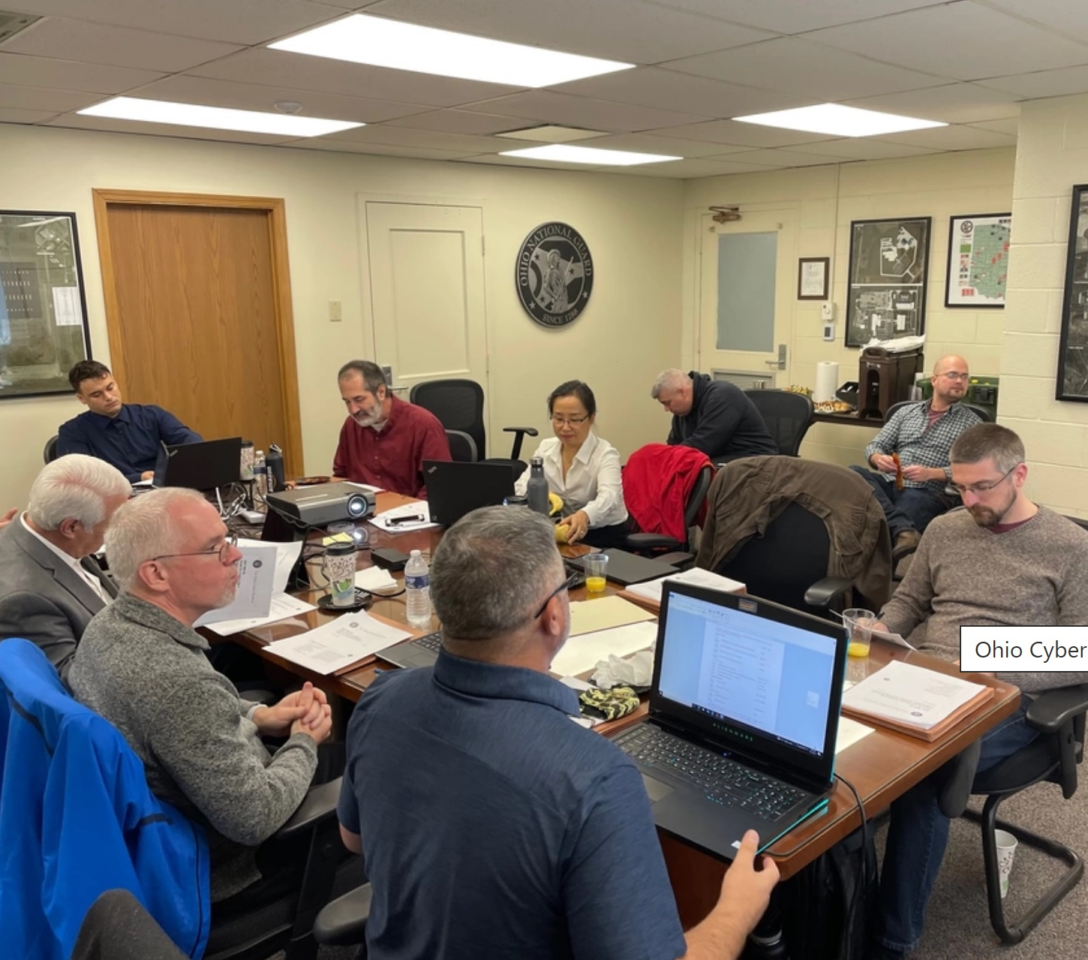
Cybersecurity Assessment Planning
Non-Disclosure Agreement (NDA)
Memorandum of Agreement (MOA)
OhCR NIST Cybersecurity Assessment Menu
Blank NIST Cybersecurity Assessment & Gap Analysis
List of Documents to Support the Assessment
Select Dates
Setup Shared Folder for Supporting Documentation
The Ohio Cyber Reserve (OhCR)
‘Building a More Cyber Secure Ohio’

Slide 17
What Type of Cybersecurity Assessment
NIST Based
  NIST Core V2 with 107 data security controls
  NIST 800-53 with 20 control families
  NIST 800-171 with 112 data security controls
  CPG Assessments for Water Plants
Hybrid
Additional Service Offerings
  Vulnerability Assessment
  POAAM Assistance / Template Offering
  Penetration Testing
The Ohio Cyber Reserve (OhCR)
‘Building a More Cyber Secure Ohio’

Slide 18
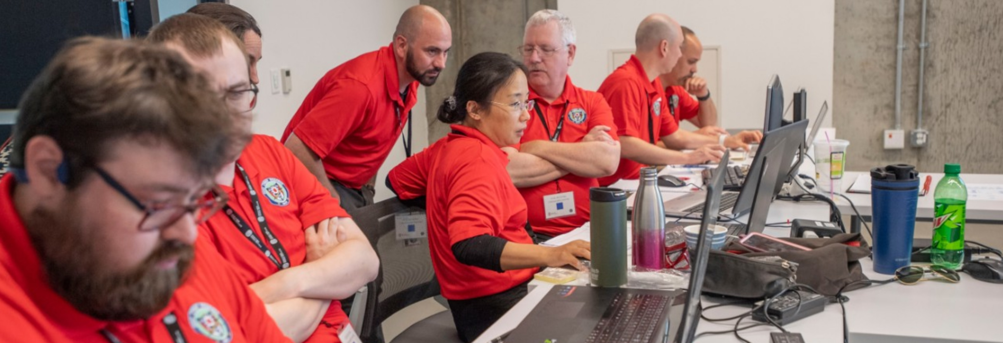
Preparation for the OhCR Team
OhCR Team Rehearsal of the 3-to-4-person team
Pre-assessment of website, social media & more

Slide 19
Education - Make & Take to Compliance
These 5 exercises that will enable your organization to have a very good working knowledge of the NIST Core V1.1 Cybersecurity Framework.
The 5 NIST Training Exercises are:
Incident Response Guide and Tabletop Exercise
Risk Management Guide, Tools & Assessment Exercise
Vulnerability Management Detection & Analysis Exercise
Organization, Third Party Access Control, and Training Exercise
Network Systems Control Exercise
At the end of each 3-hour exercise, you will be building a very capable team.
The Ohio Cyber Reserve (OhCR)
‘Building a More Cyber Secure Ohio’

Slide 20

Education to Support the POAAM Education
The newest and popular OhCR Assist - Educate Mission is POAAM support
Spend time to reduce the vulnerabilities of danger high-risk data security controls
Knowledge Management is shared throughout Ohio
  Risk Assessment
  Data Flows
  IR Response Guide
  NIST Cybersecurity Framework (NIST CSF) Controls v1.1 Playlist
  Cybersecurity Procedures
The Ohio Cyber Reserve (OhCR)
‘Building a More Cyber Secure Ohio’

Slide 21

Incident Response Training
School District Team Roles & Responsibilities
Vendor Roles & Responsibilities
Contact Numbers
Request Assistance from the State of Ohio (OhCR)
The Ohio Cyber Reserve (OhCR)
‘Building a More Cyber Secure Ohio’

Slide 22
Educate Mission
The Ohio Cyber Reserve (OhCR)
‘Building a More Cyber Secure Ohio’

Slide 23

OCRI & 19 Regional Programming Centers
The Ohio Cyber Range Institute has 19 RPCs:
University of Cincinnati
Bowling Green State University
Cedarville University
Cin-Day Cyber at SOCHE
Cleveland State/Case Western
Cuyahoga Community College
Kent State University
Lorain County Community College
Miami University
Ohio State University
Ohio University
Owens Community College
PAST Foundation
Rio Grande Community College
Shawnee State University
Stark State College
Tiffin University & Findlay Partners
University of Akron
University of Dayton
The Ohio Cyber Reserve (OhCR)
‘Building a More Cyber Secure Ohio’

Slide 24
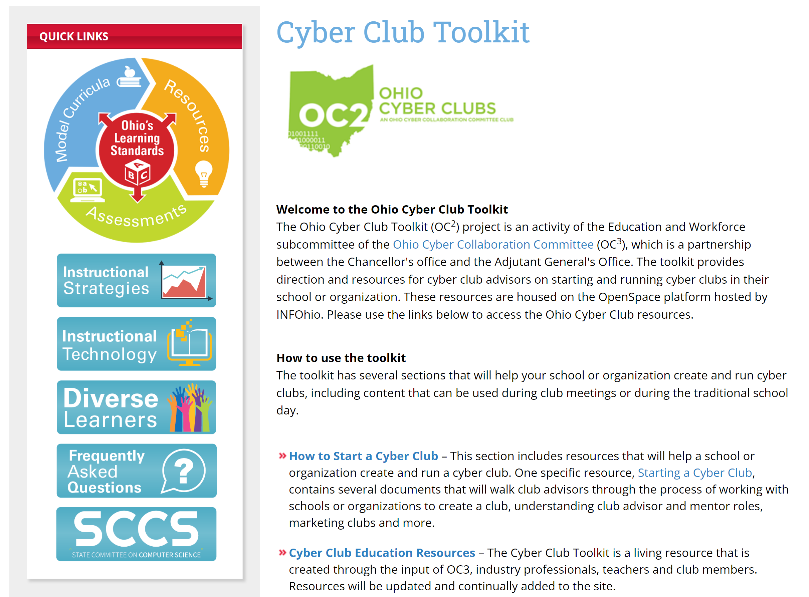
Cyber Clubs
Security Awareness at the User Level
Workforce Development
Ohio Cyber Range
Cyber Club Toolkit | Ohio Department of Education
The Ohio Cyber Reserve (OhCR)
‘Building a More Cyber Secure Ohio’

Slide 25
Incident Response Mission
The Ohio Cyber Reserve (OhCR)
‘Building a More Cyber Secure Ohio’

Slide 26
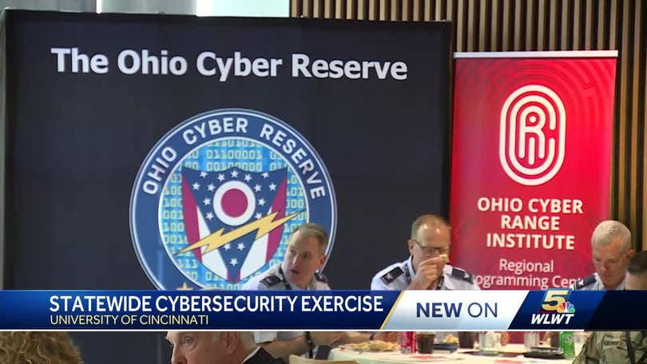
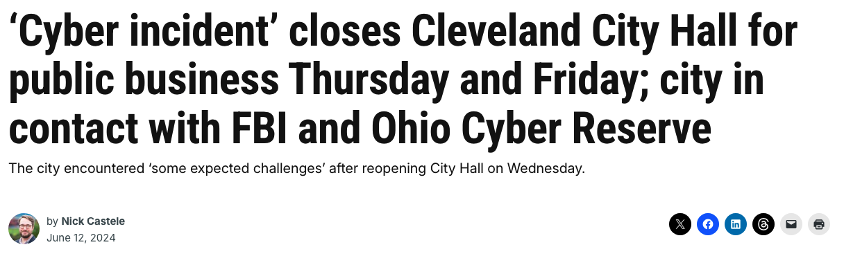
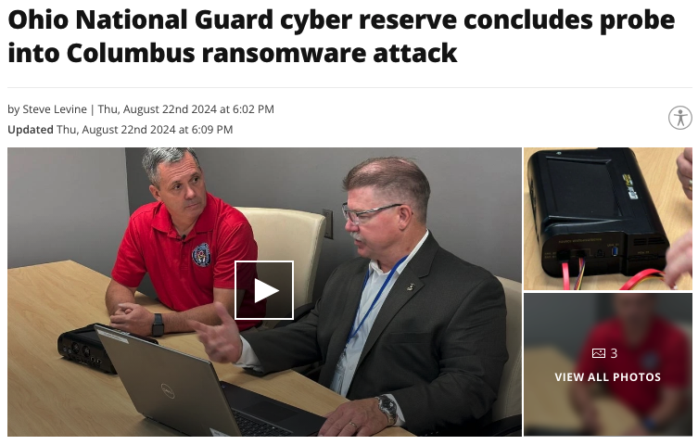

In the News…
The Ohio Cyber Reserve (OhCR)
‘Building a More Cyber Secure Ohio’

Slide 27
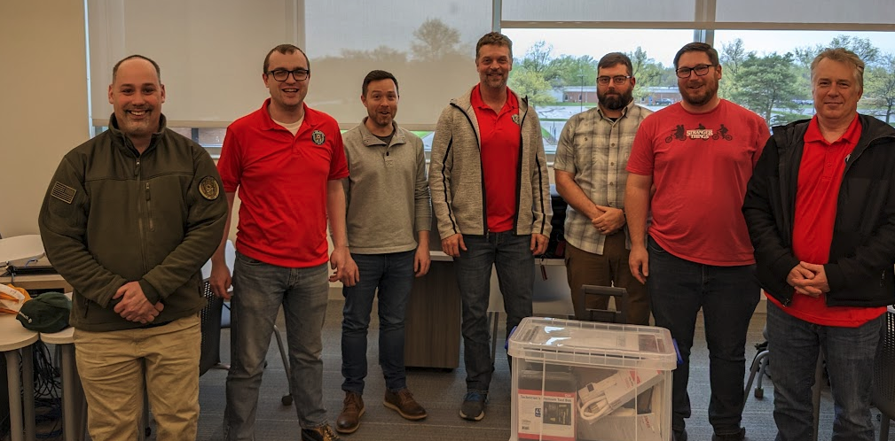
The OhCR Experience
Opportunity to give back to the local communities that we live and work in
Opportunity to grow and learn
Opportunity to become a leader
The Ohio Cyber Reserve (OhCR)
‘Building a More Cyber Secure Ohio’

Slide 28
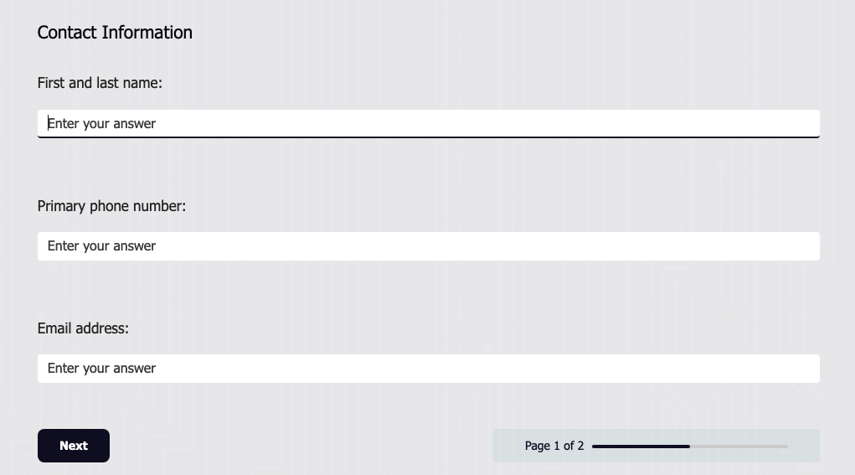
How to Join?!
Visit our website:
https://ohcr.ohio.gov/join/
The Ohio Cyber Reserve (OhCR)
‘Building a More Cyber Secure Ohio’

Slide 29

Questions
‘Building a More Cyber Secure Ohio’
The Ohio Cyber Reserve (OhCR)
‘Building a More Cyber Secure Ohio’

Slide 30

FBI Update

Slide 31

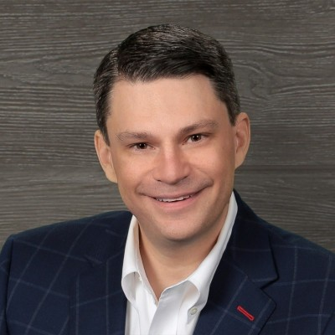

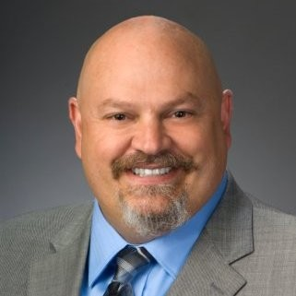
CMMC Panel Discussion
Moderator:
Panelists:
Kevin Baker
CISO
Fortress SRM
Jack Nichelson
CISO
Inversion6
Shawn Newman
Security Architect
Fortress SRM
Clarke Cummings
Principal Consultant, Cyber & Risk Advisory
Consortium Networks

Slide 32
Mark your Calendar - 2025 Events
March TBD – FBI Overview Briefing @ Eaton
April 15th – Computing Machinery High School Programing Contest @ Baldwin Wallace
May 2nd – SPRING SUMMIT @Galaxy in Wadsworth
May 22nd – Critical Infrastructure Modernization Conference (CIM) @MAPS https://criticalops.com/cim-2025-registration/

