Slide 1
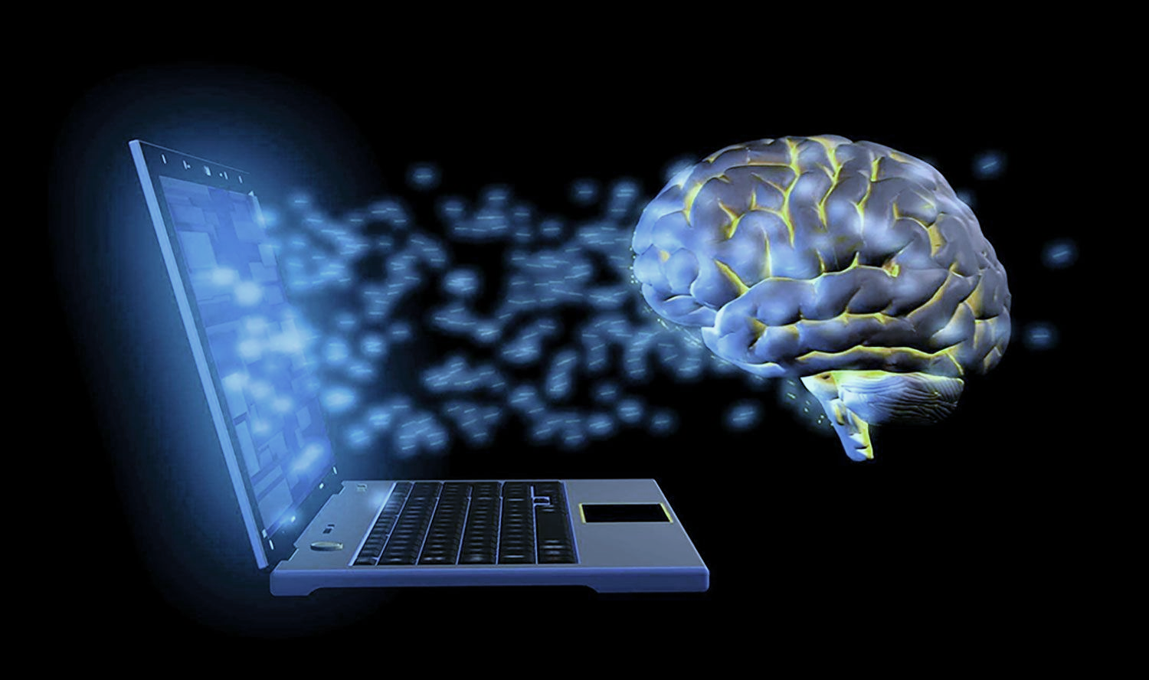
Thought Leadership
The Cognitive Impacts of Brain Computer Interfaces
Presented by
Steve Shelton
Green Shoe Consulting

Slide 2
Desired Outcomes
Goal: start a conversation on possible issues with Brain Computer Interface Technology and its impact on cognition
Understand brainwave interface technology
Understand stress (different types) and decision making
Connect these concepts
Open discussion

Slide 3



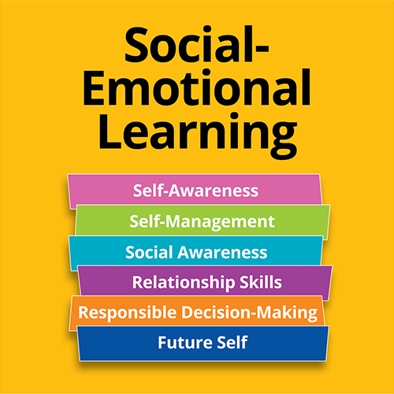





Why Am I Here?

Slide 4








About Me

Slide 5
Brain Computer Interface Technology
Brain-computer interface (BCI) technology is a way to communicate directly between the brain and an external device, using brain signals to control the device. BCIs can be used for a variety of purposes, including:
Helping people with disabilities: BCIs can help people with paralysis spell words on a screen or regain control of their limbs.
National defense: BCIs could improve national defense capabilities.
Treating neurological conditions: Companies like Neuralink are working to use BCIs to treat neurological conditions.
Rehabilitation: BCIs can be used for rehabilitation after a stroke.
Communication: BCIs can help people with amyotrophic lateral sclerosis, locked-in syndrome, and speech problems.

Slide 6
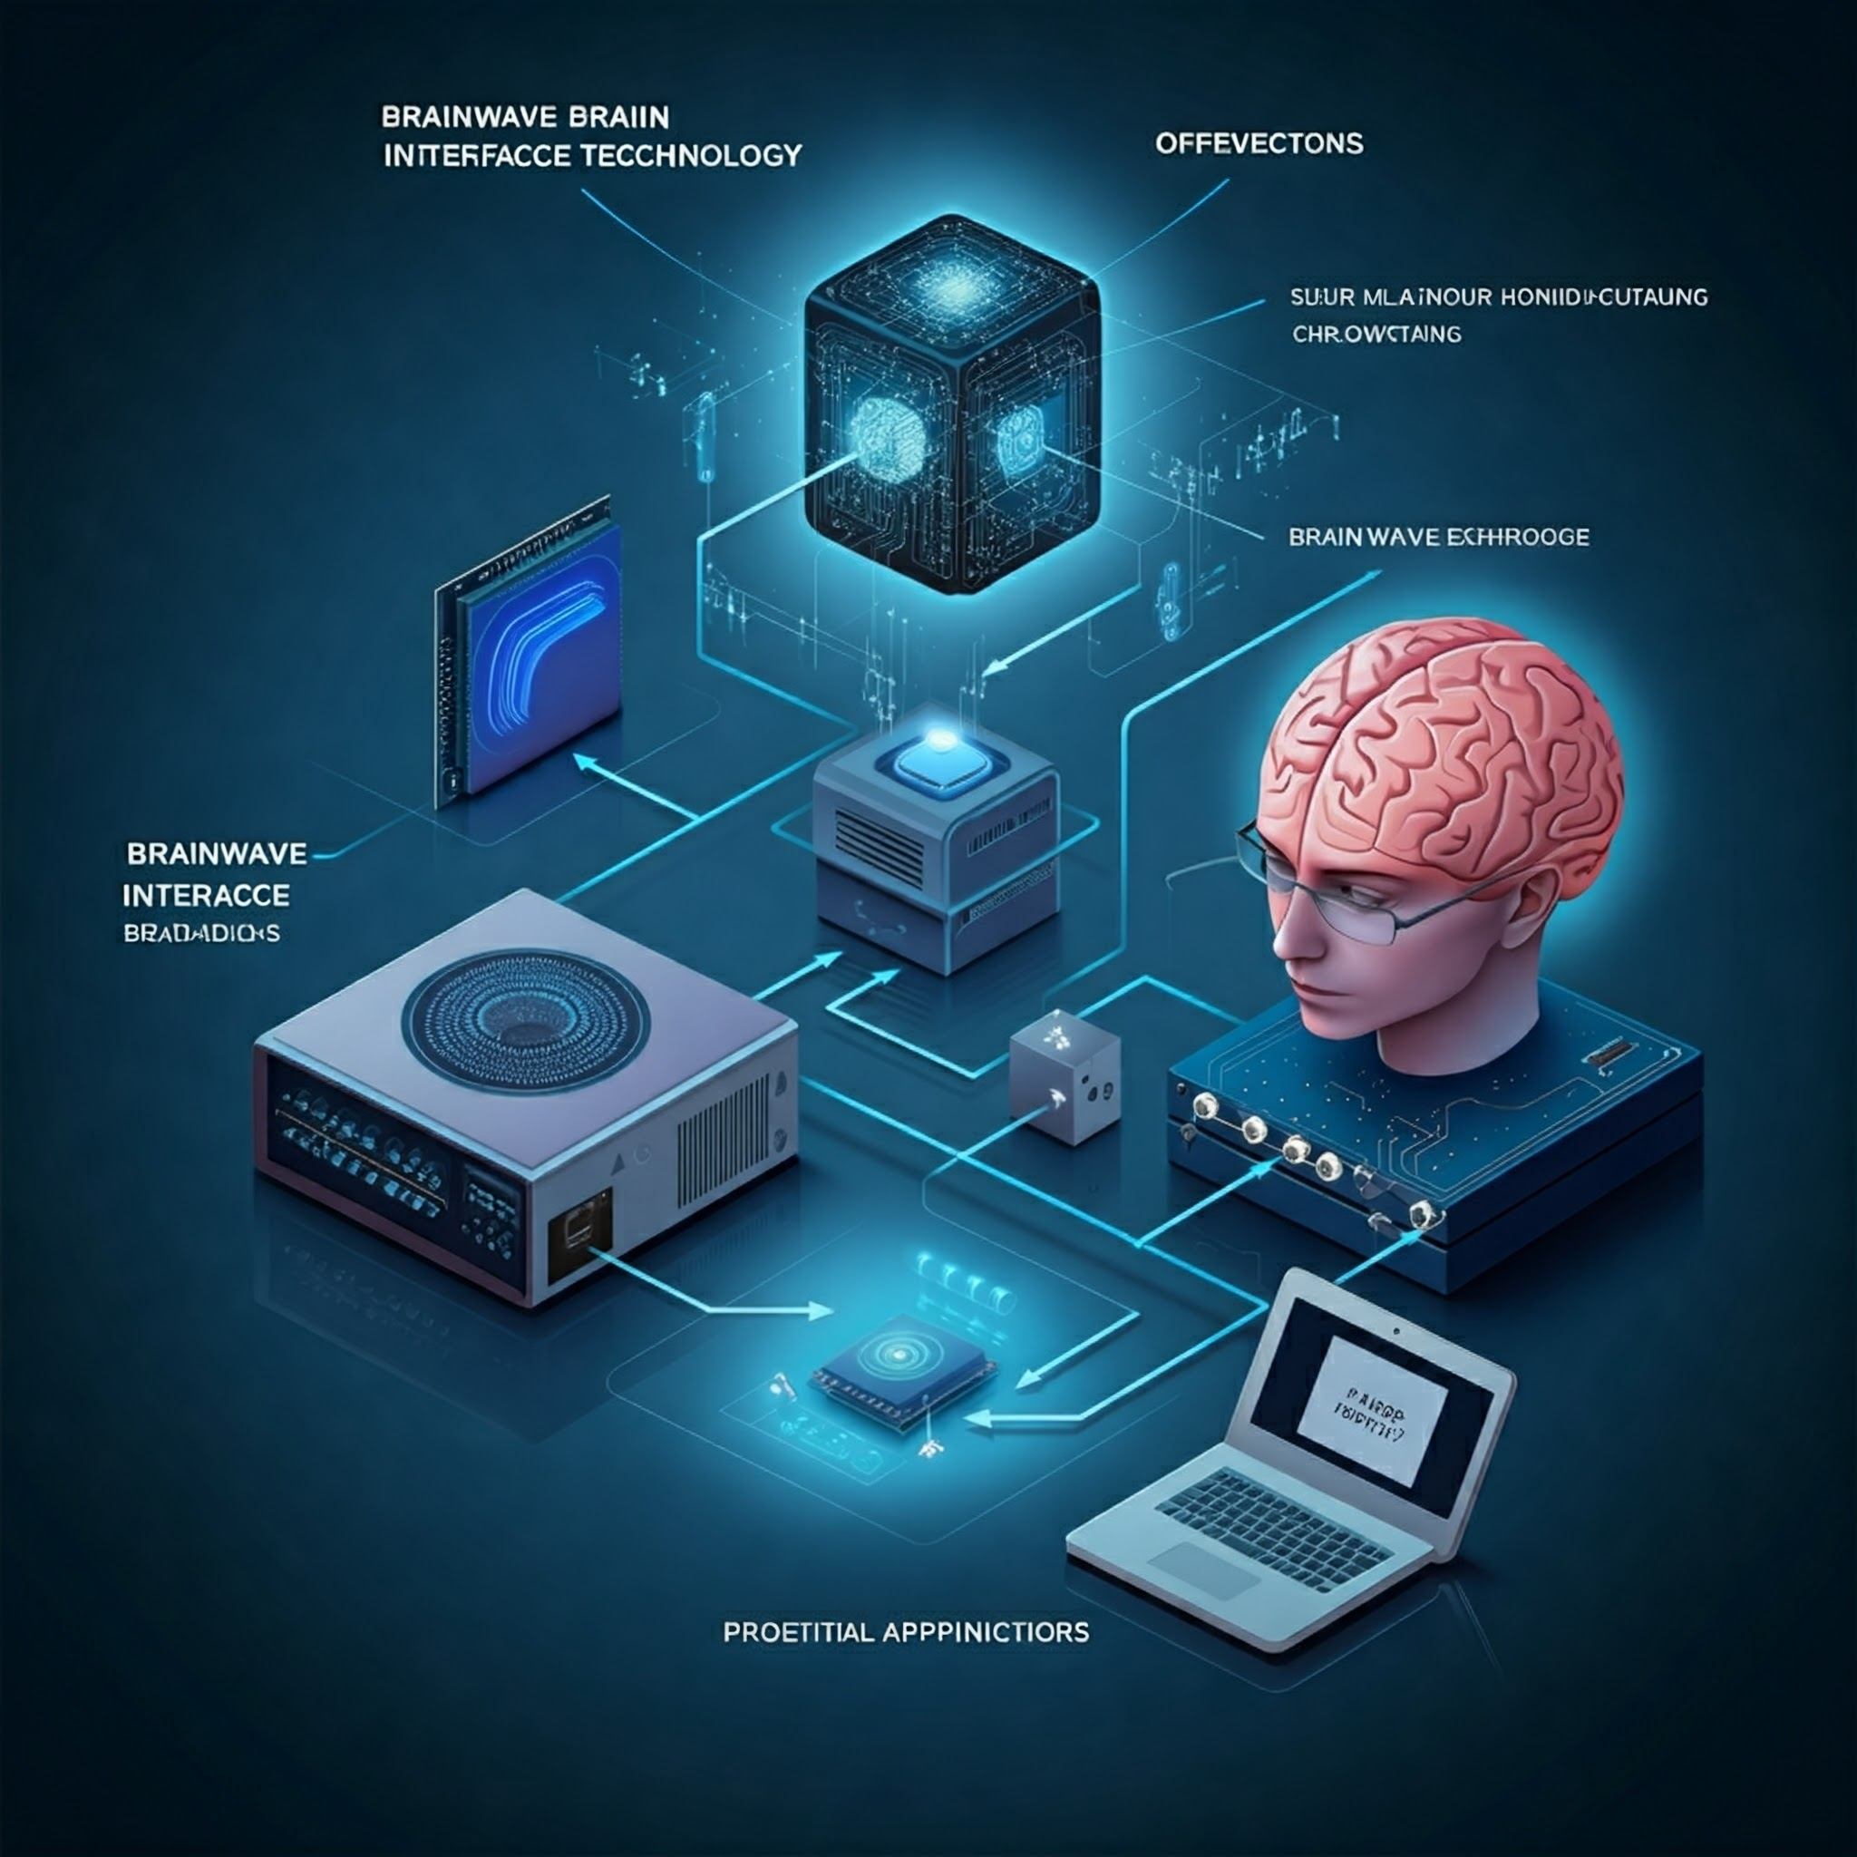
Notes:
Visual Description of Brainwave Interface Technology
1. Brain Activity:
Imagine the brain as a bustling city with millions of neurons communicating through electrical signals. These signals create patterns known as brainwaves.
2. Signal Capture:
A headset or a cap equipped with electrodes is placed on the scalp. These electrodes act like antennas, picking up the faint electrical signals from the brain.
Some advanced interfaces might involve implanted electrodes for more precise signal detection.
3. Amplification and Filtering:
The raw brainwave signals are very weak, so they need to be amplified to make them usable.
Filtering is applied to remove noise and isolate specific brainwave frequencies of interest.
4. Signal Processing:
The amplified and filtered signals are converted into digital data that a computer can understand.
Sophisticated algorithms analyze these patterns, looking for specific features associated with different thoughts, emotions, or intentions.
5. Translation into Commands:
The processed brainwave data is translated into commands that can control external devices or software.
This might involve moving a cursor on a screen, controlling a robotic arm, or selecting options in a virtual environment.
6. Feedback Loop:
The user receives visual or auditory feedback about the commands being generated, allowing them to refine their mental control and improve the accuracy of the system.

Slide 7
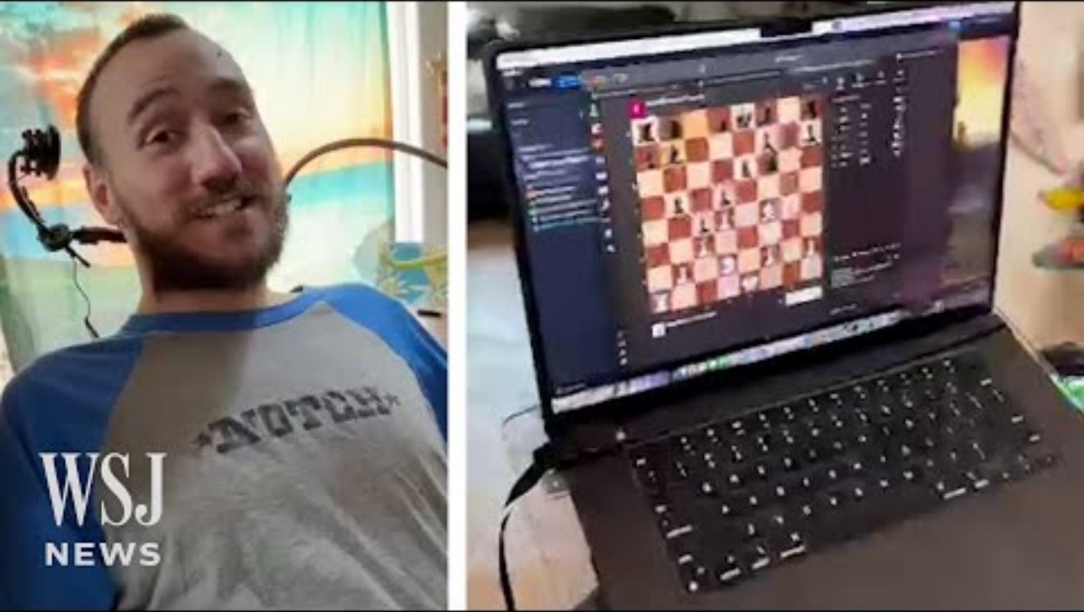

Slide 8
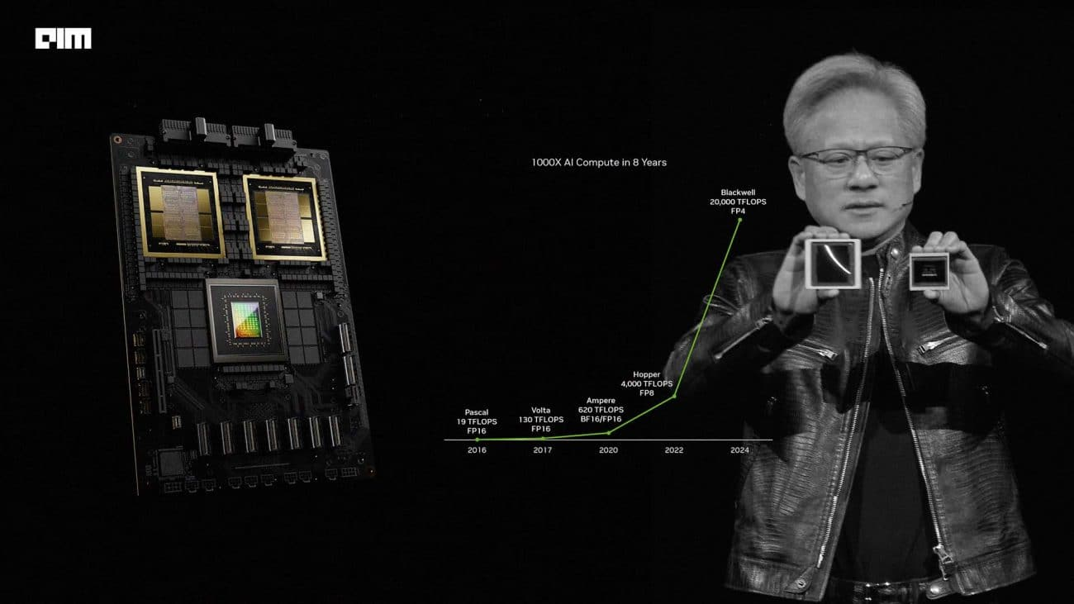
Exponential Growth

Slide 9

QUANTUM
Do in 4 minutes what traditional supercomputer would take
10,000 years to complete
158 MILLION
Times faster than the fastest supercomputer to date

Slide 10
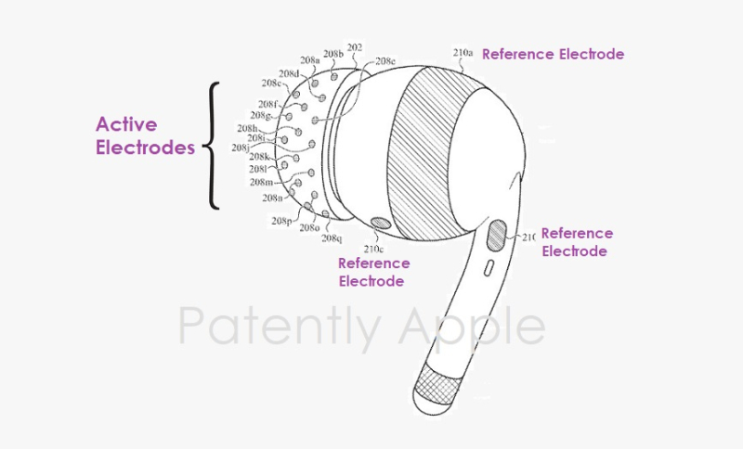
Brain Computer Interface (BCI)

Slide 11
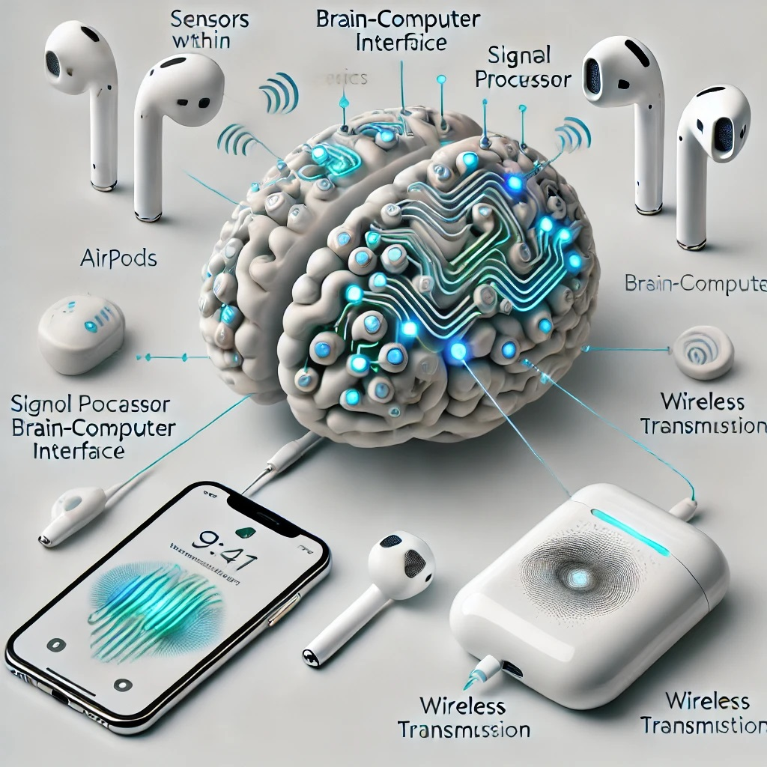

Slide 12
Workplace Challenges

Slide 13
Stress and Burnout Rates
Among Infragard Professionals
CISOs
Law Enforcement
71%
Chronic Distress
45-85%
Operational Distress
59%
Burnout
Firefighters
FBI Agents
48%
Burnout
?
Notes:
https://www.cleveland.com/news/2024/09/in-a-year-cleveland-lost-nearly-as-many-police-officers-as-columbus-and-cincinnati-combined-why.html

Slide 14

EMPLOYEE ENGAGEMENT
According to Gallup Poll of US Workers
For every 1.8 engaged employees
We have 1 actively disengaged employee
Engagement = productivity, employee retention, customer service, safety incidents, quality of work and profitability
Notes:
Last year, Gallup found U.S. employees were increasingly detached from their employers, with the workforce reporting less role clarity, lower satisfaction with their organizations and less connection to their companies’ mission or purpose. Employees were also less likely to feel someone at work cares about them.
30% of our workforce hate what they do and they hate you. They will actively work to disempower the organization.

Slide 15

CYBERSECURITY ENGAGEMENT
1.8 years
4.3 years
Made an error in their cyber roles due to burnout
vs
83%
Avg. CISO tenure
Avg. CIO tenure
CISOs interested in a job change
75%
73%
500K
CISOs experienced burnout in 2022
Cybersecurity roles open in US
30 – 40%
Of salary
Cost to replace an employee
Notes:
Numbers from IANS Research – 2023-24 State of the CISO report
Forbes 2020 article - https://www.forbes.com/councils/forbestechcouncil/2020/02/10/the-ciso-job-and-its-short-tenure/

Slide 16
What Are You Hoping to Get Out of Today?

Slide 17
WHAT’S THE IMPACT OF ENGAGEMENT?
Comparing companies in the top 25% for engagement to the bottom 25%
22% higher profitability
10% higher customer rating
28% less theft
48% fewer safety incidents
Notes:
Leaders and managers are responsible for maximizing resources
You can’t maximize resources with disengaged employees
One way to maximize engagement is to start with us. Are you going to be able to move other people, if you’re not moved?
Here’s the problem, how many of you have every experienced waking up in the morning and having the thought: “I don’t want to talk to anyone!” We all have these days. But when you fake it, do people feel it? I want to show you some ways to become engaged.
Here’s the reward to doing this: If you can learn to engage others, you will become an extraordinary leader. Not a mediocre or good one.

Slide 18

Set the Stage

Slide 19
Set the Stage
What is Stress?
What is Burnout?
A state of worry or mental tension caused by a difficult situation. Stress is a natural human response that prompts us to address challenges and threats in our lives.
Stress = your response
Stressors can be psychological or physical
A response to chronic stressors in the workplace, which have not been managed successfully.
Notes:
If you have been preparing for multiple exams and you can’t balance it all with your sleep schedule, and your other needs for comfort and wellbeing, like food, rest, sleep and social connection, that is stressful.
Stress is generic. It doesn’t distinguish between physical and emotional stress.

Slide 20
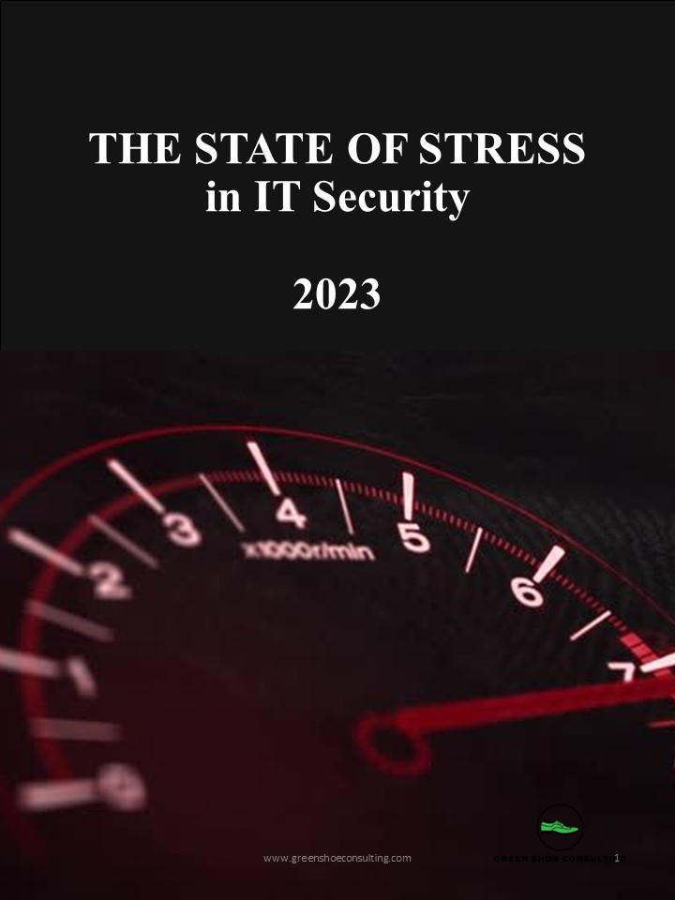
State of Stress in Cybersecurity
71%
of CISOs identify stress related to their roles as their most significant personal risk
up from 59% in 2022
54%
identified burnout as their most significant personal risk
up from 48% in 2022
To address this, organizations must prioritize succession plans and/or retention strategies to prevent CISOs from exiting unnecessarily
*Heidrick & Struggles 2023 Global CISO Survey

Slide 21

What Stresses You Out?

Slide 22
What Stresses You Out?
In Your Role:

Slide 23








What Stresses You Out?
Layoffs – job uncertainty and do more with same or less budget
Sacrifice Syndrome
Misunderstood (not valued) by business
Poor leadership
Unnecessary meetings, time management
Communicating effectively
Unrealistic expectations
Block 100% of bad stuff
Work / Life Balance

Slide 24
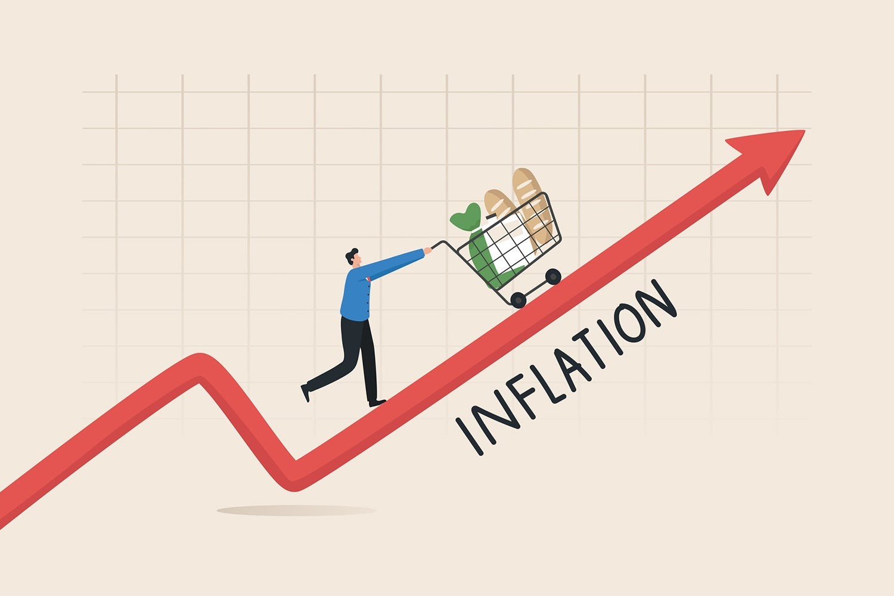



Trends In CyberSecurity
71%
Stress
59%
Burnout

Slide 25
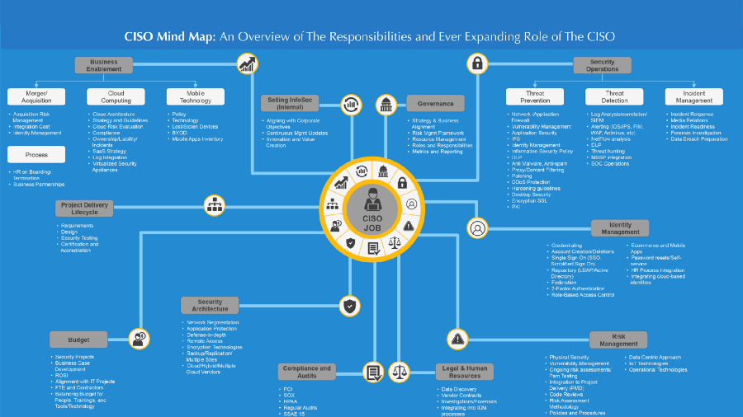

Slide 26
Types of Stress
DISTRESS
EUSTRESS
ACUTE
CHRONIC
Starting a new job
Getting married
Learning a new hobby/skill
Buying a home
Personal fitness goals
Scary movies
Public speaking
A first date
Travel
Networking events
Traffic jams
Crowds
Loud noises
Running late
Argument with loved one
Impending deadlines
Losing essential items (wallet)
Workload
Autonomy
Values
Community (relationships)
Fairness
Reward (recognition)
Trauma / PTSD
Notes:
Ask questions to have them self-reflect and understand what kind of stress they have experienced today, this week, etc
Offer them to complete stress profile or MBI?
Acute stress:
You have a collection of neurons called the sympathetic chain ganglia, which has nothing to do with sympathy. Sympa means together and there’s a group of neurons that start at about your neck, and run down to about your navel, a little bit lower, and those are called the sympathetic chain ganglia. You don’t need to remember this or memorize this. What is important to know is you have a chain of neurons that when something stresses you out, either in our mind or because something enters our environment and we see something that stresses us out, that we don’t like (heights if you’re afraid of heights), somebody you dislike walks into a room, etc., that chain of neurons becomes activated like a bunch of dominoes falling all at once. It happens very fast.
When that happens, those neurons release a neuromodulator neurochemical called acetylcholine. They release that at various sites within the body. This is important because normally, acetylcholine would be used to move muscles. Every time we move a muscle, pick up a cup of coffee3, write with a pen, walk down the street, it’s spinal neurons connecting to muscle and releasing acetylcholine. In the brain, acetylcholine is involved in focus. In muscles, it’s involved with making muscles twitch.
If we were stressed, we wouldn’t want all of our muscles twitching at once, because we would be kind of like paralyzed (aka tonic activation).
When those neurons are activated, acetylcholine is released, and there are some other neurons (postganglionic neurons) that respond to acetylcholine and they release epinephrine, which is the equivalent to adrenaline. Epinephrine is released at particular organs and acts in particular ways.
Ephinephrine acts in 2 different ways: (1) some things like the muscles in your legs and heart and other things that need to be active when you’re stressed, they have a certain kind of receptor (the beta receptor), which make blood vessels dilate. Blood rushes into our legs, the heart rate speeds up, lots of things happen that get activated.
At the same time, that epinephrine activates other receptors on certain tissues that we don’t need. The ones involved in digestion, reproduction, and other areas that are “luxuries” for when things are going well, not things to pay attention to when we’re stressed. That binds to other receptors that contract the blood vessels.
The stress response is (1) generic, (2) it pushes certain systems to be activated and other systems to not be activated, and (3) it’s a sense of agitation that makes you want to move, or say something.
That’s why you feel blood in certain parts of your body, why your throat feels dry (the salivary glands shut down when stressed),
If you want to control stress, you need to learn how to work with that agitation.
I want to give you a tool we can use now, because we’ve gone into a lot of science and I don’t want this to be a university lecture. I want to take what we already know about the stress response and use that as a framework for thinking about how one might reduce or event eliminate the stress response quickly in real time, should it arise when we don’t want it.
Like when we are taking the podium to speak, we are getting ready to join a zoom call, and all of a sudden we’re feeling flushed. We’re feeling like our heart is racing, we’re feeling a little too alert. We’re feeling a little worked up and we want to calm down.
As far as I’m aware of, the best tools to reduce stress quickly, are going to be tools that have a direct line to the autonomic nervous system. The autonomic nervous system is a name given to the kind of general features of alertness or calmness in the body.
What doesn’t work to control stress: telling yourself to calm down (that tends to make it worse)
If you want to reduce the magnitude of the stress response, the best thing you can do is to activate the other system in the body which is designed for calming and relaxation. That system is called the parasympathetic nervous system. Para means near. The parasympathetic neurons exist in the crainial nerves (left neck and lower brainstem) and in the pelvic area.
The parasympathetic neurons in the brainstem and neck area have a direct line to various features of your face, in particular the eyes (controlling eye movements, pupil dilation), the tongue, facial muscles, etc.
The neurons in the pelvic area control the genitals, bladder, and the rectum. Those don’t have a direct line to be controlled by the brain. Messages go from brain to spine to those organs.
The tool that is the quickest, grounded in physiology and neuroscience for calming down is called the physiological sigh. This is a powerful set of techniques we know from scientific studies that are very useful in reducing your stress response in real time.
There is a lot of focus and talk lately about breath work – where you intentionally sit or lie down and use your breath in specific ways for a certain amount of minutes. There is some utility in this work and we will discuss this later if there is time. What I am talking about now with physiological sighs is the very real medical school textbook relationship between the brain, the body, and the body as it relates to the breathing apparati, meaning the diaphragm and lungs and heart,
The hallmark stress response is the heart beats faster, blood is shuttled to the big muscles of the body to move you away from whatever it is the stressor is or just make you feel like you need to move or talk,
Heart rate, many of us feel is involuntary – it just kind of functions whether or not we’re moving fast or slow. If you think about it, it’s not really purely autonomic because you can speed up your heart rate by running or you can slow it down by slowing down your run. There is a way you can breathe that directly controls your heart rate through the interactions between the sympathetic and the parasympathetic nervous system.
Here’s how it works. When you inhale, your diaphragm move down. Because the lungs expand. Your heart actually gets a little bit bigger in that expanded space. As a consequence, any blood that is in your heart when this is happening, starts moving more slowly due to the larger volume in the heart. There’s a little group of neurons called the sinoatrial node in the heart that registers the rate of blood flow through the heart and send a signal up to the brain that blood is moving more slowly through the heart. The brain then sends a signal back to the heart to speed the heart up.
If you want to speed your heart to beat faster, inhale longer, inhale more vigorously than your exhales
If you want to slow your heart rate down, make your exhales longer and or more vigorous than your inhales.
The reason this is so attractive as a tool for managing stress is that it works in real time. This doesn’t involve a practice where you have to go, sit and do anything separate from life.
Emotions and stress happen in real time.
It’s wonderful to have a breathwork practice or to get a massage, or whatever you do to set your stress controls in the right direction, having tools you can go to in real time that require no learning,
There is a tool that capitalizes on this concept in a unique way – the physiological sigh. The physiological sigh was discovered in the 30s. It’s now been explored at the neurobiological level and mechanistically in far more detail. The physiological sigh is something humans and animals do anytime they are about to fall asleep. It’s something we do naturally after we’ve been crying (ugly crying) and we’re trying to recover some air or calm down; or when we are in claustrophobic environments.
We can voluntarily and intentionally control our diaphragm. Using it with this sigh, activates the phrenic nerve.
The sigh is a double inhale and long exhale.
The little sacks in your lungs (alveoli), there’s millions of these that if laid out would make the surface area of your lungs as big as a tennis court. Alveoli tend to collapse when we are stressed. Carbon dioxide builds up in our bloodstream and that’s one of the reasons we feel agitated. It also makes us very jittery. The double inhale reinflates those little sacks of the lungs, and the long exhale is now more effective at ridding your body and bloodstream of carbon dioxide. Which relaxes you very quickly.
It’s very hard to control the mind, when we are heightened states of activation (very alert of very sleepy), it is very hard to use so-called top-down mechanisms of intention and gratitude and these things that are really powerful tools when we are not super activated, stress, or tired.
Doing the physiological sigh 1 – 3 times will bring down your level of stress very, very fast.
Many people worry that their heart rate doesn’t come down fast enough. You don’t want your heart rate to come down really fast. There’s something called the vasovagal response – some people will get up in the middle of the night to use the bathroom or something, they’ll stand up out of bed and collapse/faint. That’s because the heart rate was reduced too much. Some people will see blood, or something really troubling and they’ll pass out. That’s an overactivation or an acceleration of the calming response. The person gets so stressed that their calming mechanism rebounds too fast. Your heart rate will take 20 – 30 seconds to come down to baseline.

Slide 27

Fear, Anxiety & Motivation
Threat
Vs
Challenge
Self-fulfilling Prophecy (Pattern Recognition)
Starting Belief
Potential
Amount of effort / action taken
Belief
Self-Determination Theory
Survival Instinct
Fight / Flight / Freeze
Autonomy
Competency
Relatedness

Slide 28

How Our Brains Work
(Interpreting Stress)

Slide 29
What Shapes Our Reality?
Our Decisions
FOCUS
(Thought)
MEANING
(Emotion)
ACTION
(Behavior)
Notes:
How many decision do we make in a day? 100
The minute you focus on something you give it a meaning.
Is this the end or the beginning? Am I being punished or rewarded? Or is this just happenstance?
Think about your own life – the decision that have led you to this moment.
In the last 5 years, how many decisions have you made that led you here. Haven’t there been some decisions that if you made a different decision, you would have a completely different life?
Maybe it was where you were going to live during COVID… maybe it was where you were going to work. And you met the love of your life there. Maybe it was a technology you bought. Did anyone in this room buy Crowdstrike? How would your life be different if you made a different decision? These decisions don’t just impact our own lives, it impacts others around us. The history of our world is these decisions.
Last week, there was an assassination attempt on former president and current presidential candidate Donald Trump. Regardless, your viewpoint of him, we can all agree, there would have been a major impact to a lot of people had he not decided to move his head at the last moment.

Slide 30
Two Primary Patterns That Shape Us
Your State
In the Moment
Physical / Emotional
Your Map of the World
Long term
Beliefs

Slide 31
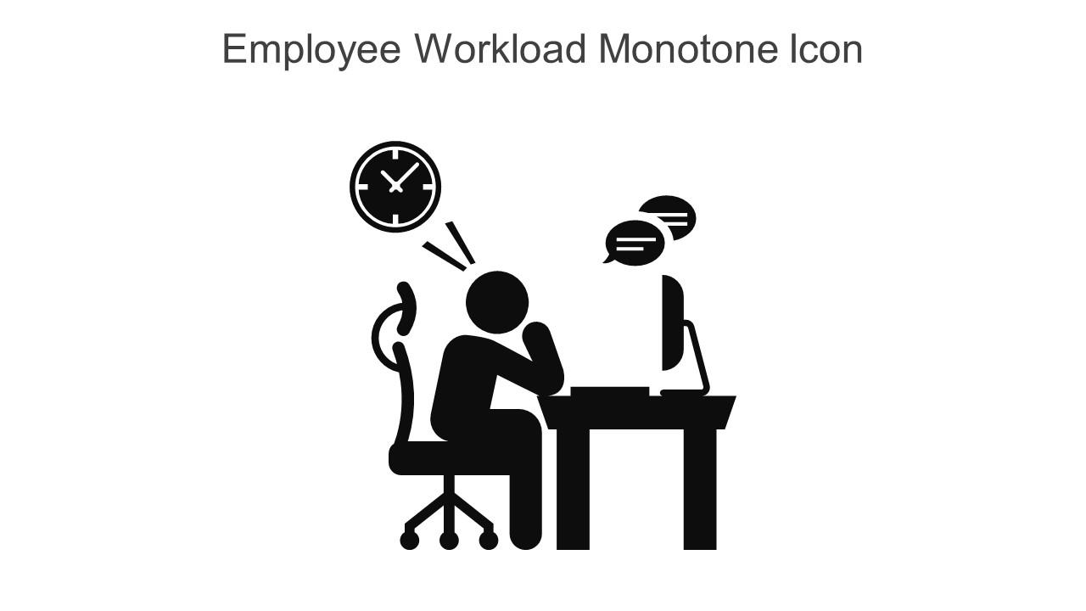




Job Fit Criteria
(Maslach & Leiter, 2022)
Workload
a lot of demands, not enough resources. Do you have the resources to handle the tasks / demands required?
Community
good, positive support? Team cohesion? Trust? You can count on those around you
Control
How much autonomy, decision-making, enforcement ability, choice do you have? Are you boxed in and can’t make those decisions?
Fairness
policies and procedures, are they fairly administered? Are the people doing certain things the ones getting promoted or getting the opportunity?
Reward
social rewards, Recognition for what you do, someone notices (sees) you, “thank you for saving us”
Values
this is what gives meaning to the work we do, it allows us to feel like we are making a difference, the things that keep you going through hard/bad times.

Slide 32
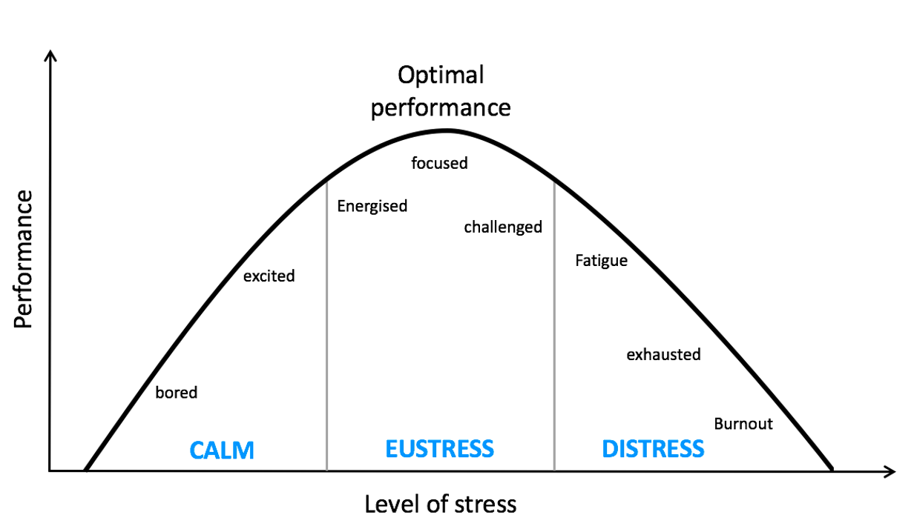
Notes:
Throw in a self-reflection question – think of a time at work when…

Slide 33
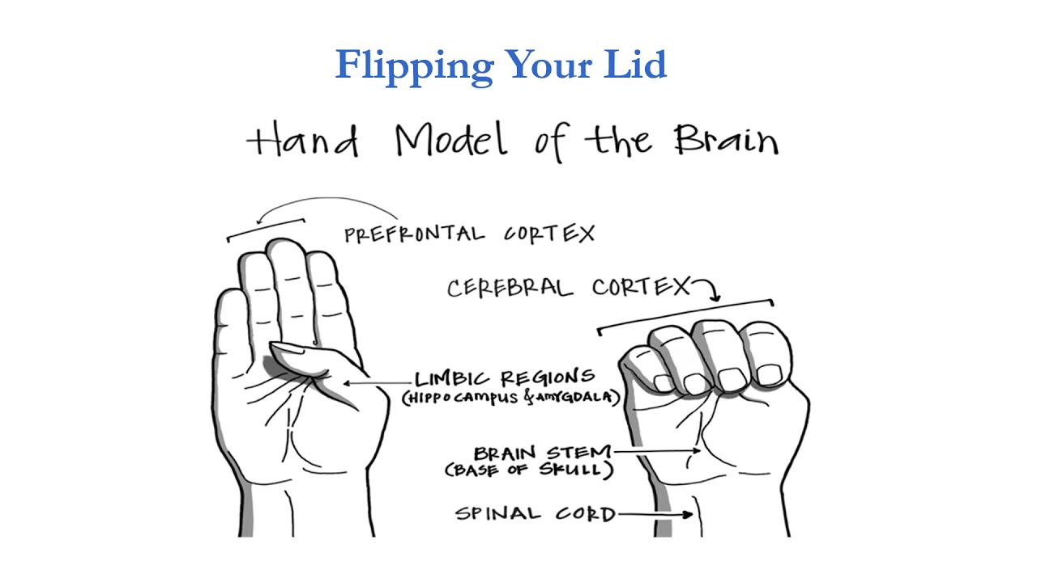

How Our Brains Work

Slide 34
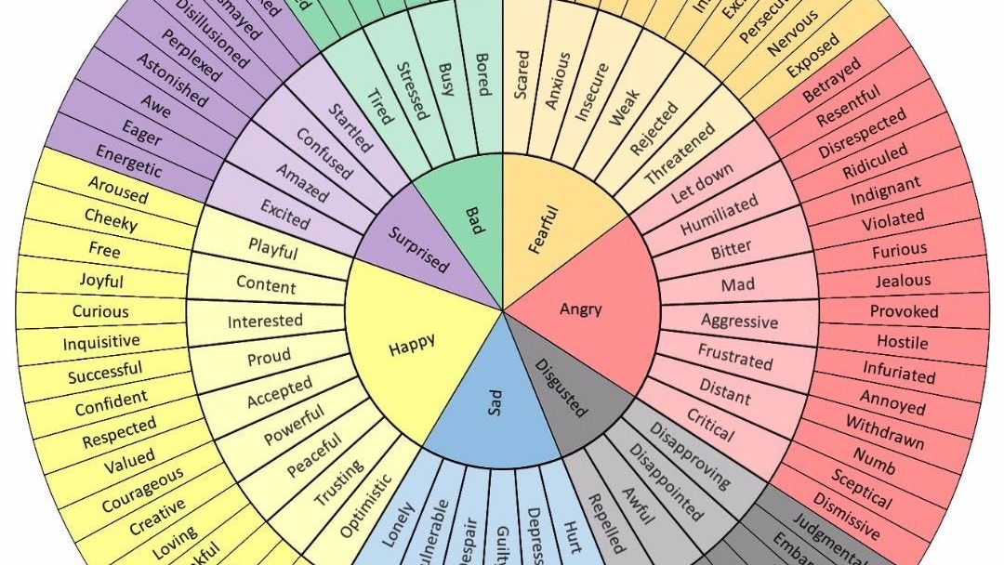

Slide 35
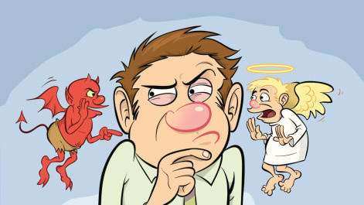

Slide 36
Possible Issues with Brainwave Interface Technology

Slide 37


Slide 38
Information Overload
Information overload is a significant cybersecurity threat that can compromise an organization's security and leave it vulnerable to cyber attacks. It can occur when the amount of information exceeds a person's working memory, which is limited to about seven units of information.
Here are some ways information overload can impact cybersecurity:
Can lead to workers not following best practices, which can leave an organization vulnerable to cyber threats.
Threat prioritization
Information overload can make it difficult to prioritize threats.
Cyber security training
Information overload can lead to a decline in engagement with cyber security training. For example, research found that more than half of office workers surveyed ignore important cyber security warnings due to information overload.
Cognitive overload
Information overload can overwhelm cognitive capacities, making it difficult for individuals and organizations to make decisions.

Slide 39


Slide 40

What Leads to Burnout?

Slide 41

CYBERSECURITY ENTRAPMENT

Slide 42

Burnout is a combination of
+
MOTIVATION
STRESS
Autonomy
Competency
Belonging
(Williams & Krane, 2021)

Slide 43


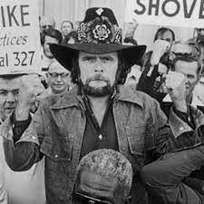


Burnout Symptoms
Emotional & Physical Exhaustion
Take this job and shove it
Cynicism
Negative response to job
Reduced concern for performance quality
Question the value/meaning of role
Professional Inefficacy
Negative self-evaluation
Decreased feelings of achievement
“no future”

Slide 44
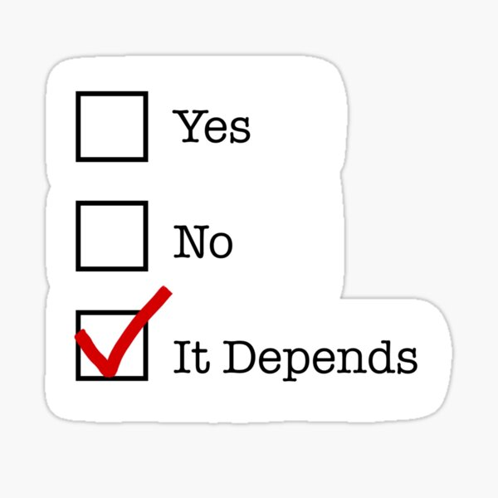

Is This a “You” Problem?
YOU
YOUR ORGANIZATION

Slide 45

What Can You Do About It?

Slide 46

“The thinking that got us to where we are is not the thinking that will get us to where we want to be”
- Albert Einstein

Slide 47
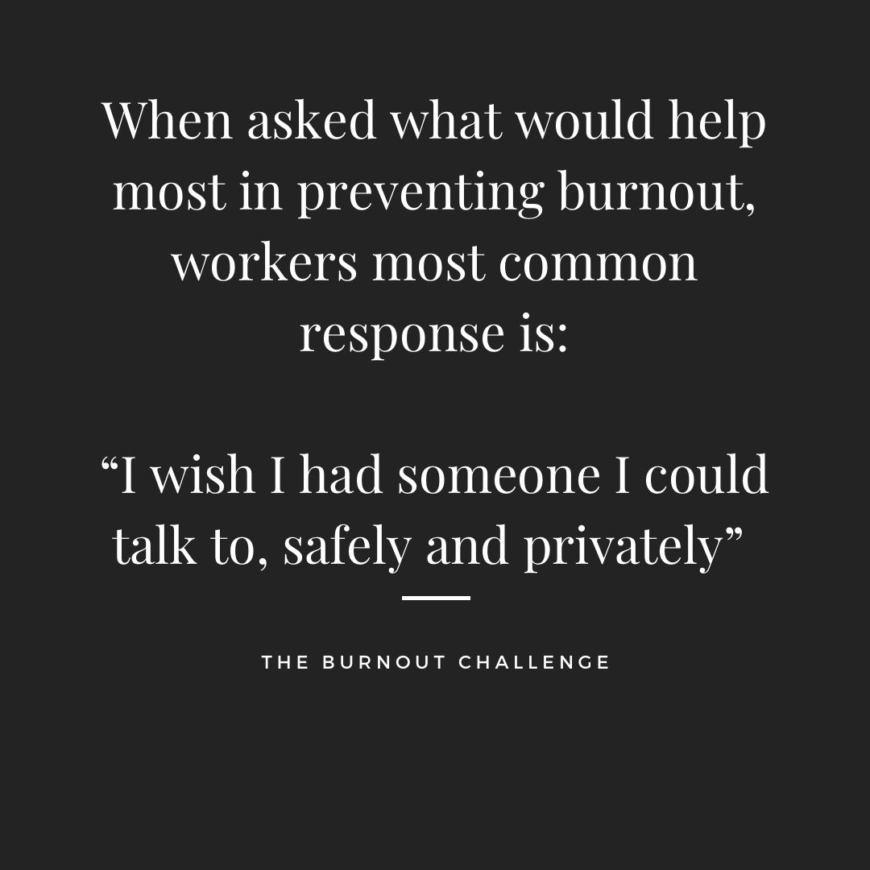

Slide 48
Fear, anxiety and stress are predictable
Therefore, we can plan for them

Slide 49
Burnout Perspectives
Perspectives
Key Variables
Intervention Strategies
Overtraining
Training Volume
Ensure appropriate work loads based on age, capacity, and skill level.
Continuously monitor individual workload responses and feeling states. Prolonged fatigue and mood disturbance are warning signs.
Avoid a “one size fits all” approach to workload design.
Recovery
Reduce workloads after a period of intense workloads or if employees are experiencing prolonged fatigue.
Educate employees about maladaptive responses to work efforts and emphasize the importance of recovery.
Ensure employees receive adequate recovery, including passive rest and more active forms of recovery.
Ensure employees engage in pursuits outside of work that increase vitality.
Nonwork stress
Provide resources and training in strategies to cope with sources of stress beyond work (e.g., personal health, family life, romantic relationships)
Do not increase workloads when nonwork stressors are on the rise.

Slide 50
Burnout Perspectives
Perspectives
Key Variables
Intervention Strategies
Psychosocial Work Stress
Demands
Identify key stressors and develop a plan for dealing effectively with them.
Adopt a positive coaching / managing style and help leadership maintain realistic expectations and positive support of employees.
Emphasize skill development is a continuous process with highs and lows.
Resources
Increase coping resources such as through effective lifestyle management.
Encourage employees to form strong social support networks.
Build self-regulations skills through mental skills training.
Self-Determination
Theory
Self-determined Motivation
Promote a stimulating work climate that emphasizes effort, learning, accomplishment, and enjoyment of the work / job.
Autonomy
Allow employees choices in their training, execution of work, and well-being plans.
Provide a rationale for decisions so employees understand why they are doing things a certain way.
Employ democratic coaching / managing that involves group
decisions when appropriate.

Slide 51
Burnout Perspectives
Perspectives
Key Variables
Intervention Strategies
Self-determination
Theory
Competence
Structure work so employees have opportunities to succeed with effort.
Aid employees in focusing on successes as well as areas in need of improvement.
Establish effective goal-setting strategies.
Continuously develop fundamental mental and emotional work skills by reinforcing effort, learning, and improvement, as well as treating mistakes as part of the learning process.
Relatedness
Foster a productive and supportive manager-employee relationship as well as positive relationships between employees.
Provide programming that builds teammate relationships and support positive social interactions.
Incorporate team building activities within the practice structure and encourage outside social activities.
Workplace
Entrapment
Benefits
Help employees recognize the benefits of their work involvement that may not be evident to them or that they overlook.
Assess what makes work rewarding to employees and incorporate those elements into work experience.

Slide 52
Burnout Perspectives
Perspectives
Key Variables
Intervention Strategies
Workplace
Entrapment
Costs
Acknowledge personal costs of work involvement and help employees develop strategies for managing them effectively.
Explore alternatives for employees in dysfunctional workplace environments.
Enjoyment
Find ways to create work variety and limit monotony.
Structure work to foster competence, autonomy, and relatedness. Refer to self-determination theory in earlier section.
Investments
While recognizing the time and energy required by work, encourage employees to maintain nonwork interests and hobbies so they do not feel they are missing out on other important life opportunities.
Social
Constraints
Promote employee social relationships with both work and nonwork associates.
Ensure directors, managers, and peers are sources of support and not pressure.
Attractiveness of Alternative Activities
Support employee exploration of other work and nonwork activities as a means of personal exploration and validation of work involvement.
Encourage employees to reflect on the meaning and value of work in their lives, including what they would miss if not in their specific role.

Slide 53
Burnout Perspectives
Perspectives
Key Variables
Intervention Strategies
Workplace
Entrapment
Job Identity
Communicate that one can strongly identify with multiple roles (e.g. job, family, personal, responsible citizen)
Encourage employees to develop other aspects of their lives beyond work and support their doing so.
Help employees put work performance into proper life perspective.
Work Control
Refer to autonomy in the earlier section of this table.
Notes:
Williams & Krane (2021), pgs 482-483

Slide 54
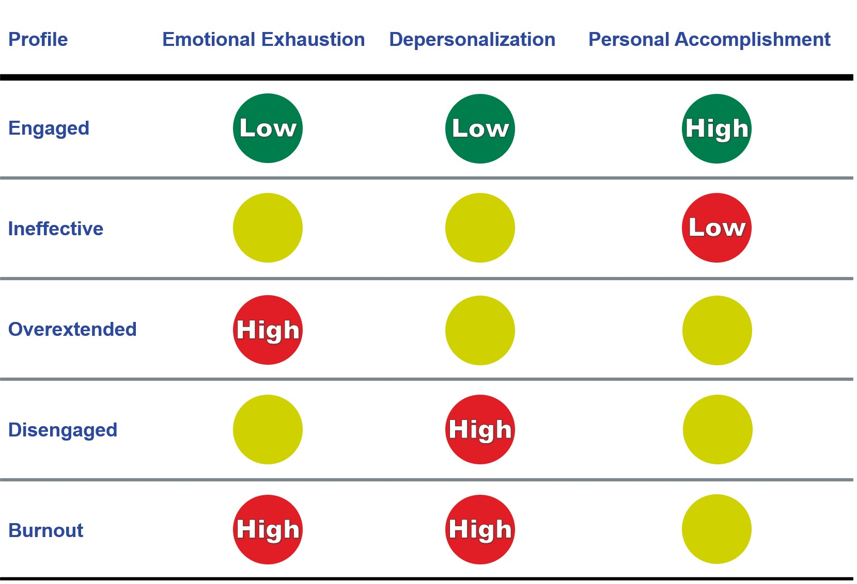
Assess Your Stress

Slide 55
Services
Assessment
Free service to identify stress / burnout levels within individuals and teams
Free service to identify job fit mismatches among individuals and teams
Group Coaching
Limited to 10 professionals per group. This service provides a 6 – 12 – 18-month engagement to build foundational performance skills for those operating in high demand, high stress environments.
Workshops (aka POC)
Introductory workshops intended to educate individuals and organizations on strategies to alleviate and prevent high stress and burnout.
Organizational Design
In depth engagement, focused on alleviating the stress burdens created by the organization on employees and teams.
Individual Consulting & Coaching
Individual support created for high performance professionals, focused on supporting the high-stress demands of their role with evidence based, applied practices.
Resilience Retainer
Breaches happen. When they do, stress levels increase dramatically. Our Resilience Retainer service provides dedicated support for specific individuals and or teams to ensure mental states are managed effectively during these times.

Slide 56
Develop Skills (Individually)
Knowing who you are and what you stand for (framework, it’s like NIST for your own decision making)
Managing your stress levels in specific situations
  Being aware of your different states (in control, losing control and out of control)
  Ability to increase or lower energy when needed
  Focusing on your controllables
Being present (transitioning) – at work, home & life
Communicating effectively (including listening)
  Having hard conversations
  Managing conflicts (personally and with others)
Time management (blocking time, prioritizing, saying no)
Leadership – in your own life and at work
  Being authentic wherever you are
  Defining success
Taking things personally – “what’s mine?”
Developing confidence in yourself (imposter syndrome)
Building a support network
Creating a holistic identity – you are more than your job
  Filling your cup
Self-care routines & habits
  Sleep, think, eat, hydrate & move WELL
ASSESS
ACQUIRE
PRACTICE

Slide 57

Personal Stress Response Plan
Know Your Triggers
Know Your Response to Stress
Control the Controllables
Replace Unsupportive Thoughts with Empowering Thoughts
Have a List (and toolbox) of Healthy Coping Skills

Slide 58

Awareness
Out of Control
Losing Control
In Control

Slide 59
Awareness – Who am I…?
 | At My Best | When I Struggle
Body Language
Focus
Self-talk

Slide 60
Stress Management Strategies (Toolbox)
Train Your Mind
Create a stress management plan
Develop resilience
Identify your stressors
Develop coping mechanisms for stressful situations
Identify Negative Thought Patterns and challenge them
Sleep
Prioritize quality sleep by establishing a consistent sleep schedule.
Create a relaxing bedtime routine.
Limit screen time before bed.
Mindfulness
Mindfulness involves being present and focused on the current moment.
Regular meditation can reduce stress, improve focus, and enhance emotional regulation.
Apps like Headspace or Calm can provide guided meditations.
Physical Activity
Regular exercise helps reduce stress hormones and boosts mood.
Aim for at least 150 minutes of moderate-intensity exercise per week.
Time Management
Prioritize tasks: Focus on high-impact tasks and delegate or eliminate less important ones.
Time blocking: Allocate specific time blocks for different activities, including breaks.
Set boundaries: Establish clear work hours and avoid overworking.
Community
Maintain strong social relationships for emotional support.
Spend quality time with loved ones.
Join professional or social groups.
Nutrition
Eat a balanced diet rich in fruits, vegetables, and whole grains.
Limit caffeine and alcohol consumption.
Stay hydrated.
Relaxation Techniques
Body scans
Progressive relaxation
Meditation
Breathwork
Visualization
Imagery
Switch off
Read fiction
Spend time in nature
Find a hobby
Watch tv / movies

Slide 61



Interrupt the Survival Response
Breath
Physiological Sigh
One big inhale
One short inhale
Long, slow exhale
Real
Time
Tool
Notes:
When our stress response (survival instinct) kicks in, our breathing apparati (diaphragm and lungs), heart and brain participate. Our heart rates increases, which creates shorter, faster breath and our heart sends blood to our large body parts (legs and arms). The intent is to run or fight. Many people think our heart rate is automatic and we cannot control it, however, that is incorrect.
When we inhale, the diaphragm moves down to give space for the lungs to expand. At the same time, our heart physically expands and blood moves through the heart slower. The heart sends a signal to the brain that blood is moving slowly through the heart. In survival instinct mode, our brain signals back to the heart to beat faster as there is a threat (we need to move urgently).
If you want your heart to beat faster, inhale longer, more vigorously than your exhales.
If you want your hear to beat slower, exhales need to be longer than inhales. When you exhale, it makes the heart a little bit smaller.
The reason this technique is so attractive is that it works in real time. This doesn’t involve a practice where you need to change location, sit down and do something separate from life.

Slide 62
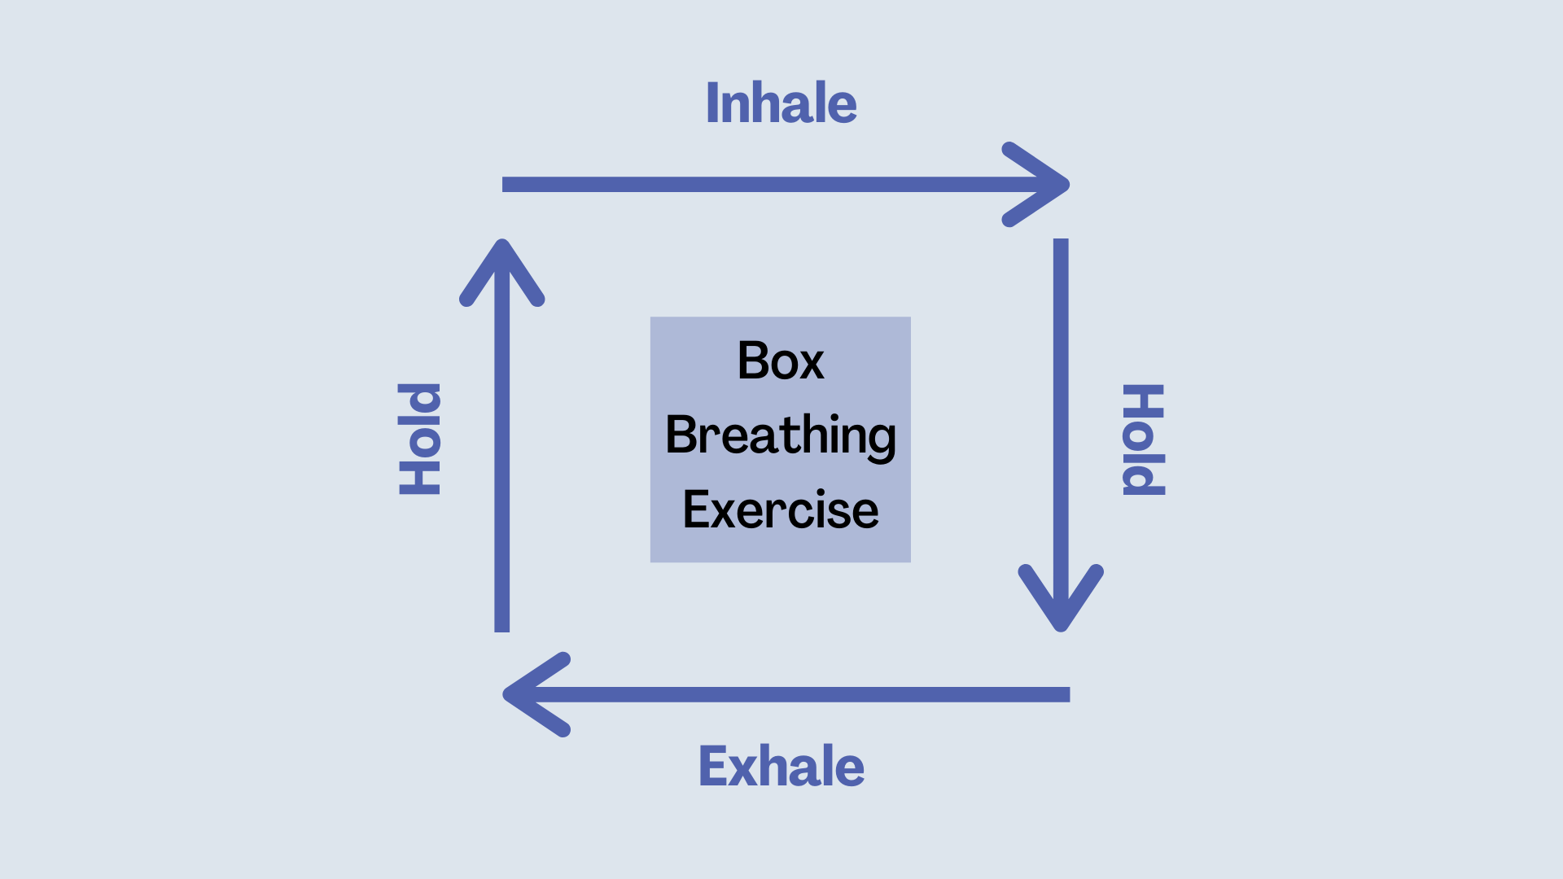
Box Breathing

Slide 63

Performance Routines
(Morning)

Slide 64

Progressive Relaxation

Slide 65
Self-care
SLEEP
WELL
THINK
WELL
MOVE
WELL
EAT & HYDRATE
WELL

Slide 66

Develop Skills (Organizationally)
Collaborate
Customize
Commit
To bring about the desired change, it’s not enough to announce, “from now on, we’re going to do things this way.”

Slide 67
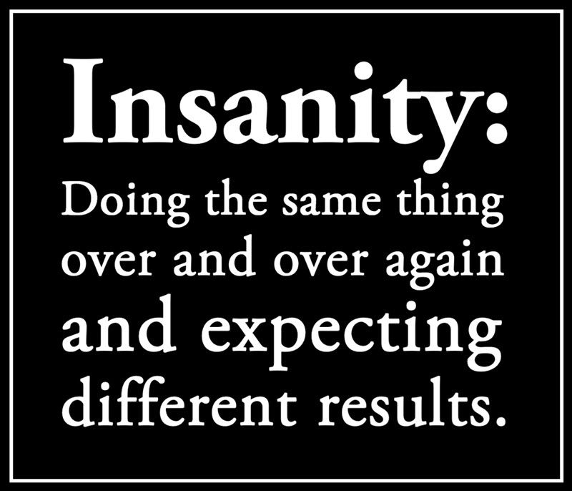
Develop Skills (Organizationally)
Identify the area of a problem mismatch
Pivot to consider a range of positives matches
Begin with attainable goals
Use the profiles to guide action
Redesign for better matches
Use design guidelines
Build in progress checkpoints
Internal and external resources

Slide 68


Slide 69
Skills We Covered
Focus: what do you focus on and what’s in your control
Self – awareness: what are your stressors and how do you respond to stress
Pattern recognition: healthy vs unhealthy coping
Real time stress management: using breathwork (box breathing) to interrupt the thought process to bring yourself back to the present moment
Performance Routine – morning routine to intentionally set you mind

Slide 70

Calls to Action

Slide 71

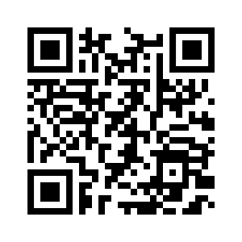
Survey Time!!!
https://forms.gle/UTqnRyRVRJN9WYw78

Slide 72
Calls To Action
Assess your Stress - https://docs.google.com/forms/d/1q1mZPQmzCDBg1FRtBmxgTywizZhpjQhQ5SnNbeDTIUs/edit
What cybersecurity communities would benefit from this information? Conferences, podcasts, etc.
Help us with our research – we are looking for 500 CISOs to complete the burnout assessment this year. Please let me know if you are willing to participate
We are looking for 2 cybersecurity organizations to take part in an 8-week study
Ask me questions

Slide 73

Thank you

