Slide 1
GOLFCOURSE SOLUTIONS, INC. www.golfcoursesolutions.info
Preserving and Improving Golf Courses
&
Real Estate Values

Slide 2
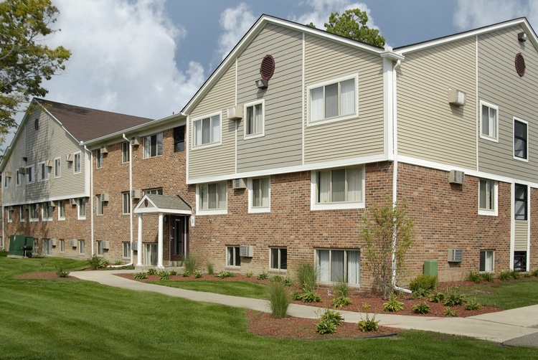
What Happens When A Golf Course Closes:
Weed Patch
Multi Family Housing Development

Slide 3
Turning Challenges Into Opportunities
Golf Course closes
Property values decline on average 25%
Surrounding business revenue drops
Tax revenue & services decline
Community suffers and quality of life declines
When a golf course goes under, not only will the community lose a key economic partner but the market value of surrounding homes drops on average by 25%.
Our program helps to protect the property value of homes around the golf courses through the acquisition, revitalization and continued operation of the golf course.

Slide 4
Turning Challenges Into Opportunities Golf Course Solutions, Inc. & Property Maintenance Solutions, Inc.
Golf Course Acquisition & Revitalization
Real Estate Value Preservation & Property Maintenance

Slide 5
Revitalization Strategy
Golf Course Memberships
Property Maintenance
Revenue
Vibrant Golf Course Community & Savings to the Homeowner
We combine the golf course acquisition and operations with the property maintenance needs of HOA’s, residential, and commercial property owners in the community.
A portion of the property maintenance service fees are reinvested to benefit the golf course and surrounding communities.

Slide 6
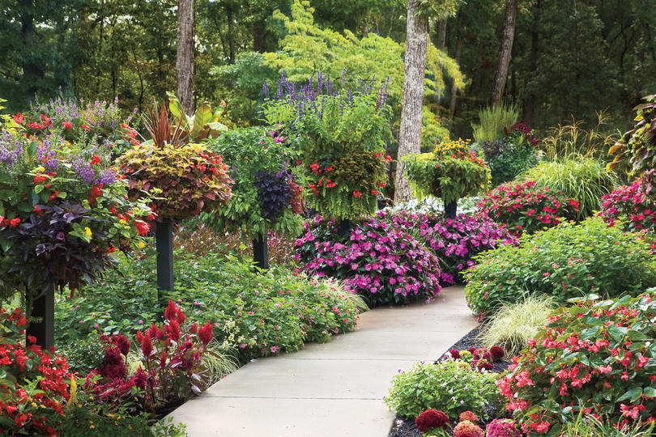
Property Maintenance Solutions, Inc. We Take Care Of Your Greens… … So You Have More Time To Enjoy Ours
We provide comprehensive property maintenance, repair, and cleaning services with a focus on cost control and expense reduction while preserving the long-term physical and economic value of our customers’ real estate assets.
We are here to enhance your lawn's appearance, working to ensure that your property's curb appeal improves dramatically.
From the initial consultation to the final design, our services are designed to transform your outdoor space into the property you have always wanted.

Slide 7
Premium Golf Trail Membership Options
Includes:
Access to all courses in our Golf Course Trail - No greens fees charged. (Tee time required) $25.00 golf cart rental fees apply
Clubhouse privileges (Reservation required if applicable)
Membership includes two adult members of same household and children under the age of 18 in same household
12 free guest passes per year
One complimentary 30 min. golf lesson per year (Reservation required)
Group event planning
Yearly Membership Appreciation Day
Printed Membership ID Cards
Online booking option
Financing options are available for qualified applicants.
COSIGNERS ARE ALLOWED.

Slide 8
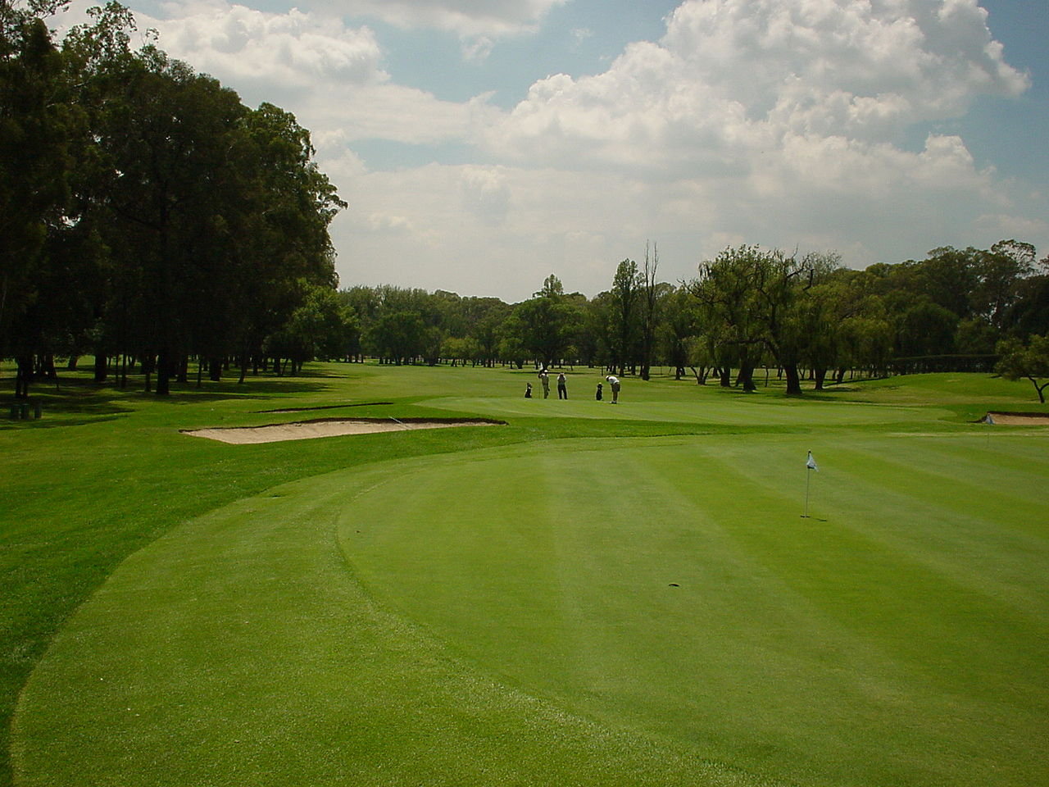
GCS Golf Course Trail
The purpose of the GCS Membership Drive is to raise capital for the acquisition and restoration of carefully selected golf course properties which will become the core of GCS's new Golf Course Trail.
Golf courses under consideration for purchase have met all key economic and long-term sustainability requirements. These include cost of acquisition & operations, quality of venue, community involvement, and ease of access.
Golf Trail Memberships are available to individuals and businesses.

