Slide 1
Algebra
Addition & Subtraction of Algebraic Fractions
Prepared and Presented By: Sir J. Dey

Slide 2

KEEP In MIND…
There is one rule for adding or subtracting fractions: the denominators must be the same
$$\frac{a}{c}+\frac{b}{c}=\frac{a+b}{c}$$

Slide 3

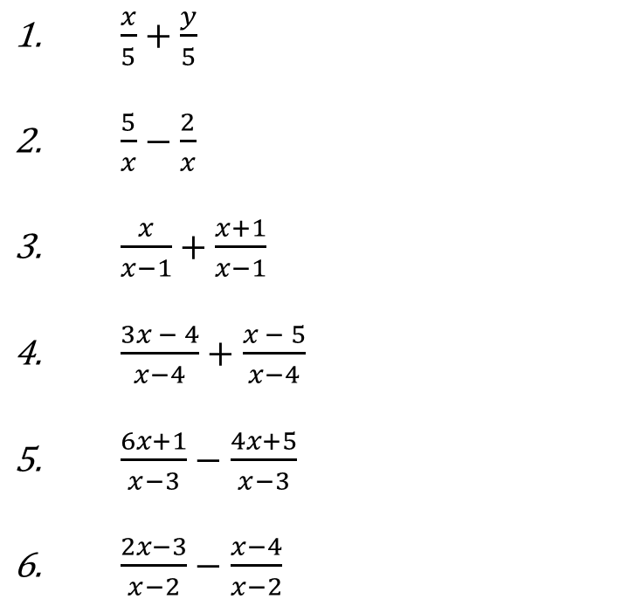
Let’s warm up…
$\frac{x}{5}+\frac{y}{5}$ $\frac{5}{x}−\frac{2}{x}$ $\frac{x}{x−1}+\frac{x+1}{x−1}$ $\frac{3x − 4}{x−4}+\frac{x − 5}{x−4}$ $\frac{6x+1}{x−3}−\frac{4x+5}{x−3}$ $\frac{2x−3}{x−2}−\frac{x−4}{x−2}$
$\frac{x+y}{5}$
$\frac{3}{x}$
$\frac{2x+1}{x−1}$
$\frac{4x−9}{x−4}$
$\frac{2x−4}{x−3}$
$\frac{x+1}{x−2}$

Slide 4
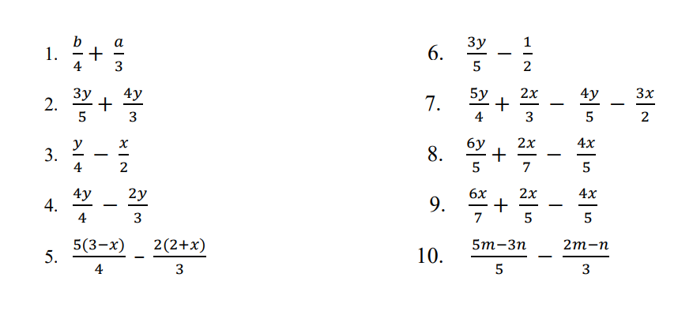
Just another walk in the park…
Simplify each algebraic fractions below:

Slide 5
KEEP In Mind…
To add or subtract fractions with different denominators, we must learn how to construct the Lowest Common Multiple of a series of terms.
The Lowest Common Multiple (LCM) of a series of terms
is the smallest product that contains every factor of each term.
For instance:
Construct the LCM of these three terms.
xz, xy, yz
LCM = xyz

Slide 6

Example #1
$\frac{5}{ab}+\frac{6}{ac}$
LCM = abc
=$\frac{5×c}{abc}+\frac{6×b}{abc}$
=$\frac{5c+6b}{abc}$

Slide 7

Example #2
$\frac{3}{2x}+\frac{5}{6y}$
LCM = 6xy
=$\frac{3×3y}{6xy}+\frac{5×x}{6xy}$
=$\frac{9y+5x}{6xy}$

Slide 8
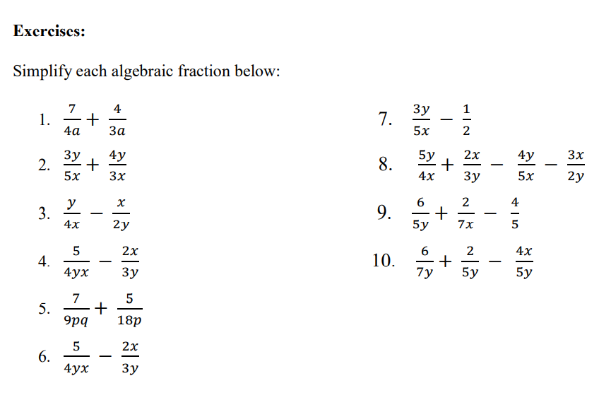
Activities

