Slide 1
Algebra:
Division of Algebraic Fractions
Prepared & Presented by: Sir J. Dey

Slide 2



Recap Activity
$\frac{2x}{9}+\frac{5x}{6}$
LCM=18
= $\frac{2x×2}{18}+\frac{5x×3}{18}$
= $\frac{4x+15x}{18}$
= $\frac{19x}{18}$
$\frac{2x−1}{8}−\frac{2x−2}{12}$
$LCM=24$
= $\frac{3(2x−1)}{24}−\frac{2(2x−2)}{24}$
= $\frac{6x−3−(4x−4)}{24}$
= $\frac{6x−4x−3+4}{24}$
= $\frac{2x+1}{24}$
$\frac{4}{3}÷\frac{2}{3}$
$$=\frac{4}{3}×\frac{3}{2}$$
$$=\frac{4^{2}}{3^{1}}×\frac{3^{1}}{2^{1}}$$
$$= \frac{2}{1}$$
= 2

Slide 3
Its this simple…
Change division sign to multiplication sign and upturn the proceeding fraction
Multiply numerators together then denominators together
Cancel factors that are common

Slide 4


Let’s work some examples…
$\frac{a^{2}}{b^{2}c^{3}}÷\frac{a}{b^{3}c^{2}}$
$\frac{4a^{3}}{5bc}÷\frac{b}{2c^{2}}÷\frac{5c^{3}}{ab}$

Slide 5

Example #1
$\frac{a^{2}}{b^{2}c^{3}}÷\frac{a}{b^{3}c^{2}}$
= $\frac{a^{2}}{b^{2}c^{3}}×\frac{b^{3}c^{2} }{a}$
$$=\frac{a^{2}{×b}^{3}c^{2}}{{ab}^{2}{×c}^{3}}$$
= $\frac{a^{2}b^{3}c^{2}}{{ab}^{2}c^{3}}$
$$=\frac{ab}{c}$$
Change division sign to multiplication sign and upturn the proceeding fraction.
Multiply numerators together then denominators together.
Cancel factors that are common.

Slide 6

Example #2
$\frac{4a^{3}}{5bc}÷\frac{b}{2c^{2}}÷\frac{5c^{3}}{ab}$
= $\frac{4a^{3}}{5bc}×\frac{2c^{2}}{b}×\frac{ab}{5c^{3}}$
= $\frac{4a^{3}}{5bc}×\frac{2c^{2}}{b}×\frac{ab}{5c^{3}}$
= $\frac{4a^{3}×2c^{2}×ab}{5bc×b×5c^{3}}$
= $\frac{(4×2)×a^{3+1}×b×c^{1+3}}{(5×5)×b^{1+1}×c^{1+3}}$
= $\frac{8a^{4}bc^{4}}{25b^{2}c^{4}}$
= $\frac{8a^{4}c^{4−4}}{25b^{2−1}}$ = $\frac{8a^{4}}{25b}$
Change division sign to multiplication sign and upturn the proceeding fraction.
Multiply numerators together then denominators together.
Cancel factors that are common.

Slide 7
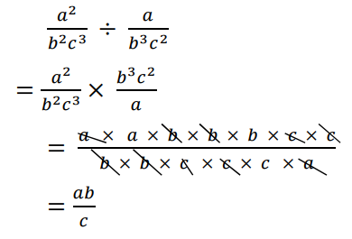
Here’s a shortcut…
Change division sign to multiplication sign and upturn the proceeding fraction.
Multiply numerators together then denominators together.
Cancel factors that are common.

Slide 8
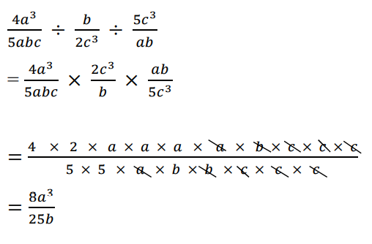
Here’s a shortcut…
Change division sign to multiplication sign and upturn the proceeding fraction.
Multiply numerators together then denominators together.
Cancel factors that are common.

Slide 9
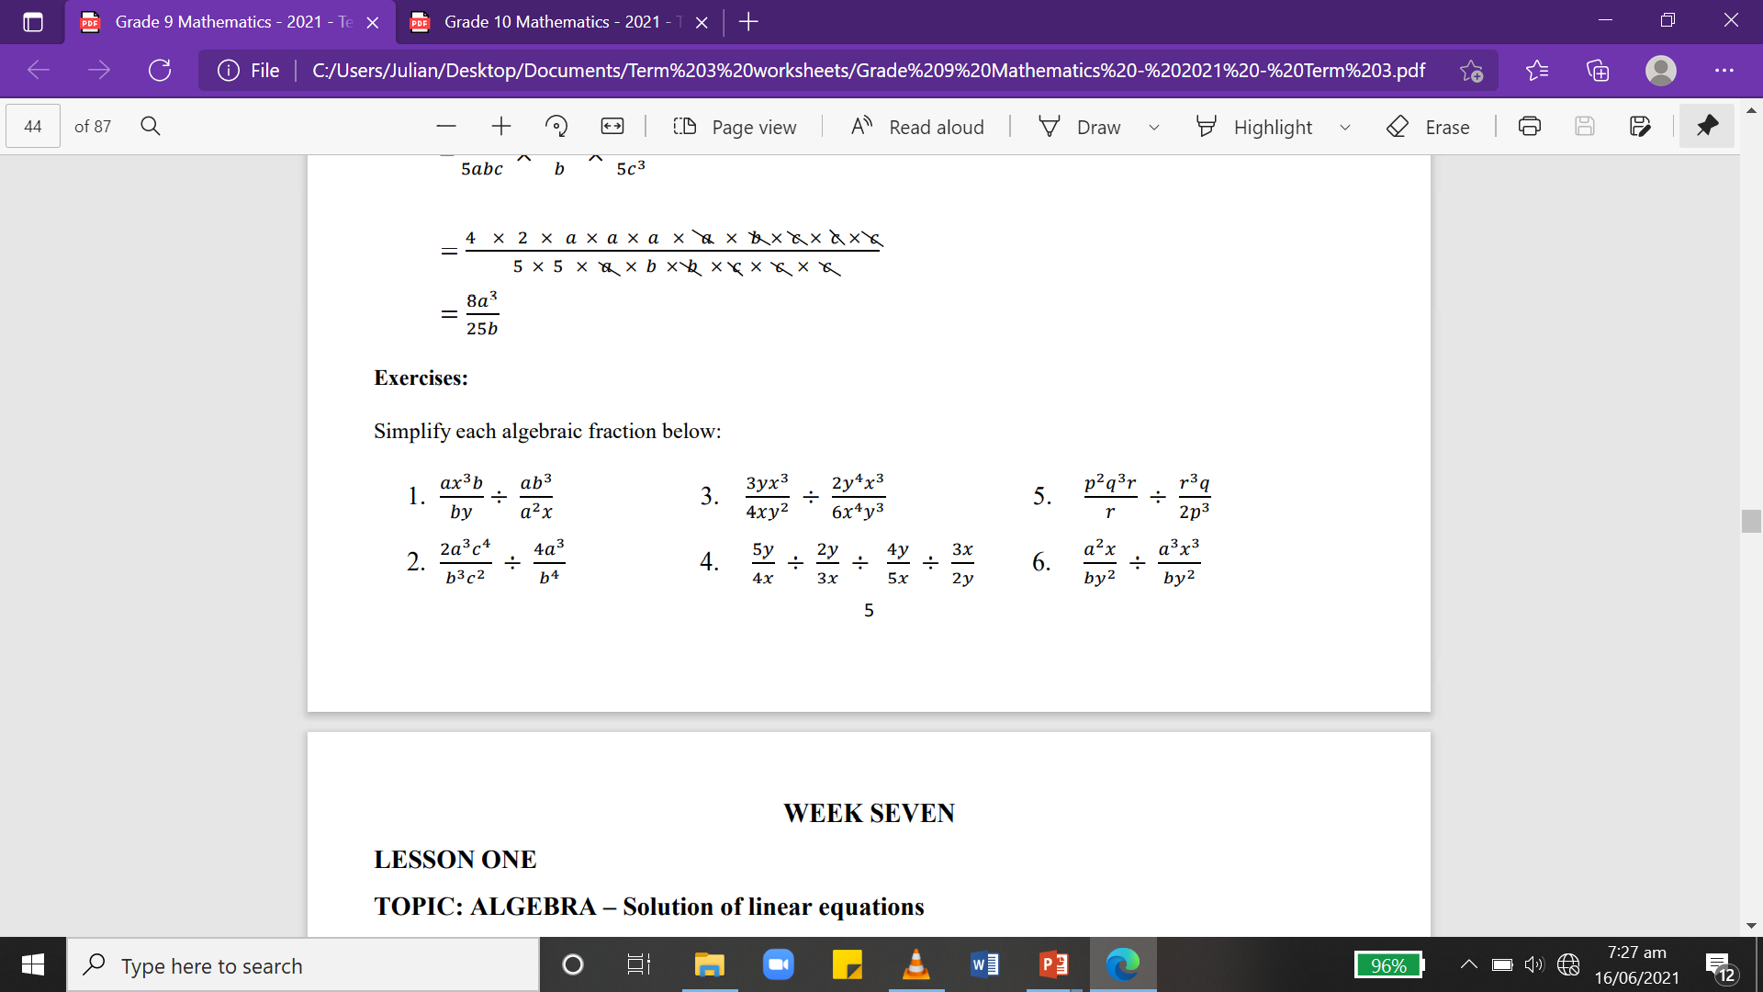
Activities

Slide 10
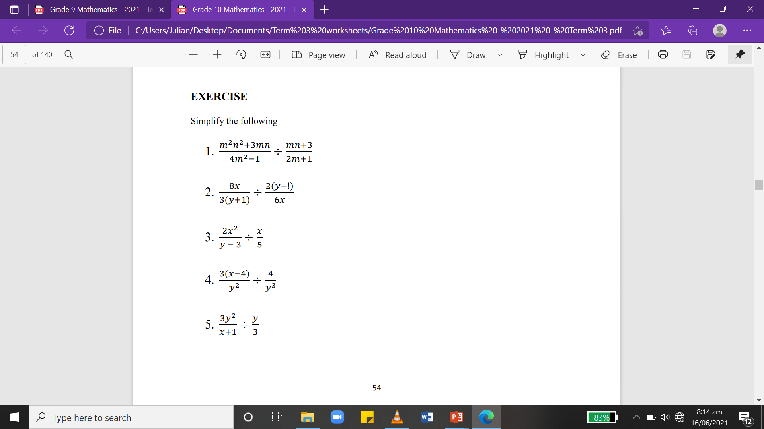
Homework
Simply the following fractions
1)
2.

