Slide 1
Algebra:
Multiplication of Algebraic Fractions
Prepared & Presented by: Sir j. Dey

Slide 2
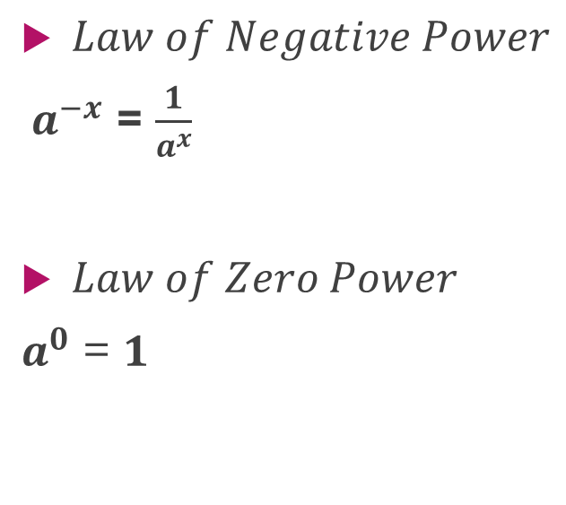
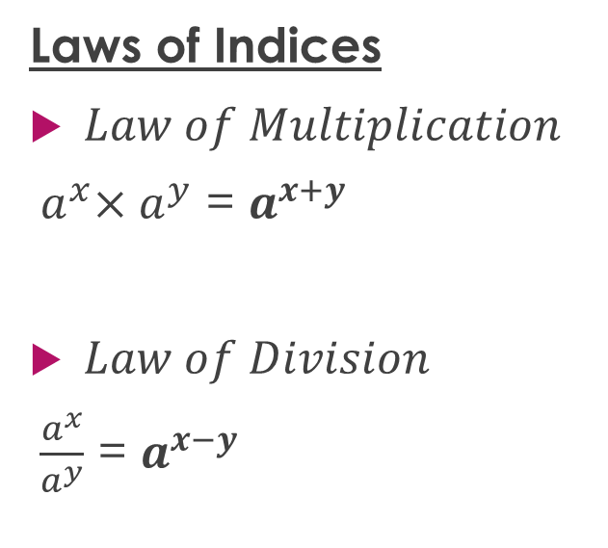
Keep in mind…
Laws of Indices
$Law of Multiplication$
${ a}^{x}×a^{y}$ = $a^{x+y}$
$Law of Division$
$\frac{a^{x}}{a^{y}}$ = $a^{x−y}$
$Law of Negative Power$
${ a}^{−x}$ = $\frac{1}{a^{x}}$
$Law of Zero Power$
$a^{0}$ = $1$

Slide 3
It’s this simple…
Multiply numerators together then denominators together
Cancel factors that are common

Slide 4
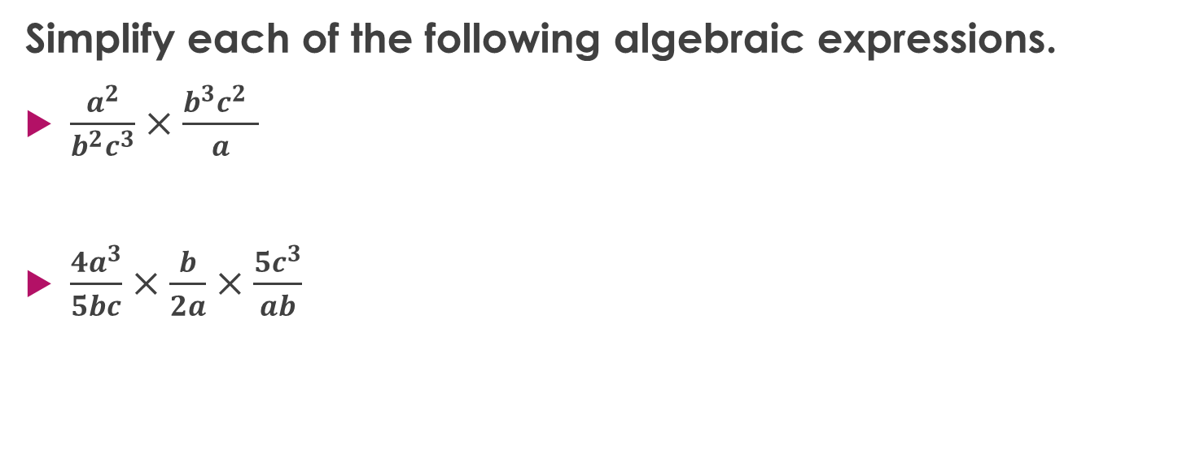
Let’s work some examples…
Simplify each of the following algebraic expressions.
$\frac{a^{2}}{b^{2}c^{3}}×\frac{b^{3}c^{2} }{a}$
$\frac{4a^{3}}{5bc}×\frac{b}{2a}×\frac{5c^{3}}{ab}$

Slide 5

Example #1
$$\frac{a^{2}}{b^{2}c^{3}}×\frac{b^{3}c^{2} }{a}$$
$$=\frac{a^{2}{×b}^{3}c^{2}}{{ab}^{2}{×c}^{3}}$$
$$\frac{a^{2}b^{3}c^{2}}{{ab}^{2}c^{3}}$$
$$=\frac{ab}{c}$$
Multiply numerators together then denominators together.
Cancel factors that are common.

Slide 6

Example #2
$$\frac{4a^{3}}{5bc}×\frac{b}{2a}×\frac{5c^{3}}{ab}$$
=$\frac{4a^{3}×b×5c^{3}}{5bc×2a×ab}$
=$\frac{20a^{3}bc^{3}}{10a^{2}b^{2}c}$
$$=\frac{2ac^{2}}{b}$$
Multiply numerators together then denominators together.
Cancel factors that are common.

Slide 7
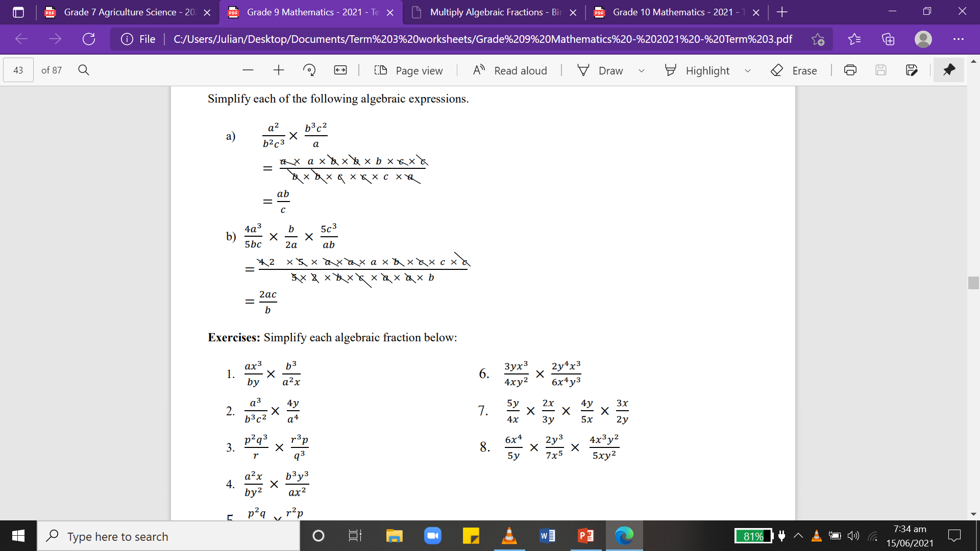
Here’s a shortcut…
Multiply numerators together then denominators together.
Cancel factors that are common.

Slide 8
Here’s a shortcut…
Multiply numerators together then denominators together.
Cancel factors that are common.

Slide 9
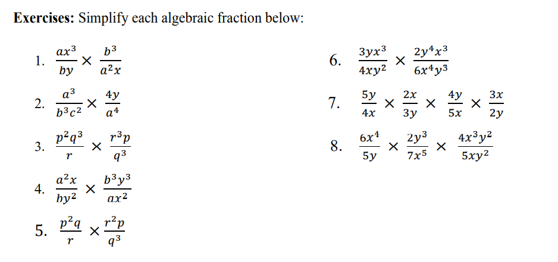
Activities

