Slide 2
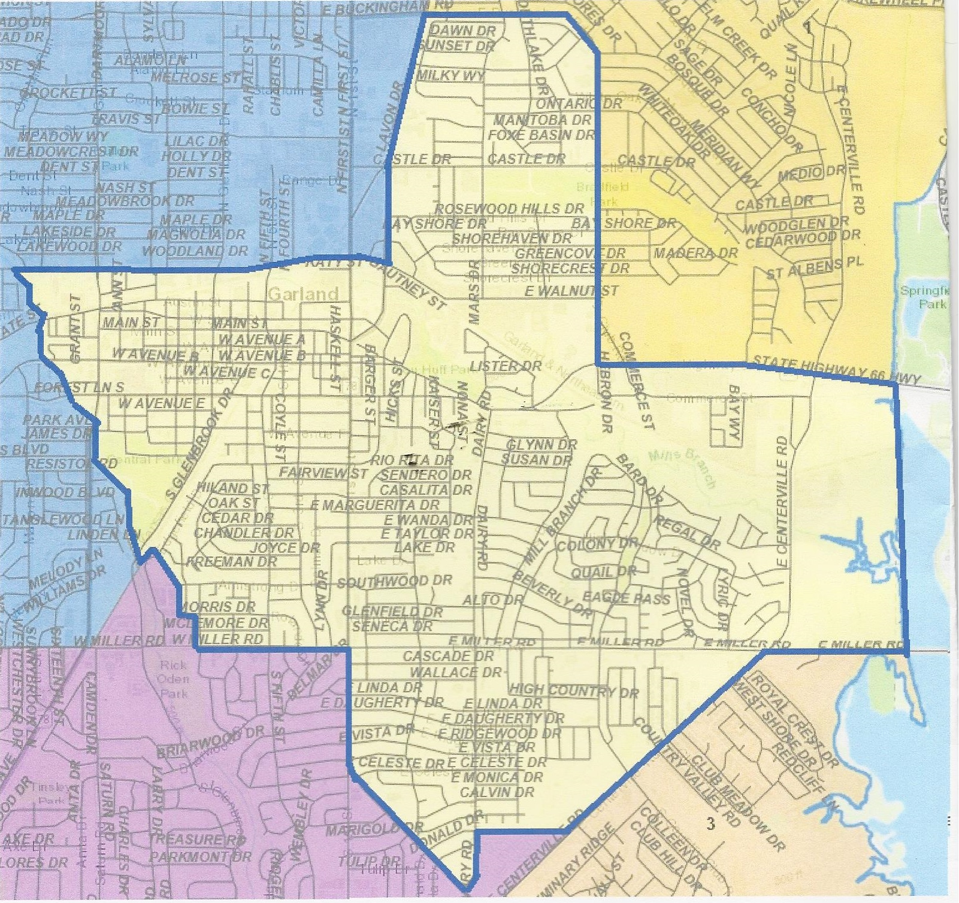
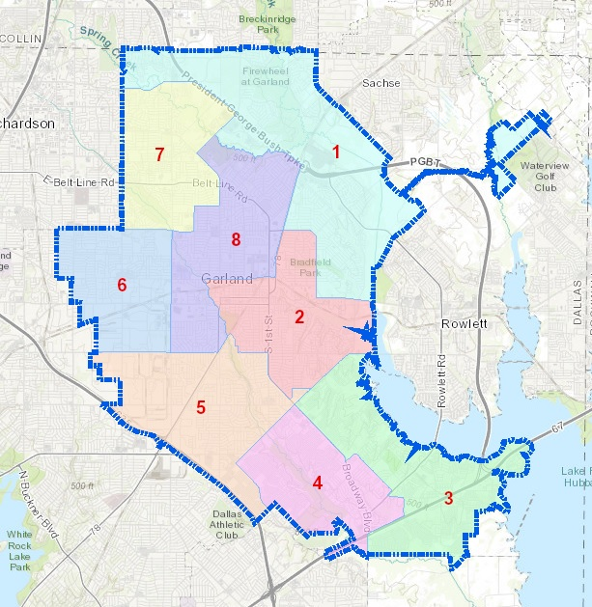
GARLAND
DISTRICT 2

Slide 3
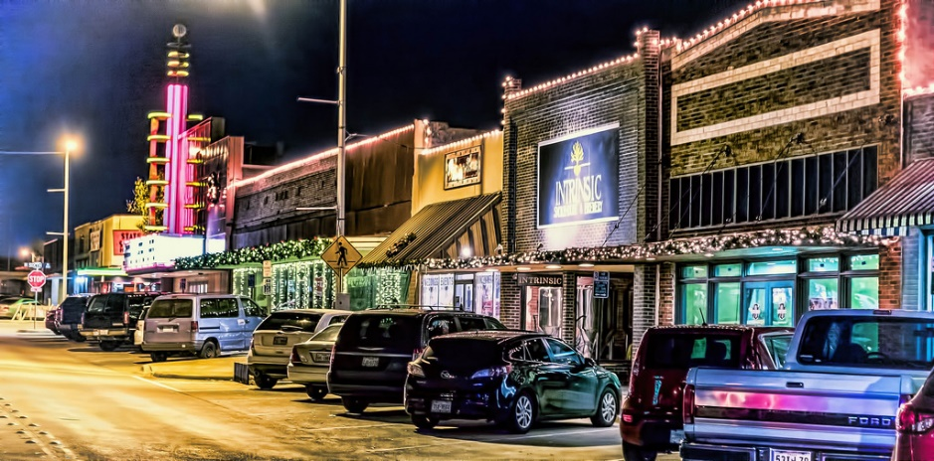
Downtown!

Slide 4
Downtown Redevelopment
Parking & Infrastructure Master Plans nearing completion (expected to be presented to Council Nov/Dec 2018)
Bid awarded for design and cost estimation of an iconic gateway sign at Main and First Streets
Installation of 6 new kiosks (by Dec 2018)
(DART Station, 5th/Austin, 5th/State, 6th/Austin, 6th/State & Main/Glenbrook)
Central Library Life and Safety Upgrade project initiated; includes future improvements to parking lot surface, exterior lighting, and Austin St. streetscape from Sixth St. to Glenbrook Dr.
Notes:
Includes Downtown parking capacity and utilization study, including proposed recommendations for maximizing parking assets. Will go to Council for review, then be presented for public input.
Includes assessment of utilities, drainage, transportation, and pedestrian infrastructure capacity and utilization. Findings and recommendations will go to Council for review, then be presented for public input.
Kiosks containing maps and advertisements will be installed in the near future at six locations throughout Downtown, including the DART rail station, 5th/Austin, 5th/State, 6th/Austin, 6th/State, and Main/Glenbrook. The kiosks will feature a map of Downtown on one side; the reverse side will accommodate changing posters, such as advertisements for upcoming Downtown or GPAC events.
Design consultant will begin this week on creating concepts and specifications for a pole-mounted gateway sign to direct vehicular traffic down Main St. to Downtown Square
Streetscape and parking lot improvements will occur at the end of the Central Library life/safety project.

Slide 5
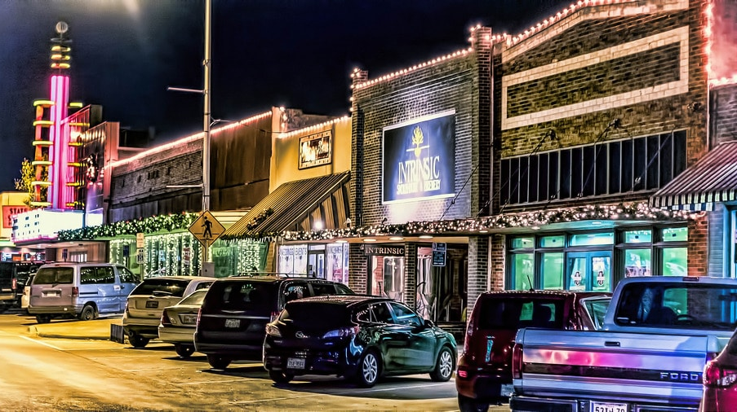
Downtown Redevelopment
In May, City Council approved a $3m project plan for the remaining Downtown TIF Funds
Downtown Coordinator position created; start date is October 1
Year-round LED lights on building rooftops and tree trunks around the Square
SPLASH radio system around the Square to pipe in music and allow for public announcements during events
Notes:
$3.0m of incremental revenue from the TIF has been programmed and implementation of these projects has already begun.
The first TIF project to be implemented is the hiring of the Downtown Coordinator, who begins on Oct. 1
Within the next two months, expect installation of new LED lights to outline building rooftops fronting the Square and a portion of Main St., as well as tree trunks in the Square plaza; these lights will remain on year-round and have the ability to change colors with events/seasons. (Seen in this picture is the old lighting – not LED lighting; the old lights were too maintenance-intensive to leave lit year-round, so they are being replaced with LED).
Also within the next two months, Installation of SPLASH radio system around the Square is expected. It will provide background music (like you hear at Firewheel Town Center), as well as offer the ability to make announcements during special events.

Slide 6
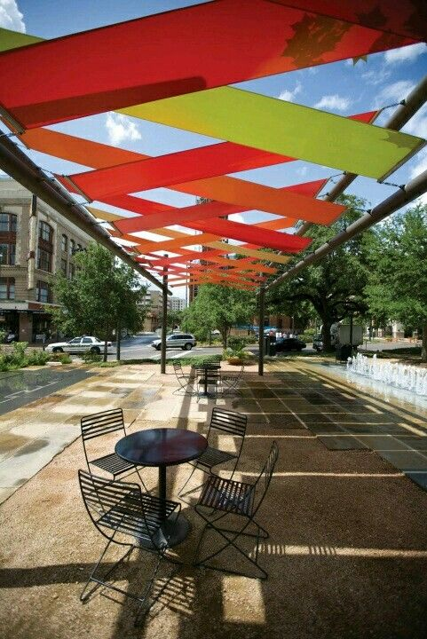
Next Up:
Creation of a Downtown Stakeholder Forum for sharing announcements, resources, and event calendar details
Selection of a seasonal décor vendor to decorate storefronts
Façade Improvement Program Pilot Project(s)
(50/50 City/Business Owner Project)
Installation of additional fixtures, such as seating, trash receptacles, drinking fountain, etc…
Purchase of a semi-permanent structure to provide shade protection and visual interest
Square redesign is scheduled to begin in early 2019, following completion of the infrastructure and parking master plans
Notes:
Secured online forum for Downtown businesses and property owners to share information with the City about event schedules, construction updates, policies, and other announcements or Q&As.
Rotate occasional season décor on storefronts to create a unified look (such as pumpkins/hay bales in the fall, flowers in the spring, etc….)
Per TDA Assessment recommendation, Benches and trash receptacles are needed on feeder streets to the Square to support an extended walkable environment; there have also been requests for a drinking fountain. (IMPORTANT: the exact number/combination/location of these fixtures is yet to be determined, but there is some budget money in FY19 budget to do something.)
$98,000 per year for five years is available beginning October 1 to implement a façade improvement program in Downtown.
Downtown business / property owners are enthusiastic about adding a temporary shade structure to create a more pleasant environment for patrons during summer months; the structure would be a truss structure similar to the temporary stage structure that is often used. Creative materials are available that to create visual interest as well as the functional purpose of creating shade; refer to examples in above pictures.
Square redesign is currently scheduled to being in early 2019. The results of the parking and infrastructure master plans will be used to create the framework (ex: curb lines) for Square redesign. This allows for scheduling coordination of Infrastructure and Square construction.
This is not an exhaustive list; there are other things like electric utility upgrades to support events, off-Square merchant signage, public art, etc…. I wasn’t sure how much time you had to devote to Downtown and if you wanted to talk about everything, or just the things that were “Next Up”. If you want me to include another slide with the rest of these projects, just let me know.

Slide 7
Join the Fun Downtown!
THIS SATURDAY!
Wine Walk: Get your tickets now to receive a commemorative 9 oz. stemless wine glass with the event logo along with an event passport, restaurant coupon book, free wine samples, 1 prize drawing ticket, and a shopping bag!

Slide 8
District 2 Crime Report Report

Slide 9
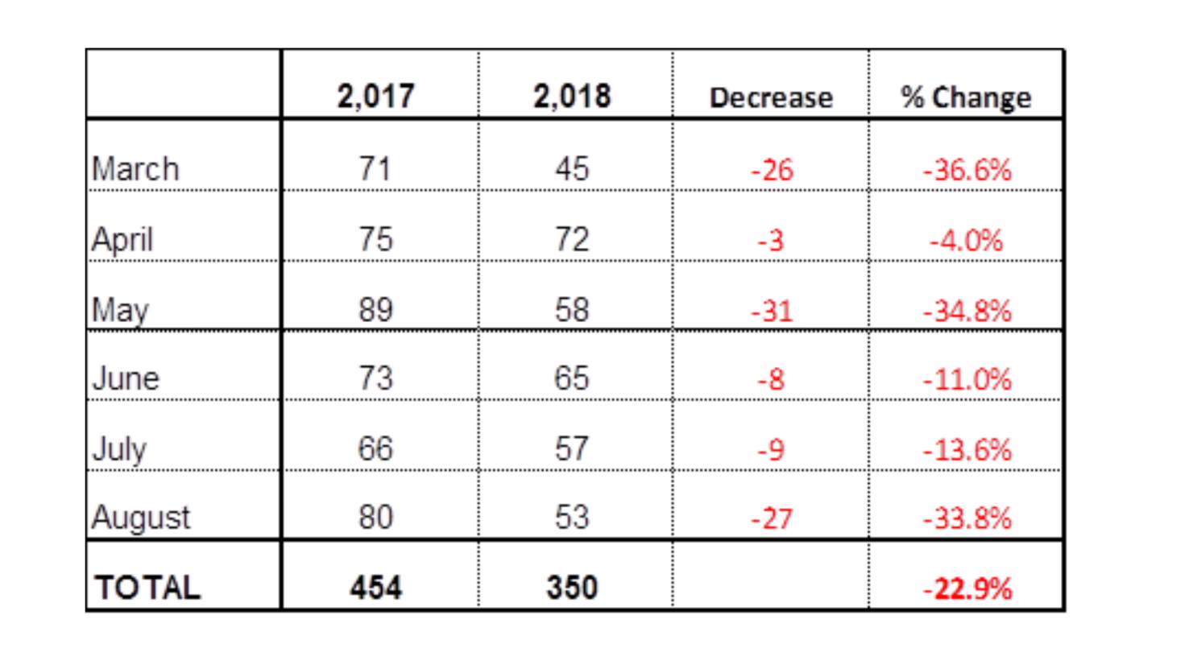
DISTRICT 2 Monthly Uniform Crime Reports Past 6 Months: 2018 Vs 2017
District 2 has experienced a 23% reduction in reported crime in 2018 over 2017
By comparison, the City of Garland has experienced a 13% reduction

Slide 10
Most Common D2 Crimes…
Theft (general) – by far the most occurrences; includes homes and businesses… as you can imagine. Don’t leave things lying around… visible for someone to walk by and take it.
2. Vehicle Burglaries – we constantly remind folks to lock their car doors… and don’t leave valuables (laptops, cellphones, purses, etc.) visible in the vehicle. Take them with you, if possible.
3. Auto Theft – is a state-wide and nation-wide issue. Please don’t leave car running with keys in it… surprisingly, that often happens at convenience stores. And…
4. Residential Burglaries – are a distant 4th… please close garage doors. Open garage doors are too tempting for some criminals to pass up… ☺.

Slide 11
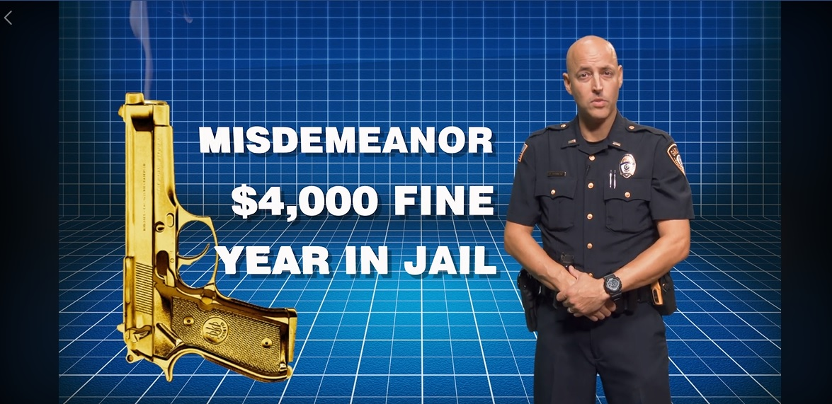
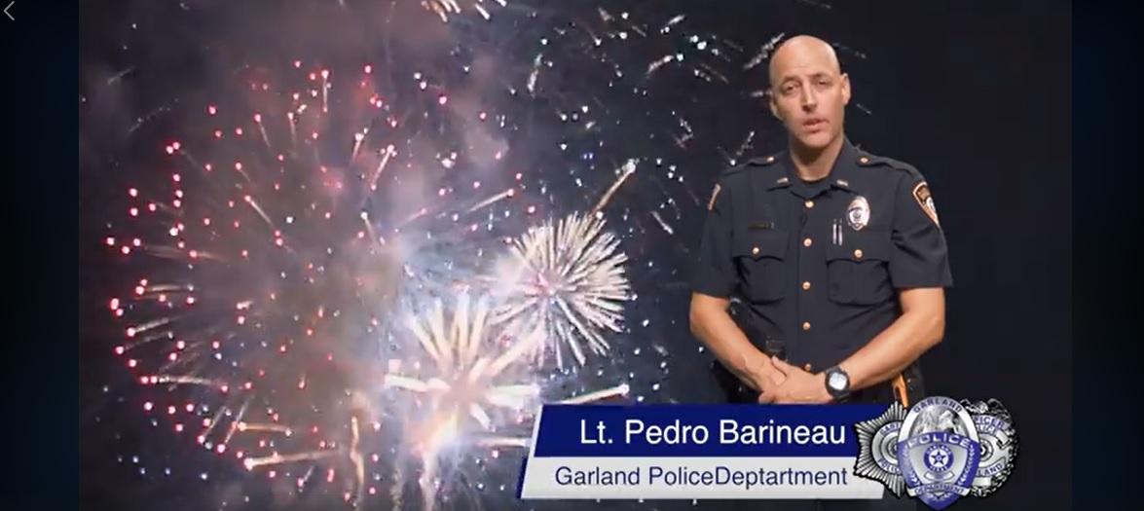
Illegal Fireworks & “Celebratory” Gunfire
New! Public Service Announcement (PSA) in English and Spanish regarding the dangers and consequences
New! Fireworks/Celebratory Gunfire “task forces” will work on holidays to take calls & respond

Slide 12
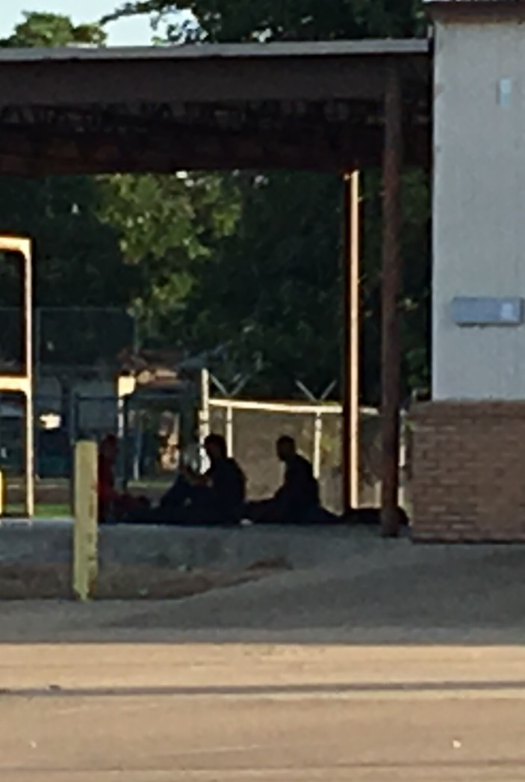
HOMELESS CONCERNS

Slide 13
Concerns FOR the Homeless
Health & Safety (vulnerable to crime, elements, disease, other illness)
Mental/Emotional Support (depression, PTSD, suicide, mental illness)
Basic Human Needs Met (“Whatever you did for one of the least of these, you did for me.” –Jesus, Mt 25:40)
Concerns ABOUT the Homeless
Community Safety (accosting staff at Churches & Senior Center)
Public Health & Sanitation (sanitation issues at parks)
Growing Homeless Population (many coming from Dallas)

Slide 14
Held Brainstorming Meeting 9/7
12 participants, ranging from social workers, health care workers and pastors to community activists and police officers.
Identified some resources currently available in District 2:
Axe Memorial Church (Extreme Weather Shelter, Showers)
New Liberty Baptist Church (Meals, Showers)
Homeless Nexus (Hygiene Items, Food, Clothing, etc.)
Wendy Sheriff (GPD Homeless/Mental Health Liaison)
Good Sam (Food Pantry)
Friendship House (Food, Clothing, Household Items, School Supplies)
Matthew 25:40 Project (Gen Assistance to Find Housing, Jobs, etc.)
First Presbyterian (Bag lunches)
Hope Clinic (Health Care)
Salvation Army (NEW “Home Sweet Home” Program Coming to Garland/Oct 1^{st)}

Slide 15
Homeless Action Plan…
Coordinated Needs Assessment (first stop)
Identify barriers to homeless recovery
Substance abuse? Untreated mental illness? Disability?
Create Appropriate Intervention
Rehab? Mental health treatment? Applying for aid?
Temporary/Transitional Housing
Barriers to Finding Employment:
Laundry Services
Haircut/Nail Trim
Safe storage of possessions while they go to job interviews
Criminal History

Slide 16
In Danger of Homelessness? Help is Near!
The Salvation Army’s “Home Sweet Home Program” is coming to Garland on Oct 1st, and will serve families at risk of homelessness due to financial hardship or crisis.
Household income at or below 30% Area Median Income
Resident of Dallas County
Documentation (like an eviction notice)
Cannot be a sex offender

Slide 17
Animal Shelter/Animal Services

Slide 18
Garland Animal Shelter: A (Hot & Cold) Blast From the Past
Built in 1965 as an “Open Air” Shelter (before central Heat & A/C became common in commercial facilities).
In 1965, Garland’s population was less than 70,000 (fewer people, fewer pets)
Fast-forward 53 years: Garland’s population is now 236,000+ (more people, more pets)
Shelter is now an embarrassment, inadequate in space, lacking modern amenities, and functionally outdated, including old plumbing systems that require regular repairs. It’s a dinosaur.
It is not fixable. Pouring millions of tax dollars into an inadequate facility in order to “bandaid” it is not feasible. The only “fix” is to build a new shelter.

Slide 19
Why Wasn’t a New Shelter Built Years Ago When Surrounding Cities Built Theirs ?

Slide 20
I Don’t Know.
☹

Slide 21
Not Just Cramped; DANGEROUS
This summer (end of July) the Garland Animal Shelter suffered a distemper outbreak.
Garland chose to work with volunteers and rescues to save the dog population rather
than “clearing the shelter” through mass euthanasia (most common method to contain
a distemper outbreak).
Garland’s response has been praised both statewide and nationwide.
The Cornell University College of Veterinary Medicine, a global leader in veterinary
medicine, guided Garland’s medical response.
Cornell identified overcrowding (over 120 dogs in 78 cages) as a probable "major
contributing cause" to the outbreak.
The Shelter has since returned to the ASV (Association of Shelter Veterinarians) standard
of one animal per cage (with some exceptions).

Slide 22
A Newsworthy Outcome
Although 17 distemper-positive dogs eventually had to be euthanized, 100+ dogs were safely rescued or adopted.
Shelters across the nation have called to consult with Garland Animal Services about their response to the outbreak (every shelter’s nightmare).
Despite the devastating outbreak over the month of August, Garland STILL maintained a 93.1% Live Release Rate, significantly exceeding the 90% minimum standard many “no-kill” shelters use. Garland continues to have one of the highest LLRs rates among municipal shelters in the Metroplex.
Live Release Rates last 6 months: March 95.3%, April 96.8%, May 99.2%, June 96.04%, July 98.2%, August 93.1%. Average = 96.5% for last 6 months.

Slide 23
So Can We Finally Build A New Shelter??!
YES--possibly! It appears likely that funding for a new Animal Shelter will be included in the potential 2019 Bond Election. (materials on table)
If so, Garland citizens will have the opportunity to VOTE next May for a new shelter to be built in Garland.
Current cost estimates range from $10 million - $20 million.
That would build a top-class modern facility more than adequate in size for our current needs, and planned for future growth in Garland.

Slide 24
What I Promised In Feb This Year:
“I will strongly advocate to get a new shelter included in next year’s bond election… In the meantime, though, I will also advocate for immediate short-term improvements to the existing Animal Shelter—ways to incrementally improve the conditions for both animals and staff while we’re waiting for a new shelter.”

Slide 25
Shelter Improvements Since May 2018:
Added a full time employee to the kennel area to focus on animal care
Added a Community Outreach Coordinator to oversee volunteers and manage our social media platforms
Purchased evaporative coolers for every building in the shelter
Added a play/meet and greet area to exercise pets and allow prospective adopters to interact with pets prior to adopting them
Installed hand sanitizing stations throughout the shelter
Switched cleaning agents to a more effective solution
Medical team working on ensuring at least 95% of adoptable animals are sterilized prior to leaving the shelter
Installed surveillance system throughout shelter
Retrained staff on animal vaccinations, decease prevention, and distemper response
Implemented a standardized feeding policy based on the size & weight of the animal
Enhanced our adoption program by giving free adoptions to Veterans, 70 and older, Police/Fire, city employees, and citizens on their birthday
Extended hours for rescues to be able to pick up based on staff availability
Began partnership with GISD to provide workforce training to disabled students
…AND MORE

Slide 26
Street & Sidewalk Repair Plans

Slide 27
Which Streets Get Fixed?

Slide 28
D2 Projects Started/Completed to Date in FY 2017/2018
Project Limits Project Type Comments
Broadway Blvd.* Dairy to First Concrete Street Repair Completed 8/18
Centerville Road* Broadway to SH 66 Concrete Street Repair Completed 5/21/18
Miller Road* First to Fifth Concrete Street Repair Under Construction
Alto Drive Curtis to Dairy Street Reconstruction Completed 4/25/18
Freemont Drive Miller to Southwood Street Reconstruction Completed 7/19/18
High Hollow Drive High Grove to High Mesa Street Reconstruction Completed 3/14/18
Linda Drive Cumberland to Dairy Street Reconstruction Completed 6/13/18
Buckingham Road* Lavon to Pleasant Valley Asphalt Overlay Completed 6/18
Country Club Road* Pleasant Valley to Walnut Asphalt Overlay Completed 7/18
Mainline Drive Commerce to Traffic Trail Asphalt Overlay Completed 8/18
Tower Drive Commerce to Gasoline Alley Asphalt Overlay Completed 8/18
*These streets are border streets between District 2 and other Council Districts.

Slide 29
Upcoming Projects in FY 18/19
Project Limits Project Type Comments
Forest Lane Garland Ave. to Duck Creek Concrete Street Repair Starts Late Fall 2018
High Meadow Drive Dove to Country Club Concrete Repair/Water Line Bid Awarded
High Meadow Circle High Meadow to End Concrete Repair/Water Line Bid Awarded
Wycliff Drive Danbury to Miller Street Reconstruction Starts 12/18
Celeste Drive Dairy to East End Street Reconstruction No Start Date Set
Linda Drive Dairy to Highmont Street Reconstruction No Start Date Set
Note: Two other streets (Arcady – Celeste to Linda and Curtis – Davidson to Susan) are also on our infrastructure construction program, but they will not likely begin until FY 19/20.
PLEASE TAKE A PRINTED COPY OF “ROCKY ROADS IN GARLAND” WITH THESE PROJECTS LISTED

Slide 30
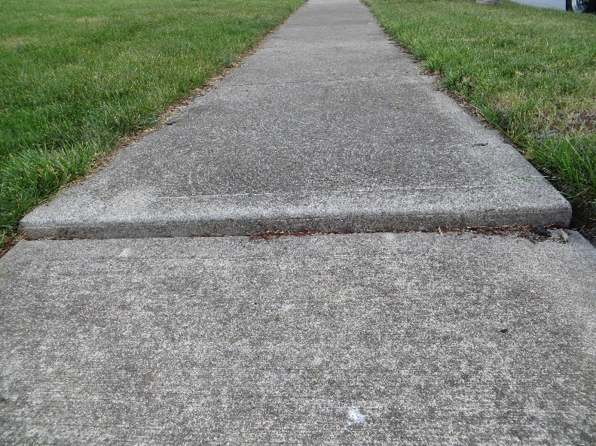
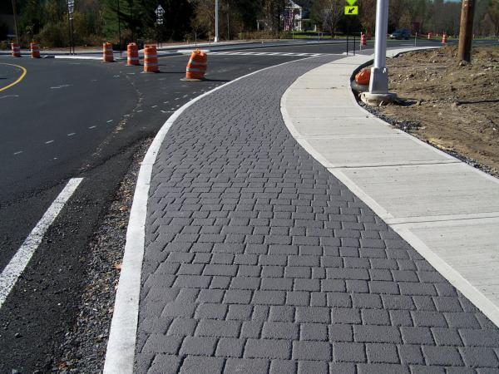
SIDEWALKS…
The Street Department has no sidewalk condition list similar to the street and alley condition list.
When the Street Department reconstructs a street, they also replace the sidewalks.
For all other repairs/replacements, call the Engineering Department at
972-205-2170 to learn about the 50/50 Sidewalk Participation Program. Engineering will contract the repairs and pay 50% of costs, and the homeowner need only pay their 50% (immediately, or by a home lien).

Slide 31
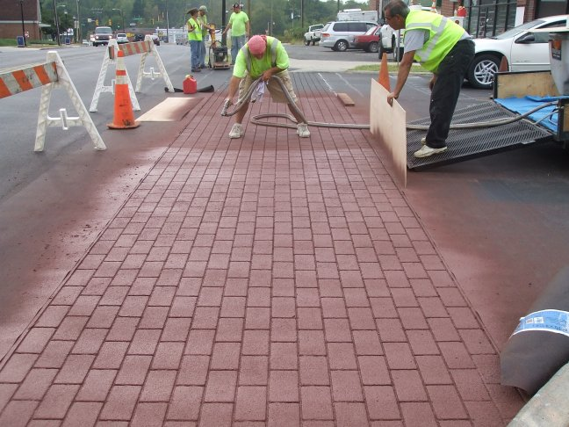
Master Sidewalk Plan / New Ideas
Several City Council Members, including me, are actively seeking some better solutions for our city’s sidewalks, especially for public areas without level sidewalks or ramps for accessibility.
Deteriorated (or absent) neighborhood sidewalks remain
a high-volume complaint in District 2.
One possible lower-cost solution might be patterned
asphalt sidewalks. Shorter lifespan, but reasonably
attractive and easier on backs due to slight “give”.

Slide 32
Dog Park/Central Park

Slide 33
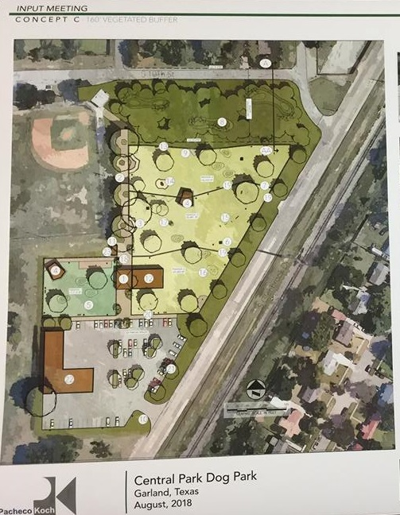
Here’s the Latest Look:

Slide 34
Estimated Project Timeline:
• Feb. 2019 – Construction Documents complete
• May 2019 – Bidding and Procurement complete
• June 2019 – Parks Board Bid Award Recommendation
• June 2019 – City Council Bid Award Recommendation
• July 2019 – Begin Construction
• Nov. 2019 – Dog Park Opens

Slide 35
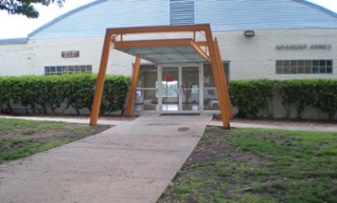
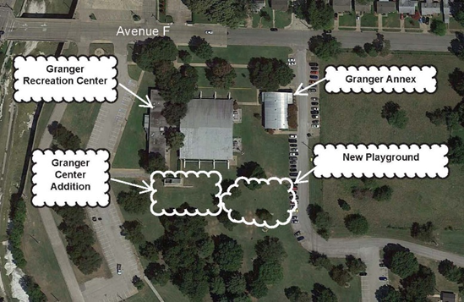
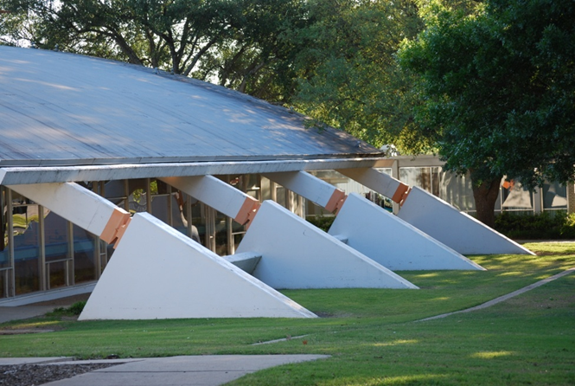
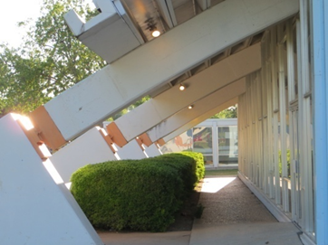
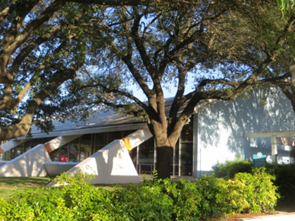
Granger Annex
Granger Recreation Center Renovation
Granger Center was Recognized by the Dallas Chapter of the American Institute of Architects with a “25 Year Award”, presented to outstanding structures more than a quarter of a century old.

Slide 36
Granger Recreation Center & New Addition
Renovation of the 21,375 square-foot recreation center Includes:
New Maple Wood Flooring
Re-Painting All Rooms + Exterior & Concrete Surfaces
New Restroom Floor Tile & Ceramic Tile Walls
New Countertops & Plumbing
New Fitness Room Flooring
New LED Lighting in Double Court Gymnasium
Structural Glass Walls
New Electrical Service & Panels
New Roofing
New HVAC
Landscape, Sidewalk and Drainage Improvements
,
The schedule currently targets April-May 2019 for completion.

Slide 37
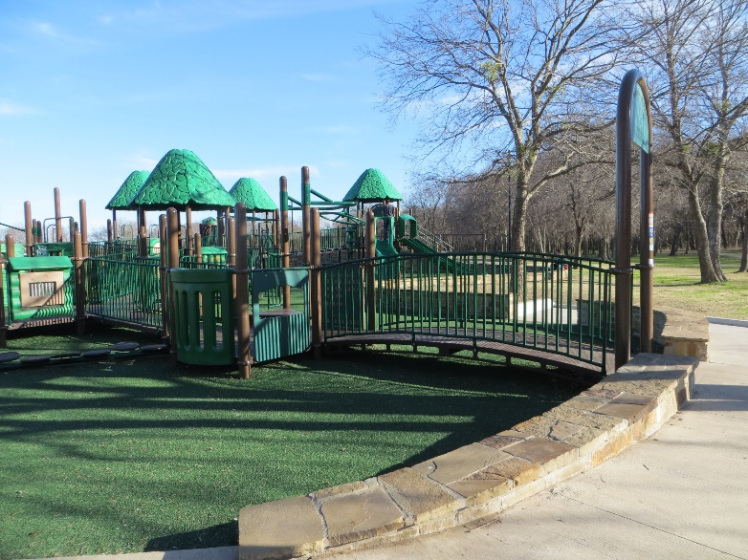
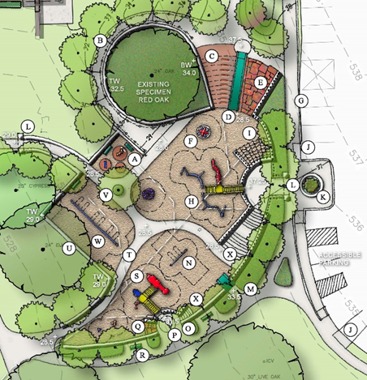
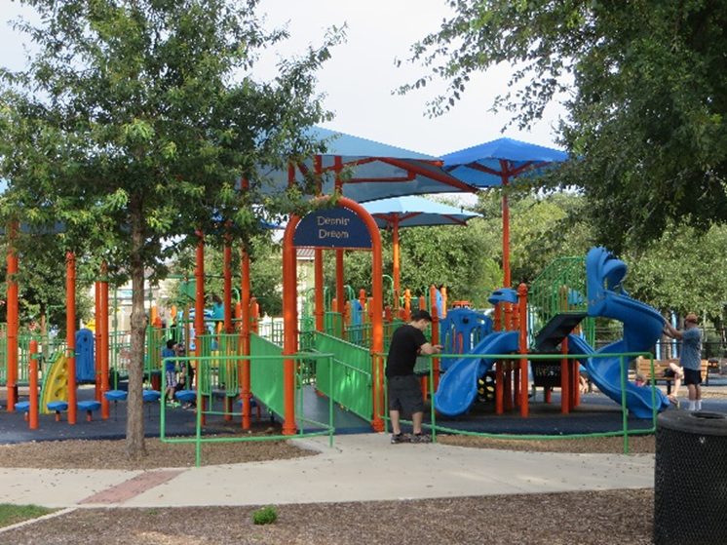
Examples of Play Areas Incorporating Inclusive Access to Play
Central Park Play Area with Inclusive Access
Pre-Design Concept

Slide 38
Central Park Playground
TIMELINE:
OCTOBER 2018: Parks Dept Present Central Park playscape budget options to City Council
Option #1 $500,000 Accessible playscape with limited sensory features
Option #2 $800,000 Accessible playscape with mid-range sensory features
Option #3 $1.3mm Accessible playscape with full design sensory features.
February 2019: Construction Docs Complete
March 2019: Bid Project
May 2019: Open Bids
June 2019: City Council Award Construction Contract
July 2019: Start Construction

Slide 39
Skate Park: On the Move DISTRICT 5 OR BUST!

Slide 40
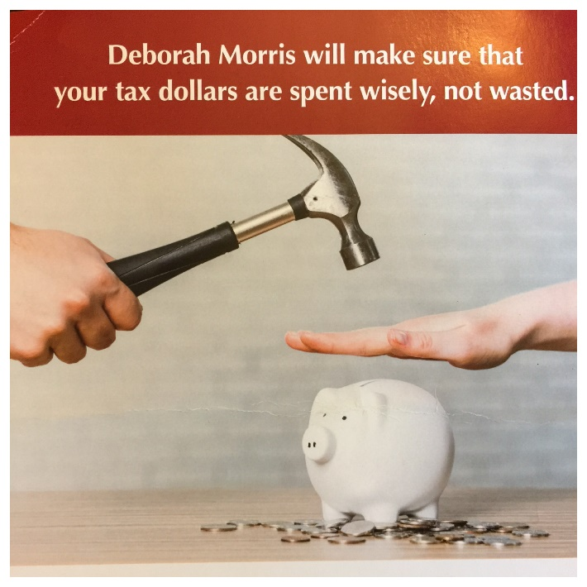
Morris Accountability Report (Yes, I Said This )
So How Have I Spent YOUR $$?
You have paid me $1790.00 5/15 - 9/19 ($99.44/week). ☺
You have paid $104.71 total in meal expenses for my monthly lunch meetings with the City Manager (both our meals) through Aug. In Sep I decided to start paying my own bill.
You paid $649.29 total to send me to Waco 7/25-7/26 for the Texas Municipal League’s Newly Elected Official’s Training.
You will be paying approx. $1100 to send me to Corpus Christi Nov 6 – 9 to attend the Texas Downtown Conference (to learn how other Texas downtowns are growing and developing).

Slide 41
NEIGHBORHOOD ISSUES

Slide 42
Neighborhood Issues: LOOSE DOGS
Out of the 11,015 calls for service received between March and August 2018,
4042 were for stray animals
Average of 260 dead animals are picked up from Garland roads each month, and far too many are dogs.
CALL GARLAND ANIMAL SERVICES when you see a stray dog: 972-205-3570
Recurring problems? Garland Animal Services will patrol specific areas and streets until the issue is under control.
Stray dogs are not released to their owners until an enclosure inspection is performed.
Garland Animal Services now partners with Code Compliance re: inadequate fences with dogs so owners can be notified BEFORE the dog(s) escape.

Slide 43
Neighborhood Issues: NOISE!
Barking Dogs… Radios/TVs/Musical Instruments… Exterior Loudspeakers…
Construction Work… Power Equipment… ENCLOSED Places of Public Entertainment.…
Powered Model Mechanical Devices… Refuse Collection… Vibration…Emergency Signaling…
Watercraft…Mechanical Sweeping or Cleaning… Industrial Noise
(Article V Sec 22.70)
“If any sound listed…above can be heard in a residential area at a distance of 50 feet or more from the closest property line of the property where the sound originates, there shall be a presumption that the sound unreasonably disturbs or interferes with the peace, comfort and repose of neighboring persons of ordinary sensibilities.”
(Article V Sec 30.57)
WORKING HOURS: Any outside work being done adjacent to an occupied residential subdivision or adjacent to an occupied residential use, including multifamily uses, shall be prohibited between 8:00 p.m. and 7:00 a.m. each day of the week.

Slide 44
Who do you call to report loud late-night parties?
Police Non-Emergency Number: (972) 485-4840
Who do you call to report a chronically loud business?
Garland Health Department: (972) 681-9778

Slide 45
Neighborhood Issues: OVER-PARKING
Many older neighborhoods in District 2 suffer from crowded street parking—narrow streets, smaller homes, too many cars per house, large commercial vehicles & trailers
The Public Safety Committee will be bringing some new commercial truck/trailer neighborhood parking restrictions to Council soon which will help.
City Staff is currently assembling an array of existing parking ordinances to find
ways to address the over-parking issues being experienced in our neighborhoods.
It is currently illegal to: Block Driveways, Block Sidewalks, Park More than 18” from Curb, Park Facing the Wrong Direction, Park Within 15’ of a Fire Hydrant, Park Within 30’ of a Stop Sign, etc.

Slide 46
QUESTIONS?

