Slide 1
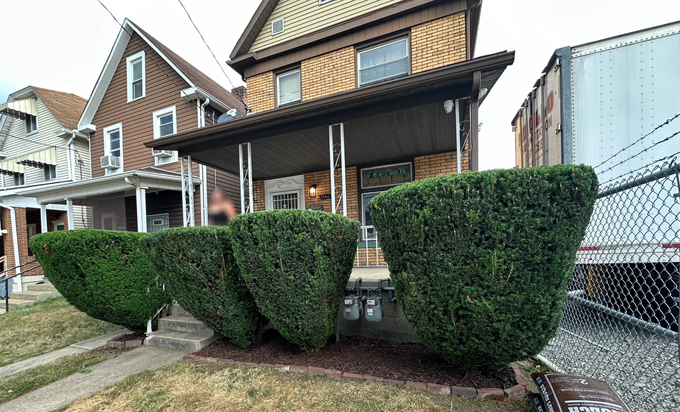
1366 Third Avenue
Apartment A
Arnold Pennsylvania 15068
For Rent: $1,000.00/month
2-bedroom, 1-bathroom, first floor apartment
Tenant pays all utilities
Brand new interior renovation
Shared backyard with upstairs tenant
Brand new appliances
Parking spaces available
Application fee
Security deposit required
No pets

