Slide 1
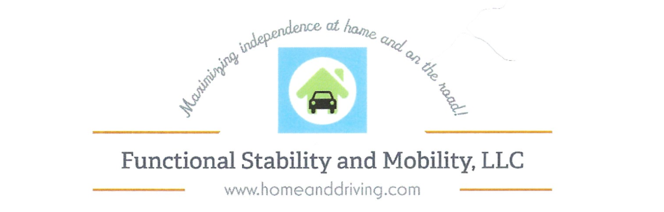
Stroke & Returning to Driving
Megan Frazier, MS, OTR, DRS

Slide 2
Course
Objectives
How a stroke can impact our ability to continue driving safely.
Feel free to write questions in the chat room throughout the presentation
All information shared in the group is confidential.
Explore options for getting back on the road

Slide 3
Course
Overview
We will learn…
  Meaning of driving & influence on a driver’s decisions
  How our body and brain impact our driving
  How a Stroke specifically impacts driving
  State requirements after a Stroke

Slide 4
Course
Overview
We will learn…
  Self Assessments available
  What to do if you want to improve your driving skills
  Resources to get you back to driving & accessing the community

Slide 5

Who am I?
Megan Frazier, MS, OTR, DRS
Occupational Therapist and Driving Rehab Specialist
Over 15 years experience working with aging populations & 12 years in Central Texas
Owner of Functional Stability and Mobility, LLC
Contact Information:
  (254) 290-3333
  Megan@homeanddriving.com
  www.homeanddriving.com

Slide 6
The
Meaning of Driving
Freedom and spontaneity
Status and identify
Only way to get places
Sense of self-worth
Desire to help others
Other??

Slide 7

Risk Factors for Driving
After 70 there is higher risk of being involved in a collision
Medication use and reduced physical function increase risk of accidents and injury
Deaths increases around ages 60-65 because of fragility
Drivers 85+ have the highest fatality rates per mile
More than 90% of crashes are preventable

Slide 8
Typical Challenges for Drivers
  Making left turns at intersections, especially without a traffic light
  Driver distraction
  Driving at dusk or at dawn
  Merging into another traffic lane
  Failing to yield to right-of-way

Slide 9

Driving and the Brain
https://www.google.com/search?q=funny+memory+memes&tbm=isch&source=iu&ictx=1&fir=QScQqcbXS1XdDM%253A%252CgCqs2NGqi4x31M%252C_&usg=AI4_-kQkCOeizdzuDtXINvVcCwYYrhr3Qg&sa=X&ved=2ahUKEwiX1vuguPTeAhVCPq0KHePDABcQ9QEwBHoECAUQDA#imgrc=QScQqcbXS1XdDM:

Slide 10

Driving and the Brain
    Attention and alertness
    Problem Solving
    Memory
    Way Finding Skills
    Reactivity and Anticipation

Slide 11
How does a Stroke affect cognitive skills?
Needs help or instructions from passengers
Doesn’t observe signs or signals
Makes slow or poor distance decisions
Gets easily frustrated or confused
Gets lost even in familiar areas
Drifts across lane markings
Difficulty with multitasking

Slide 12
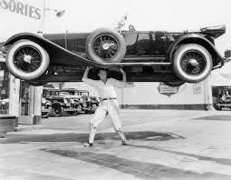
Driving and the Body
https://www.whiterivercu.com/3-things-you-need-to-know-before-buying-a-new-car/

Slide 13

Driving and the Body
    Strength
    Flexibility
    Endurance
    Reaction Time
    Range of motion

Slide 14
How does a Stroke affect these skills?
Increased fatigue
Weakness in arm, leg or both affecting ability to steer or push pedals
Unable to feel pressure placed on pedals
Difficulty maintaining balance when turning

Slide 15
How does a Stroke affect these skills?
Difficulty getting into/out of vehicle
Difficulty turning head to scan for traffic
Slow reaction time
Increased risk of seizures

Slide 16
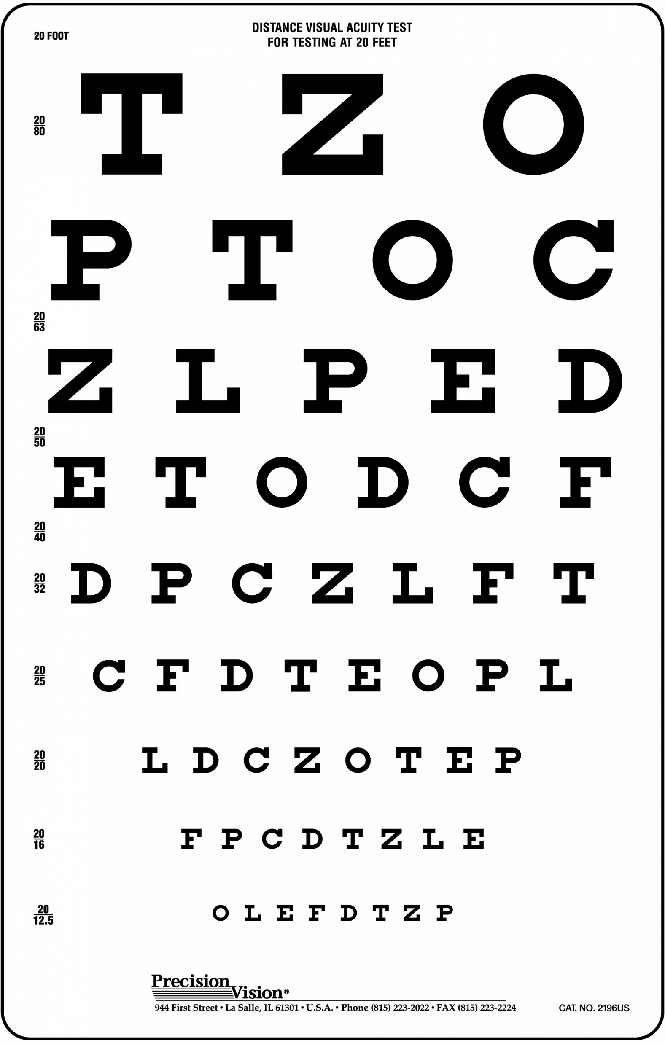
Driving and
Vision
https://www.precision-vision.com/product/distancevisualacuitytest/?gclid=Cj0KCQiA8_PfBRC3ARIsAOzJ2uqlsGkAwvc_d-nmd4-5qPJW4uK6g6ruDH05apU-7coxWoCzqBwu4asaAqG5EALw_wcB

Slide 17

Driving and Vision
    Depth perception
    Peripheral vision
    Visual spatial skills
    Contrast sensitivity

Slide 18
How does a Stroke affect these skills?
Double or blurred vision
Loss of central vision in one or both eyes
Visual field loss
Visual processing problems
Slowed eye movements
Neglect or inattention to one side
Difficulty with scanning entire field of view

Slide 19


Visual Processing & Visual Search

Slide 20

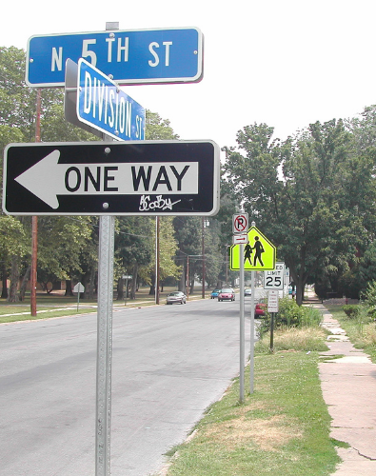
Visual Processing & Visual Search

Slide 21

Driving and Medications
Prescription drugs are the most prevalent of all drugs found in drugged drivers involved in fatal crashes (46.5%)
Roadwise RX: Understand how your medication affects your driving http://roadwiserx.com/

Slide 22
Driving and Medications
Some medications increase a driver’s risk:
  Antidepressants up to 41%
  Diphenhydramine:
    Severely impairs the ability to follow at a safe & constant distance, maintain speed, & maintain lane position
    One single dose of this medicine can have the same effect on driving as being above the legal limit for blood alcohol concentration

Slide 23

State Requirements for Driving
https://i.pinimg.com/564x/b4/0e/ad/b40eadd1677d579ccd128acc8e7eaa3c.jpg

Slide 24
State Requirements for Driving
Recurrent TIA
Recurrent TIAs may preclude the operation of passenger vehicles
Patients treated with appropriate anticoagulant therapy should be able to resume driving
A 1 month driving restriction should follow the last know episode if not treated with anticoagulant therapy

Slide 25
State Requirements for Driving
Blackout
Temporary loss of consciousness due to decreased blood flow to the brain
6 month driving restriction period

Slide 26
State Requirements for Driving
Stroke
Dependent upon the physical & neurological deficits following recovery & rehabilitation has stabilized
Demonstration of Driving ability through DPS’s comprehensive driving test should be completed for moderate to severe motor, sensory, visual or language deficits
If visual deficit present, must be cleared by an ophthalmologist prior to driving (& must meet the peripheral vision requirements)

Slide 27
What are the State Agencies involved with driving?
Department of Public Safety (DPS)
Medical Advisory Board
Texas Department of Licensing and Regulation (TDLR)
Texas Workforce Commission (TWC)

Slide 28
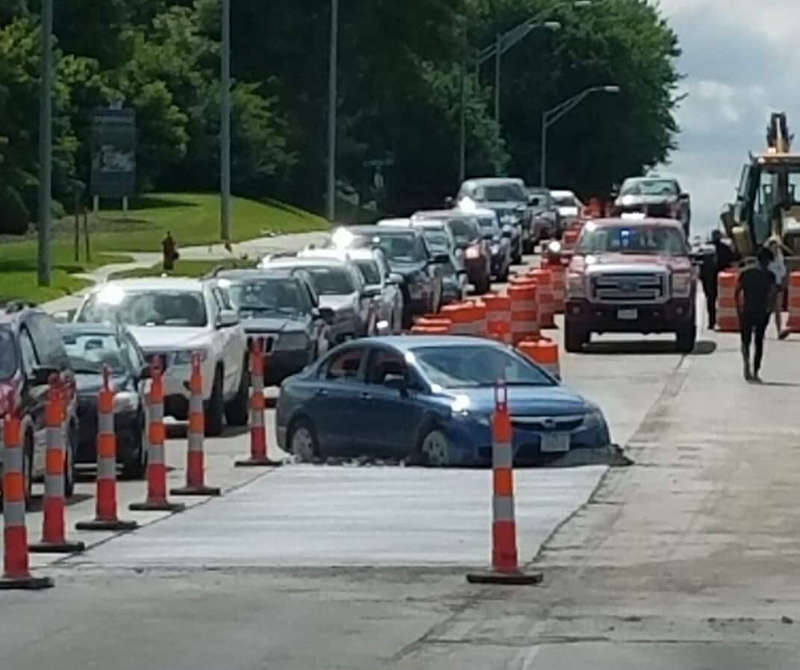
Warning Signs
https://i.redd.it/2coa15o58pzy.jpg

Slide 29
Warning
Signs
Doesn’t observe signs, signals, or other traffic
Inappropriate driving speeds (too fast or too slow)
Poor road position or wide turns
Accidents or near misses
Difficulty with parking (parking outside the lines, taking up multiple spaces)
Other drivers often honk horns
Ticketed moving violations or warnings

Slide 30
Warning
Signs
Look
Look at frequency and severity of signs
Look
Look for changes in driving skills
Look
Look for patterns
Avoid
Avoid an alarming reaction
Track
Track observations over time
Ask
Ask partner, family and friends

Slide 31
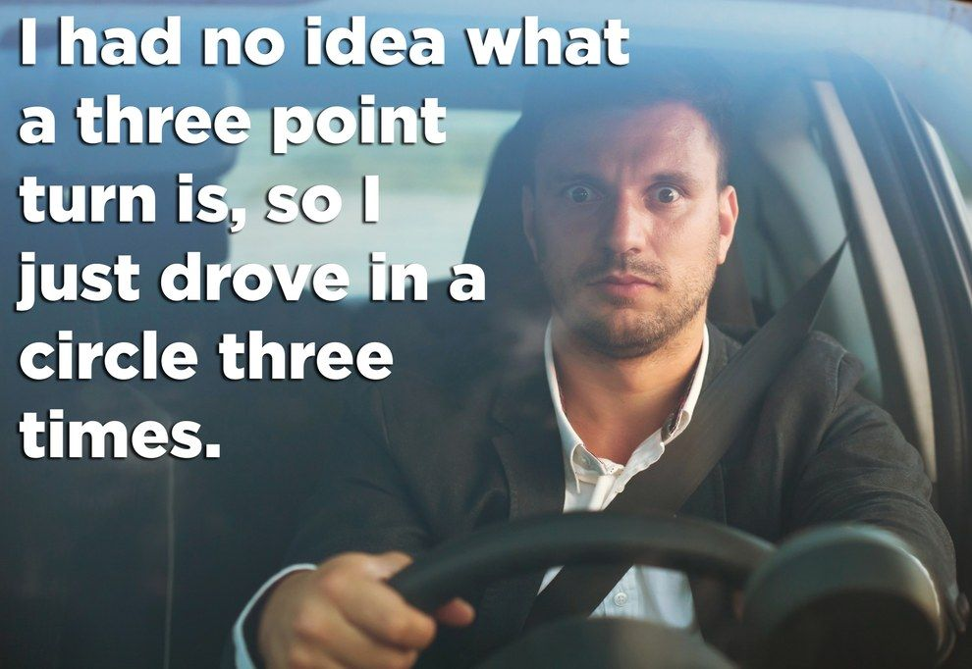
Self Assessment Tools
https://i.pinimg.com/originals/1b/88/80/1b8880fb94e460d463c4c80c6a829aa1.jpg

Slide 32
Self Assessment Tools
SAFER Driving The Enhanced driving decision workbook
  http://www.um-saferdriving.org/firstPage.php
Drivers 65 Plus: Check your performance.
  https://seniordriving.aaa.com/wp-content/uploads/2016/08/Driver652.pdf
Drive Well Toolkit
  https://one.nhtsa.gov/Driving-Safety/Older-Drivers/Drive-Well-Toolkit:-Promoting-Older-Driver-Safety-and-Mobility-in-Your-Community
Driver’s 55 Plus: Check your own performance.
  http://elderlydrivingassessments.com/images/individ/55plus.pdf

Slide 33
Self Assessment Tools
Warning Signs for Older Drivers: The Hartford Guide
  www.safedrivingforalifetime.com
BCAT System Driving Self-Assessment
  https://www.thebcat.com/self-assessment-tools/driving-self-assessment
Fitness to Drive Screening Measure
  http://fitnesstodrive.phhp.ufl.edu/us/
Are you a smart, defensive driver?
  https://www.aarp.org/auto/driver-safety/info-2015/quiz-are-you-a-defensive-driver.html?intcmp=AE-ATO-ADS-SFTY-ROW2-SPOT1#quest1

Slide 34
What can I do to do improve my driving skills?
First
Make an appointment to see your MD to discuss your concerns and desire to return to driving
Second
Make an appointment with an outpatient Occuapational Therapist, Physical Therapist and/or Speech Therapist depending on your residual deficits
Third
Make an appointment with an Occupational Therapist Driver Rehab Specialist

Slide 35
Visit with your physician
You need medical clearance from your doctor
Check that medication will not impact your driving
Discuss your desire to return to driving and any concerns the MD may have
Ask for a therapy consult if needed to address any deficits you may still have that may impact your driving

Slide 36
Outpatient Therapy
Outpatient therapy (PT/OT/ST) can help you address any remaining deficits
Physical Therapy
  Balance, Endurance, strength, leg control, reaction time, ROM
Occupational Therapy
  Navigation skills, strength, ROM, safety, attention, scanning, motor planning
Speech Therapy
  Problem solving, language deficits, safety

Slide 37
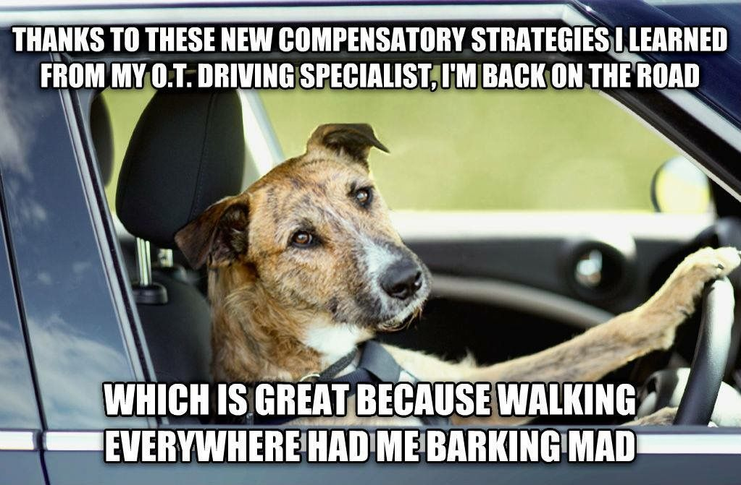
Occupational Therapist
&
Driver Rehab Specialist (OT DRS)
https://paspahang.org/funny-dog-rescue-memes/

Slide 38
What is an
OT DRS?
An Occupational Therapist that has had specialized training in assessing driving and community mobility needs
Look at how your Stroke affected your ability to drive and what additional training and possible modifications you may need to start driving again
Complete On-Road Evaluations and training to determine Fitness to Drive
Teach people how use modified controls (left foot accelerator, hand controls, steering wheel modifications, additional mirrors) as needed
Most are certified by the Association for Driver Rehab Specialists (ADED) or the American Occupational Therapy Association (AOTA)

Slide 39
What does an evaluation look like?
Clinical Evaluation
Looks at vision, strength, reaction time, memory, attention, sequencing, sensation, range of motion
On-Road Assessment
Looks at ability to react to on-road demands, scan environment and react to hazards, obey traffic laws and signals, vehicle control

Slide 40
Types of Programs
Hospital Based with clinical and simulator assessment (no on-road assessment)
Hospital Based with clinical and on-road assessment
Outpatient Clinic Based
Private Practice with clinical and on-road assessment

Slide 41
How much does it cost?
Medicare/Insurance does not cover driving evaluations
Programs vary (typically $350-600 for an evaluation)
Training is a separate charge (typically charged by the hour)
Additional costs: cost of adaptive equipment, installation

Slide 42

Additional Suggestions
See your doctor regularly
Take your medication as prescribed
Exercise and eat healthy
Take care of your car and keep up with regular maintenance
Set up a driving retirement plan
http://www.drivelab.ca/assessment-and-treatment-programs

Slide 43
Additional Resources
MIT AgeLab web.mit.edu/agelab
AARP Driver Safety www.aarpdrivingsafety.org
National Highway Traffic Safety Administration www.nhsta.gov
National Safety Council www.nsc.org
Certified Driver Rehabilitation Specialists www.driver-ed.org
National Stroke Association www.stroke.org
American Occupational Therapy Association www.aota.org
Association for Driver Rehabilitation Specialists www.added.net

Slide 44

Thank You!
Please feel free to reach out with any questions or concerns in the future.
www.homeanddriving.com
(254) 290-3333

