Slide 1
Bare Minerals
Atmospheric Nature
Brooke Behan

Slide 2
Moodboard
Clean approach to nature
Focus on neutral colors that highlight the tones of the makeup
Earth, water, fire, wind
Simplicity
Immersive relaxation experience
Giving the consumer a feeling of grounding
Nature X Beauty

Slide 3
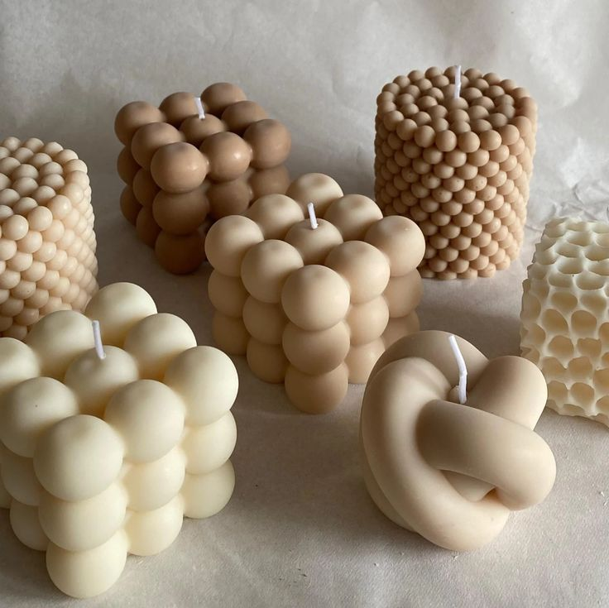
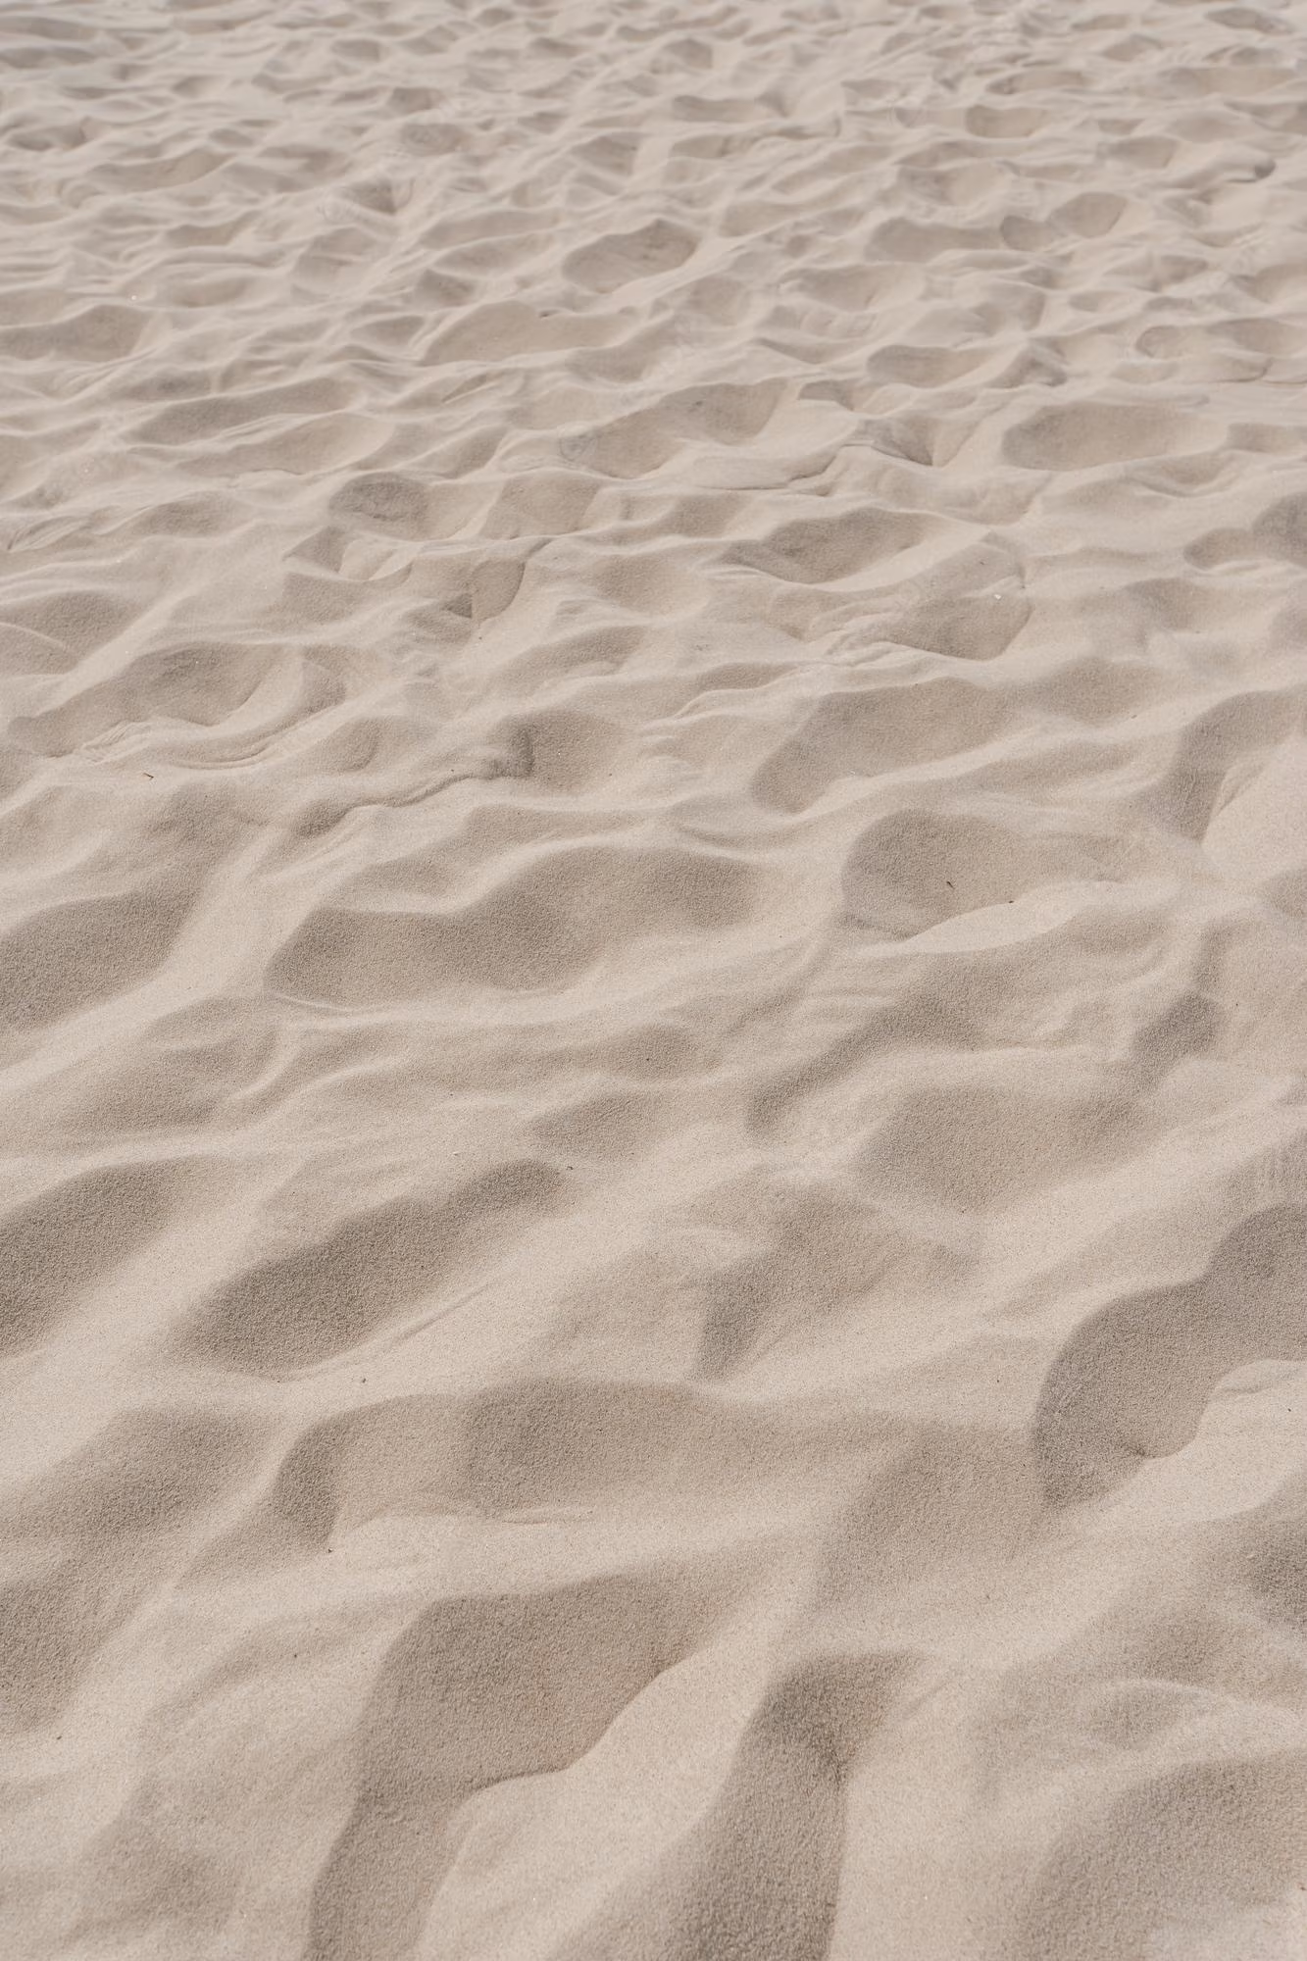
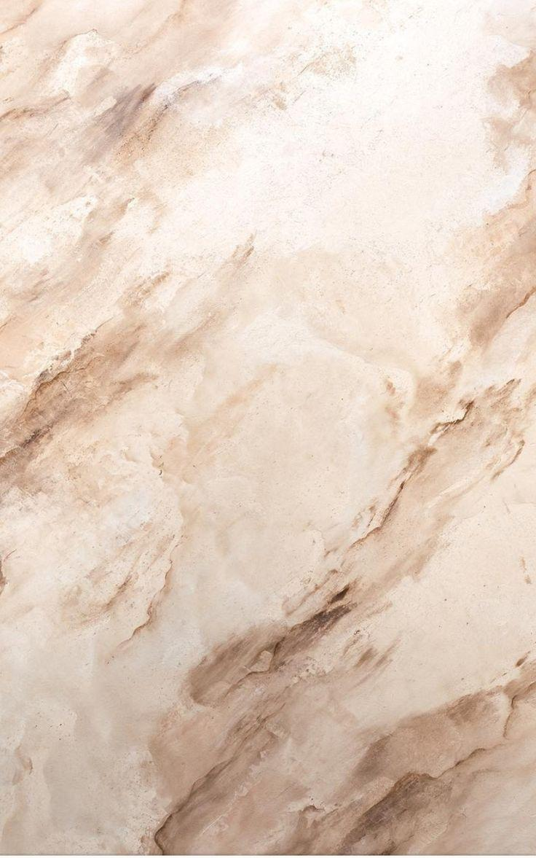
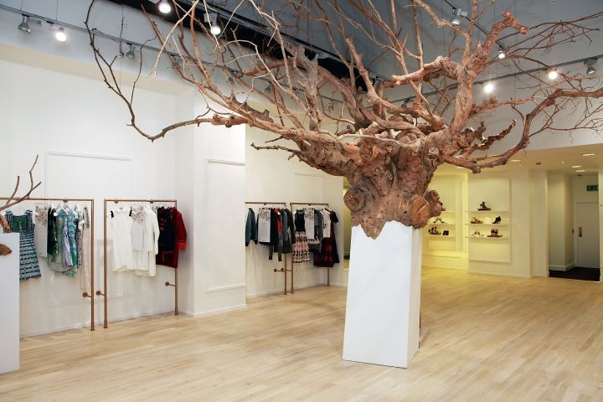
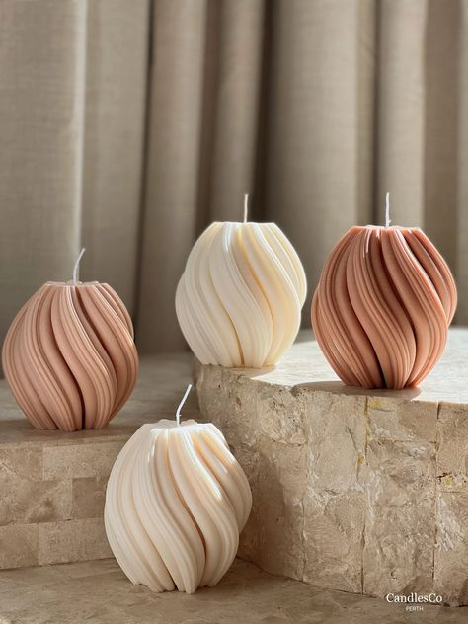
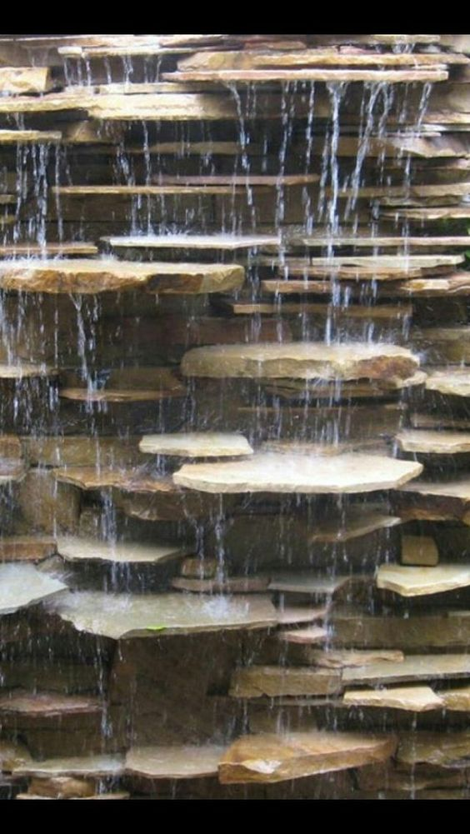

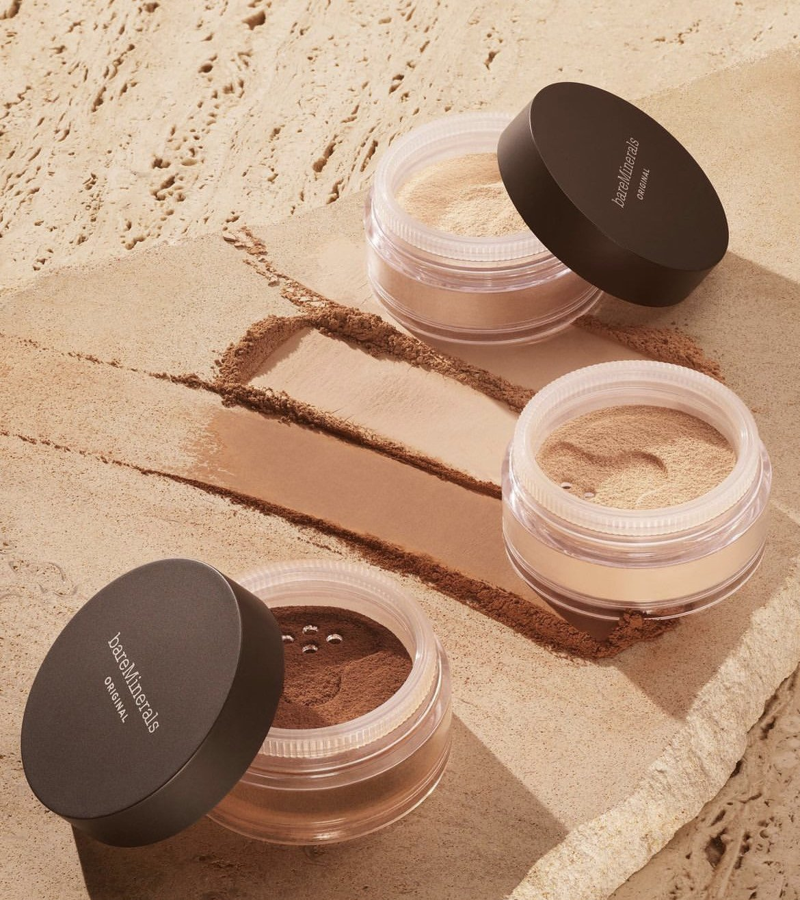
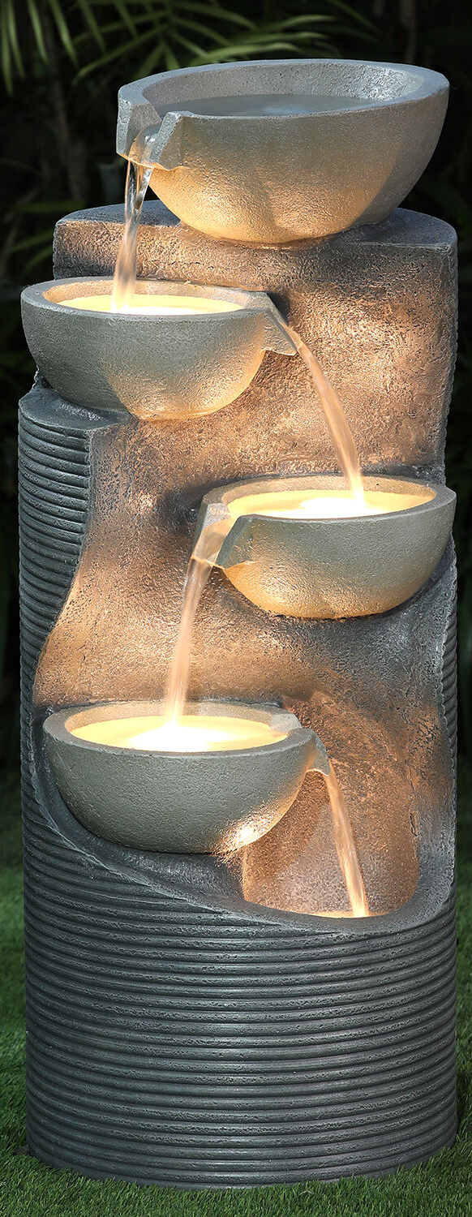
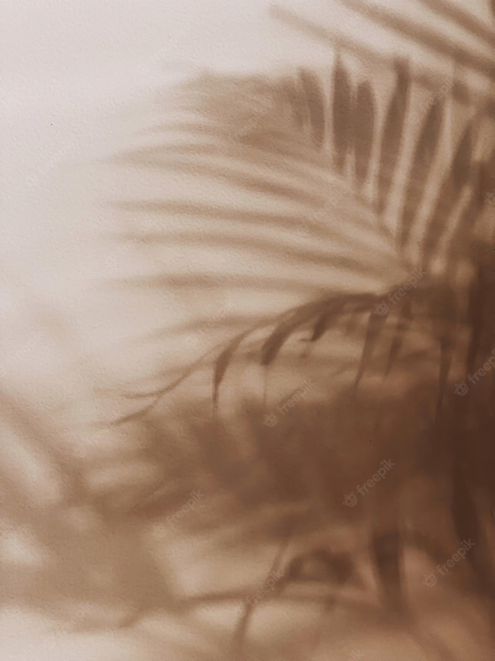
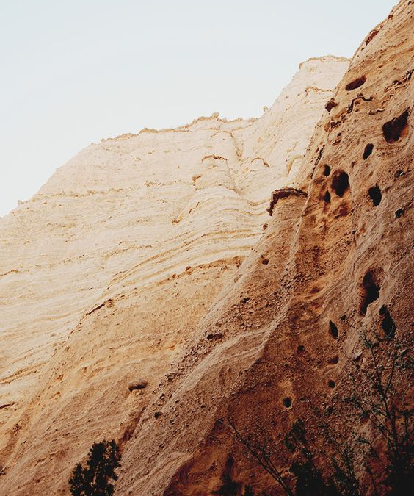
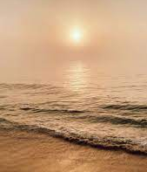

Slide 4
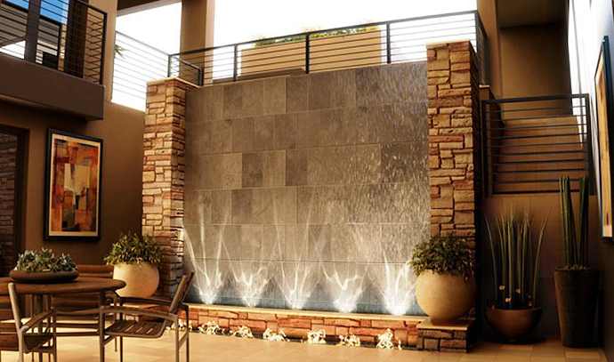
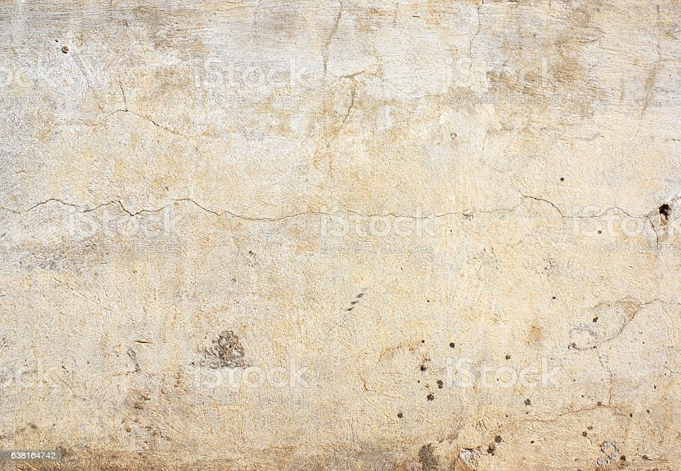
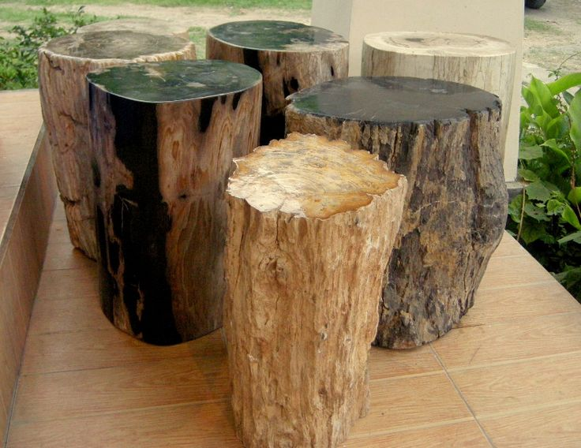
Look and Feel
water features
Distressed walls
Wooden props and furniture
Sand elements
Neutral marble accents

Slide 5
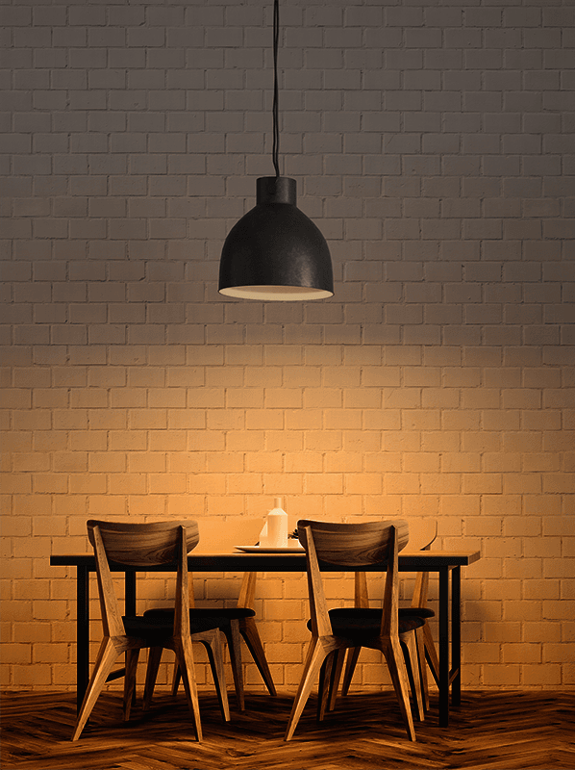
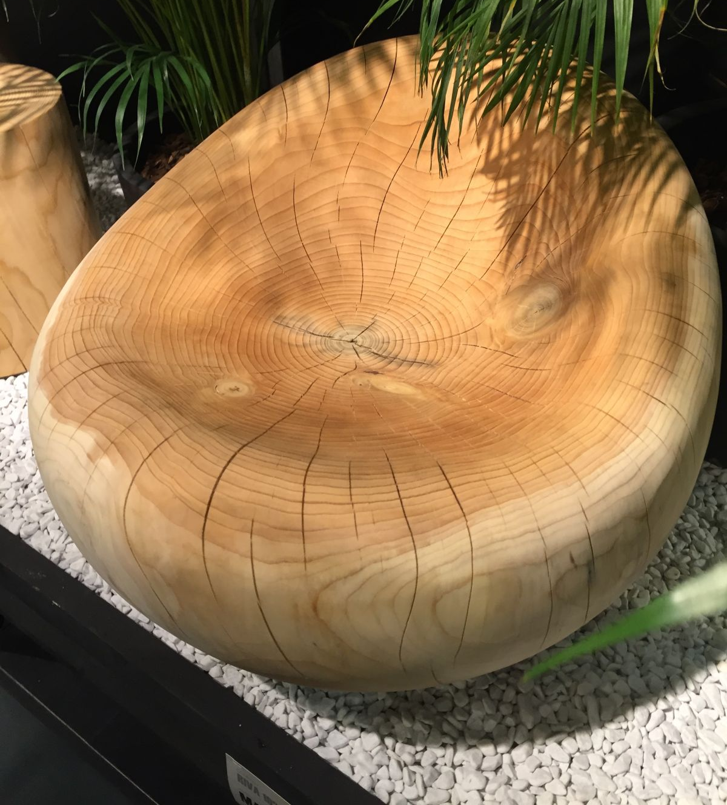
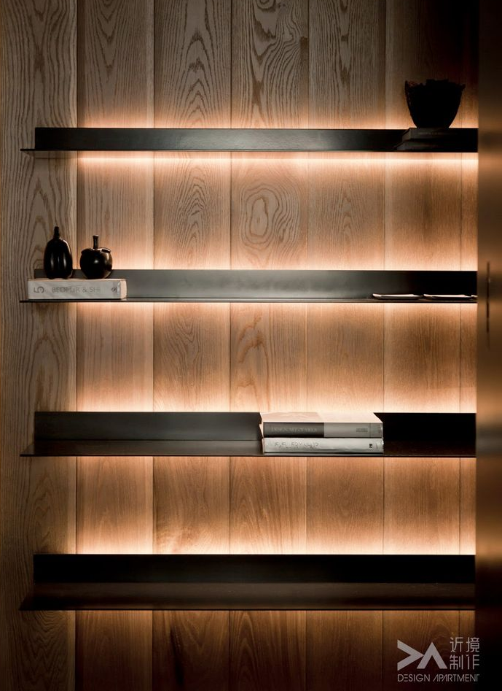
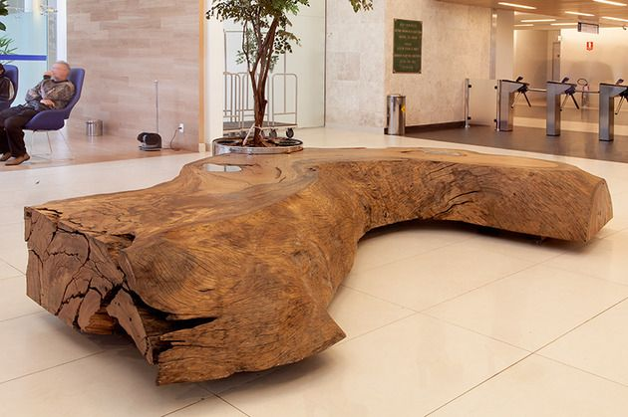
Lighting and Furniture
Mostly hanging lights with some spotlights attached to the ceiling and around the product
Dim lighting with highlights on the products and nature elements in the store
Furniture that looks like it was cut from nature and not in the usual chair and table shapes
Also would use electric candles to set the relaxing mood of the store

Slide 6
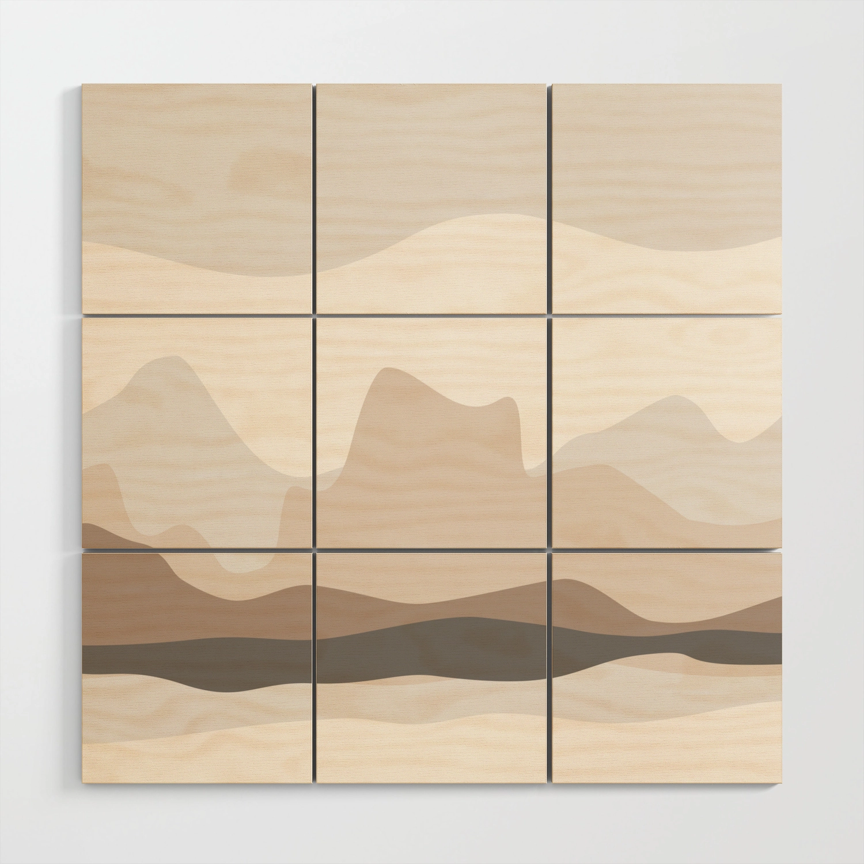
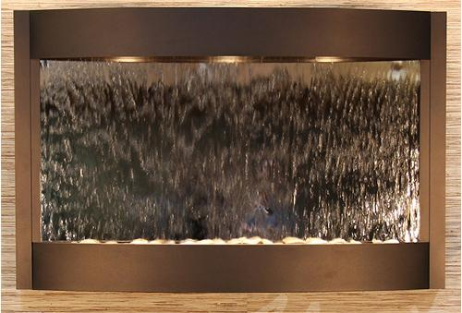
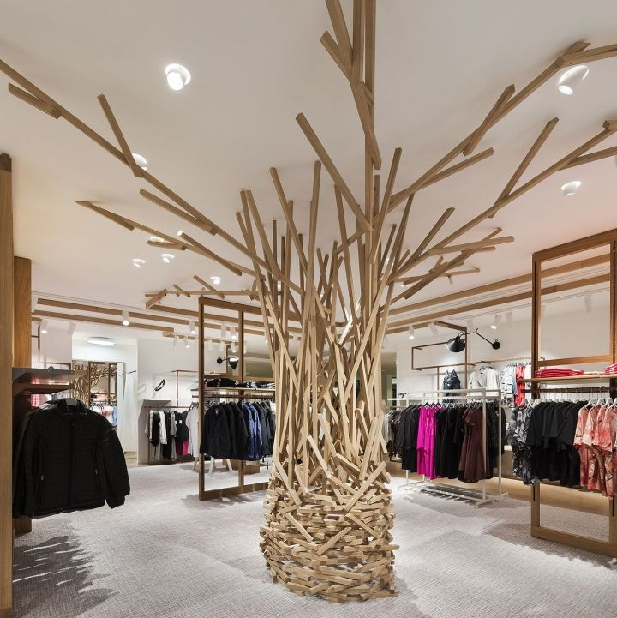
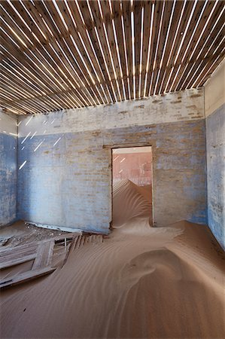
Props
Abstract paintings of nature that mimic the tones of foundation and other makeup
Small and large water features to bring zen and clean energy to the space
Possibly a “sand room” of the store where there is a path that people can walk through but around them is all sand
Some sort of big “tree of life” element in the center of the store

Slide 7
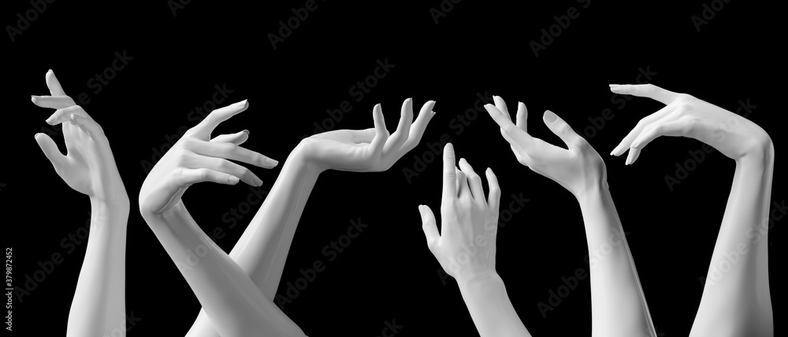
Mannequins
I would use mostly tables, surfaces, and other props to show the makeup. However, I would use mannequins like these to hold some of the product to draw the consumers attention. A possible idea is to have the mannequin holding a product under the water feature in the store to have the product one with the nature element and make it pop visually.

Slide 8
Resources
https://www.majesticfountains.com/blogs/news/types-of-indoor-fountains
https://www.bareminerals.com/
https://www.pinterest.com
https://society6.com
https://www.homedit.com
https://zanibonilighting.com/blog/post/warm-dim

