Slide 1
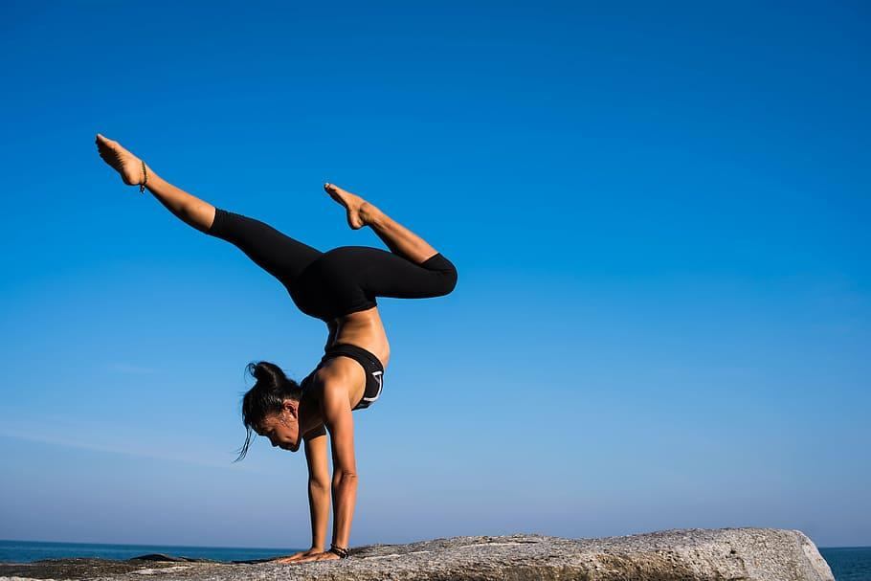
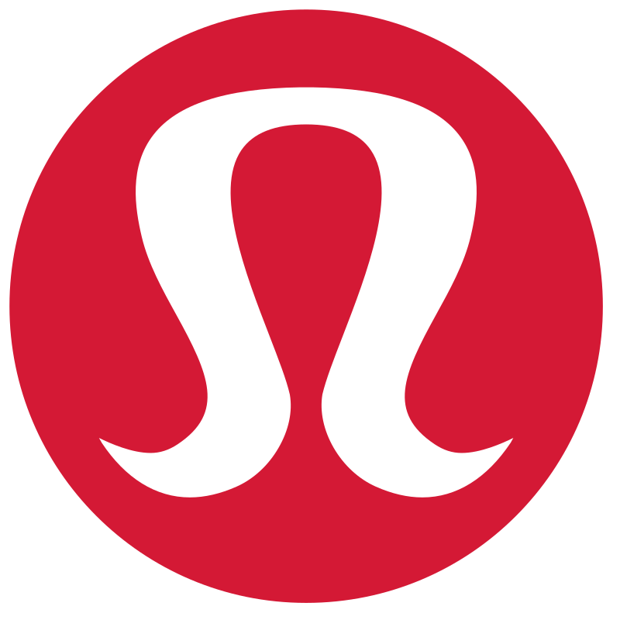
LemonLyfe

Slide 2
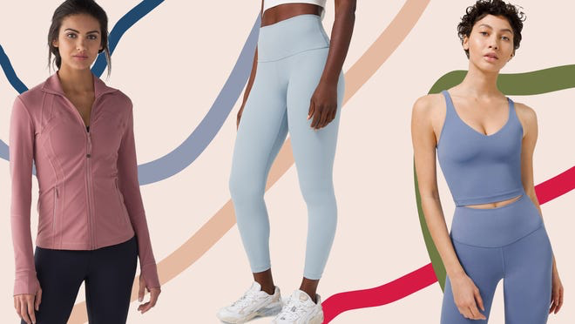
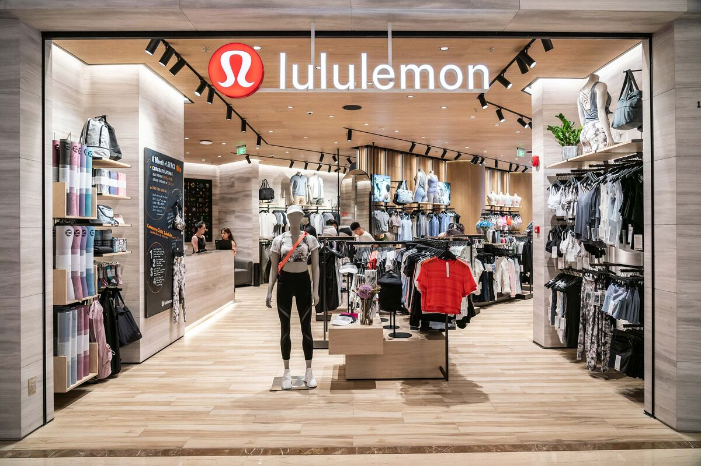
Foundation
Lululemon was founded by Chip Wilson in Vancouver, Canada in 1998. Wilson had experience in the surf, skate, and snowboarding industries and wanted to fill the industry gap for high-quality yoga wear. He also noticed that most athletic apparel was designed primarily for men and did not prioritize style or comfort and wanted to change that.
The company originally started as a design studio and retail store in Vancouver and as it gained popularity through yoga and fitness enthusiasts as well as event marketing such as yoga classes, workshops, and other events. Overtime they were able to not only build loyalty among customers but also built a community, creating the strong brand identity and reputation they have today.
They are now a leading company in the athleisure wear industry with a wide range of athletic apparel and have over 650 stores internationally, continuing to expand everyday.

Slide 3
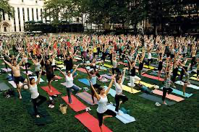
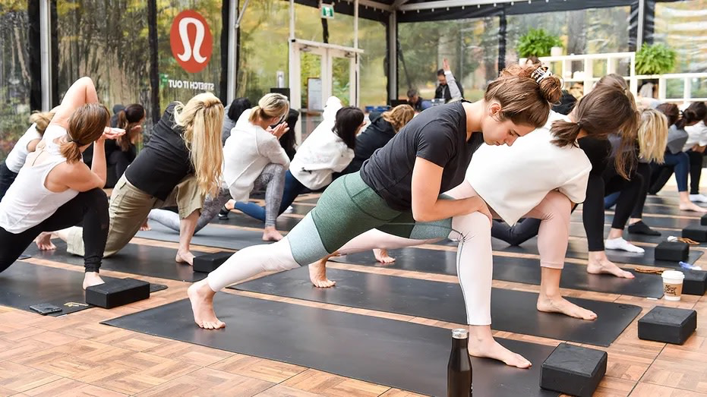
Brand Identity and Values
Identity
Positive and empowering culture
  Promotes positivity and empowerment throughout the brand and among customers.
  They work to encourage self-expression, body positivity and inclusivity for an uplifting and supportive environment
Personal development
  LuluLemon encourages employees and consumers alike to develop personal goals in both the fitness category and life in general. They want to inspire others to lead a healthy and balanced lifestyle.
Connection and community
  The brand prides itself on building a strong community around its brand. They host yoga classes and organize community events.
Values
Quality
  They are committed to creating high-quality products which combines functionality, style, and creativity.
Durability
Innovation
  They design their fabrics specifically to enhance performance and comfort. They invest in research and development to create technically advance merchandise that will last a lifetime.

Slide 4
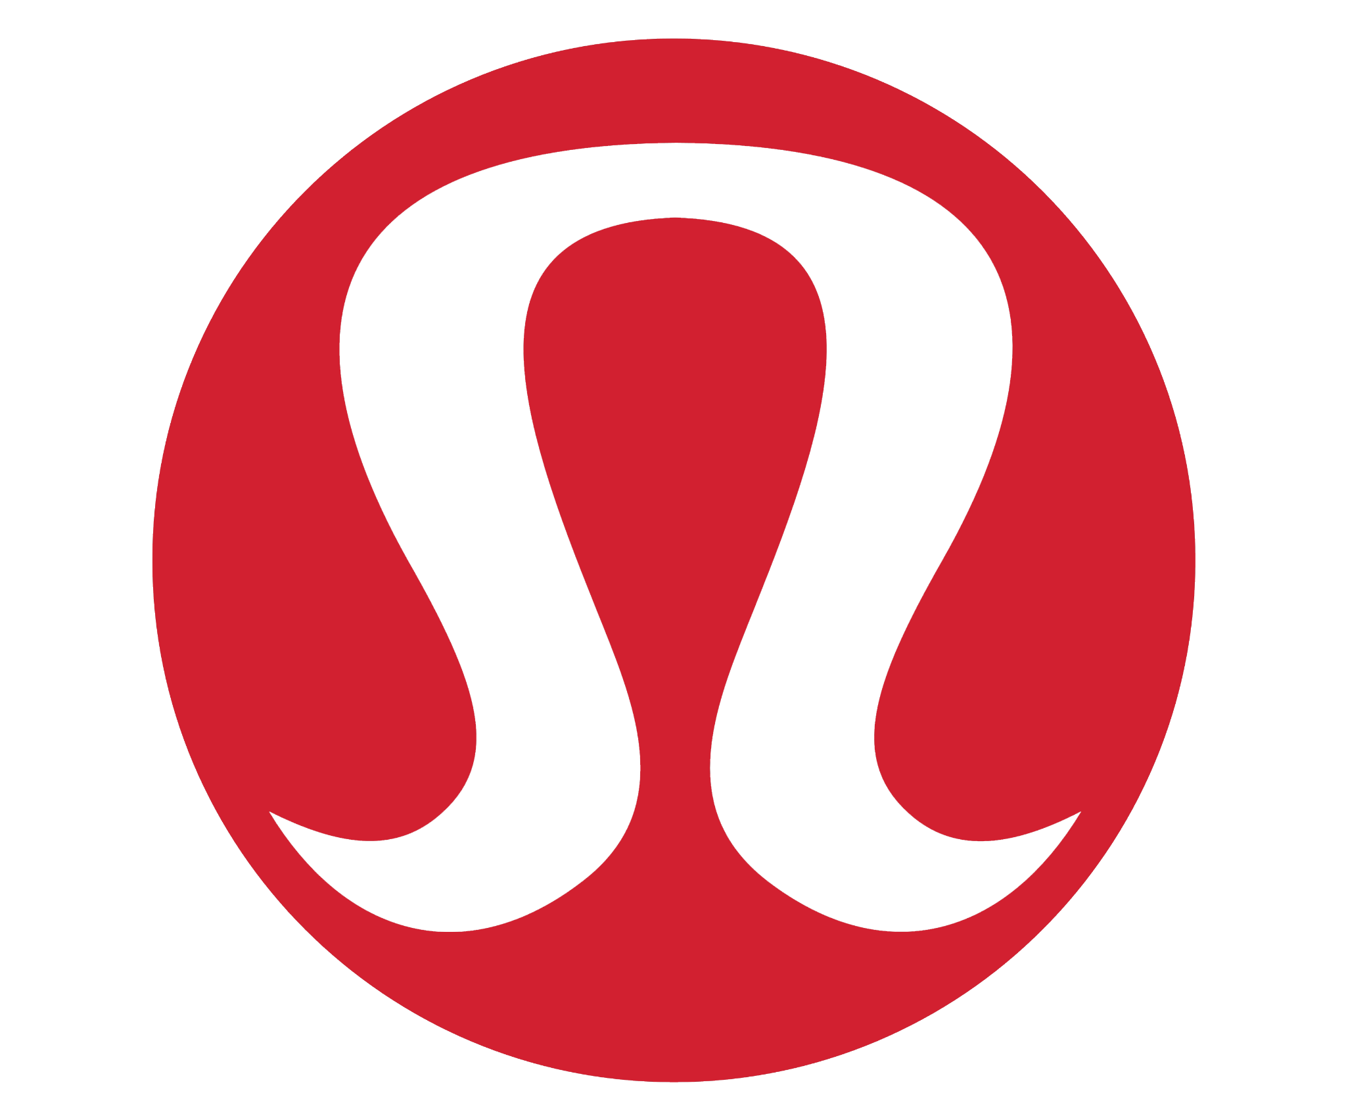
Brand Prism
Culture:
Fitness as a lifestyle
Personality:
Athleisure
Casual
Put together
Youthful
Physique:
High quality athletic wear
Known best for their leggings
Iconic horseshoe shape logo
Self-image:
Adventurous
Spiritual
Healthy
Reflection:
Made for both men and women who love to exercise and look good doing it
Relationship:
Good quality
Brand loyalty

Slide 5
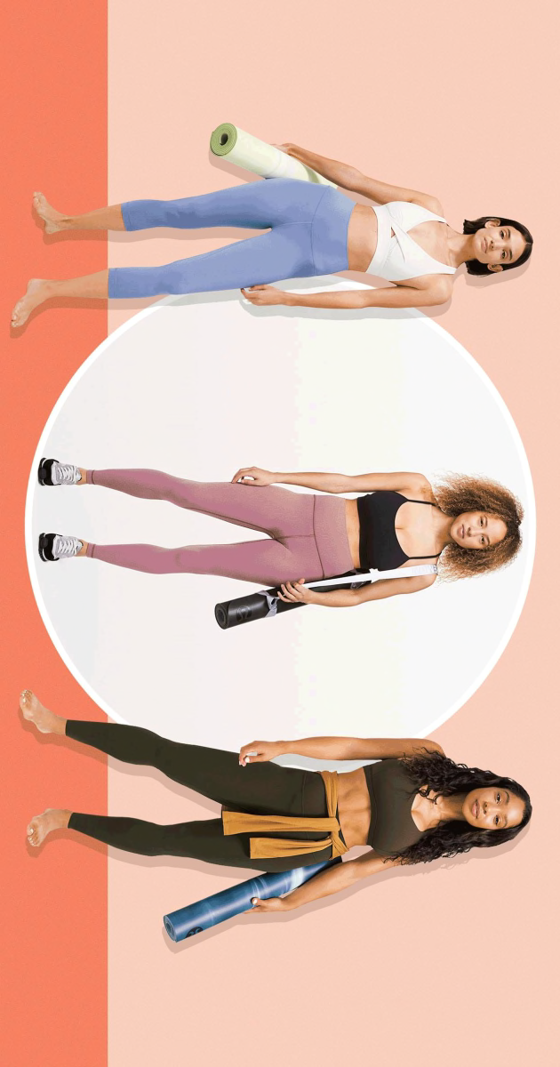
Positioning
Lululemon is positioned in the athletic apparel market. They have the unique experience as a brand of being one of the first luxury athletic wear lines on the market. They sold a lifestyle from there very first days and we want to continue that with LemonLyfe. Through the companies success they pulled off changing the entire market of athletic wear along with how society sees athletic clothes forever. Before 10 years ago, Lululemon was the only of its kind in terms of “fashionable” athletic wear. They were positioned in a market that could not compete with them. Now, ten years later, many brands have jumped on lululemons idea of making comfortable athletic wear fashion forward. Today, they are positioned in a market that have several competitors such as Free People Movement, Alo Yoga, and Athleta. Even though they now have strong competitors Lululemon has always been a fearless trailblazer in the market and set the example of success that other brands to follow.

Slide 6
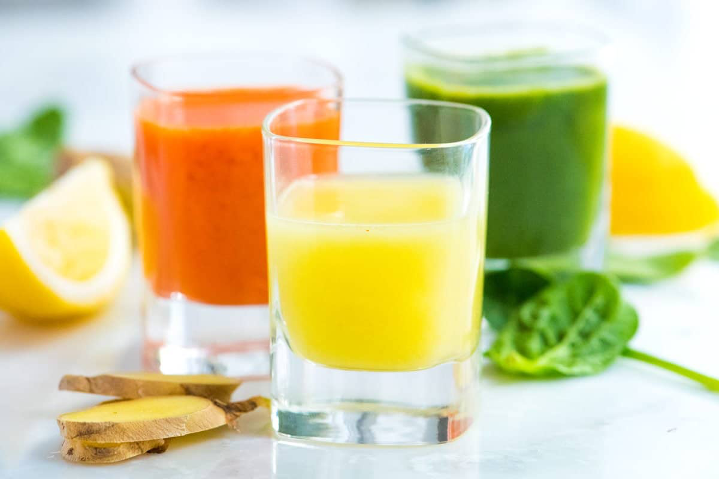
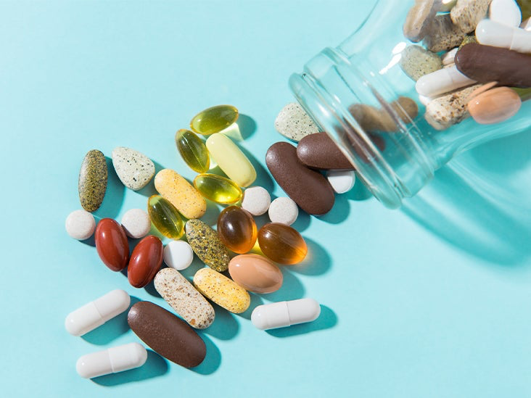
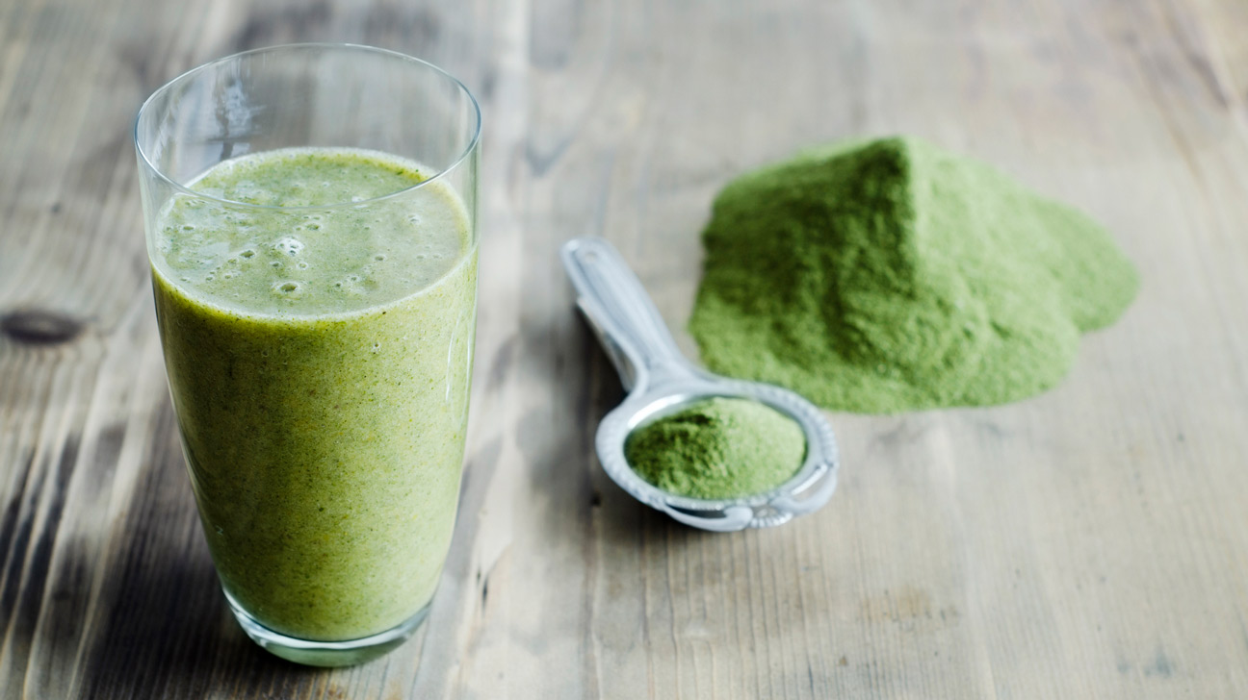
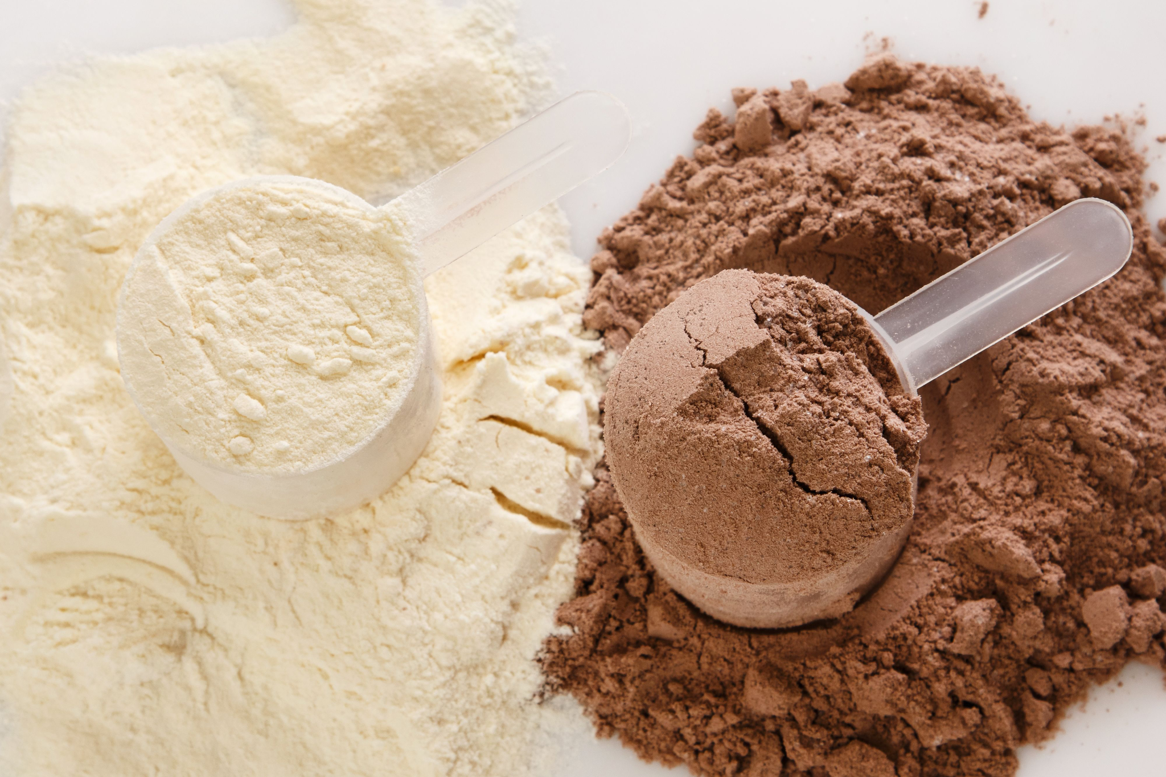
Brand Extension
LemonLyfe
Products included:
ACV/ginger/lemon juice shots
Pre-workout
Pre & probiotics
Greens powder
Protein powder
“Liquid IV” packets
Multi vitamin
Vitamin C
Energy drinks
LemonLyfe, a brand extension of LuluLemon, seeks to incorporate Lululemon’s core values of an active lifestyle into organic, simple daily supplements that their customers can enjoy.
Message:
“Live Lemon inside and out.”
*P.S! Of course there will be Lemon flavored options*

Slide 7
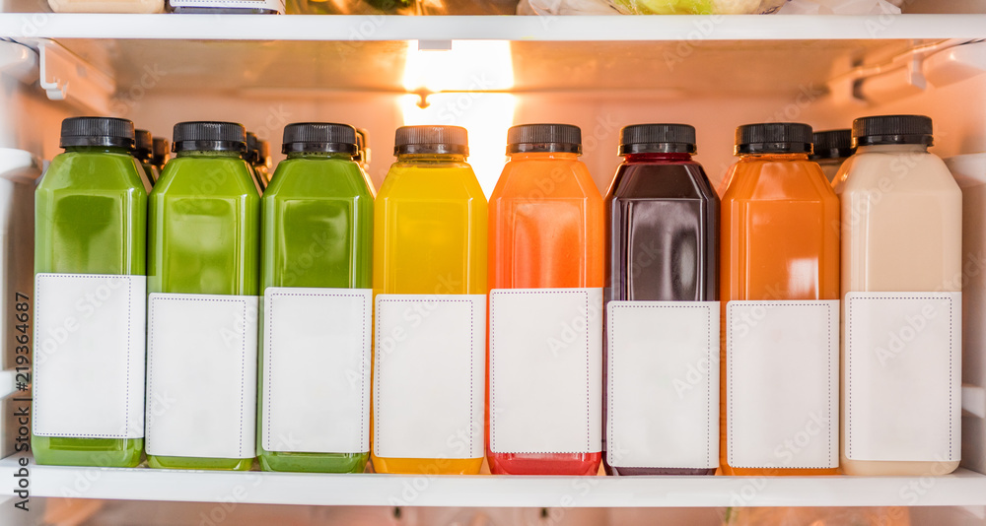
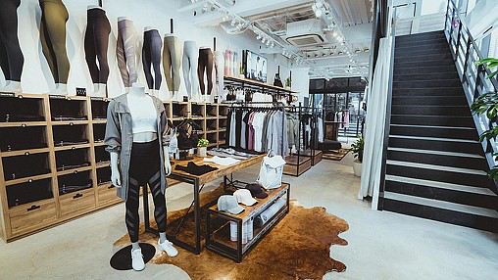
Incorporation
Incorporating LemonLyfe into physical LuluLemon stores can be as simple as including a small section, with shelving and a fridge, in each Lulu location.
Near the front of the store to gather customer attention and attraction
Keeping the refrigerated product line small and concise will be easier to maintain and manage
Additionally, offering small products like “liquid Iv” packets and vitamins near the checkout area will create a “grab and go” effect on a customer’s way out
Price: As LuluLemon is already a more expensive activewear brand, supplement prices may range from 5$-70$ in order to incorporate higher quality ingredients and still be affordable for Lululemon clientele

Slide 8
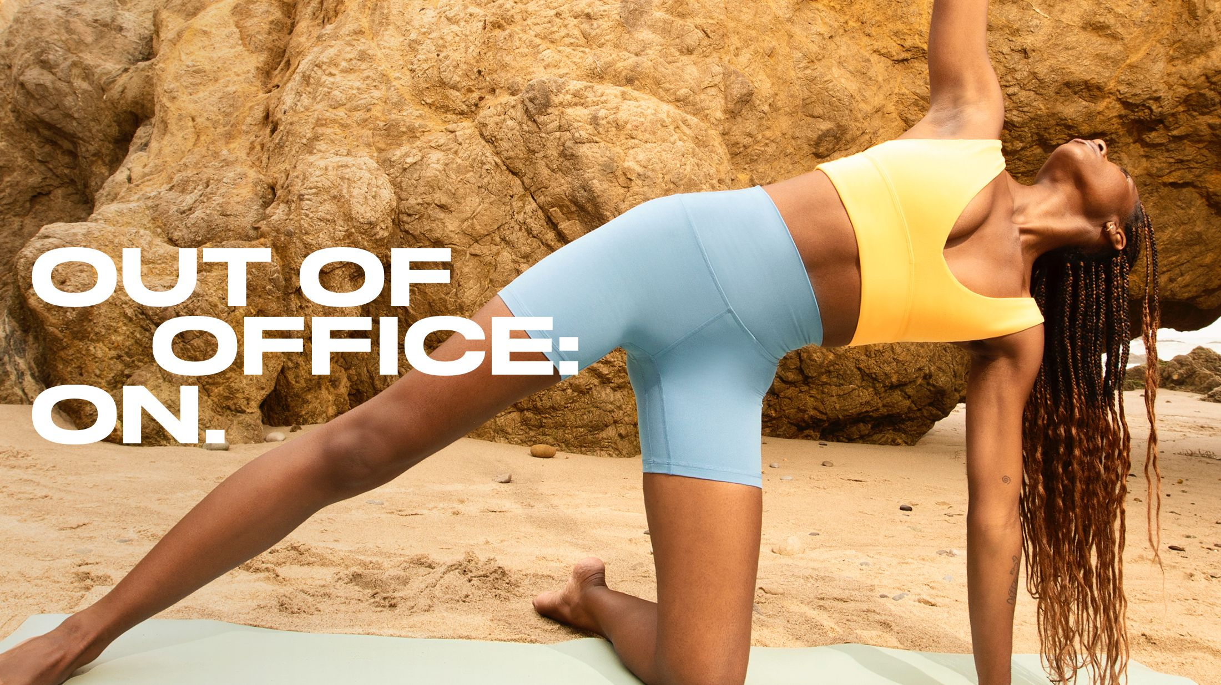
QUESTIONS?

