Slide 1
Plasma sterilization of dispersed material
G.Paskalov
Applied Quantum Energies LLC, Naples, FL, USA;
Howard Q. Zhang
USDA, Western Regional Research Center. Albany, CA, USA

Slide 2
Current methods of decontamination must weigh the level of microbial reduction with the amount of acceptable product degradation. Some current methods affect detriment upon the substrate. For instance, substances with heat-labile active ingredients are prone to degradation when exposed to high heat; the active element in dry and steam heat treatments. Oxidizing agents, such as, ethylene oxide or sodium hypochlorite can either be reactive toward or be absorbed into the processed material.
Cold, low pressure RF plasma (CLPP) was modeled for decontamination of powdered botanicals, such as: hydrilla, stinging nettle leaf, organic wheat grass powder and saw palmetto. Chia seeds were tested as a coarse-material out-group.
CLPP can decontaminate without modifying compounds liable to heat or oxidation. During CLPP treatment, decontamination is achieved as a result of direct contact with ions of high kinetic energy, electrons and UV radiation. In this study, plasma decontamination of different nutritional supplements was carried out in a controlled atmosphere for two different plasma reactor configurations: stationary shelf and rotary drum. The CLPP device includes RF generator; matching network; plasma reactor; gas supply and vacuum unit. Variables include: power, plasma gas composition; pressure and processing time. Treated materials were assessed for Total Coliform, Escherichia coli, Staphylococcus aureus, Pseudomonas aeruginosa, yeast and mold. A comparative analysis of air, pure oxygen and pure nitrogen plasma gas upon an oxidation-prone substrate was also done.

Slide 3
For most samples, a 3 to 5 log reduction in bacterial colonies was observed within 15 minutes of processing. Efficiency of inactivation was variable for different types of bacteria and also depends of the powder size distribution and plasma gas mixture. A comparison analysis of survival curves and plasma optical emission spectral data demonstrate that Nitrogen/Oxygen gas mixture play a significant role in inactivation of bacteria, yeast and mold. All processed materials were in the temperature range between 20C to 60C immediately after venting of the chamber. Preservation of ascorbic acid using pure nitrogen was observed, with only 2.5% decomposition to dehydroascorbic acid after 15 minutes of treatment.
Processing parameters, such as power, processing time and temperature, are unique to the product and batch in order to inactivate microorganisms without affecting the material property. Using non-thermal plasma for treatment of food powder is a promising technology due to that processed material does not content toxic residuals and the temperature range can be kept to an acceptable level. The next step of plasma development is pairing it with other decontamination process such as RF pulse electric field treatment. Synergetic effects might be more significant than either technology alone.

Slide 4
EXPERIMENTAL SET UP
Shelf Configuration.
Paddle
Rotation
24.25” = 616 mm
24”
Powder
20”
5 mm
Drum Configuration
12.25” = 311 mm

Slide 5
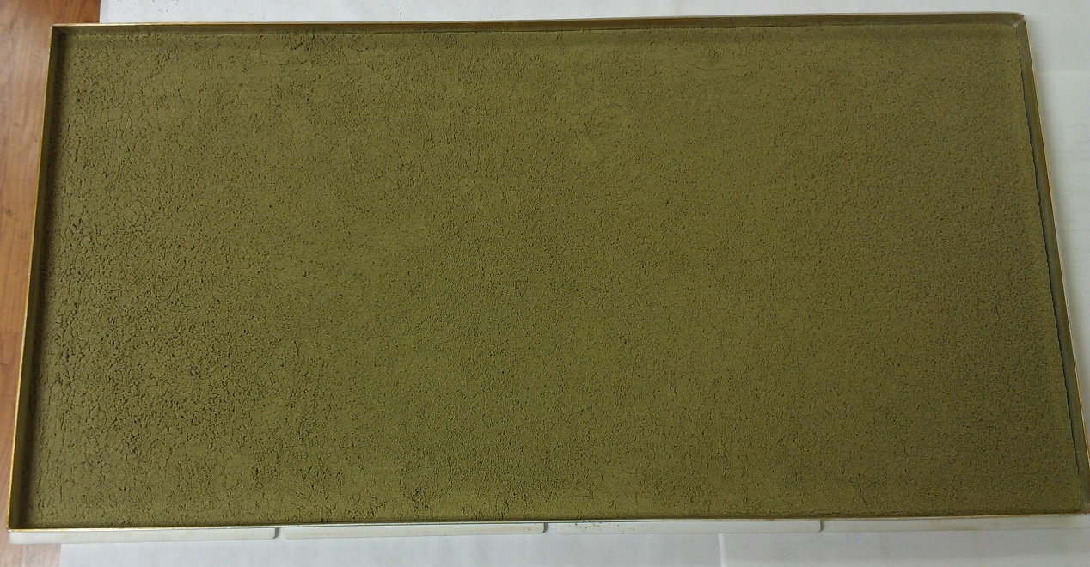
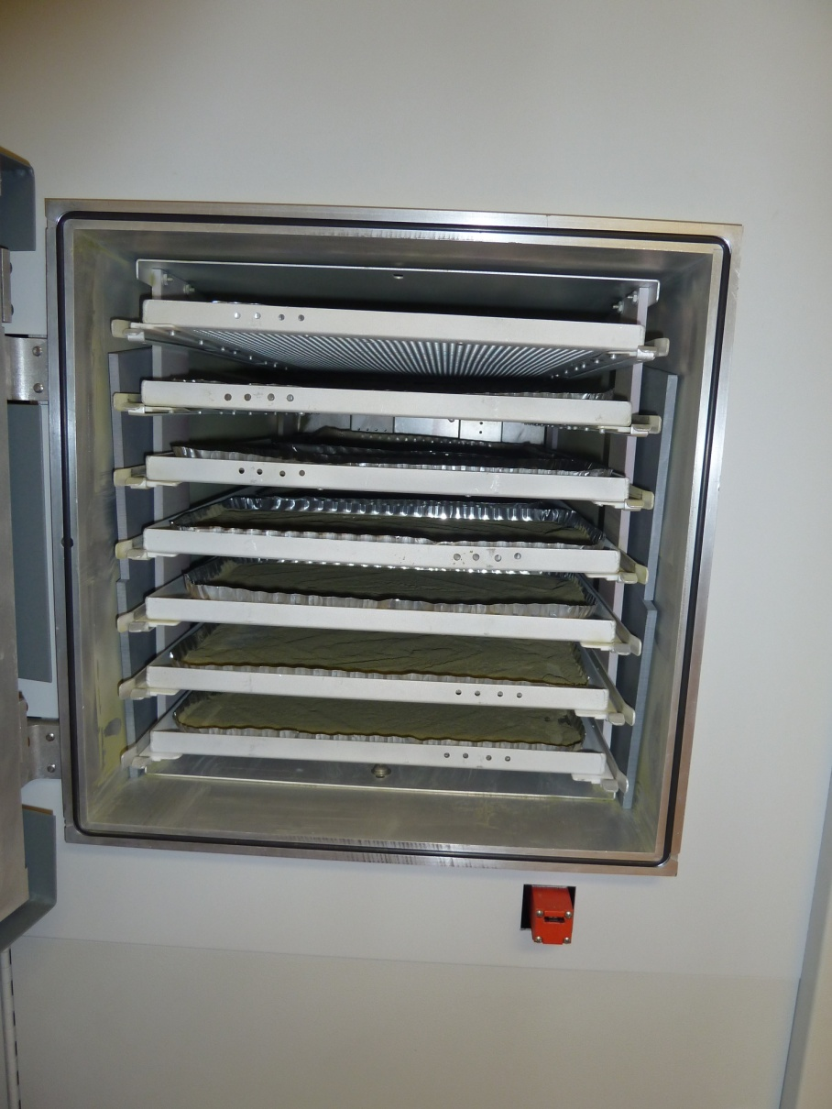
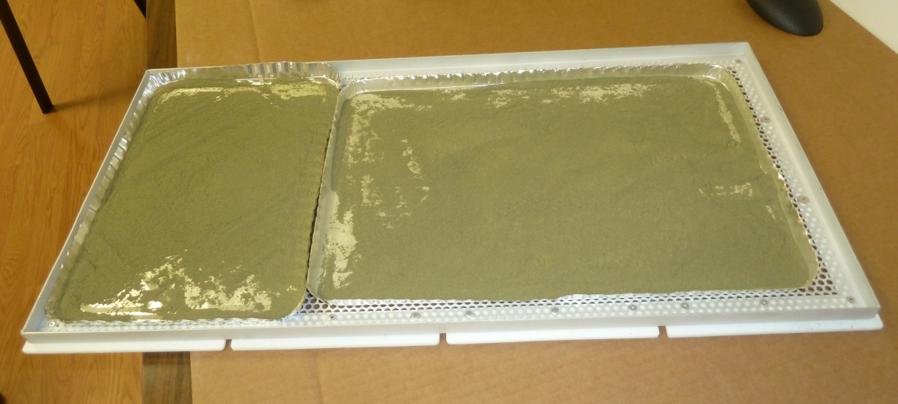
Shelf Configuration and Powder Load

Slide 6
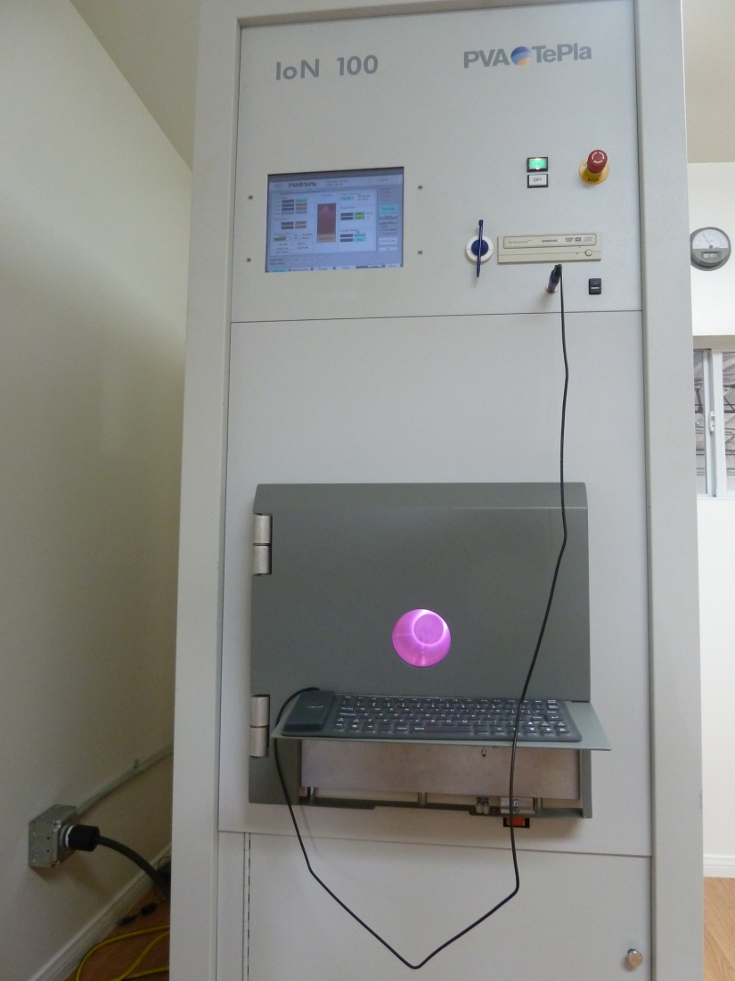
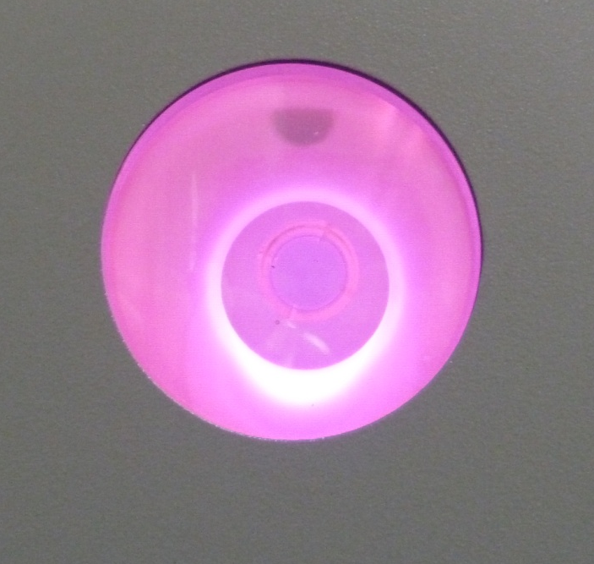
RF Plasma System–Drum Configuration
RF Generator
P = 0.1 to 10 kW
f = 13.56 MHz
Matching Network
RF Plasma ( Air, O2, CO2,N2,Ar etc..)
Drum’s rotation
Internal RF electrode
Processing Material
External electrode
(Drum)

Slide 7
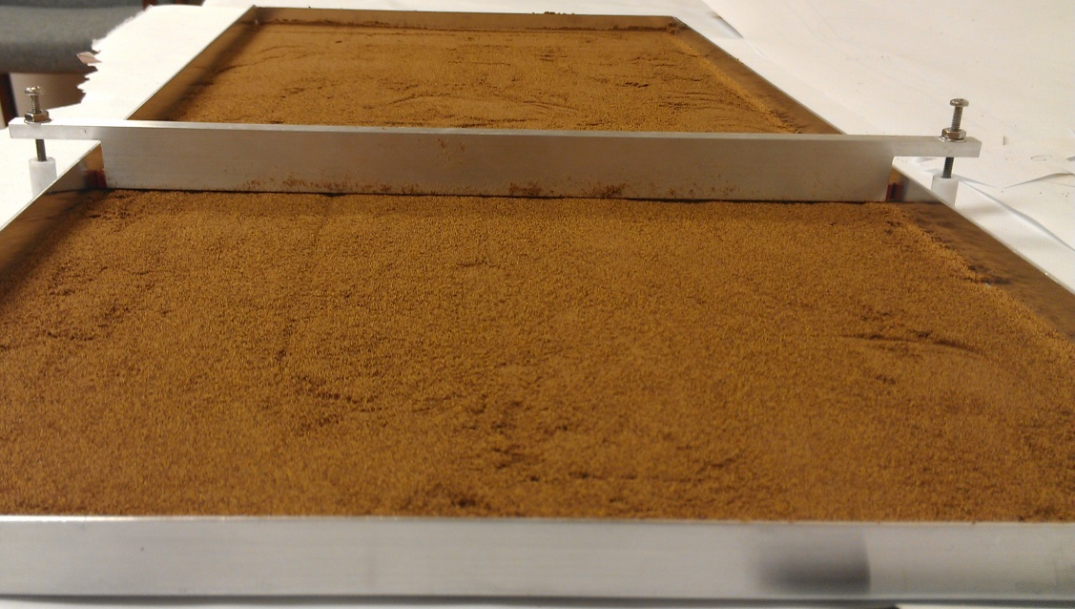
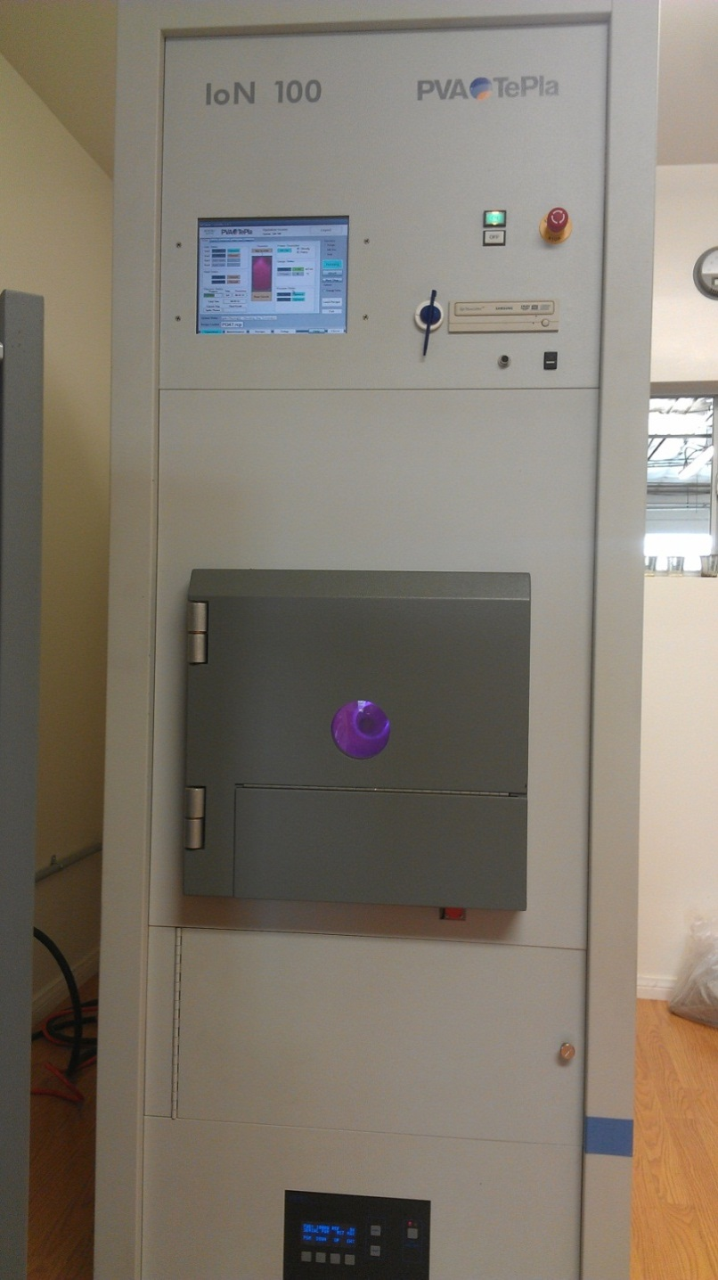
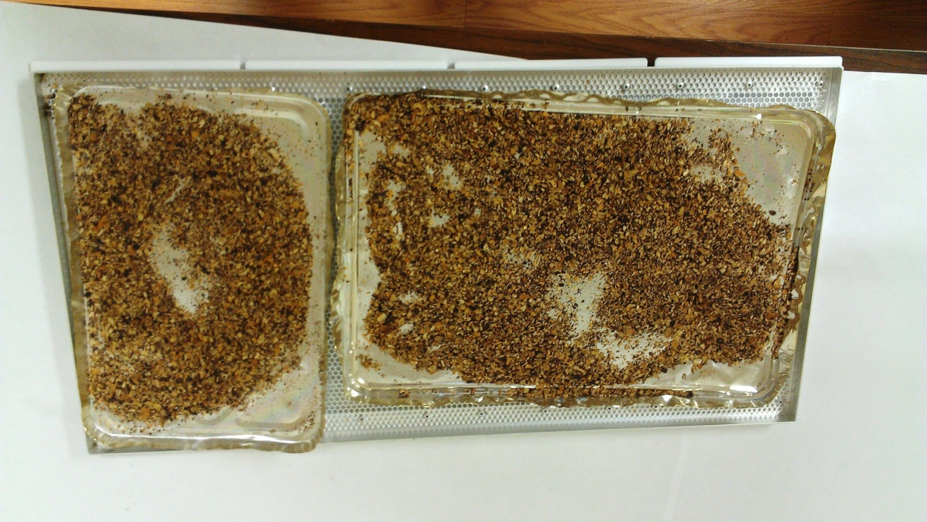
Saw Palmetto
Processing System
Shelf Configuration
( Coarse; Load = 150 gr.)

Slide 8
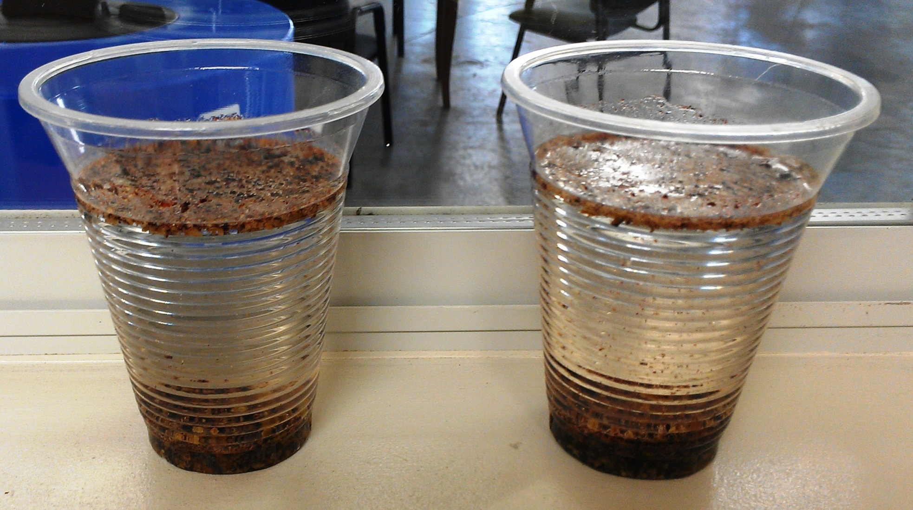
Hydrophilic Test
Before
After

Slide 9
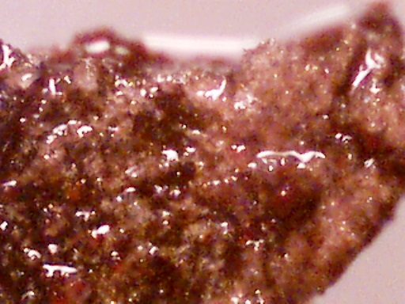
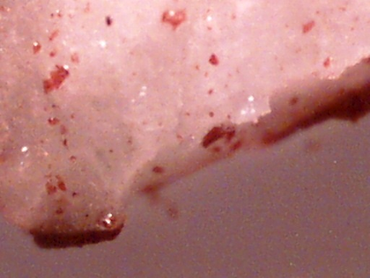
Saw Palmetto
x60
Coarse
x60
 | Time, min | 7.5
O₂ Content,% | 0 | 4,300
 | 25 | 1,300
 | 100 | 350

Slide 10
Plasma Gas Effect
When using a mixture of nitrogen and oxygen gas to create plasma, radicals of both species are produced. Often, nitrogen and oxygen radicals combine to produce NO_{x} species. Within the NO_{x} moiety, nitric oxide acts as an antimicrobial agent.
Nitric oxide (NO) is a highly reactive compound that is partially ionized. Nitric oxide is formed when both monatomic nitrogen and oxygen radicals combine. It exists as a gas that is readily permeable through cellular membranes. While it is an essential signaling molecule in many metabolic pathways in low concentrations, higher concentrations cause cellular damage. Nitric oxide reacts strongly with DNA bases. The reaction removes an amine group from the nitrogenous base in a process called deamination. Depending on the base, deamination creates either a non-informative site or a transition to a different base. Non-informative sites are remedied by DNA repair enzymes; however, it is likely that a mutation will occur at the site. Base transitions are much more common. NO semi-selectively delaminates cysteine, and the product of the reaction is the base tyrosine. The mutation is permanent, as repair enzymes are unable to recognize the change in bases.

Slide 11
Saw Palmetto Test Results
Oxygen/Air | 36% O2/63% N2
Time | Temperature | SPC/1000 | % Left | % Kill
0 | 25 | 140 | 100 | 0
1 | 35 | 140 | 100 | 0
3 | 40 | 94 | 67.1 | 32.9
5 | 47 | 110 | 78.6 | 21.4
7 | 65 | 98 | 70 | 30
9 | 80 | 99 | 70.7 | 29.3
11 | 90 | 72 | 51.4 | 48.6
15 | 110 | 29 | 20.7 | 79.3
Air | 20% O2/79% N2
Time | Temperature | SPC/1000 | % Left | % Kill
0 | 25 | 110 | 100 | 0
1 | 30 | 85 | 77.3 | 22.7
3 | 48 | 100 | 90.9 | 9.1
5 | 74 | 77 | 70 | 30
7 | 87 | 11 | 10 | 90
9 | 75 | 91 | 82.7 | 17.3
11 | 94 | 64 | 58.2 | 41.8
15 | 105 | 43 | 39.1 | 60.9
Oxygen | 100% O2
Time | Temperature | SPC/1000 | % Left | % Kill
0 | 25 | 150 | 100 | 0
1 | 40 | 130 | 86.7 | 13.3
3 | 50 | 110 | 73.3 | 26.7
5 | 55 | 130 | 86.7 | 13.3
7 | 80 | 94 | 62.7 | 37.3
9 | 90 | 58 | 38.7 | 61.3
11 | 97 | 20 | 13.3 | 86.7
15 | 120 | 0 | 0 | 100

Slide 12
Laboratory’s Assay comparison
Michelson vs Silliker
 | Michelson |  | Silliker
 | Total Plate Count | Kill | Aerobic Plate Count | Kill
 | cfu/gm | % | cfu/g | %
Sample ID
020513SPF-IN | 120,000 |  | 1,300
020513SPF-OX-1 | 7,500 | -94 | 650 | -50
020513SPF-OX-2 | 60 | -100 | 20 | -98
020513SPF-OX-3 | 1500 | -99 | 80 | -94
020513SPF-OX-4 | 11,000 | -91 | 1800 | 38
020513SPF-ONX-5 | 40,000 | -67 | 1300 | 0
020513SPF-OXN-6 | 17,000 | -86 | 1200 | -8

Slide 13
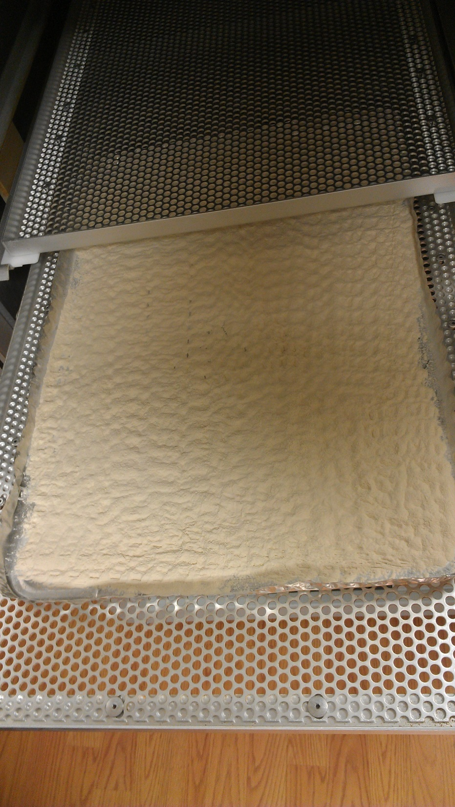
Shark Curtilage

Slide 14
Hydrilla
Lot | Aerobic Plate Count, cfu/g | E.coli and Coliform | Pseudomonas | Staphylococcus | Yeast, cfu/g | Mold, cfu/g
030211-I | 1,200,000 | Negative | Negative | Negative | 700* | 100
030211-2 | 285,000 | Negative | negative | Negative | 200 | 100
030211-1 | 212,000 | Negative | Negative | Negative | 300 | 0
030211-3 | 28,000 | Negative | Negative | Negative | 0 | 0
100311-C2-A | 8,800,000 | 9,000 | Negative | Negative | 7,000 | 1000
100311-P2-A | 10,000 | < 1000 | Negative | Negative | 4,000 | 0
100311-P3-A | 10,000 | <1000 | Negative | Negative | 3,000 | 0

Slide 15
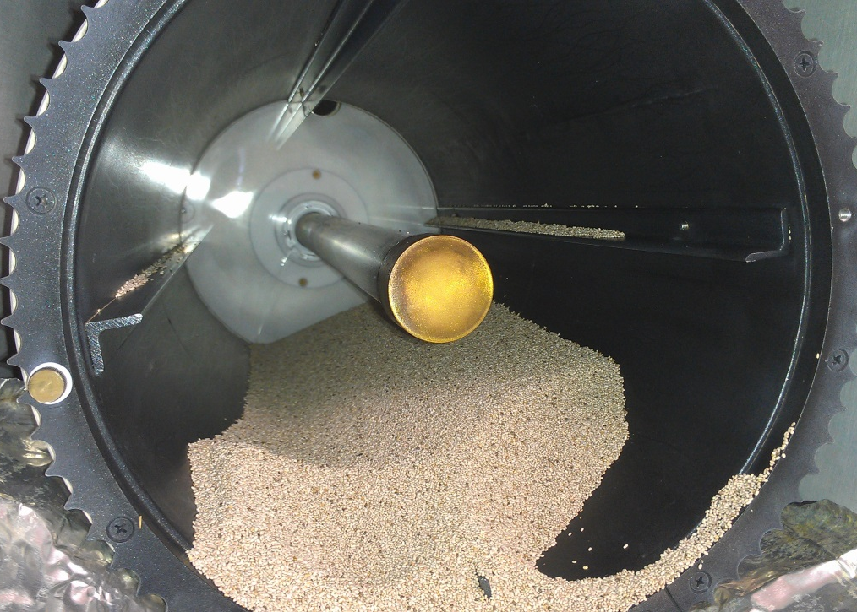
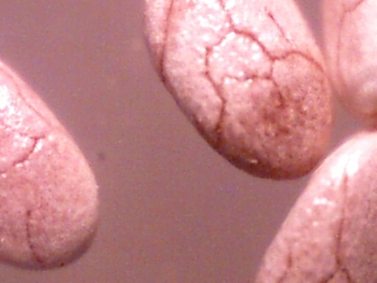
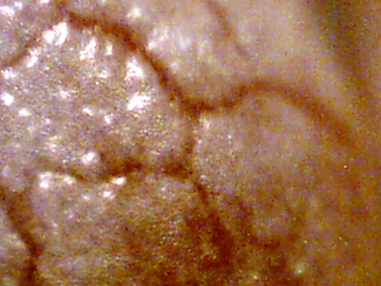
Chia Seeds

Slide 16
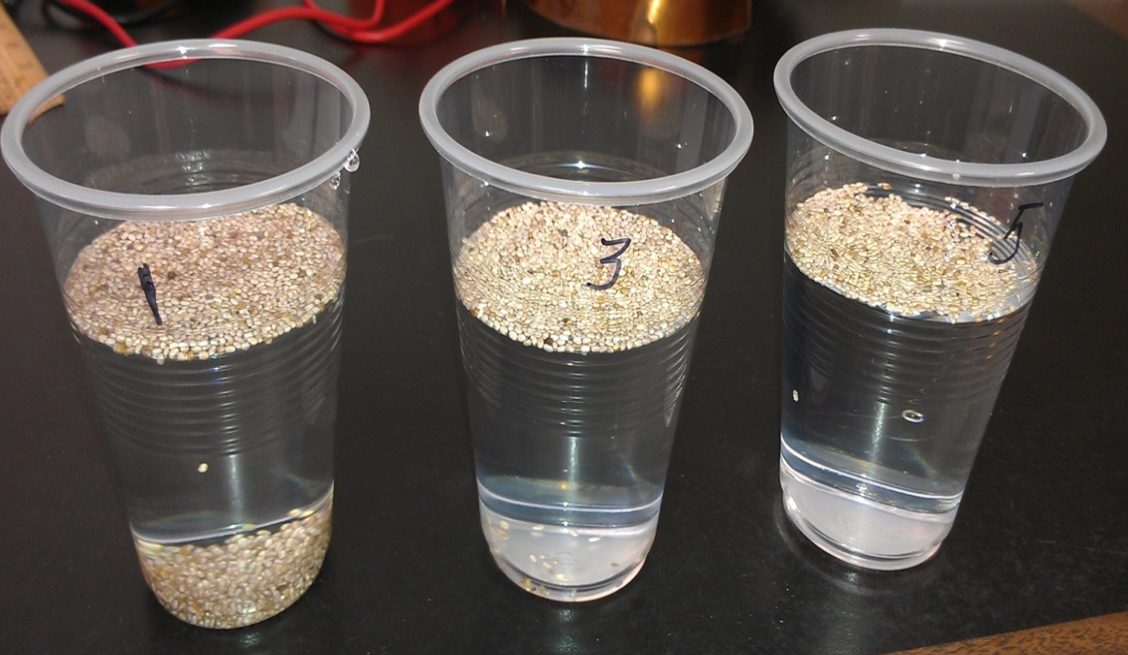
Chia Seeds
Chia seeds testing ( Lot# SPI-PUE-CHIA-(W)-2012-01)
Date: February 12, 2013 |  |  | Initial ID | Result, cfu/gm
Configuration | Drum |  | 021213CS-IN | 400
 | 1 | 2 | 3 | 4 | 5 | 6 | 7 | 8 | 9
Sample ID | 021213CS-A-1 | 021213CS-O-1 | 021213CS-AO-1 | 021213CS-A-2 | 021213CS-O-2 | 021213SPF-A-3 | 021213CS-A-4 | 021213CS-O-3 | 021213CS-O-4
Load, lbs | 5 | 5 | 5 | 5 | 5 | 1 | 1 | 1 | 1
Power, W | 1000 | 1000 | 1000 | 1000 | 1000 | 1000 | 1000 | 1000 | 1000
Presure, mTorr | 999-1200 | 1000-1245 | 1100-1360 | 1200-1346 | 1060-1263 | 1000 | 670-929 | 600-740 | 1000
Time, min | 10 | 10 | 10 | 20 | 20 | 10 | 10 | 10 | 10
Gas | Air | Oxygen | Air/Oxygen | Air | Oxygen | Air | Air | Oxygen | Oxygen
Flow, ccm | 250 | 100 | 25/75 | 250 | 100 | 250 | 250 | 100 | 100
Temperature, C | 40 | 40 | 40 | 54 | 56 | 56 | 52 | 60 | 58
Result,cfu/gm | 140 | 100 | 360 | 270 | 500 | 80 | 130 | 40 | 90
Kill, % | -65 | -75 | -10 | -33 | 25 | -80 | -68 | -90 | -78

Slide 19
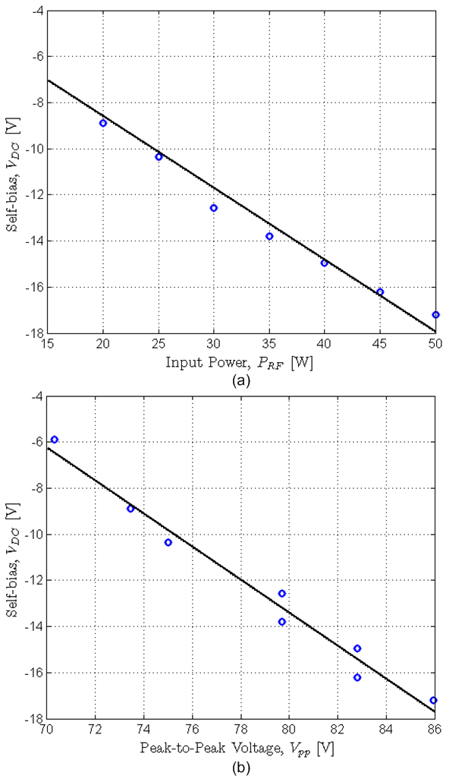
Plasma Parameters

Slide 20
Drums Rotation Control
Equipment rack
AQE032513
Control Panel
( General Set Up)
Pressure gauge
Gas temperature
Vacuum system Control
Water flow 8
Water flow 7
Water flow 6
TV
Water flow 5
Vacuum
system
Water flow 4
Water flow 3
Water flow 2
Water flow 1
MN1
RFG1
MN2
RFG2
Processing chamber
( 8 Drums)
MN3
RFG3
Front Door
MN4
RFG4
MN5
RFG5
MN6
RFG6
MN7
RFG7
MN8
RFG8
Air1
O1
O2
Air2
O3
Air3
O4
Air4
Oxygen
Air
Air5
O5
Air6
O6
O7
Air7
O8
Pressure
regulators
Air8

Slide 21
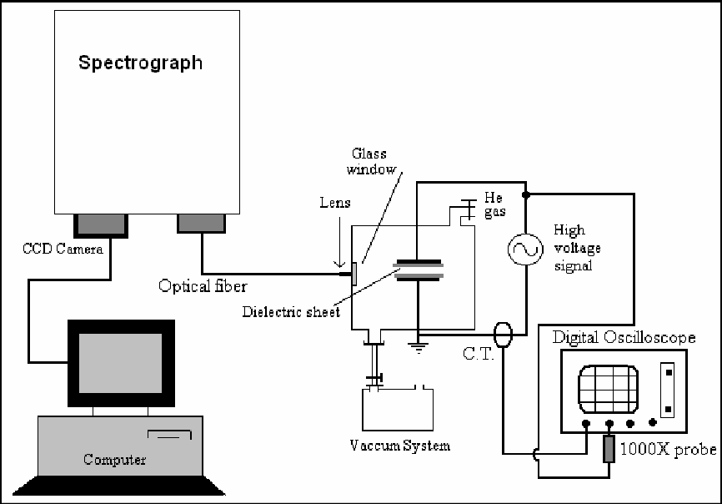
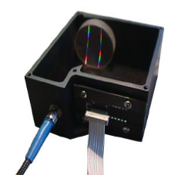
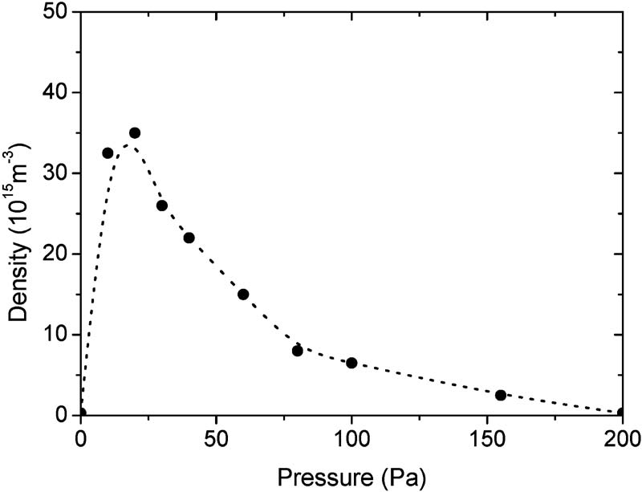
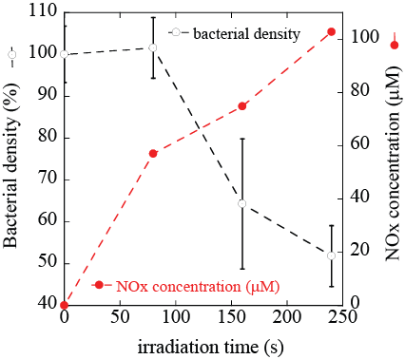
Air, Oxygen and Nitrogen Plasma
BLACK-Comet
spectrometer
[BLK-CXR-SR]
Plasma density versus pressure
(ICP; 27 MHz; 250 W)
Optical emission spectroscopy characterization of oxygen plasma during degradation of Escherichia coli D. Vujošević, et al.
Plasma Laboratory F4, Jožef Stefan Institute J. APPL. PHYS.101, 2007
E.coli was irradiated with Air plasma and incubated for 1 h

Slide 22
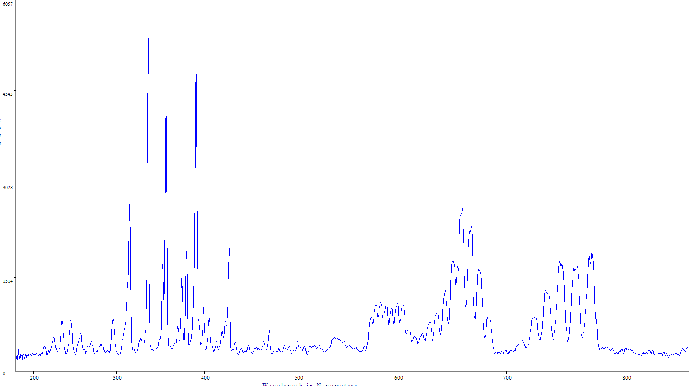
Spectra Analysis 100% N2, 5% flow 300W Added Ar Page 2
6057

Slide 23
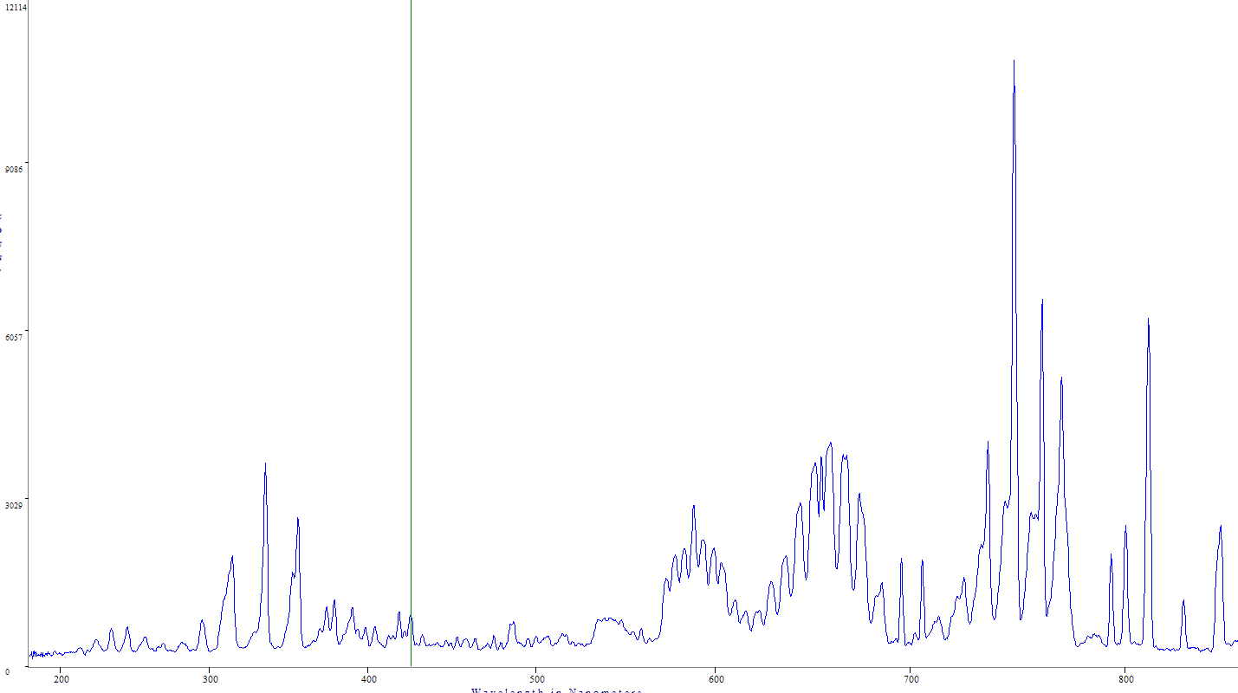
Spectra Analysis 40% N2, 5% flow 300W Added Ar (60%)
12114

Slide 24
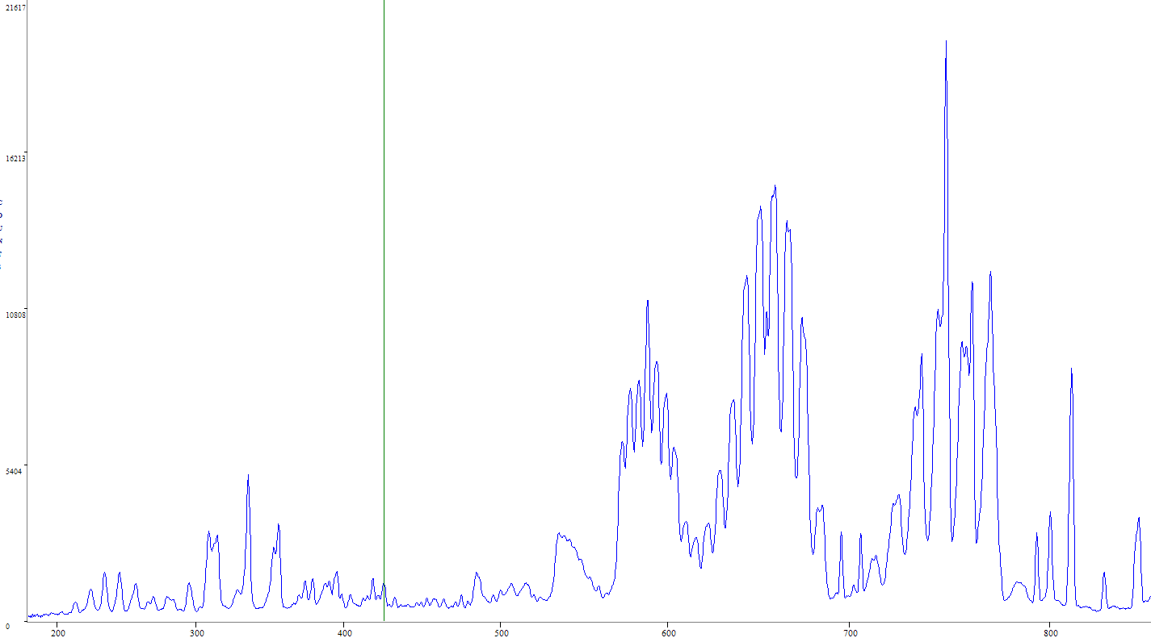
Spectra Analysis about 40% N2, 5% flow 500W Added Ar (60% of pressure)
21617

Slide 25
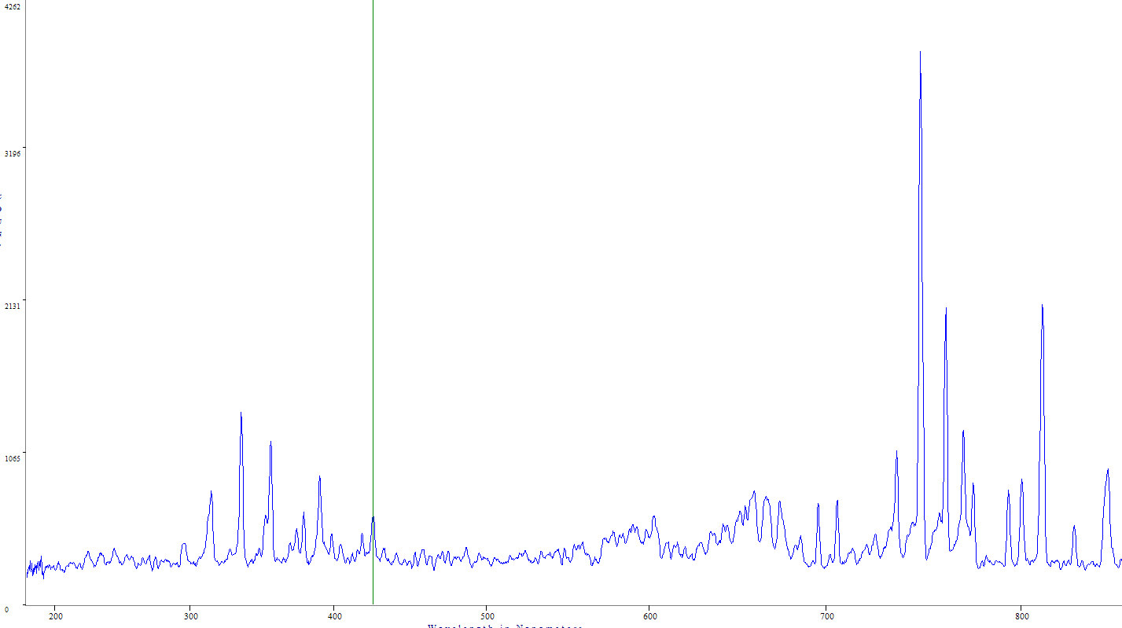
Spectra Analysis 10% O2, 40% N2, 50% Ar 300W P= 136, full open control
4262

Slide 26
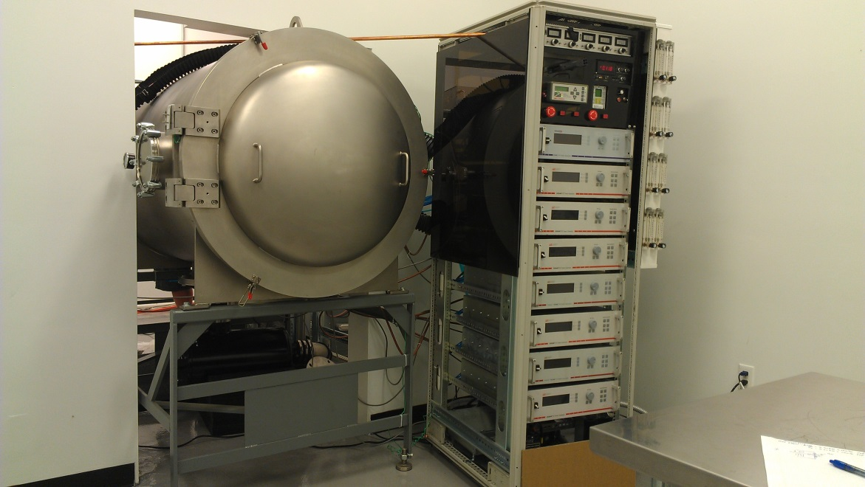
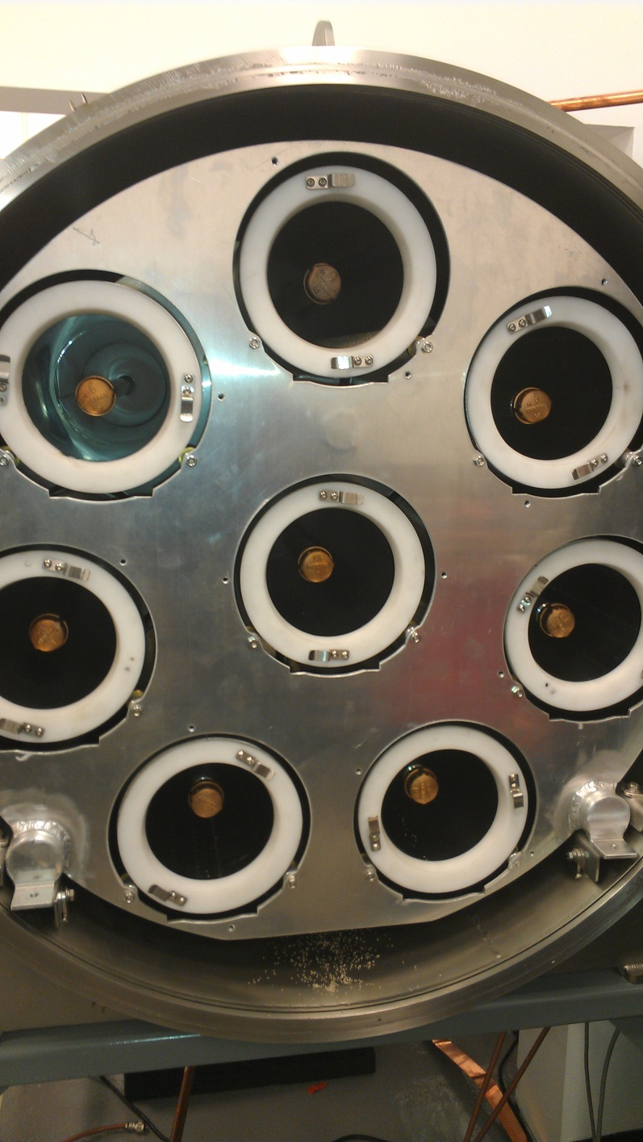
Pilot unit

Slide 27
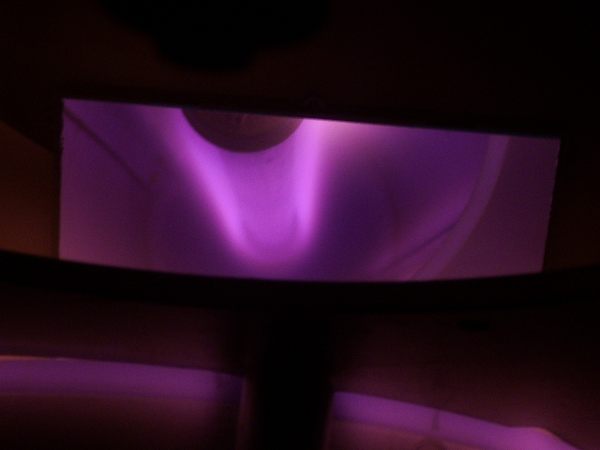
Plasma In Operation

Slide 28
Exhaust
Pure Plasma
Saw Palmetto
*- at 2min; **- at 7 min. (total time - 7.5min)

Slide 29
Moisture and Outgassing
Moisture effect ( based on experimental data)
Material | Chia Seeds | SPF | NL
Load, g | 2270 | 200 | 430
Processing time, min | 5 | 7.5 | 15
Moisture before treatment, %wt. | 2.75 | 5.5 | 4.05
Water content, ml | 62.425 | 11 | 17.415
Moisture after treatment, %wt. | 2.5 | 2.45 | 2.6
Water content, ml | 56.75 | 4.9 | 11.18
Water vapor, ml/min/kg | 0.5 | 4.07 | 0.97
DP, mTorr | 500 | 488 | 433 | 460
Gas (Air), sccm | 100 | 100 | 0 | 0
Rate [Torr x L x sec] |  |  | 3.72 | 3.96
SPF | Thickness - 4 mm; 3rd shelf; Power= 1000 Watts;
 | Time, sec | 10
P₁, mTorr | 1069 | 1090 | 1077 | 1067
P₂, mTorr | 1900 | 1970 | 1870 | 1874
DP, mTorr | 831 | 880 | 793 | 807
Gas (Air), sccm | 100 | 100 | 0 | 0
Rate [Torr x L x sec] |  |  | 6.82 | 6.94
Note: Outgassing rate is the amount of gas leaving some unit area of surface (volume) in unit time [Torr x liter x square cm x Second]
Shelf surface , cm² |  | 1978
Chamber Volume, cm³ |  | 86000

Slide 30
Conclusion
Using non-thermal plasma for treatment of food powder is a promising technology due to that processed material does not content toxic residuals and the temperature range can be kept to an acceptable level.
The next step of plasma development is pairing it with other decontamination process such as RF pulse electric field treatment. Synergetic effects might be more significant than either technology alone.

