Slide 1
Pure I/O Information and Operations Integration
This presentation is best viewed in Power Point Slide Show presentation mode
Wayne Morgan
WWTP’s move into the age of the IIoT
This presentation was given at the 2018
Georgia Rural Water Association Conference
In Helen, GA.
Permissions were given by those involved and certain names have been removed intentionally.

Slide 2
Kind of a
VIRTUAL REALITY
VR
Assurance in the age of the
IIoT
The Internet of things is the network of physical devices, vehicles, pumps, motors, and other items embedded with electronics, software, sensors, actuators, and HUMAN connectivity which enables these things to connect, collect and exchange data

Slide 3
Notes:
`

Slide 4
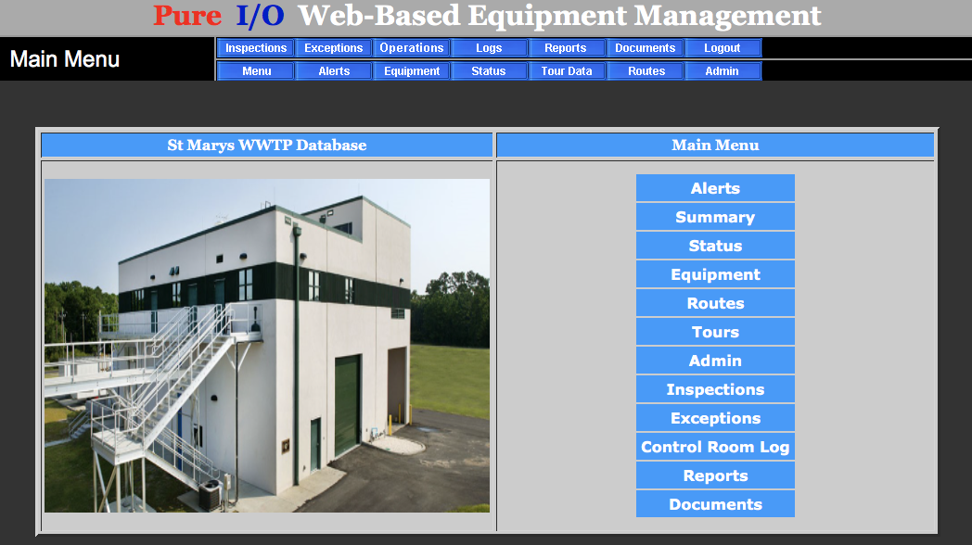

Slide 5
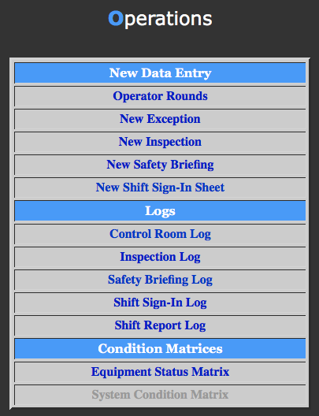
PURE I/O supports Operational Compliance
Sign-In using PURE
Safety Briefings in PURE
Environmental Inspections
Equipment Inspections
Operational Log Entries

Slide 6
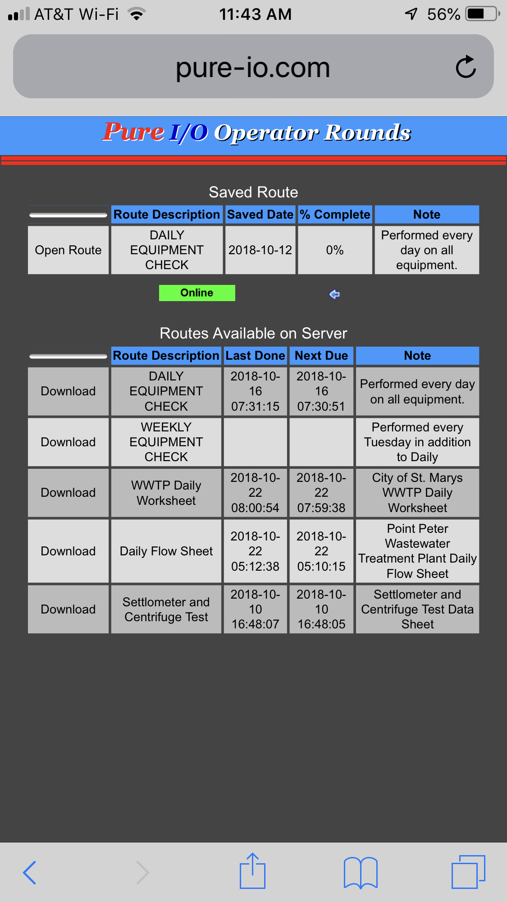
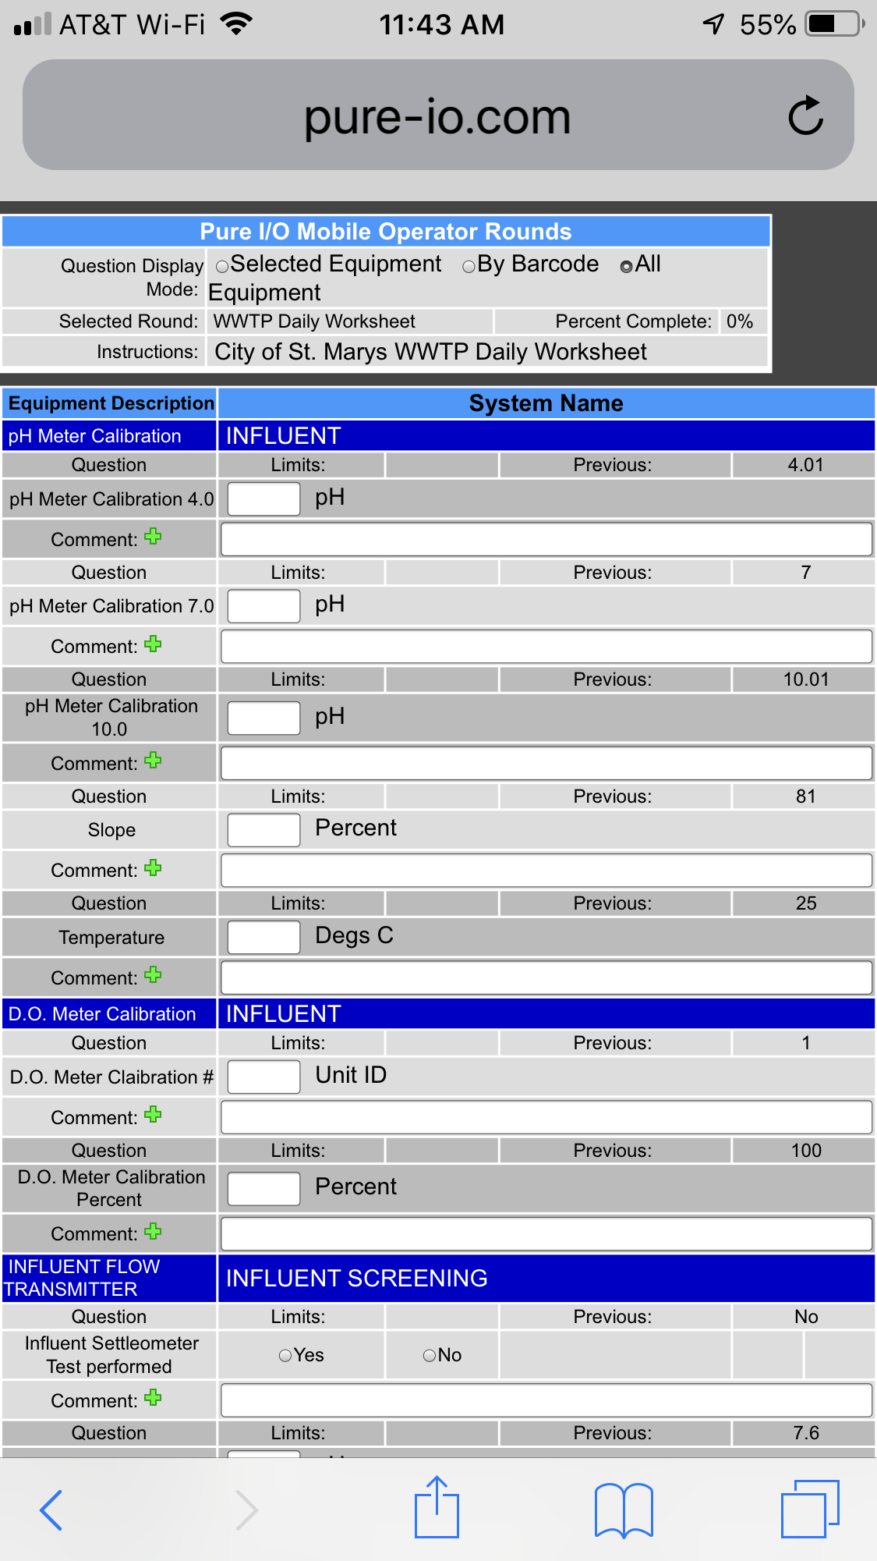
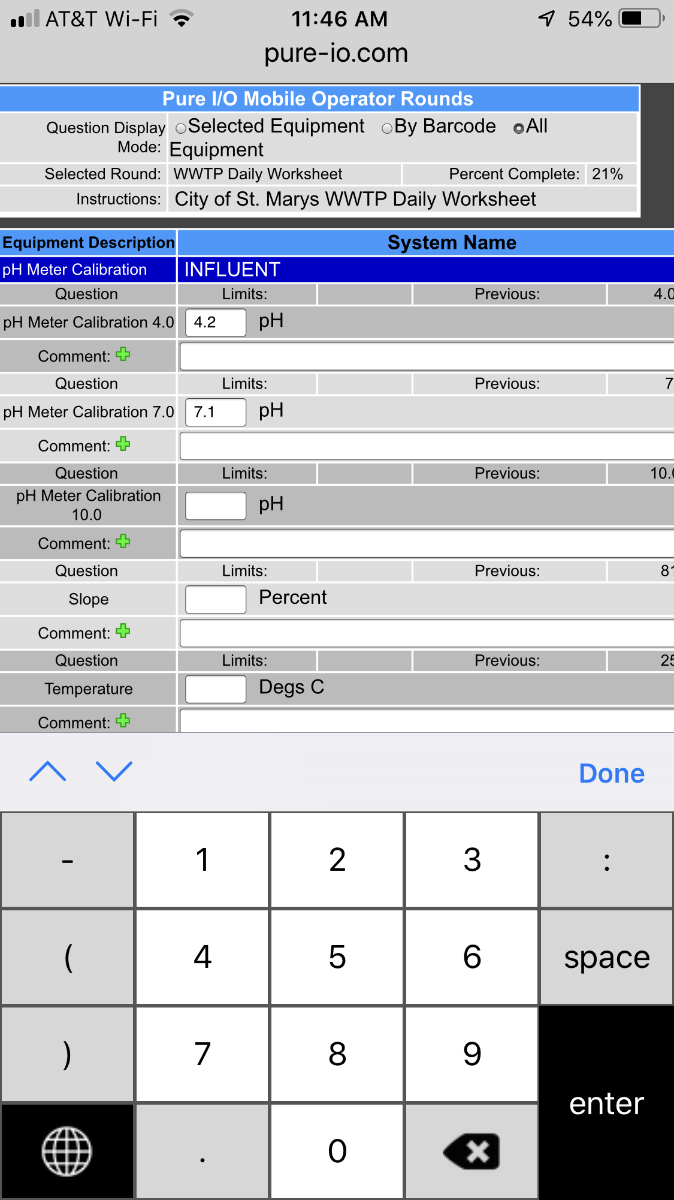

Slide 7
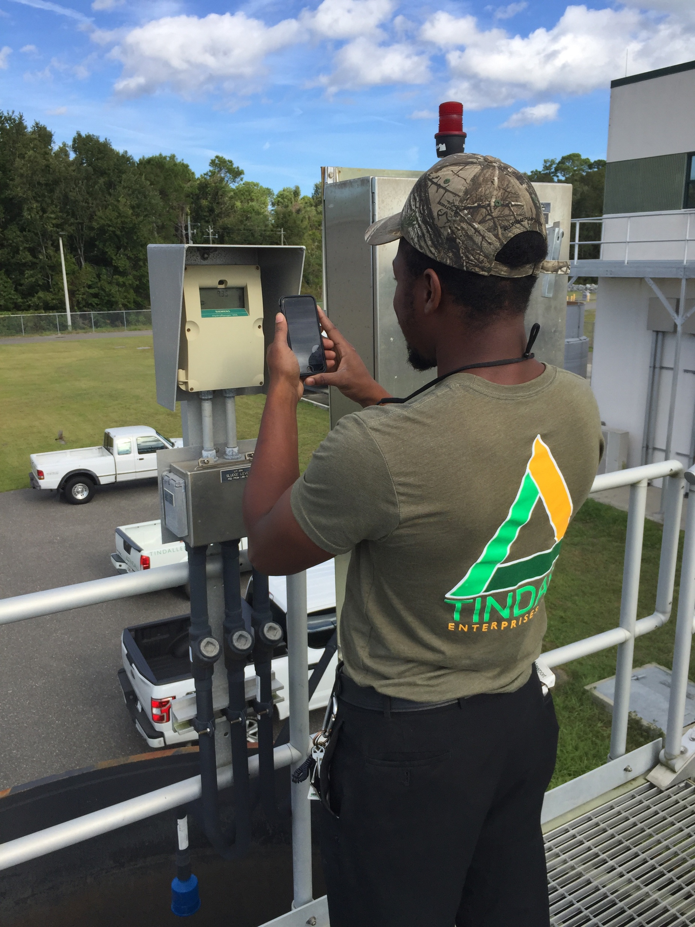
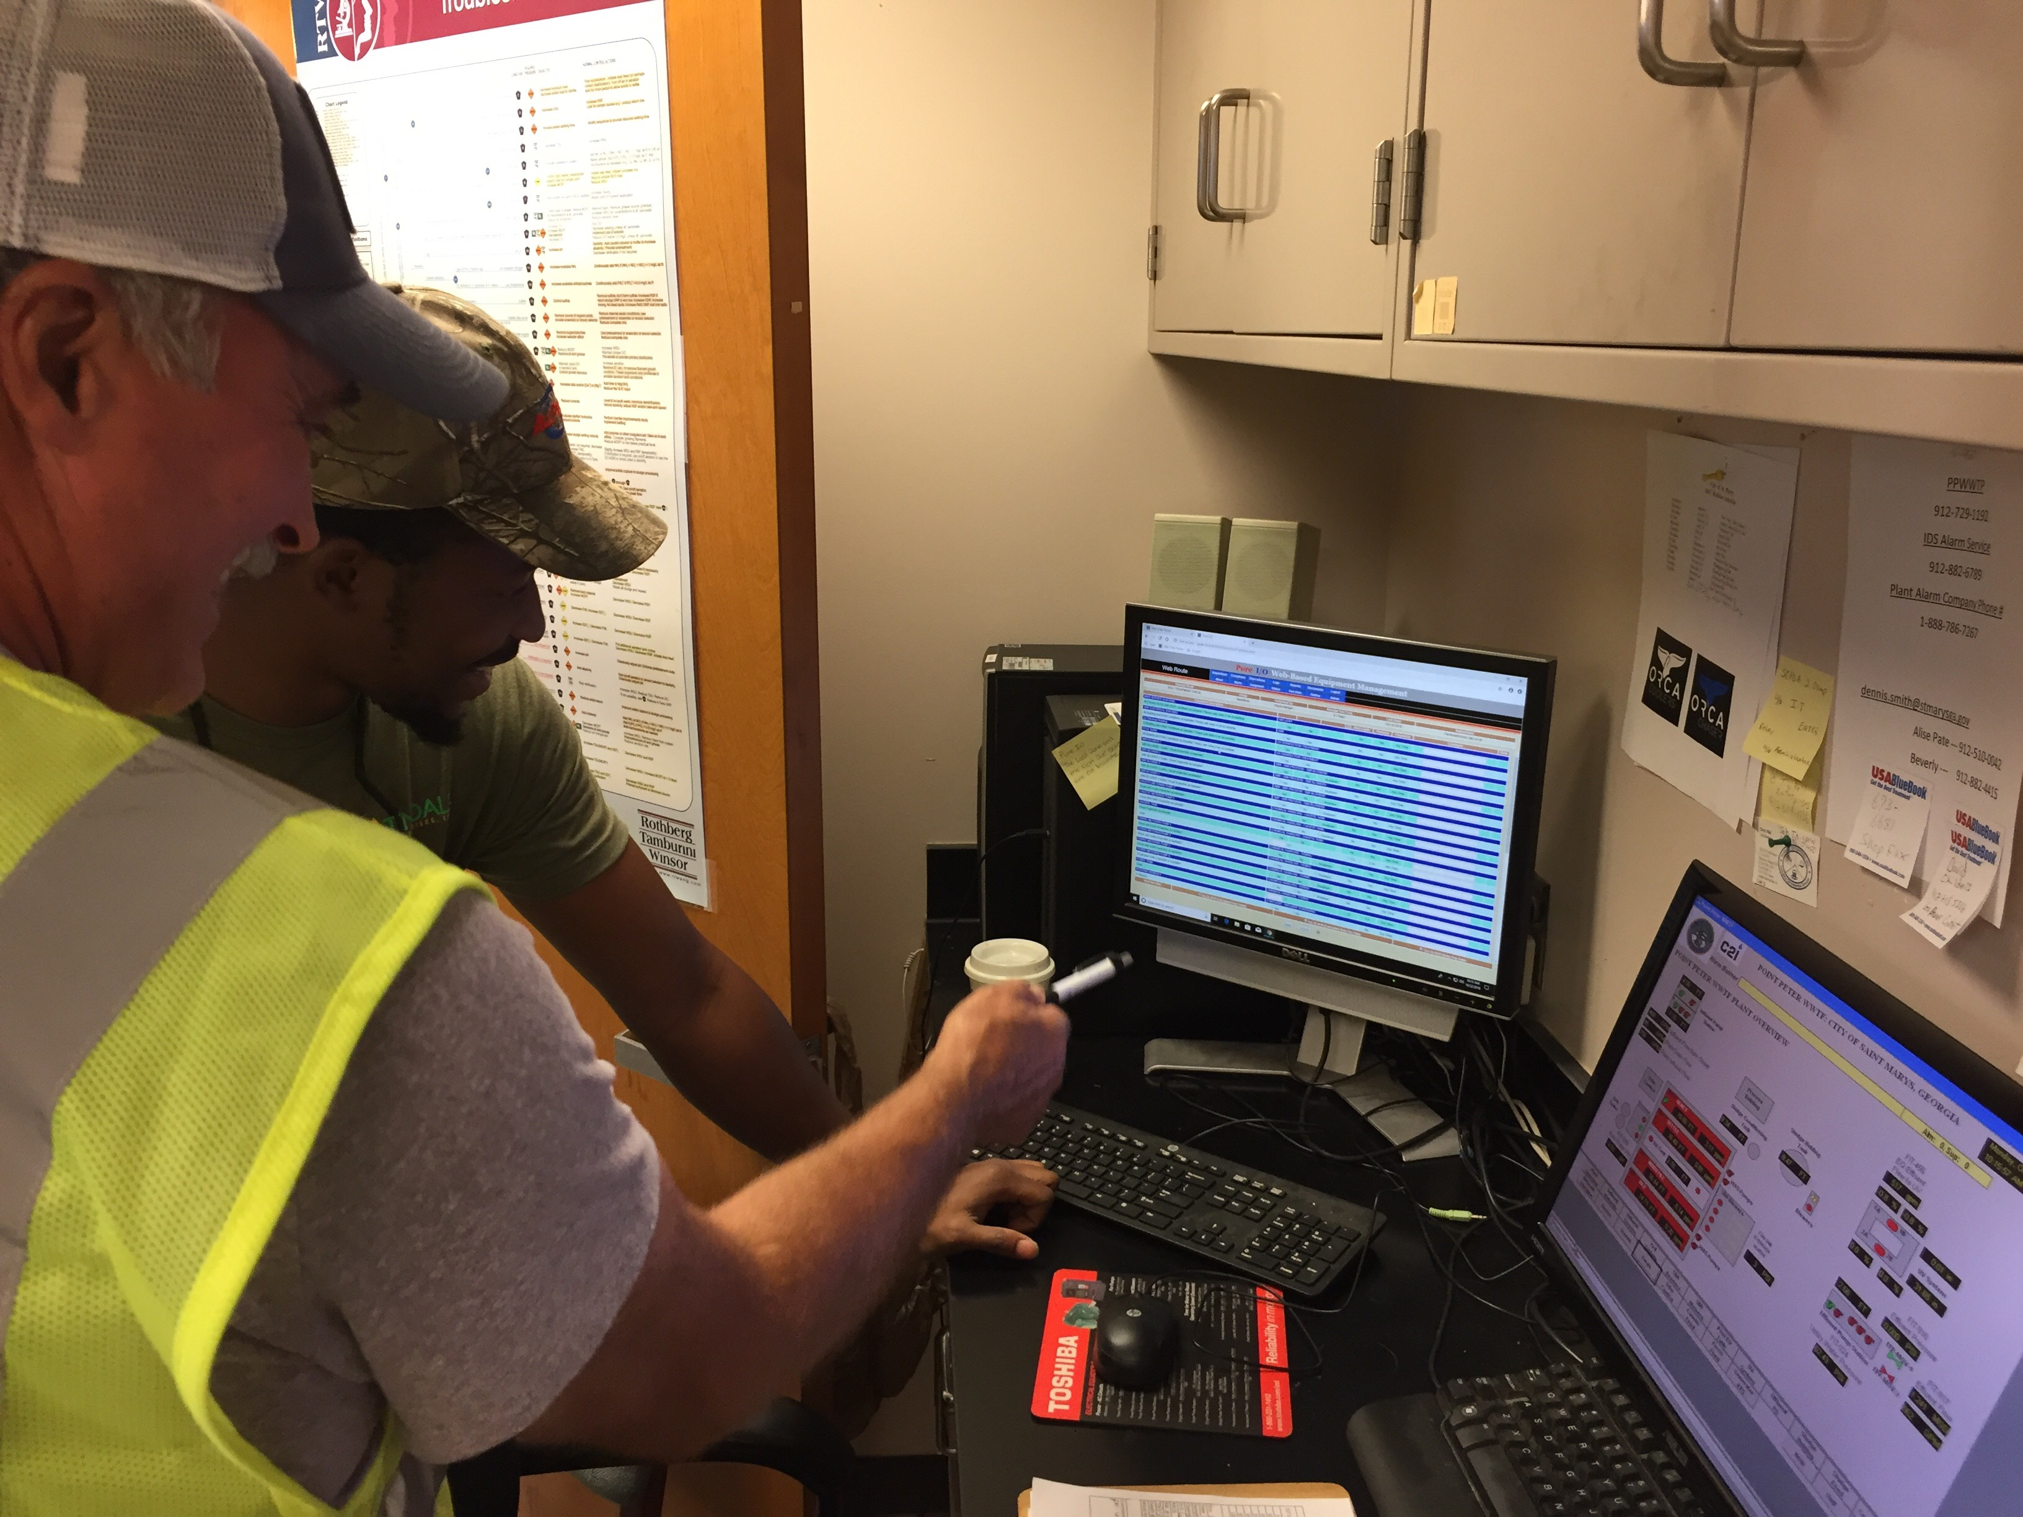

Slide 8
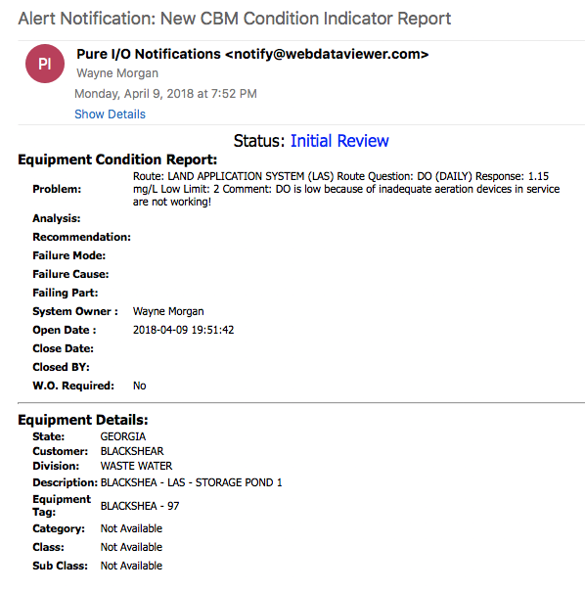
Email Notifications on Exceptions or Concerns
Gives brief description of Concern
System/Asset Owner
Shows the Customer and Division
Tells the “What and Where”

Slide 9
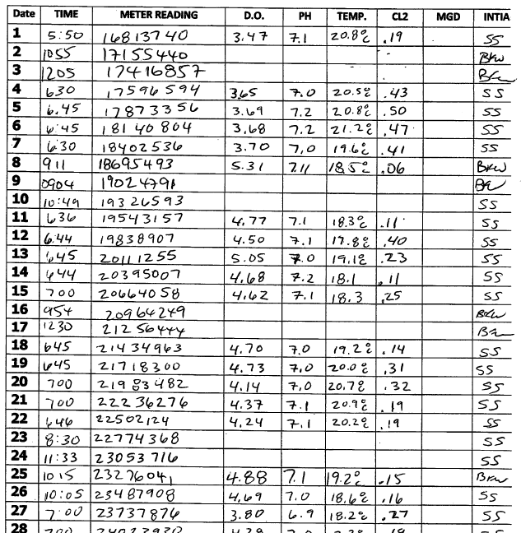
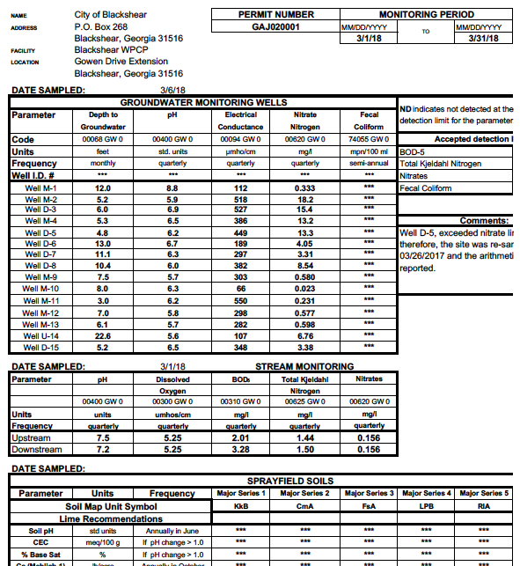
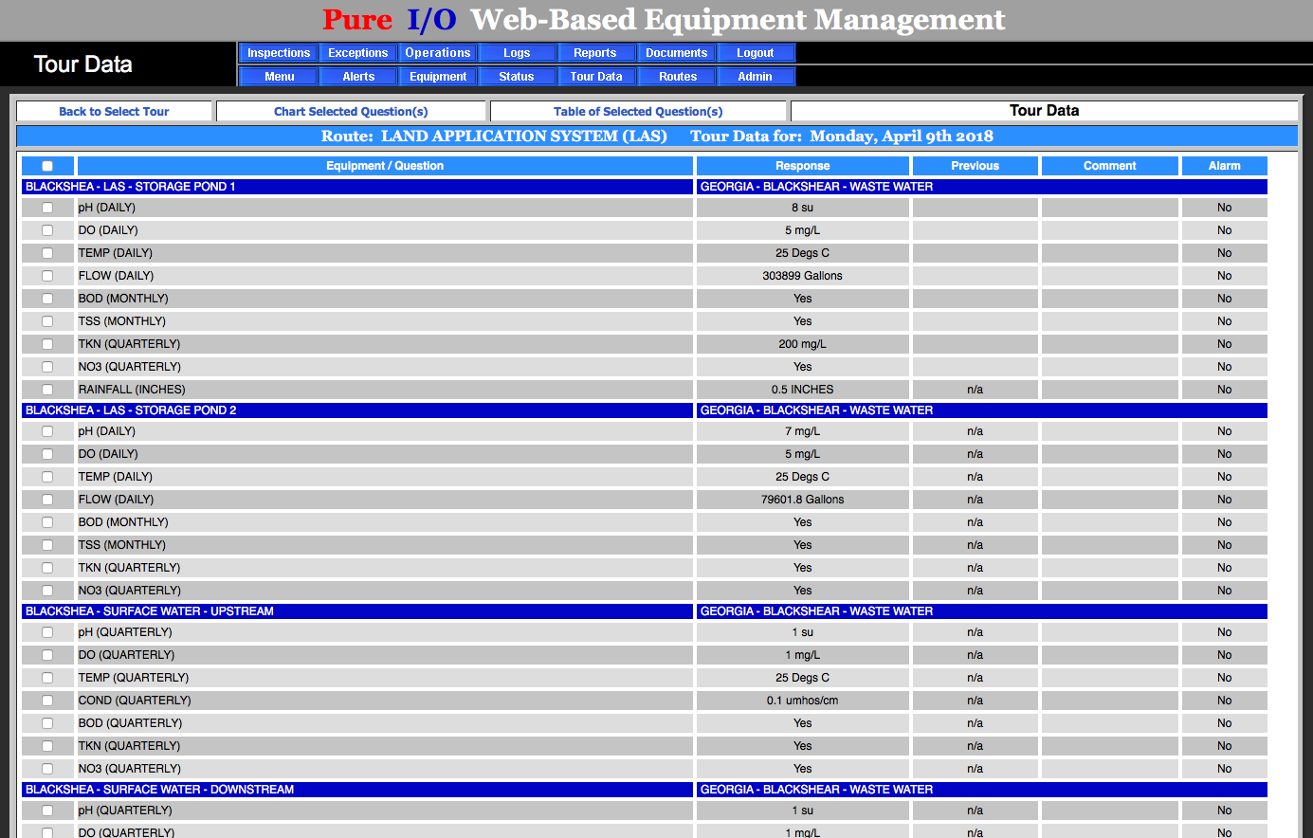

Slide 10
Names Removed

Slide 11
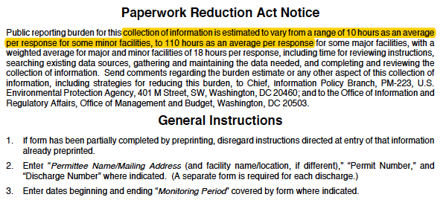

Slide 12
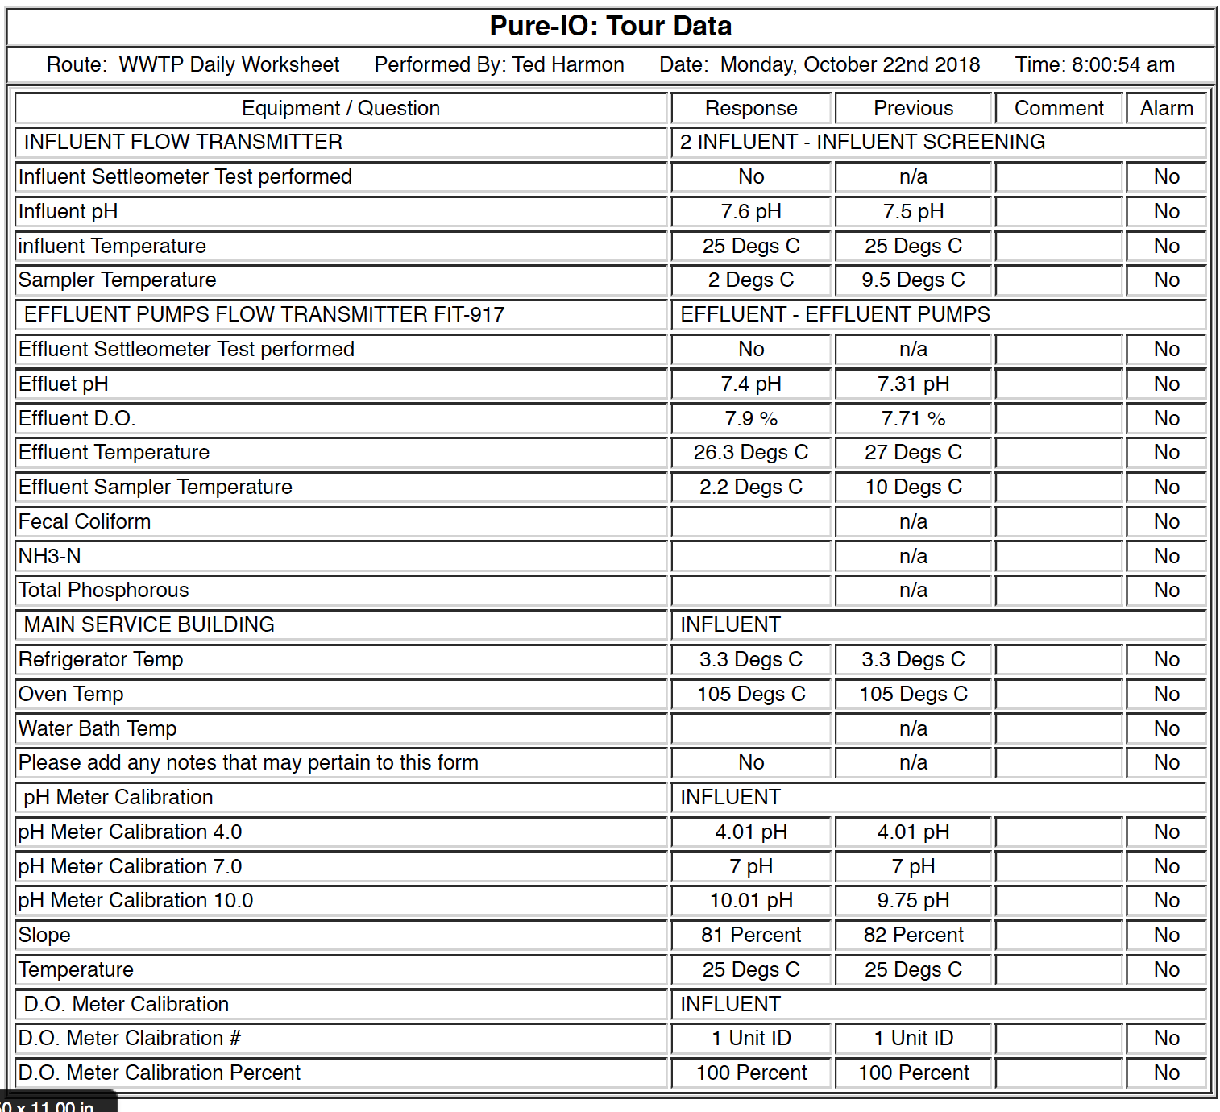
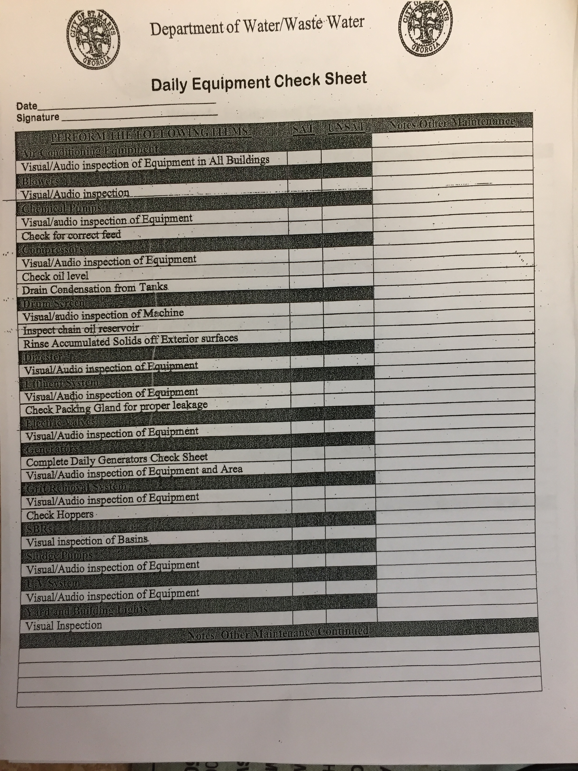

Slide 13
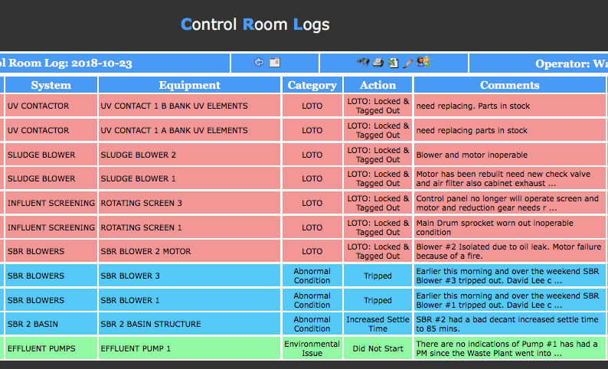

Slide 14
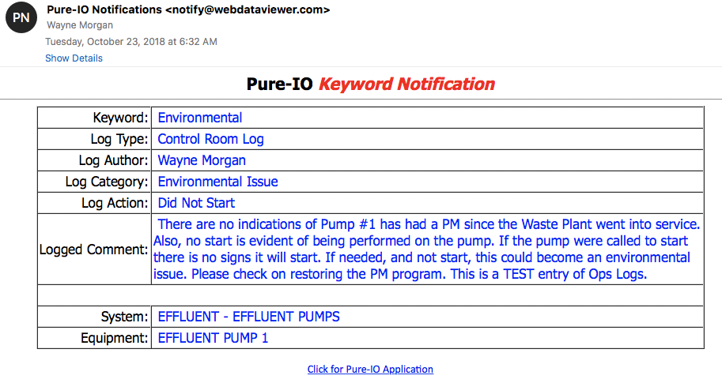

Slide 15
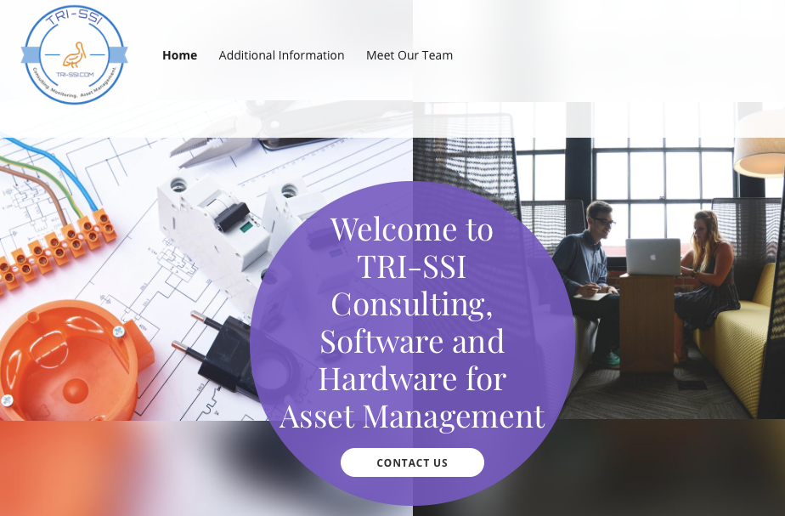
TRI-SSI, LLC
Pure I/O

Slide 16
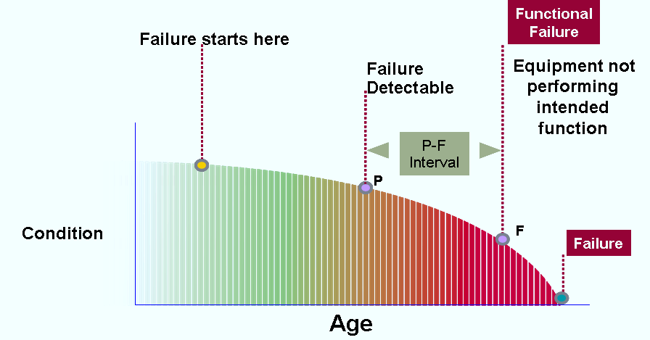
>80% of Equipment Failures are Random!
Assured Inspections & Maintenance Is The Key!

