Slide 1
EarthShare
Final Deliverable
December 1, 2021
Notes:
Anna

Slide 2
Agenda
1
Introductions
2
Project Scope
3
Survey Results
4
Recommendations
5
Next Steps
Notes:
Anna

Slide 3
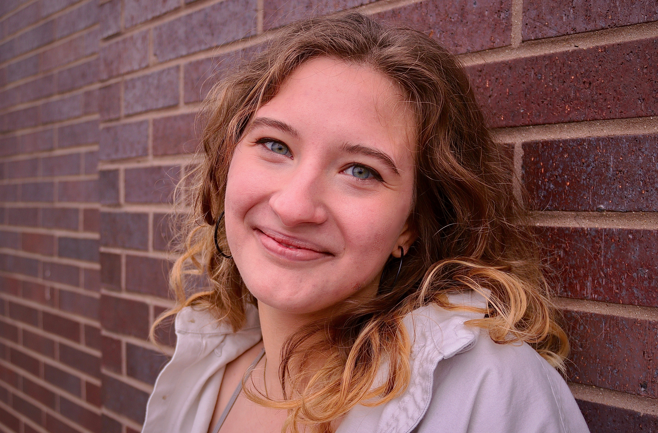
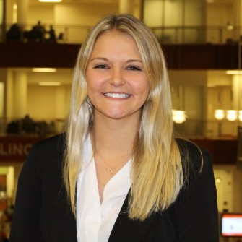
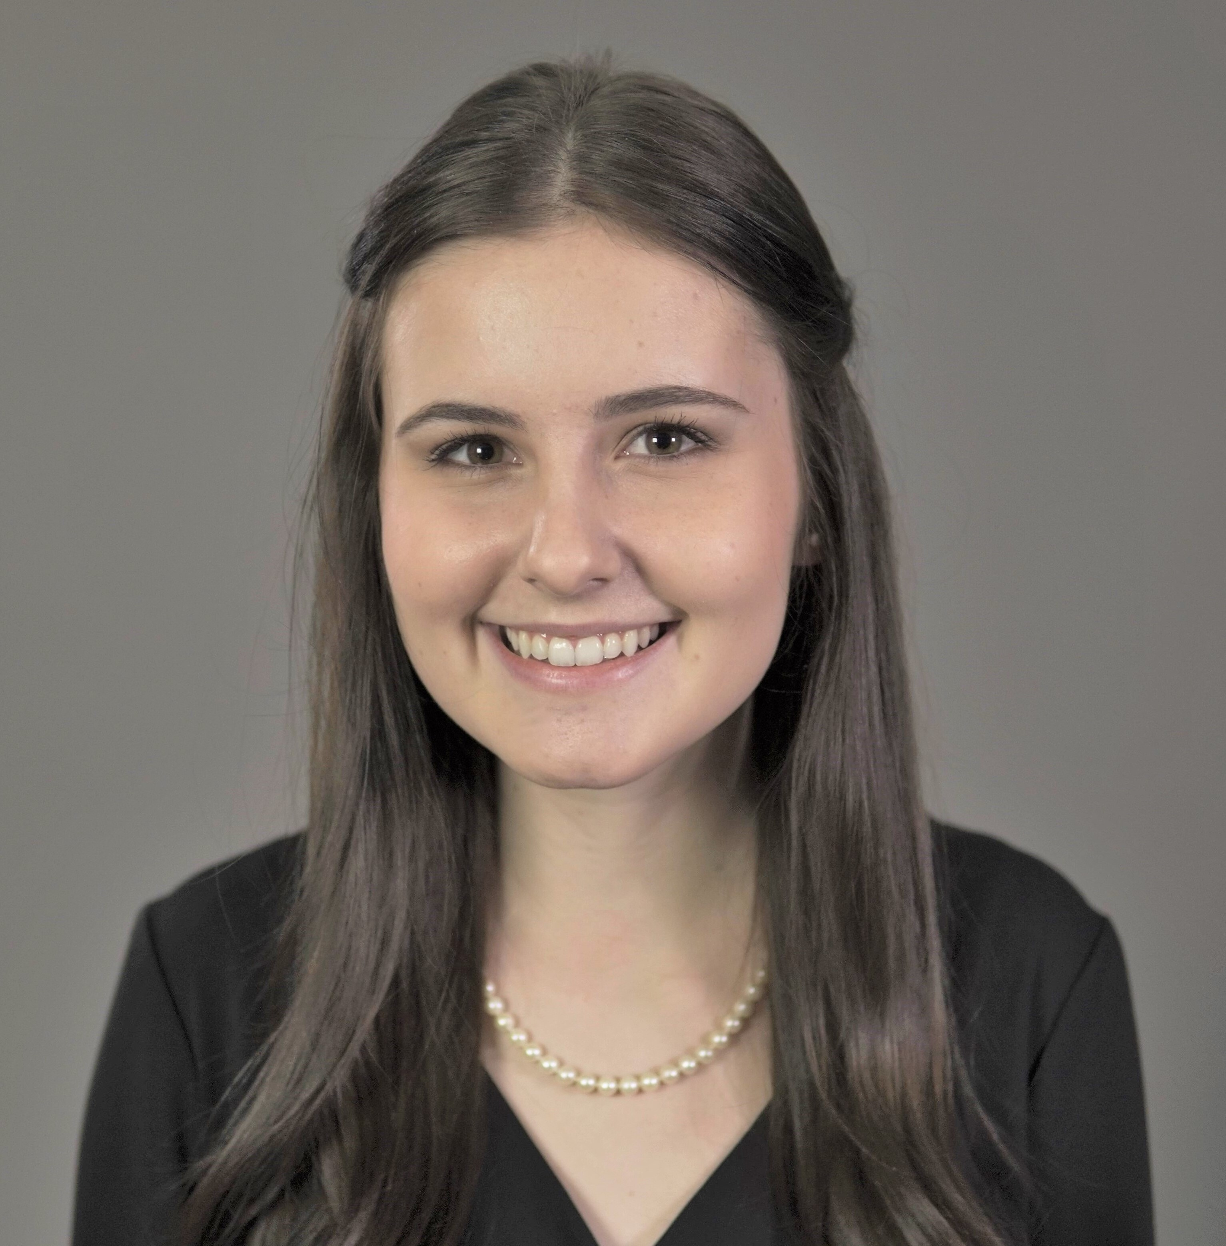
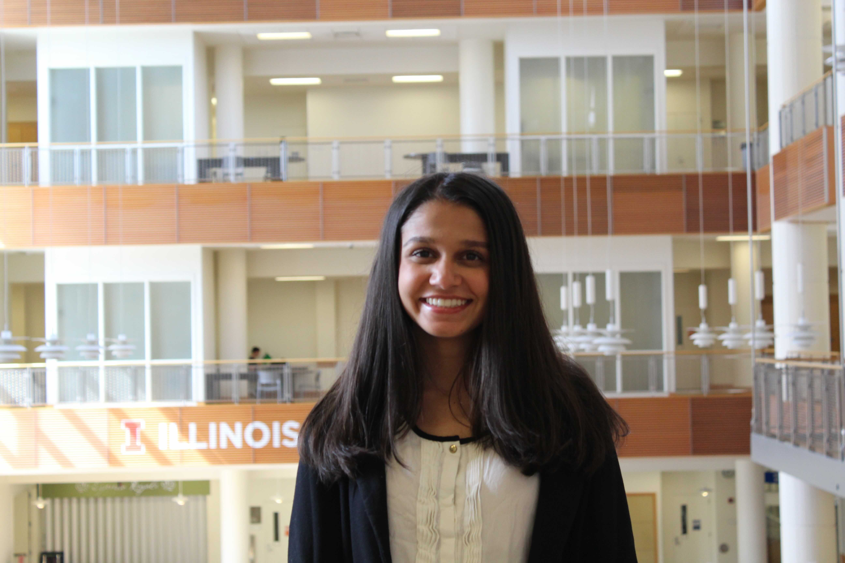
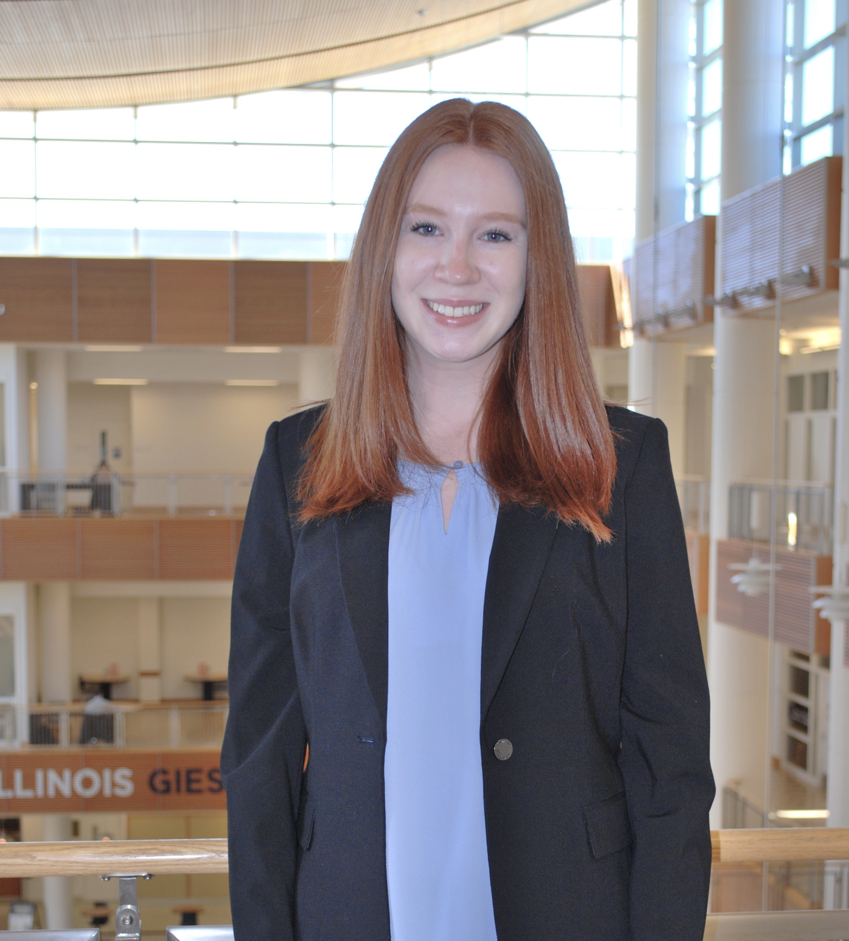
Introductions
Annee Mattson
Advertising
Partner
Anna Riedl
Marketing
Project Manager
Cassidy Steel
Natural Resources &
Environmental Sciences
Senior Consultant
Audrey Freeman
Industrial Engineering
Consultant
Sanika Salgaonkar
Finance & Information
Systems
Consultant
Nicola Setterdahl
Finance
Consultant
Grace Mies
Economics
Consultant
3
Introductions
Project Scope
Overview
Recommendations
Next Steps
Notes:
Everyone

Slide 4
Project Scope
4
Notes:
Anna

Slide 5
Project Scope
EarthShare tasked SCNO with conducting marketing research and looking into a landscape analysis
Project Focuses
Marketing Research
Potential major university and RSO partnerships in the Midwest and at UIUC
Research on how to increase community engagement through micro influencers and campaigns
Landscape Analysis
Survey research to see how college campuses engage with environmental causes
Research on awareness campaigns and fundraising events on college campuses
Project Approach
Divided workstreams into a marketing research focus and a landscape analysis focus based on clients needs
Conducted mainly secondary research through credible outside sources
Research
5
Research
Introductions
Project Scope
Survey Results
Recommendations
Next Steps
Notes:
Anna

Slide 6
Project Scope: Timeline
Our team is wrapping up Phase 4 and moving on to Phase 5 to finish recommendations and start the implementation process
Project Kick off
Distributing roles and focuses
Analysis and Recommendation
Defining Best Practices and putting together next steps
Follow-up
After project is complete, check-in to see progress
Phase 1
Phase 2
Phase 3
Phase 4
Phase 5
Secondary Research
Collecting and compiling research from outside sources
Final Deliverable
Presenting Final recommendations
Project Scope
Survey Results
6
Introductions
Recommendations
Next Steps
Notes:
Anna

Slide 7
Survey Results
7
Notes:
Anna

Slide 8
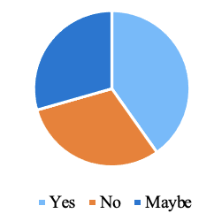
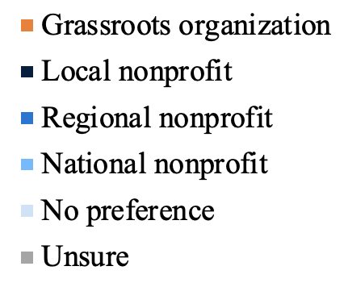
Survey: Summary of Statistics
A summary of survey respondent demographics, environmental interests, and willingness to donate/contribute to a cause
Demographics
Issues that are considered most urgent
Interest in internships with environmental organizations
35%
26%
19%
19%
Drinking water
Renewable Energy
Climate Crisis
Pollution
1%
Donation Experience
45%
are willing to donate $5-10 monthly
56%
are willing to donate $10+ to a cause they’re passionate about
Have not donated
Website
Mail
RSO
In-person event
Social Media
Jr.
Soph.
Sr.
Fresh.
Grad.
80%
19%
1%
Female
Male
Nonbinary
Nonprofits they are most likely to support or donate to
90%
are willing to volunteer
79%
are willing to spread awareness
82%
Of respondents are involved in 1 or multiple RSO’s on their college campus
Introductions
Project Scope
Survey Results
Recommendations
Next Steps
8
Notes:
Grace

Slide 9
Marketing Recommendations
9
Notes:
Grace

Slide 10
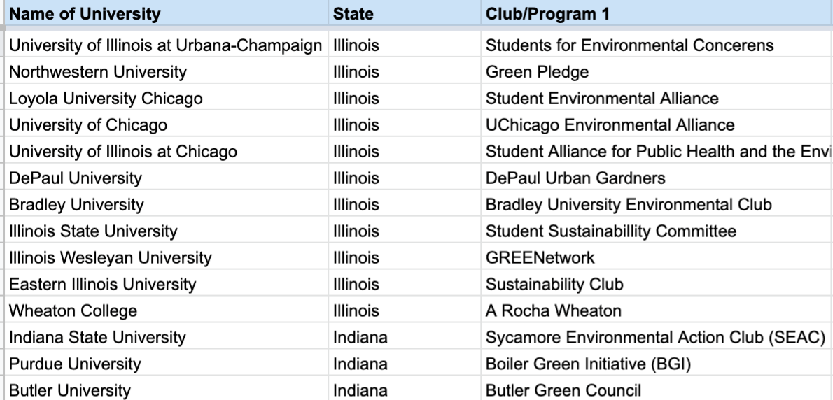
Midwest University Database
This database serves as a comprehensive resource of Midwest universities, student-run clubs and programs, and contacts
Purpose
Organize large amounts of data in a concise manner
Create a representative sample – small, midsize, and large universities are all included
Locate contacts at prominent Midwest universities
40+
Midwest Universities Represented
Set-up
Name of university
Midwest state
Active sustainability clubs and their descriptions
Active institutes and their descriptions
Contact information
Use
Browse universities based on geographic location and/or name recognition
Easily contact a sustainability representative from each university
Recommendations
10
Introductions
Project Scope
Survey Results
Next Steps
Notes:
Grace

Slide 11
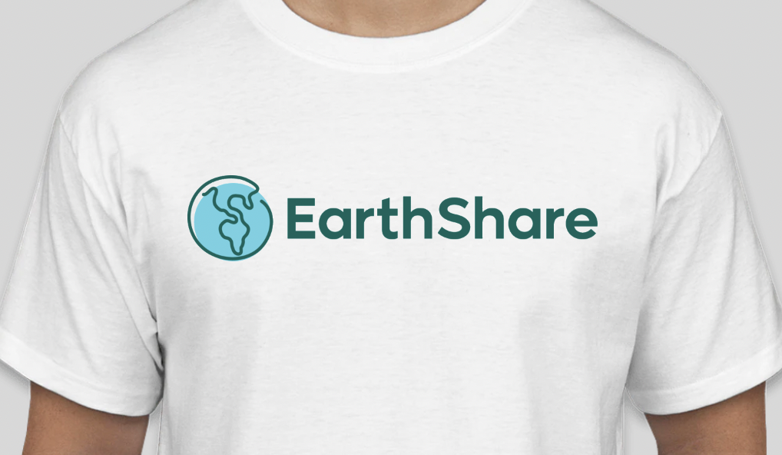
EarthShare Merchandise
Merchandise is an popular incentive that would prompt individuals to donate, support EarthShare, or support a nonprofit
80%
Of surveyors said they were interested in purchasing merchandise from an environmental nonprofit
Cost Analysis
Merchandise Design: $0 - $50 depending on product
Typical Profit: dependent upon the supplier and purchasing order size
Medium to low time commitment
Marketing: social media
Likely to fall in low price range for most factors
Popular Merchandise
91%
Of surveyors said they may be more likely to donate to a cause if they could receive merchandise
T-shirts
Tumblers
Hats
Reusable water bottle/straws
Sticker
Pens
Source: DesignHill 2021
Recommendations
11
Introductions
Project Scope
Survey Results
Next Steps
Notes:
Cassidy

Slide 12
Finding Micro Influencers
Using social media, hashtags, and influencer databases are easy ways to find relevant micro influencers
Ways to Find Micro Influencers
Steps For Reaching Out to Micro Influencers
Social Media Evaluation
Hashtags
Influencer Databases
Follow them on social media
Engage with their posts (like and comment)
Send an outreach email or DM the influencer
In your outreach message be direct, explain why you chose to work with them, and what your goal is
See who is engaging with your posts by commenting or retweeting
Already passionate about your brand
Connected to your target audience
More likely to work with you
Can look up #YourBrandName to see people who are already engaged with your brand
Use hashtags with topics relating to your brand as well
#Sustainability, #ClimateChange, #Eco-Friendly
1. Scrunch.com
Quickly search for a topic
Shows statistics (audience size and approximate cost)
2. TinySponsor.com
Micro influencers only
Pay influencers directly
Hey Sara,
My name is Jill, and I’m the Marketing Manager at GoGreen.
I came across your Instagram, and I love how you use sustainable products in your everyday life. The way you used that beeswax food wrap is so creative!
Here at GoGreen, we focus on creating eco-friendly home products to help reduce our carbon footprint. Because we share the same values, I think you’d be the perfect ambassador for our brand.
We’d love to hear your thoughts and work out a fun, green partnership! Are you free for a call tomorrow?
Influencer’s Name
Introduction
Content Reference
Brand Introduction and Fit
Clear CTA
Source: Social Media Today, 2018
Recommendations
12
Introductions
Project Scope
Survey Results
Next Steps
Notes:
Sani

Slide 13
Risks and Obstacles of Micro Influencers
Some obstacles of working with micro influencers include lower outreach, more research, less experience, and less brand lift
Lower Outreach
More Research
Less Experience
Less Brand Lift
Smaller amount of followers
Fewer viewers see content
Targeted audience causes smaller demographic to see posts
Larger influencers typically are easier to find and show up before smaller influencers
More difficult to find a micro influencer that fits all of one’s criteria
Large influences create lots of posts because they promote many brands
Smaller influencers don’t promote as many brands
Posts may be of lower quality
Smaller amount of viewers leads to less people seeing the promotions
People’s perceptions of the brand will be not as impacted
Source: Influencer Marketing Hub, 2021
13
Introductions
Project Scope
Survey Results
Recommendations
Next Steps
Notes:
Sani

Slide 14
Fundraising Recommendations
14
Notes:
Sani

Slide 15
Virtual Fundraising Event: Online Gala
Virtual galas provide an effective and safe way to connect with supporters in an online setting
Overview
Advantages
Online fundraising event focused on celebration with donors
Mix of live and pre-recorded components
Reliant on peer-to-peer fundraising
Include performances, presentations, auctions, and prizes to entertain audience and encourage donations
Cost Effective
Average in-person gala cost: $25,000 - $70,000
Average virtual gala cost: $1,000 - $10,000
Easy to Replicate
Several online models from recent years to duplicate
Available courses and tutorials
Examples
Homeless Families Foundation: No Show Mother’s Day Gala
- Raised 131% of original goal
Saul Mirowitz Jewish Community School: Gala in the Clouds
- Nearly 300 donors
Indwell Affordable Housing: HOPE@HOME Virtual Gala
- Successfully replaced three in-person fundraising events
Supporter Based Fundraising
Peer-to-peer fundraising: raises about 2x as much compared to other virtual fundraising initiatives
High Engagement, Low Commitment
Variety of entertainment options to appeal to donors
One-time, hour-long virtual event
Source: Cause Vox, 2021
Recommendations
15
Introductions
Project Scope
Survey Results
Next Steps
Notes:
nicola

Slide 16
Sample Virtual Gala: 2020 Washington Performing Arts Gala
A recent example of a virtual gala and key takeaways in a successful transition to an online model
Model
Cost Analysis
1.5 hour duration
Hosted on YouTube
Free tickets, suggested donations
Live auction and awards presentation
Streaming platform: $0 - $500
Video production: $250 - $20,000
Auctioneer: $0 - $1,000
Online auction software:
$1,000 - $3,000
Marketing: $0 - $1,500
Expenses: Up to $1,000
Likely to fall in middle range for most factors
68%
of survey respondents have
donated via a social media fundraiser
Steps to Success
Keep program short
Vary performance
Highlight sponsors and event info
Push event via social media
Source: Washington Performing Arts Center, 2021
16
Introductions
Project Scope
Survey Results
Recommendations
Next Steps
Notes:
nicola

Slide 17
Fundraising Events on Campus
An overview of different types of fundraising events on campus and a breakdown of a merchandise order fundraiser
Types of Fundraisers
Select
Select the merchandise that will be sold
Ex: Bamboo Utensil Kit
Merchandise orders
Bake Sales
Head Shots
Raffle wheels on the Quad
“Pay – to – Pet” with Illini Service Dogs
“Pay – to – Play” (Committee Feud, Jeopardy, Sports Games)
Restaurant Fundraisers (Mia Za’s, Chipotle, Noodles and Company)
Create Form
Create order form with supply and pricing details Ex: Google Form
Order Supplies
Order enough supplies to satisfy order form responses and have day of purchases
Distribute
Distribute supplies on campus or ship supply kits
Ex: On the quad and at monthly meeting
Society Of Women Engineers Fundraising Example
“The reusable bamboo utensils are here! Each set contains a fork, knife, spoon, straw, straw cleaner, and SWE engraved pouch! The sets are $8 and can be picked up on campus. Click here to see what they look like and buy one! Contact Anna Riedl at 815-275-2416 or adriedl2@Illinois.edu”
Source: The Sweekly, 2021
17
Introductions
Project Scope
Overview
Recommendations
Next Steps
Notes:
Audrey

Slide 18
Pop-Up Events and Space Rental
When, where, and how to reserve a pop-up tent for an external organization on the quad at the University of Illinois
Event Rental
Cost Analysis
When
Earth Day: Friday April 22, 2022
Green Quad Day during Earth Month
Time: Between 9 am – 5 pm when people have class
University Outdoor Rental Fee: $25-55 per hour
Tent/Canopy: $60-$200
Small giveaways: Stickers, succulents, reusable straws, etc.: $2 - $5
Larger giveaways: T-shirts, Tote Bags, Utensil Kits: $10-$20
Where
Anniversary Lawn: Outside the Illini Union facing the main Quad
Outdoor spaces throughout the University campus
How
66%
Of surveyors said they would most likely attend a fundraiser on the quad
67%
Of surveyors are more likely to donate to a cause if they received merch or swag
Fill out the online request form for premises & facilities at the Illini Union
For other areas on campus, fill out the general Outdoor Space Requests
Source: Illini Dance Twitter, 2021
18
Introductions
Project Scope
Overview
Recommendations
Next Steps
Notes:
Audrey
With each App sign-up or donation given:
Stickers with Logo
Reusable straws
Reusable Silverware Kit
T-shirts with Logo
Reusable water bottle with logo
Reusable tote bags with logo
Small Succulents with information card into pot
Free Food
Raffle or spin to win merchandise or gift card

Slide 19
Platform Recommendations
19
Notes:
Audrey

Slide 20
Creating a Podcast
Steps to generate a podcast to enhance target demographic knowledge on environmental matters
Podcast Format
Choosing
a Platform
Key Takeaways
Determining objectives (who, what, why, and how) of podcast
Series formatting, hosting and interviewing
Episode format: Teaser → Welcome → Ad Spot → Interview → Call to Action
Intro and outro music
Top podcast listening apps: Apple Podcasts, Spotify, Google Podcasts, Stitcher, Tunein
Storage capabilities
Website integration
Audience analytics
In-app marketing features
Podcast #1 way respondents are willing to learn about environmental topics
Need for effective podcast description
27.5% will listen up to 5 minutes to determine interest
Recommended episode duration: 18-30 minutes
Source: The Podcast Host, 2021
20
Introductions
Project Scope
Survey Results
Recommendations
Next Steps
Notes:
Nicola

Slide 21
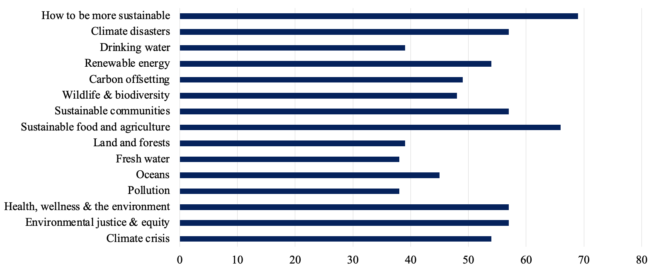
Podcast Topics and Tips
A successful podcast can be created by speaking on popular topics, building credibility, and ensuring authenticity
Podcasting Tips for Success
Authenticity
Story-telling
Provide value in each episode
Have a reoccurring segment/theme
Guest speakers
Connect to audience's emotions
Leave audience with a call to action
Risks
Sustainability Tips
Time investment
Research intensive
Slow build to reach audience
IP and content protection
Focus on current topics
Utilize uplifting tone
Invite experts to speak
Provide additional resources
Provide tips in each episode
Connect to social media platforms and interact with audience
Make it relatable
Source: Podcasting Hacks 2021
21
Introductions
Project Scope
Survey Results
Recommendations
Next Steps
Notes:
Cassidy

Slide 22
Sustainability Challenges
Through various sustainability challenges, people will be able to support the environment in a fun, competitive manner
Sustainability
Challenges
Example
Challenges
Incentives to
Participate
Challenges people of all ages can participate in to increase and enhance sustainability within people’s normal routines
63% of survey participants said yes and 28% of participants said maybe to participating in sustainability challenges
Recycling
Pick up litter
Going somewhere by bike instead of driving
Start a compost pile
Plant a tree in your community
Turn the lights off when leaving a room
Turn off the water while brushing your teeth
Start your own garden
Donate clothes
Points system:
Easier/smaller activities get fewer points
Give out prizes for getting a certain number of points
Show a leaderboard to increase competition among students
Clubs and individuals can compete against one another
Source: SCNO, 2021
22
Introductions
Project Scope
Survey Results
Recommendations
Next Steps
Notes:
Sani

Slide 23
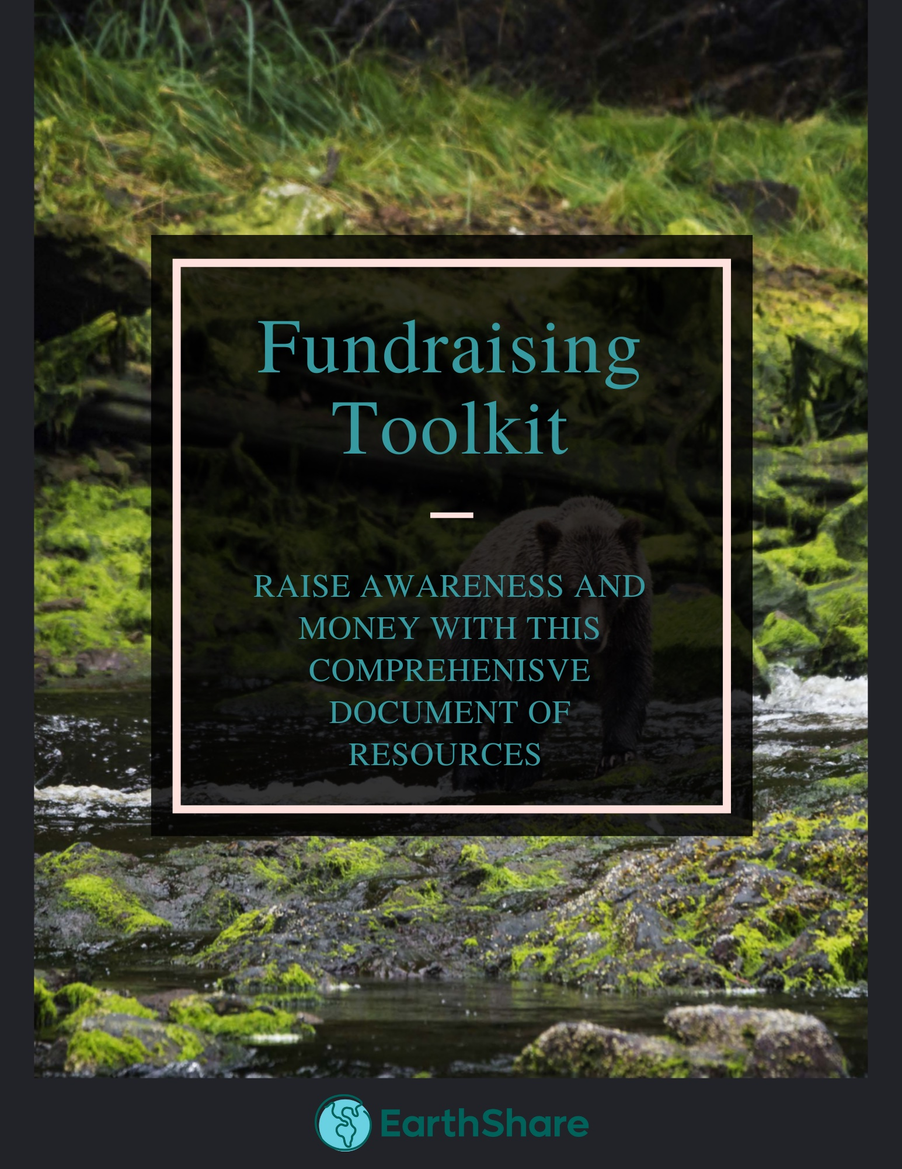
Fundraising Toolkit
Individuals will be able to successfully create a fundraising event with tips and steps provided in an online toolkit
Purpose
Use
EarthShare will provide individuals with an overview of how to be successful when fundraising
Consists of steps to success when constructing a plan, choosing a cause to raise money for and inspiring ideas
Will be located on EarthShare’s website or application
A document of event-planning resources
A “how-to” focused on raising money for a cause such as the climate crisis, sustainable agriculture, pollution, etc.
34
surveyors said they would create or contribute to an online fundraiser to raise environmental awareness
Content
Best Practices
Campaign Strategies
Fundraising checklist that highlights before, during, and after fundraising
Fundraising ideas
23
Introductions
Project Scope
Survey Results
Recommendations
Next Steps
Notes:
Anna

Slide 24
Next Steps
24
Notes:
Anna

Slide 25
Next Steps
The next phase of the project is to use the research we collected and recommendations we formed to start implementation
1
2
3
External Final Deliverable
Complete Implementations
Wrap-up the Project
Use feedback given in internal Final Deliverables to revise slides so they are presentable to client
Finalize details in our implementations so that we can pass them on to EarthShare by the end of the project
Send white pages and slide deck to EarthShare and check on implementation progress
25
Introductions
Project Scope
Survey Results
Recommendations
Next Steps
Notes:
Anna

Slide 26
Sources
Winn, Ross. “The Ultimate Guide to Starting a Podcast.” Podcast Insights®, 26 Aug. 2021, https://www.podcastinsights.com/start-a-podcast/.
Campos, Zoe. “How to Start a Podcast: Your 2021 Step-by-Step Guide.” Castos, 8 Nov. 2021, https://castos.com/how-to-start-a-podcast/.
Maxey, Isabella, et al. “The Best Podcast Apps 2021.” Resonate Recordings, 26 Aug. 2021, https://resonaterecordings.com/equipment-reviews/best-podcast-apps/
McDonald, Alex. “How Much Does It Cost to Throw a Virtual Gala?” TravelPledge News, 17 Aug. 2020, https://blog.travelpledge.com/how-much-does-it-cost-to-throw-a-virtual-gala/.
“Webinar: Washington Performing Arts' Virtual ... - Youtube.com.” Youtube, Washington Performing Arts Center, 24 Mar. 2020, https://www.youtube.com/watch?v=Ql_Nk3vCrcc.
“Student Groups.” Institute for Sustainability, Energy, and Environment, University of Illinois at Urbana-Champaign, https://sustainability.illinois.edu/actionsinitiatives/getting-involved/.
Ussery, Michael. “The Top Ten Most Eco-Friendly Colleges – Midwest.” Do Amore, Do Amore Limited Company, 22 May 2015, https://www.doamore.com/the-top-ten-most-eco-friendly-colleges-midwest/. Accessed 15 October 2021.
Delbaere, Marjorie, et al. “Social Media Influencers: A Route to Brand Engagement for Their Followers.” Wiley Online Library, Psychology of Marketing, 11 Oct. 2020, https://onlinelibrary-wiley-com.proxy2.library.illinois.edu/doi/10.1002/mar.21419.
Kay, Samantha, and Rory Mulcahy. “(PDF) When Less Is More: The Impact of Macro and Micro Social Media Influencers' Disclosure.” ResearchGate, Journal of Marketing
Management, Jan. 2020, https://www.researchgate.net/publication/338953266_When_less_is_more_the_impact_of_macro_and_micro_social_media_influencers'_disclosure.
AdornThemes. (2021, May 12). 17 eco friendly activities for the best summer ever. ReduceWasteNow. Retrieved December 1, 2021, from https://reducewastenow.com/blogs/guides/eco-friendly-activities.
https://www.socialmediatoday.com/news/how-to-find-quality-micro-influencers-even-if-youre-clueless-about-influe/522996/
Nonprofit Awareness Campaigns: The Complete Guide for 2021. OneCause. (2021, November 5). Retrieved December 1, 2021, from https://www.onecause.com/blog/awareness-campaigns/.
Virtual fundraising events: Complete Guide for Nonprofits. OneCause. (2021, March 31). Retrieved December 1, 2021, from https://www.onecause.com/blog/virtual-fundraising-events/.
Pricesheet outdoor - campusrec.illinois.edu. (n.d.). Retrieved December 1, 2021, from https://campusrec.illinois.edu/wp-content/uploads/2016/04/PriceSheet-Outdoor.pdf.
Illini Union. Rates and Capacities - Illini Union. (n.d.). Retrieved December 1, 2021, from https://union.illinois.edu/plan-an-event/request-space-at-the-union/rates-and-capacities.
26
Introductions
Project Scope
Survey Results
Recommendations
Next Steps
Notes:
Anna

Slide 27
Thank you! Questions?
Final Deliverables
December 1, 2021
Notes:
Anna

