Slide 1

“Where Have We Been & Where Are We Headed”
August 18, 2025
Dr. Robert Burton, President
Pastor Terry Woodard, Vice-President,
Pastor Derek Griffin, Secretary/Treasurer

Slide 2

Vision & Mission Recap
- Promote Christian unity, collaboration, and community uplift
- Provide spiritual and civic leadership
- Foster advocacy, education, and economic development

Slide 3
Where Have We Been (Highlights)
Increased visibility across Clayton County and Metro ATL
Greater collaboration with local and civic leaders
- Expanded events to include social impact and interfaith focus

Slide 4

April 2, 2025 – Prayer at the Capitol Steps
Details:
- Public prayer gathering at the Georgia Capitol
- Focus: unity, peace, justice, and revival
- Strong turnout and spiritual impact on city leaders

Slide 5
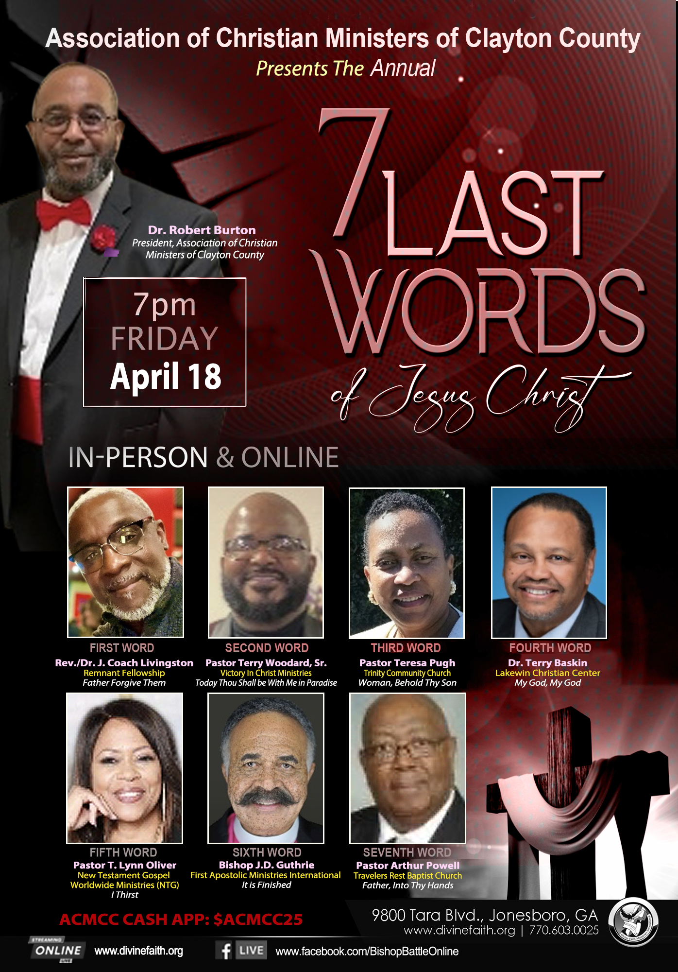
April 18, 2025 – Seven Last Words of Jesus Christ
Seven Last Words
Details:
- Annual Holy Week gathering
- Powerful lineup of preachers
- In-person & online format broadened reach

Slide 6
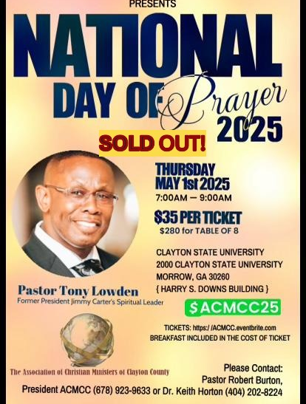
May 1, 2025 – National Day of Prayer
Highlights:
- Interdenominational and civic participation
- Public prayer across multiple county sites
- Theme: “Lift Up the Word – Light Up the World”

Slide 7

May 17, 2025 – ACMCC First Women’s Conference
Theme: “God’s Daughters Impacting the Kingdom for Such a Time as This” (Ester 4:14)
Highlights:
- Dynamic speakers and panel discussions
- Health, wellness, and empowerment focus
- Launch of Women’s Ministry Arm of the ACMCC

Slide 8


July 12, 2025 - Restorative Justice/Record Restriction Summit/Career Expo| 9:00 am – 1:00 pm
July 12, 2025 - Positioning Yourself to Buy A Home | 2 :00 – 4:00 p.m.

Slide 9
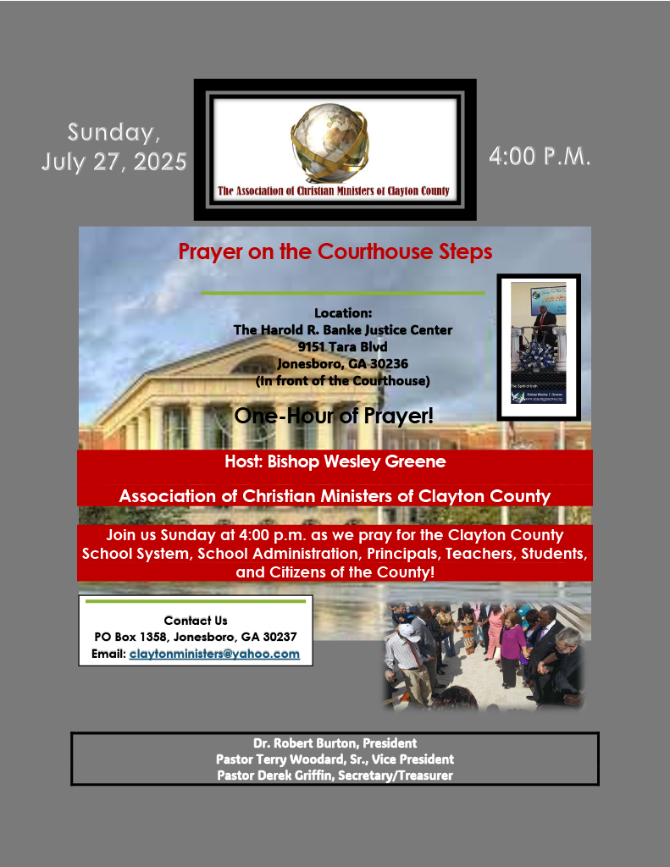
July 27, 2025 - Courthouse Prayer & Back to School Scholarship
Summer 2025 Initiatives:
- Prayer on Courthouse Steps: justice, youth, safety, and CCPS
- Scholarship Awards (7): $1000 each to selected students
- Community support from faith & business sectors

Slide 10
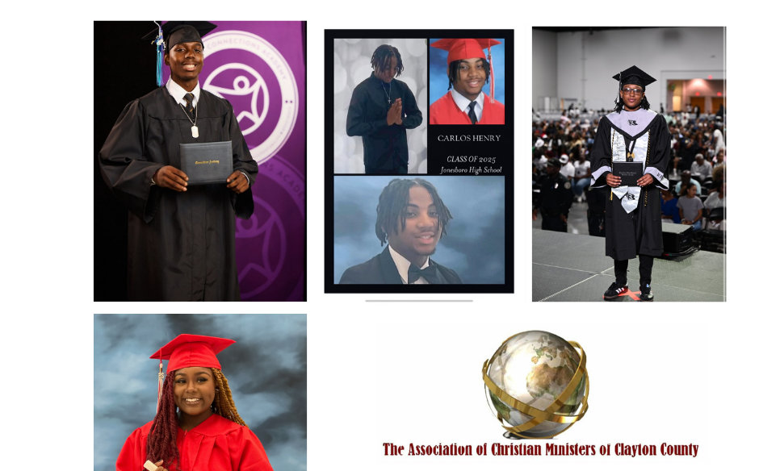
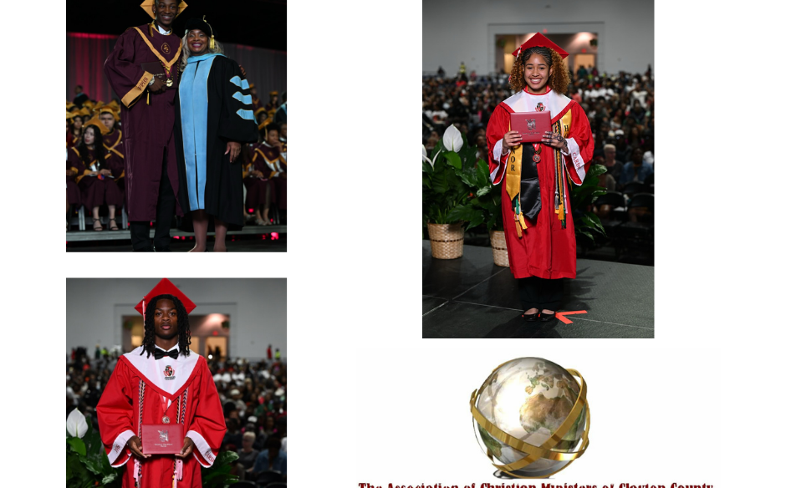
2025 Scholarship Award Winners!
Mr. Emannuel Smith
Mr. Makenzie Thompson
Mr. Carlos Henry
Ms. Shanyah Moore
Mr. Me’Shun Spivey
Ms. Madison Williams
Mr. Christian Smith

Slide 11
“Where Are We Headed”
- Strengthen youth outreach & mentorship
- Build interfaith and civic coalitions
- Expand digital footprint and media presence
- Leadership training & succession planning

Slide 12
Call to Action
Stay engaged, serve, and support
Join a working committee
Pray for bold vision and unity
Let’s go forward together stronger, wiser, and more “impactful”

Slide 13

ACMCC HUNT FOR 100 SCHOLARSHIPS
The “Hunt For 100” Scholarship Campaign Tour: TBD – December 2025
The ACMCC is committed to impacting the lives of graduating high school students in Clayton County by awarding one hundred $1,000 scholarships. This initiative is about instilling hope and inspiration in our youth and contributing to the growth and prosperity of our community.
FUNDRAISING COMMITTEE!

Slide 14

ACMCC Thanksgiving Food Giveaway!
Location: Riverdale Town Center
Date: November 22, 2025
Time: 10:00 a.m. – 3:00 p.m.
NEED TO UPDATE THE OLD FLYER!

Slide 15
Faith Fortitude and Food Bank Initiative – Mrs. Keisha Cobb
TENTATIVE: Friday, September 5, 2025

Slide 16
Upcoming 2025 ACMCC Major Events
October 4, 2025 – World Unhoused Day (Host: Pastor Keith Barksdale)
1
November 22, 2025 – Thanksgiving Food Drive/Distribution at the Riverdale Town Center, 10:00 a.m. – 3:00 p.m. (Host: Pastor Terry Woodard)
2
December 5, 2025 – ACMCC 2025 Scholarship/Award Banquet. Location: “This Is It Headquarters Banquet Hall” in Fayetteville, GA. Guest Speaker/Preacher: Pastor Tony Lowden, Jabez Ministries. Honored Guest: The Honorable Michael Thurmond.
3

Slide 17
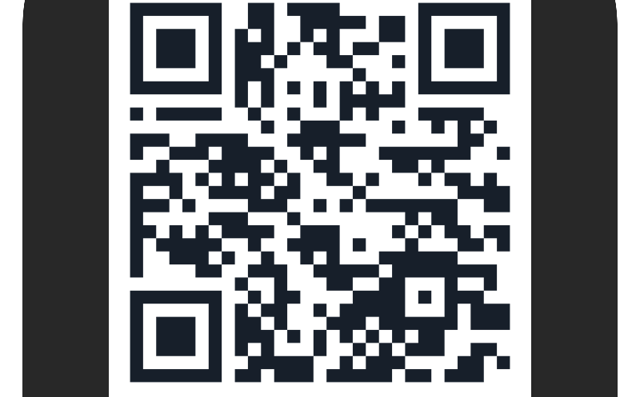
QUESTION/ANSWERS
Thank You!
Contact Information: claytonministers@yahoo.com
Website: www.acmcc.org

