Slide 1



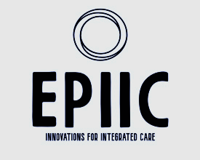

Early indicators of working collaboratively to enhance integrated care transformation. A case study impact analysis using triple lock approach
Professor Sally Hardy, Director of NICHE Anchor Institute, Faculty of Medicine and Health Sciences, UEA
and
Dr Pinar Guven-Usla, Associate Professor in Accounting, Norwich Business School, UEA
Notes:
This paper outlines the process of new forms of collaboration, associated with integrated care systems introduced in England in 2022. Lessons learned from a novel approach to anchor institutes, being positioned in higher education institutions, to form distinctive partnerships across local, national, regional and international collaborators forms the basis of impact evidence reported here as 'ripples in the pond'.

Slide 2
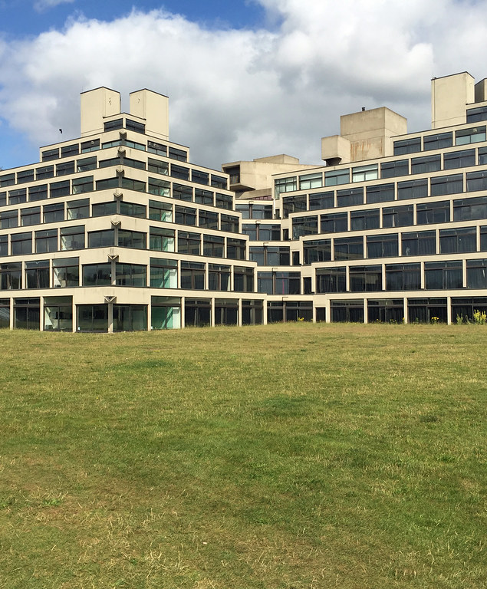
NICHE Anchor Institute, UEA
NICHE strategic objectives: Enabling people to live and work well by:
Improving health inequalities across rural and coastal communities
Workforce development and transformation
System collaboration and transformation through effective partnership working
Sustainable outcomes for health and wellbeing. - Improving outcomes through addressing what matters to people and their communities.
Notes:
https://www.kingsfund.org.uk/insight-and-analysis/blogs/anchor-institutions-local-communities 5 Nov 2021.
Achieved funding from NHS England, East of England, (December 2022) to explore what factors contribute to effective integrated care system and associated workforce transformation requirements.
Anchor Institutes are defined (Kings Fund, 2021) as large organisations that are unlikely to relocate and have a significant stake in their local area. They have sizeable assets that can be used to support their local community’s health and wellbeing and tackle health inequalities, for example through procurement, training, employment, professional development, and buildings and land use.
Conventionally, Anchor Institute are health or care provider organisations, not Higher Education Institutions.

Slide 3
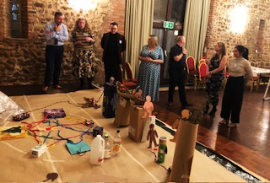
NICHE Anchor Institute, UEA
Creative methods and approaches (active participation across all stakeholders)
Igniting place –based innovations within and across integrated
Care system partners
Embedding improvements, driven by practitioners and people who
Know what matters (backing thoroughbreds)
Knowledge exchange (shared learning events), transfer (benchmarking)
and mobilisation (national, regional and international partners)
Four major workstreams: Workforce intelligence, Therapeutic Optimisation Workforce Optimisation, and Evaluation (evidence gathering and dissemination)
Shared Governance framework
Notes:
https://www.kingsfund.org.uk/insight-and-analysis/blogs/anchor-institutions-local-communities 5 Nov 2021.

Slide 4
NICHE Anchor Institute, UEA
Collaboration, tensions, challenges and opportunities:
Collaborations achieved across 500+ participants, 64 + local innovation projects, 12 HEIs, 5 International MOUs, and a series of collaborative joint publications, conference papers and dissemination events
Tensions: addressing change, at pace, within conventional/traditional/hierarchical infrastructures
Challenges: Relationship and personnel changes, government interventions, fiscal savings, global health challenges, climate change
Opportunities: Transformation at pace, within infrastructures of support and enablements, new topologies, new coalitions.

Slide 5

Early indicators of working collaboratively to enhance integrated care transformation.
A case study impact analysis.
NICHE Anchor Institute: The Case Study site
Methods and Approaches
‘True’ Collaboration: Challenges, Tensions and Opportunities
Early impact indicators at system level, financial and economic, socio-symbolic levels (as a triple helix).
Recommendations for scalability addressing global health challenges.
Notes:
Using critical social science, participatory approaches and collaborative inquiry has been useful theoretical and pragmatic methodologies, from which to explore 'true' collaboration. Our findings suggest that facilitating effective partnerships, across complex systems is a dynamic process that brings tensions, challenges and opportunities. We outline examples of each, and argue how infinite change and structural inequalities can impeded innovation uptake, whilst creative methodologies blended with critical social science have forged new alliances, that are shaping the future of health and social care systems and architecture. Implications arising from our work to date identify the need for closer alliances and collaborative arrangements are still needed, to encourage embeddedness, where innovation update can be scaled with sensitivity, suitable for the communities they serve. Importantly, the workforce plays a significant core role in transformation, as both knowledge wealth creators, but also as knowledge wealth mobilisers. Influencing and shaping service models, fit for purpose, within the contexts within which people live and work together. For successful sustainable change to cascade further, the workforce remain central to any transformative process to be reimagined. We conclude with a horizon scan as to what and how improved population outcomes can be realised, in the face of climate change and manmade disasters looming ahead. ORAL PAPER - Short SynopsisHealth and social care as integrated system partners are further strengthened when facilitated to achieve collaboration. Drawing on case study material, we share lessons learned on sustainable impact. Co-presenting author BioPinar Guven-Uslu is associate professor in accounting at Norwich Business school. Prior to entering academic, she worked for Deloitte, in areas of financial auditing and management consultancy. Pinar has a first degree in Economics, and a double masters in accounting and finance. Her phD is in benchmarking large organisations, and implementing performance management in the National Health Service (NHS). She is currently working on digitalisation and changing accountancy practice for better performance management and control in health care organisations. She has worked in England, Zambia, Vietnam, UAE and her home country of Turkey. Presenting AuthorProf Sally Hardy
Affiliations: University Of East Anglia Presenting AuthorAssociate Professor Pinar Guven-Uslu
Affiliations: University Of East Anglia BiographySally Hardy has worked in public sector organisations for over 40 years, both in the UK and overseas. Commencing as a nurse, her work has led to research and collaboration across health and academic partnerships, with common goal of promoting wellbeing. Sally currently leads the NICHE initiative at UEA, bringing partnership working at local, national, regional and international levels as part of anchor institute roles, for enhanced civic engageme

Slide 6
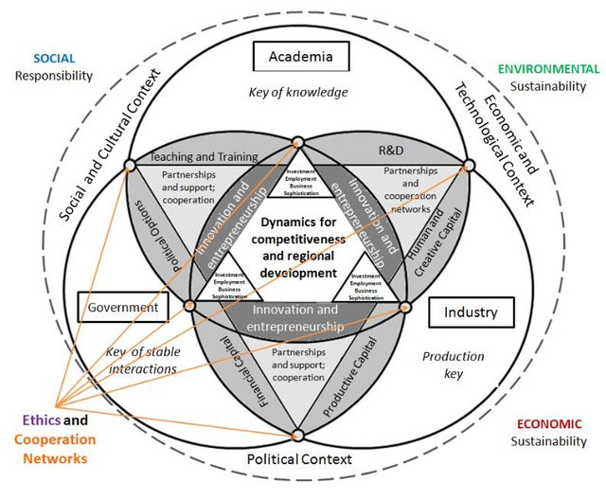
NICHE Anchor Institute, UEA
Early Indicators: (Triple helix triangulation)
New forms of hybrid governance
New topologies / knowledge
Enhanced integration performance
Population data
Rural workforce requirements
Quality, safety outcomes
Workforce capacity, capability and confidence (professional expertise)

Slide 7
NICHE Anchor Institute, UEA
New forms of measurement: working with inclusivity and cultural sensitivities.
Values propositions: What matters to the person (either as patient, citizen, health and care professional)
1: Human and creative capital: Igniting innovations, engaging people’s hearts, minds and souls in transformation as intention, human flourishing and well-being measures
2: Political capital: policies, procedures, payments, pathways - true partnerships
3: Economic capital: Efficiencies, Productivity, Reduced length of stay etc

Slide 8
Evidence table
NICHE Projects and Programmes | Political Capital | Economic Capital | Human and Creative Capital
‘Kingtsugi’ Projects | x | x | x
NICHE Fellows | x | x | x
Ignite: Developing inclusive and compassionate cultures | x | x | x
Planting Seeds of Change | x | x | x
THEO | x | x | x
Workforce Optimisation | x | x | x
Workforce Intelligence | x | x | x
Evaluation (internal and external ) | x | x | x
Notes:
https://www.kingsfund.org.uk/insight-and-analysis/blogs/anchor-institutions-local-communities 5 Nov 2021.

Slide 9
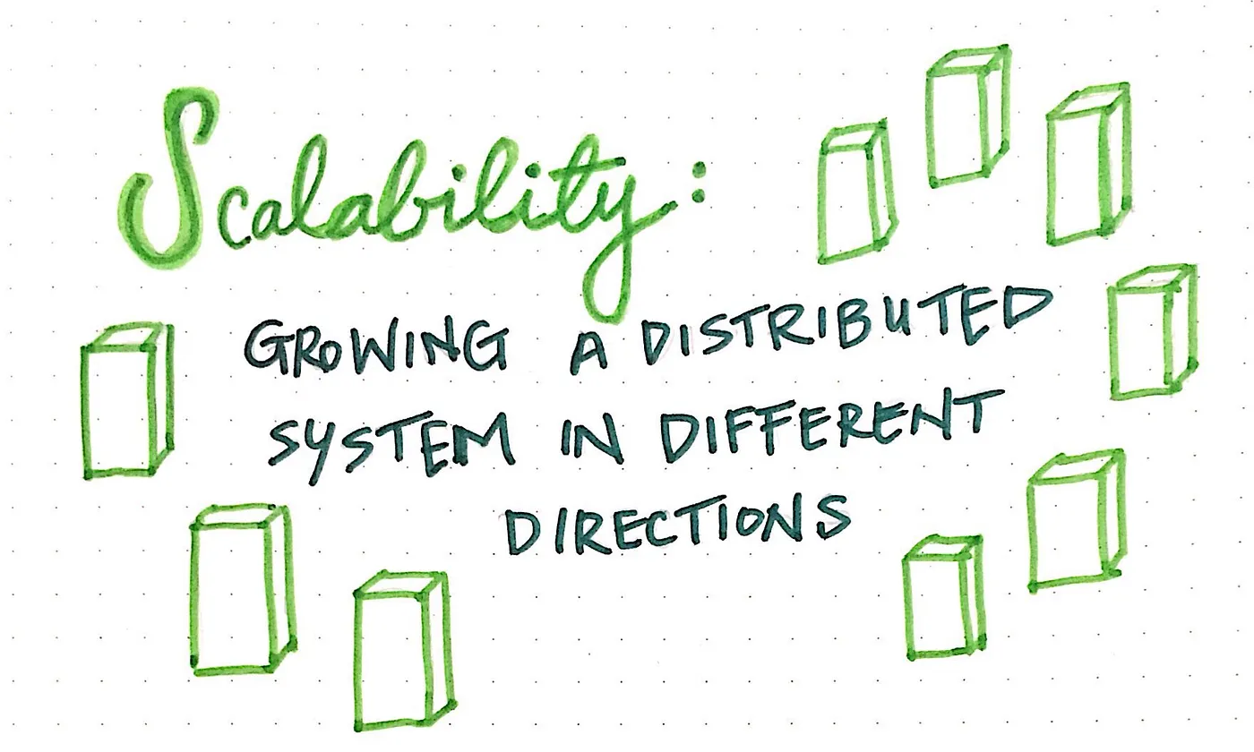
NICHE Anchor Institute, UEA
Recommendations for scalability
Context, community, cultural sensitivities
Local knowledge and practice expertise
(ripple impact)
Limitations:
Small sample groups (learning disabilities)
Invalid performance measures
Value impact – fiscal, social, planet, human….
= ‘EPIIC’ opportunities

Slide 10
References
Farinha, L., & Ferreira, J. J. (2013). Triangulation of the triple helix: a conceptual framework. Triple Helix Association, Working Paper, 1.
Websites of interest
EPIIC –ebsite: www.epiic.org.uk
NICHE website: https://www.uea.ac.uk/groups-and-centres/projects/niche
Notes:
https://www.kingsfund.org.uk/insight-and-analysis/blogs/anchor-institutions-local-communities 5 Nov 2021.

