Slide 1

EPIIC Conference: The workforce we need for integrated care
The challenges facing the workforce in integrated care, particularly in the East of England.
Breakout sessions
11.30-12.30
12.30-13.30
19.03.25 – at UoS
Led by:
Louise Pinder, Director of Practice Learning , ARU
Emily Handley, Head of Education, C&P ICB.
Notes:
Challenges facing the workforce in the EoE

Slide 2

Our ICS collaboration to date
Scene setting workshop – ICS priorities and aspirations established
Cross organisation governance and processes developed
Business cases and stakeholders identified
Iterative reviews/ evaluation
Collaboration agreement between CPICB & ARU
Project delivery

Slide 3
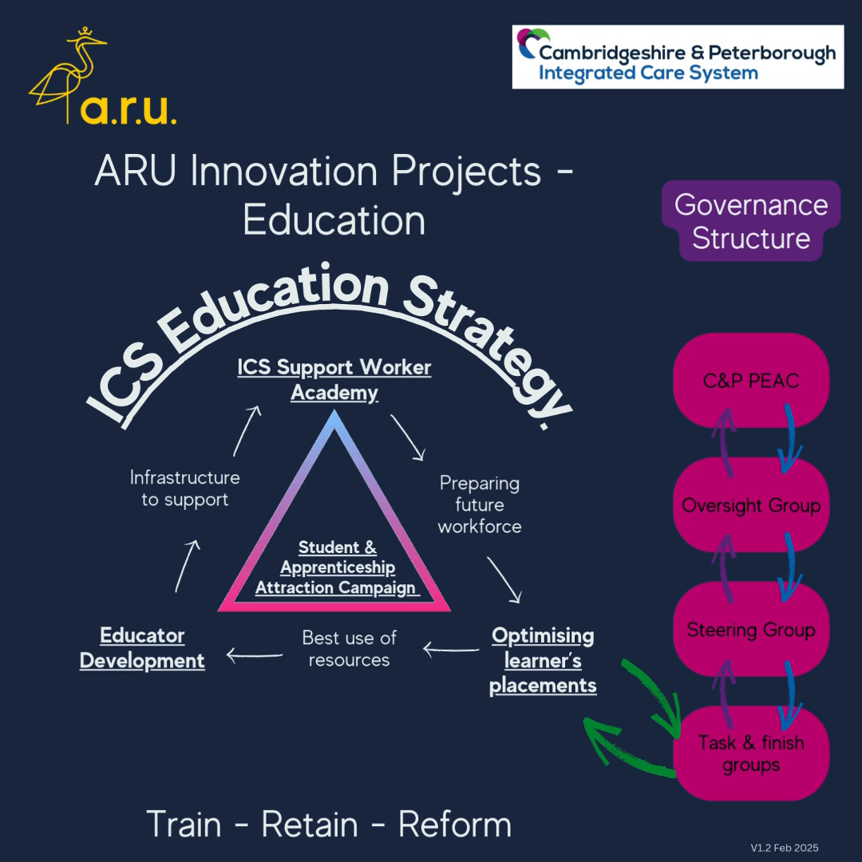
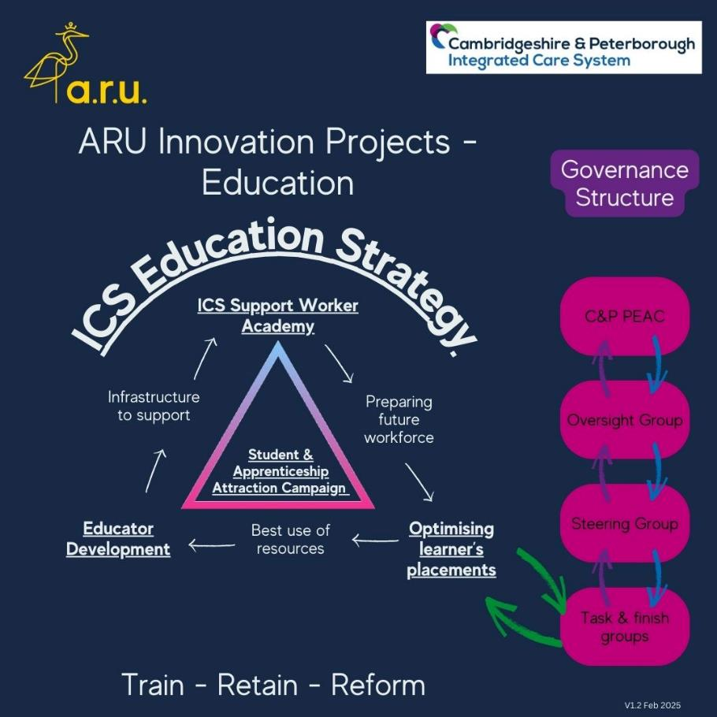
Programme Overview
The programme is a collaboration between Cambridgeshire & Peterborough ICS (C&P) and Anglia Ruskin University (ARU).
The programme is supported by funding from NHS England and delivers direct investment into projects.
The aim is to develop, test and review collaborative innovations to support workforce development and person-centred outcomes across the ICS using a range of methodologies, including quality improvement.

Slide 4
Projects in detail
Support Worker Academy
Optimising Learner Placements
Meeting Workforce Needs: Evaluate how well the Support Worker Academy helps address staff shortages, improves patient care, and supports the NHS Long Term Workforce Plan.
Training and Development: Assess whether the training provided helps support workers gain the skills they need to deliver better care and progress in their careers.
Collaboration and Resources: Check how effectively healthcare organisations and universities work together to share resources and create opportunities for support workers.
Long-Term Impact: Look at whether the changes made by the Academy are sustainable and truly make a difference for patients, staff, and the wider healthcare system.
Alignment with Learning Objectives: Do placements align with desired objectives? Do placements provide learner experiences that match academic and career goals? Assess connections between placement tasks and theory.
Quality and Diversity of Placement Opportunities: Are there enough diverse and high-quality placement opportunities available? Evaluate placements to ensure a mix of exposure across all relevant sectors.
Accessibility and Equity: Are placements accessible to learners regardless of location, socioeconomic background, or disabilities? Assess barriers to participation such as financial costs, location of placements, and bias in selection processes.
Support and Supervision: Evaluation of adequacy of support and supervision during placements. Availability of mentors or supervisors, feedback mechanisms, and support systems to provide meaningful learning experiences.
Evaluation and Feedback Mechanisms: Is there an effective system to evaluate placement effectiveness and gather feedback from learners and host organisations? Implement systems for continuous improvement, such as structured feedback forms, regular reviews, and post-placement assessments, to refine the programme.

