Slide 1
Delivering innovation in the Neurorehabilitation Online Clinic (NROC) 2024

Slide 2
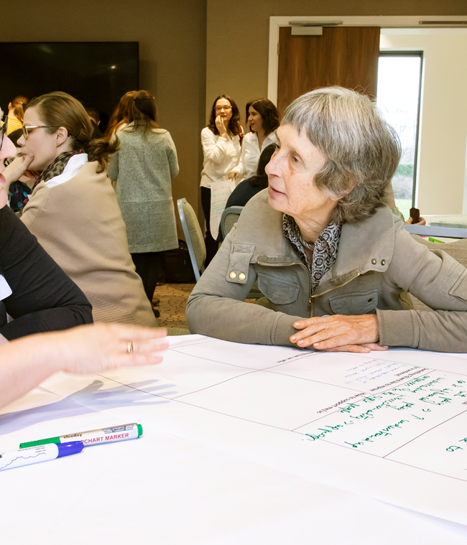
INTRODUCTION
Neurorehabilitation – within the Health, Wellbeing and Care Hub.
The Health, Wellbeing and Care Hub (HWCH) encompasses virtual and face to face working to provide client centred care.
Provides a spectrum of therapies, working together a interdisciplinary team.
Fills the gap and provides services to adults and children, families and communities who have unmet needs
Part of this package is the virtual clinic (NROC) to support people who need to have neurorehabilitation, for example a Stroke survivor.

Slide 3
NROC
Active rehabilitation clients
Clients sharing their stories students gaining an understanding
Professional skills – working as a team, goal setting, IT, timekeeping, clinical note writing.
Virtual Learning Platform – co-creating resources (students and clients)
Teaching sessions – learning together
Northampton Stroke Hub - groups and developing resources

Slide 4
Referral process

Slide 5
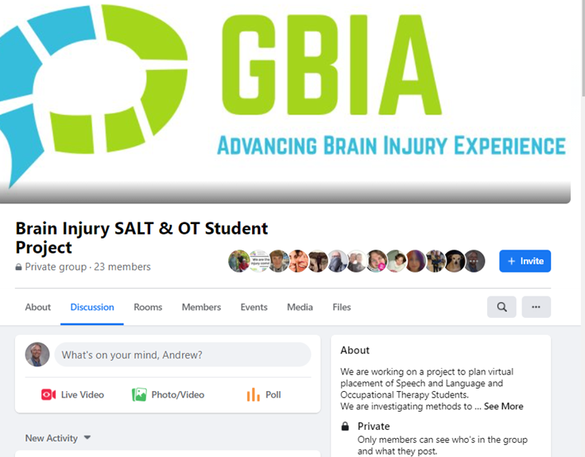
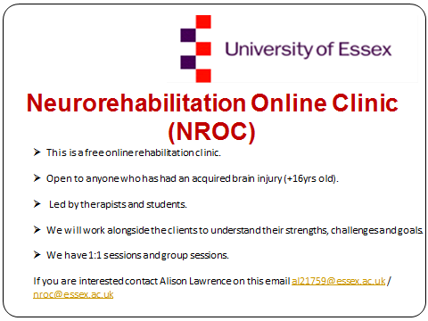
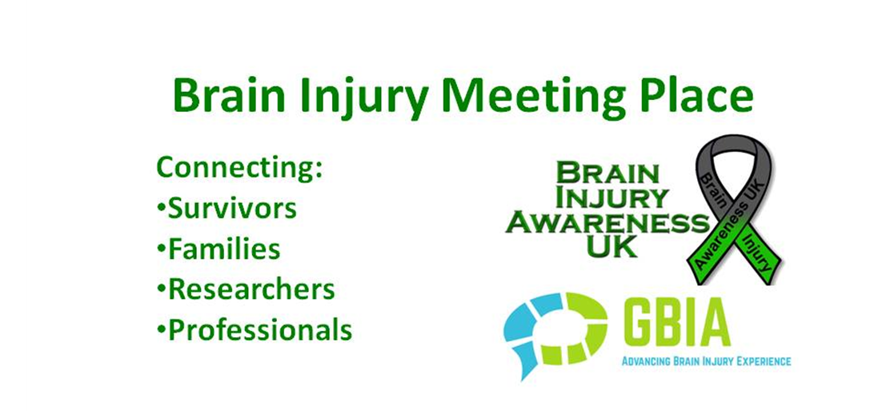
RECRUITMENT
Advertising and Recruitment for Clients.
We advertise with:
Headway
Stroke Association
Different Strokes
Twitter
Facebook

Slide 6
The Placement.

Slide 7
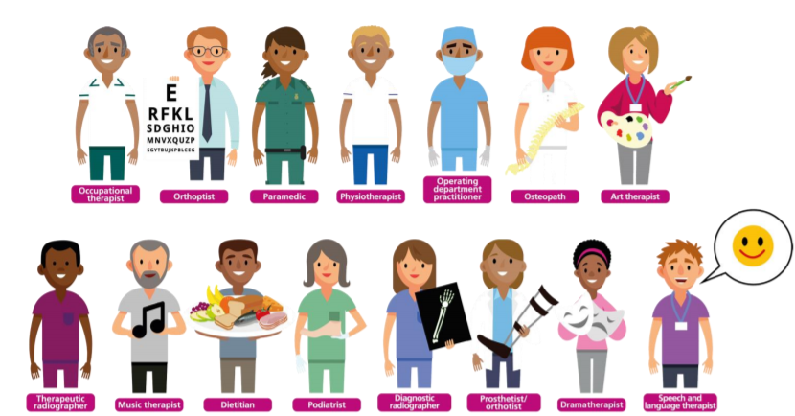
Rehabilitation as a team.
Professional skills.
Co-production.
Teaching sessions.

Slide 8




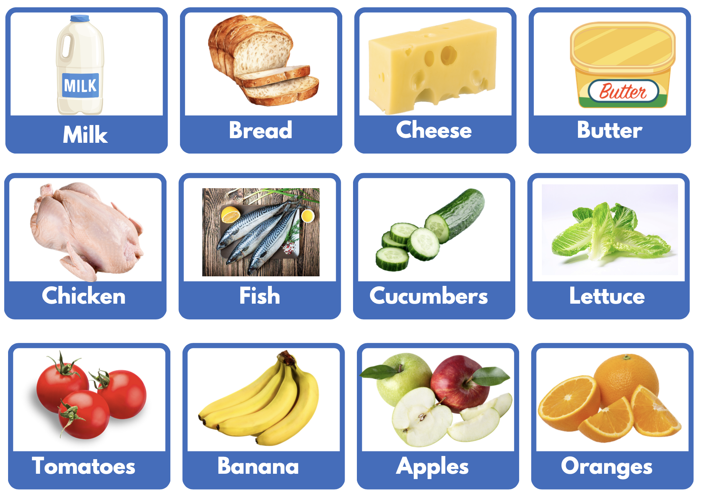

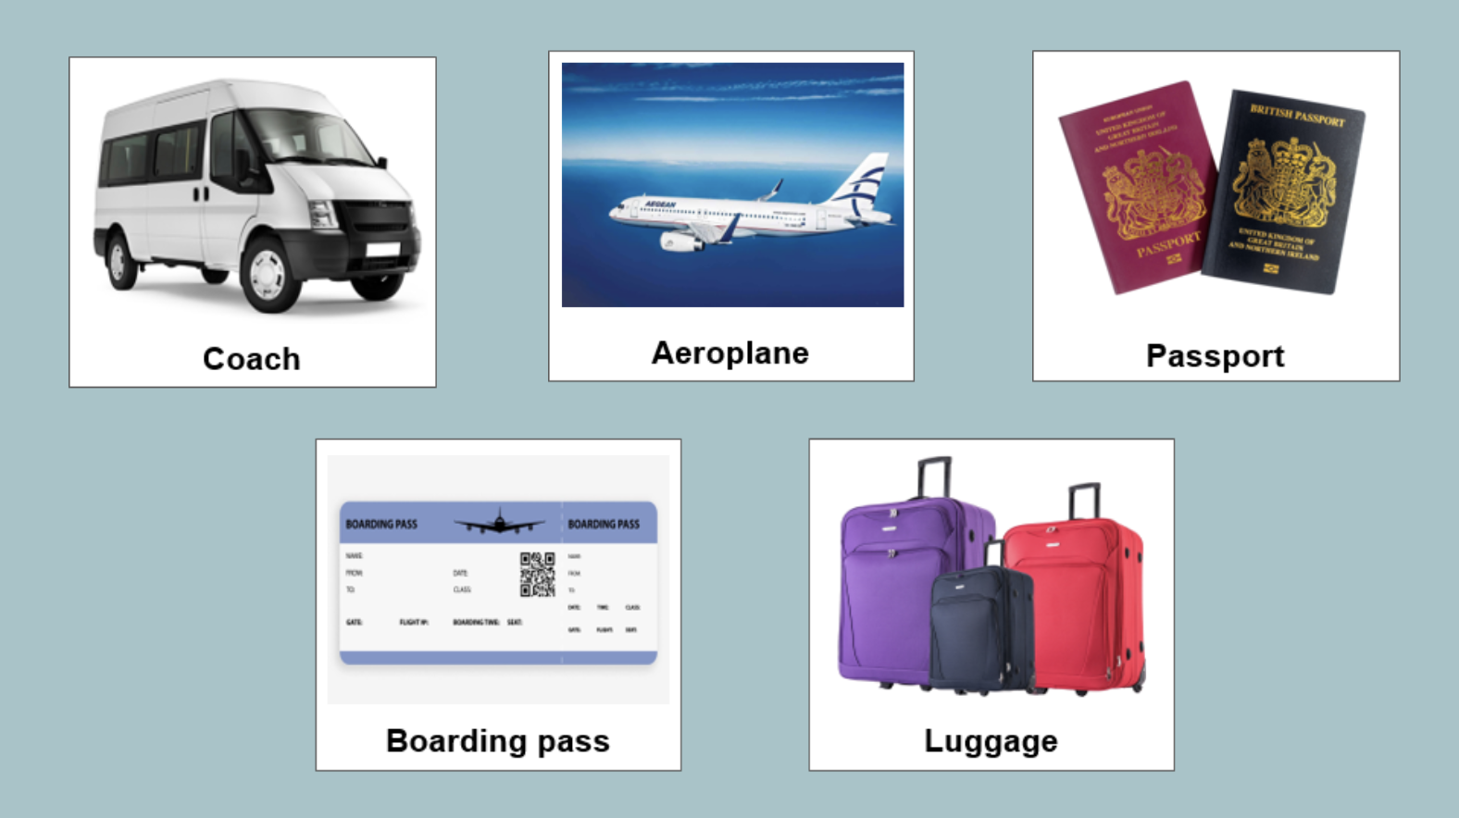


SLT case study - WT
Case History
STRENGHTS
Communication
CHALLENGES
Short, functional phrases
Lip reading
Variable word repetition
Writing
Visual recognition
WFDs
Intelligibility – apraxia
Receptive language
79-year-old female
Ischemic Stroke (2022)
Expressive and receptive aphasia
Apraxia of Speech
No physical challenges
Living with husband. Daughter visits regularly. Large, supportive family.
Always accompanied by a family member leaving the house. Reduced interest in seeing friends post-stroke.
AAC
Shopping list board
Communication boards (holiday and airport)
Melodic Intonation Therapy
Rationale - Ideal candidate: lip reading, good attention span, severe expressive aphasia
Outcomes -
1st session: 3/10 targets produced
3rd session: 10 full phrases produced on at least one occasion
Notes:
(Helm-Estabrooks et al., 1989; Norton et al., 2009)

Slide 9
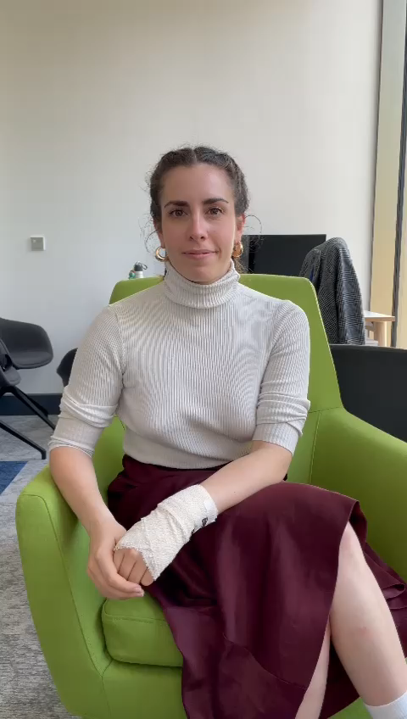
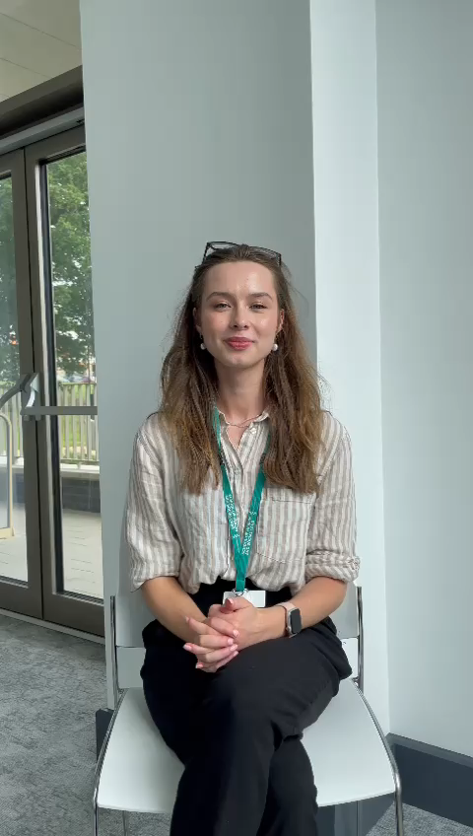
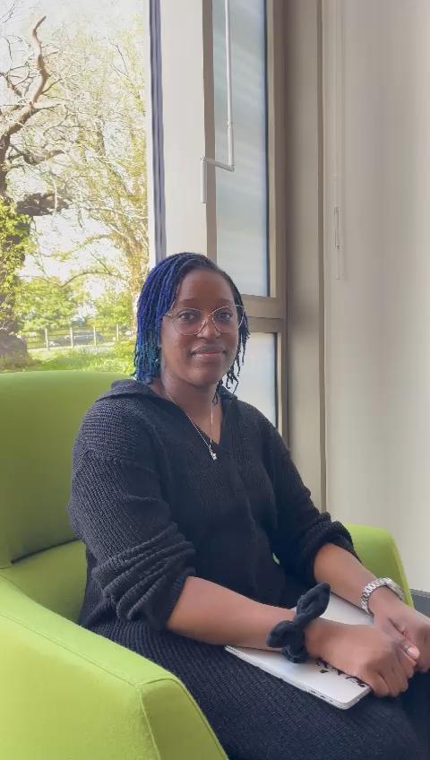
Melodic Intonation Therapy

Slide 10
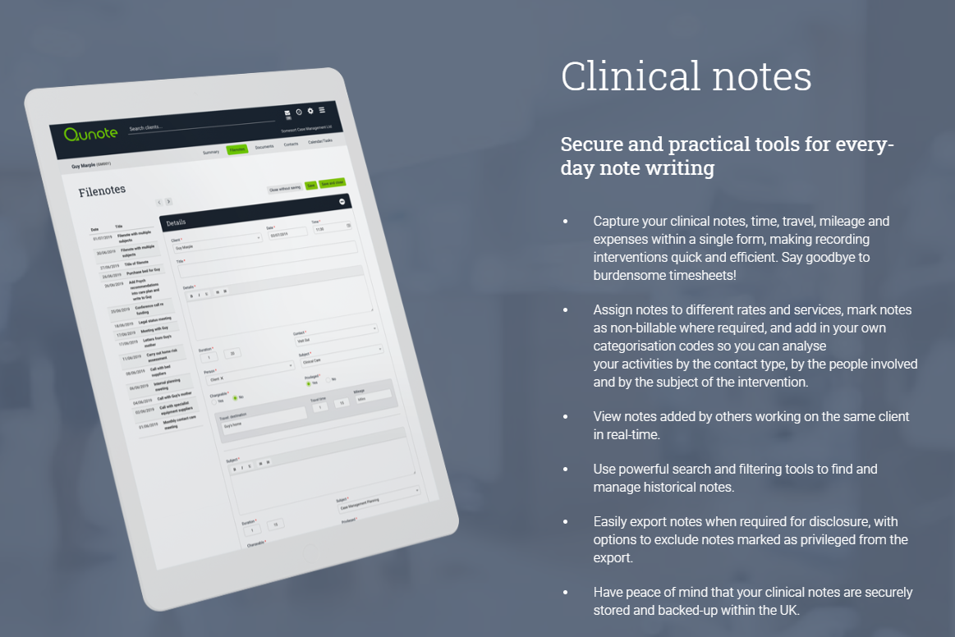
PROFESSIONAL SKILLS
Using Qunote to write casenotes.
Date and time
Your name, grade, profession and ward, also if any other professionals were present.
Add if any family members were present and their name and relation to the patient.
Consent gained
Case notes should be completed within 24 hours of seeing the client.
Be clear, concise and logical.
S Subjective What the client said…
O Objective What you observed…..
A Assessment your analysis of the situation…
P Plan what is your plan next…..

Slide 11
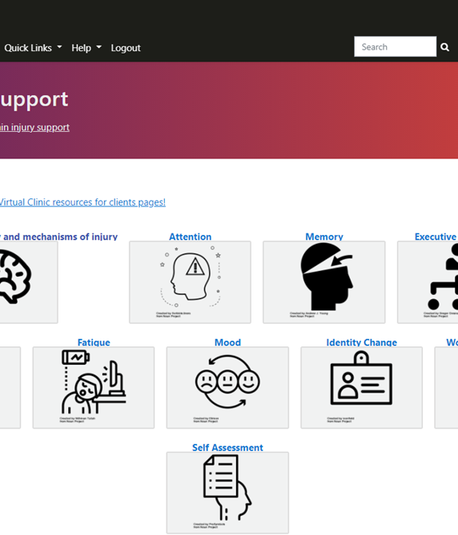

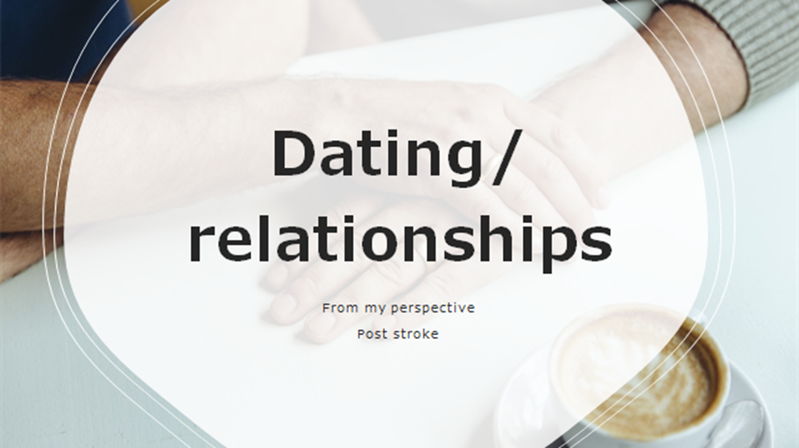
CO-PRODUCTION
Open Essex (Moodle X)
Open access learning platform
Development of materials for patients
Asynchronous work
Working with a Lived Experienced Group.

Slide 12
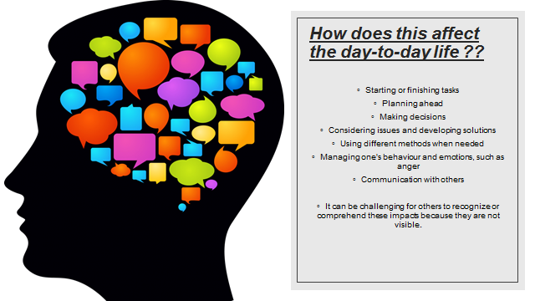

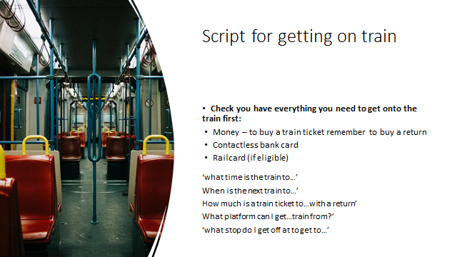

TEACHING SESSIONS + CASE STUDIES
Here are some students teaching resources.

Slide 13
Feedback

Slide 14

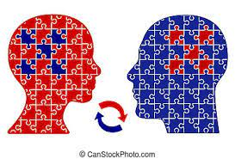
STUDENT FEEDBACK 2022-2024.
Learn to work independently efficiently.
Learn to work in a group.
Building a rapport with the clients.
Getting to see the growth in some of the people attending the clinic.
Working alongside speech and language therapy.
Working on my communication skills with diverse people with varied difficulties.
How to administer assessments in a virtual setting.
The importance of involving family members in the client's care plan
How strategies can help to enable client's communication post TBI
It's a very wonderful experience. Planning sessions, debriefing and reflections after sessions, developing resources, being involved in executing therapy activities(client centred ) and involved in both individual and group therapy sessions, providing feedback to service users, caseload management, writing SOAP notes on Qunote.

Slide 15


CLIENT FEEDBACK 2024
‘ I am grateful to all the help you have given me, particularly during the winter when I had seizures on holiday. It has given me the confidence to speak, thank student for the conversation starters and topics. The fatigue sessions were a great bonus. I didn't realise that you can split up the finance and shopping and housework, to suit yourself. I haven't got a partner to help me. The student suggested half hourly which suits me, I don't get the fatigue that I used to.
Thank you for all the students who took part and I wish them well during the coming years.
With my new found confidence, I wish to be discharged from the clinic to be able to carry on life as the new me.’
(March 2023)
I’ve started the new year inspired by your students and have 2 journals I want to share with you. One is a Wellness and Fitness tracker which also tracks mood. The other is just a daily planner where I am going to set myself daily targets.’
(Jan 2024)
Let me start by thanking you and the students for investing so much time and effort into clients rehabilitation, you really are all worth your weight in gold!
Client said he is really enjoying the sessions and says the students are lovely and incredibly patient with him.’
(Feb 2024)
‘Thank you for your time and the time of your students. I thought their manner was excellent. I hope you all found it useful. Client also liked you. Thanks for taking care of us.’
(Feb 2024)

Slide 16
Next Steps

Slide 17


GOING FORWARDS
Next Steps
  To strengthen the recruitment of participants from Mid and South Essex
  To explore links with mental health nursing, and other programmes in the school, and SRES Physiotherapy (for example Health Promotion, Wellbeing Groups, Mindfulness Groups, Moving and Handling, Carer support) to support placements.
  CPD opportunities
  Upskilling existing AHP and nursing workforce on this innovation.
  Involvement in PhD and grant funding
  Continuation of co-construction of Health, Wellbeing and Care Hub learning environment – developing client friendly resources and services.
  Introduce research placements.

Slide 18
nroc@essex.ac.uk
Alison Lawrence

