Slide 1
Norfolk Initiative for Coastal & Rural Health Equalities (NICHE).
‘EPIIC University Partners Conference’
Monday 24th June 2024
Presenters:
Professor Jonathan Webster, Co-Director NICHE Anchor Institute, UEA
j.webster@uea.ac.uk
Professor Sally Hardy, Principal Investigator NICHE Anchor Institute, UEA
s.hardy@uea.ac.uk

Slide 2
System Level Transformation
Norfolk Initiative for Coastal and Rural Health Equalities (NICHE) – Anchor Institute
One of six HEIs in East of England, to receive £3Million NHS England (formerly Health Education England) investment to explore factors that contribute to an effective integrated health and social care system.
Demonstrating evidence and outcomes of : Workforce and system level effectiveness
NICHE strategic objectives :
Improving health inequalities across rural and coastal communities.
Workforce (capacity and capability) development and transformation.
System collaboration and transformation through effective partnership working.
Wellbeing and sustainability
Our work aligns closely to Norfolk and Waveney ICS Strategic Goals:
To make sure that people can live as healthy a life as possible; to make sure that you only have to tell your story once and to make Norfolk and Waveney the best place to work in health and care.

Slide 3
NICHE Stakeholder Map
ICB/ East of England | ICS/ East of England | HEI Anchor Institutes East of England | HEALTH/NHS | SOCIAL CARE | COLLABORATING /CIVIC PARTNERS | INTERNATIONAL (MOUs)

Slide 4
Workstreams align with System level Objectives
NICHE
1:Workforce Intelligence
4: Evaluation
Health Inequalities
Workforce transformation
Optimising wellbeing
2: Therapeutic Optimisation
3: Workforce Optimisation
System transformation
NICHE Website : www.uea.ac.uk/groups-and-centres/projects/niche

Slide 5
Programmes of Work (in progress or development)…
The 3 R’s – Recruitment, Retention & Retainment
Psychology Led Staff Wellbeing Initiative – Led by QEHKL
Student Interdisciplinary Schwartz Rounds – Led by UEA
NICHE Embedded Fellowships (x4)*
Embedded Scholarship Programme (x 3 Cohorts) – Led by the JPUH
Embedded Research/ Improvement Evaluations ‘Kintsugi’ Programmes (x4)*
ARC Funded Fellowship (x1)
Arts & Humanities Fellowship (x2)
Graduate ‘THRIVE’ Programme – Led by the QEHKL
Match funded small embedded Improvement Evaluation programmes (Mini ‘Kintsugi’) (x3)
HEI Anchor Evaluation across the East of England.

Slide 6
A Flavour…NICHE Fellowship grants
Norfolk Hospice Tapping House: ‘Seeing Red’- Improving End of Life Care Pathway Across West Geographic Place.
Norfolk Community Healthcare: Norfolk Antenatal Pathway for Women and Birthing People with Learning Disabilities. Anca has been identified by the Chief Nurse Office, as part of the #NHS75 Years’ celebrations for her research.
Norfolk & Suffolk NHS FT: Co-producing a Child Holistic Rural and Coastal Health Passport (CORACLE).
James Paget University Hospitals: Improving Early Mobilisation after Femeral Fracture Surgery: An MDT approach.

Slide 7
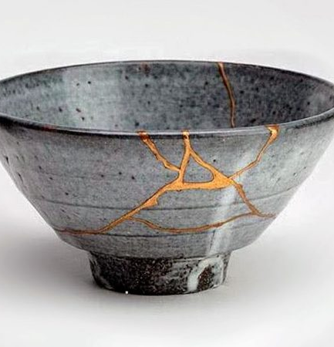
7 ‘Kintsugi’ Place-Based Projects : ‘Kintsugi’ is taken from the Japanese art of melding broken pottery with gold, silver or platinum to enhance the uniqueness and value of the original piece.
4 NICHE Funded Kintsugi Projects are:
Developing an intervention to support the retention of health and social care professionals in Norfolk – School of Social Work, UEA.
Evaluating the Impact and Effectiveness of Structure, Process and Outcomes of the Take a Chance on me Programme – Take a Chance on Me, Social Enterprise.
Norwich Museums Community Club, an embedded evaluation - Norwich Museums.
Evaluation of a novel early career prescribing programme to support workforce development, retention and diversification of pharmacists in the East of England – School of Pharmacy, UEA.
3 NICHE Match Funded Mini Kintsugi Projects:
Embedded Improvement Evaluation, Norfolk Safeguarding Adults Board – Norfolk County Council.
‘My Story, My Words, My Voice’, a quality improvement initiative to improve equity of access and inclusion for marginalised service users – Norfolk and Waveney ICB.
Homeless Health Needs Audit & Embedded Project Evaluation in Norfolk – Norfolk and Suffolk NHS Foundation Trust.

Slide 8
Regional Evaluation: 6 HEI Anchor Institutes
Realist evaluation using mixed methods
Aims
Evaluate the impacts of the six AIs in the East of England.
Examine the processes underpinning delivery and impact including associated enablers and challenges.
Examine implications for future practice and policy (including any insights related to scalability and sustainability of the models).
Capture the learning and insights of relevance for local and national level decision makers.
Set of evaluation questions targeted at AIs, ICSs, AI investment outcomes

Slide 9
And there’s more in 2024…
Focus on enabling knowledge wealth/ actionable insights from across all 4 workstream developments
Operational model/theory of change across 6 HEI Anchor Institutes East of England with Skills for Health (the Workforce Development Trust)
Reaching out/ dissemination of innovations to seek and to support ongoing development and sustainability across ICS.
Share and dissemination of metrics and associated key messages and learning.
Key focus on building capacity, capability and confidence that makes a difference across N&W, Regional and International partners – as a potential REF impact case study.

Slide 10
Any Questions?
NICHE Website
www.uea.ac.uk/groups-and-centres/projects/niche
Follow us on twitter/ X
@UEA_NICHE

