Slide 1
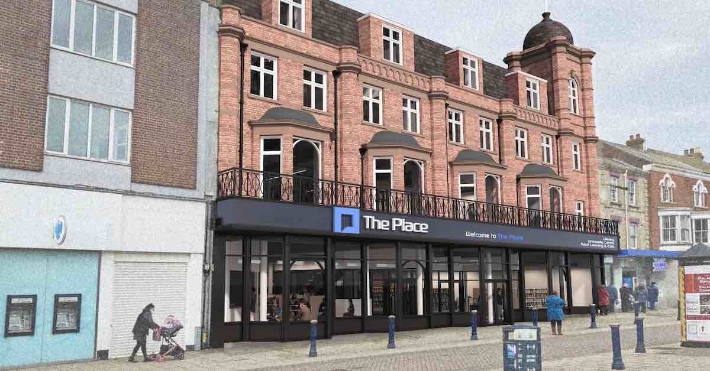

The Place Great Yarmouth
Overview of development and student initiatives
Sam Chenery-Morris and Mandi Syrett

Slide 2

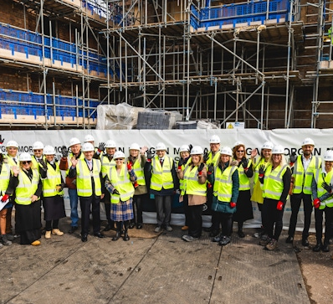
Overview
Initial MOU and Objectives
Construction Details and Challenges
Project Board and Operations Group
Market Research and Statistics
Curriculum Panel and Partnership
University of Suffolk Direct Delivery

Slide 3

Initial MOU and Objectives
Multi-Party Collaboration
The MOU signed by multiple parties aims to enhance education and learning in Great Yarmouth.
Objectives of the Learning Hub
The learning hub aims to raise skill and qualification levels while meeting local business needs. To integrate with local culture enhancing its presence in the town centre.
Learning Centre
Establishing a library and advice centre to support adult learning and community engagement in skills development. Progression to Further Education- East Coast College.

Slide 4
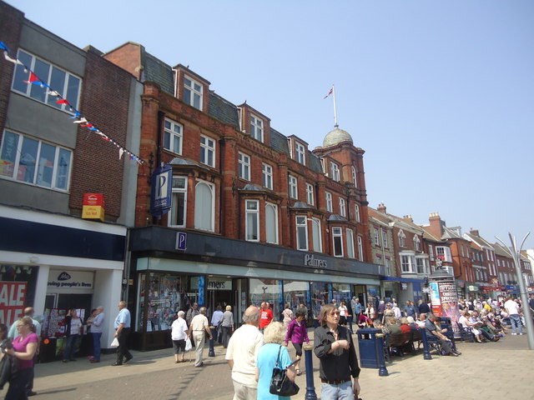
Building and Funding Details
Iconic Building Renovation
The old Palmers department store has been refurbished, enhancing its role as a central community hub in Great Yarmouth.
Funding Overview
The £18m project is funded by the Future High Street Fund, Town Deal, and contributions from local authorities and universities.
Investment from Anchor Institutions
Investment from the University of Suffolk and East Coast College contributes £3.5 million, including funds from Health Education England (Now NHSE).

Slide 5

Construction Details and Challenges
Start of Construction
Construction began on 12 September 2023, focusing on the refurbishment and transformation of the existing building.
Complex Challenges
The project faced challenges due to asbestos removal and unexpected decay of roof trusses, causing delays. Further issues with electrical sign off.
Completion Timeline
Anticipated practical completion was set for 20 February 2025, with the operational date by the end of March 2025.
The opening of The Place is currently delayed by approximately two months to second week in May 2025.

Slide 6
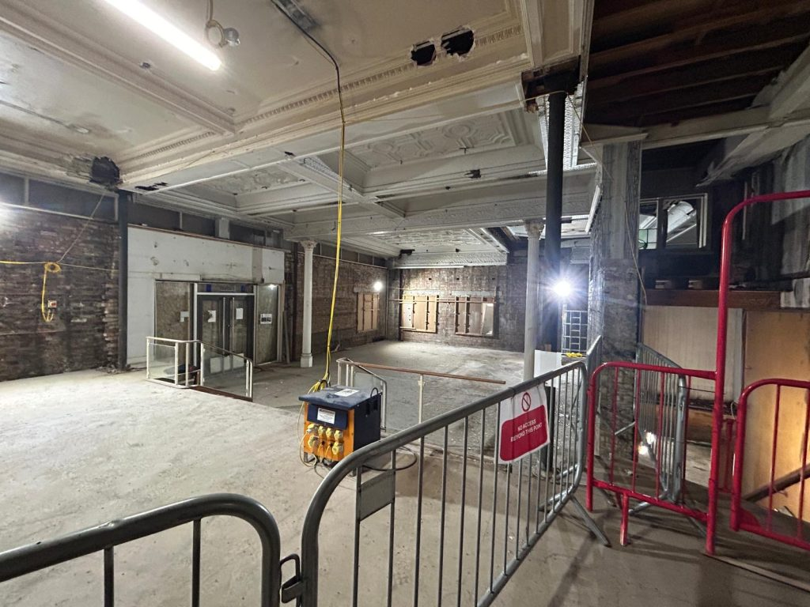
Agreements and Leases
Landlord and Leases
Great Yarmouth Borough Council serves as the landlord.
Norfolk County Council (NCC) Lease Details
NCC holds a lease for the Ground Floor and Basement, providing library and registrar services along with educational facilities.
East Coast College (ECC) Teaching Space
ECC leases the 1st floor, creating significant teaching and learning spaces for various educational activities.
University of Suffolk (UoS) Sub-Lease Details
UoS has a sub-lease from ECC for the 2nd floor, featuring multiple classrooms and a simulation ward.

Slide 7

Project Board and Operations Group
Project Board Updates
The Project Board oversees updates on construction, partnerships, and operational readiness until the building becomes operational.
Chair and Meetings
Chaired by Natasha Hayes, the Project Board meets approximately every six weeks to ensure collaboration and oversight.
Operations Group Preparation
Started in April 2024, the Operations Group prepares for practical elements of the operational opening. The Operations Group addresses key issues such as security, cleaning, and customer experience in its ad hoc meetings.
IAG Training Sub-group to the Ops Group
A new group commenced in June/ July 2024, this group will look at how key staff in the library and elsewhere in The Place can be supported about appropriately engaging with prospective learners coming into The Place.

Slide 8

Market Research and Statistics
Employment, unemployment and economic inactivity in Great Yarmouth
  Employment in Great Yarmouth has increased compared with the previous year (ONS 2024) 67.9% ages 16 to 64. Great Yarmouth's employment rate was lower than across the East of England as a whole in the year ending December 2023.
  Unemployment (people looking for work) has risen since a year earlier (4.5% aged 16+). The unemployment rate for Great Yarmouth was higher than across the East of England as a whole.
  Economic inactivity (29.3% ages 16-64).
Education Levels in Great Yarmouth
Office for National Statistics (ONS) found that 26% of people in Great Yarmouth had no qualifications which ranked as the sixth worst performing local authority area in England and Wales.
GCSE English and maths 73.6% (average 78.7% (ONS 2022-23).
Level 3 or above qualification 52.8% (66.9%)
Market research shows only 18.2% of residents aged 16 and above have a university-level qualification, indicating low education levels.
Demand Trends in Education
Great Yarmouth ranks second in educational demand within Norfolk, highlighting a growing interest in higher education. However, ECC recruit small numbers to their programmes and need to switch programmes on and off due to demand/ no demand.

Slide 9

Curriculum Panel and Partnership Agreement
Curriculum Panel Composition
The Curriculum Panel includes representatives from Norfolk Adult Learning, ECC, and the University of Suffolk.
Meeting Frequency
The meetings of the Curriculum Panel are ad hoc, scheduled as needed based on the agenda.
Partnership Agreement Draft
A draft for the Partnership Agreement is being prepared for discussion among all building occupants, aiming for completion by October 2024.

Slide 10

Collaboration and Customer Experience
Collaborative Institutions
Collaboration between the library, Norfolk Adult Education, ECC, and UoS enhances the customer experience for prospective learners.
Key Point of Contact
A shared post at the GF level will serve as a key point of contact for learner inquiries, streamlining support.
Advanced Knowledge Sharing
Collaboration on the 1st floor will ensure that inquiries are handled by knowledgeable staff from ECC and UoS.
Community Engagement
UoS aims to engage the community not only through direct courses but also by encouraging inquiries for higher education.

Slide 11
University Of Suffolk Space
A 12-person general teaching room
A 18-person general teaching room
A five bedded simulation ward
An open collaboration / common room space suitable for c.8 people

Slide 12

Nursing and Allied Health Profession courses
Nursing Programs
Two-year degree apprenticeship courses for Nursing Associate and Adult Nursing are pending NMC approval, aiming to start in September 2025. Potential for direct entry Nursing Associate and Adult Nursing (subject to minimum cohort size).
Assistant Practitioner Apprenticeship
The Assistant Practitioner apprenticeship is a two-year program validated for delivery in September 2025 (subject to a minimum cohort size).
Continued Professional Development
The School of Nursing, Midwifery and Public Health and Allied Health Sciences will offer Continuous Professional Development (CPD) courses tailored for health professionals at James Paget NHS University Hospital Trust.

Slide 13

Social Sciences and Humanities
Psychological Therapies Training
The program aims to prepare students for graduate NHS jobs in psychological therapies while awaiting further discussions.
Continuing Professional Development (CPD)
A variety of CPD courses are available, focusing on clinical supervision and specialized training for psychological therapists.
Leadership Development Coaching
A coaching offer for leadership development is currently in development to support aspiring leaders in the field.
Creative Writing CPD Course
A CPD course in creative writing aims to enhance skills and therapeutic practices for professionals in the field.

Slide 14
Development Progress
The Place in Great Yarmouth has achieved considerable progress in community development and service enhancement.
Collaboration Efforts
Collaboration among stakeholders has been crucial for fostering partnerships and enhancing service delivery.
Skills Training Initiatives
Skills training programs have been essential for empowering individuals and enhancing employability within the community.
Sustainable Success
Continued efforts are vital to ensure the long-term success and sustainability of The Place's initiatives.
Conclusion

Slide 15
Sam Chenery-Morris
and
Mandi Syrett

