Slide 1


Nasreen Ali
Professor of Public Health Equality

Slide 2
Today's objective
"How can research, outreach, and theatre drive real change in workforce development? In this presentation, we'll explore how the CTOP initiative is making an impact.”
✅ The Talk, Listen to Change (TLC) Workforce Research Programme
📌The Collaborative Targeted Outreach Programme (CTOP)
🎭 Applied theatre: the development and delivery of the CTOP play

Slide 3

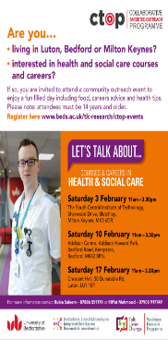
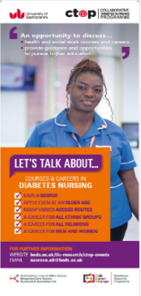




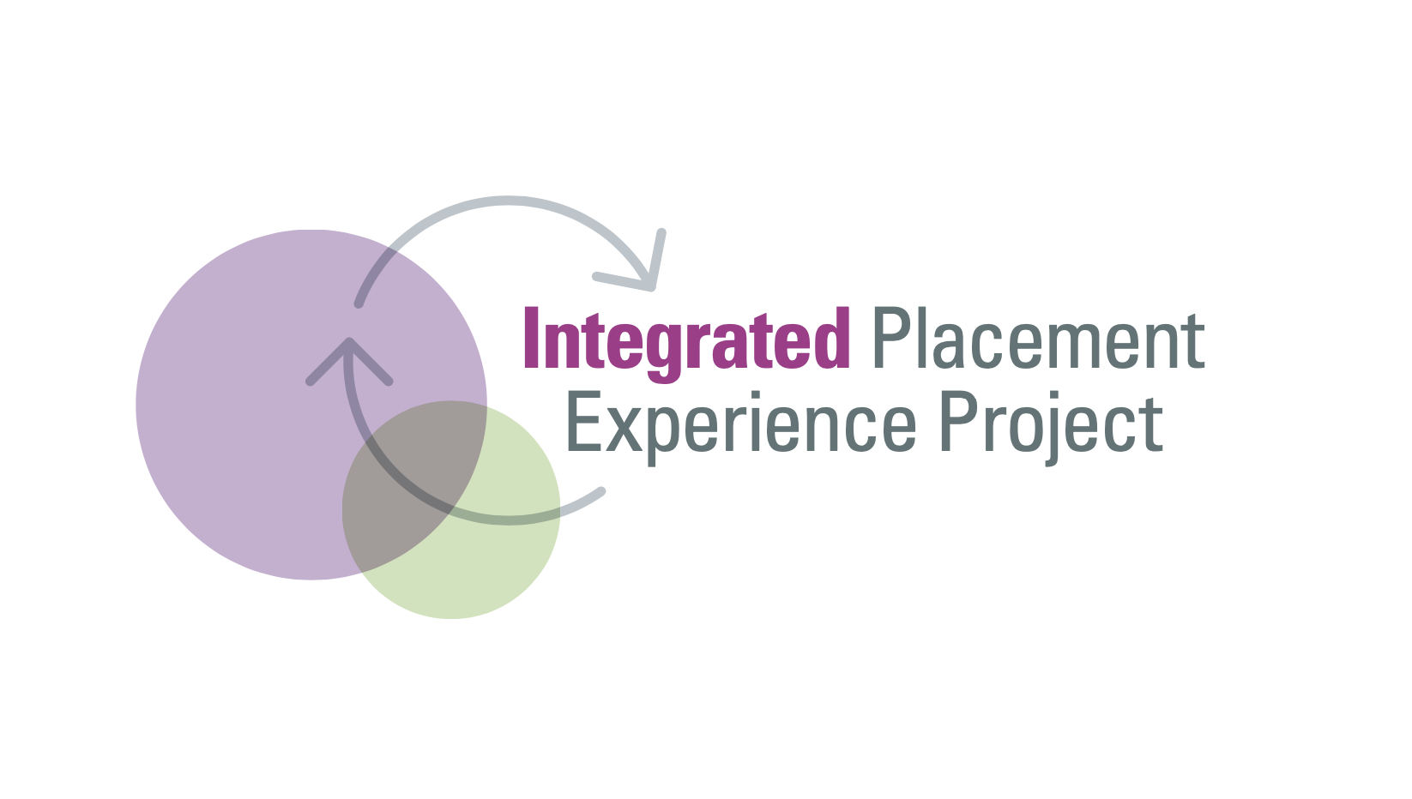




How can we recruit an inclusive and diverse integrated care workforce?
How can we prepare an integrated care curriculum?
CPD for integrated care
How can we expand placement capacity/develop an integrated care workforce?
How can we reduce avoidable frequent admissions to A&E?
How can we support retention of a diverse, inclusive and resilient workforce across BLMK health and social care organisations?
Web- based resources
iSort
BAME
Staff experiences
of work and career progression
Workforce development for inclusive and integrated care

Slide 4
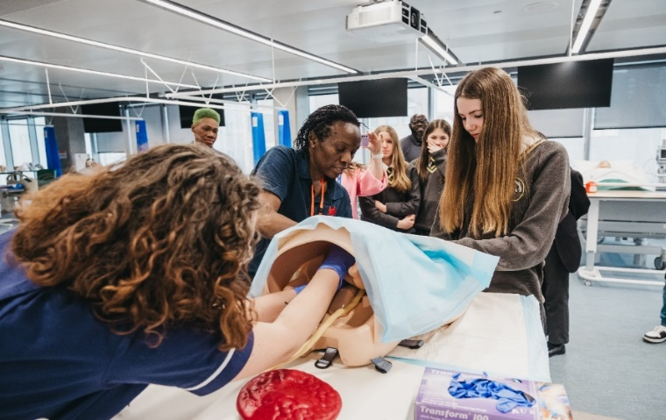
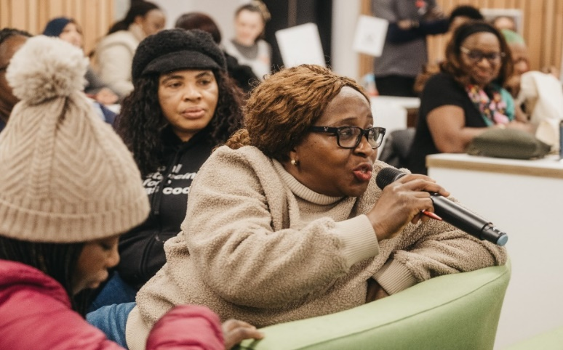
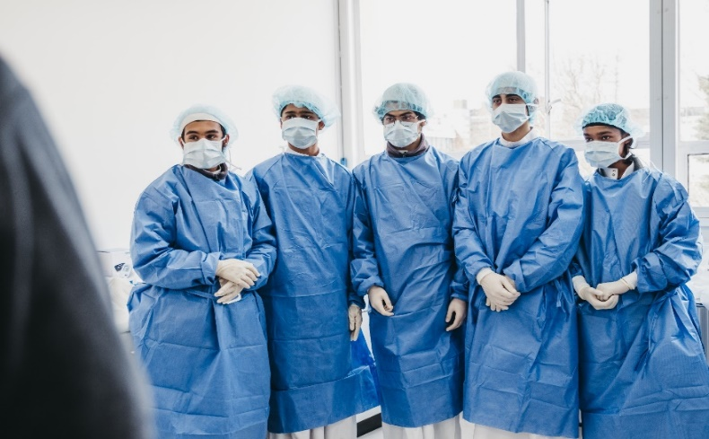
Design, Delivery & Reflections
Aim: to engage with young people, parents, career-switchers, and underrepresented groups to improve knowledge, perceptions, status, and the number of people choosing courses and careers in health and social care.

Slide 5

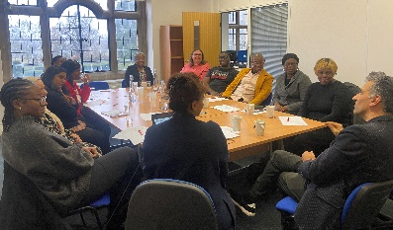
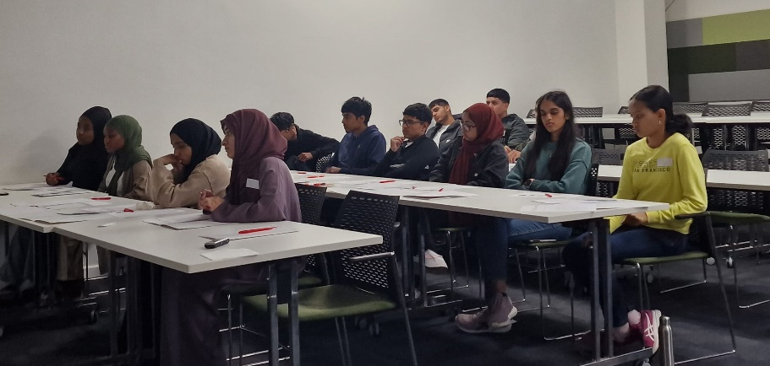
Co-production
& delivery: CTOP focus groups and events breakdown
x15 CTOP young people’s focus groups (92 participants). July 2023 – September 2023.
x2 school events (x10 schools, 150 pupils). 15 & 29th February 2024.
x3 community events: Milton Keynes, Bedford & Luton (over 300 attendees across events). 3rd, 10th, 17th February 2024.
Engaged with 113 organisations in BLMK
  13 religious places of worship
  20 community groups
  8 charities
  7 council-related organisations
  7 sports-recreational clubs
  6 educational organisation
Notes:
Talking about how we designed & delivered CTOP
Research has informed this intervention
First time on widening participation began in 2015 , funded by then HEE
Design – fine tuned it now, but was based on research that began in 2015 i.e more focus groups with a diverse population. In 2015, it was SA community and only nursing and midwifery (high Wycombe and luton), CTOP feasibility intervention was luton only
Branched out: ethnic groups/underrepresented groups, geography, courses and careers (allied health professions and social work)

Slide 6
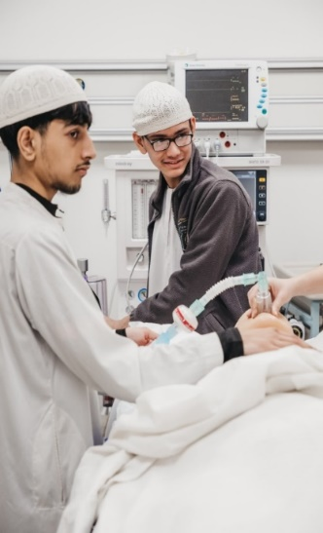
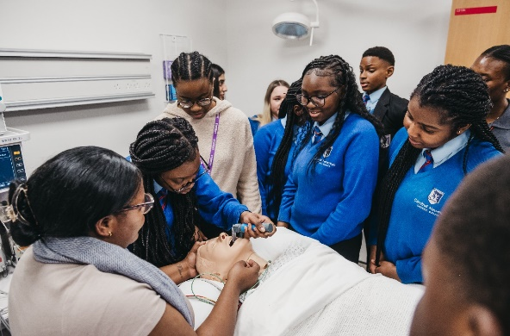
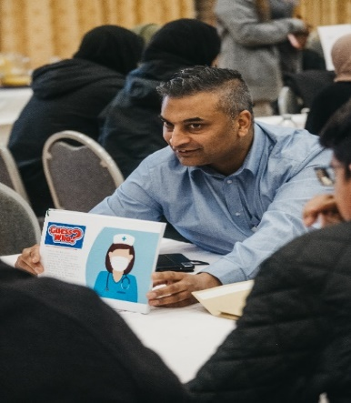
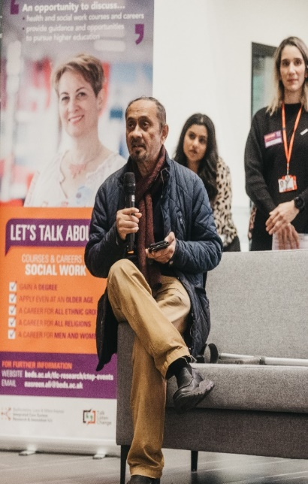

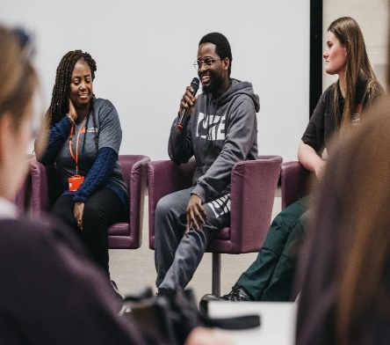
CTOP events
Healthcare professionals/guess who quiz
Lived experience stories
Course and caters to stalls
UoB staff available for advice
Lunch
Schools CTOP also included:
A visit to the UoB library
A visit to the simulation suite
Notes:
Talking about how we designed & delivered CTOP
Research has informed this intervention
First time on widening participation began in 2015 , funded by then HEE
Design – fine tuned it now, but was based on research that began in 2015 i.e more focus groups with a diverse population. In 2015, it was SA community and only nursing and midwifery (high Wycombe and luton), CTOP feasibility intervention was luton only
Branched out: ethnic groups/underrepresented groups, geography, courses and careers (allied health professions and social work)

Slide 7
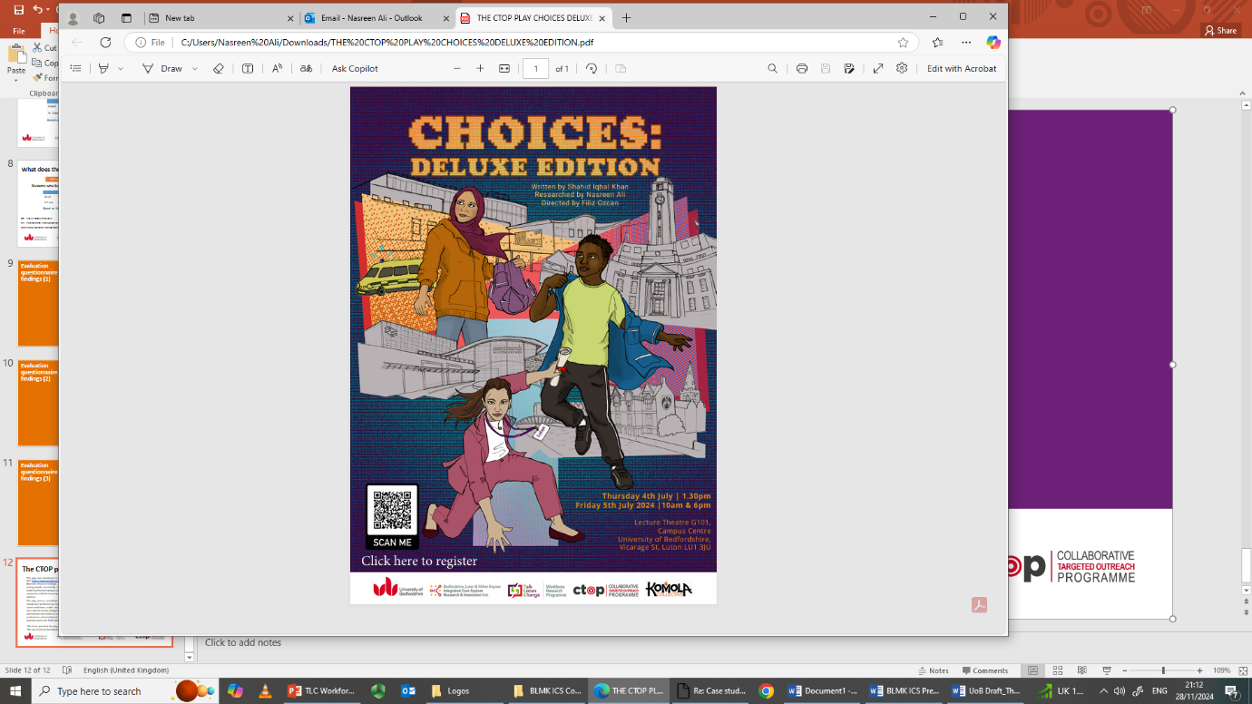
The CTOP play
Filiz Ozcan
Director

Slide 8




Commission
Applied theatre: the CTOP play
Introduction to Komola Collective
Purpose and focus of the commission
Highlighting opportunities within Health and Social Care
The initiative to diversify the workforce
Rich, culturally attuned care

Slide 9
Process
PERFORMANCE
SCRIPT
DEVELOPMENT
REHEARSALS
RESEARCH PHASE
DEVISING
PHASE
Creative exploration of verbatim interviews
Monologues
Duologues
Ensemble exercises
Inspired by simulation suite
Narrative taking place in two worlds - Gaming world /real life experiences
Representative of the participants who took part in the research
Framing the story
Movement
Sound design
Projection & animation
Post show discussions
Recording the radio play
Filming the play
Simulation suite
Exhibition
Interviews
Audition process

Slide 10
Did we make an impact?
Applied theatre: the CTOP play
About 26% of pupils attending CTOP outreach events come from neighborhoods in POLAR4 Q1 or Q2, where the fewest people enter higher education.
Based on deprivation indicators, 50% of pupils attending were classified as disadvantaged.
Raised the knowledge, perceptions, and status of health and social care courses and careers.
Participants said it raised aspirations.
Effective in attracting underrepresented groups, young people, and career-switchers.
Notes:
Index of MultipleDeprivation (IMD); Education, Skills, and Training Deprivation (EST); and Income Deprivation Affecting Children Index (IDACI).

Slide 11

"CTOP is built on genuine community engagement and empowerment, requiring dedicated skills, time, and resources to ensure that diversity and inclusion in the NHS workforce move beyond rhetoric to reality—ultimately leading to better health, better care, and greater value."
nasreen.ali@beds.ac.uk
filiz.ozcan@icloud.com
Notes:
Talking about how we designed & delivered CTOP
Research has informed this intervention
First time on widening participation began in 2015 , funded by then HEE
Design – fine tuned it now, but was based on research that began in 2015 i.e more focus groups with a diverse population. In 2015, it was SA community and only nursing and midwifery (high Wycombe and luton), CTOP feasibility intervention was luton only
Branched out: ethnic groups/underrepresented groups, geography, courses and careers (allied health professions and social work)

