Slide 1
”To enable the best
possible integrated
care accessible for all”

Slide 2
What's the problem we are trying to solve?
Changing from thinking differently to doing differently
Embedding co-production in all aspects of integrated care
Building leadership skills, capacity and capability
Educating the workforce about integrated care to build capacity, competence and proficiency
Enabling workforce development that supports partners to work effectively and comfortably across organisations
Delivering research affecting immediate change
Fearlessness about change and innovation

Slide 3




Primary benefit of the
Integrated Care Academy
Empower people with knowledge, skills and expertise
Collaboration and networks
Community building
Evidence and communicate successes

Slide 4






“To enable the best possible integrated care accessible to all”
Embedding co-production​​
Providing education and experiential learning
Developing and Implementing innovation​​
Supporting workforce transformation​​
Providing leadership skills development​​
Delivering impactful research​​

Slide 5
Education and Experiential Learning
Development and delivery of Postgraduate Certificates (PGC) Programmes - focused on understanding and driving integrated care, including input from experts by experience
  PGC Integrated care pathway on SEMBA
  PGC Professional Practice – Integrated care

Slide 6
Our People and Our Workforce
Design & Deliver
Integrated Workforce Planning & Transformation training courses
Train the Trainers Course
Understanding need
Bespoke coaching and mentoring development programmes
Alumni
Longitudinal return on investment by those who have engaged with the ICA
Develop
The Association of Health & Care Workforce Planning (www.ahcwp.com)
Designed and delivered x6 Integrated Workforce Planning & Transformation training courses along with x1 Train the Trainers Course (over 100 people)

Slide 7
Co-production in Integrated Care
Co-production
hub
200 members, enabling people to connect and share problems and solutions
Network of networks
Network of networks events on specific topics, gaining feedback for initiatives
Partnership working
Supporting closer working relationships, with Healthwatch Essex and Suffolk
Training and support
182 people received co-production training across EoE

Slide 8
Research in Integrated Care
Research Team Development
Real World Evaluation
Research Delivery
3 PhD Students
Coproduction
Mental Health
End of Life Care
Integrated Care Planning for Older People
Digital Upskilling for Community Pharmacy
Local knowledge exchange
Knowledge Sharing
Integrated Care Approaches of Frailty Prevention
Urgent and Emergency Care Responses and Falls
Practical and useful outputs to deliver immediate and effective change

Slide 9
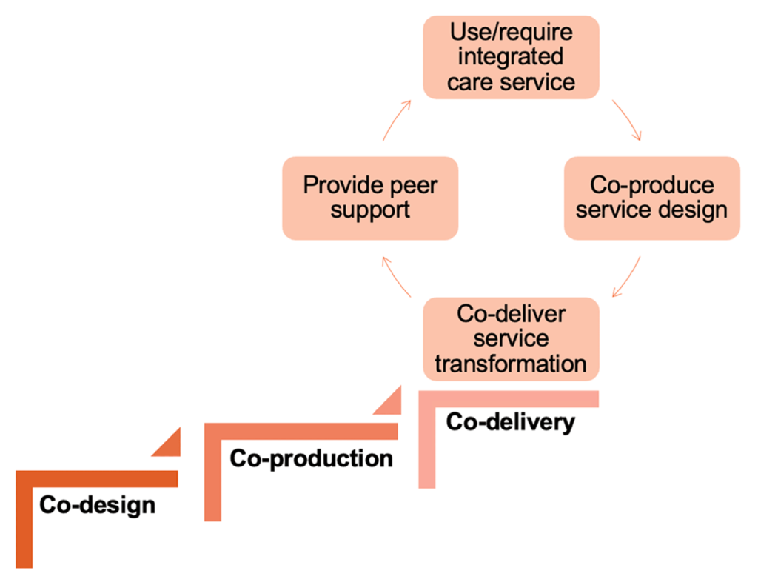
Co-production research
How has co-production with service users, unpaid carers and the workforce impacted the design and transformation of integrated health and care services?

Slide 10
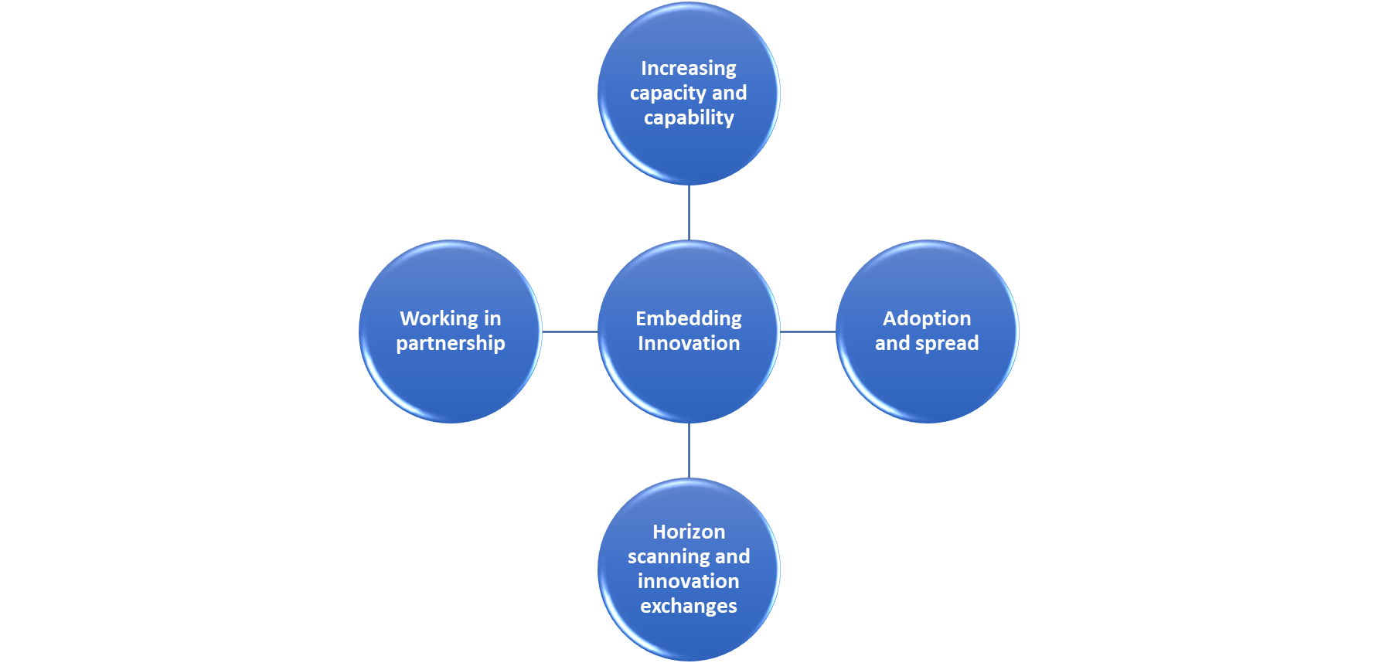
System Innovation Development

Slide 11
Achievements and Impact
Integrated Care Fellows Programme
One Team Programme
EoE Lead Cancer Nurse Development Programme
Coaching and Mentoring Programmes
Notes:
Integrated Care Fellowship Cohort 3 – Regional Fellowship sponsored by the Primary Care School
One Team – a professionally agnostic training programme focused on making integration work
Appointment of strategic delivery partner (subject to contract and collaborative agreement)
Alumni network launch
Coaching refresher and supervision support, initially focussed on mental health providers but now widened out across Suffolk & North East Essex
East of England Lead Cancer Nurse Development Programme which uses a combination of group coaching and 1:1 coaching sessions for all participants

Slide 12
Enabling leadership and innovation
Understanding self in the context of understanding others​
Network building across agencies they had not considered before
Translating networking into tangible actions with service users
Change can be for the better
The importance of presentation skills and making the most of time to think​
Understanding the system in which they work and the role they play
Ability to innovate and change culture is there

Slide 13
Thank you ica@uos.ac.uk https://integratedcareacademy.org.uk

