Slide 1


Inclusive workforce and building resilience
Professor Nasreen Ali
Programme Lead

Slide 2


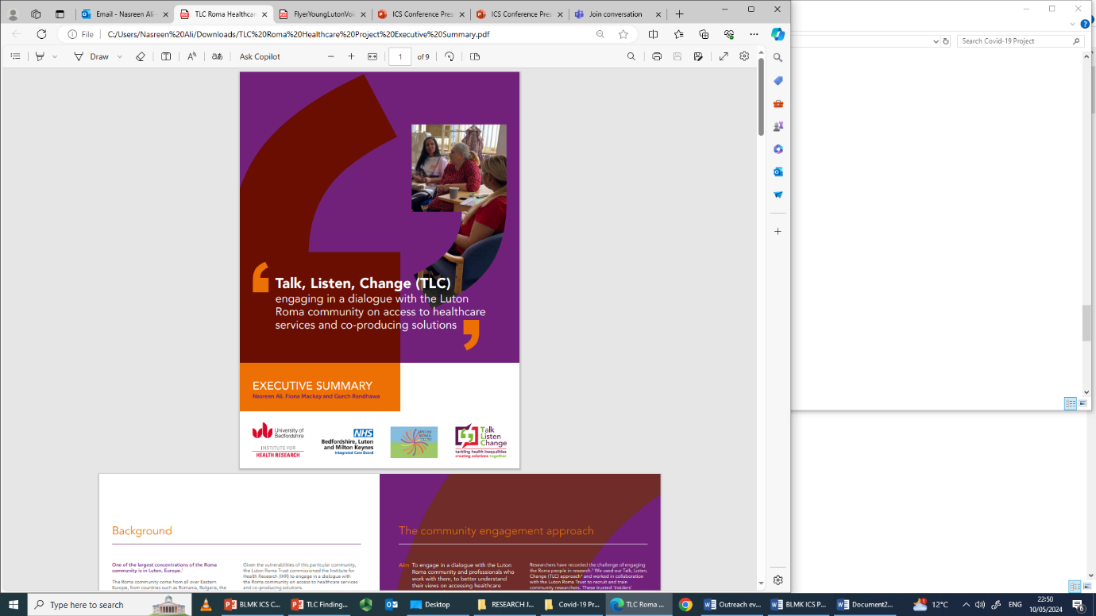
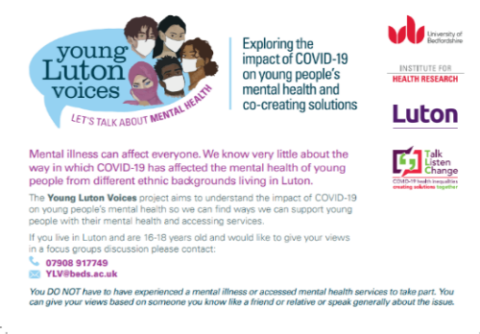
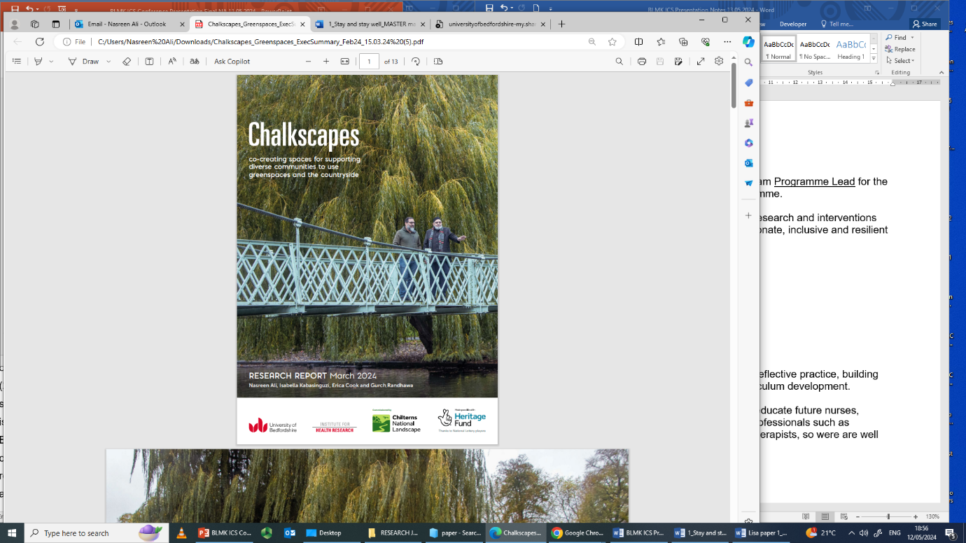
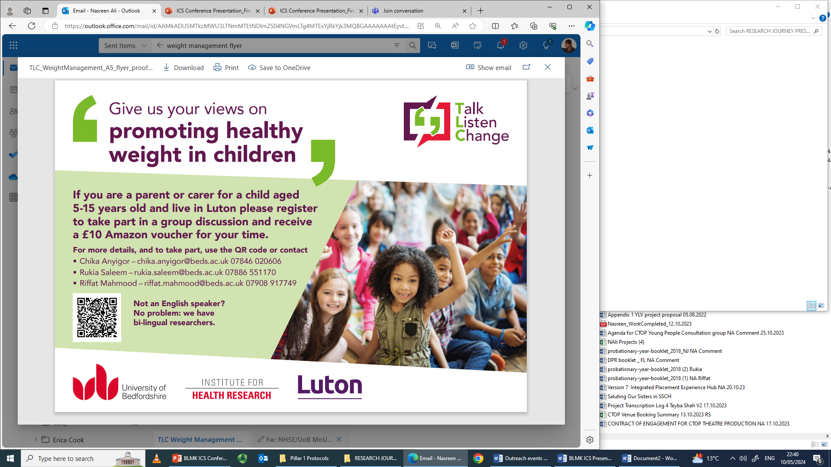
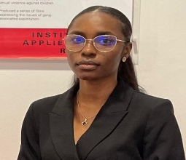
What's
An approach which is culturally competent
and uses sensitive methods which prioritise voice and experience to enable co-production of solutions.
Osasenaga Akenbor
PhD built environment, cultural diversity and physical activity in Luton

Slide 3
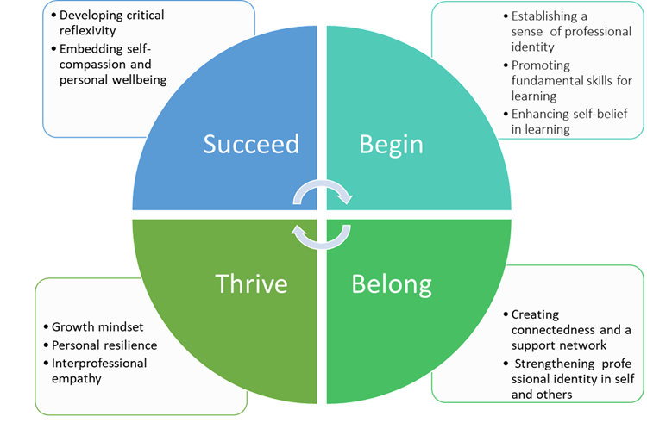
Conceptual framework

Slide 4

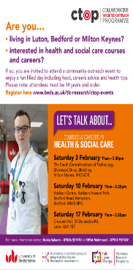
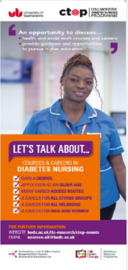










How can we recruit an inclusive and diverse integrated care workforce?
PhD
How can we prepare an integrated care curriculum?
How can we reduce avoidable frequent admissions to A&E?
Integrated
care placements
(IPE project)
How can we expand placement capacity/develop an integrated care workforce?
Web- based resources
Schwartz Rounds
Reflective supervision
iWRAP
How can we support retention of a diverse, inclusive and resilient workforce across BLMK health and social care organisations?
BAME
Staff experiences
of work and career progression
CPD
Workforce development for Integrated Care

Slide 5

Collaborative Targeted Outreach Programme (CTOP)
Professor Nasreen Ali, Dr Nishani Jeyapalan,
Dr Fani Liapi, Rukia Saleem & Riffat Mahmood

Slide 6
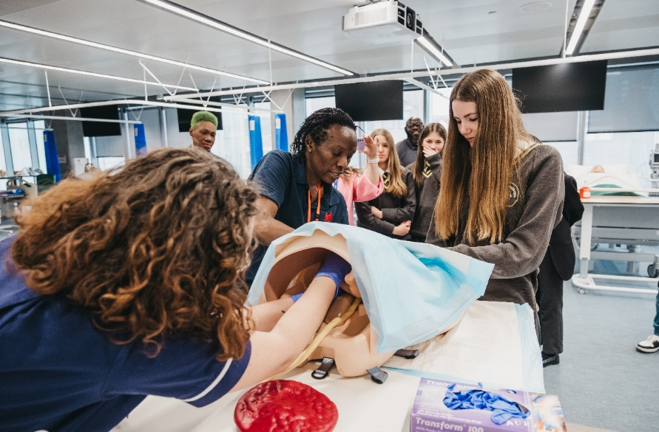
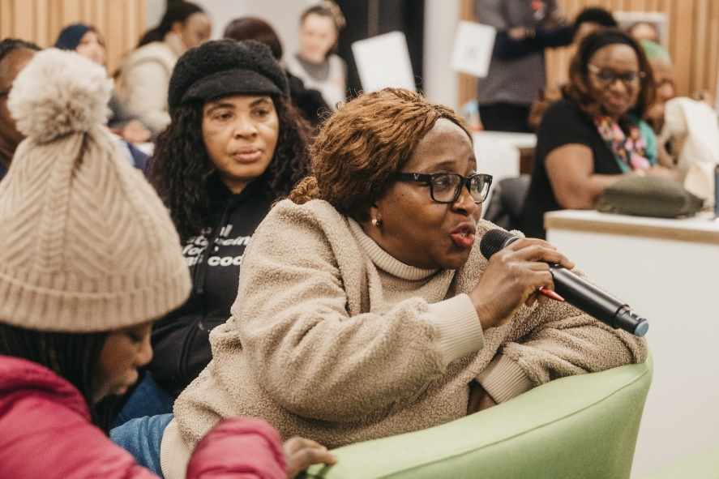
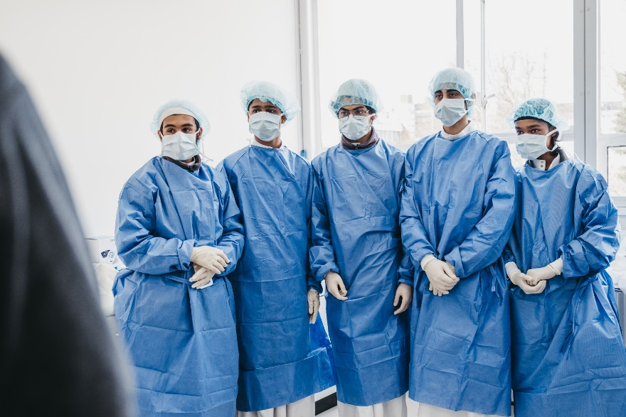
Design, Delivery & Evaluation

Slide 7


Aim of CTOP
To engage with young people, parents, career-switchers and underrepresented groups to improve knowledge and perceptions of nursing, midwifery, the allied health professions and social work
Notes:
aims to contribute to developing an inclusive health and social care workforce by engaging with young people, parents, career switchers, under-represented groups and communities from diverse ethnic backgrounds to improve their knowledge, perceptions and status of nursing, midwifery, allied health professions and social work to increase their representation on courses and in the NHS workforce. In this presentation we will describe the outreach events we have developed and delivered and discuss early evaluation findings which highlight the importance of culturally competent community approaches that could be adapted to widen participation of underrepresented groups, contribute towards user-centred health and social care, maximise untapped workforce capacity and reduce inequalities.
Talking about how we designed & delivered CTOP
Research has informed this intervention
First time on widening participation began in 2015 , funded by then HEE
Design – fine tuned it now, but was based on research that began in 2015 i.e more focus groups with a diverse population. In 2015, it was SA community and only nursing and midwifery (high Wycombe and luton), CTOP feasibility intervention was luton only
Branched out: ethnic groups/underrepresented groups, geography, courses and careers (allied health professions and social work)

Slide 8



Why…
To help contribute to the development of an inclusive health and social care workforce
A workforce that reflects the communities it serves because culturally responsive healthcare is linked to:
improvements in quality of care for patients
better patient adherence to medical and self-care regimes
improved outcomes

Slide 9
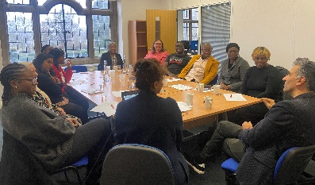
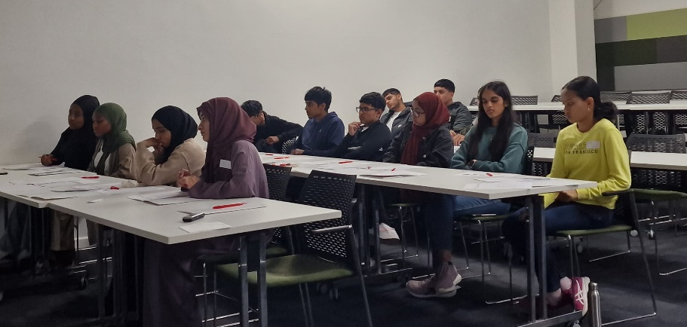
Co-production
Selection of merchandise for events
Creating CTOP branding, recruitment flyers & branding
Designing the event programme
Discussing how to showcase local communities and their work
Input for future CTOP events
Continuous conversations with local communities and young people
Total of 113 total organisations contacted
  13 religious places of worship
  20 community groups
  8 charities
  7 council-related organisations
  7 sports-recreational clubs
  6 educational organisation
Notes:
Talking about how we designed & delivered CTOP
Research has informed this intervention
First time on widening participation began in 2015 , funded by then HEE
Design – fine tuned it now, but was based on research that began in 2015 i.e more focus groups with a diverse population. In 2015, it was SA community and only nursing and midwifery (high Wycombe and luton), CTOP feasibility intervention was luton only
Branched out: ethnic groups/underrepresented groups, geography, courses and careers (allied health professions and social work)

Slide 10
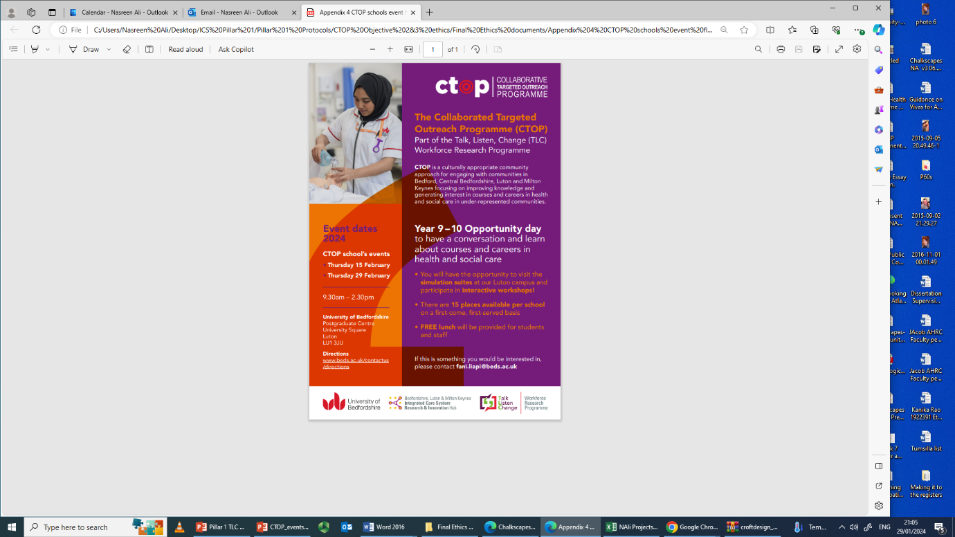
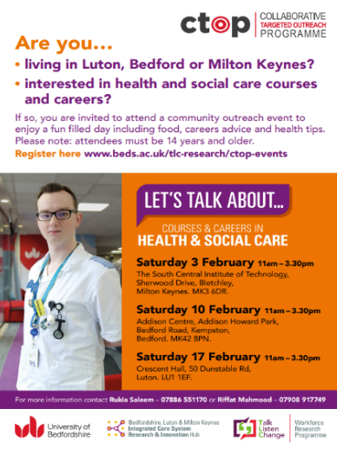

Delivery: CTOP focus groups and events breakdown
15x CTOP young people’s focus groups (92 participants)(July 2023 – September 2023)
2x schools events (x10 schools): PGR centre, simulation suite and library (UOB , Park Square campus) (15 & 29th February 2024)
3x community events: Milton Keynes, Bedford & Luton (over 300 people in attendance across events) (3rd, 10th, 17th February 2024)

Slide 11
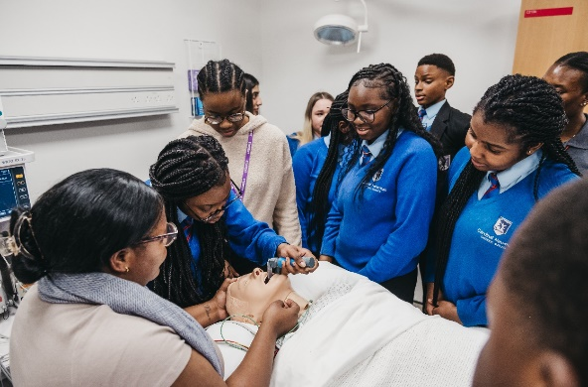

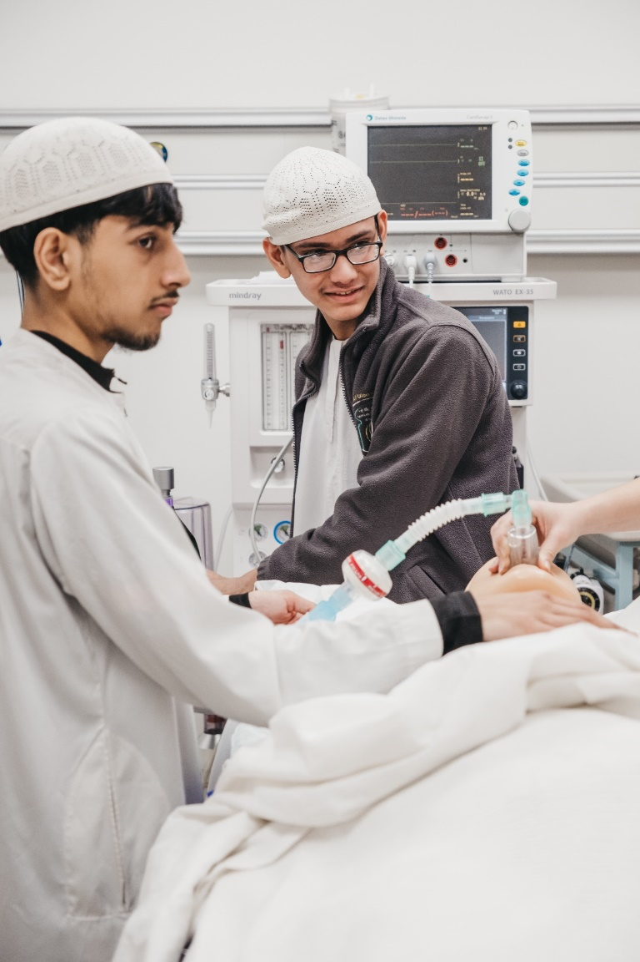
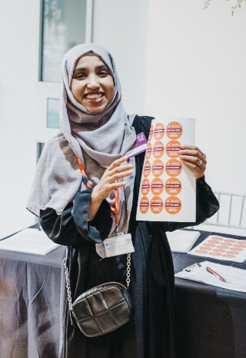
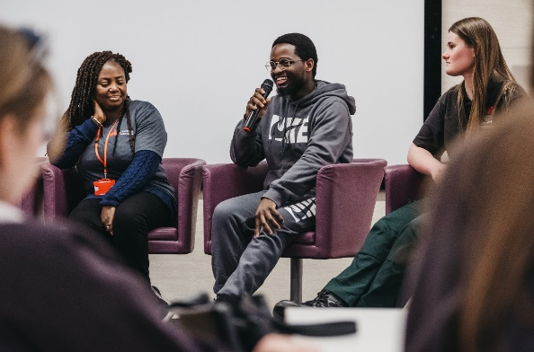

CTOP schools
events
Welcome schools-
Pastry breakfasts provided
Brief introduction to CTOP
Simulation suite
Stalls included: midwifery, physiotherapy, operating department, custody suite and simbulance
Library tour
Real-life stories: health and social care workers
Notes:
aims to contribute to developing an inclusive health and social care workforce by engaging with young people, parents, career switchers, under-represented groups and communities from diverse ethnic backgrounds to improve their knowledge, perceptions and status of nursing, midwifery, allied health professions and social work to increase their representation on courses and in the NHS workforce. In this presentation we will describe the outreach events we have developed and delivered and discuss early evaluation findings which highlight the importance of culturally competent community approaches that could be adapted to widen participation of underrepresented groups, contribute towards user-centred health and social care, maximise untapped workforce capacity and reduce inequalities.
Talking about how we designed & delivered CTOP
Research has informed this intervention
First time on widening participation began in 2015 , funded by then HEE
Design – fine tuned it now, but was based on research that began in 2015 i.e more focus groups with a diverse population. In 2015, it was SA community and only nursing and midwifery (high Wycombe and luton), CTOP feasibility intervention was luton only
Branched out: ethnic groups/underrepresented groups, geography, courses and careers (allied health professions and social work)

Slide 12
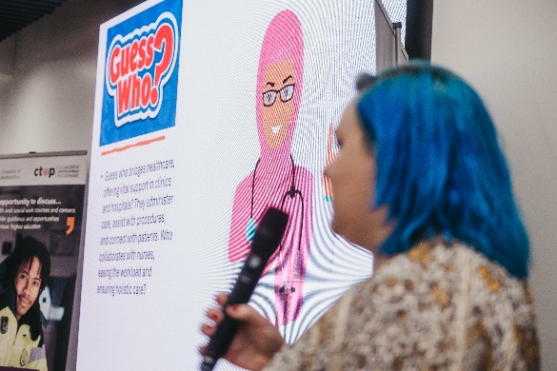
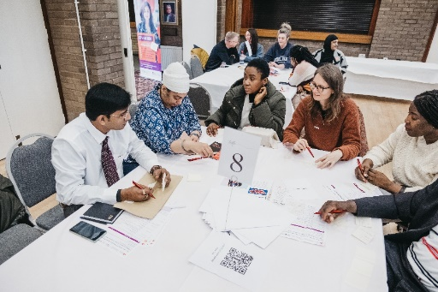
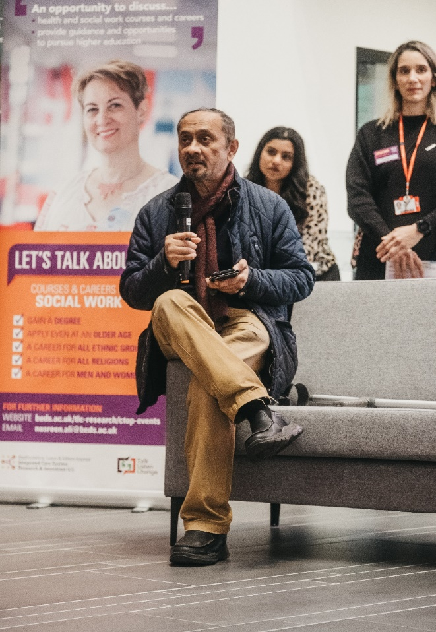
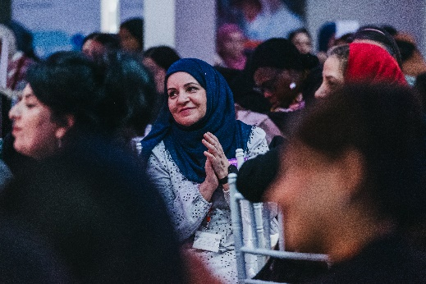
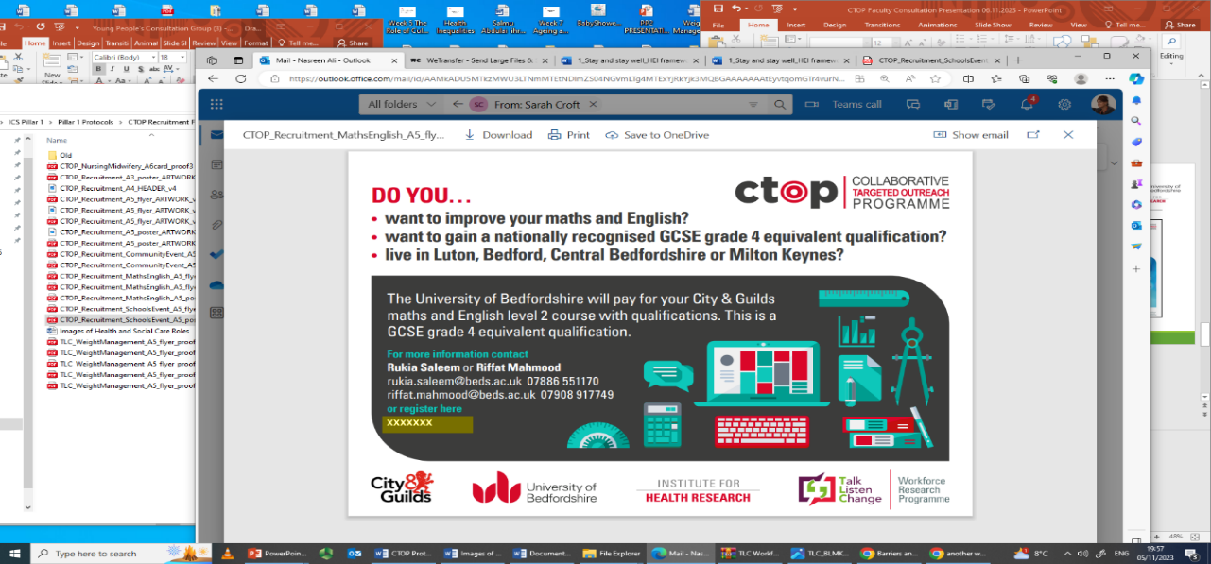
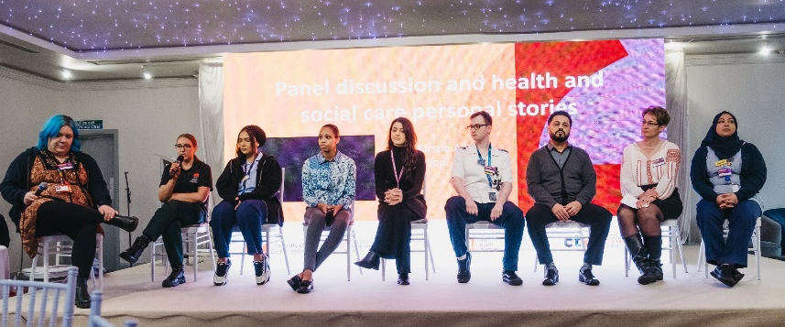
CTOP community events outline
Welcome
communities
Brief introduction to CTOP
Guess who style health and social care quiz
Lunch, CTOP stalls & networking
Real-life stories: health and social care workers

Slide 13
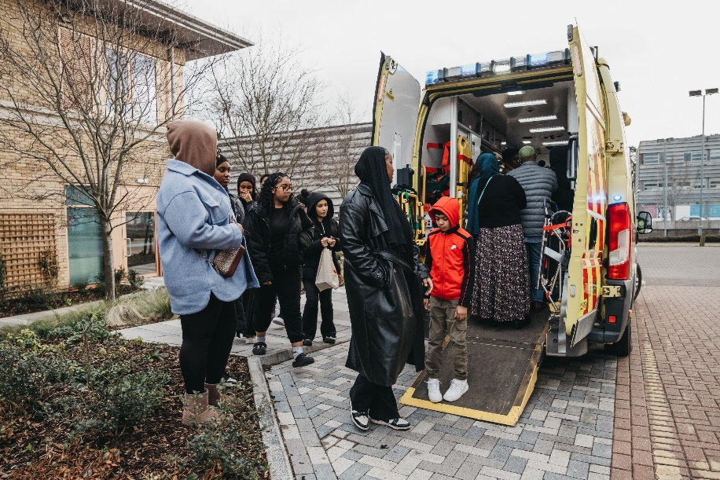
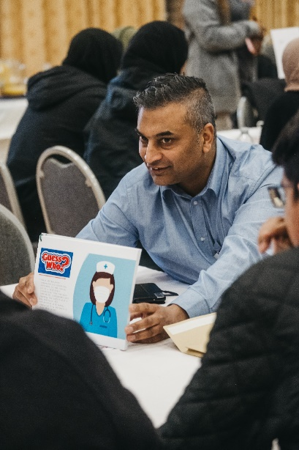
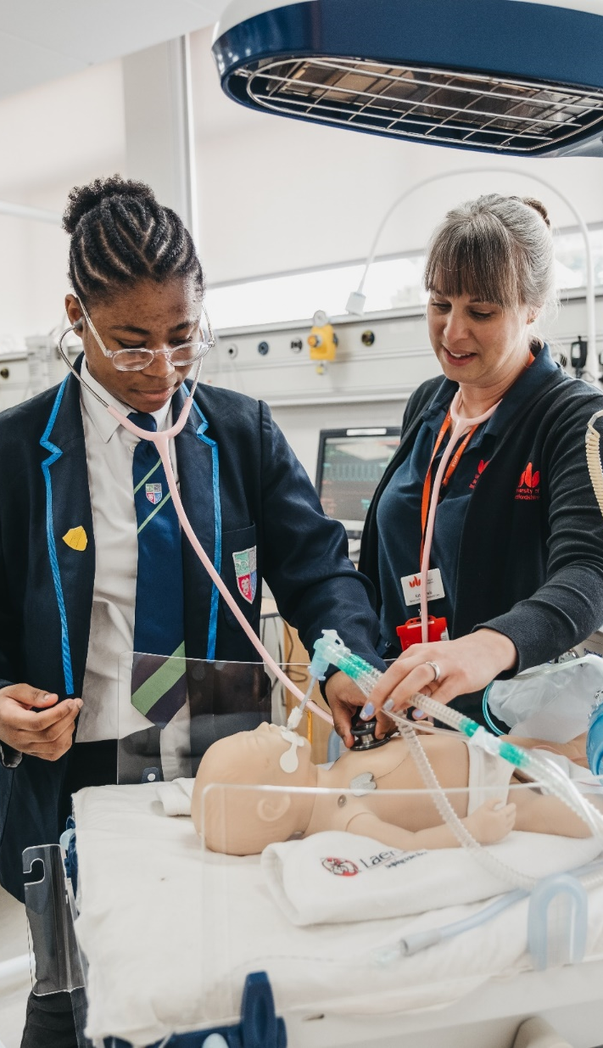

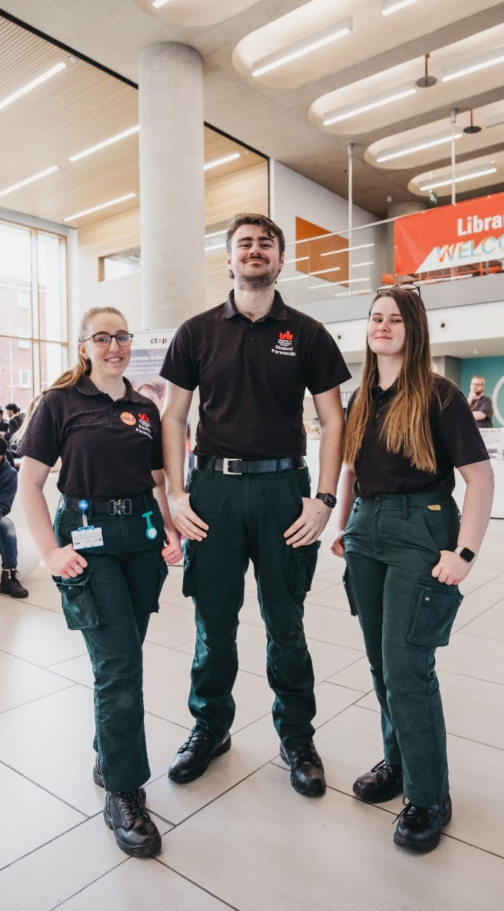
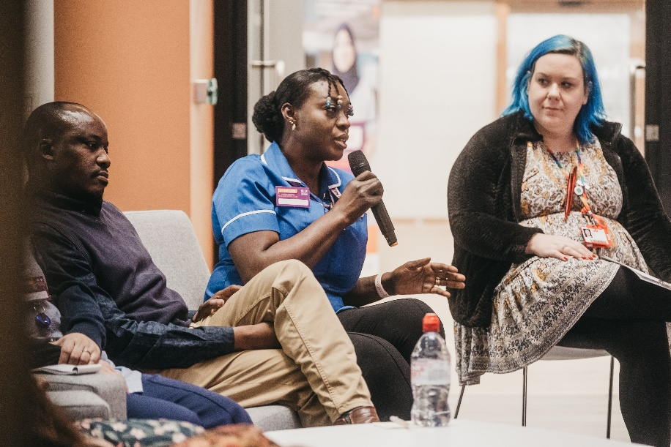
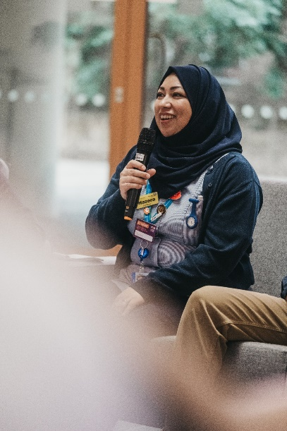
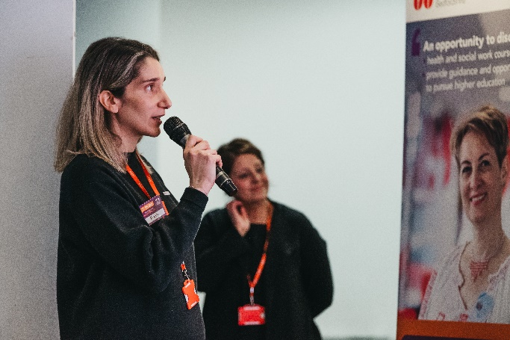
Evaluation of CTOP

Slide 14
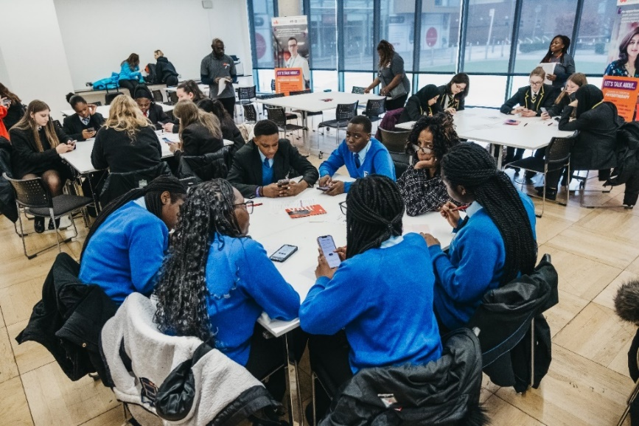
CTOP evaluation
Aim:
To understand the outcomes, and experiences of attendees at outreach events targeting young people and community members.
Data Collection:
HEAT data (ROAM team)
Questionnaires administered before and after outreach events.
Mentimeter for digital completion & hardcopy versions.
UOB admission team (future ambition)
Notes:
aims to contribute to developing an inclusive health and social care workforce by engaging with young people, parents, career switchers, under-represented groups and communities from diverse ethnic backgrounds to improve their knowledge, perceptions and status of nursing, midwifery, allied health professions and social work to increase their representation on courses and in the NHS workforce. In this presentation we will describe the outreach events we have developed and delivered and discuss early evaluation findings which highlight the importance of culturally competent community approaches that could be adapted to widen participation of underrepresented groups, contribute towards user-centred health and social care, maximise untapped workforce capacity and reduce inequalities.
Talking about how we designed & delivered CTOP
Research has informed this intervention
First time on widening participation began in 2015 , funded by then HEE
Design – fine tuned it now, but was based on research that began in 2015 i.e more focus groups with a diverse population. In 2015, it was SA community and only nursing and midwifery (high Wycombe and luton), CTOP feasibility intervention was luton only
Branched out: ethnic groups/underrepresented groups, geography, courses and careers (allied health professions and social work)

Slide 15
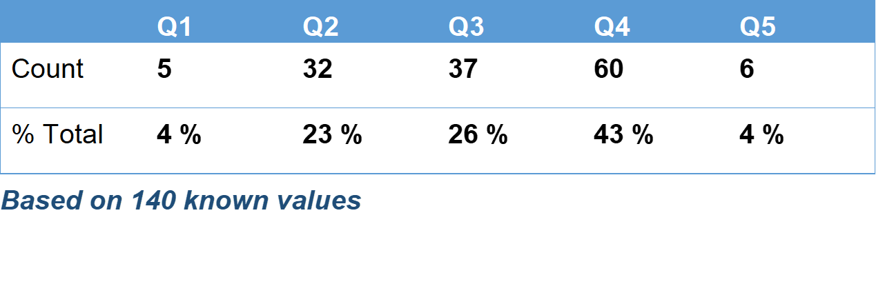
What does the HEAT data tell us?
160 students attended CTOP events
Students who live in a low higher education participation neighbourhood

Slide 16
What does the HEAT data tell us?
160 students attended CTOP events
Students who live in a high deprivation neighbourhood

Slide 17
Evaluation questionnaire findings (1)
Notes:
aims to contribute to developing an inclusive health and social care workforce by engaging with young people, parents, career switchers, under-represented groups and communities from diverse ethnic backgrounds to improve their knowledge, perceptions and status of nursing, midwifery, allied health professions and social work to increase their representation on courses and in the NHS workforce. In this presentation we will describe the outreach events we have developed and delivered and discuss early evaluation findings which highlight the importance of culturally competent community approaches that could be adapted to widen participation of underrepresented groups, contribute towards user-centred health and social care, maximise untapped workforce capacity and reduce inequalities.
Talking about how we designed & delivered CTOP
Research has informed this intervention
First time on widening participation began in 2015 , funded by then HEE
Design – fine tuned it now, but was based on research that began in 2015 i.e more focus groups with a diverse population. In 2015, it was SA community and only nursing and midwifery (high Wycombe and luton), CTOP feasibility intervention was luton only
Branched out: ethnic groups/underrepresented groups, geography, courses and careers (allied health professions and social work)

Slide 18
Evaluation questionnaire findings (2)
Notes:
aims to contribute to developing an inclusive health and social care workforce by engaging with young people, parents, career switchers, under-represented groups and communities from diverse ethnic backgrounds to improve their knowledge, perceptions and status of nursing, midwifery, allied health professions and social work to increase their representation on courses and in the NHS workforce. In this presentation we will describe the outreach events we have developed and delivered and discuss early evaluation findings which highlight the importance of culturally competent community approaches that could be adapted to widen participation of underrepresented groups, contribute towards user-centred health and social care, maximise untapped workforce capacity and reduce inequalities.
Talking about how we designed & delivered CTOP
Research has informed this intervention
First time on widening participation began in 2015 , funded by then HEE
Design – fine tuned it now, but was based on research that began in 2015 i.e more focus groups with a diverse population. In 2015, it was SA community and only nursing and midwifery (high Wycombe and luton), CTOP feasibility intervention was luton only
Branched out: ethnic groups/underrepresented groups, geography, courses and careers (allied health professions and social work)

Slide 19
Evaluation questionnaire findings (3)
Notes:
aims to contribute to developing an inclusive health and social care workforce by engaging with young people, parents, career switchers, under-represented groups and communities from diverse ethnic backgrounds to improve their knowledge, perceptions and status of nursing, midwifery, allied health professions and social work to increase their representation on courses and in the NHS workforce. In this presentation we will describe the outreach events we have developed and delivered and discuss early evaluation findings which highlight the importance of culturally competent community approaches that could be adapted to widen participation of underrepresented groups, contribute towards user-centred health and social care, maximise untapped workforce capacity and reduce inequalities.
Talking about how we designed & delivered CTOP
Research has informed this intervention
First time on widening participation began in 2015 , funded by then HEE
Design – fine tuned it now, but was based on research that began in 2015 i.e more focus groups with a diverse population. In 2015, it was SA community and only nursing and midwifery (high Wycombe and luton), CTOP feasibility intervention was luton only
Branched out: ethnic groups/underrepresented groups, geography, courses and careers (allied health professions and social work)

Slide 20
CTOP reflections
Notes:
B roll footage – student events/community events/images

Slide 21
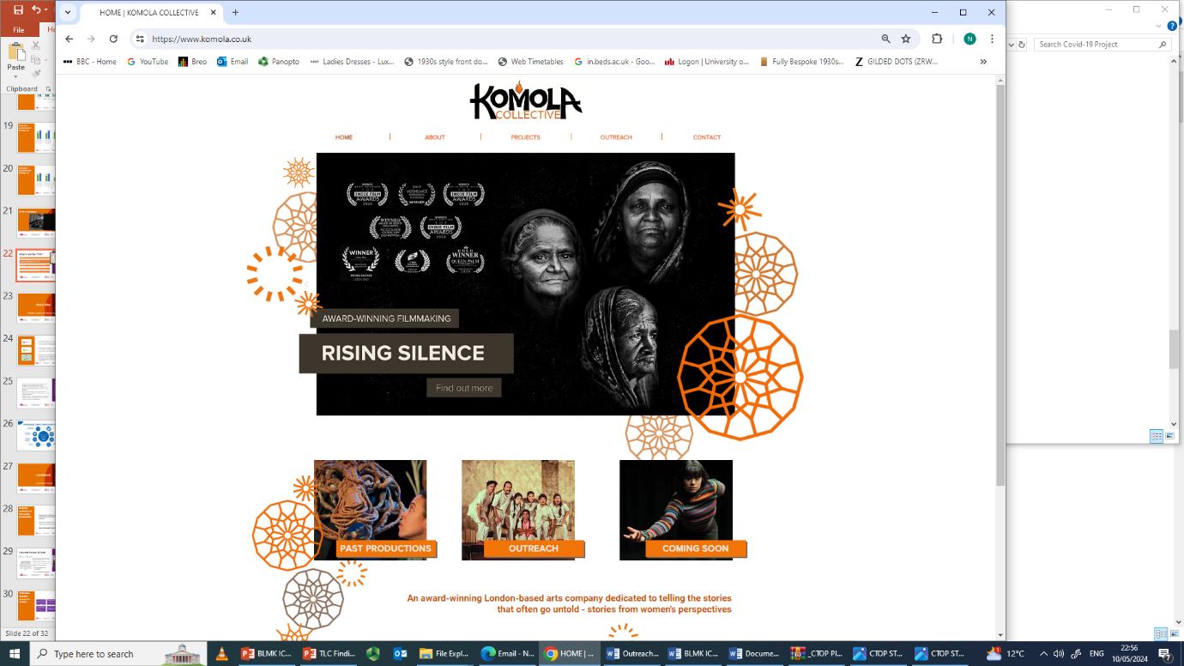
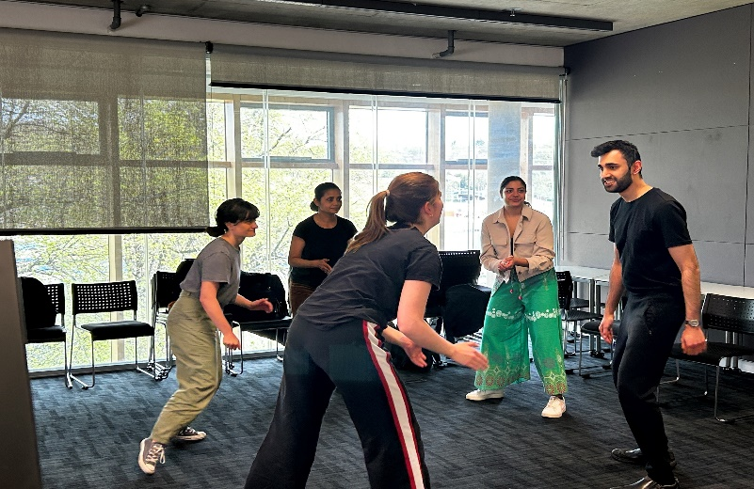
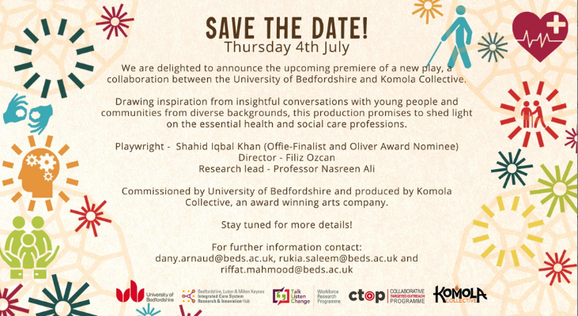
What’s next for CTOP?
Continuing with the evaluation
Dissemination of CTOP findings e.g. publications, evaluation report, presentations
CTOP on tour: focussing on apprenticeships, Muslim boys, Irish and Eastern European communities, more CTOP schools events
Continuing recruitment for Maths & English course
CTOP play & gallery
Performances : July 4th 2024 @ 6pm
July 5th 2024 @10am & 2pm

