Slide 1





Project partners
“Involving excluded patients in research”
Breaking down barriers to research participation for refugees & asylum seekers
Margaret.Greenfields@aru.ac.uk

Slide 2
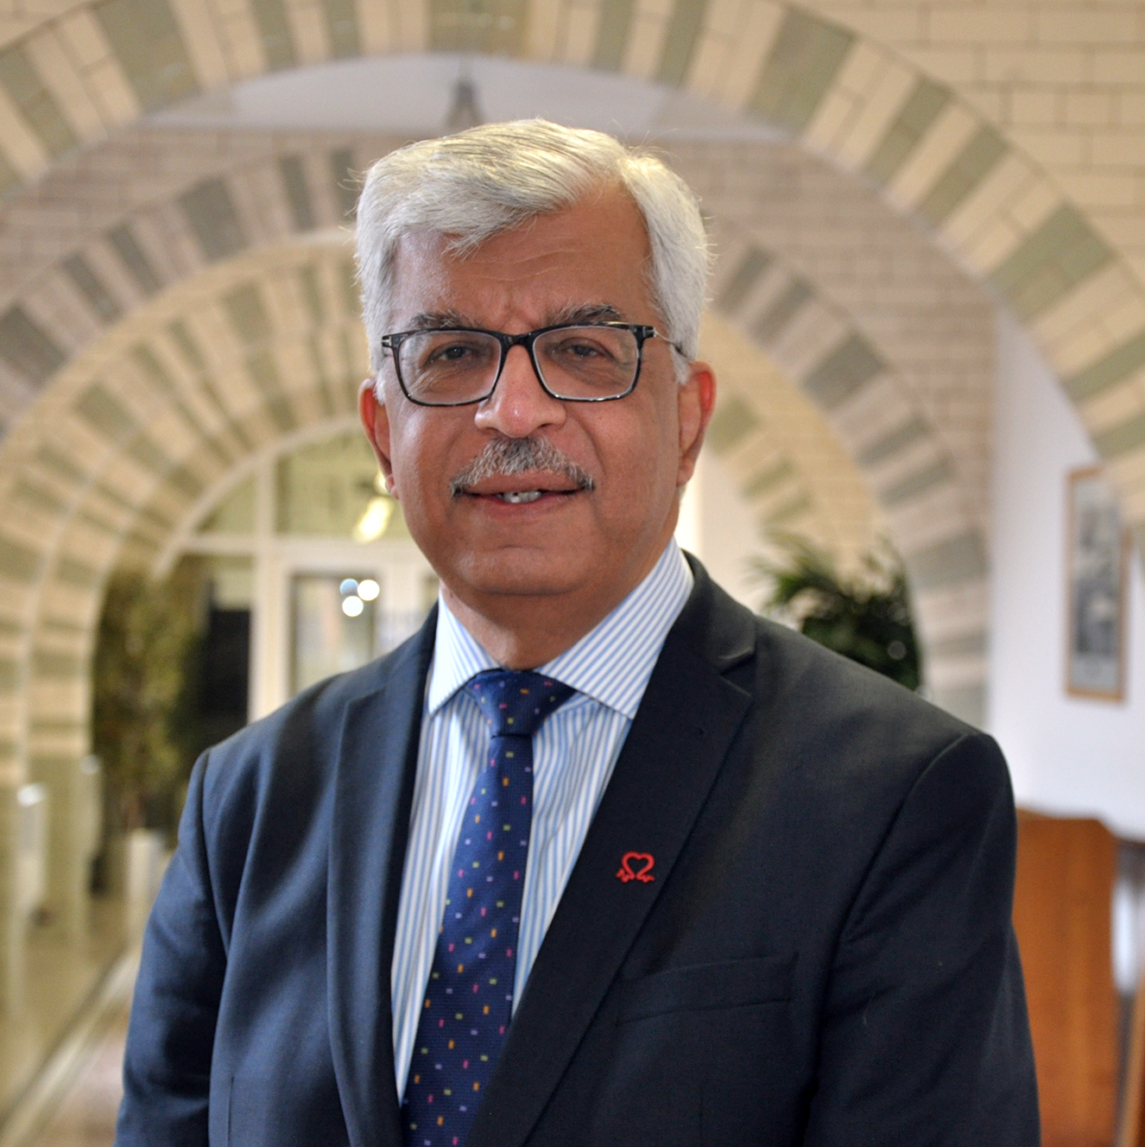

For research to be relevant, it is important we reach every sector of our population, including under-served populations.
Identifying barriers to participation in research, and co-developing solutions, which this work so clearly aims to address, is the only way to increase diversity, and therefore, the generalisability of our research findings
Prof Sir Munir Pirmohamed
MB ChB (Hons), PhD, FRCP, FRCP(E), FFPM, FRSB, FBPhS, FMedSci

Slide 3
Co-produced project aims and objectives
To explore system barriers to research engagement of refugees and asylum seekers at different stages of their post-migration journey
To triangulate the experiences of people with lived experience, civil society and statutory service providers as well as health and social care researchers
To explore health professionals’ knowledge and understanding of refugees and asylum seekers, their views of system-based barriers to refugee and asylum seeker engagement in research and their own experiences of trying to engage these populations
To explore refugee and asylum seeker perspectives of health/social care systems and knowledge of research participation
To identify potential solutions to barriers
To produce a plan of action including recommendations and training for practitioners to support increased meaningful, empowered participation of refugees and asylum seekers in research.

Slide 4
Overarching approach
Exploring system barriers to health / research engagement of refugees and asylum seekers at different stages of their post-migration journey
Scoping review of literature and exemplar research activities
Input from individuals with lived experience, civil society and statutory service providers, and health and social care researchers via workshops / interviews
Identifying solutions and building an action plan to increase meaningful, empowered participation in research
Co-development of an action plan to operationalise solutions based on at final stakeholder workshop
Recommendations and training for practitioners and refugees and asylum seekers
Notes:
Steering group meetings – includes health professionals and ARU staff and students with lived experience of the refugee and asylum system and clinical expertise

Slide 5
Project Activities (November 23-February 24)
Steering group meetings (x5) to oversee and guide the project – SG included health professionals, migration research experts and ARU staff and students with lived experience of the refugee and asylum system
3 workshops with community organisations who represent/support refugees and asylum seekers and people with lived experience – Peterborough, Cambridge and Online
2 workshops with health and social care professionals and clinical researchers – Cambridge and Online + small group interview (Peterborough) + individual interviews
Full day final event to discuss findings, recommendations and feed into action plan - Peterborough
Notes:
Steering group meetings – includes health professionals, internationally recognised research experts and ARU staff and students with lived experience of the refugee and asylum system

Slide 6
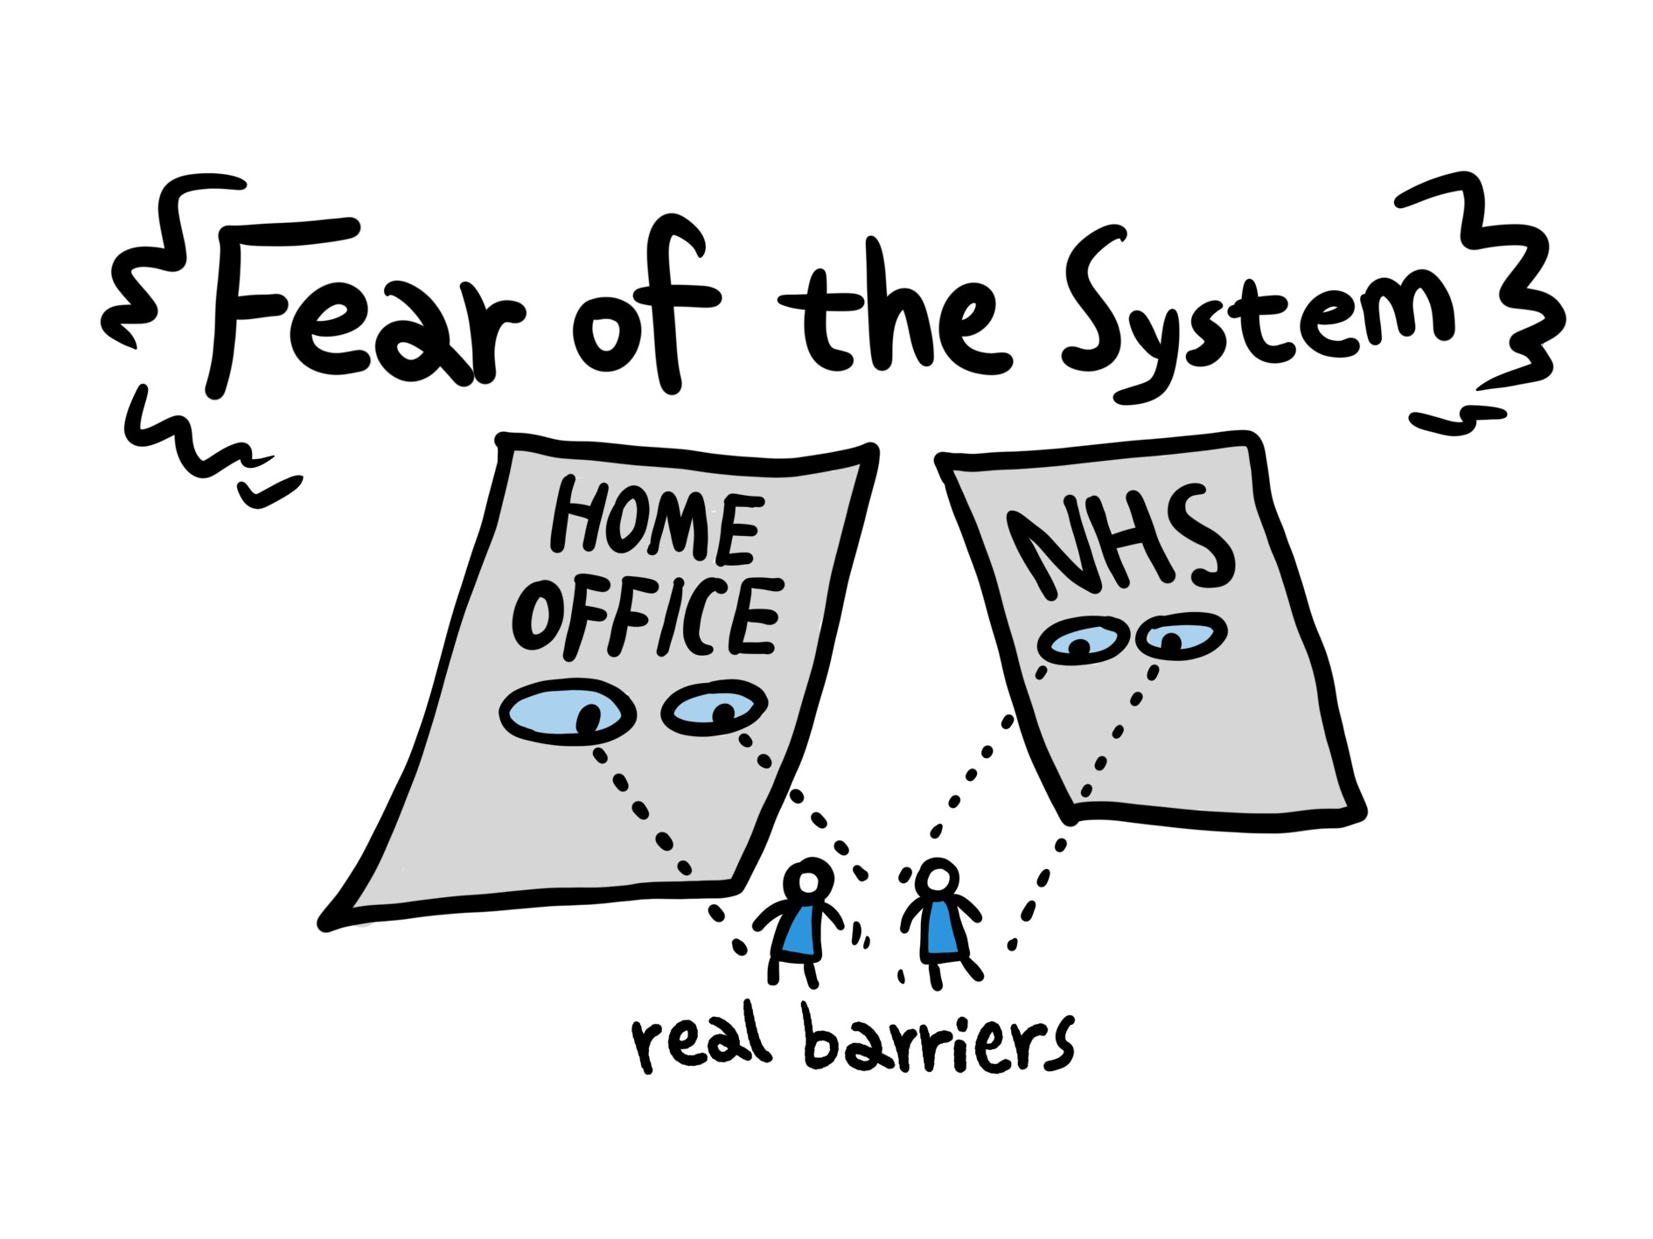
Findings from Communities
Shame and fear about certain health conditions – will I be deported?
Off-putting entry points into NHS system – inadequately trained admin staff/receptionists are barriers to understanding/positive experience
Previous traumatic experience of medical system in other countries
Lack of transport and/or funds to attend
Lack of knowledge of NHS system and limited understanding of research / research opportunities
Overwhelmed / lack of capacity / more immediate pressing concerns
Inappropriate interpreters e.g. non-attendance, incorrect translations, cultural clashes
Essential need for advocates to provide guidance about NHS / health research

Slide 7

Findings from Health Professionals
Communities’ lack of Trust in processes/strangers “distrust of research can remain, and rightly so”
Concerns over undertaking “risky” research – power dynamics/cost-time input and concerns over whether informed consent given etc
Researchers’ lack of cultural awareness/experience working with vulnerable groups
Lack of capacity to build longitudinal relationships with community groups/worries over being (or being seen to be) extractive
Ethics Panels as a barrier to research - misunderstandings of regulations/or fear creating barriers to commencing/undertaking research in a timely manner “our ethics panel can sometimes be a bit funny around giving vouchers for reimbursement for time”
Practicalities – “trying to engage in anything long-term is not necessarily realistic because next week they might be sent elsewhere in the country” [from initial accommodation]
Communication barriers e.g. incorrect translations, cultural clashes, literacy (written/digital)

Slide 8
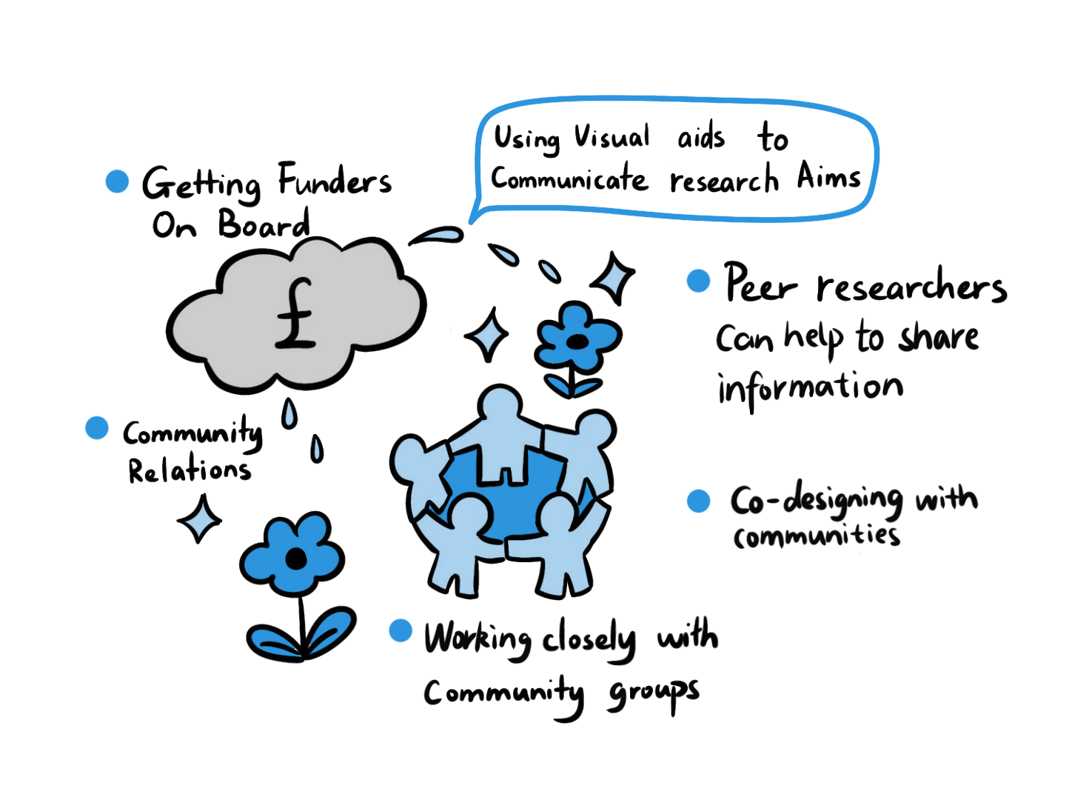
Solutions agreed by Health Professionals and Community Members
Co-designed resources to educate health professionals made with communities to address lack of cultural awareness and knowledge intersectionality
More trained and empowered peer-researchers
Introduction of grant applications which are conditional on demonstrating addressing barriers/ cultural awareness.
Educating university ethics committees about realities of researching with refugees and asylum seekers
Educating gatekeepers i.e. receptionists about diverse communities
More accessible materials for diverse communities about both health research and the NHS, including visual aids.

Slide 9
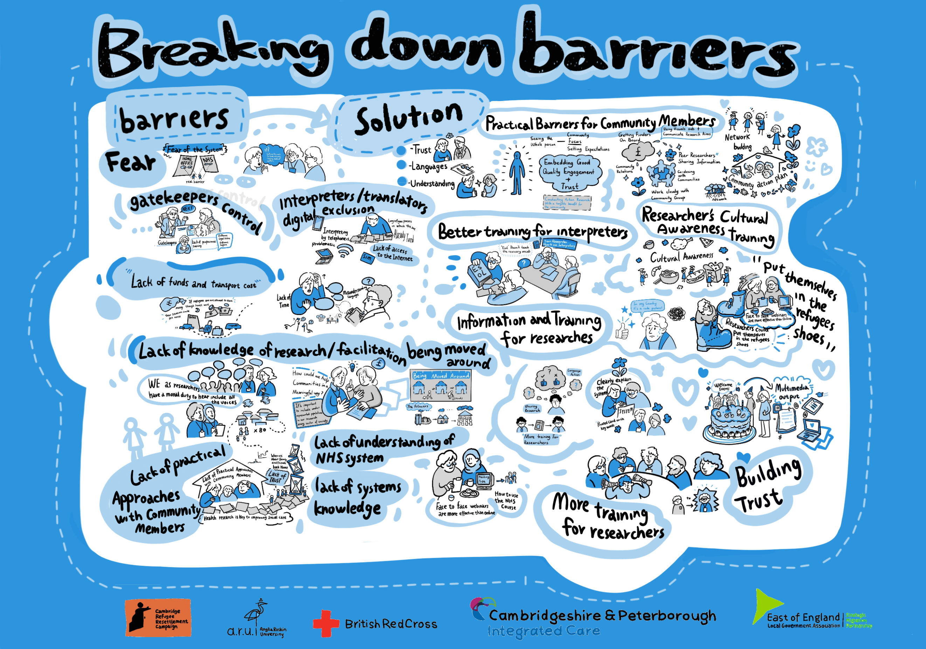
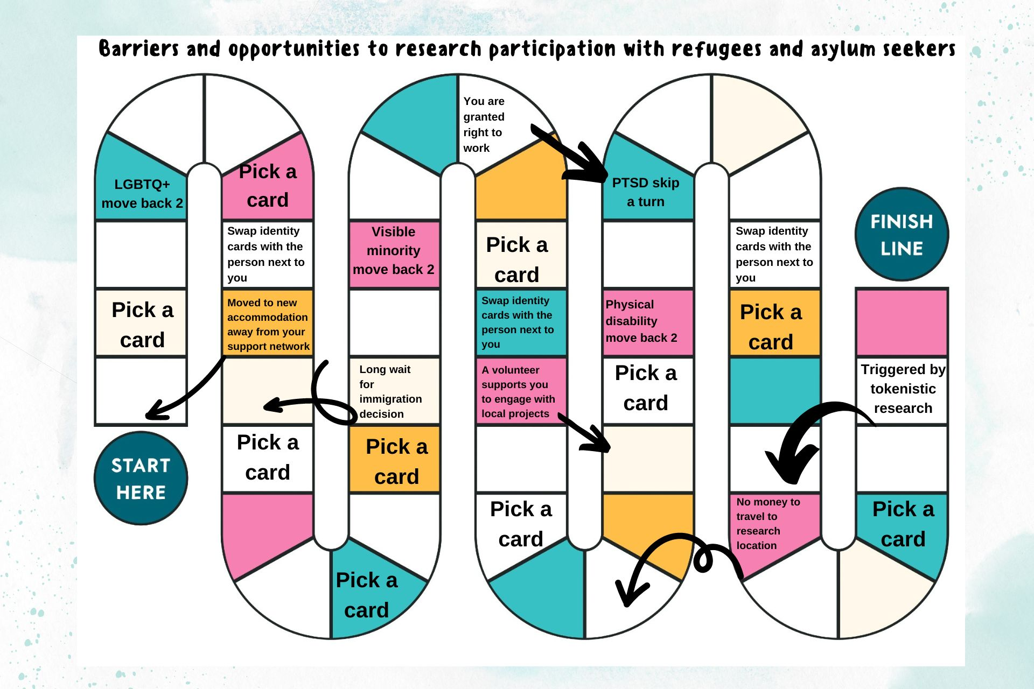
Outputs
Snakes and Ladders game
Jigsaw of barriers
Project report
Action plan
Infographic
Images from live scribing

Slide 10
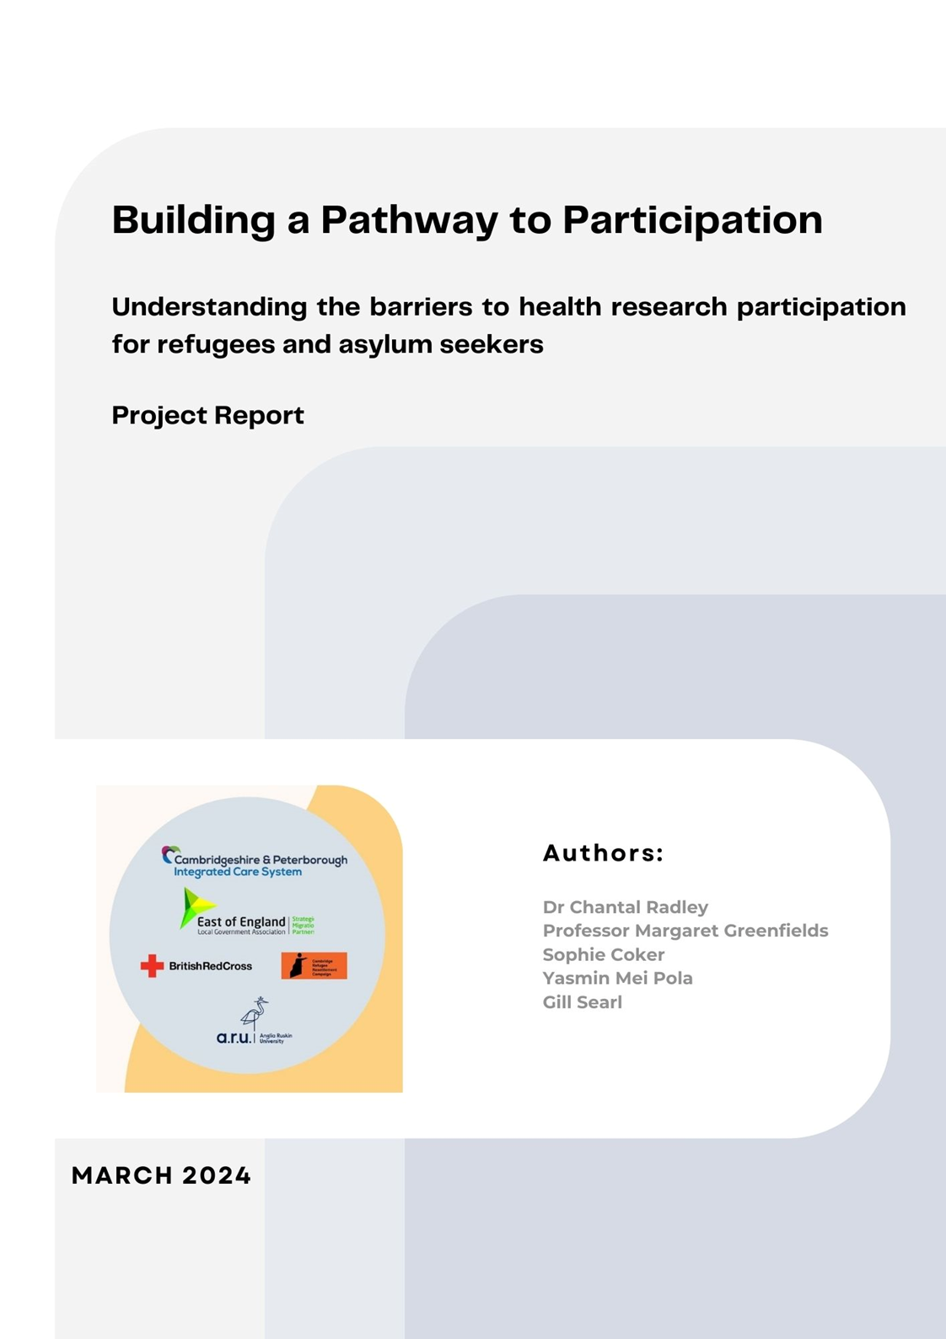
The Report can be found here: https://doi.org/10.25411/aru.25724301.v2 https://aru.figshare.com/articles/report/Building_a__Participation_understanding_the_barriers_to_health_research_participation_for_refugees_and_asylum_seekers_-_a_project_report/25724301/2

