Slide 1

A Web-Based Decision Support Tool for Integrated Care
Eren Demir¹, Richard Hammond² ,Jennifer Beard³, Usame Yakutcan¹, Zichong Lyu¹, Mark Lim², Alison Studer², Laura Moore⁴, Carol Smith⁴, and Rebecca Cornish⁵
¹Hertfordshire Business School,²Hertfordshire and West Essex ICB, ³University of Hertfordshire, ⁴East and North Hertfordshire NHS Trust, and ⁵The Princess Alexandra Hospital NHS Trust
June 2024

Slide 2

Current Landscape
Overview
    HWE ICS supports 1.6 million people
    Complex healthcare system with multiple referrers, providers, and clinical pathways
    Lack of standardized pathways across the system.
  Current Situation
    178,702 people on the referral to treatment waiting list
    Some patients waiting in excess of 18 months
    Expected surge in demand for healthcare services in 2024/25:
  735,298 new outpatient visits
  1,159,172 follow-up appointments
  606,518 diagnostic pathways and elective treatments

Slide 3


Primary Challenge
Escalating demand for healthcare services leading to mounting waiting lists and surge in outpatient visits, diagnostic tests, and elective treatments
Multifaceted challenges across resource management, including:
    Staffing
    Theatre availability
    Bed capacity
    Clinic accessibility

Slide 4

Addressing Challenges
Need for scenario planning to manage planned care effectively
It will be necessary to model a range of possible scenarios, such as:
    Community diagnostic centres
    Elective hubs
    Changes in theatre sessions
    Improved patient pathways
  To alleviate waiting times and minimize disruptions caused by other system pressures.

Slide 5
Aims
Therefore, our core aim is to create a versatile and impactful web-based Decision Support Tool, hosted on NHS Servers, to tackle these critical challenges in HWE ICS.
This tool aims to evidence the potential impact of changes before their practical implementation, ensuring informed decision-making.
Our ambition is for this tool to ascertain the most beneficial and efficient interventions, prioritising patient-centred care, improved patient outcomes, and effectiveness.

Slide 6
Key Objectives
The web-based DST accessible on any device, will address pivotal questions, including but not limited to:
Do we have a demand-capacity gap at either specialty or Trust level based on current trends and at what stage of the pathway?
What impact could change in referral patterns have on our waiting lists, yearly activity planning and recovery planning?
How will current and future transformative changes impact the Trusts?
What constitutes an optimized and essential workforce?
How will changes, such as innovative care models and altered operational methodologies—like modifications in theatre sessions—affect quality and productivity?
Which interventions will enhance efficiency, effectiveness, capacity, and cost-effectiveness?
How can we use population health demographics to plan healthcare provision?
In what ways can we mitigate health inequalities and improve outcomes across demographic groups?
How do we identify the required number of non-human resources—such as diagnostic equipment, beds, theatre sessions, clinics, etc.—to meet current and future demands effectively?

Slide 7
The Developmental Process
    This tool will be customised to capture the system wide patient pathway, to support integration care-friendly policies and interventions.
    This will involve
Qualitative Mapping
Data Collection and Analysis
Development
Evaluation and Deployment

Slide 8
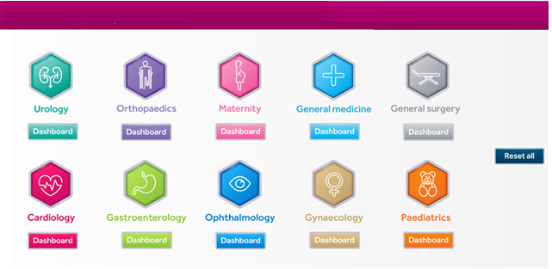
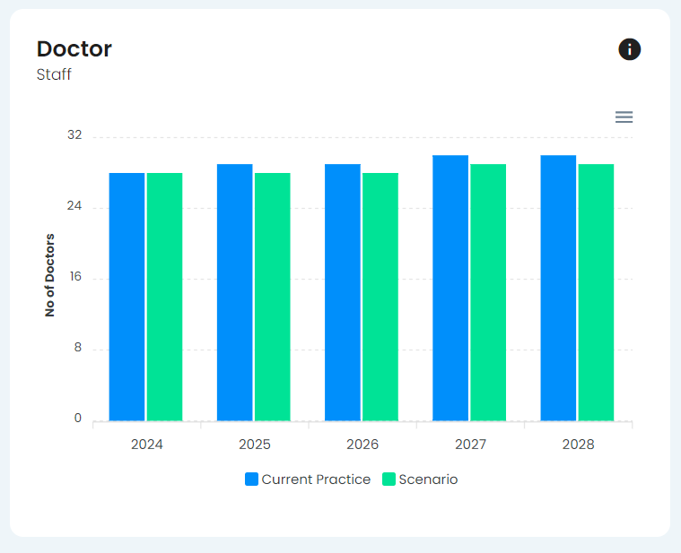
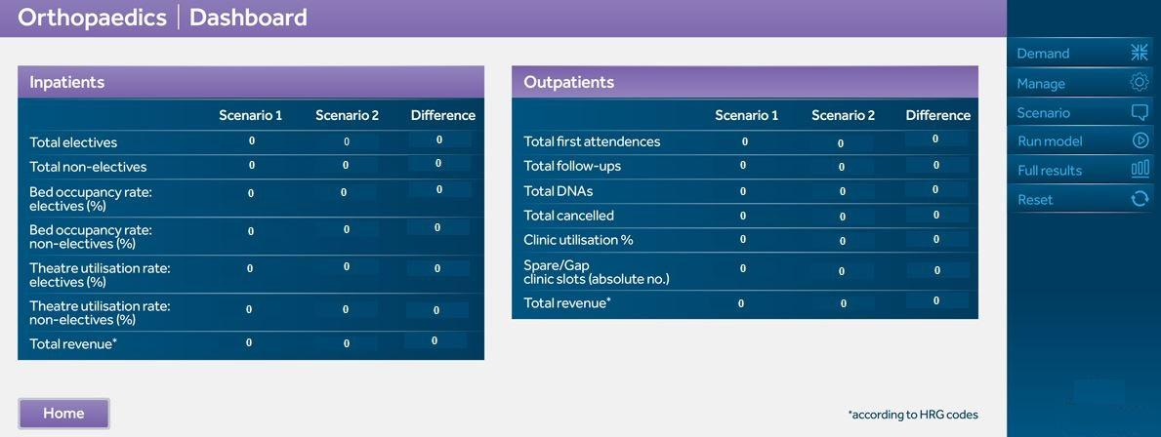
Web-based DST (An illustration)

Slide 9
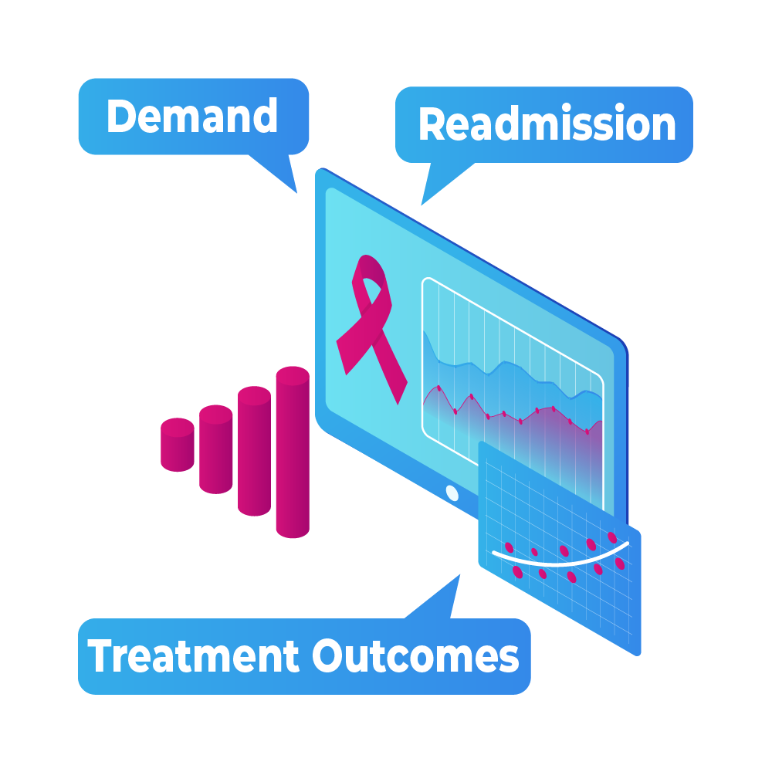
Outputs

Slide 10
Outcomes
  Outcomes expected from the web-based DST are as follows:
  Reduced waiting list size and wait for patients.
  Reduction in potential harm to patients and disease progression due to shorter waiting times.
  Improved utilisation of capacity in Outpatients, Diagnostics and Theatres.
  Move towards more system standardisation for clinical pathways reducing unwanted variation across the system.
  Financial benefits – better use of capacity, which could be reduced and closed or used for unmet demand.
  Wider social economic benefits with patients being able to return to society sooner.
  Workforce supports the system strategy of Right People, Right Place every time.

Slide 11
Scaling
  We plan to validate the tool's effectiveness through local testing, ensuring its readiness for deployment.
  The solution will be adaptable for easy customisation to other ICSs when required, offering the opportunity for national scalability.
  This presents an opportunity for greater savings by eliminating the need for purchasing individual user licenses and software usually priced between £5,000 to £20,000 per license (per user). This excludes annual expenses for cloud-based server fees, ranging from £50,000 to £500,000 per year.
  If the solution is scaled, a very high return on investment.

Slide 12
Thank you, any questions?

