Slide 1



A Short Guide to Best Practice for Research Ethics Committees – working with under-served populations : assessing research proposals involving Inclusion Health Communities
EPIIC Conference 2025
Margaret Greenfields and Sophie Coker

Slide 2
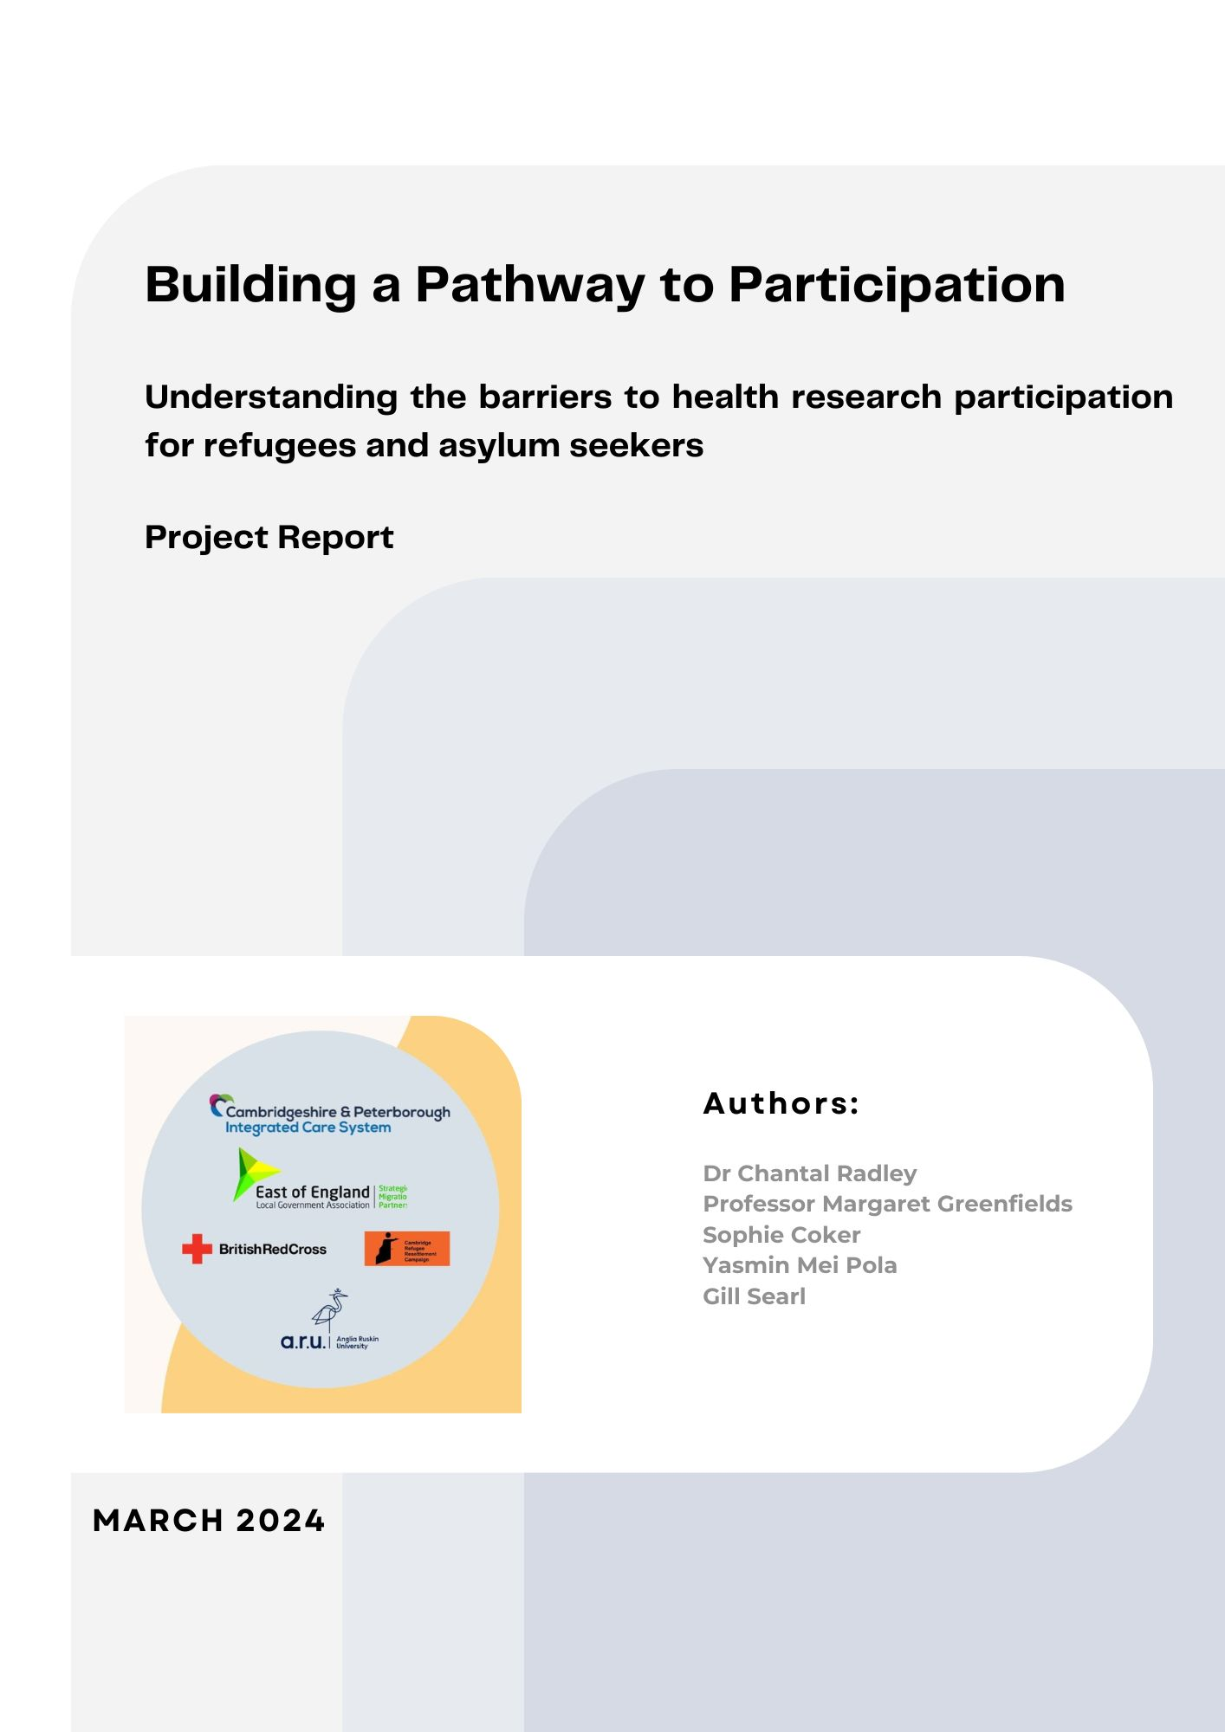
Project Context
A previous CPICS REN project (Radley, Greenfields et al, 2024) identified the need for guidance for Research Ethics Committees (RECs) to support effective research with inclusion health (IH) communities
A regional REN showcase event in July 2024, hosted by CPICB, demonstrated wide-spread support for the idea of designing guidance briefs, as multiple REN members and partners reported faced barriers to conducting meaningful research with IH community groups as a result of lack of knowledge, or over-caution expressed by REC members.
Notes:
A key finding pertained to barriers to, and delays in, commencing research with communities emerging from misunderstandings by ethics panels unfamiliar with refugee and asylum-seeking populations (Radley et al, 2024, p.47)
Researchers also highlighted the issue of inadequate cultural competency within university ethics panels, and that that panels frequently fail to draw on external experts who could comment on the feasibility and design of applications to support engagement in a safe and meaningful manner. Participants repeatedly expressed concern that ethics panel members tend to err on the side of caution, potentially constraining researchers' capacity to engage in collaborative co-design and Patient and Public Involvement (PPI) initiatives. Furthermore, researchers commented that they felt that a significant lack of awareness exists amongst ethics panel members regarding the rights to health access, right to work and migratory status impacting refugees and asylum seekers. One participant commented that this lack of understanding can result in the refusal of applications if researchers attempt to justify the need to compensate community researchers or participants for their valuable time and contributions, particularly if using vouchers rather than standard financial remuneration (Radley et al, 2024, p.48).

Slide 3

‘Given the emphasis on the way in which ethics committees can inadvertently have a blocking effect on research with refugees and asylum seekers; online guidance materials should be developed by researchers with experience in undertaking effective co-production with such populations for dissemination to ethic committee members, to support discussion and inform panel members about relevant research and engagement issues and how researchers can effectively, safely and ethically overcome barriers’ (Radley, Greenfields et al, 2024, P.68).

Slide 4

Quick Note on Terminology?
Inclusion Health Groups: an umbrella term used to describe people who are socially excluded, who typically experience multiple overlapping risk factors for poor health, such as poverty, violence and complex trauma. This includes people who experience homelessness, drug and alcohol dependence, migrants without regularised status, Gypsy, Roma and Traveller communities, sex workers, people in contact with the justice system and survivors of modern slavery (NHS, 2025).
Under-served Groups: The term ‘under-served’ groups was popularised by the NIHR (National Institute of Health Research - UK) in a 2020 publication which highlighted that some groups of people are included in health research less often than one would expect based on their population prevalence or health care needs/burden of ill-health. As a result, there is much less information on the treatment and service needs of these individuals. There is no single definition of what is 'under-served', rather this is highly context-specific

Slide 5
What is the role of RECs?
Research Ethics Committees (RECs) play a crucial role in protecting research participants and ensuring studies are conducted ethically and responsibly (NHS, 2023). However, healthcare research today faces intense competition, pressure for productivity, limited funding, and a market-driven focus on efficiency—factors that can threaten research quality and integrity (Drolet et al., 2023; Goedhart, 2021; Academy of Medical Sciences, 2022). It is within this landscape that RECs assess research proposals to ensure ethical compliance in participant recruitment, data handling, and dissemination.
Sieber (2004) identifies five key ethical concerns relevant to RECs:
communication with participants and communities,
data collection and use,
external influences on research,
balancing risks and benefits, and
choosing appropriate research methods and theories.

Slide 6

Structure of the Research?
Building on previous work and cited demand
Drafting a guide for RECs from knowledge and experience of conducting health research with IH populations
Send to critical readers – expert researchers and individuals from REC panels working in both academic and clinical settings
Re-circulate revised guide
Convene consultation meeting / online dialogue/interviews with critical readers to discuss further as required
Amend and re-design as required based on feed-back.

Slide 7
Additional Mini Guides
Four additional Mini Guides for RECs specifically assessing research with:
GTRSB Communities
Homeless People
Individuals seeking asylum or with refugee status
People with impaired mental capacity

Slide 8
Main Guide has five top tips
Assessing Risks in Context and Across Different Life Experiences
Timeliness and Flexibility in Approvals
Supporting Researcher Training in Cultural Competence
Balancing Incentives with Agency
Facilitating Inclusive Methodologies

Slide 9
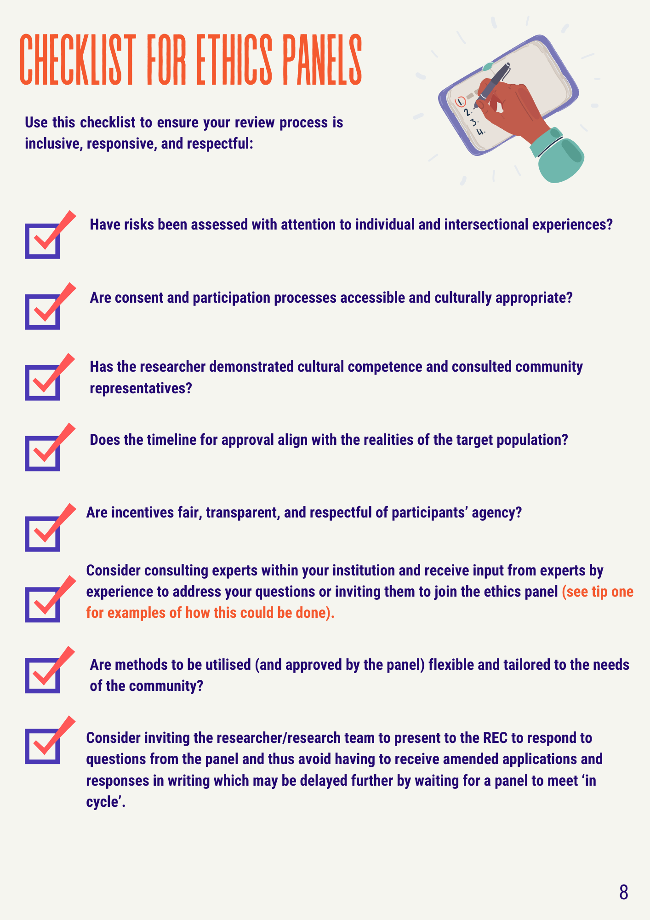
Checklist
Working together with REC panel members with significant experience, specialists/experts and researchers to create a checklist to help panels assess research proposals involving IH communities
9

Slide 10
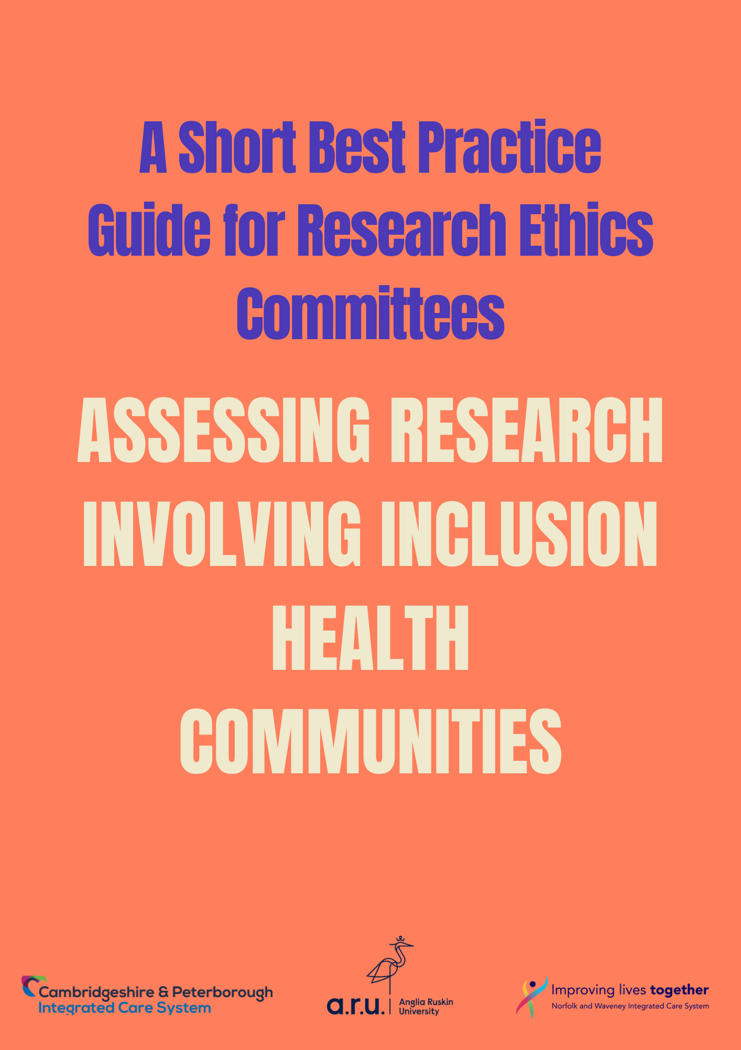
Any Questions?
Margaret.Greenfields@aru.ac.uk
Sophie.Coker@aru.ac.uk

Slide 11
Co-creating asset and place-based approaches to tackling refugee and migrant health exclusion
(MigRefHealth)

Slide 12


Background
Funded through UKRI ‘Collaborative Community Research to Tackle Health Inequalities’
To create and test collaborative models for the integration of cultural, community and natural environment assets into health and care systems.
The aim is to create healthier communities and environments across the UK.

Slide 13
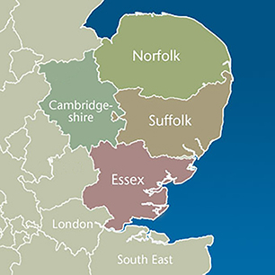
Three Regions:
Universitiesworking with Community Partners
East of England Essex, Suffolk, Norfolk, Cambridge
Three Regions
Anglia Ruskin University
North
London Islington & Barnet
Middlesex University
South London Lewisham & Greenwich
13
Greenwich University

Slide 14
Community Partners
Lead Community Researcher | Role | Organisation
Tamara Joseph | Co-investigator | Barnet Citizens - Citizens UK
Catherine Walston | Co-investigators | Cambridge Refugee Resettlement Campaign
Louise Gooch, Gill Searl and Farsh Raoufi | Co-investigators | East of England Local Government Association
Ligia Macedo and Louise Humphries | Co-investigators | GYROS
Alan Robertson | Co-investigator | Lewisham Refugee & Migrant Network
Sue Lukes | Co-investigator | Migration Work CIC
Kirit Sehmbi | Co-investigator | The Queen's Nursing Institute
Additional advisory partners are Essex County Council and New Citizens Gateway

Slide 15



Core Areas of Research
Accommodation
Food/Nutrition
Support Services

Slide 16
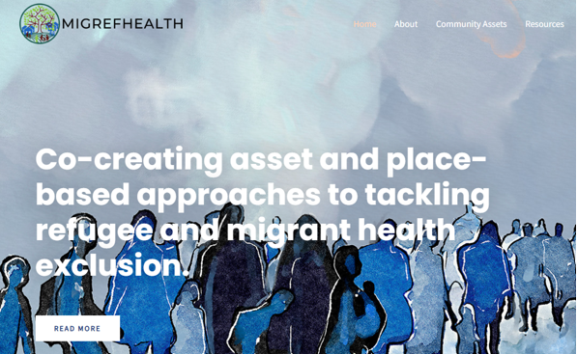
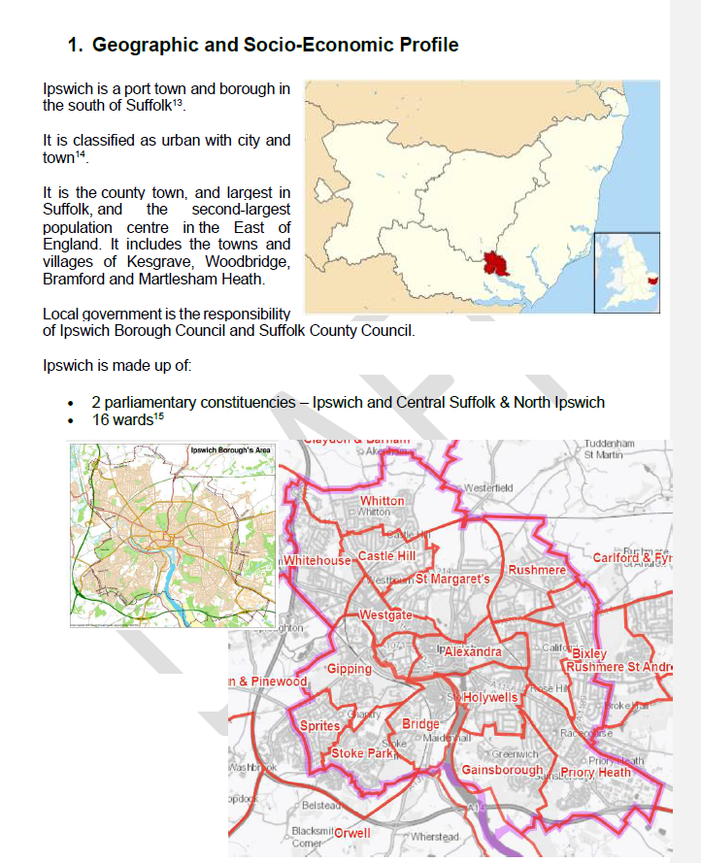
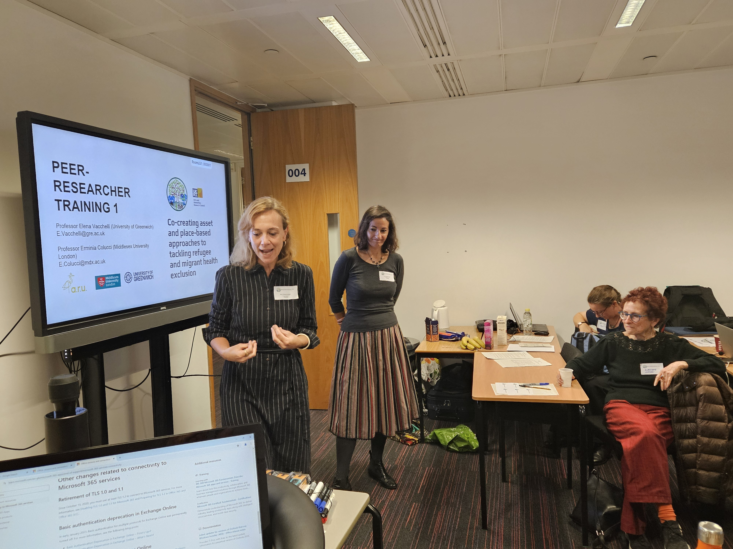
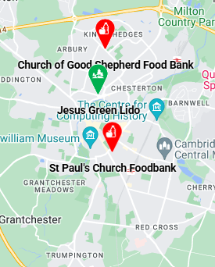
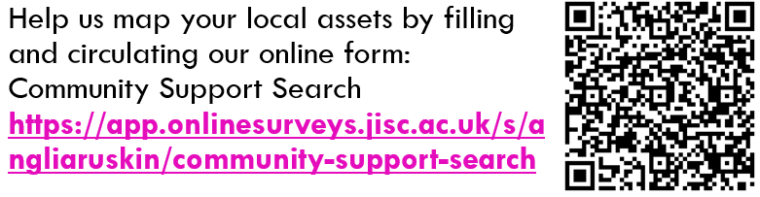
Project progress year 1
CCR recruitment, training and 75 walking interviews completed
Website, map v1, field site profiles, preliminary interviews and asset mapping forms completed. www.migrefhealth.co.uk
Margaret Greenfields – project as at 12/3/25

Slide 17
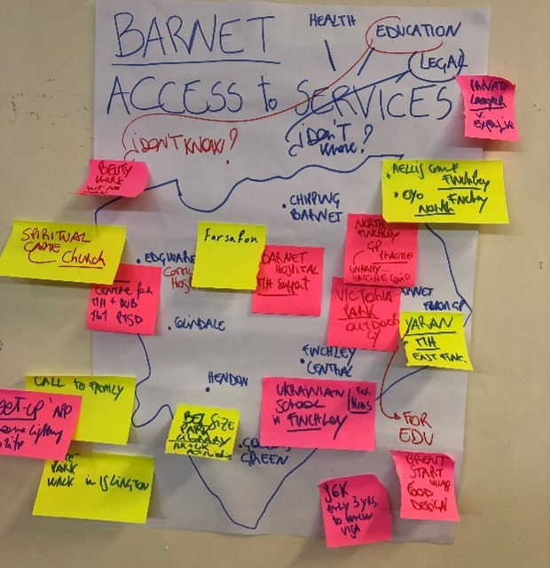
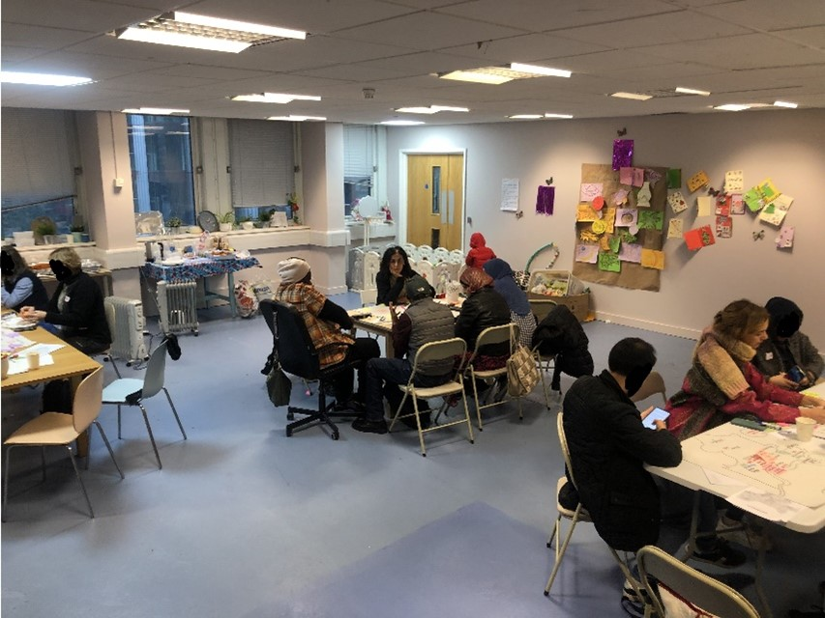
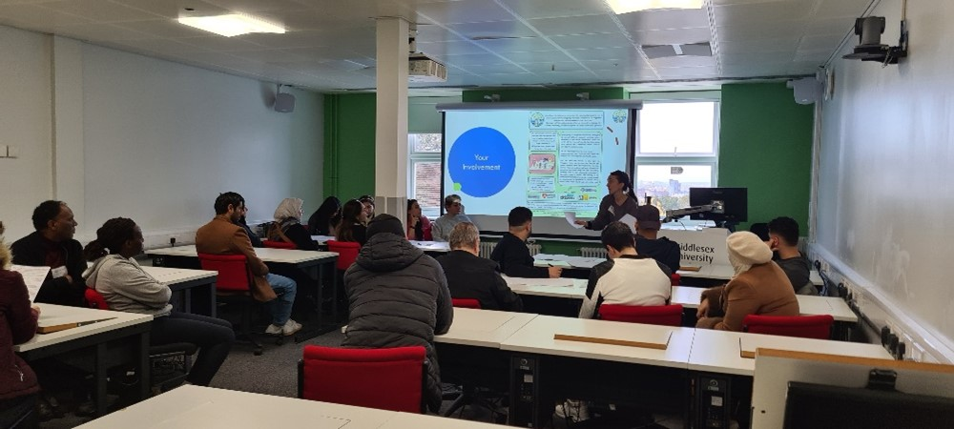
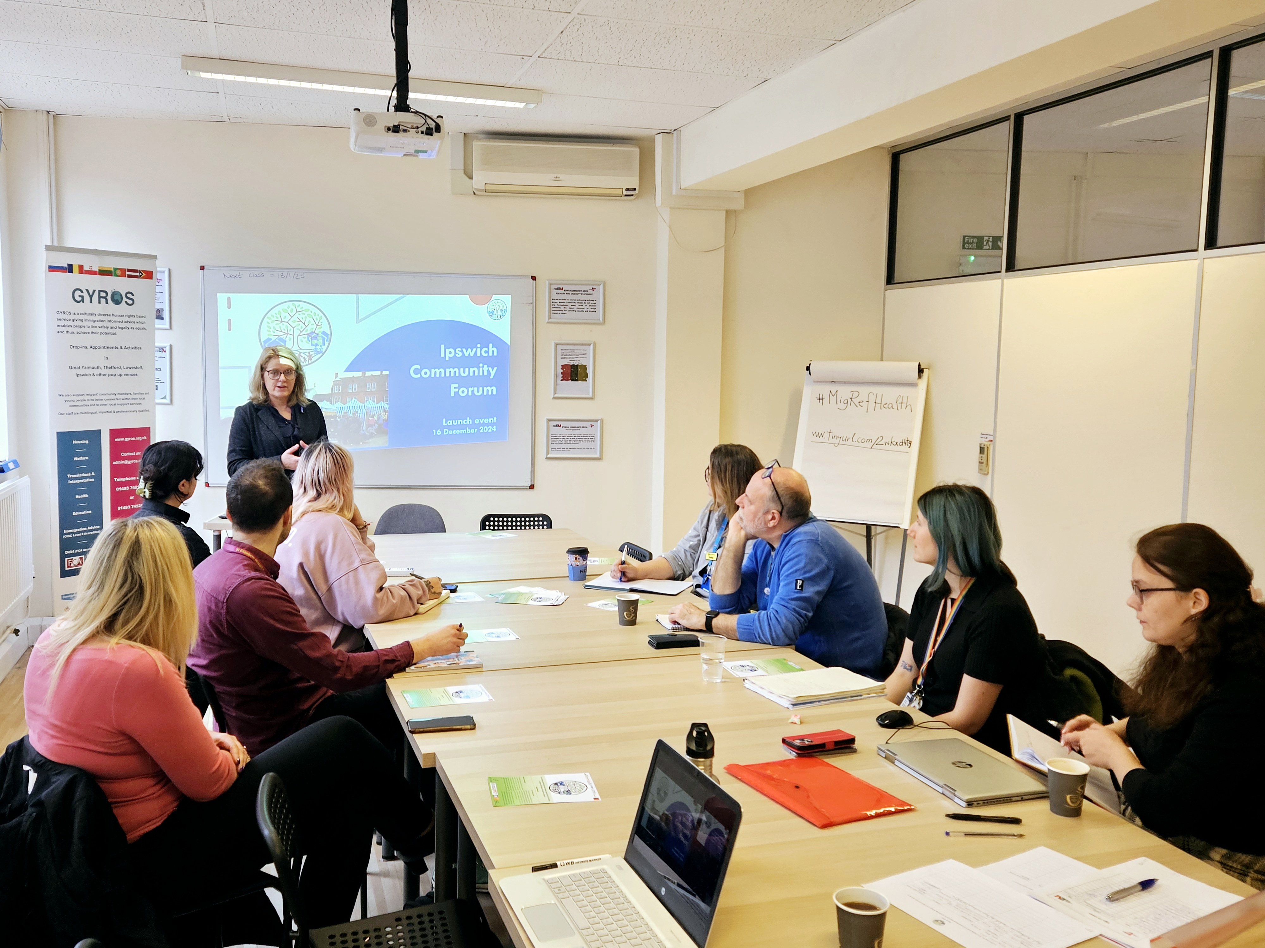
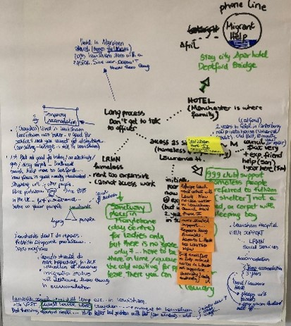
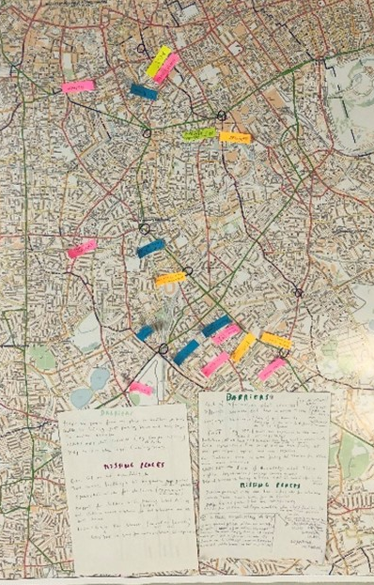
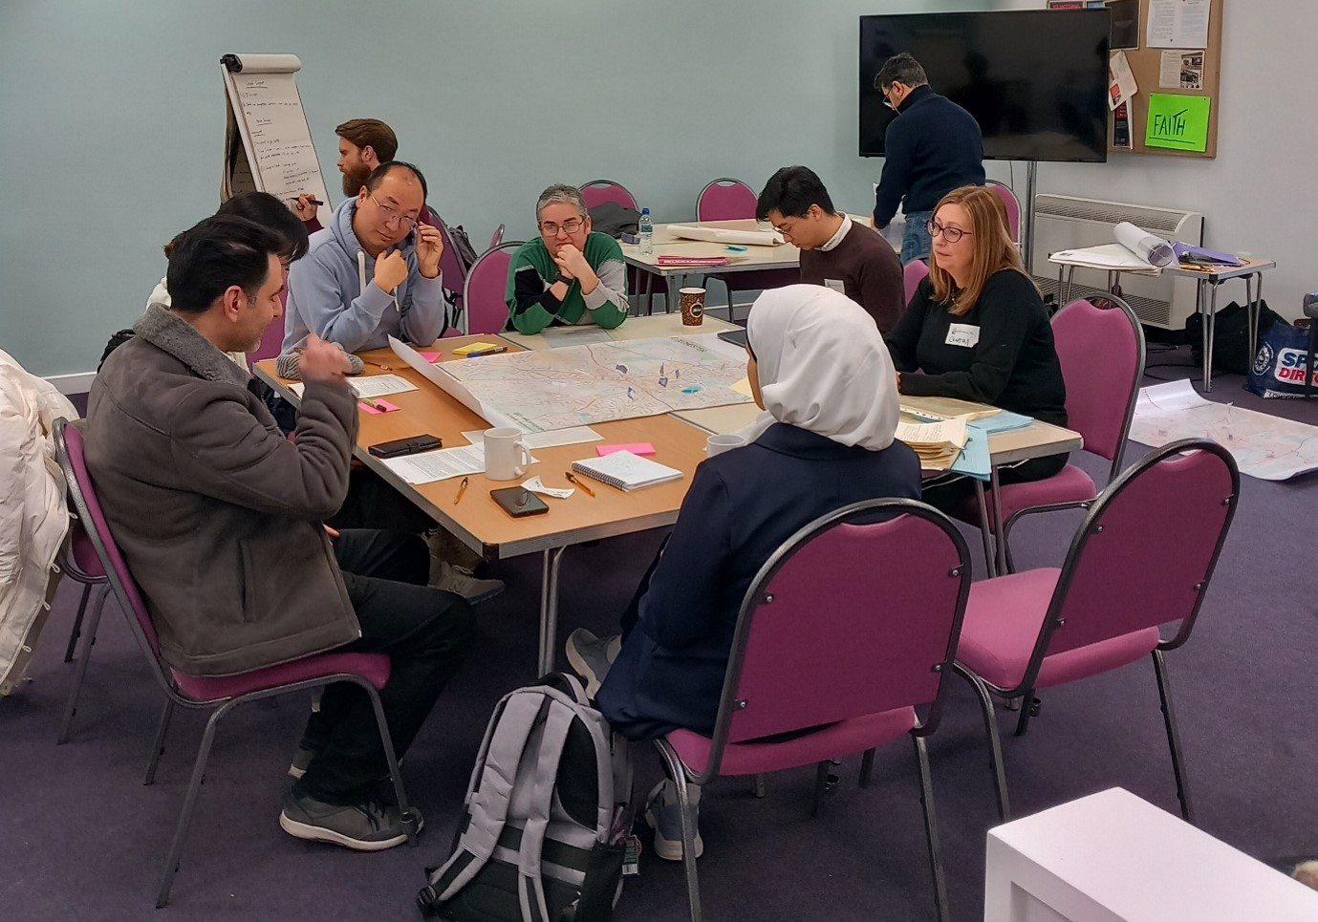
Project progress
Project launches and 2 focus group sessions almost all completed in the 12 fieldsites, with the 4 core plus EU and non-EU groups.
Data analysis now starting…..
Margaret Greenfields – project as at 12/3/25

Slide 18
Getting Involved (Spring/Summer 2025)
……..
Our 8 East of England Field-Sites:
Lowestoft and Great Yarmouth
Ipswich and Norwich
Peterborough and Cambridge
Colchester and Weathersfield Adjacent (Braintree)
will each be holding stakeholder engagement events between May and July as well as continuing with our creative data-gathering sessions with participants.
Please contact our project manager Natalie Bignell at admin.migrantrefugeehealth@aru.ac.uk
or speak to Principal Investigator Margaret Greenfields
Margaret Greenfields – project as at 12/3/25

Slide 19


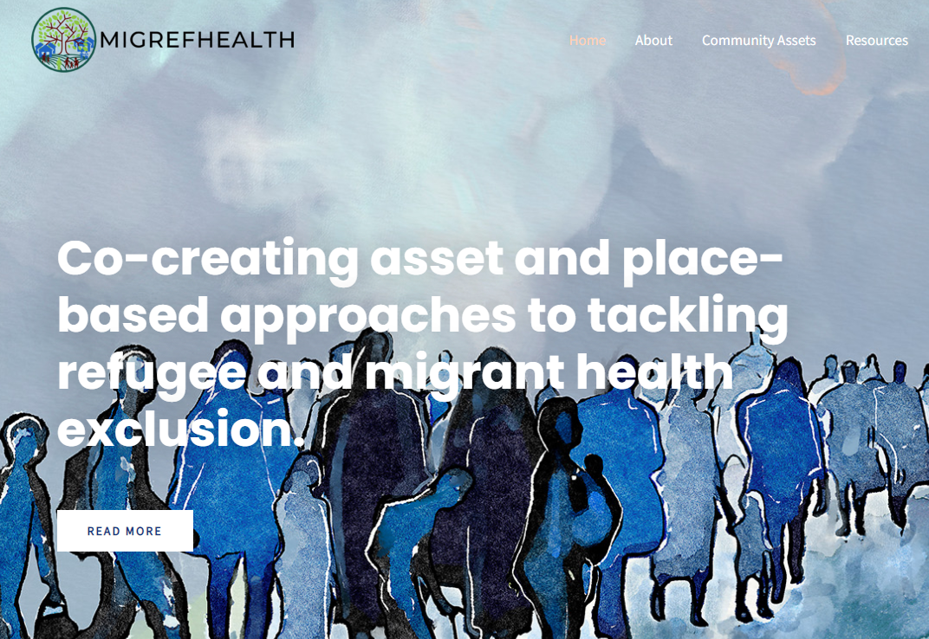
Find Out More
https://x.com/migrefhealth
www.migrefhealth.com

Slide 20
Any Questions??
Margaret Greenfields
margaret.greenfields@aru.ac.uk

