Slide 1
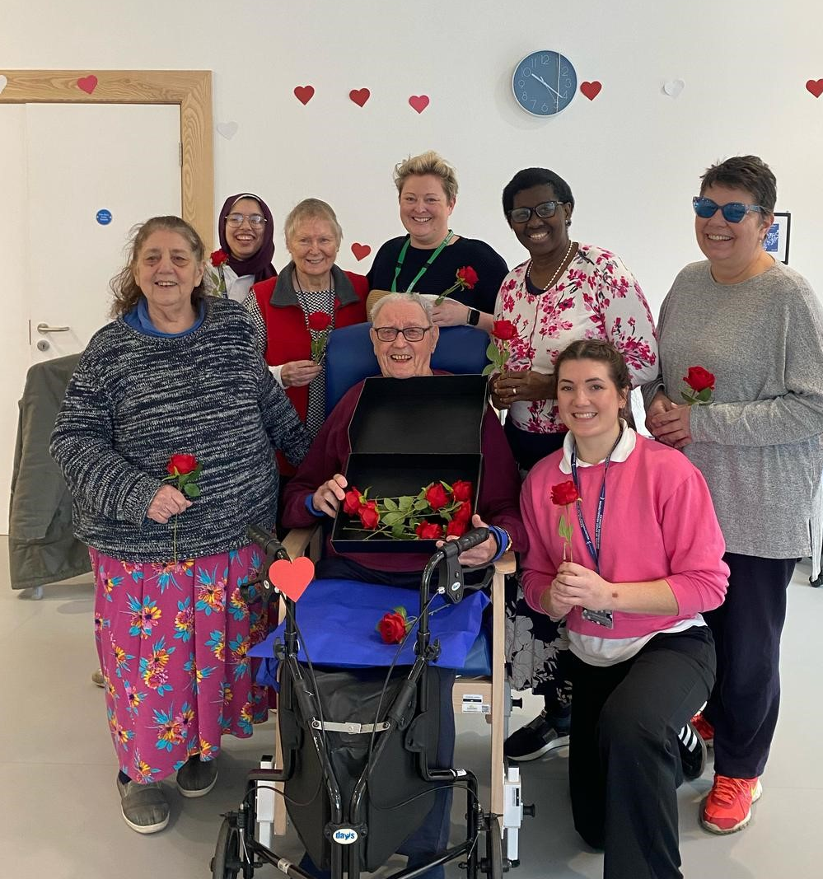
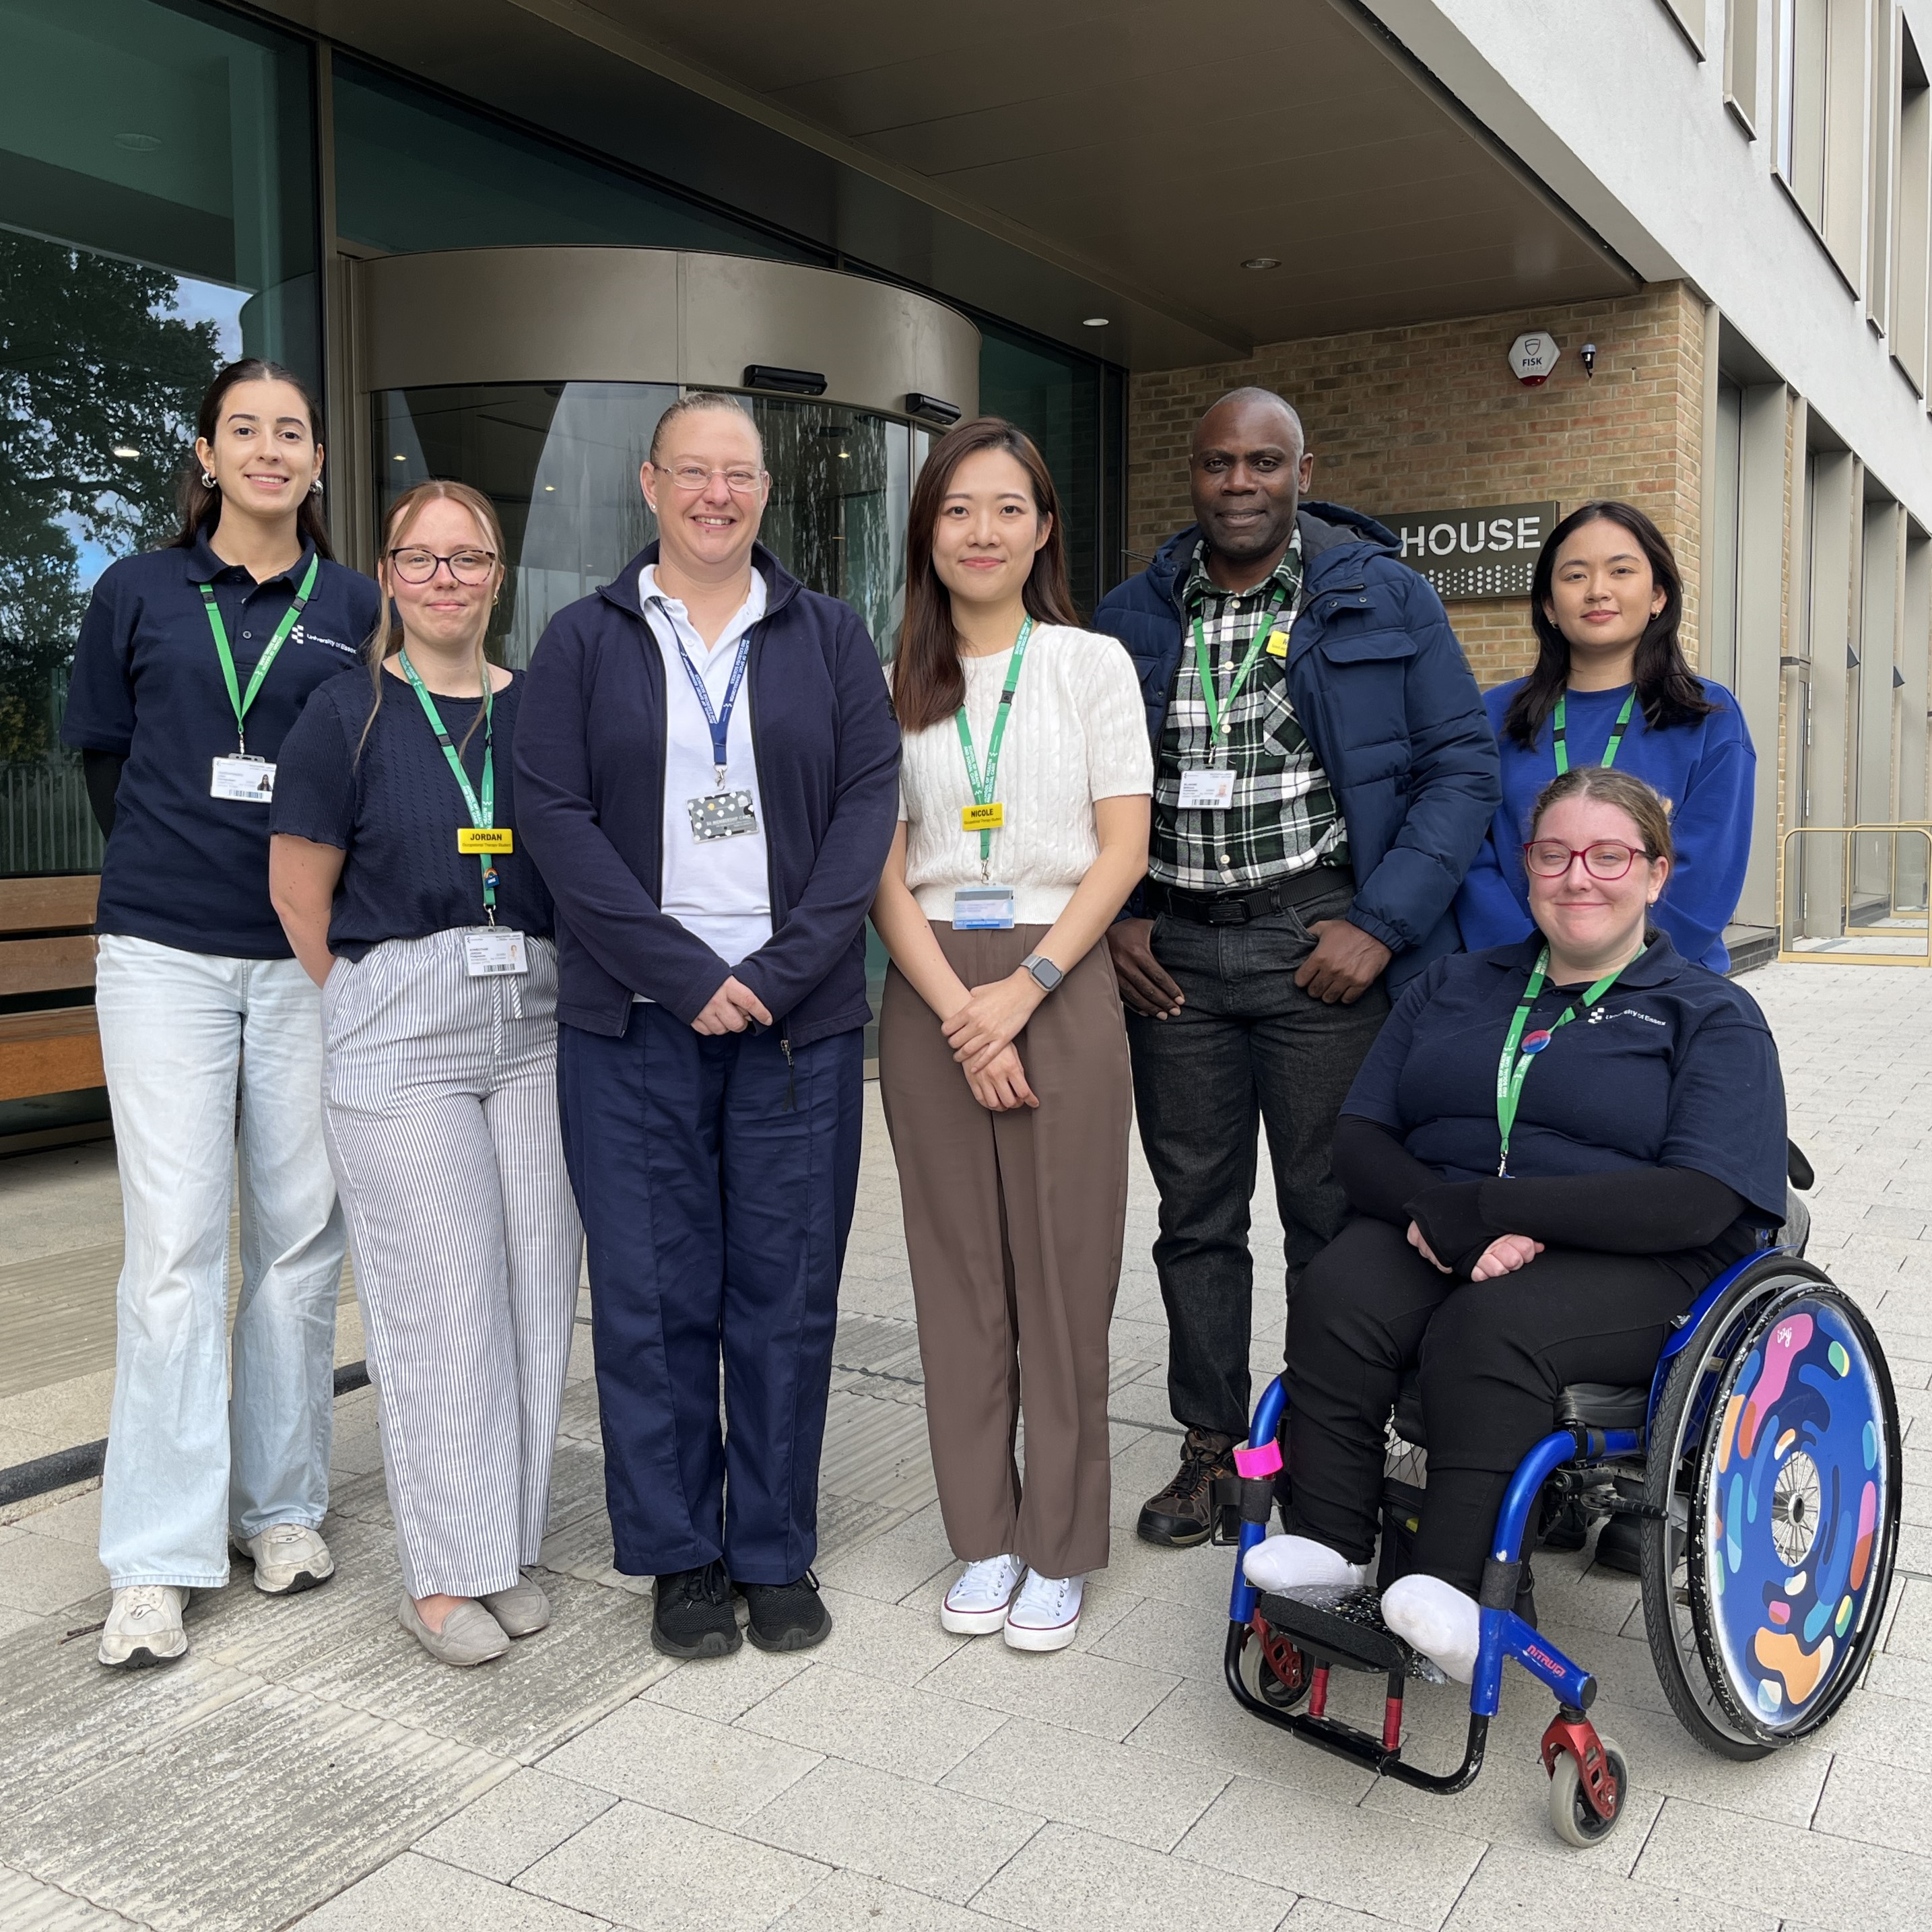
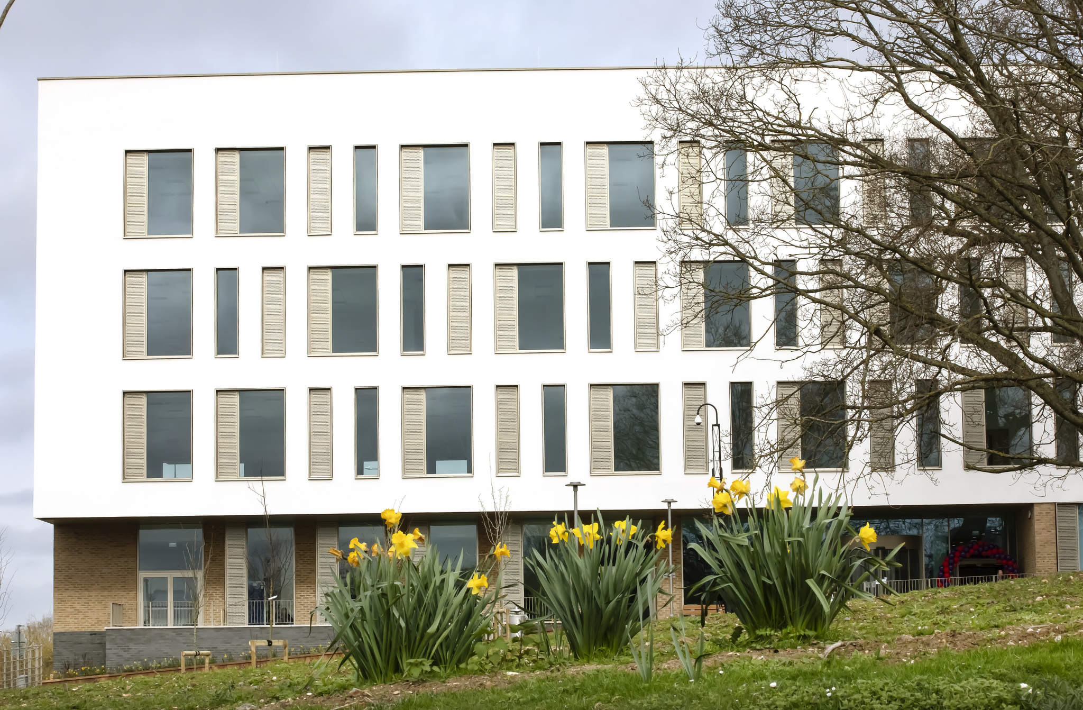
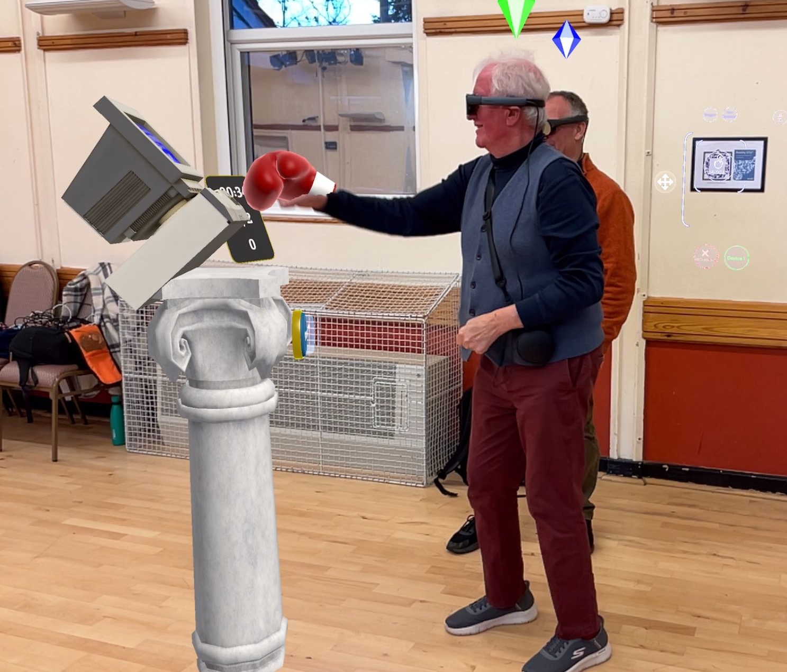
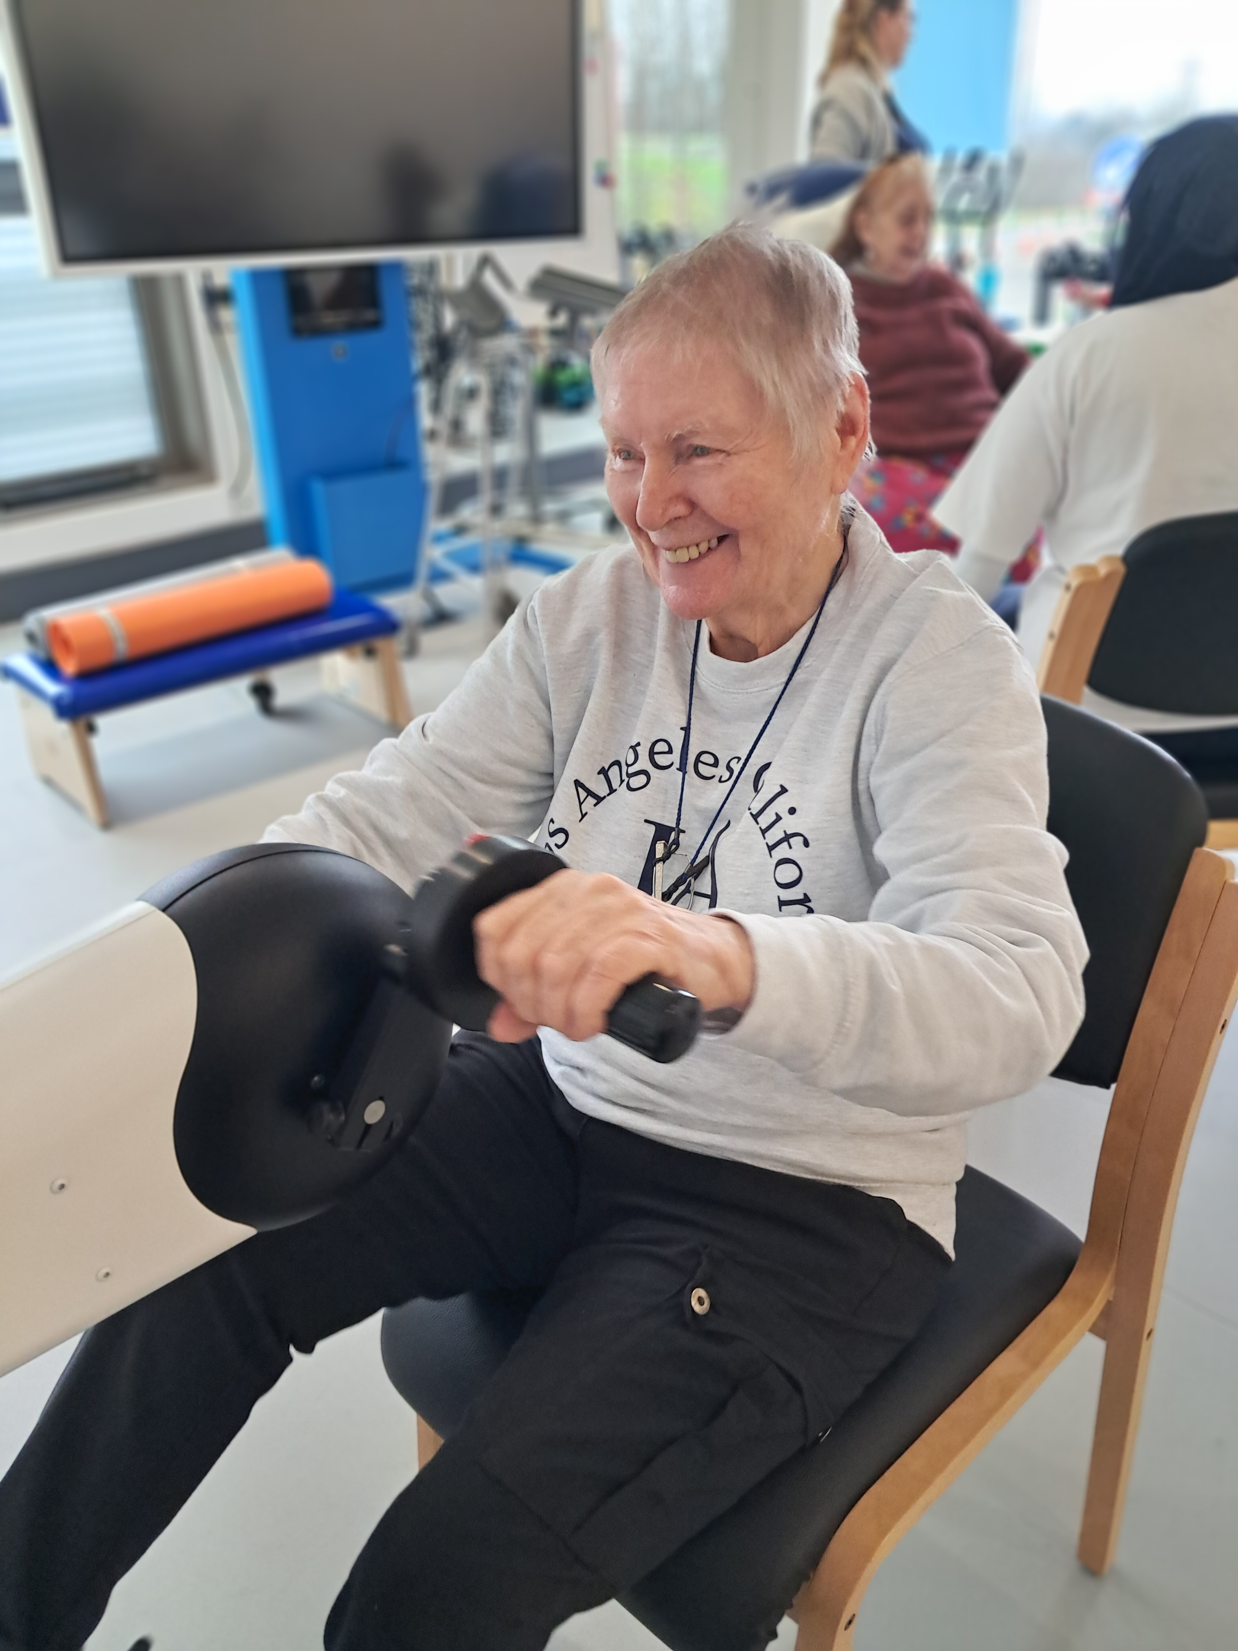
Health, Wellbeing and Care Hub

Slide 2
Health, Wellbeing and Care Hub
Workforce Development
Service Provision
Clinical Research
The Three Pillars

Slide 3
Themes
Promoting Mental Health and Wellbeing
Communication Support
Knowledge Exchange
Facilitating Mobility
Enhancing Cognition
Negotiating Life
Health, Wellbeing and Care Hub

Slide 4
Student and Service Update
Supported 62 AHP and nursing student placements since January 2024 to date (including 3 x physio students from UoS and in discussions with ARU to take their students)
Offered internships to BSc psychology students
80 new referrals accepted from the community
690 clinical care contacts completed (22% of these were online clinics)
Commissioned to provide a pro-active frailty service via SNEE ICB in collaboration with Tendring Community Transport Service

Slide 5
Services Mobilised
Move and Meet – Group
Upper limb – Group
121 Physiotherapy – adults, including augmented reality (Strolll)
121 Occupational Therapy – adults
121 Speech and Language Therapy – adults and children (including working in mainstream schools)
Neuro-online clinics – NROC
Elective home education project
Adults with developmental language disorder service
Wiggle and Words
NHS health checks – Nursing students

Slide 7
CPD Activity
Hosting termly Hub lecture series
Supporting Essex Babylab parent coffee mornings
Delivered full day CPD event in collaboration with Babygro and Psychology school
Regular evening seminars/webinars via Eventbrite

Slide 8
Developing Child Trauma Awareness: Trauma Causes, Effects, and Interventions
Carol Westby, PhD, CCC-SLP
Bilingual Multicultural Services
Albuquerque, NM 87106
mocha@unm.edu

Slide 9
CPD Activity
Hosting termly Hub lecture series
Supporting Essex Babylab parent coffee mornings
Delivered full day CPD event in collaboration with Babygro and Psychology school
Regular evening seminars/webinars via Eventbrite
Commissioned to provide online education to Sussex NHS Trust in offering online rehabilitation clinics

Slide 10
Research Opportunities
Part of UoE Impact Academy Leadership Forum
The Hub estate is being costed into pan-University research grants
NIHR grant to host an ‘Acquired Brain Injury Social Care Network’ as part of the family of NIHR research incubator - PhD student to be hosted in the Hub
Promoting undergraduate and postgraduate research projects
Well-established links with Healthwatch Essex

Slide 11
Research Opportunities
Clinical research interest from national charities such as PDUK
SEND screening tool in collaboration with MSE ICB
Development of the POAT – Profiling Outcomes Across Time -outcome measures
Research Innovation: Children and young people (CYP) in care with social care services, adults with Developmental Language Disorder and CYP in elective home education.

Slide 12
Other Successes & Opportunities
Short-listed for two SNEE ICB AHP awards – one for innovative student placement delivery and the 2nd for student support worker of the year
Mobilisation of new service offers – co-produced with our communities
Submission of six abstracts to a national (Child Language Symposium - CLS) and international (International Association of Communication Sciences and Disorders - IALP) conference based on clinical research and practice undertaken in the Hub
Offering volunteer opportunities within clinical and administration services across the region and beyond

Slide 13
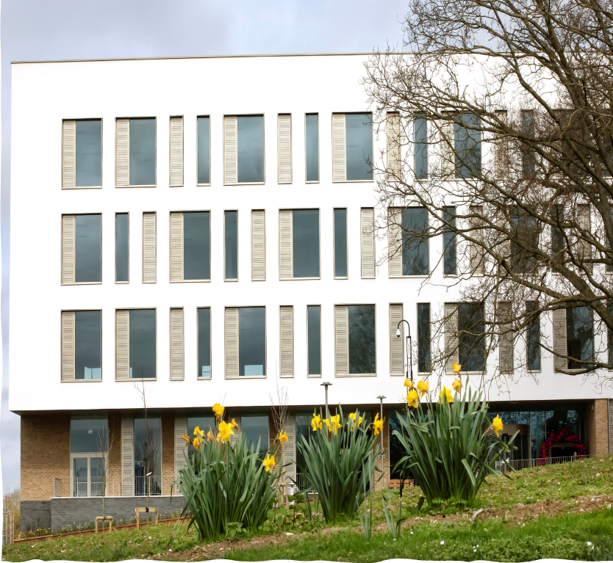
Thank You!
Get in touch
Health, Wellbeing and Care Hub
@EssexUni_HWCH
Health, Wellbeing and Care Hub | University of Essex
Clingoe House, Knowledge Gateway, University of Essex, Boundary Road, Colchester, CO4 3GS
Telephone: 01206872460
Email: healthwellbeingcare@essex.ac.uk

