Slide 1


University of Hertfordshire ICS Partnership
Research and Innovation
Hub update
Phillip Smith, Fiona Smith
Head of Research and Innovation
Hertfordshire and West Essex ICB)

Slide 2

The University of Hertfordshire Integrated Care System (UHICS) Partnership Programme Research and Innovation hub
19th March 2025

Slide 3
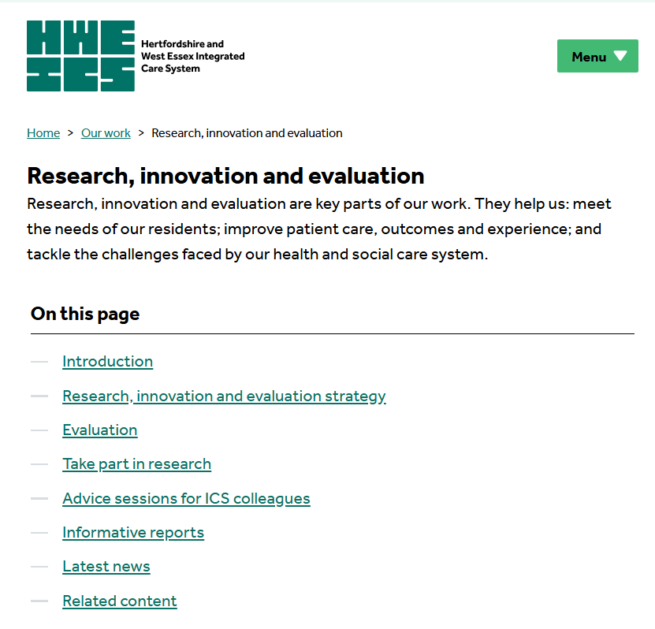
Purpose of this presentation
More details on
our public website
To give you an update on the Research and Innovation Hub
To promote awareness to colleagues across both the HWE ICB, the University of Hertfordshire and wider and stimulate discussion
We are very happy to discuss further, please contact us via hweicbhv.researchandinnovation@nhs.net

Slide 4

Purpose of the Research and Innovation Hub
To make the best use of the university's expertise to support the delivery of the Hertfordshire and West Essex Research and Innovation strategy.
The implementation of the strategy will bring several benefits to residents:
1) enhanced healthcare services,
2) more inclusive research,
3) increased community involvement,
4) more relevant workforce development,
5) improved health outcomes and
6) better economic benefits (which also promotes health outcomes).

Slide 5

The UH ICS funded support
2 x new research co-ordinator roles with 0.2 FTE managerial support
Having the co-ordinating resource based in Hertfordshire University further joins up the HWEICS research and innovation network providing access to the world leading research skills in the university.

Slide 6
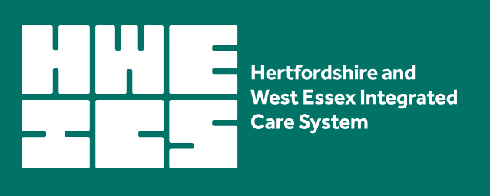
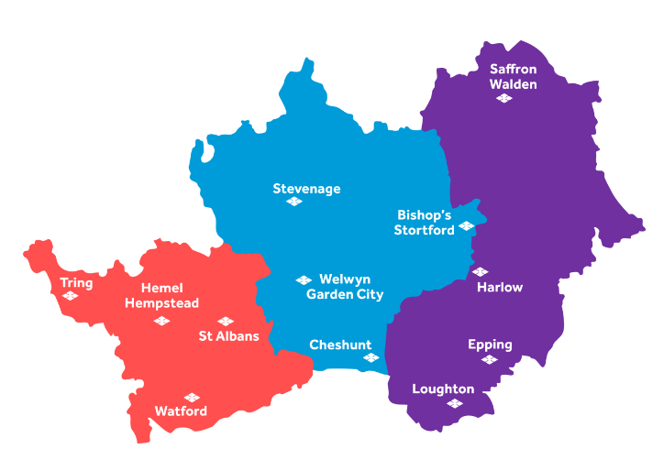
Hertfordshire and West Essex Integrated Care System
The H&EWE ICS plans and delivers health and social care services to just over 1.6 million.
The system brings together a wide range of organisations, committed to a shared vision of working together to improve the health and wellbeing of the people who live in our area.
H&EWE ICS has the ambition to become a national exemplar for the generation and use of research and innovation to enhance or redesign services to better meet our local priorities in a more inclusive way.

Slide 7
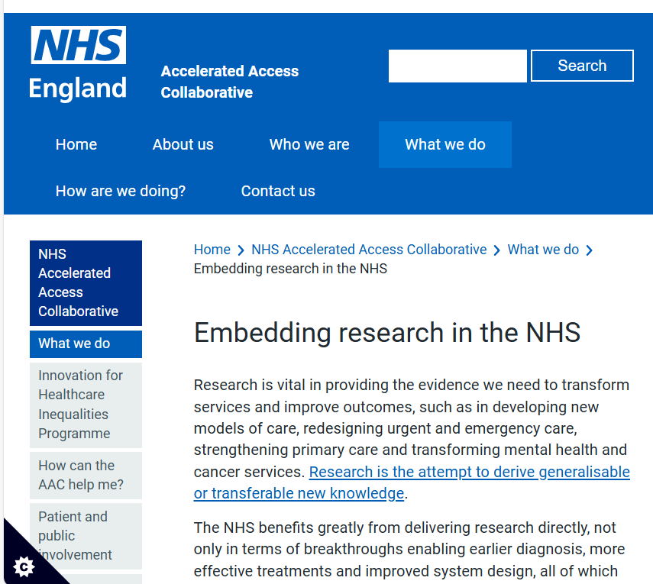
Legal duties on ICBs around the facilitation and promotion of research
The Health and Care Act 2022 sets new legal duties on ICBs around
the facilitation and promotion of research in matters relevant to the health service, and
the use in the health service of evidence obtained from research.
NHS England guidance available.

Slide 8
A theory of change to fill a gap…
2024 situation |  | NHS England expectation
A modest level of research (proportion of population) with < 60 % of research aligned with ICS priorities. |  | Do more research, particularly of local relevance to our residents
Most ICS organisations are research active Research participation is not currently inclusive |  | Improve system ability to deliver research for all people in all settings (especially Public Health)
Many expert individuals but gaps in many settings. No system-wide approach to workforce development. |  | Co-ordinate and develop the research workforce across all settings
No systematic use of research and innovation to enhance services and to support service redesign |  | Improve system ability to use research and innovation for better population health outcomes
H&WE ICS Research and innovation lead post funded but not yet filled. |  | Co-ordinate activity within and collaborate nationally to better meet local priorities and needs
Ability to generate external income; one-off additional resource needed to make step-change to financial sustainability. |  | Ensure financial sustainability
We want to bridge this gap for all residents in the Hertfordshire and West Essex integrated care system

Slide 9

Research and Innovation Hub to bridge the gap
ICB Research and Innovation lead
Virtual Research and Innovation Office
Research Engagement Network Development
Research and Innovation commitment from across the ICS and beyond (to include the public, service users, patients and residents)

Slide 10
Our two-year plan
Establish H&WE ICB Governance
Create the H&WE ICS Research and Innovation hub
Develop and implement a cohesive research and innovation strategy
Actively support and develop our existing research workforce, develop research capabilities where none currently exist and further expand research into non-NHS settings
Enhance our research portfolio to support strategic objectives, sustainability and a quality service to meet the research needs of key collaborators and stakeholders, especially public health
Achieve financial sustainability
Ensure effective communication to our partners and residents
Promote innovation to improve patient experience and help reduce particular pressures
Act on best practice recommendations to address specific inclusion barriers

Slide 11
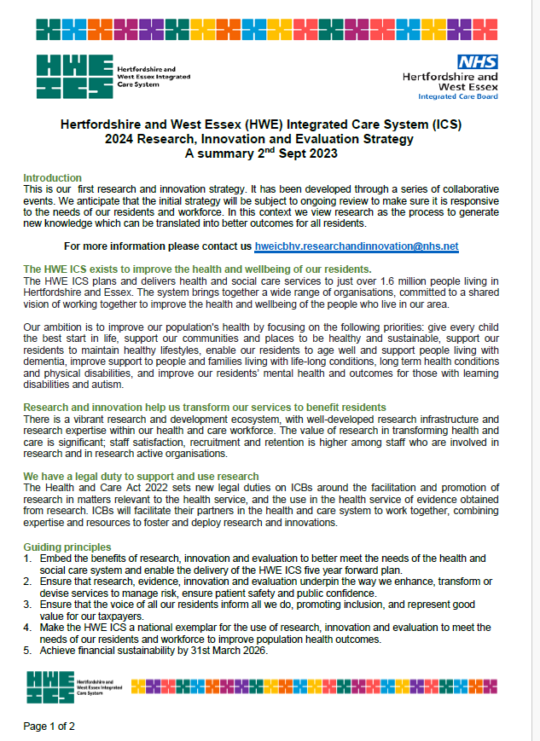
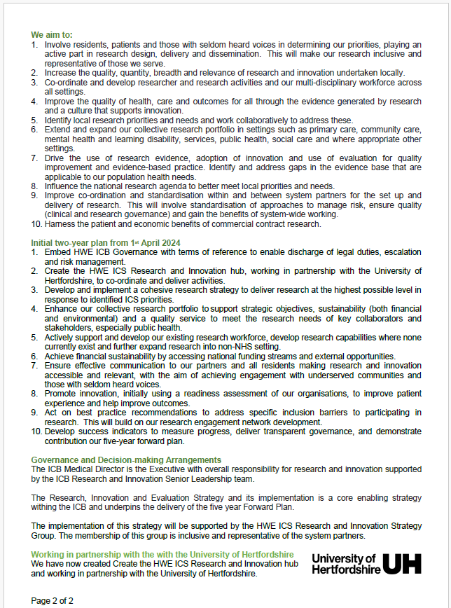
H&WE ICS Research and Innovation Strategy

Slide 12
Our practice of change
Turning ideas to action to impact to benefit all residents
Health priorities for all
Research evidence to inform
Research activity to fill gaps
Research workforce
Generation and use of Innovation
Service transformation
Evaluate to know what works

Slide 13

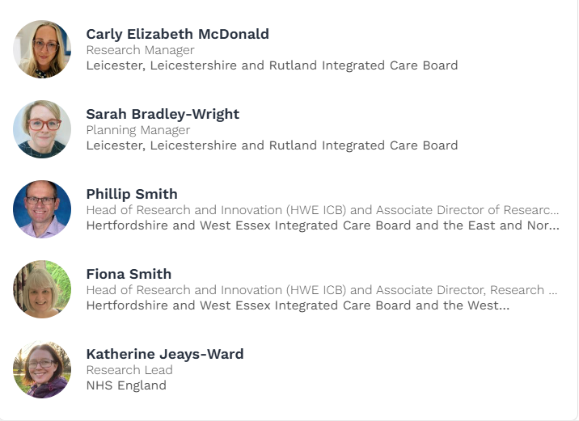
National exemplar
How ICBs can support research and embed evidence?
This workshop aims to enhance the understanding of the role of Integrated Care Boards (ICBs) to both support and embed research. The objectives include
identifying practical actions to support research and embed evidence,
gathering feedback from experienced attendees on implementing these actions, and
capturing insights to support the creation of a future summary document.

Slide 14
Progress against strategic objectives (1 of 2)
Objective | 10th Mar 2025 Status
1. Embed HWE ICB R&I SLT Governance with terms of reference to enable discharge of legal duties and risk management. | Initial terms of reference established
2. Create the HWE ICS Research and Innovation (R&I) hub to co-ordinate and deliver activities. | Achieved
3. Develop and implement a cohesive research strategy to deliver research at the highest possible level in response to identified ICS priorities. | Strategy developed and implementation started
4. Enhance our collective research portfolio to support strategic objectives, sustainability (both financial and environmental) and a quality service to meet the research needs of key collaborators and stakeholders, especially public health. | Assessment of NHS research activity. Provision of advice service
5. Actively support and develop our existing research workforce, develop research capabilities where none currently exist and further expand research into non-NHS setting. | Assessment of workforce in progress. Promotion of research in new settings such as schools

Slide 15
Progress against strategic objectives (2 of 2)
Objective | 10th Mar 2025 Status
6. Achieve financial sustainability by accessing national funding streams and external opportunities. | Initial income. Charging model and the use of UH cost centre
7. Ensure effective communication to our partners and all residents making research and innovation accessible and relevant, with the aim of achieving engagement with underserved communities and those with seldom heard voices. | HWE ICS and UH ICS websites live. Newsletter produced for HWE ICS and also for UH (internal) Delivery of Research Engagement Network (REN) programme
8. Promote innovation, initially using a readiness assessment of our organisations, to improve patient experience and help improve outcomes. | Promoted the use of innovation and contributed to a guidance document for ICBs
9. Act on best practice recommendations to address specific inclusion barriers to participating in research. This will build on our research engagement network development. | Research Engagement Network (REN) Additional PARITY funding #BePartofResearch
10. Develop success indicators to measure progress, deliver transparent governance, and demonstrate contribution our five-year forward plan. | Initial indicators via HEWE ICS Research Strategy group

Slide 16

Summary
UH ICS funding secured to embed UH as an anchor institute
Research and innovation strategy in place
System working established to promote research and innovation i.e. the facilitation and promotion of research in matters relevant to the health service, and the use in the health service of evidence obtained from research.
Significant progress, more to do
More details on our public website
We are very happy to discuss this further
hweicbhv.researchandinnovation@nhs.net

