Slide 1
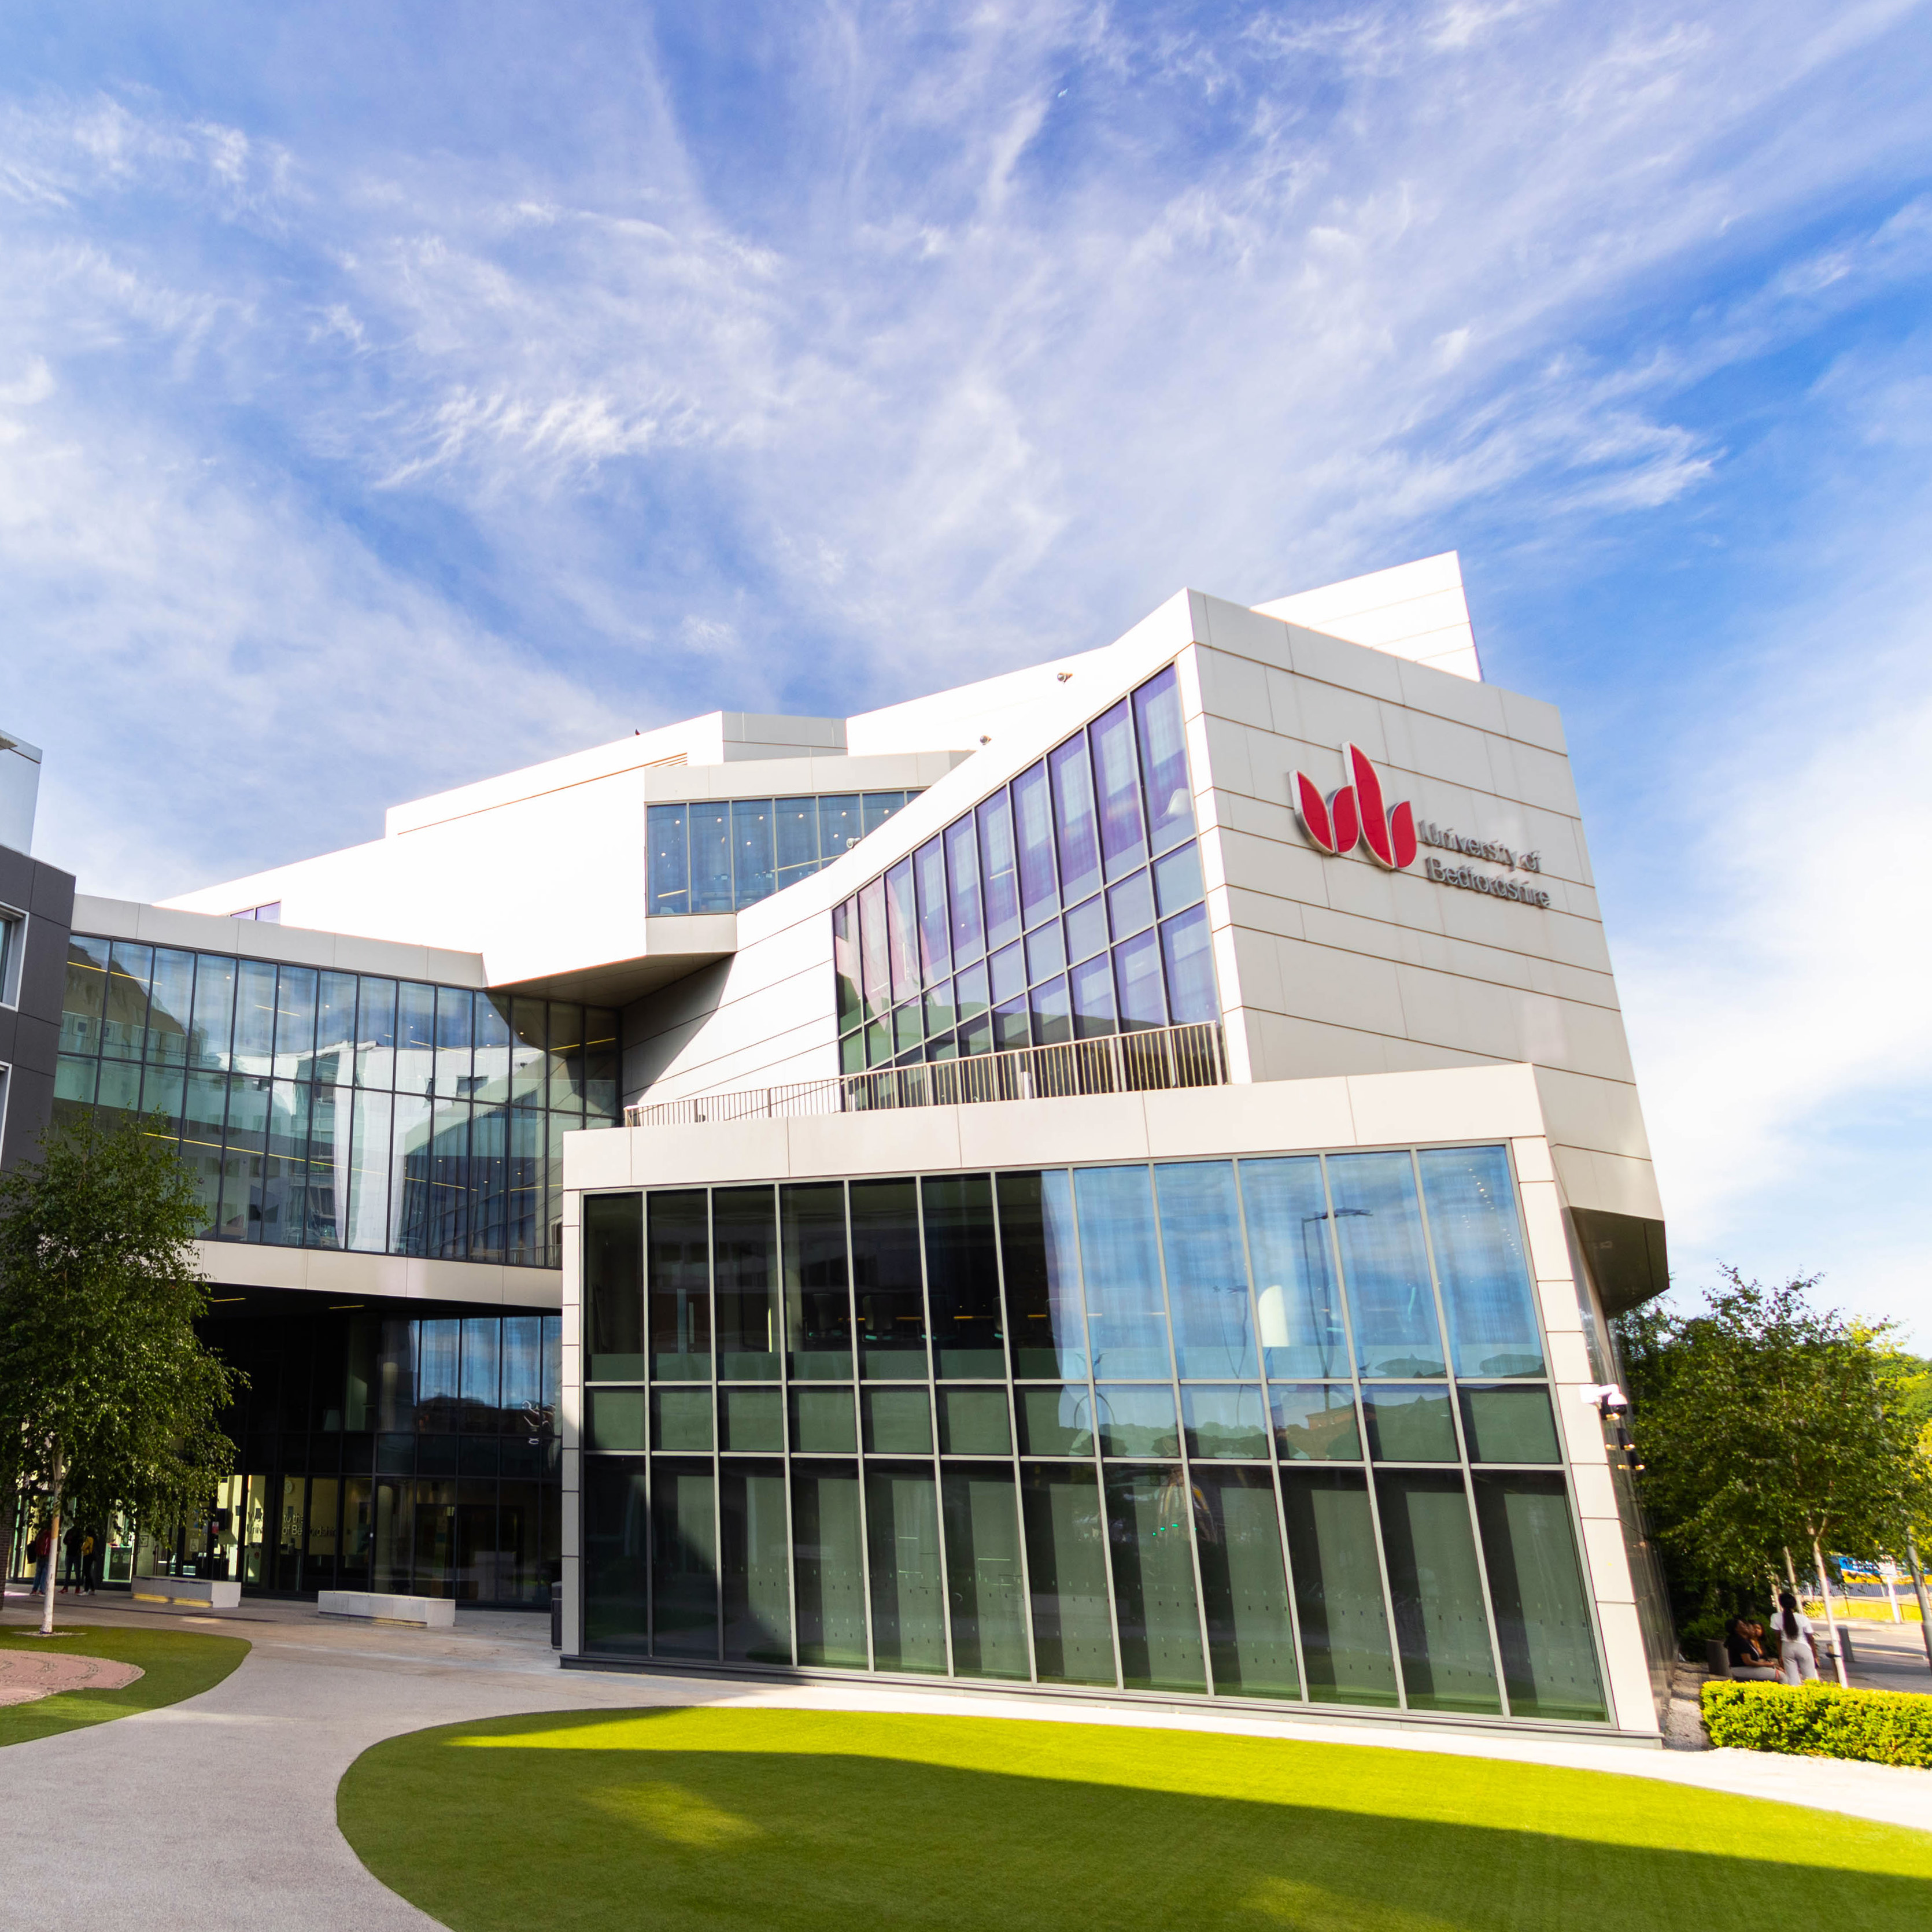
Breakout Session Theme 2:
Current Initiatives in Integrated Care
EPIIC Conference 2025
Dr Santosh Yatnatti
Project Manager
BLMK ICS Research and Innovation Hub
University of Bedfordshire
Prof Yannis Pappas
Director
BLMK ICS Research and Innovation Hub
University of Bedfordshire
19 ^{th} March 2025

Slide 2
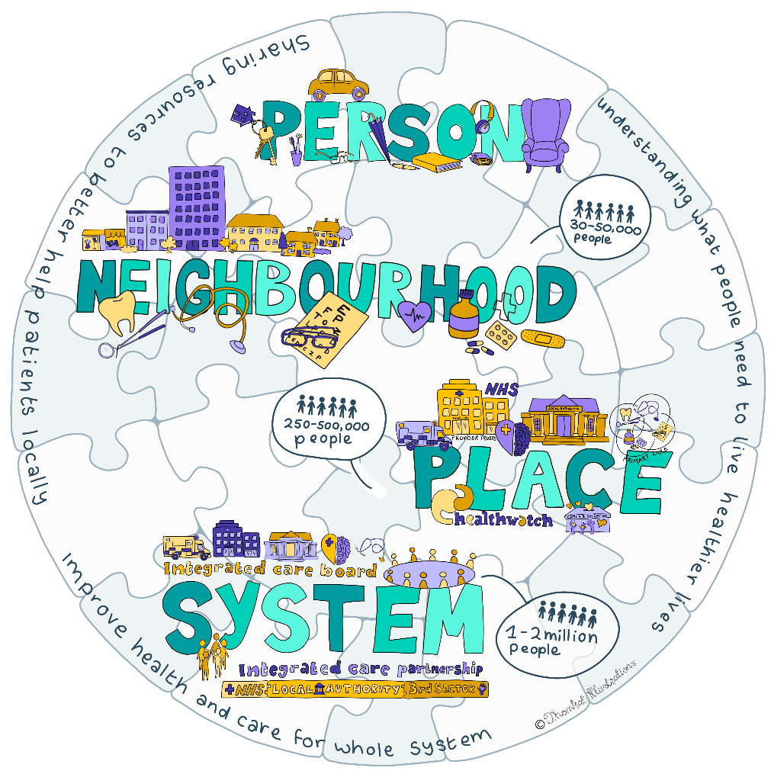
The ICS structure

Slide 3
Darzi Report
More people are living with multiple and more complex problems, and as highlighted by Lord Darzi, the absolute and relative proportion of our lives spent in ill-health has increased.
Through the 10 Year Health Plan, the government will focus on 3 strategic shifts, moving care from:
hospital to community
sickness to prevention
analogue to digital

Slide 4
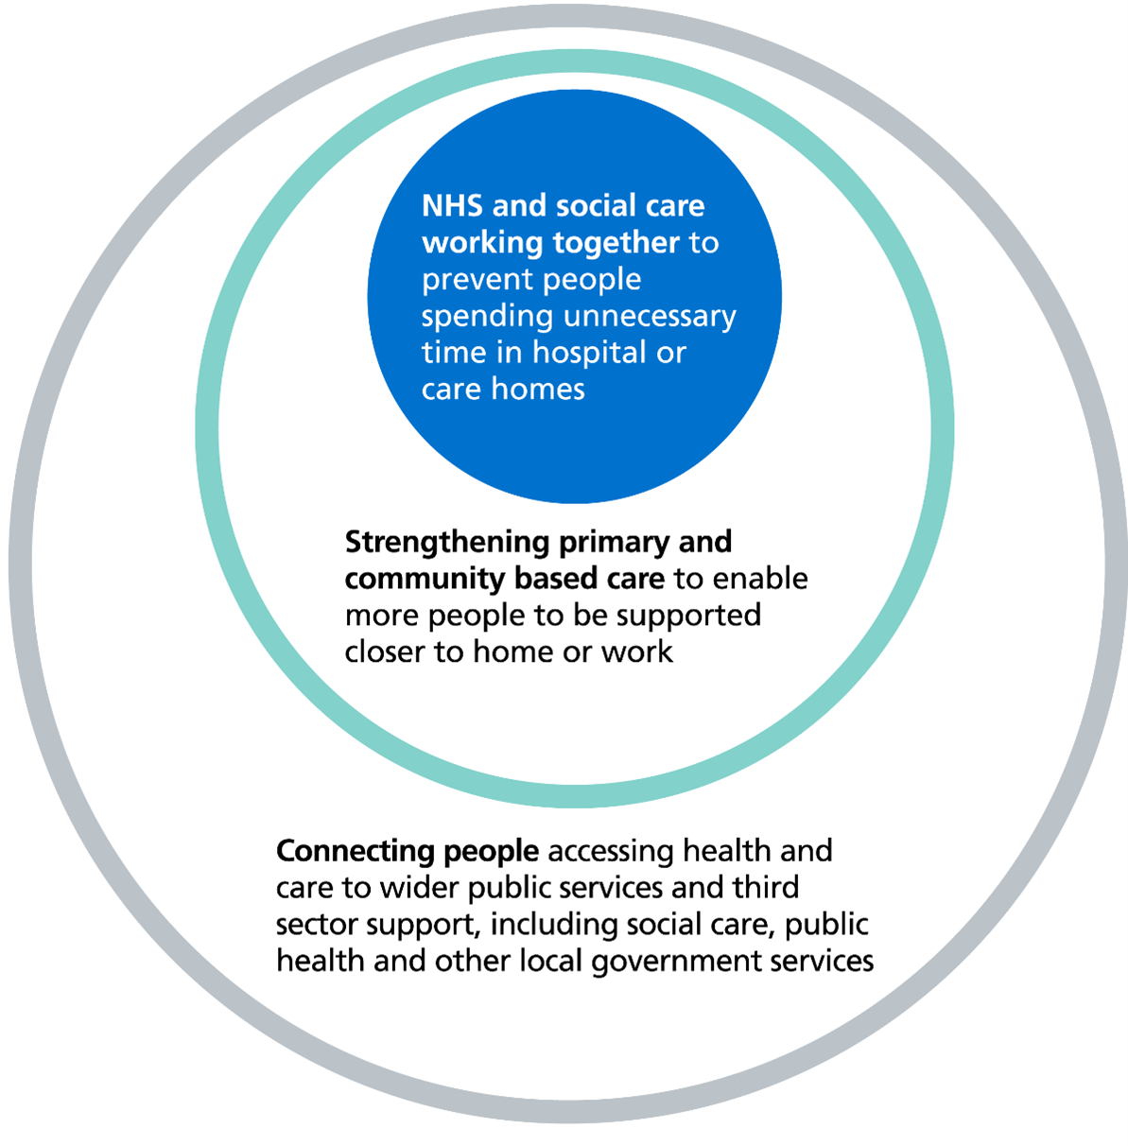
Neighbourhood health approach

Slide 5
Some questions to consider:
Are the current integrated care systems and boards equipped to deliver truly integrated care?
What has gone well so far?
How can integration be facilitated further?
Let’s also discuss your questions/ideas!

