Slide 1
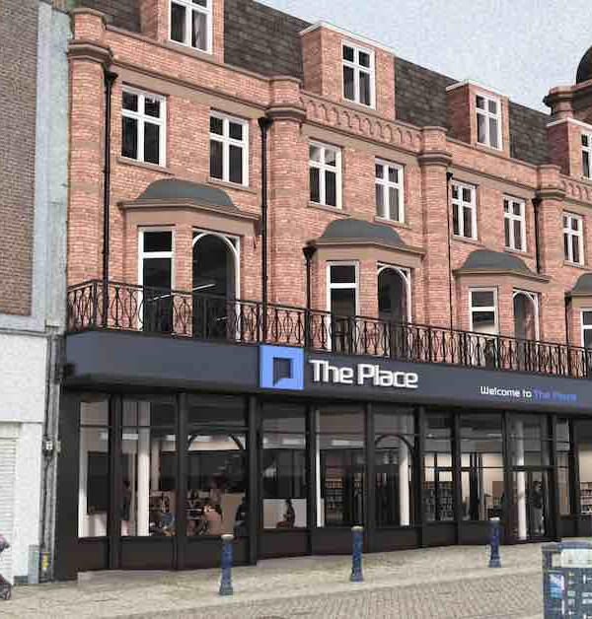
The Place, Great Yarmouth
Overview of development and student initiatives
Notes:
---
This presentation provides an update on 'The Place' in Great Yarmouth, including its background, development progress, and strategies for skills development and governance. We will also discuss the construction progress and initiatives to increase student recruitment.

Slide 2
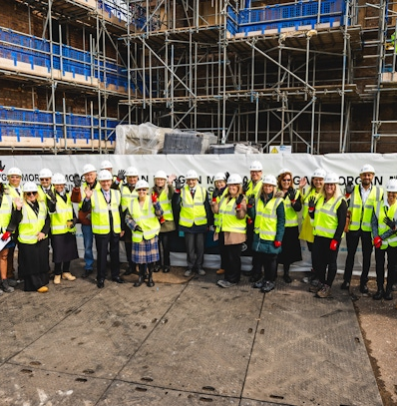
Overview
Initial MOU and Objectives
Construction Details and Challenges
Project Board and Operations Group
Market Research and Statistics
Curriculum Panel and Partnership Agreement
UoS Direct Delivery
Notes:
In this presentation, we will cover the background and development of The Place, progress on collaboration, skills development strategies, governance structures, construction updates, and recruitment initiatives. Each section will provide insights into the current status and future plans for The Place.

Slide 3

Initial MOU and Objectives
Multi-Party Collaboration
  The MOU signed by multiple parties aims to enhance education and learning in Great Yarmouth.
Objectives of the Learning Hub
  The learning hub aims to raise skill and qualification levels while meeting local business needs. To integrate with local culture enhancing its presence in the town centre.
Learning Centre
  Establishing a library and advice center to support adult learning and community engagement in skills development. Progression to Further Education- East Coast College.
University Campus Concept
  Offering degree courses under a Great Yarmouth campus umbrella, either delivered by ECC and validated by the HEI institutions or delivered directly
Notes:
---
This slide references information from the following file: https://ccucsac.sharepoint.com/sites/GreatYarmouthThePlaceUniversityHub/_layouts/15/Doc.aspx?sourcedoc=%7B3195B0B4-148D-48C3-8629-F807A125DBF2%7D&file=SMG170624%20-%20Update%20on%20Great%20Yarmouth,%20The%20Place%20-%20Updated%20%26%20Final.docx&action=default&mobileredirect=true&DefaultItemOpen=1
Following an initial multi-party MOU signed in July 2020 between Great Yarmouth Borough Council, University of East Anglia, East Coast College, University of Suffolk and Norfolk County Council for the establishment of a new ‘learning hub’ based in Great Yarmouth Town Centre within the former Palmers department store building, building works has progressed, with a now opening date set for c.March 2025.
In July 2020 Great Yarmouth Borough Council (GYBC), University of East Anglia (UEA), East Coast College (ECC), University of Suffolk (UoS) and Norfolk County Council (NCC) signed an MOU setting out the principles underpinning the intentions to collaborate and progress the concept of a learning hub and university campus facility based in Great Yarmouth town centre.
The development of a learning hub was aimed at:
ü raising skill, qualification & aspiration levels;
ü meeting the needs of local and regional businesses for specific skills in high demand/growth sectors;
ü facilitating university validated degree courses for local students creating “University Campus Great Yarmouth”;
ü developing a forum by which Library facility can further develop and integrate into the Town Centre location.

Slide 4
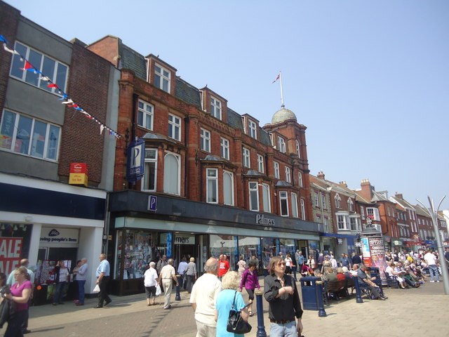
Building and Funding Details
Iconic Building Renovation
  The old Palmers department store has been refurbished, enhancing its role as a central community hub in Great Yarmouth.
Funding Overview
  The £18m project is funded by the Future High Street Fund, Town Deal, and contributions from local authorities and universities.
  Investment from Anchor Institutions
  Investment from the University of Suffolk and East Coast College contributes £3.5 million, including funds from Health Education England.
Notes:
---
This slide references information from the following file: https://ccucsac.sharepoint.com/sites/GreatYarmouthThePlaceUniversityHub/_layouts/15/Doc.aspx?sourcedoc=%7B3195B0B4-148D-48C3-8629-F807A125DBF2%7D&file=SMG170624%20-%20Update%20on%20Great%20Yarmouth,%20The%20Place%20-%20Updated%20%26%20Final.docx&action=default&mobileredirect=true&DefaultItemOpen=1
The building identified for this development and currently being refurbished is the old Palmers department store – an iconic location and building right in the centre of Great Yarmouth, facing the market square on Market Place. The c. £18m project is jointly funded through the Future High Street Fund, Town Deal and match funding from Norfolk County Council and the University of Suffolk.
The project will allow Norfolk County Council to move the town's current public library from Tolhouse Street to this more central location in the town centre. Along with the library relocation, adult learning services, the Registry Office, Norfolk Citizens Advice, and other community support services will also be relocated.
The library will be co-located with a new university and learning centre through a partnership with East Coast College and the University of Suffolk. East Coast College is planning to relocate their current Higher Education, Access to Higher Education and Adult Learning provision to the new university centre. Its Suffolk Road campus in Great Yarmouth will remain the base for its Further Education and vocational training provision. The College will teach degree-level courses at the university centre, accredited by the University of Suffolk, and University of Suffolk will also deliver courses directly.

Slide 5

Construction Details and Challenges
Start of Construction
  Construction began on 12th September 2023, focusing on the refurbishment and transformation of the existing building.
Complex Challenges
  The project faces challenges due to asbestos removal and unexpected decay of roof trusses, causing delays.
  Further issues with electrical sign off
Completion Timeline
  Anticipated practical completion was set for 20th February 2025, with the operational date by the end of March 2025.
  The opening of The Place is currently delayed by approximately two months to second week in May. The delay is due to legal issues around power which are being dealt with between solicitors and UK Power Networks.
Notes:
---
This slide references information from the following file: https://ccucsac.sharepoint.com/sites/GreatYarmouthThePlaceUniversityHub/_layouts/15/Doc.aspx?sourcedoc=%7B3195B0B4-148D-48C3-8629-F807A125DBF2%7D&file=SMG170624%20-%20Update%20on%20Great%20Yarmouth,%20The%20Place%20-%20Updated%20%26%20Final.docx&action=default&mobileredirect=true&DefaultItemOpen=1
Construction works started on 12th September 2023 on the refurbishment and transformation of the existing building. The works are being undertaken by construction and infrastructure specialists Morgan Sindall Construction, which were procured through the SCAPE National framework. Building work has been extraordinarily complex in this Victorian building, with various elements of asbestos and unexpected roof trusses decay causing project delays. There are no less than 8 different roofs on this multipart building!
It does appear however that all the considerations have now been uncovered and anticipated practical completion is 20th February 2025, with an operational date end March 2025 once furniture installation etc complete (an anticipated 3-week process).
The UoS is planning any necessary NMC accreditation visits around this programme.

Slide 6
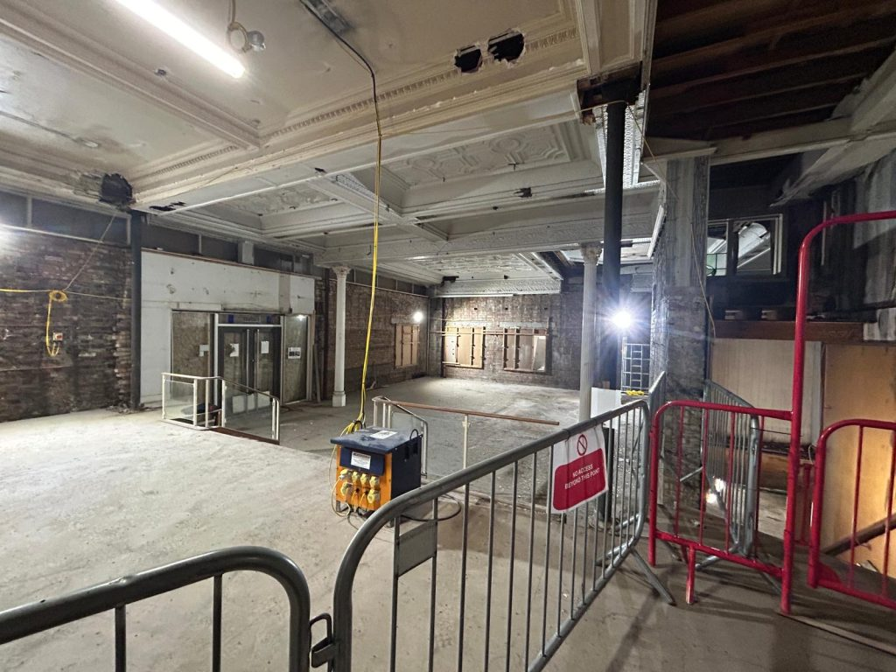
Agreements and Leases
Landlord and Leases
  Great Yarmouth Borough Council serves as the landlord.
Norfolk County Council (NCC) Lease Details
  NCC holds a lease for the Ground Floor and Basement, providing library and registrar services along with educational facilities.
East Coast College (ECC’s) Teaching Space
  ECC leases the 1st floor, creating significant teaching and learning spaces for various educational activities.
UoS Sub-Lease Details
  UoS has a sub-lease from ECC for the 2nd floor, featuring multiple classrooms and a simulation ward.
Notes:
---
This slide references information from the following file: https://ccucsac.sharepoint.com/sites/GreatYarmouthThePlaceUniversityHub/_layouts/15/Doc.aspx?sourcedoc=%7B3195B0B4-148D-48C3-8629-F807A125DBF2%7D&file=SMG170624%20-%20Update%20on%20Great%20Yarmouth,%20The%20Place%20-%20Updated%20%26%20Final.docx&action=default&mobileredirect=true&DefaultItemOpen=1
Further agreements during the time since signing the initial MoU has concluded that:
· GYBC is the landlord for all parties in the building, and is issuing two 125yr leases for further parties involved
· NCC is the tenant and has a lease for the Ground Floor and Basement. The services they will run from there includes Library and Registrar services, and facilities for Norfolk Adult Education
· ECC has a lease for the 1st to 3rd floors, creating significant teaching and learning space
· UoS has a sub-lease from ECC for the 2nd floor, which includes
o A 12-person general teaching room
o A 18-person general teaching room
o A five bedded simulation ward
o An open collaboration / common room space suitable for c.8 people
· It was confirmed in May 2024 that UEA would not take up residence in the building, implying that ECC would occupy the expansive 1st floor as always envisioned, and the smaller 3rd floor footprint.

Slide 7

Project Board and Operations Group
Project Board Updates
  The Project Board oversees updates on construction, partnerships, and operational readiness until the building becomes operational.
Chair and Meetings
  Chaired by Natasha Hayes, the Project Board meets approximately every six weeks to ensure collaboration and oversight.
Operations Group Preparation
Starting in April 2024, the Operations Group prepares for practical elements of the operational opening. The Operations Group addresses key issues such as security, cleaning, and customer experience in its ad hoc meetings.
IAG Training Sub-group to the Ops Group
  A new group commenced in June/ July 2024, this group will look at how key staff in the library and elsewhere in The Place can be supported about appropriately engaging with prospective learners coming into The Place.
Notes:
---
This slide references information from the following file: https://ccucsac.sharepoint.com/sites/GreatYarmouthThePlaceUniversityHub/_layouts/15/Doc.aspx?sourcedoc=%7B3195B0B4-148D-48C3-8629-F807A125DBF2%7D&file=SMG170624%20-%20Update%20on%20Great%20Yarmouth,%20The%20Place%20-%20Updated%20%26%20Final.docx&action=default&mobileredirect=true&DefaultItemOpen=1
4.1 Project Board
o This forum is taking updates on construction progress, partnership arrangements such as leases, communications and PR and overseeing operational readiness planning and will see the collaboration through to once the building is operational
o The Board is chaired by GYBC (Natasha Hayes, Executive Director- Place, GYBC) and meets c. 6 weekly
o Once operational this Project Board will reduce in frequency of meetings
o UoS representatives include Michelle Martin and Sam Chenery-Morris
4.2 Operations Group
o Commencing in April 2024, and is preparing for practical elements of operational opening
o The Group is chaired by GYBC (Natasha Hayes) and meeting dates are currently ad hoc as key issues are being considered such as security, cleaning, customer experience etc.
o UoS representatives include Laura Pennie, Mandi Syrett, Leigh-Anne Logan Smith and Emma Pell/ Dawn Parsons

Slide 8

Market Research and Statistics
Education Levels in Great Yarmouth
  Market research shows only 18.2% of residents aged 16 and above have a university-level qualification, indicating low education levels.
Demand Trends in Education
  Great Yarmouth ranks second in educational demand within Norfolk, highlighting a growing interest in higher education.
Popular Undergraduate Courses
  BA (Hons) Person-Centred Counselling and other programs show high enrolment trends at East Coast College, reflecting student interests.
Notes:
---
This slide references information from the following file: https://ccucsac.sharepoint.com/sites/GreatYarmouthThePlaceUniversityHub/_layouts/15/Doc.aspx?sourcedoc=%7B3195B0B4-148D-48C3-8629-F807A125DBF2%7D&file=SMG170624%20-%20Update%20on%20Great%20Yarmouth,%20The%20Place%20-%20Updated%20%26%20Final.docx&action=default&mobileredirect=true&DefaultItemOpen=1
Market research done by MCI indicated that:
· In Great Yarmouth, only 18.2% (1 in 5) of people aged 16 and above have a university-level qualification. The statistics, using data from the 2021 Census, also ranked the borough sixth for the area with residents having no qualifications with 26.5% having none
· According to HESA data from 2021/22, University of East Anglia, The Open University, Anglia Ruskin University, The University of Lincoln and Norwich University of the Arts were the top 5 highest undergraduate recruiters from the Norfolk region
· Application and enrolment trends from our partner institution East Coast College in Great Yarmouth show the highest undergraduate course recruiter across the last few years has been
o BA (Hons) Person-Centred Counselling, with 22 applications in 23/24 and 16 enrolments.
o Other top courses for enrolment include:
§ BA (Hons) Applied Care Practice (Children & Families),
§ BA (Hons) Creative Arts Practice and
§ BSc (Hons) Applied Psychology
o According to IDP demand tracker, over the last 2 years Great Yarmouth is the 2nd highest conurbation within Norfolk where demand is coming from, behind Norwich
o The most popular courses viewed within the county of Norfolk from the last 2 years have been
§ LLB (Hons) Law
§ BSc (Hons) Psychology
§ BSc (Hons) Physiotherapy
§ BSc (Hons) Computer Science and
§ BSc (Hons) Economics

Slide 9

Curriculum Panel and Partnership Agreement
Curriculum Panel Composition
  The Curriculum Panel includes representatives from Norfolk Adult Learning, ECC, and the University of Suffolk.
Meeting Frequency
  The meetings of the Curriculum Panel are ad hoc, scheduled as needed based on the agenda.
Partnership Agreement Draft
  A draft for the Partnership Agreement is being prepared for discussion among all building occupants, aiming for completion by October 2024.
Notes:
---
This slide references information from the following file: https://ccucsac.sharepoint.com/sites/GreatYarmouthThePlaceUniversityHub/_layouts/15/Doc.aspx?sourcedoc=%7B3195B0B4-148D-48C3-8629-F807A125DBF2%7D&file=SMG170624%20-%20Update%20on%20Great%20Yarmouth,%20The%20Place%20-%20Updated%20%26%20Final.docx&action=default&mobileredirect=true&DefaultItemOpen=1
4.3 Curriculum Panel
o TOR here , meeting frequency ad hoc
o This panel include Norfolk Adult Learning, ECC and UoS
o UoS representative is Sam Chenery-Morris
4.4 Partnership Agreement
o A Partnership Agreement is currently in draft for issue and discussion by all parties that will occupy the building, with a target deadline of October 2024 for completion.

Slide 10

Collaboration and Customer Experience
Collaborative Institutions
  Collaboration between the library, Norfolk Adult Education, ECC, and UoS enhances the customer experience for prospective learners.
Key Point of Contact
  A shared post at the GF level will serve as a key point of contact for learner inquiries, streamlining support.
Advanced Knowledge Sharing
  Collaboration on the 1st floor will ensure that inquiries are handled by knowledgeable staff from ECC and UoS.
Community Engagement
  UoS aims to engage the community not only through direct courses but also by encouraging inquiries for higher education.
Notes:
---
This slide references information from the following file: https://ccucsac.sharepoint.com/sites/GreatYarmouthThePlaceUniversityHub/_layouts/15/Doc.aspx?sourcedoc=%7B3195B0B4-148D-48C3-8629-F807A125DBF2%7D&file=SMG170624%20-%20Update%20on%20Great%20Yarmouth,%20The%20Place%20-%20Updated%20%26%20Final.docx&action=default&mobileredirect=true&DefaultItemOpen=1
All parties to the building are thoughtful about the customer experience of potential learners coming into the building with questions about further or higher education. In this regard it requires collaboration between the library and Norfolk Adult Education, ECC and UoS.
Discussions are ongoing about a shared post at GF level (within the library) who will be a key POC for these enquiries. More advanced knowledge will be in place on the 1st floor where ECC and UoS will need to collaborate to ensure any prospective learner enquiries can appropriately be dealt with.
A key tenet of UoS involvement in The Place is of course not just promoting uptake from the community on direct delivered course by UoS at The Place, but also encouraging enquiries for study at our Ipswich campus.

Slide 11

Nursing and Allied Health
Nursing Programs
  Two-year degree apprenticeship courses for Nursing Associate and Adult Nursing are pending NMC approval, aiming to start in 2025.
Assistant Practitioner Apprenticeship
  The Assistant Practitioner apprenticeship is a two-year program that requires curriculum development and validation for implementation.
Continued Professional Development
  The School of Nursing, Midwifery and Public Health and Allied Health Sciences will offer Continuous Professional Development (CPD) courses tailored for Professionals at James Paget University Hospital.
Notes:
---
This slide references information from the following file: https://ccucsac.sharepoint.com/sites/GreatYarmouthThePlaceUniversityHub/_layouts/15/Doc.aspx?sourcedoc=%7B3195B0B4-148D-48C3-8629-F807A125DBF2%7D&file=SMG170624%20-%20Update%20on%20Great%20Yarmouth,%20The%20Place%20-%20Updated%20%26%20Final.docx&action=default&mobileredirect=true&DefaultItemOpen=1
7.1 School of Allied Health Sciences
o Direct delivery opportunities are limited due to the lack of specialist teaching space, but we will be targeting CPD courses especially in Allied Health Professional subjects – servicing specifically James Paget University Hospital
7.2 School of Nursing, Midwifery and Public Health
o Nursing Associate and Adult Nursing (Degree Apprenticeship) both 2-year courses subject to NMC approval – from as soon as possible after opening in 2025
o Assistant Practitioner (2-year apprenticeship) subject to curriculum development and validation

Slide 12

  University Of Suffolk Space
  A 12-person general teaching room
  A 18-person general teaching room
  A five bedded simulation ward
  An open collaboration / common room space suitable for c.8 people

Slide 13

Social Sciences and Humanities
Psychological Therapies Training
  The program aims to prepare students for graduate NHS jobs in psychological therapies while awaiting further discussions.
Continuing Professional Development (CPD)
  A variety of CPD courses are available, focusing on clinical supervision and specialized training for psychological therapists.
Leadership Development Coaching
  A coaching offer for leadership development is currently in development to support aspiring leaders in the field.
Creative Writing CPD Course
  A CPD course in creative writing aims to enhance skills and therapeutic practices for professionals in the field.
Notes:
---
This slide references information from the following file: https://ccucsac.sharepoint.com/sites/GreatYarmouthThePlaceUniversityHub/_layouts/15/Doc.aspx?sourcedoc=%7B3195B0B4-148D-48C3-8629-F807A125DBF2%7D&file=SMG170624%20-%20Update%20on%20Great%20Yarmouth,%20The%20Place%20-%20Updated%20%26%20Final.docx&action=default&mobileredirect=true&DefaultItemOpen=1
7.4 School of Social Sciences and Humanities
o We want to ensure that we are training students for psychological therapies graduate NHS jobs pending NHS England (education) further discussion and commissioning
o CPD courses - including Developing Excellence in Clinical and Therapeutic Supervision, Living with Cancer and Beyond (a training for psychological therapists), KSA (Knowledge-Skills-Attitudes) course for those training for roles in NHS talking therapies services and the Insights into Counselling course
o In development: coaching offer for leadership development
o CPD course – creative writing

Slide 14
Conclusion
Development Progress
The Place in Great Yarmouth has achieved considerable progress in community development and service enhancement.
Collaboration Efforts
Collaboration among stakeholders has been crucial for fostering partnerships and enhancing service delivery.
Skills Training Initiatives
Skills training programs have been essential for empowering individuals and enhancing employability within the community.
Sustainable Success
Continued efforts are vital to ensure the long-term success and sustainability of The Place's initiatives.
Notes:
In conclusion, The Place in Great Yarmouth has made significant progress in various areas, including development, collaboration, skills training, and student recruitment. Continued efforts are essential to ensure its success and sustainability.

