Slide 1
Transition
It’s never to early to start

Slide 2
Presenters
Elizabeth Tornquist-
Seconday Transition Project Coordinator MCIE
Missie Baxter-
Instructional Facilitator Special Education HS

Slide 3
HS Team
Dawson Robertson- Transition Resource Teacher
Stephanie Hayes- Transition Resource
Teacher- work programs
Colleen Garrant- Resource Teacher
Christine Johnson- Resource Teacher

Slide 4
Secondary Transition Planning
Transition planning is a process mandated by the Individuals with Disabilities Education Act (IDEA 2004) for all students who have an Individualized Education Program (IEP) in K-12 education. The purpose is to facilitate the student’s move from school to post-school activities
Notes:
Transitions are a routine part of every student’s educational experience. And though they can be exciting and something to look forward to, for many students with disabilities and their families, transitions are often a time of stress and anxiety.
Typically, individuals with disabilities encounter multiple transitions throughout their time in school: early intervention services to preschool, preschool to elementary school, elementary to middle school, middle school to high school, and finally high school to adulthood (e.g., postsecondary education, employment). This last transitional phase is known as secondary transition.
Transitioning from high school to the adult world can be a challenging time for students, especially those with disabilities, as they enter a world of unfamiliar routines, new environments, and novel experiences. To make the transition as smooth as possible, teachers and school personnel, along with others (e.g., families, community agencies), should assist students with disabilities in the process of selecting appropriate goals and developing the requisite skills to achieve these goals in the areas of:
Employment:
Education/Training:
Independent Living:
Community involvement
Though secondary transition planning is a part of the individual education program (IEP) process, it is not intended to be a static activity that only occurs annually during a student’s IEP meeting. Instead, it should be an ongoing planning process that helps students develop independence, which in turn helps them to reach their career and adult-living goals.

Slide 5
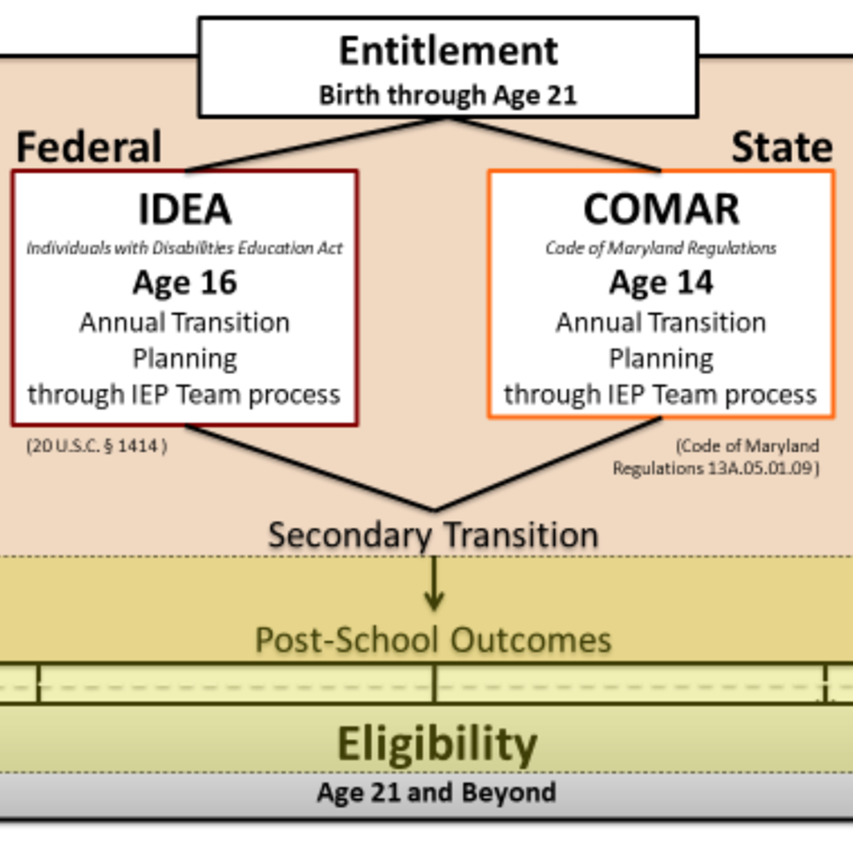
Transition Legislation
Secondary
Transition is
Grounded in
Legislation
Notes:
ST is grounded in legislation and required for SWD ages 14 and older in MD—COMAR went above the federal requirement to begin ST at age 16.
In MD a student’s transition plan needs to be in effect when he/she turns 14 years old meaning that the process will begin and a plan written when the student is 13 and will turn 14 during that IEP year.
Under IDEA and COMAR students are entitled to the services that have been identified that they need to receive
After graduation it is no longer what a SWD is entitled to receive but what services they apply for, are deemed eligible to receive and what is available.
After graduation, there is no entitlement or guarantees for services.
Entitlement vs Eligibility is a key concept for families to be aware of throughout the transition planning process to prepare

Slide 6
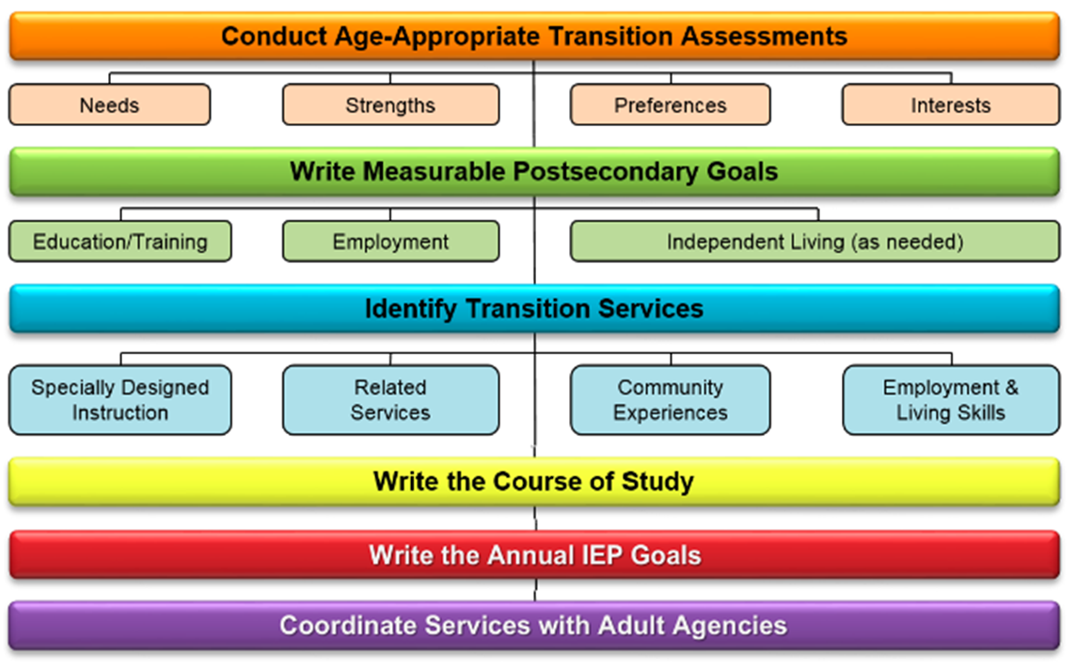
Secondary Transition Planning Process
Notes:
Transition Planning should be the first step in developing the Individualized Education Program (IEP) for students, age 14 and older. It begins by conducting AA transition assessments to discover the student’s interests, preferences, strengths and needs.
From there:
The student and school staff establish postsecondary goals/outcomes in employment, education/training; and if appropriate, independent living. These are based on the student’s interests, preferences and assessments. (the IEP team determines if appropriate)
Knowing what the future goals are for the student, the IEP team then backward maps to address what transition activities, services, course of study and annual goals will be needed during the upcoming school year to reasonably enable the student to progress toward his/her outcomes.
In addition, linkage with adult service agencies is discussed.
The ongoing monitoring of transition activities occurs and progress on the activities is reported in writing to parents quarterly in conjunction with the quarterly reporting of IEP goal progress.
The entire process is updated annually. Any adjustments to the IEP will be made to ensure that the student continues to move toward his/her stated outcomes.

Slide 7
What is the Transition Plan?
Written documentation of the on-going process that reflects the continuing development and changing needs of the student
Part of the IEP
Based on student’s individual needs, strengths, skills and interests
Used to identify and develop goals and activities for the student
Notes:
Now that we have looked at the process, let’s take a look at what a Transition Plan is.
A transition plan is the section of the IEP that outlines transition goals and services for the student. The transition plan is based on the student’s interests, preferences, strengths and needs. Transition plan is used to identify and develop goals and activities which need to be accomplished during the following year to assist the student in meeting his/her post-high school goals.
An IEP team, when starting the annual meeting with the TP, will naturally flow into connecting appropriate annual IEP goals and transition activities to the advancement of the student to his/her PSGs.
The transition Plan should reflect:
Who the student is- the student should be able to review the plan and say, “That’s me all right!"
What they want to do – everyone who reads the plan should clearly see what the student wants for his/her future; no one should be guessing or presuming
The skills-what are they? What will be done to address them?

Slide 8
Resources
Secondary Transition Planning Guide for Individuals with Disabilities
Secondary Transition Technical Assistance Bulletin (TAB)
Transition Talks

Slide 9
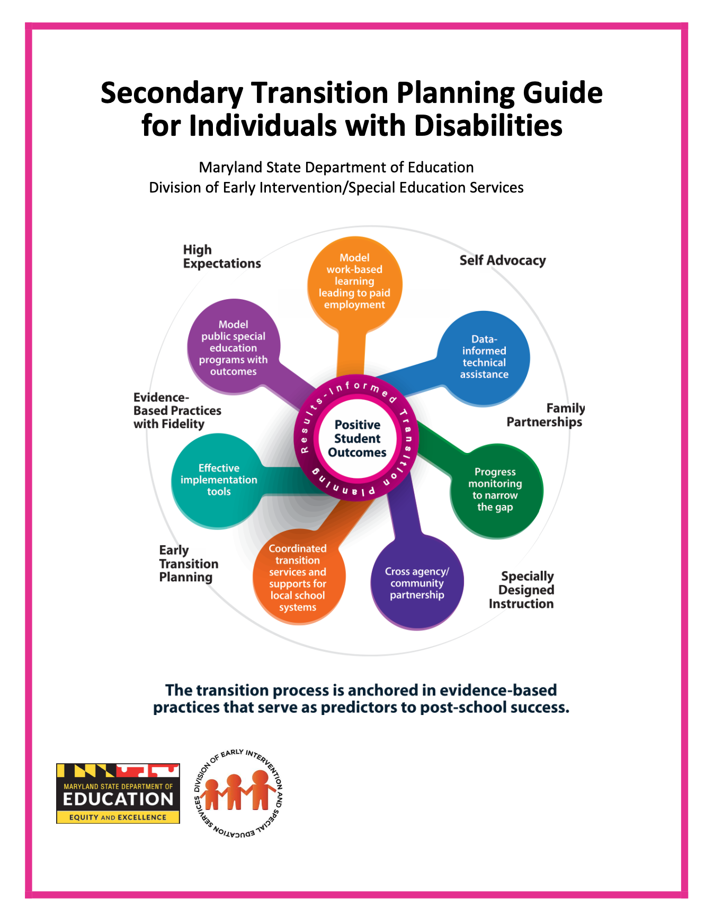
Notes:
This is what families are given at IEP meetings:
The Secondary Transition Planning Guide for Individuals with Disabilities is provided to the student and parents at every annual IEP meeting.
The Maryland State Department of Education Secondary Transition Planning Guide for Individuals with Disabilities provides information to students, parents/guardians, educators, and community agencies about the transition process. Although every student will have individualized transition goals and outcomes, this guide provides “preliminary” information about the requirements of the transition process under the Individuals with Disabilities Education Act (IDEA) as well as recommended strategies and resources to acquire a positive outcome. This guide will provide details about the following topics: ● Transition Planning (leading to employment and postsecondary education outcomes, according to IDEA) ● Roles and Involvement of Partners ● Requirements for the Maryland High School Diploma and the Maryland High School Certificate of Program Completion ● Maryland Summary of Performance (formerly Maryland Exit Document) ● Entitlement vs. Eligibility ● Age of Majority ● Maryland Adult Service Agencies 1. Division of Rehabilitation Services (DORS) 2. Developmental Disabilities Administration (DDA) 3. Behavioral Health Administration (BHA) 4. Maryland Department of Labor– Division of Workforce Development and Adult Learning (MDL) ● Benefits ● Postsecondary Education/Disability Support Services ● Transportation/Travel Training ● Healthcare ● Community Access 1. Recreation/Leisure 2. Guardianship 3. Social Security 4. Financial Planning/Special Needs Trusts/Estate Planning ● Transition Process: Agency Linkage Appendix A: Recommended Timeline(s) Appendix B: Postsecondary Education/Disability Support Services FAQs Appendix C: Specific Populations/Resources Appendix D: Frequently Used Acronyms and Glossary
This guide is to be given to the student and parents at each annual IEP meeting. The guide has a xxx that must be signed by both the student and parent/guardian annually to document receipt of the Planning Guide. It is suggested that the signed receipt of this guide be uploaded to the MOIEP and the original placed in the student’s confidential file where special education records are kept. This way a copy of the form is available at all times-a lesson learned during the current school closures.

Slide 10
Notes:
The Secondary Transition Technical Assistance TAB --Provides information on the legal policy, implementation and implementation tools that drive the Secondary Transition Process in Maryland.
Included in Section !, the Legal Policy is an FAQ s a great deal of information about all sections of secondary transition planning.
Section 2: Implementation—Addresses systemic change requires not just knowledge of what is legally
required, but also the implementation of policies and procedures that work. The importance of high
expectations, early transition planning (MD begins at 14), family partnerships, self-advocacy, and
EBPs are key predictors to positive outcomes.
Section 3: Implementation Tools
The Maryland State Department of Education (MSDE), Division of Early Intervention and Special Education Services (DEI/SES) and strategic partners developed a number of secondary transition implementation tools that are aligned with the national evidence-based practices and predictors of post-school success. A description and a link to access each tool is provided in this TAB to spotlight some of those tools.

Slide 11
Notes:
Transition Talks
On MLL – EBPs 26 currently
For families and transition professionals/ educators

Slide 12
It’s never too early to….Start
Plan with the end in Mind
Promote Independence
At school and Home
Consider Chores/Jobs at home
Start Planning- explore the
possibilities- ask why not

Slide 13
HCPSS Transition
Starts in Middle School officially
IEP - will turn 14 (7th or 8th)
Continues till Exit
Formal- IEP transition Goals
Informal- everyday activities

Slide 14
Diploma and Non-Diploma
In School Exploration
ARL
CRD
Child Care Courses
Course offered to all
Foundations of Tech
Foods Class….
Etc….

Slide 15
Work Programs
In school Jobs
Career and Community Explorations
CCE
Work Study
Community Connections
Project Search

Slide 16
In School Work
Usually a class
Either Tutorial
Work Course
Complete Jobs in Building
Coffee Bars, Office Jobs,
Shredding, Lost and Found

Slide 17
Career and Community Explorations (CCE)
Small Groups leave School
Work in Community
Assigned to other school Teachers
Job Explorations
On job and classroom
3 days at work 2 days classroom

Slide 18
Work Study
Independent Job Experience
Paid or unpaid
With little support/fading supports
Can be one or a few over the year

Slide 19
Community Connections
Up to a 2 year Program
Located HCC
Mornings- classroom or community
Afternoon Independent work
Minimal supports- job coachin

Slide 20
Project search
One year Program- year of exit
Must be eligible
DDA and DORS
Interview selection
Intern with Howard County Govt
One hour classroom
Internship rest of day

Slide 21
Out Side Agencies- Eligibility
DORS- Department of Rehabilitation Services
DDA- Developmental Disabilities Administration- Apply 14
There are others we will talk about at IEP meeting

Slide 22
It’s Never too Early to think about Transition

Slide 23
Questions
Every High School has a Transition teacher
Dawson Robertson
Dawson_Robertson@HCPSS.org
Missie Baxter
Missie_baxter@hcpss.org

