Slide 1
Department of Special Education Update
May 19, 2021

Slide 2
If you know Mai, you know that she is…
Kind
Committed
Passionate
Resourceful
Helpful
Detail-oriented
...and so much more!

Slide 3
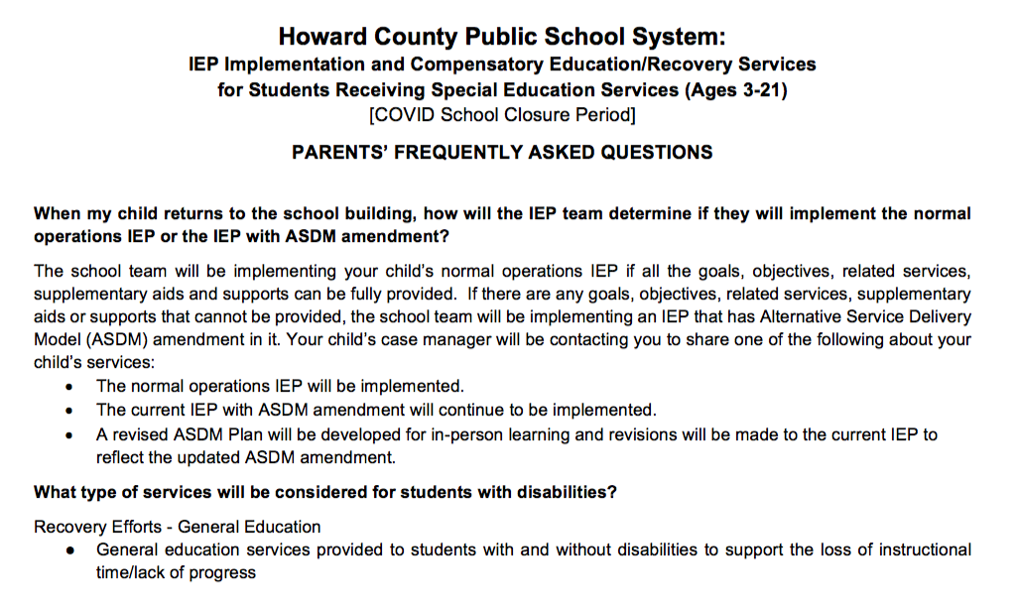
HCPSS: Frequently Asked Questions
HCPSS Department of Special Education Parent FAQ: IEP Implementation and Compensatory Education/Recovery Services
https://help.hcpss.org/special-education

Slide 4
Compensatory Education/Recovery Services
Special education instruction and/or related services owed to a student with disabilities as a result of a school system’s
failure to provide the student with services in accordance with their Individualized Education Program (IEP).

Slide 5
Compensatory Education/Recovery Services
Not unique to the pandemic
Based on assessed needs - not just about regression, also about the progress made/not made
Not necessarily an hour by hour calculation
Designed to place students where they would have been if not for the denial of FAPE

Slide 6
Each student with an IEP will be evaluated for compensatory education/recovery services
Parents will receive a “parental input form” from case manager prior to any decisions--**PROVIDE INPUT**
Parents will receive a Compensatory Education/Recovery Services determination from HCPSS

Slide 7
Each student with an IEP will be evaluated for compensatory education/recovery services
Once the determination letter is received, parents will have the option to:
Submit agreement with the proposed determination
Submit additional input and/or requests for consideration
Submit disagreement with request for an IEP meeting

Slide 8
What if the school denies compensatory education or a parent disagrees with the determination?
Request an IEP meeting
Contact others who may be able to assist: SECAC, HCAS, PPMD, FSRC, other parent support groups, HCPSS Department of Special Education
Parent may file a complaint with the Maryland State Department of Education
Parent may request mediation and/or file for a due process hearing request

Slide 9
Family Support and Resource Center (FSRC) Compensatory Conversations
Thanks to those who attended the first sessions (May 3rd & 13th)!
Wednesday, May 26 - 6:30-7:30 p.m.
Wednesday, June 2 - 6:30-7:30 p.m. - en espanol

