Slide 1

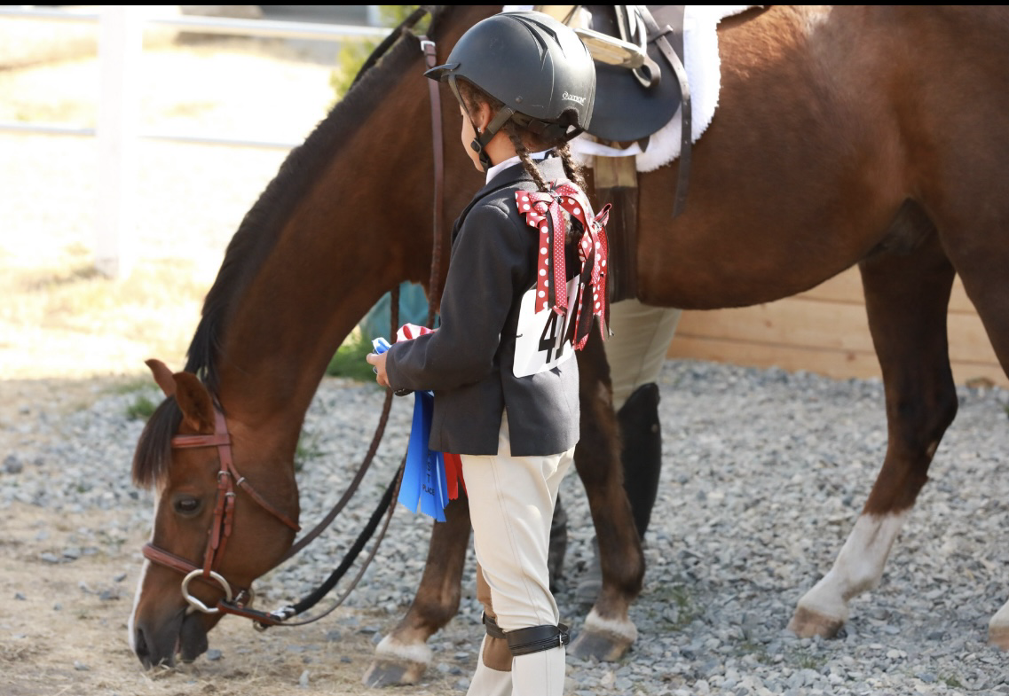
CLIP-CLOP FARM HUNTER JUMPER
CLASSIC 2026
Hitch Stable Show Dates (Circle Date)
June 27, July 11, September 5, November 14 & December 12
2027 SHOWS January 9, 2027, February 6,
March 6, April 3, May 1, June 26, July 10,
September 4, November 13, & December 11
Enter online @ http://horsespot.net
Look up Clip-Clop Hunter Jumper Classic
              Mail entries to:
              Clip-Clop Farm, LLC
33 Lilliemae Ln, Poplarville MS 39470
503-899-2279
Clipclopfarmllc@gmail.com
www.clipclopfarm.com

Slide 2
2026 Clip-Clop Farm Show Staff
Show Manager/Course Designer: Eva Cameron USHJA# HJ5567868
Show Steward: Kim McGrath USHJA #HJ107689
Show Secretary: Andrae Cameron
Medic: Call 911
On-Call Vet: TBD
General Information & Rules
1. Boots and ASTM certified helmets are required for all riders.
2. Outdoor arena is 120’ x 280’ with sand footing.
3. Indoor arena is 200’ x 300’ with sand footing.
4. Management reserves the right to combine/modify classes as needed.
5. One Horse/One Rider combination for point tallies.
6. Must compete in all classes of division to be eligible for division awards.
7. Must have a minimum of 3 participants in classes for points to count.
8. Beginner Rider in first year of showing.
9. Dogs MUST be on a leash!!!!
10. Fees refunded only with vet certificate and refunded 1 week after show.
11. Entries must be postmarked one week prior to the show to avoid the $25 post entry fee.
12. Schooling is available Friday 3pm – 8pm, Saturday 7am – 8am.
13. Stalls are available on a first come, first serve basis with deposit required. Stabling will be available Friday after 12pm.
Points for Clip-Clop Farm Daily and Series Shows Points are awarded as follows:
1st place-10 pts, 2nd place-6 pts, 3rd place-4 pts
4th place- 3 pts, 5th place-2 pts, 6th place-1 pt
Proof of Negative Coggins must be shown at check-in before schooling/showing.
Show Themes
**June-Tropical **July-Patriotic**September-Favorite Sports Team
**November Harvest/Thanksgiving***December-Christmas/Holiday
Costume contest: Each show at the Exhibitor Party will have costume contest based on theme to win fun prizes!
Barn Relay Race: Mix of kids and adults from your barn to win fun prizes.

Slide 3
SATURDAY, 8:30 AM START
JUMPER ARENA
CCF Pole Jumpers (Walk/Trot)
CCF Pole Jumpers (Walk/Trot)
CCF Cross-Rail Jumpers (.30m) Warm-Up
CCF Cross-Rail Jumpers (.30m)
CCF Cross-Rail Jumpers (.30m)
CCF Cross-Rail Green Pony/Horse Jumpers (.30m)
CCF Cross-Rail Green Pony/Horse Jumpers (.30m)
CCF Warm-Up Beginner Jumpers (.45m)
CCF Beginner Jumpers (.45m)
CCF Beginner Jumpers (.45m)
CCF Green Pony/Horse Jumpers(.60-.65m) Warm-Up
CCF Green Pony/Horse Jumpers(.60-.65m)
CCF Green Pony/Horse Jumpers(.60-.65m)
CCF Jumpers (.60-.65m) Warm-Up
CCF Jumpers (.60-.65m)
CCF Jumpers (.60-.65m)
CCF Jumpers Non-Pro (.60-.65m)
CCF Jumpers Non-Pro (.60-.65m)
CCF Jumper Classic (.60-.65m)
CCF Jumpers (.70-.75m) Warm-Up
CCF Jumpers (.70-.75m)
CCF Jumpers (.70-.75m)
CCF Jumpers Non-Pro (.70-.75m)
CCF Jumpers Non-Pro (.70-.75m)
CCF Jumper Classic (.70-.75m)
CCF Jumpers (.80-.85m) Warm-Up
CCF Jumpers (.80-.85m)
CCF Jumpers (.80-.85m)
CCF Jumpers Non-Pro (.80-.85m)
CCF Jumpers Non-Pro (.80-.85m)
CCF Jumper Classic (.80-.85m)
CCF Gamblers Choice/Team Challenge
SATURDAY, 8:00 AM START
HUNTER ARENA
33. CCF Walk Trot Hunter U/S
34. CCF Walk Trot Equitation U/S
35. CCF Walk Trot Canter Hunter U/S
36. CCF Walk Trot Equitation U/S
37. CCF Trot a Pole Hunter U/S
38. CCF Trot a Pole Hunter
39. CCF Trot a Pole Hunter
40. CCF Trot a Pole Equitation
41. CCF Trot a Pole Equitation
42. CCF Trot a Pole Equitation U/S
43. CCF Lead-line Walk
44. CCF Lead-line Walk-Trot
45. CCF Lead-line Walk-Trot Poles
46. CCF Trot a Cross-Rail Hunter 12” Warmup
47. CCF Trot a Cross-Rail Hunter 12”
48. CCF Trot Cross-Rail Hunter 12”
49. CCF Trot Cross-Rail Hunter 12” U/S
50. CCF Trot a Cross-Rail Equitation 12"
51. CCF Trot a Cross-Rail Equitation 12”
52. CCF Trot a Cross-Rail Equitation 12” U/S
53. CCF Trot a Cross-Rail Hunter Green Horse/Pony 12” U/S
54. CCF Trot a Cross-Rail Hunter Green Horse/Pony 12”
55. CCF Trot a Cross-Rail Hunter Green Horse/Pony 12”
56. CCF Mini Stirrup Hunter Warm-up
57. CCF Mini Stirrup Hunter
58. CCF Mini Stirrup Hunter
59. CCF Mini Stirrup Hunter U/S
60. CCF Mini Stirrup Equitation U/S
61. CCF Mini Stirrup Equitation
62. CCF Mini Stirrup Equitation
63. CCF Hunter 18” Warm-Up
64. CCF Hunter 18”
65. CCF Hunter 18”
66. CCF Hunter 18" U/S
67. CCF Equitation 18" U/S
68. CCF Equitation 18"
69. CCF Equitation 18"
70. CCF Medal 18”
71. CCF Green Horse/Pony 2’ Warm-Up
72. CCF Green Horse/Pony 2’
73. CCF Green Horse/Pony 2’ U/S
74. CCF Short/Long Stirrup Hunter 2’ Warm-Up
75. CCF Short/Long Stirrup Hunter 2’ U/S
76. CCF Short/Long Stirrup Hunter 2’
77. CCF Short/Long Stirrup Hunter 2’
78. CCF Short/Long Stirrup Equitation 2’
79. CCF Short/Long Stirrup Equitation 2’
80. CCF Short/Long Stirrup Equitation 2’ U/S
81. CCF Medal 2’
82. Barn Relay Race
*Show Daily and Series Hunter & Jumper Champion/Reserve Champion awarded
*Riders must have at least 3 riders in division to count for points*
  Hunters/Equitation: Walk/Trot, Walk/Trot/Canter, Trot a Pole, Lead-line, Trot a Cross Rail, Cross Rail Green Pony/Horse, Mini Stirrup, 18”, Green Horse/Pony, 2', 2’3, 2’6 Divisions
  *Riders compete in Medals for Year End Finals at the last show. Must qualify with 15 points.

Slide 4
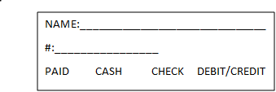
CLIP-CLOP FARM HUNTER JUMPER
CLASSIC 2026
Hitch Stable Show Dates (Circle Date)
June 27, July 11, September 5, November 14, & December 12
2027 SHOWS January 9, February 6,
March 6, April 3, May 1, June 26, July 10,
September 4, November 13, & December 11
OFFICE USE ONLY
ONE HORSE/RIDER per entry form (Mark show above)
Rider Name: ___________________________________________DOB: ______________Phone:____________________
Horse/Pony Name: _____________________________________Age/Sex :______________Breed/Hands____________________
Trainer Name:________________________________________Phone:__________________________
Rider Mailing Address:____________________________________________________
CLASSES (Hunter/Eq)_______________________________________________________________________
CLASSES (Jumpers)_________________________________________________________________________
CLASSES (Medals/Classics/Gambler's Choice/Team Challenge)_________________________________________________
Office Fee(per equine/rider combo): $20.00 per combo ____1___ x $ 20.00 = $__20.00___
Facility/Schooling/Grounds Fee : $30.00___1___x $30.00 = $__30.00__
HUNTER/EQ. CLASSES- $20.00 per class or ______ x $20.00 = $__________
JUMPER CLASSES-$25.00 per class or ________x $25.00 = $__________
CLASSIC/MEDAL CLASSES- $40.00 per class or _________x $40.00 = $____________
Post Entry Fee $25/per horse/rider combo or _______x $25.00 = $____________
Stalls: Day Stall(if available) ______ x $50.00 = $__________
Stall: Weekend Stall (Fri-Sat)_____x $85.00= $__________
Haul Ins (Per horse/rider combo)_______x $30.00 per day= $________
Shavings per bag- $10/bag (outside allowed) ______x $10.00 =$________
Camping (Hookups): $100 per night ________ x $100.00=$_______________
Camping (Dry Camping): $40 per night ______ x $40.00 = $__________
Photography Non-Refundable Deposit for Photos(if you want photos)___1____x $50.00 = $__________
TOTAL $______________________ (3% credit card fee of total due)
ENTRY AGREEMENT: By entering and signing this entry blank, and on behalf of myself and my participants, guardians, representatives, employees and agents, I AGREE to release and hold harmless Clip-Clop Farm, LLC, BREC’s Farr Equestrian Park & Hitch Stables and their officials, directors, volunteers, agents and employees for any action. I represent that I am eligible to enter and/or participate under the rules of the Competition, and every horse I am entering is eligible as entered. This document waives important legal rights. Read it carefully before signing. I AGREE in consideration for my participation in this competition ("Competition"), which is managed by Clip-Clop Farm LLC, BREC’s Farr Equestrian Park & Hitch Stables to the following: I AGREE the construction and application of Clip-Clop Farm, LLC, BREC’s Farr Equestrian Park & Hitch Stables rules are governed by the laws of the State of Mississippi and Louisiana, and any action instituted against Clip-Clop Farm, LLC, BREC’s Farr Equestrian Park & Hitch Stables must be filed in the State of Louisiana and Mississippi. I AGREE that Clip-Clop Farm, LLC, BREC’s Farr Equestrian Park & Hitch Stables as used herein includes Competition Management, as well as all of their officials, officers, directors, employees, agents, personnel, and volunteers. I AGREE that I choose to participate voluntarily in the Competition with my horse, as a rider, handler, lessee, owner, agent, coach, trainer, or as parent of guardian of a junior exhibitor. I am fully aware and acknowledge that horse sports and the Competition involve inherit dangerous risks of accident, loss, and serious bodily injury including but not limited to broken bones, head injuries, trauma, pain, suffering, or death. ("Harm"). I AGREE to hold harmless and release Clip-Clop Farm, LLC, BREC’s Farr Equestrian Park & Hitch Stables and Competition Management from all claims for money damages or otherwise for any Harm to me or my horse and for any Harm of any nature caused by me or my horse to others, even if the Harm arises or results resulted, directly or indirectly, from the negligence of the Competition. I AGREE to expressly assume all risks of Harm to me or my horse, including Harm resulting from the negligence of the Competition. I AGREE to indemnify (that is, to pay any losses, damages, or costs incurred by) the Competition and to hold them harmless with respect to claims for Harm to me or my horse, and for claims made by others for any Harm caused by me or my horse while at the Competition. I ACKNOWLEDGE that no protective equipment can guard against all injuries. If I am a parent or guardian of a junior exhibitor, I consent to the child's participation and I AGREE to all of the above provisions and I AGREE to assume all of the obligations of this Release on the child's behalf I represent that I have the requisite training, coaching and abilities to safely compete in this Competition.
BY SIGNING BELOW, I AGREE to be bound by all applicable terms and provisions of this entry blank.
________________________________________________________________Rider or Guardian / Date
_________________________________________________________________Trainer / Date

Slide 5

Clip-Clop Farm Show Photography Form
($50 Non-Refundable Deposit due at time of sign up)
Name of Exhibitor: __________________________________________________________
Address: __________________________________________________________________
City:__________________________State: __________Zip: _______________________
Phone Number/Email: __________________________________________
Name of Horse/Pony: ____________________________________
Classes_____________________________________________________________
We are excited to serve the horse show as the official photographer. Please sign the release to ensure photos can be taken and used. SAVE 20% ON YOUR FIRST ORDER WHEN YOU BUY PHOTOS & GIFTS OFF OF THE WEBSITE WWW.ACPHOTOART.COM
For more information contact: Andrae Cameron, 24949 SW Baker Road, Sherwood OR 97140
Phone: 503-421-8724
Email: Sales@acphotoart.com or acphotollc@gmail.com
PHOTO RELEASE
For good and valuable consideration, the receipt of which is hereby acknowledged, I,
________________________________, hereby grant AcPhotoArt permission to use my likeness in a photograph in any and all of its publications, including but not limited to all of AcPhotoArt's printed and digital publications. I understand and agree that any photograph using my likeness will become property of AcPhotoArt and will not be returned.
I acknowledge that since my participation with AcPhotoArt is voluntary, I will receive no financial compensation. I hereby irrevocably authorize AcPhotoArt to edit, alter, copy, exhibit, publish or distribute this photo for purposes of publicizing AcPhotoArt's programs or for any other related, lawful purpose. In addition, I waive the right to inspect or approve the finished product, including written or electronic copy, wherein my likeness appears. Additionally, I waive any right to royalties or other compensation arising or related to the use of the photograph.
I hereby hold harmless and release and forever discharge AcPhotoArt from all claims, demands, and causes of action which I, my heirs, representatives, executors, administrators, or any other persons acting on my behalf or on behalf of my estate have or may have by reason of this authorization.
Printed Name: _________________________________ Date: _________________________
Signature: ______________________________________________________
Signature: ______________________________________________________
Signature of guardian if under 18 years of age

