Slide 1
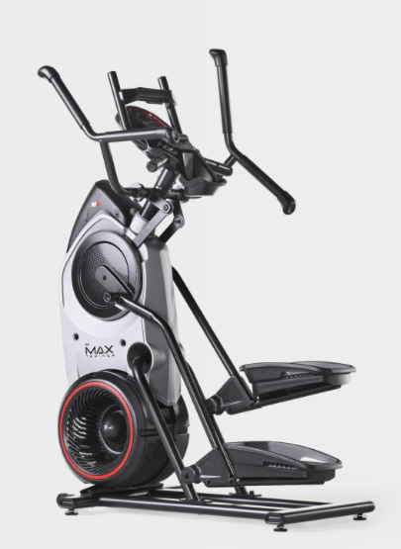
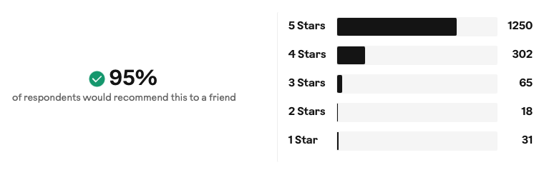
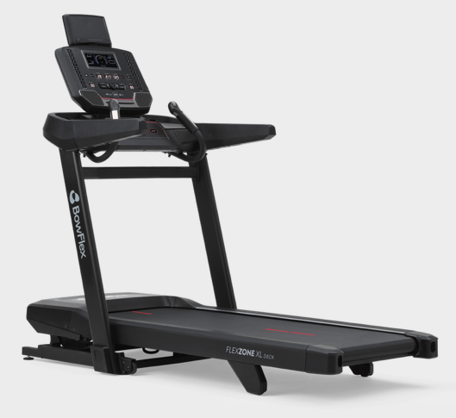
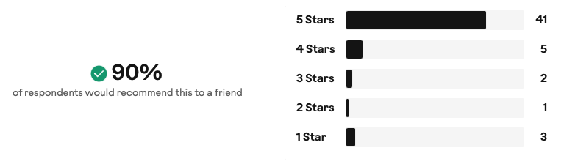
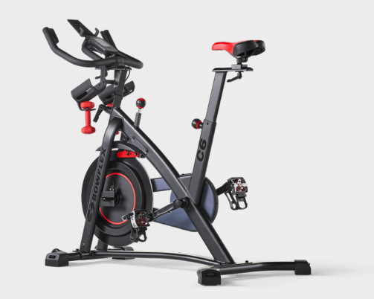
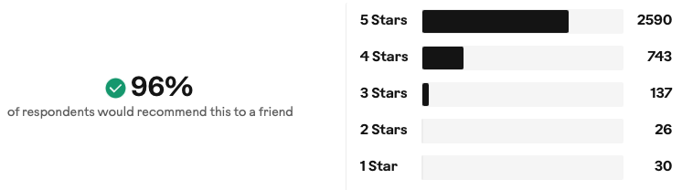
Centra Falls Homeowners Association, Inc.
Gym Equipment Order – Recommended Only
One (1) Eliptical
BowFlex Max Trainer M6
$999.00 through 2/21 then $1,299.00
Two (2) Treadmills
BowFlex T9 Treadmill
$1,399.00 through 2/21 then $1,799.00 (each)
$2,798.00 through 2/21 then $3,598.00 (total)
One (1) Stationary Bike
BowFlex C6 Bike
$899.00 through 2/21 then $999.00

Slide 2
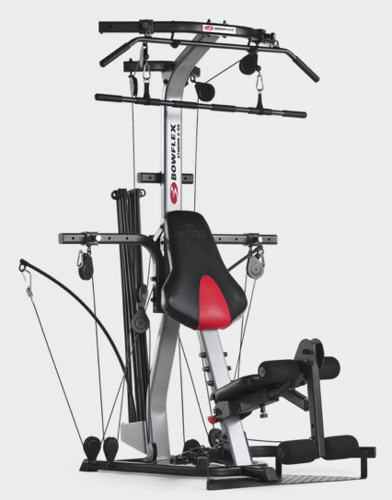
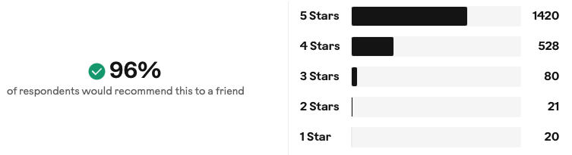
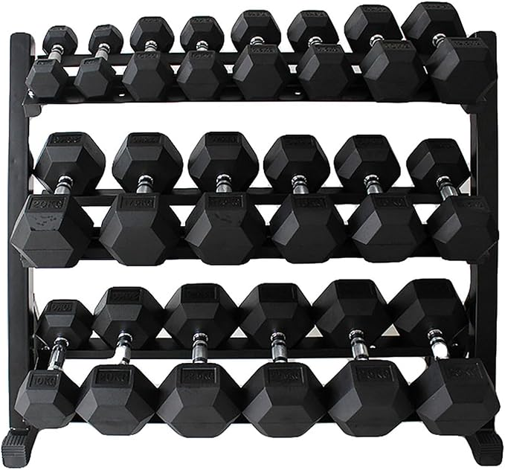
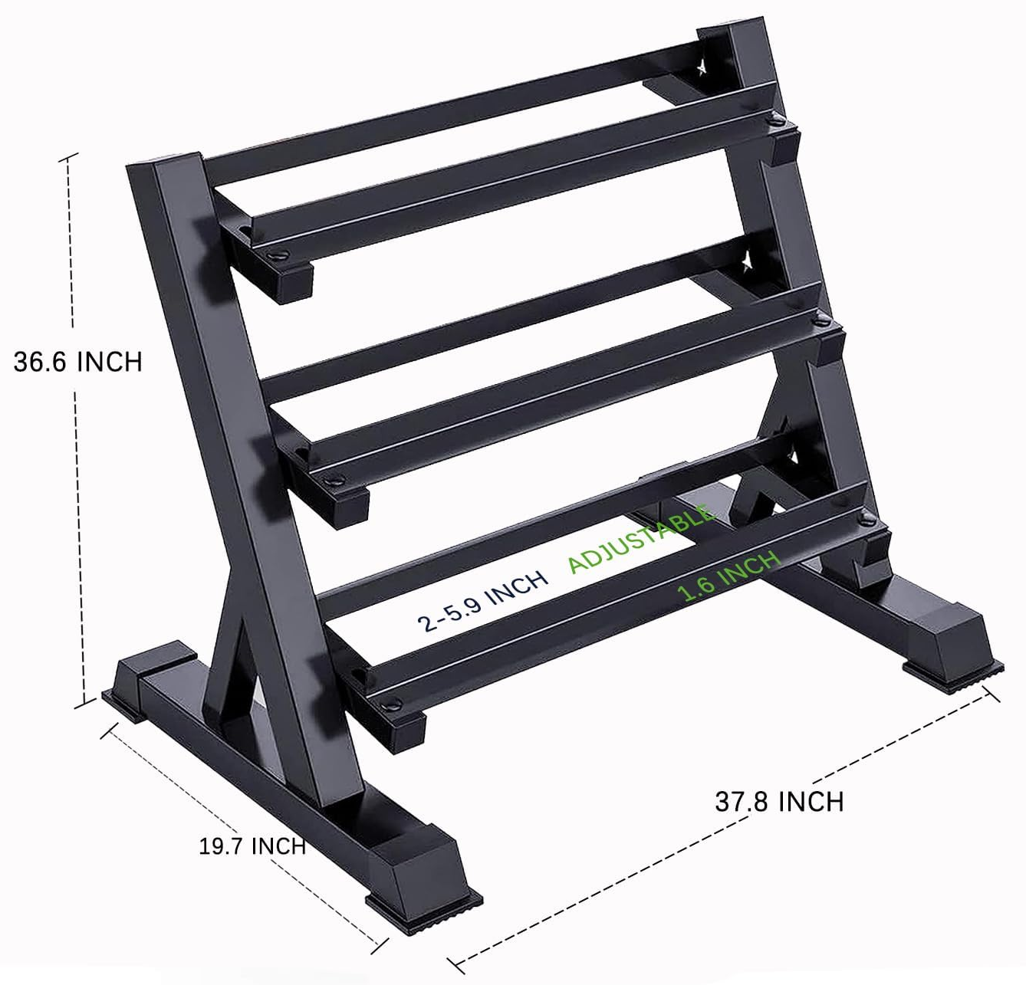

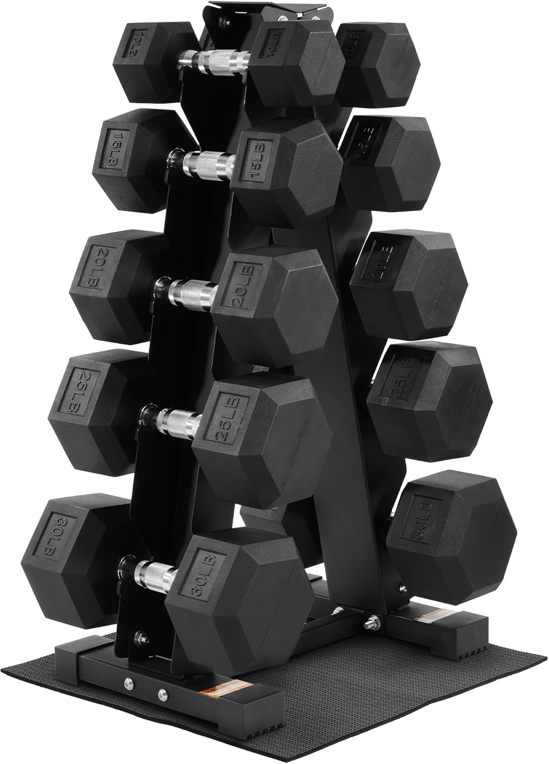
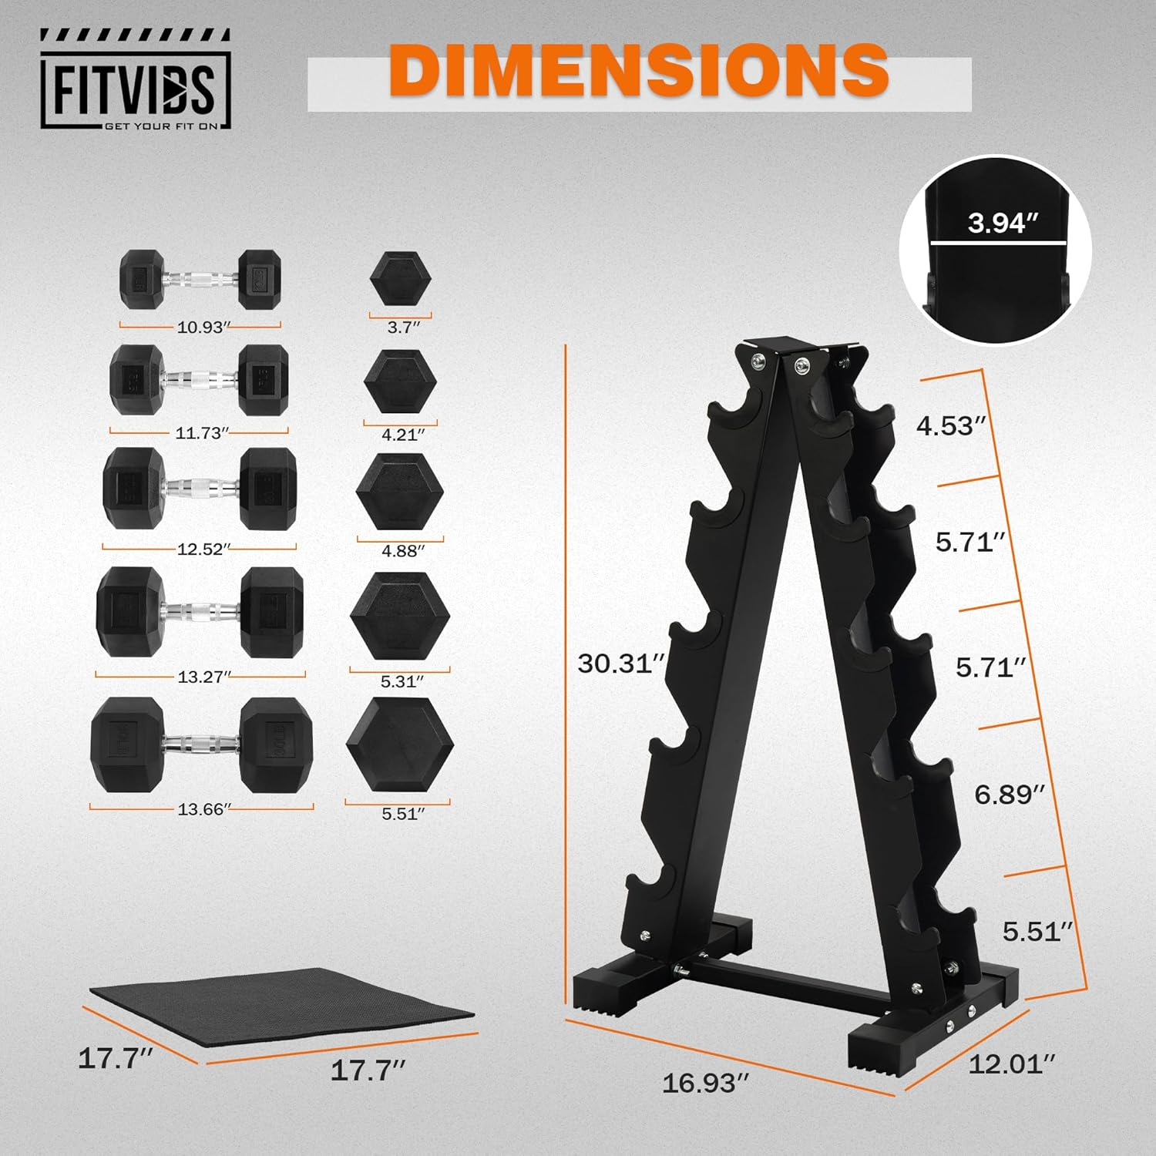

Centra Falls Homeowners Association, Inc.
Gym Equipment Order – Recommended Only
One (1) Multi-Gym
BowFlex Xtreme 2 SE Home Gym
$999.00 through 2/21 then $1,499.00
Chest, arms, leg extension, fly’s
DOES NOT DO: Incline bench press
One (1) Weight Rack
2 @ 10# | 2 @ 20# | 2 @ 25# | 2 @ 30# | 2 @ 40# | 2 @ 50# [350#]
$528.99 Total
https://a.co/d/08CZq7GB
One (1) Weight Tree
2 @ 10# | 2 @ 15# | 2 @ 20# | 2 @ 25# | 2 @ 30# [200#]
$299.99 Total
https://a.co/d/0frtfIdJ

Slide 3
Centra Falls Homeowners Association, Inc.
Gym Equipment Order – Recommended Only
Budget Breakdown
Item | Unit Cost | Ext Cost
1 Elliptical | $1,299.00 | $1,299.00
2 Treadmills | $1,799.00 | $3,598.00
1 Stationary Bike | $999.00 | $999.00
1 Multi-Gym | $1,499.00 | $1,499.00
1 Weight Rack | $528.99 | $528.99
 | TOTAL: | $7,923.99

