Slide 1




GFCT
GFCT computerisation seminar 28-11-2019

Slide 2

GFCT – Graham Fulford
GFCT computerisation seminar 28-11-2019

Slide 3


Todays seminar is dedicated to
David and Dorothy Baxter Smith

Slide 4
And is in memory of, and with many thanks to
Roger Wootton
Gary Steele MBE
Keith Cass MBE
David Smith
Mike Lockett
Jim Swainton
For their selfless dedication to improving Prostate Cancer Awareness and early diagnosis alongside brave fights against the disease itself.

Slide 5
Thanks to the following
sponsors without whom today
and this new initiative could
never have happened
Bedford PCSG
Boston Scientific
Craighaven Ltd
Dave Mathews
Empresa Ltd
Henry VIII Trust Warwick
Keith Harrison
Lucey & O’Sullivan
Marshall Developments Ltd
Newbold Developments Ltd
Solutions UK Ltd
TGFP Ltd
The Doctors Laboratory
WA and Mrs PC Jenkin
Warwick in Need
Warwick Provident Dispensary
Warwick United Charities

Slide 6
GFCT – mission statement
To promote as much prostate health awareness as possible including supporting a PSA testing programme to encourage as many men as possible over 40 to get tested and to get ‘a score on the door’

Slide 7
Gfct – 2005
Introduction to DBS with first testing event at the Spa Centre in Leamington Spa in October attracting 151 men leading to 6 cancer finds and needing a follow up session in November with a further 110 tests and 6 cancer finds!

Slide 8
GFCT – 2006-2013
Developing a network of like minded people including:
PCaSO
PCSG’s
Lions
C.H.A.P.S
Rotarians
Masons
And many more with the number of tests steadily increasing year on year.
Mechanising the result sending system to relieve David and Dorothy having to spend every evening at their dining room table!

Slide 9
Gfct – 2014
Sue and I becoming increasingly concerned that with more and more men returning for a follow up test we were unable to provide the all important ‘history’ of their scores with the resultant PSA velocity!
In August through personal sponsorship and support of the late, great, Gary Steele MBE, launched a planned 22 month programme to computerise all past and ongoing results.
We were supported by Katrina Jakeway, Ken Williams and Mike Young who helped design and implement the existing Access based system. Thanks to the dedicated resolve of Wendy Hodgkinson and Steve Valentine this project came in 3 months early being completed in February 2016.

Slide 10
Gfct – 2014-2015
We became concerned that whilst we now had history and ‘PSA Velocity’ we still needed to ensure men were aware of the potential impact of change and developed our current ‘Amber Alert’ system.
Described to me by Alan Doherty as:
“something to be very proud of and which currently the NHS has no way of matching”

Slide 11
Gfct – 2016/17
Continued growth with interest being shown by “Corporates” – keen to look after their male workforce members

Slide 12
Gfct – 2018/19
Cliff and Andrew as grateful recipients of the now well established PCaSO Testing programme offered to help them set up a computer based, rather than paper driven booking and appointment system.
Changed our name to GFCT

Slide 13
Gfct – June 2019
Having appointed Susan Hart as Trustee to manage the charity, asked her view on:
“the best way forward to streamline the operation and increase the number of tests we could do, particularly given the interest being shown in a testing programme by more groups and corporates”
The reply?
“Let men book online and get their result online”
The online journey begins…….

Slide 14
GFCT – Database statistics
There are over 140,000 test records.
There are over 100,000 men on the database.
These men live in 69,500 unique postcodes, including 6 European postcodes.
The number of annual tests has risen steadily from only 315 in 2005 to 27, 804 in 2018.
The most popular birth date is 13th March 1947 – where there are 35 men.
The most popular birthday is 2nd March – where there are 487 men.
The most popular birth year remains where it has been since the start – 1947 – when 5936 men were born.
The most popular first name on the database is Dave/David, of which we have over 5800.
There are almost 3000 unique first names on the database.
The breakdown of PSA scores by decade is as follows:
All Tests |  |  | Amber Alerts
Age | Highest PSA | Average PSA | No. AA | with FT | FT = 0.18 | Avg FT
30-39 | 6 | 0.81 | 2 | 0 | N/A | N/A
40-49 | 25 | 0.94 | 34 | 11 | 0 | 0.22
50-59 | 299.4 | 1.32 | 174 | 90 | 6 | 0.19
60-69 | 1251 | 2.27 | 510 | 281 | 19 | 0.2
70-79 | 1175 | 2.84 | 452 | 259 | 9 | 0.21
80-89 | 192.4 | 3.56 | 53 | 40 | 2 | 0.25
Note:
These statistics are correct as of the 15th November 2019.

Slide 15

PCASO - Online Registration System for PSA Testing Events
GFCT computerisation seminar 28-11-2019

Slide 16
PCASO team
Roger Bacon
Cliff Carter
Peter Weir
Vivian Miles

Slide 17
PCaSO Sussex
Vivian Miles, Treasurer

Slide 18
Turnbull-Fry

Slide 20
PCaSO Sussex: position end 2018
All tests must be booked.
Manual booking and admin system feeding into GFCT.
System worked well to professional standards including GDPR compliance.
Enormous strain caused by surge in testing demand post Turnbull-Fry.
Situation critical at end of autumn 2018 testing season.

Slide 21
PCaSO Sussex: 2019
New booking and admin system using Event Espresso introduced progressively during 2019.
Easy to use, minimal user training required.
98% of bookings now online, reducing phone calls
Hand-written registration forms eliminated.
Blood vial labels printed by system.
Closer working relationship with pathology labs.
Registrations and results uploaded to GFCT system.
Next step: fully integrated GFCT system.

Slide 22
PCASO
GFCT computerisation seminar 28-11-2019

Slide 23
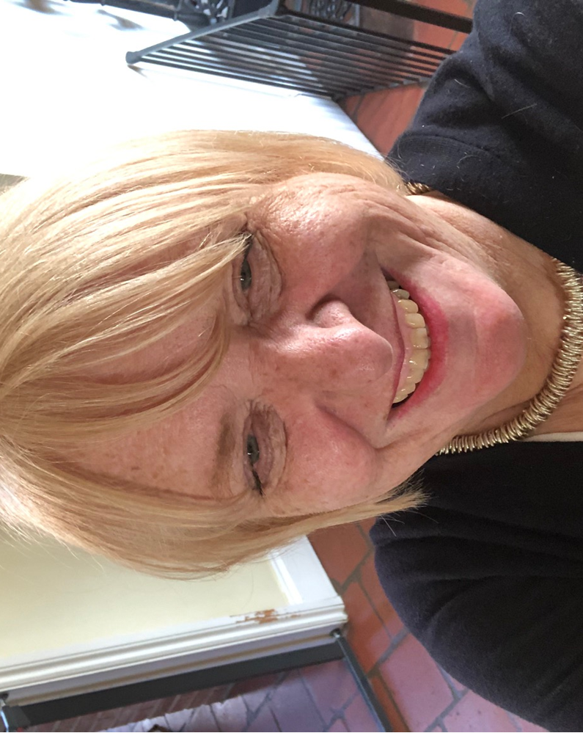
GFCT – Susan hart
GFCT computerisation seminar 28-11-2019

Slide 24
Background
Known Graham and Sue for 35 years
Corporate and Start up Businesses
Four Businesses
  Customer care and sales and marketing training company
  DDAT – Business Development Consultant – within 18 months we had taken the company from 3 people to 271 people. Opened 18 clinics in 4 Continents, Procedures and Systems in place
  Online business to business recruitment
  Property Taxation

Slide 25
Findings
Everything was paper based
The PCaSO, Prostate Project and Leighton Hospital had their online systems starting using spreadsheets which we could quickly upload and process letters.
GFCT has been using this system, as it has made life at lot easier, however, there are still some issues, such as partial matches when inputting the data that takes time sorting out. No personal records or enabling guys to get their history of tests.
Prior to the event –
  No forward advice provided – when events are taking place
  No information for the laboratory when bloods arrive. So DBS, the Lab and the office are working in the dark!
  Consent forms arrive weekly without a venue and who organised the event.
  We don’t get all the consent forms.
  This occurs weekly!

Slide 26
Journey of a consent form and issues!
What I have observed at events:-
  How people complete consent forms, no tables are provided, completing them standing without a clipboard
  Handwriting is like a doctors! Welsh names and towns!
  Missing consent forms!
  The blood results sent to us, the names don’t match the consent forms, and the date of birth do not correspond
  At a recent event, a guy completed a consent form, handed it to me to complete the blood form. When I copied his name across to the form, he said “that’s not my name”. He had spelt his own name incorrectly!

Slide 27
Journey of a consent form [continued]
So we have become detectives
  We have to decipher – names transposed, so Joseph Hugh becomes Hugh Joseph
  Then the date of birth may have been typed incorrectly.
  Incomplete postcodes – so we look up the address on the Royal Mail post code finder. This all takes time.
  Email addresses are incomplete or just wrong [1’s and I’s o’s and 0]
  Eventually we find the gentleman concerned and we get the result out to the correct man.
    One case, it took half a day to sort out, because the blood results had been inputted incorrectly and the date of birth mistyped

Slide 28
Journey of consent form [continued]
Processing of Results
  Once inputted into the database
    Emails
      Perceived to be spamming people by Hotmail, Yahoo and Sky
      Increase in emails, because people are becoming more technical and most people now have a smart phone or computer or tablet
        Deciphering the handwritten email addresses has been a challenge
      We get returned letters, stating addressee not at this address
      We contact these people by phone and they inform us the details are correct
        So we send them again
  Costly and we are fire fighting and my brief from Graham and Sue was to increase the number of men tested.

Slide 29
NeW procedures have been put in place
There is now a form for all organisers to complete prior to an event taking place. Please advise us when the events are taking place!
If you advise us we then know how many phlebotomists we will require. Also how may people we need in the office to process results.
On receipt of the consent forms, we now count them
  We are finding discrepancies immediately – usually consent forms are missing
  When the consent forms have been inputted into the database
    We do a quality control check to ensure the people have the correct PSA score
    At this point we also check for typo faults with names and whether there was sufficient blood for the result to be provided
    We send out kits for a retest for insufficient blood

Slide 30
SO WHAT TO DO?
Stop relying on volunteers?
Have freelance permanent staff – 4 at least for 10,000 per month!?
Still have human error – no one is perfect!
Increasing the number of staff, means:-
  Larger offices!
  More hardware!
  Increased overheads!
  So increasing the processing costs!

Slide 31
Solution – TO SOLVE ALL THE ISSUES
Web based
Gentleman can input their own details, SO THEY ARE CORRECT! They will be able to build up a history of their PSA scores, which their doctor will be able to access
They will be able to select a convenient appointment time to suit their lifestyle
We will know how many people will be attending each event
So we will know how many phlebotomists we will need for each event
RESULTS WILL BE AVAILABLE WITHIN 72 HOURS!

Slide 32
Thank you to the team
During October we processed 10,000 consent forms
  Caitlin, Carla, Katrina, Jane, Jon, Mike, Sam and Wendy who have worked long days and weekends to help stay on top of the inputting. They are a brilliant team!
Graham’s future plan
  Is to get as many men tested around the UK – 10,000 men a month!!
  So the solution is – computerise the system – every man to have a PSA Bank Account!

Slide 33
GFCT – Susan hart
GFCT computerisation seminar 28-11-2019

Slide 34
GFCT – guest speaker
GFCT computerisation seminar 28-11-2019

Slide 35



My PSA Tests
https://mypsatests.org.uk
Matthew Brine (MD @ Empresa Limited)
20 years developing Bespoke Systems, Apps and Websites
w: empresa.co.uk e: m.brine@empresa.co.uk

Slide 36
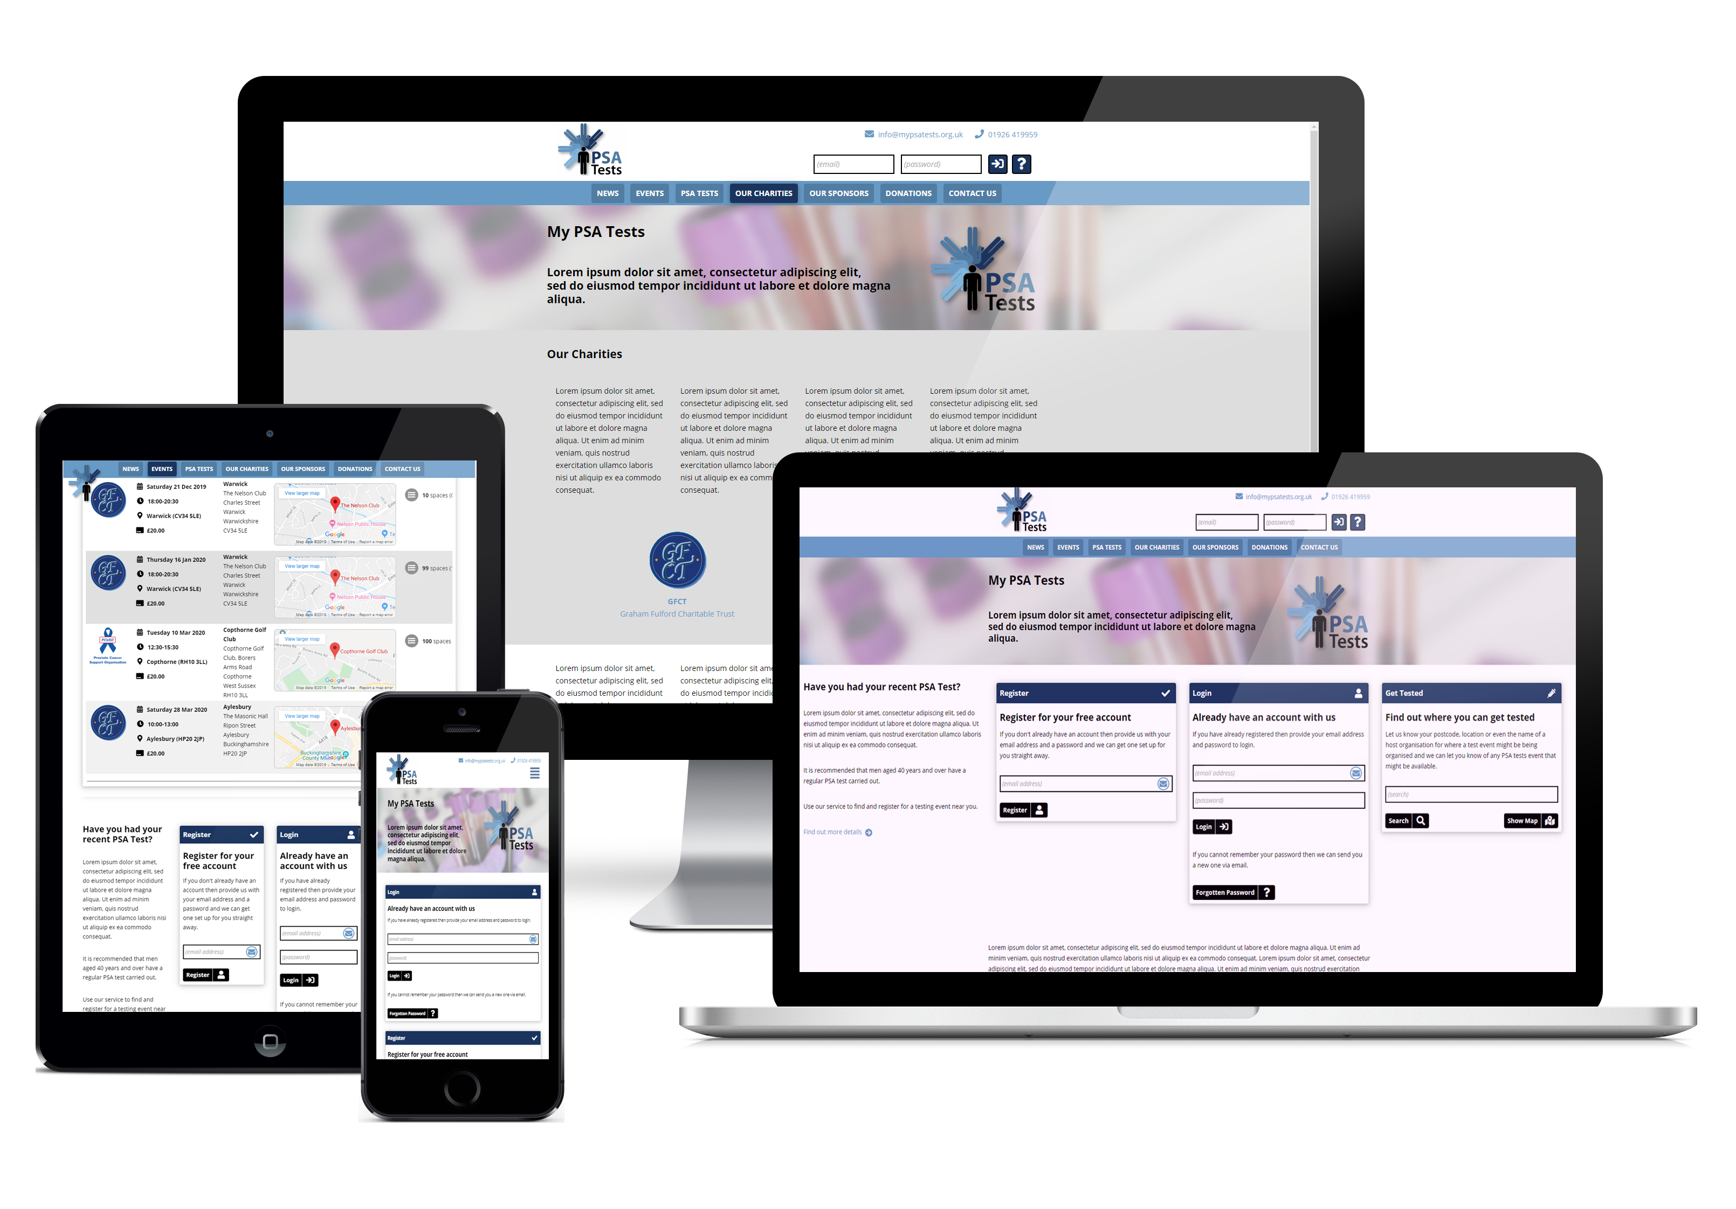

Slide 37
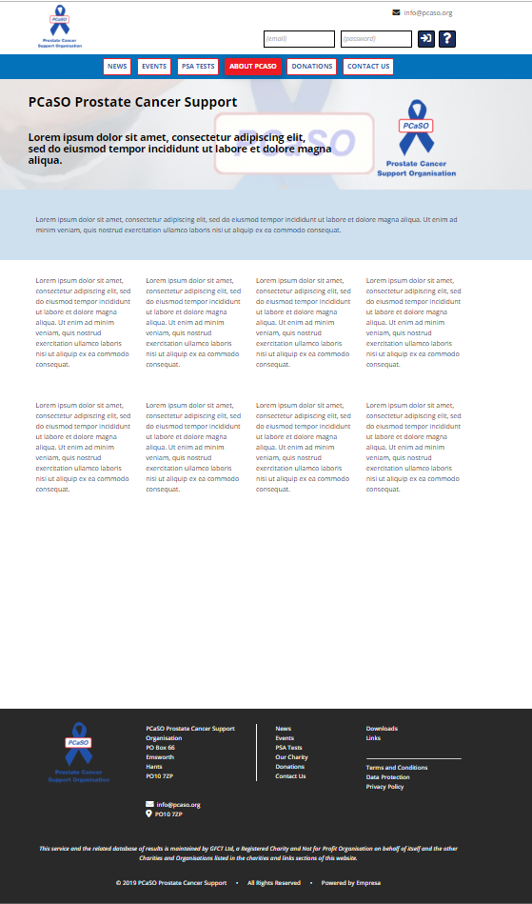
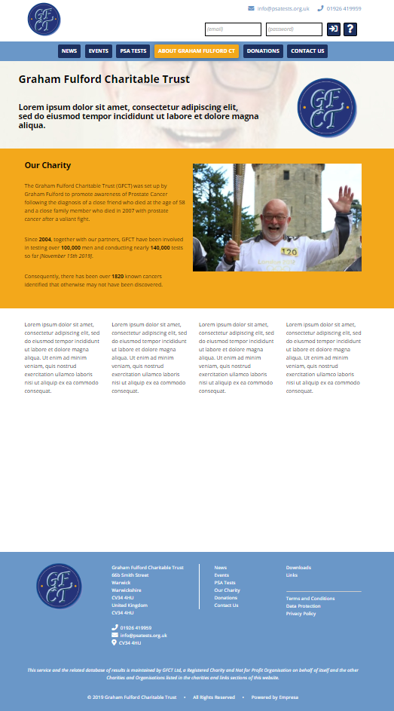
Charities
White Labelling for Charity Branding
  Fonts, Colours, Images
  Re-enforcing their identify for their visitors
  Charity Information Page
  Shared News and Information
https://GFCT.mypsatests.org.uk
https://PCaSO.mypsatests.org.uk
National Database of PSA Testing
Shared Results for National Analysis/Reporting
Accessibility to Testing Events across the UK
  Find an Event near you, which Charities are in your area?

Slide 38
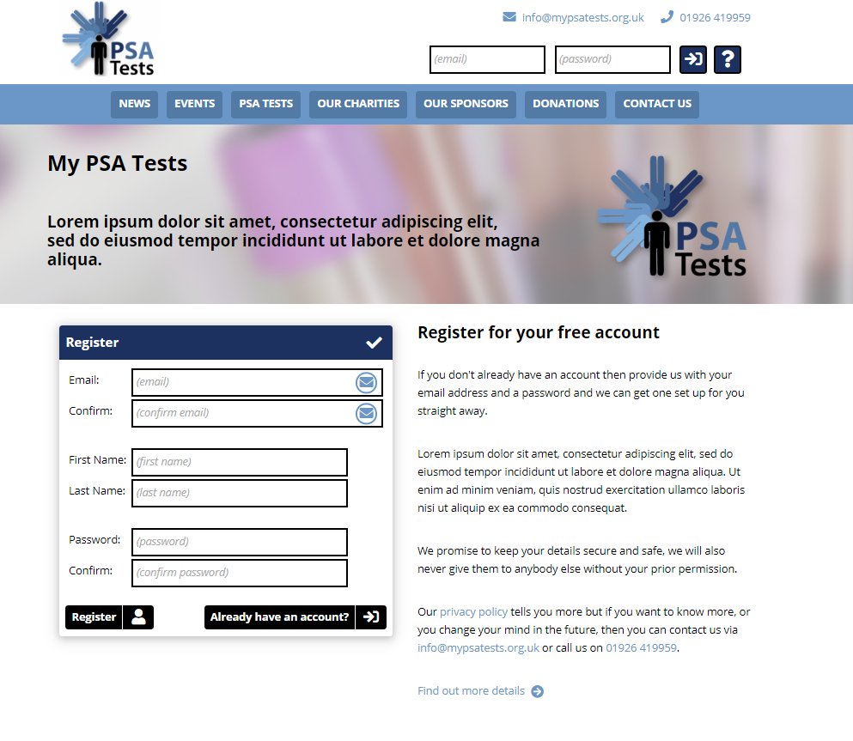
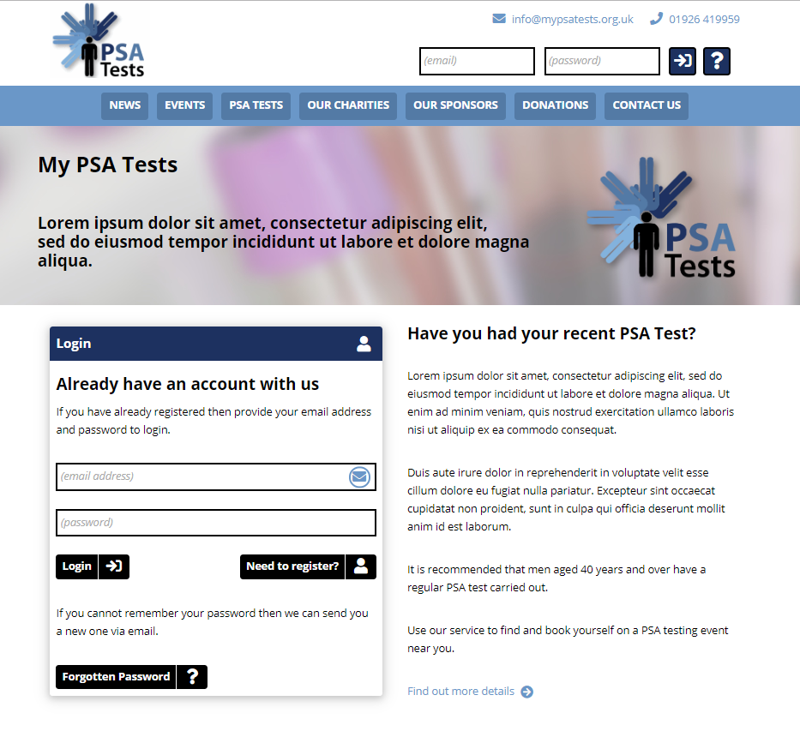
Visitors
Free Registration
  Email (Primary method of Login)
  Name (First + Last Name)
  Password
Login (Email address)
Forgotten Password (Email password resets)
Users allocated Unique User ID
Email addresses can be updated
No other data required until booking for an event
Accounts can be created by Administration (on behalf…)

Slide 39
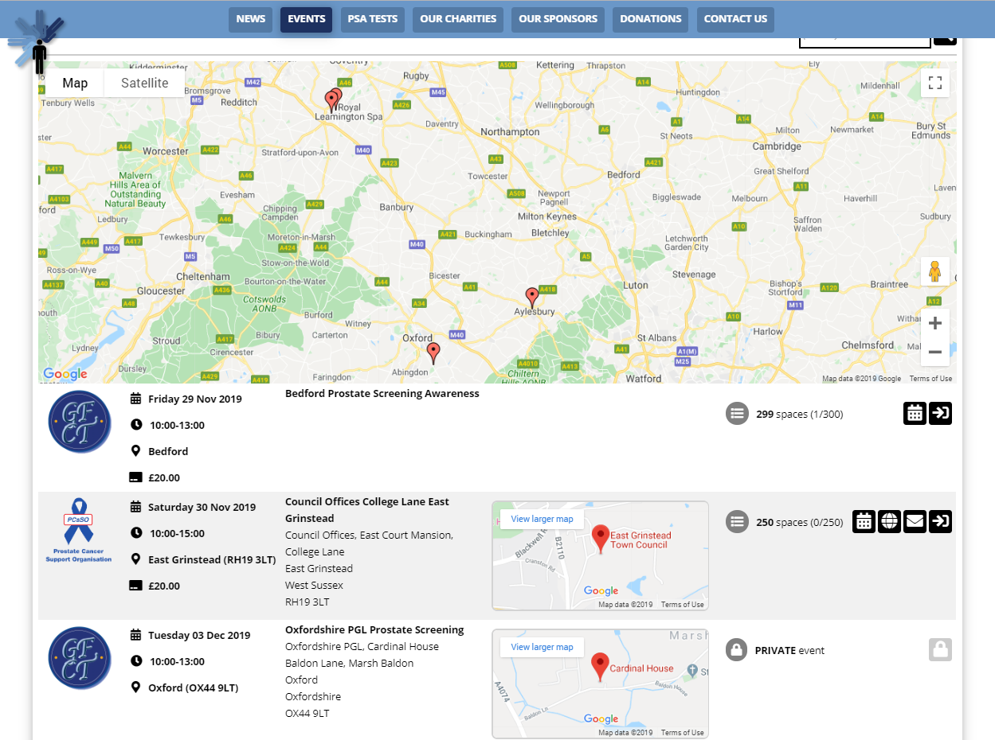
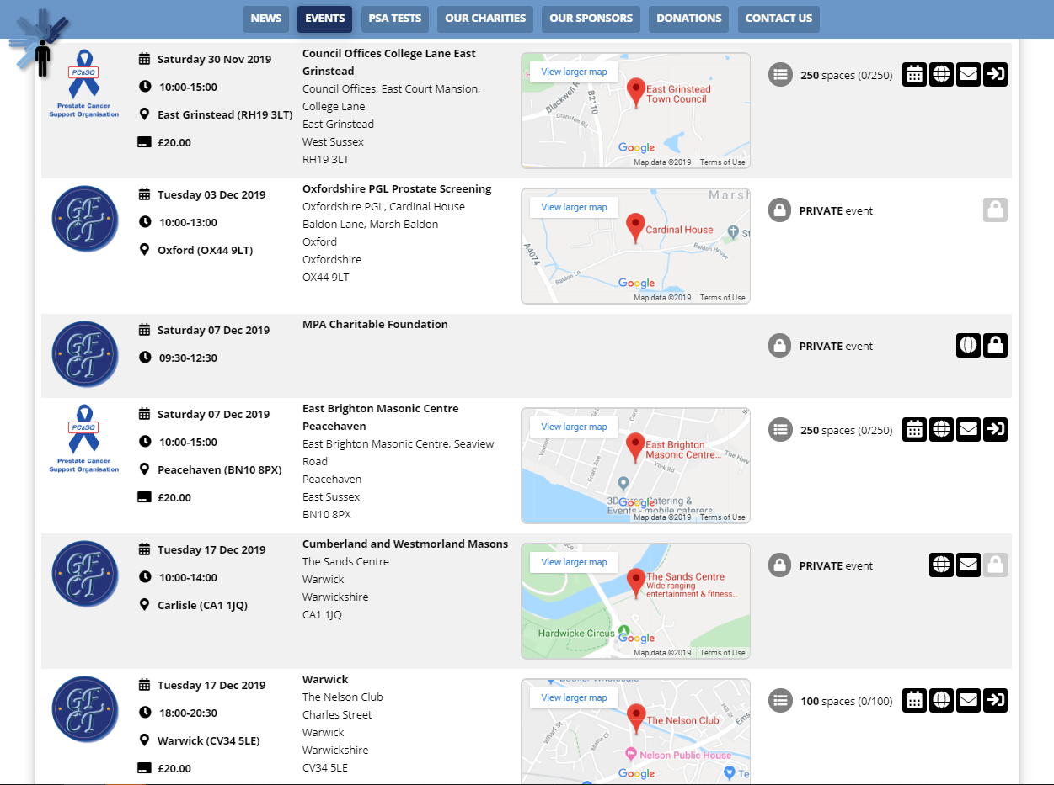
Events
Dates and Timings
Venues
  Locations / Maps
  Website / Email / Telephone
Information for Event / Venue
Timings / Slots / Durations – random defaults to help spread selections
Bookings
  Limitations – Slots per Time (“Locked during booking”)
  Open / Closed Booking Periods (+ “Waiting Lists”)
  Free / Fixed Price / Donations (+ Gift Aid)
  Administration option for manual telephone / face to face bookings
  Unique user + event + booking codes are assigned
Open Events
Private Events (optional code to access)
Searching / Filtering - Charity, Locations and Venues

Slide 40
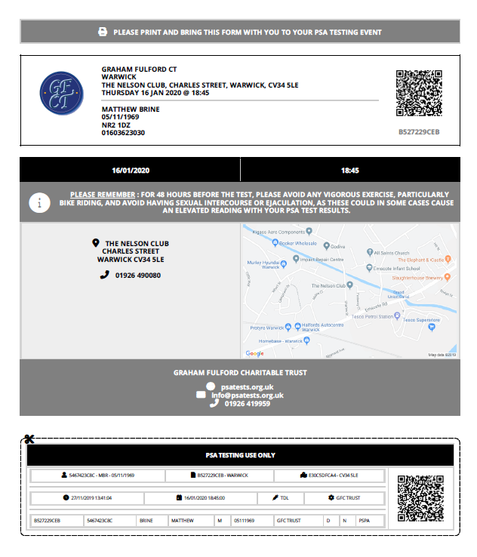
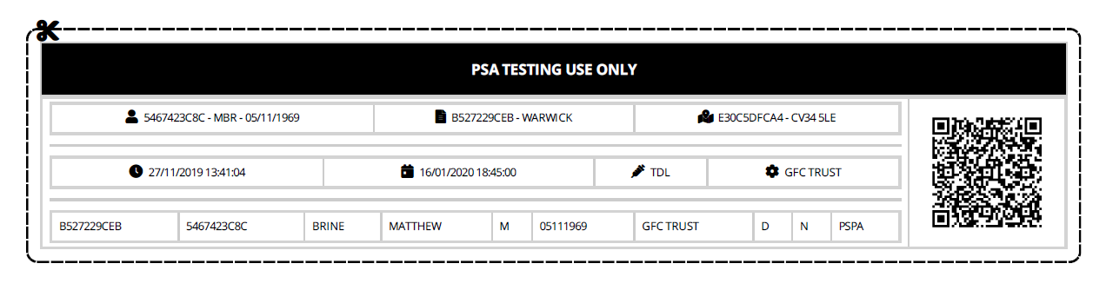
Confirmation
Consent Forms will be processed at the point of booking (+ capturing address/DOB)
Optionally requesting the method of result notification (email, letter, telephone)
Booking Forms – Print / Emailed/ Download (PDF)
Customisable Forms per Charity
  Content / Layout – Template is White Labelled
  QR Code/ Bar Code Requirements for Laboratory
  Data Quality improvements using scanning codes to embed data
Full Sheet or Tear Off Sheet (Format as Required)
Optionally Printed on Paper or Labels
Printed and brought to the event
Printed onsite if IT equipment and Wi-Fi/3G+ available
Reminder emails / texts sent “n” days prior to the event
Emails will include tracking codes (?) identify when read
Paper letters will still be an option where required
Future : Paperless Testing (Labels ONLY)

Slide 41
Testing
Registration facility to identify who turns up (key in code or scan QR code)
Registering and printing forms onsite if IT equipment and Wi-Fi/3G+ available
  Usage of laptops and tablets by volunteers on the day of testing
  Future potential to have “kiosk” tablets available for self-service
Reporting to see track attendances and no shows at the event
Hand written sheets will be a fallback option (“manual linking of results data”)
Non digital accounts will be available for people not wanting to register
Forms to be attached with the blood sample
Forms can be tailored as required by Laboratory
  Tear off slips or entire forms
  Pre-printed forms will improve data quality
  Future approach could be printing labels on test tubes
Invitations to future events as required (“n” years, as per results)

Slide 42
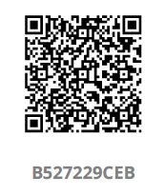
Results
Laboratory will be able to scan the forms or type in codes when receiving samples
Results once processed will be published to secure cloud storage by lab systems (TDL)
Data will be transmitted electronically back to the central results database
  Codes returned in result data to allow us to identify person, event and booking
  Paper based on manually produced forms will appear with manual interaction (fallback only)
  Results will be processed with both a lab and charity defined R/A/G status (score + medical Qs)
  Future development to cope with other ways to interface with other labs (CSV, API, email, services etc)
Administrators will be able to monitor the results processing
  Identify which results are missing or delayed (action required?)
  See who has logged on and looked at their results via the system
Statistics of all current and previous data can be merged for matching users
  Historical “n” years of data from GFCT database will be loaded in results database
  Automated and semi-automated matching new and old results (matching to historical data – awareness of hoax users)
Emals will be sent as the result has arrived and been processed – “user will log on to see results” (tracked when logged on)
Email and text message nudges can be sent where people haven’t logged on
Allowance for letter mail merging where print and post is still required or requested

Slide 43
Results

Slide 44
Considerations
Quality of Registrations
  Avoid duplications when registering by checking email/name/dob etc
  Activity to import legacy data from GFCT database – matching process
Email Security and SPAM
  Emails need to be sent with DNS SPF records for all domains
  Content of emails need to be well formed HTML
  Flexibility to send via Charity email server or Empresa services
  Sending emails from mypsatests.org.uk by reply addresses set
  Emails contain tracking images (?) to audit read notifications
Scalability
  Restricted by infrastructure rather than technology used
  Consideration for shared and dedicated services in future
  Unlimited users, charities and events (scalable)
  Resilience using cloud infrastructure (monitored 24x7x365)

Slide 45
Futures
“My PSA Tests” App for iOS and Android
More labs interfacing to consider (automated/manual)
More formats for forms
Variation to data capture and terms to be agreed
Potential source for more test results data
Reporting and statistical analysis
Feedback -> Development -> Feedback -> …

Slide 46
























Process
Register
Result
Booking
Confirmation
Reminder
Test
Laboratory
Events
Notify
Report
Check In

Slide 47
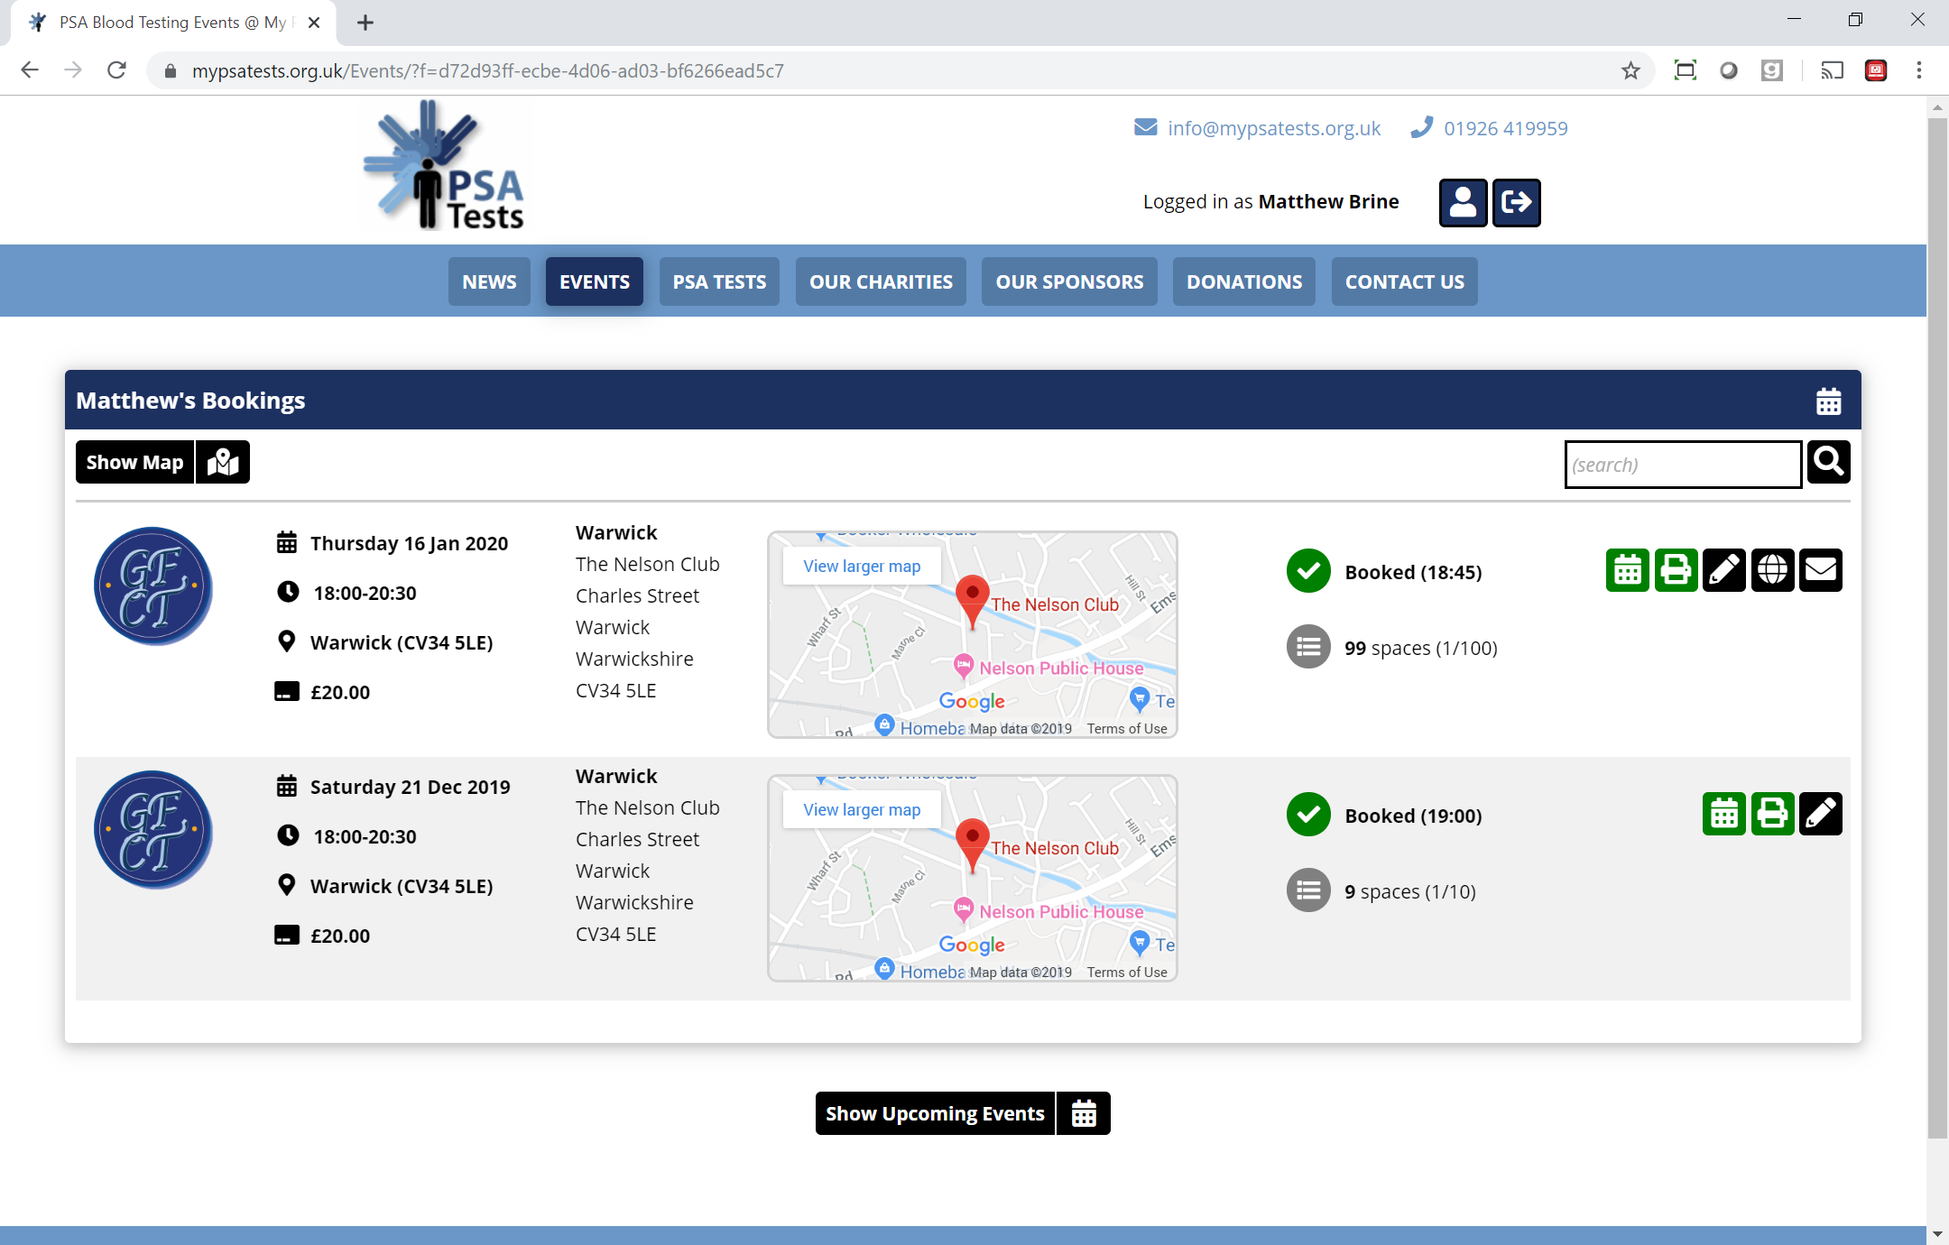
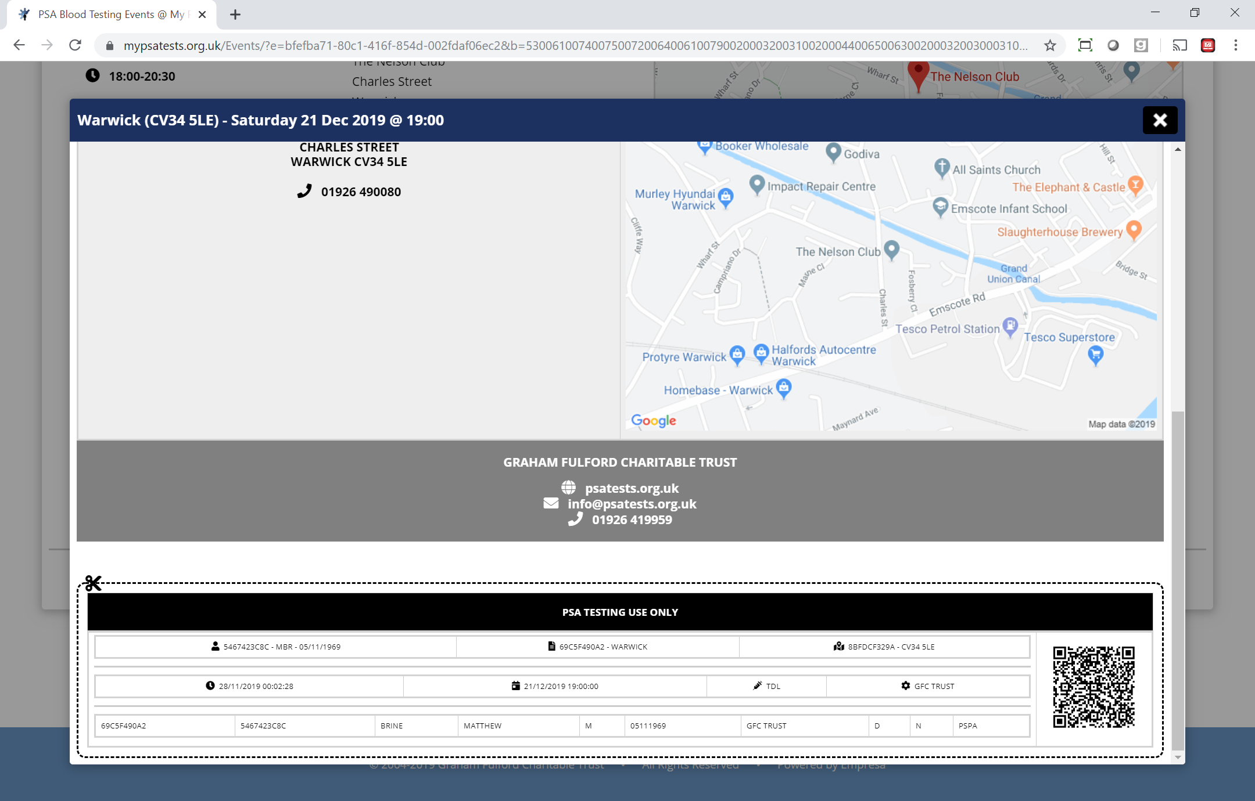
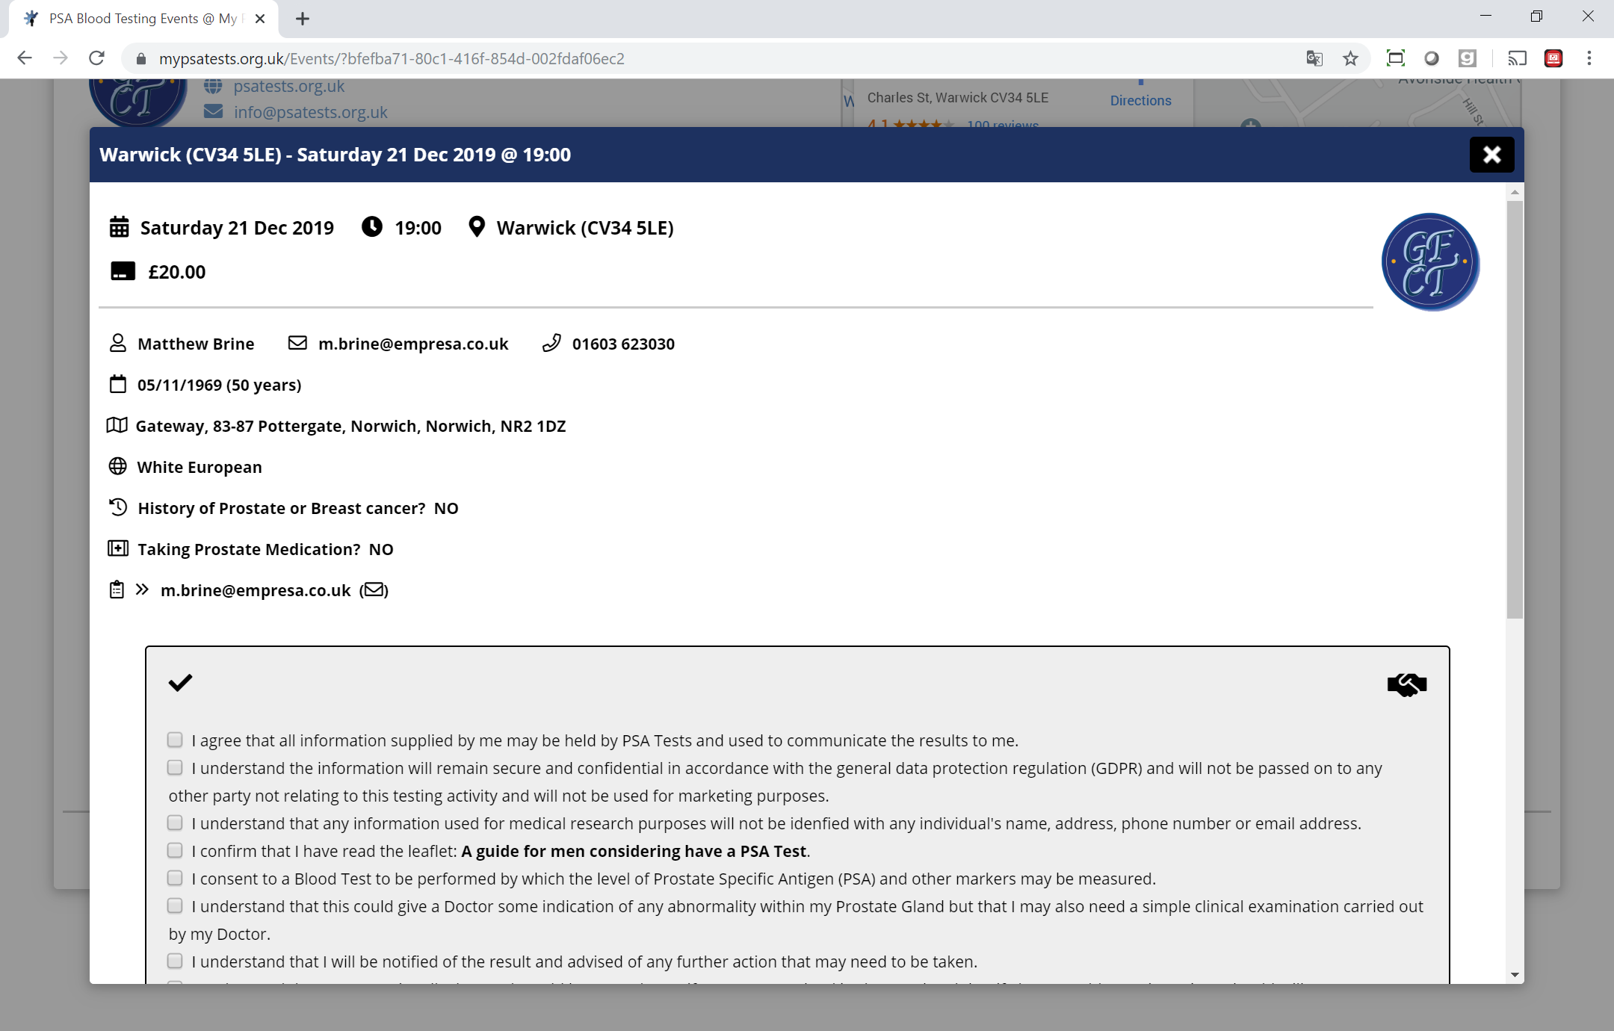
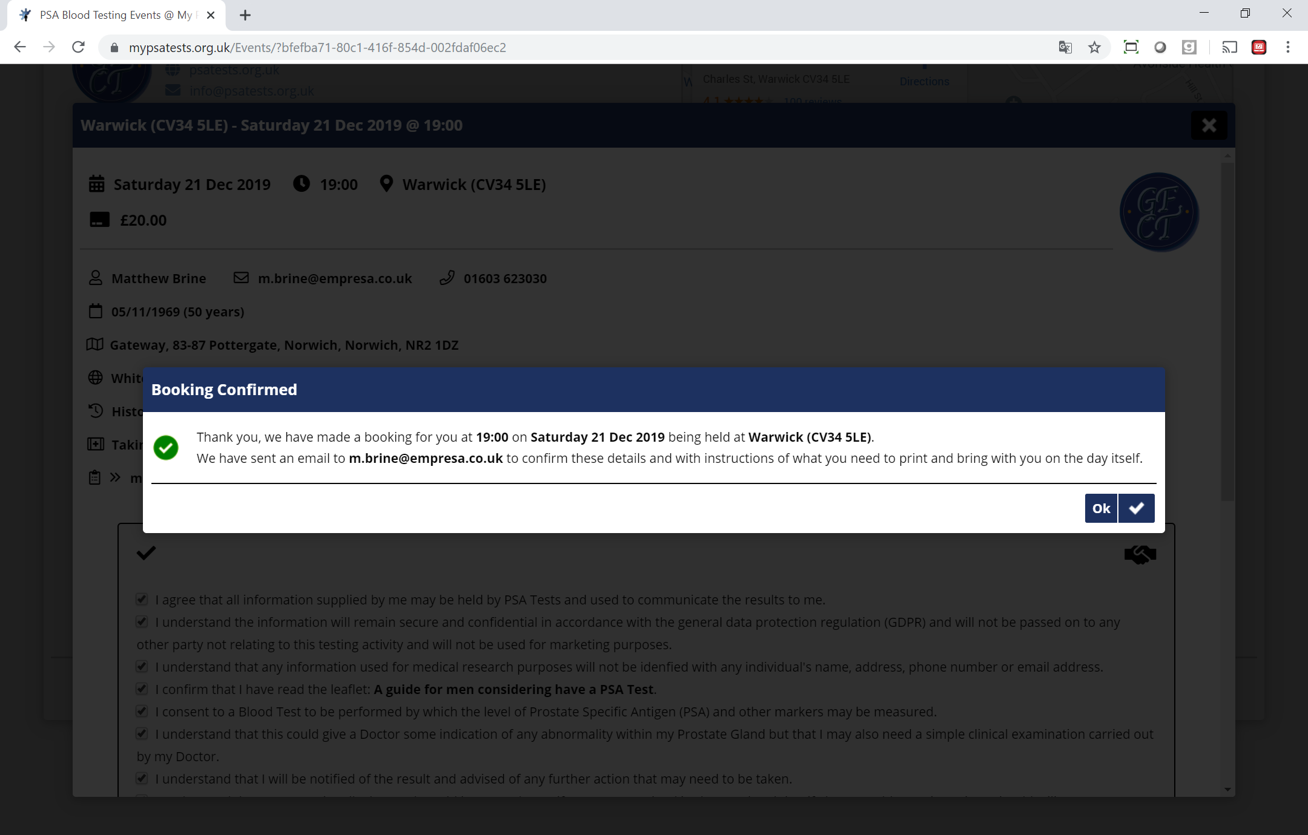
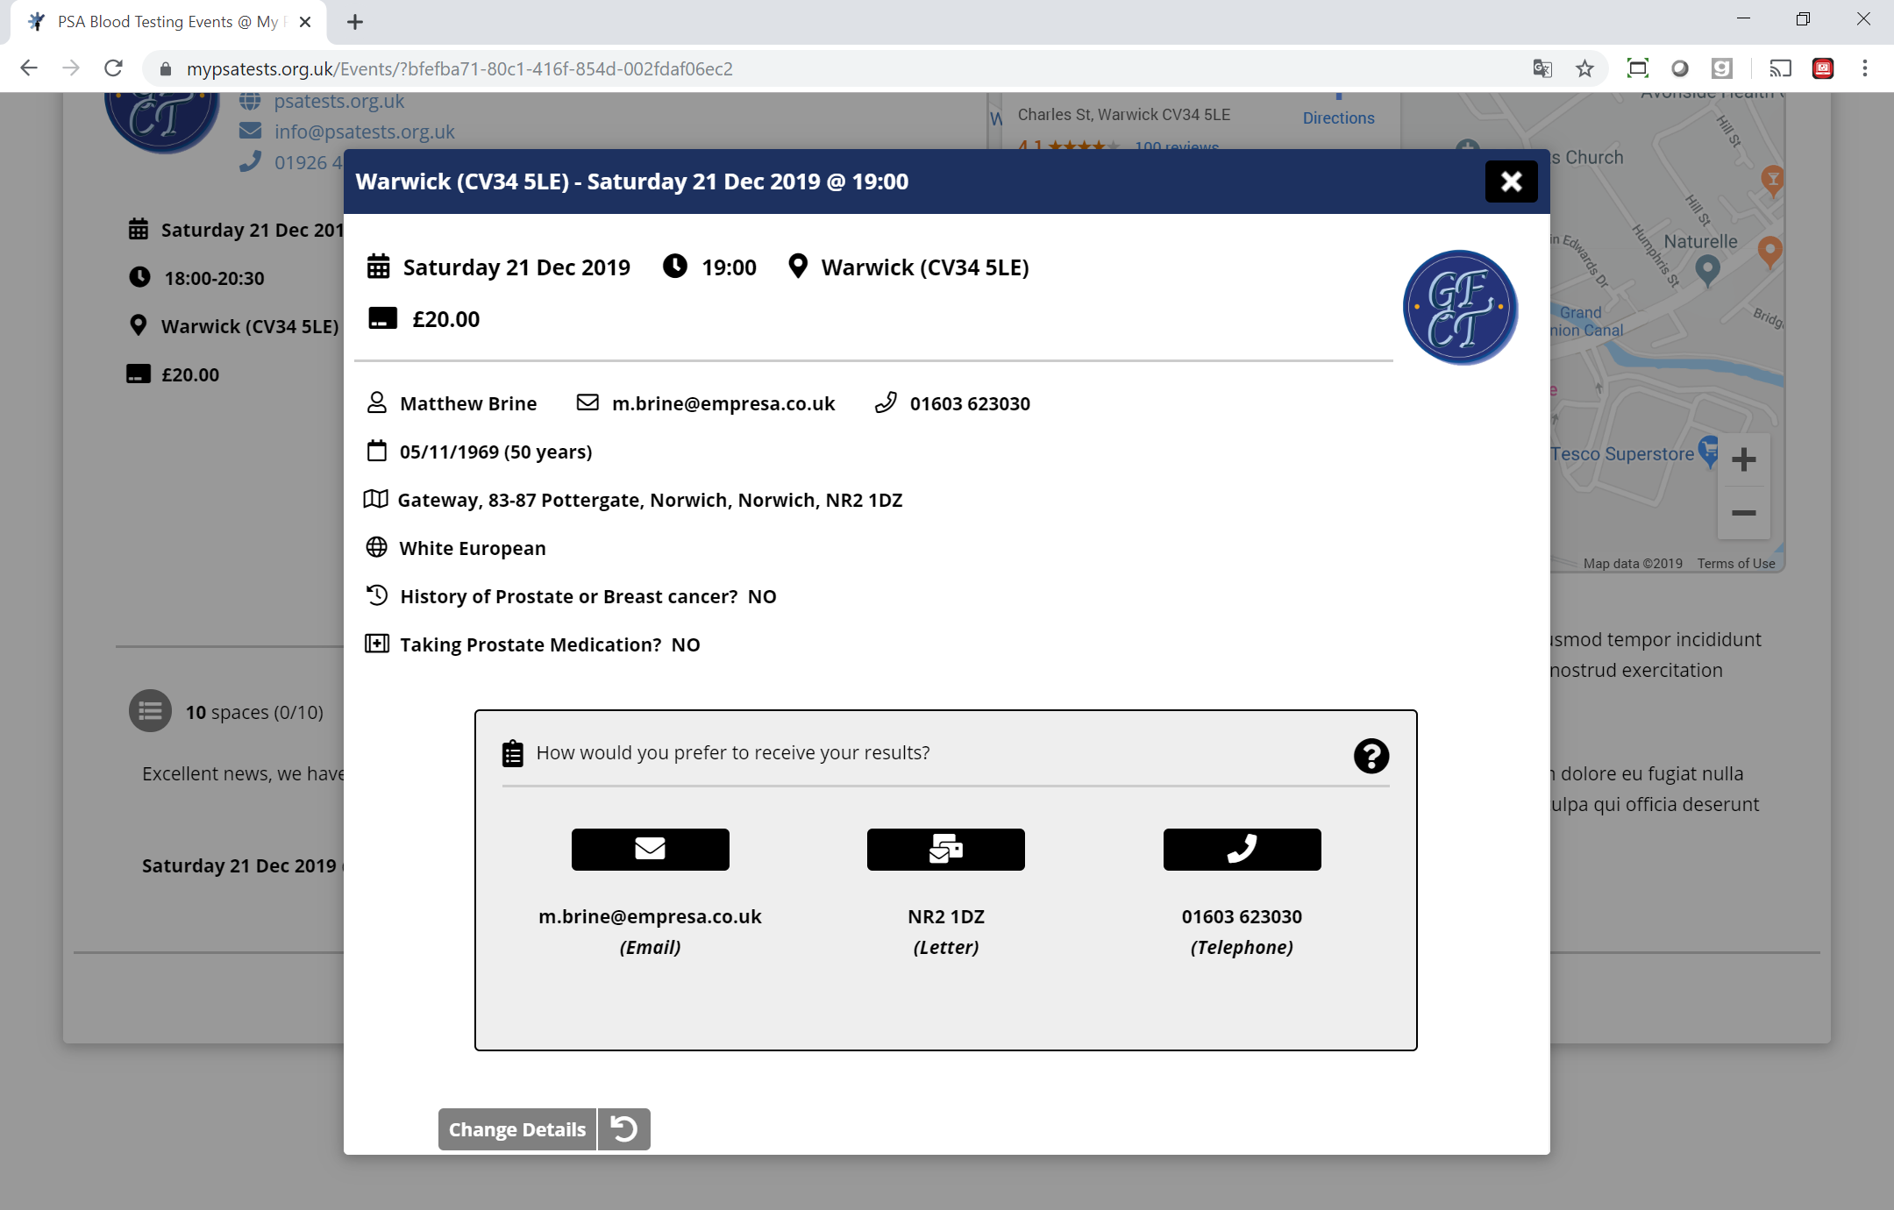
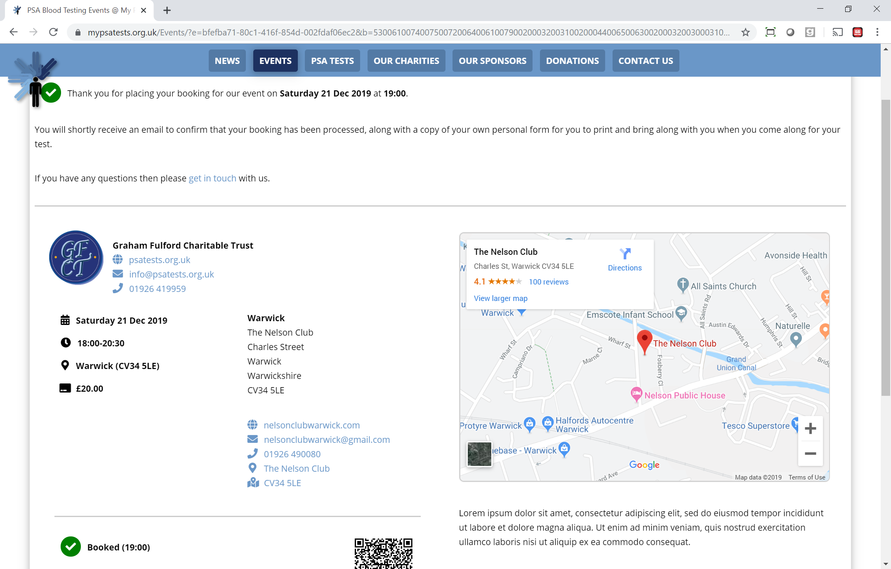
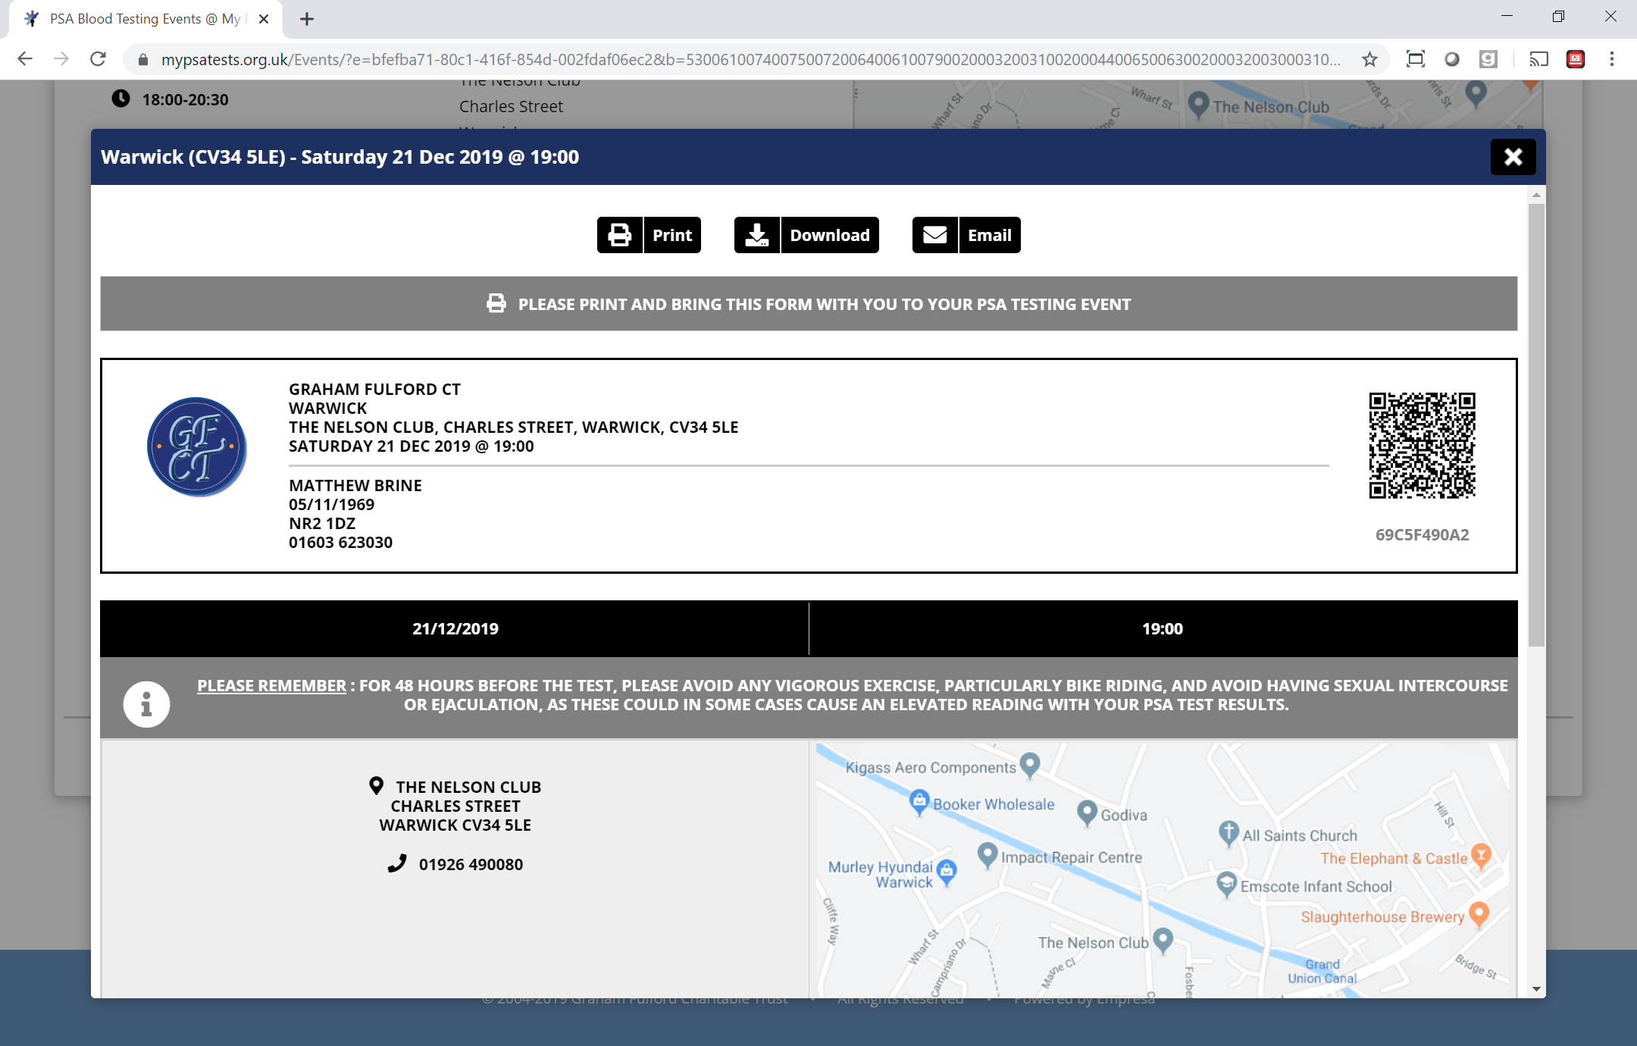
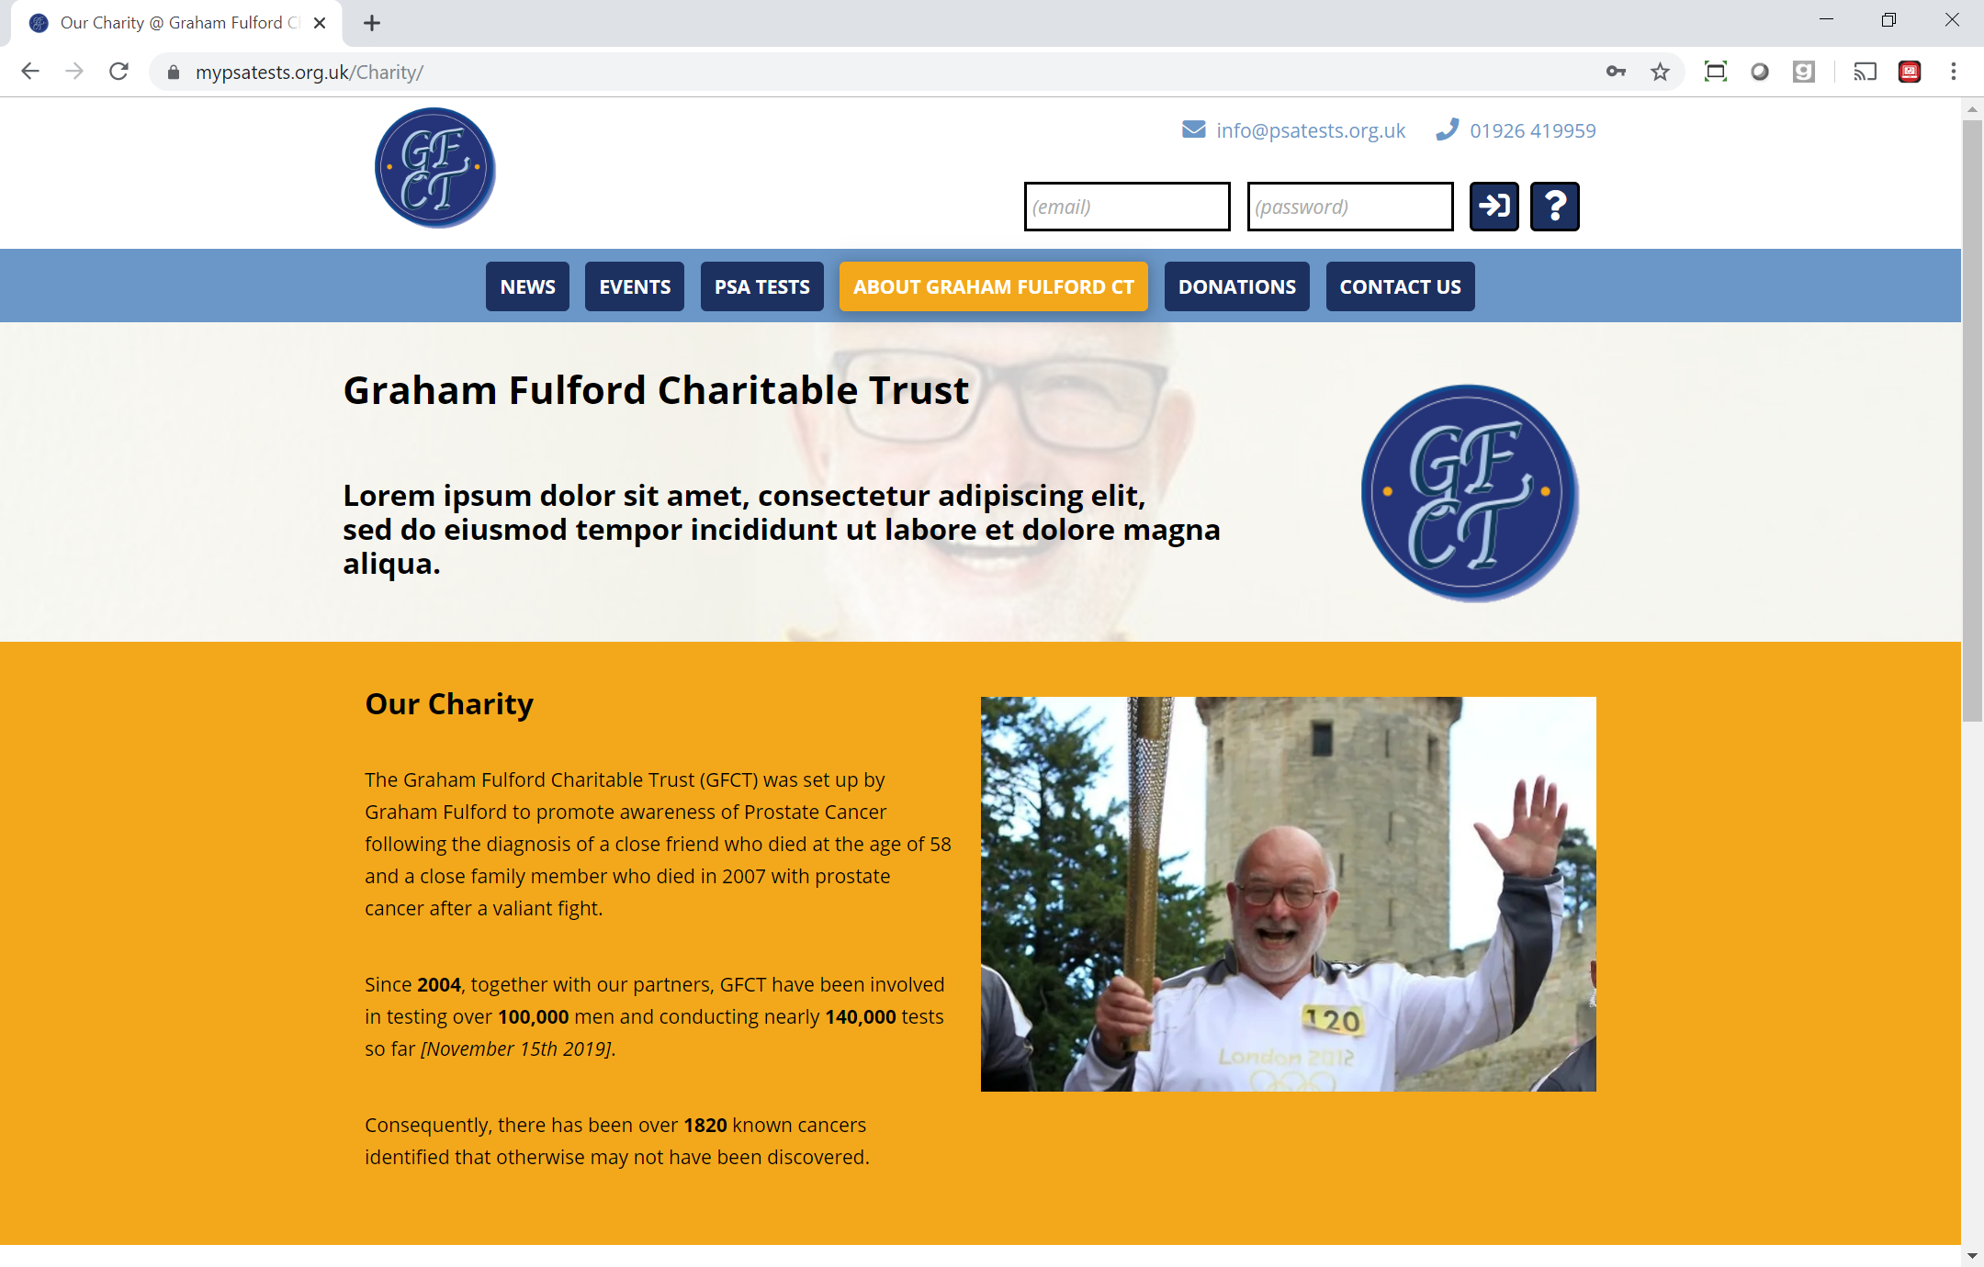
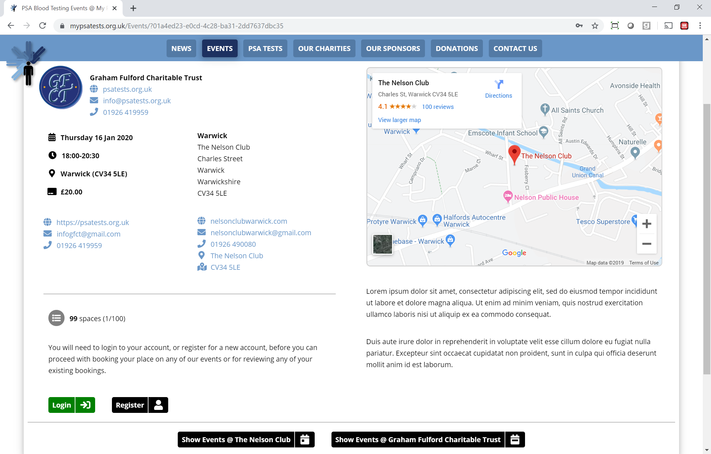
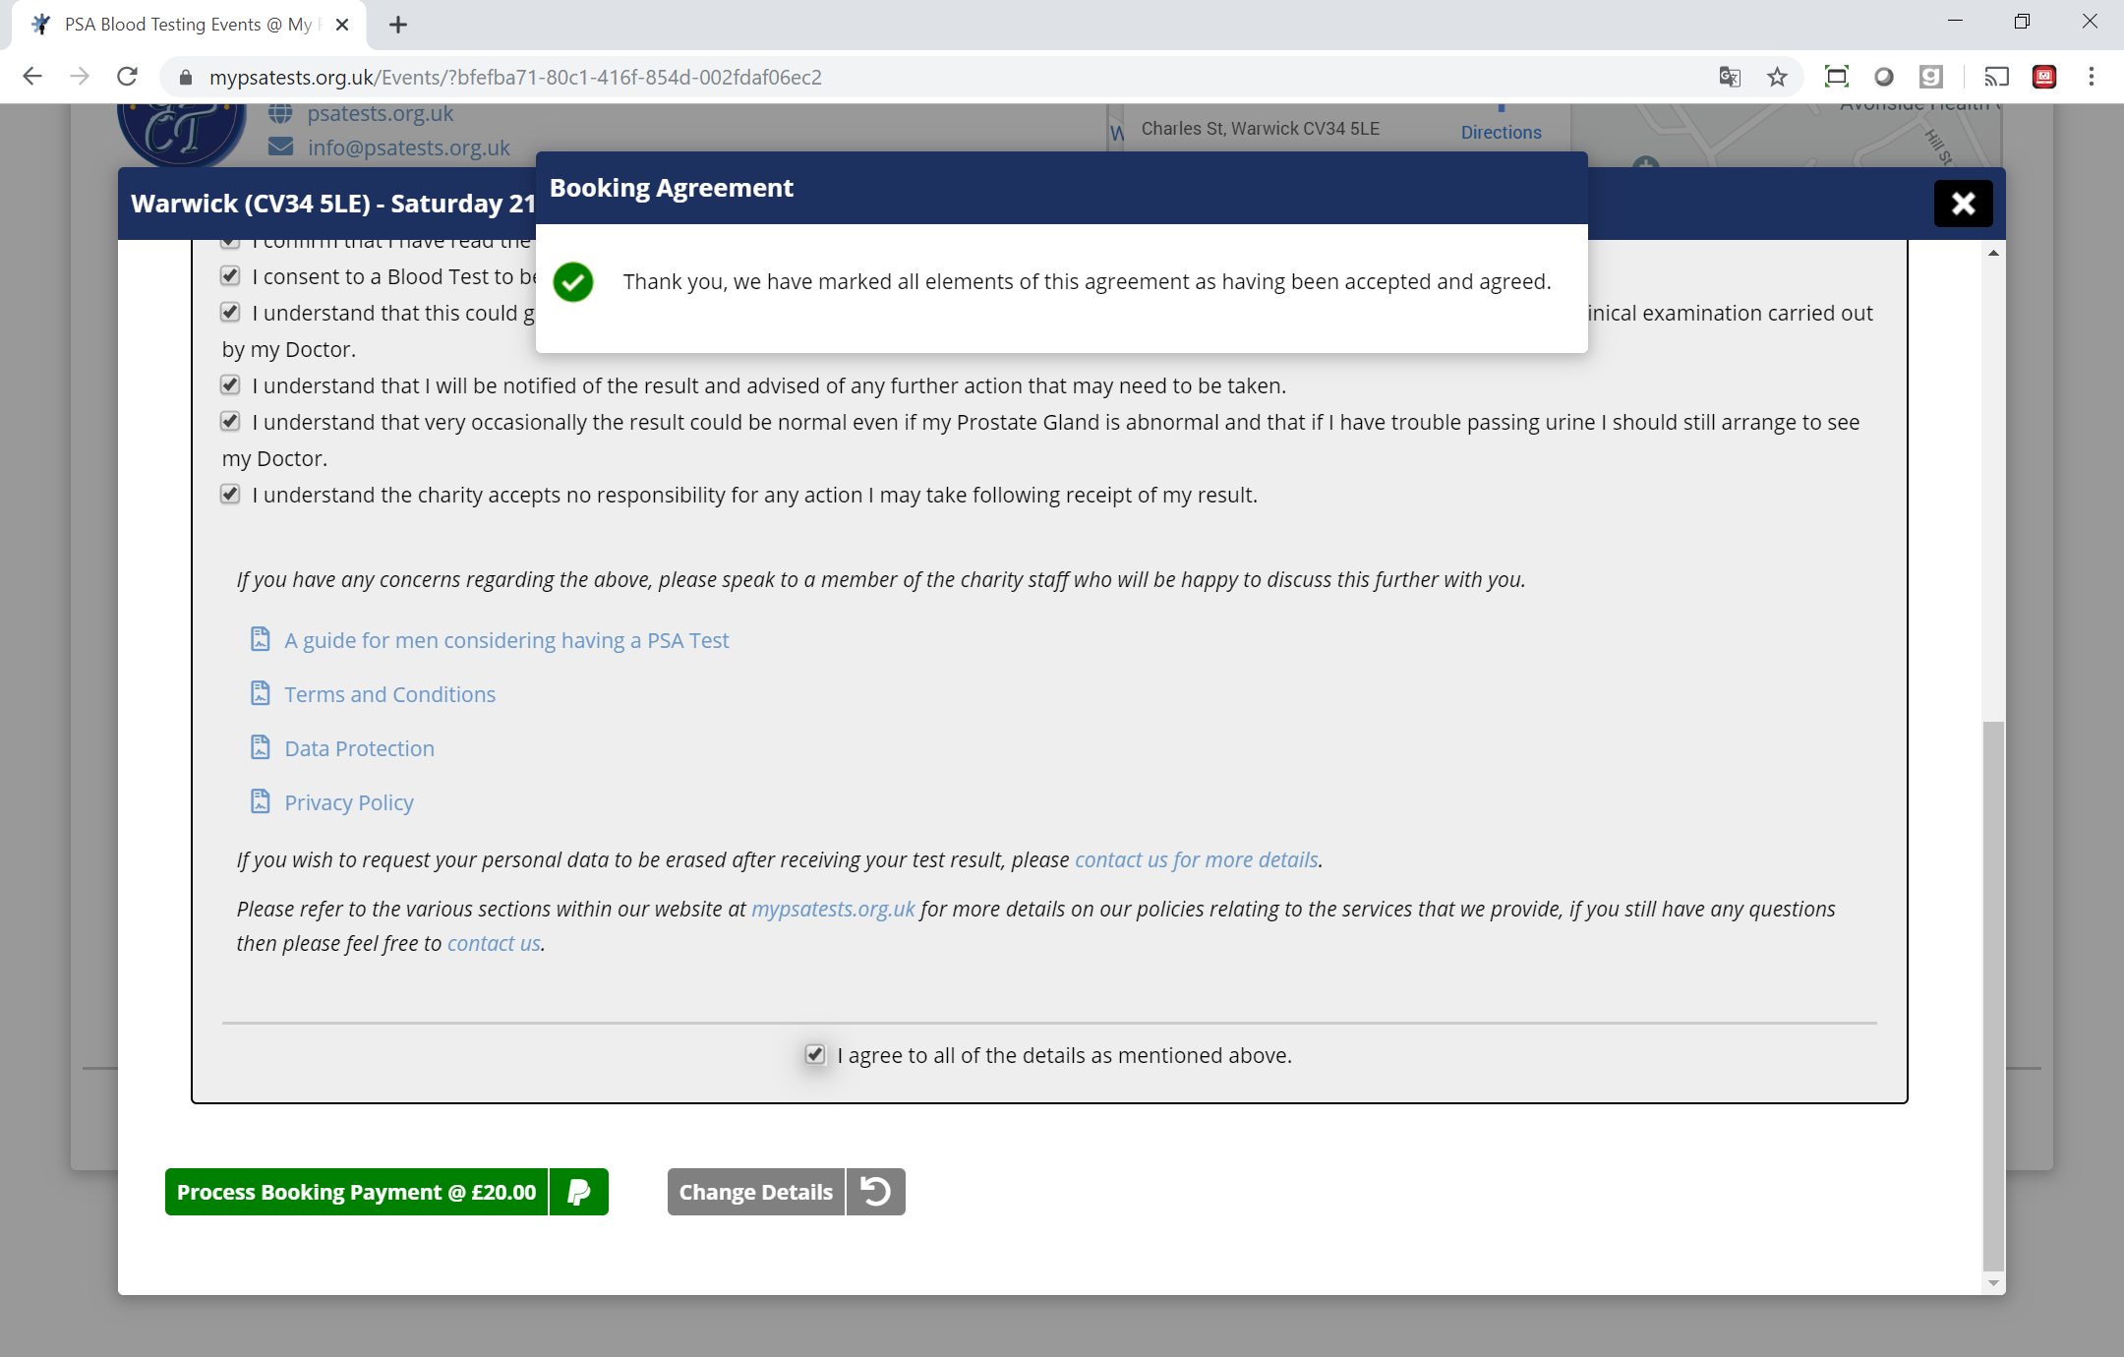
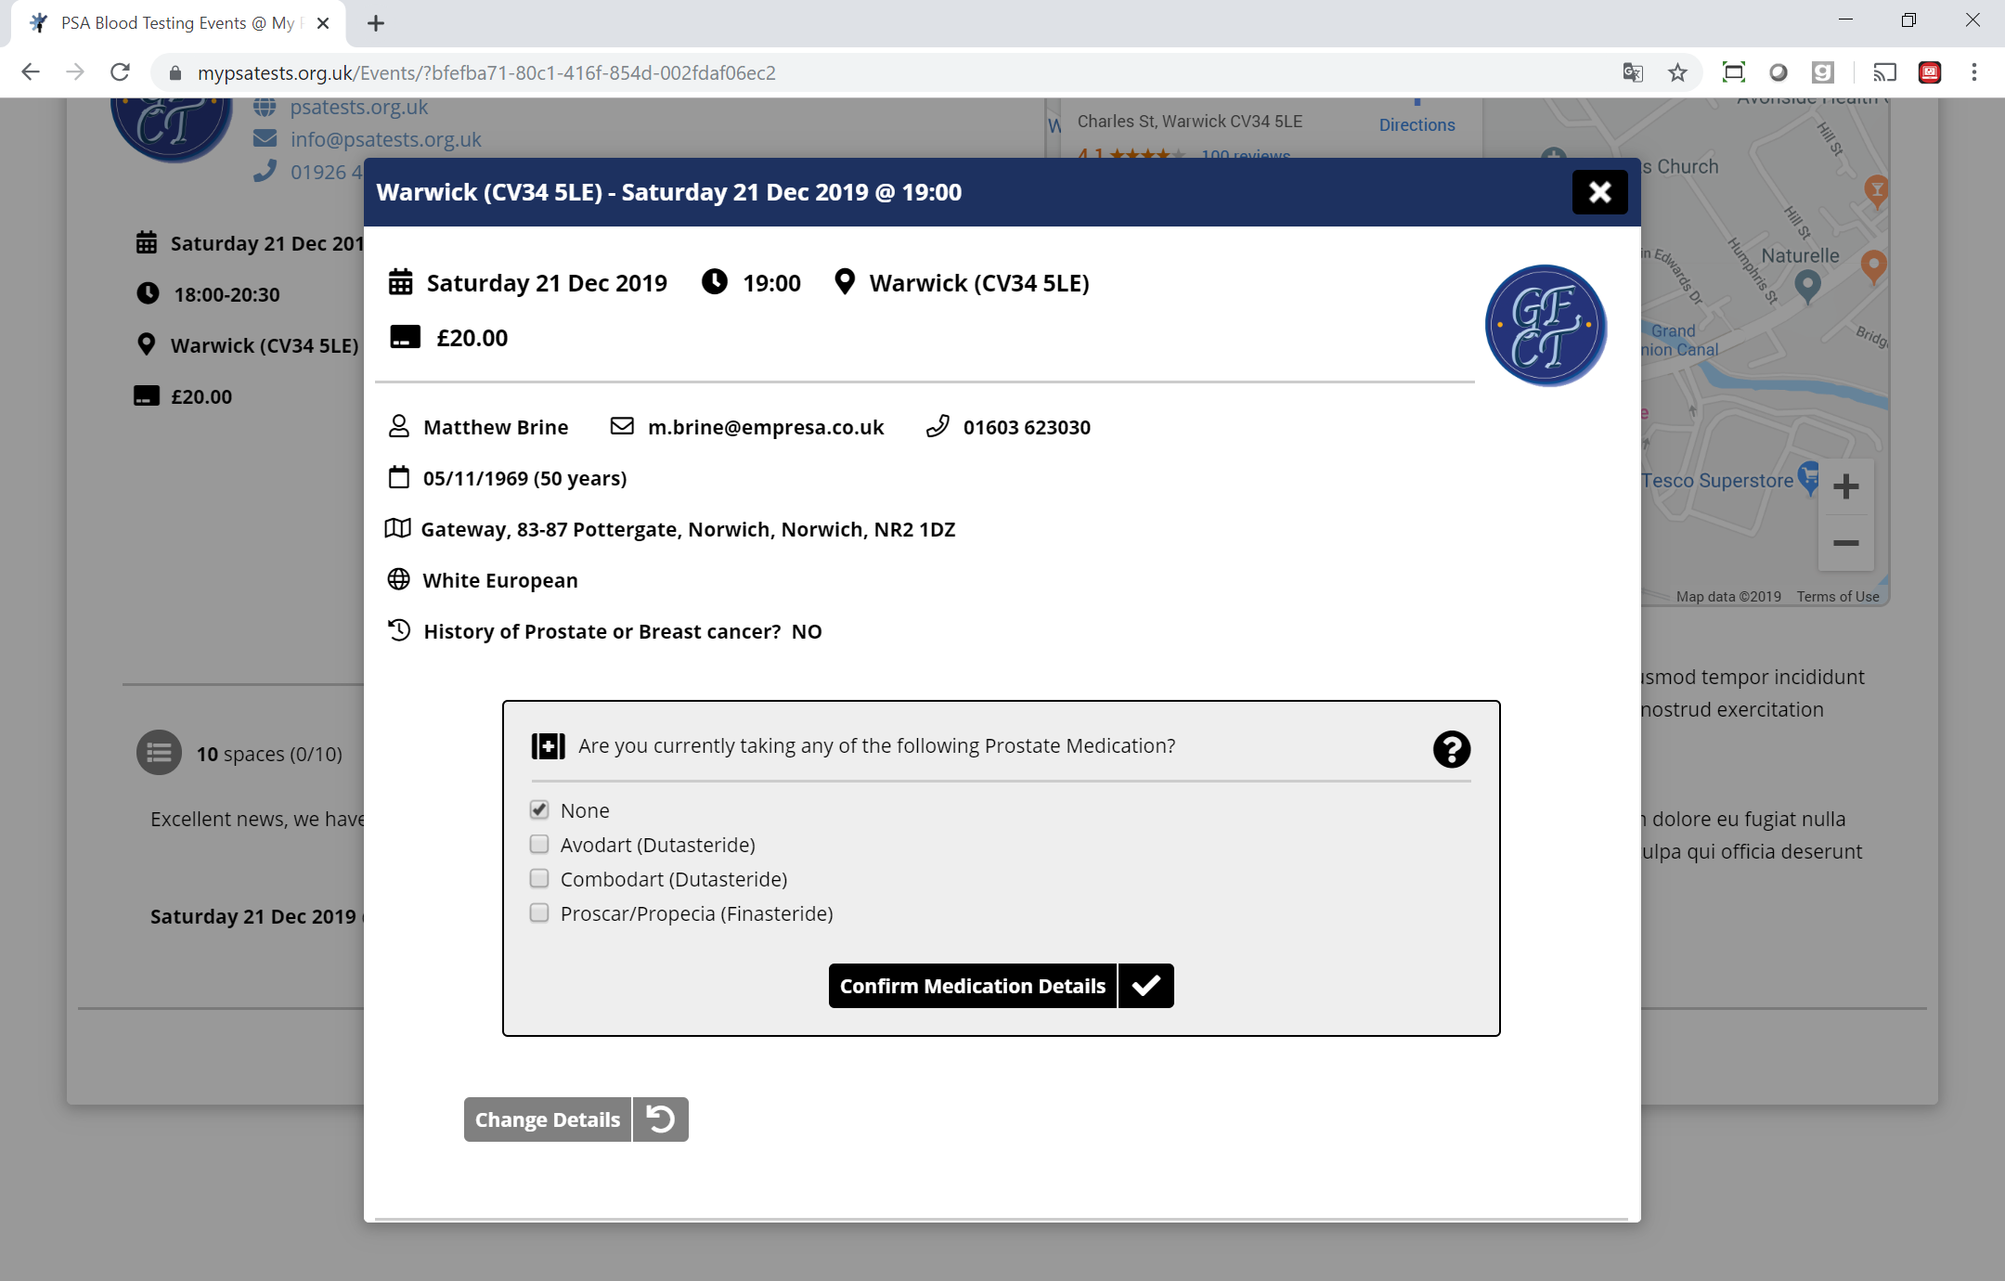
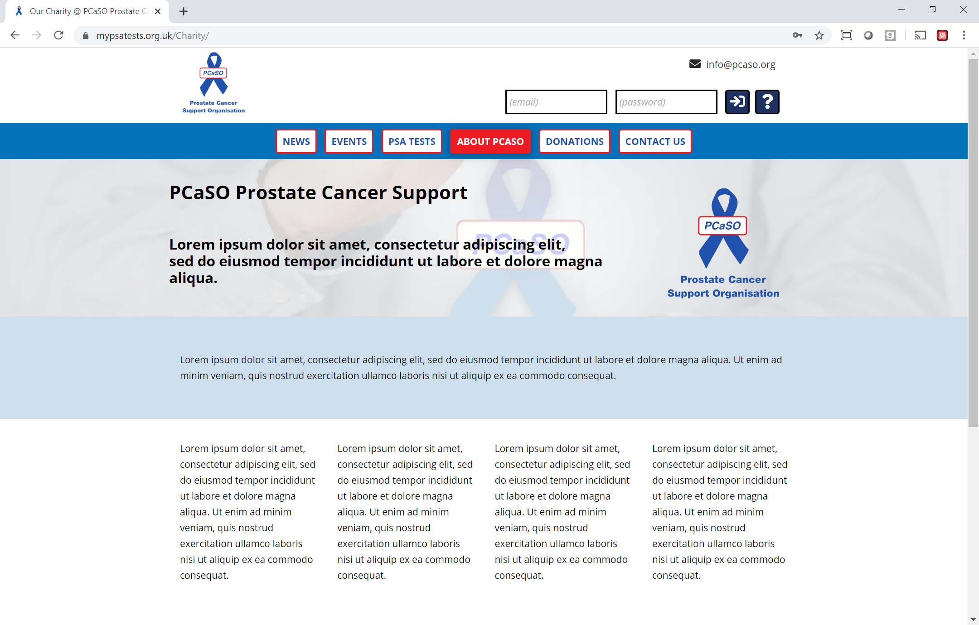
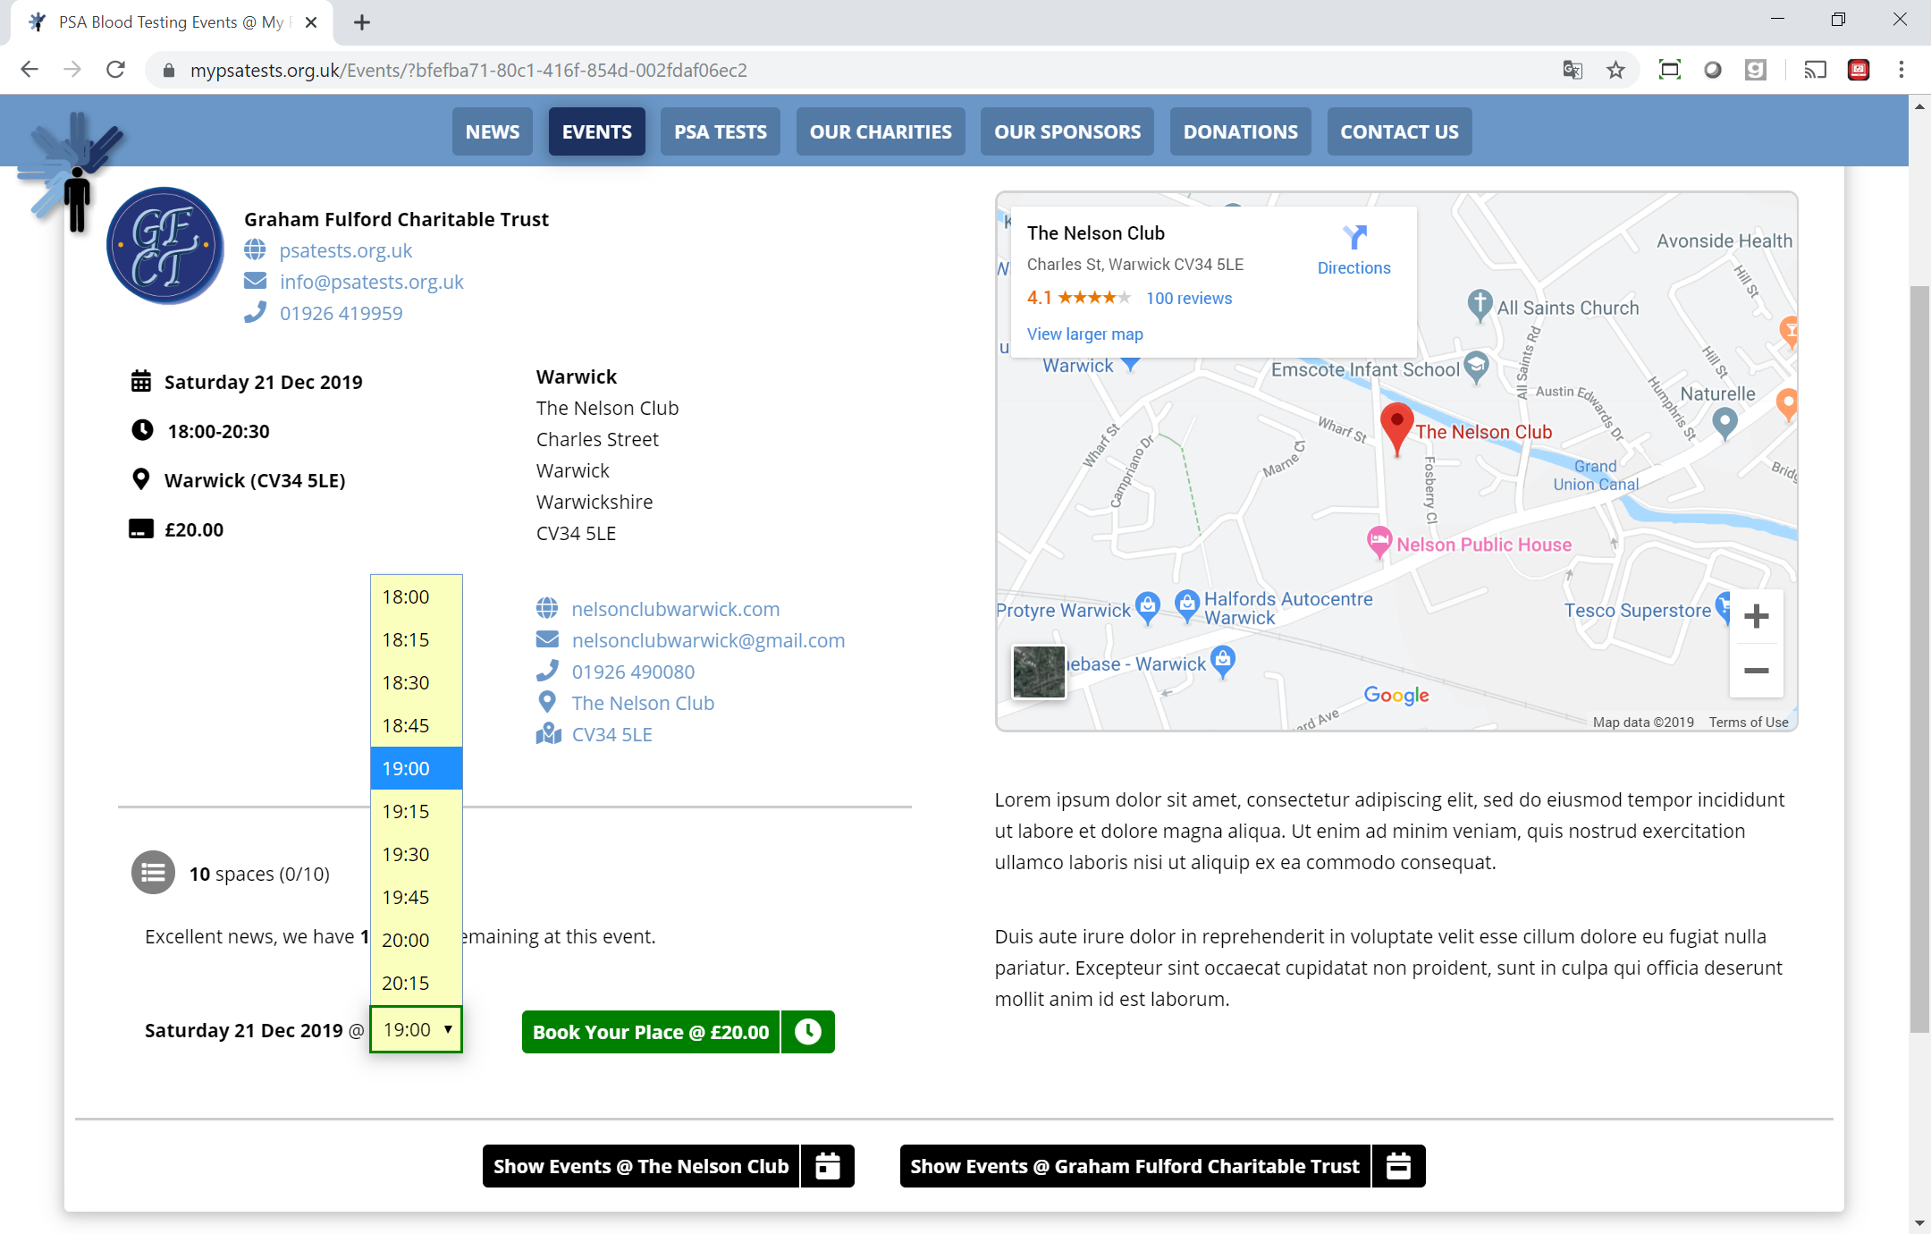
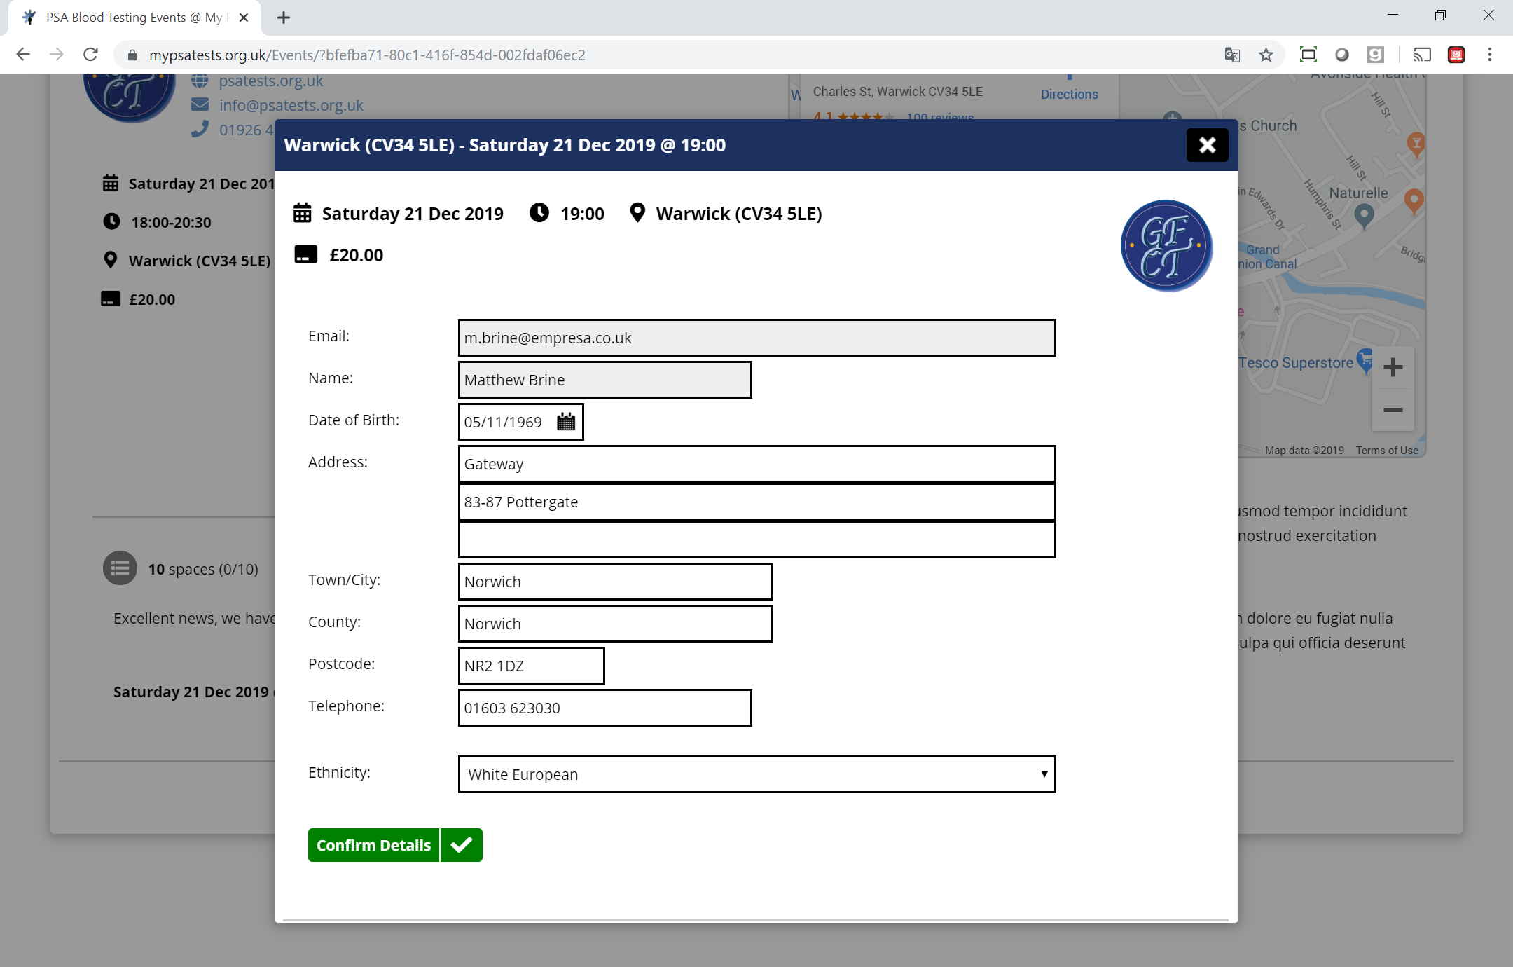
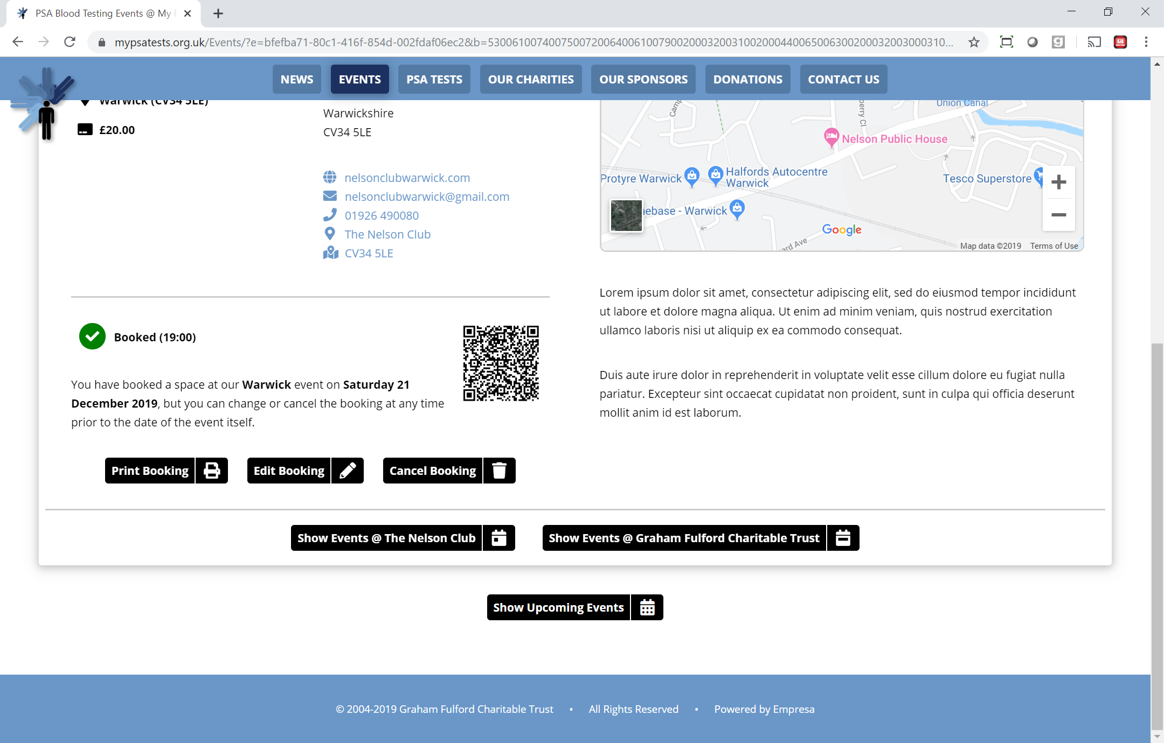
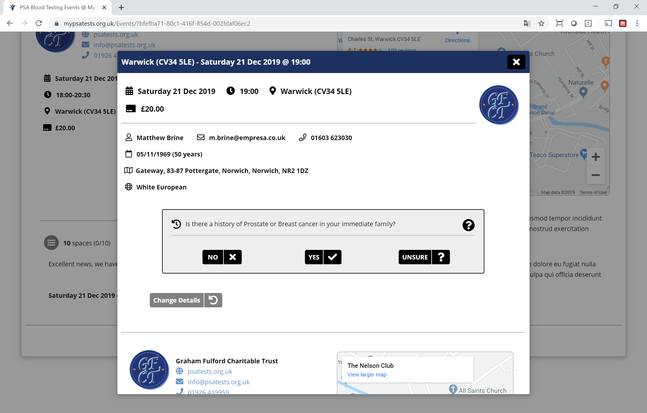
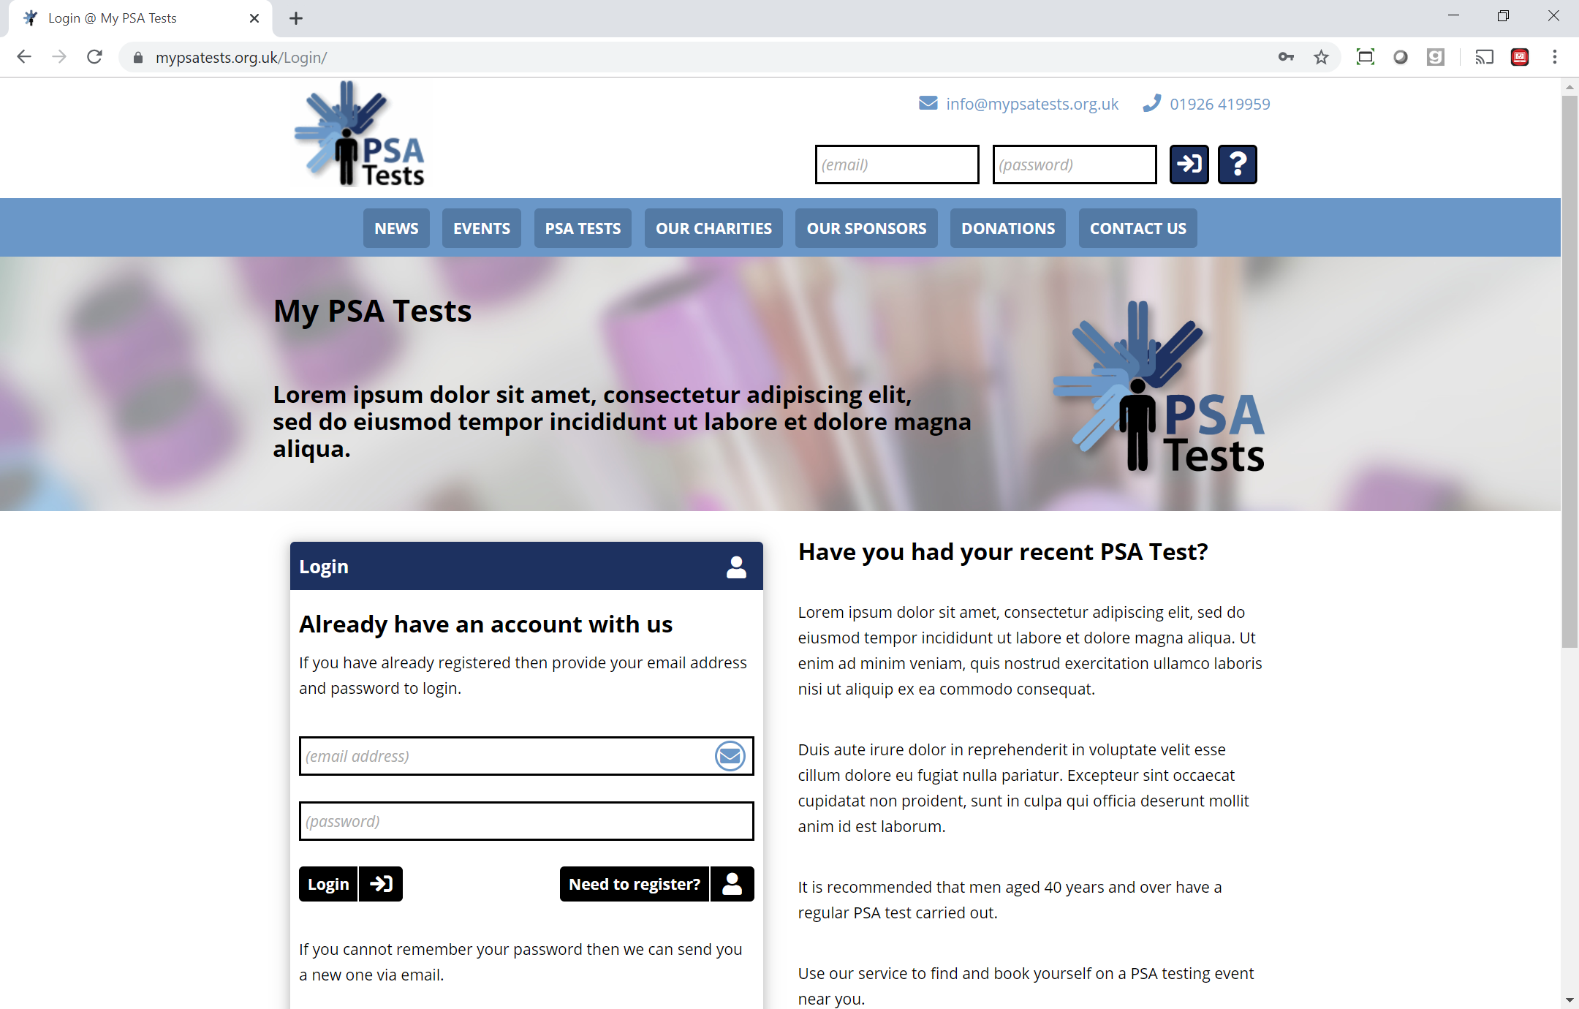
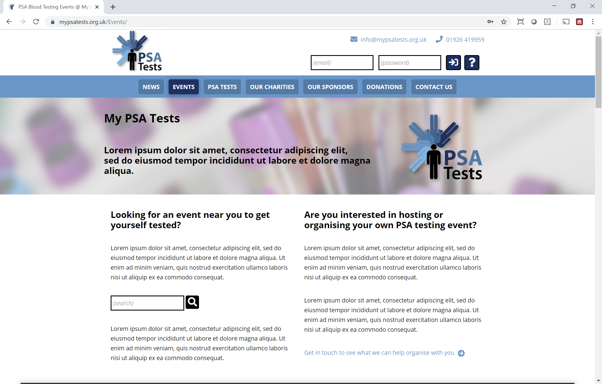
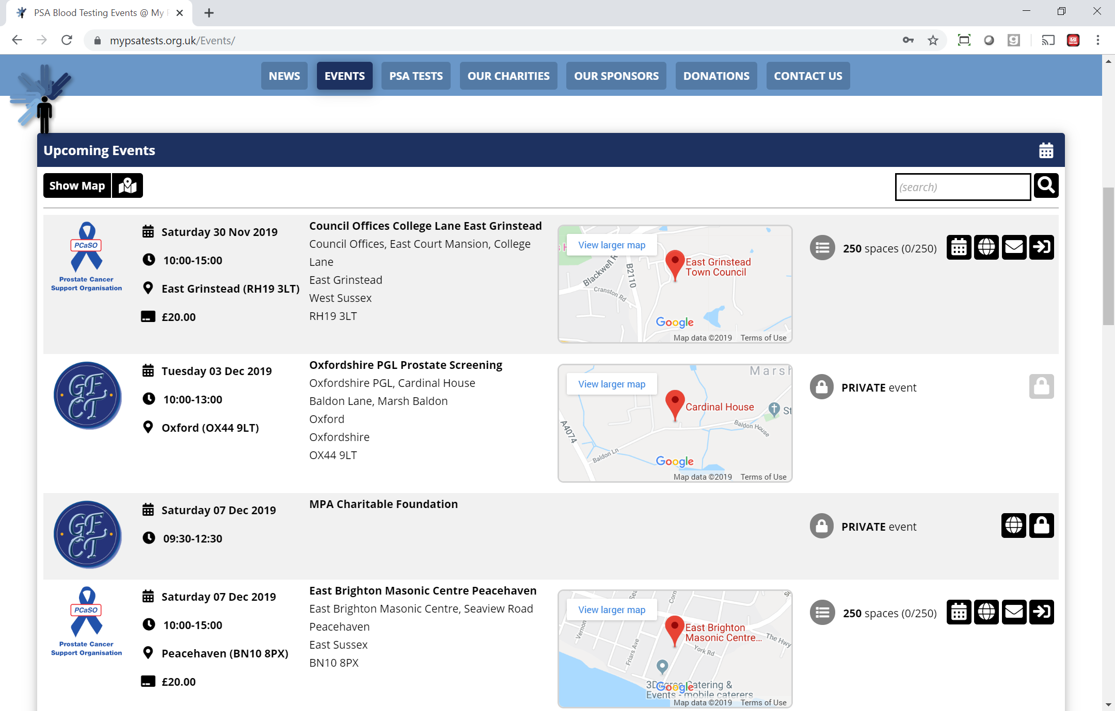
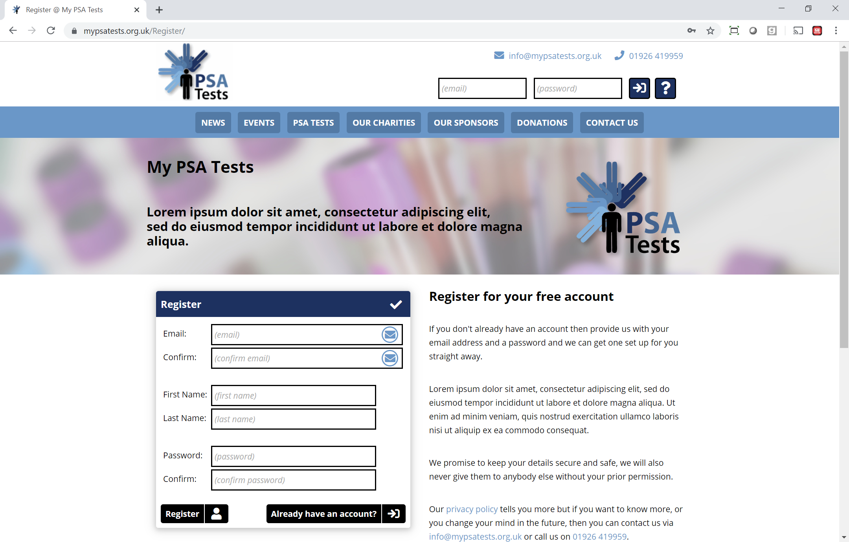
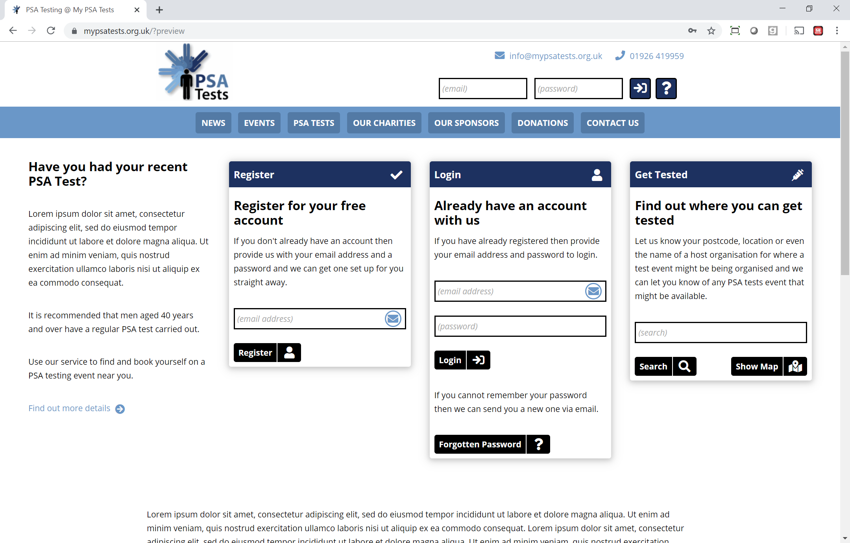
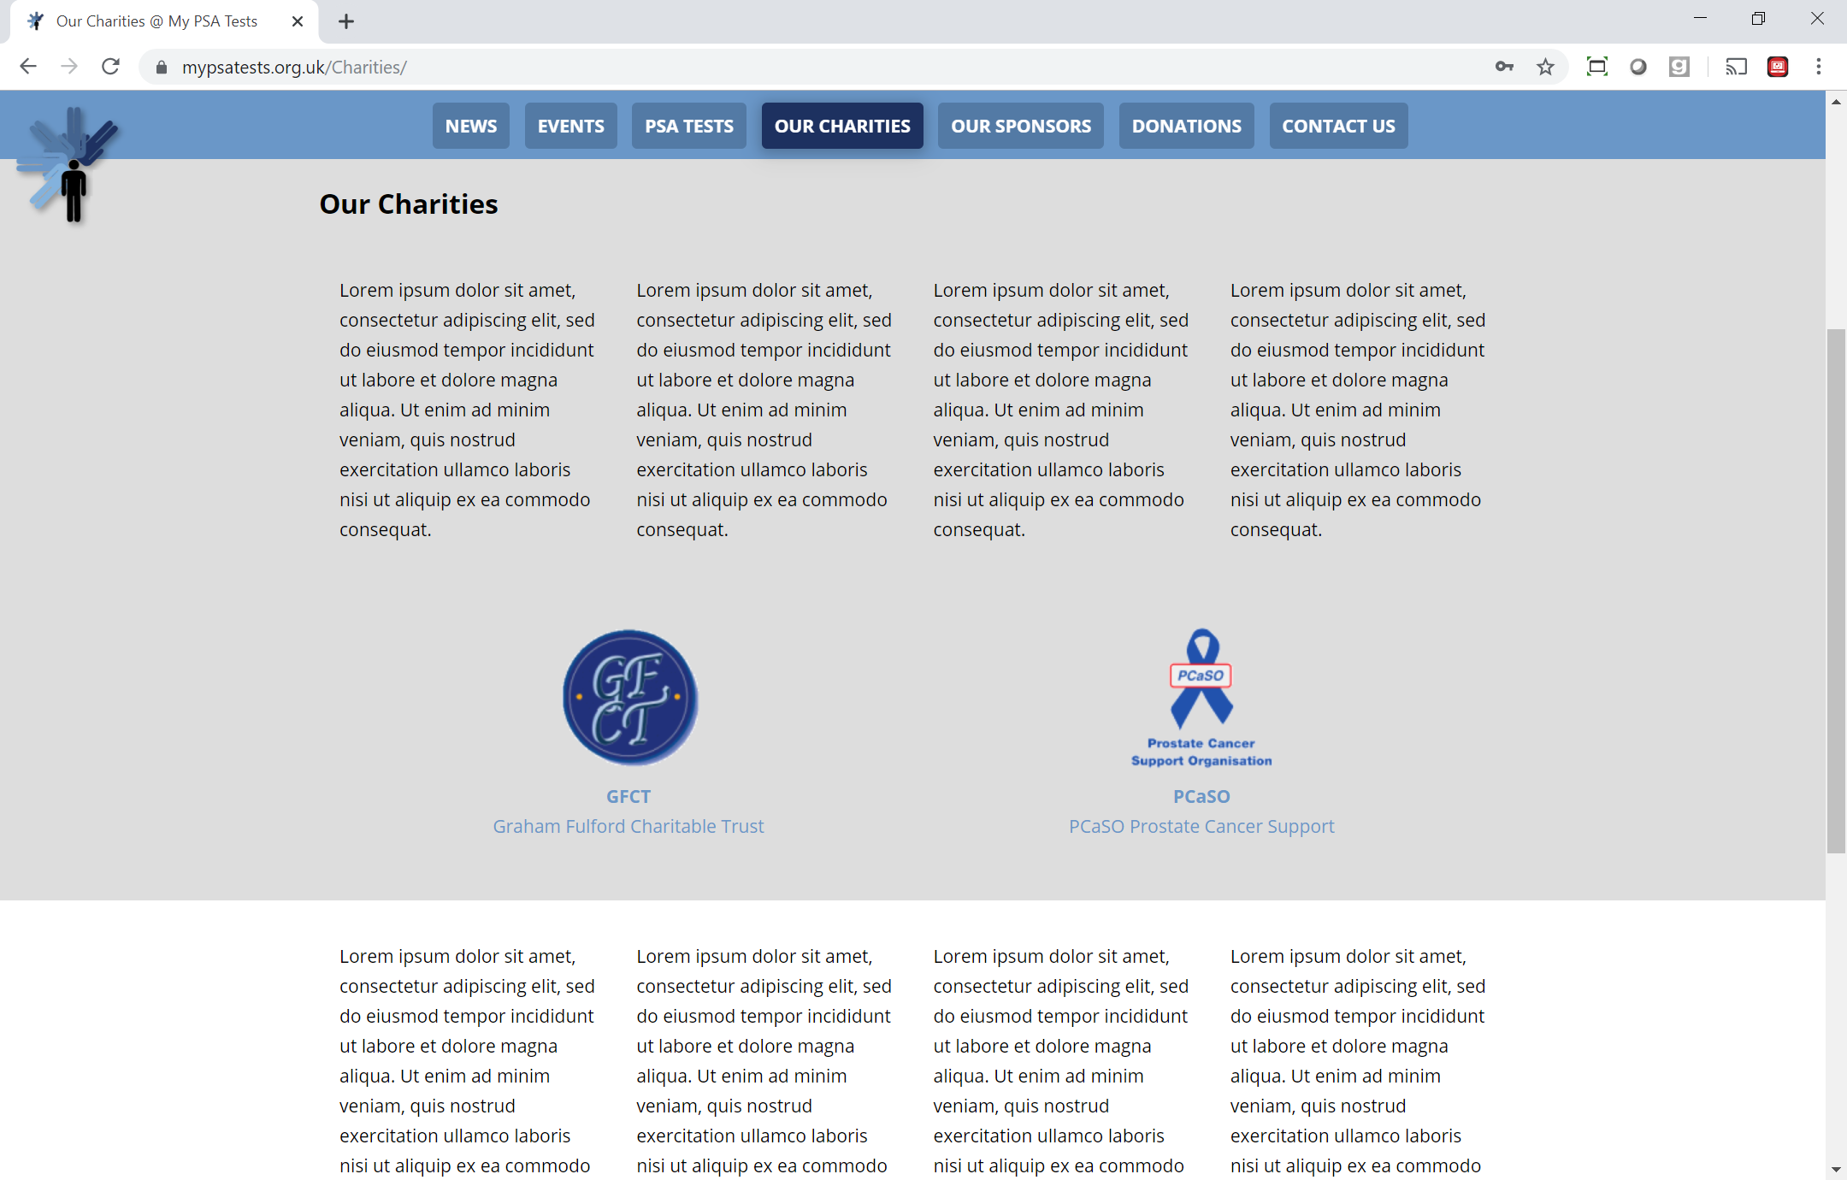
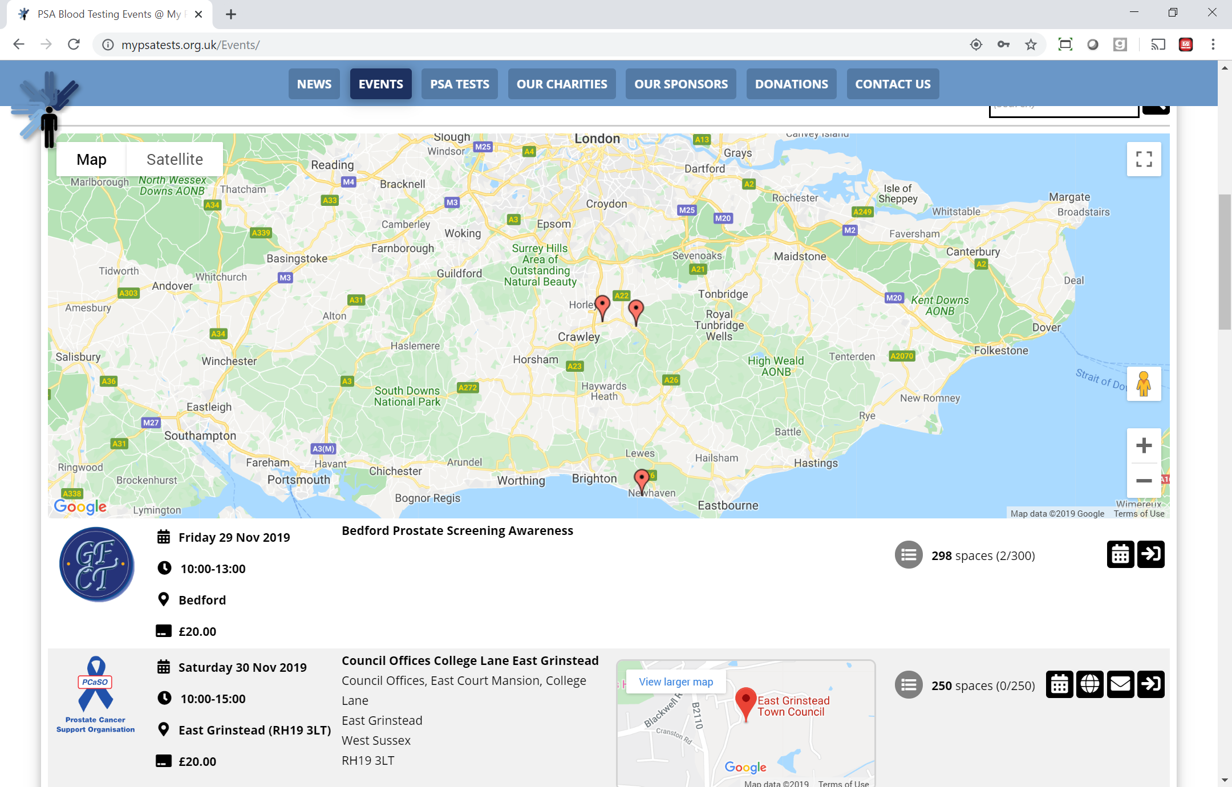
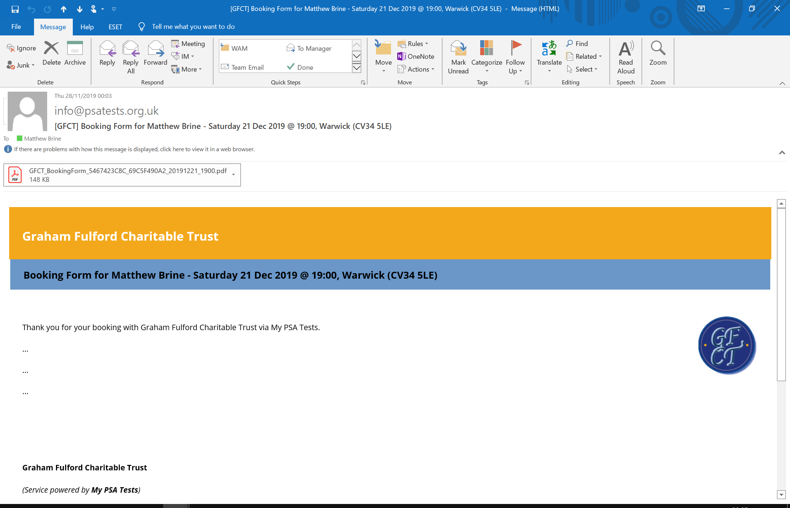
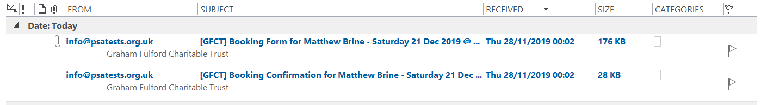
Take a Tour

Slide 49
Thank you…
Any questions?

Slide 50
Try it out…
https://www.mypsatests.org.uk
Unlock code = LETMEIN
Mobile Device responsive issues
Booking Form formatting issues
Email white labelling issues
Payments disabled for preview

Slide 51







Huawei E5573bs-322 4G Mobile Wi-Fi
Wireless internet access for all devices if no onsite Wi-Fi (using Three 4G network)
Epson Expression Home XP-2100
Wireless Printing with Wi-Fi Direct to Allow All Devices to Print over Wi-Fi
Surface Go for Business (Windows 10 Pro) – Wi-Fi / 64GB / 4GB
Wireless Access to Internet and Wireless Printing – «Portable/Walkabout Usage»
Surface Book 2 for Business (Windows 10 Pro) – Wi-Fi / 256GB / 8GB / i5 / 13.5”
Wireless Access to Internet and Wireless Printing – «Desk Usage»
Storage / Protective Cases

Slide 52
GFCT – guest speaker
GFCT computerisation seminar 28-11-2019

Slide 53
GFCT – Graham Fulford
GFCT computerisation seminar 28-11-2019

Slide 54
Gfct – TDL Error count
Event Location | Date | No. Tests | Errors
 |  |  | Surname | Forename | DOB | Total | %
Calne | 03/08/19 | 181 | 3 | 2 | 1 | 6 | 3.31
Oakengates | 16/09/19 | 253 | 5 | 3 | 5 | 13 | 5.14
Whitchurch | 23/09/19 | 487 | 1 | 1 | 1 | 3 | 0.62
Stone | 24/09/19 | 371 | 3 | 5 | 2 | 10 | 2.70
Devizes | 28/09/19 | 270 | 6 | 2 | 2 | 10 | 3.70
Flint | 08/10/19 | 328 | 7 | 10 | 1 | 18 | 5.49
Newport | 14/10/19 | 591 | 6 | 4 | 2 | 12 | 2.03
Penrith | 17/10/19 | 397 | 10 | 7 | 4 | 21 | 5.29
Totals |  | 2878 | 41 | 34 | 18 | 93 | 3.23

Slide 55
GFCT – Graham Fulford
GFCT computerisation seminar 28-11-2019

Slide 56
GFCT
GFCT computerisation seminar 28-11-2019

Slide 57

GFCT – Boston Scientific
GFCT computerisation seminar 28-11-2019

Slide 58
Bedford PCSG
Boston Scientific
Craighaven Ltd
Dave Mathews
Empresa Ltd
Henry VIII Trust Warwick
Keith Harrison
Lucey & O’Sullivan
Marshall Developments Ltd
Newbold Developments Ltd
Solutions UK Ltd
TGFP Ltd
The Doctors Laboratory
WA and Mrs PC Jenkin
Warwick in Need
Warwick Provident Dispensary
Warwick United Charities
Roger Wootton
Gary Steele MBE
Keith Cass MBE
David Smith
Mike Lockett
Jim Swainton
David and Dorothy Baxter Smith
Graham Fulford
Sue Fulford
Susan Hart
Ken Williams
Steve Valentine
Wendy Hodgkinson
Katrina Jakeway
Jon Young
Mike Young
David Skinner
Clare Brown
Sam Brown
Caitlin McBride
Carla Towey
Jane Towey

