Slide 1
The CAEP Annual Planning & Fiscal Reporting Webinar
August 2019

Slide 2
Agenda
3-year plans
Annual plans
NOVA Processing
Fiscal Reporting in NOVA
What’s FIFO?
Closing out CAEP funds
Data & Accountability final report & practice with promise
Questions

Slide 3
Planning
3 year plans were due June 7, 2019.
These are regional plans to guide your consortium.
They are not “approved” by the State – but submission is required.
3 year plans drive the annual plans – due August 15th.
Annual plans drive the member work plans due September 30th.
Notes:
Same process as last year. Only difference is 3 year plan which will be used to create annual plan and each members’ objectives and budgets.
Approval of your plan is when the plan was put in NOVA. Submission = approval. This month there will be a summary of all the plans in the next newsletter .
Plans are due the 15th of August. Allows time for agencies / members to create plan and budget. Bottom line deadline is October 30th certification. No micro-managing of delivery and due dates. Miss October 30th deadline and there’s a problem with reporting for first quarter. We can manage our own schedule basically up to the 30th of October.

Slide 4
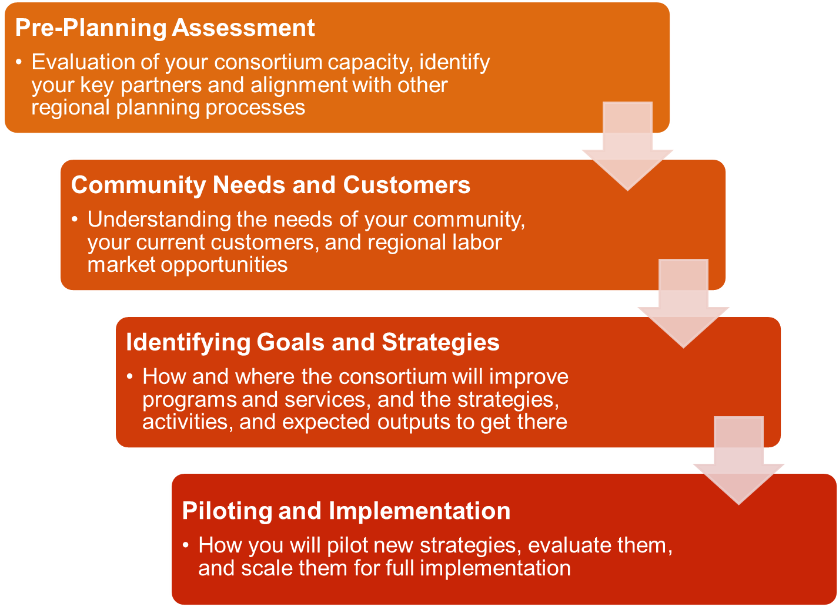
Notes:
Annual plan just focuses on the objectives through June 30, 2019.
See next slide.

Slide 5
19-20 Annual Plan
Same as last year (see 18-19 annual plans in NOVA).
Same text boxes to complete in NOVA.
Aligns with the 3 year planning process.
Consortium must type in NOVA the responses to the annual planning prompts.
All members must certify the annual plan.
Notes:
Be careful of what objectives you list.
If someone is going to a conference, then there should be an objective that fits that. Hiring teacher or classified or spending in some way (staff development) so that it is covered. Ask members what they are projecting on spending for the year.

Slide 6
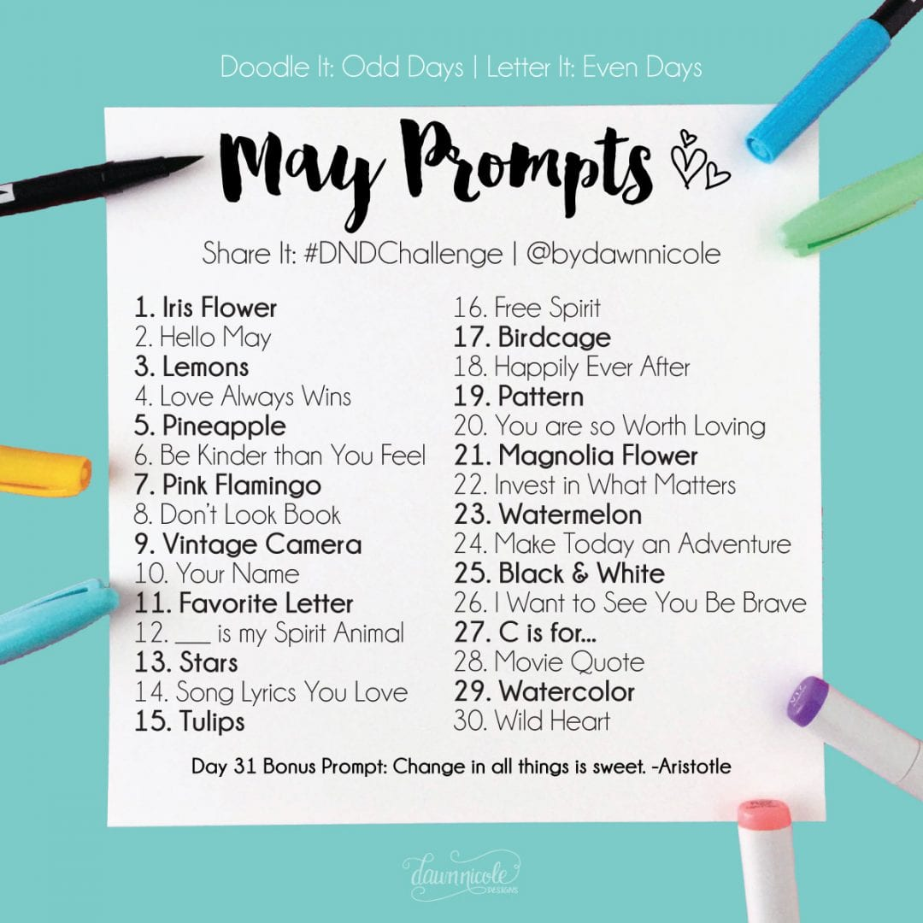
Review of Annual Plan Prompts

Slide 7
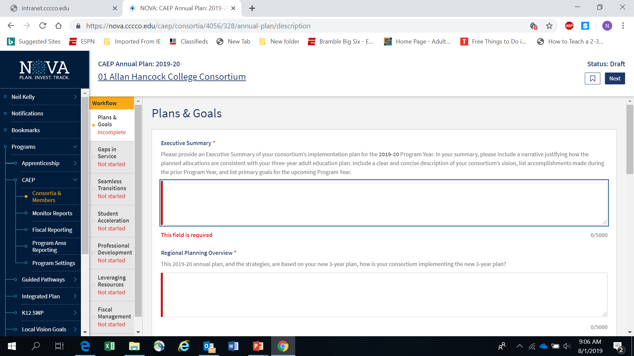
Notes:
Once the annual plan is populated then the members put in their annual plan and their budgets.
Be sure to scroll to bottom that your text isn’t cut off due to character limit (which includes spaces)
No special formatting allowed.
Unlimited regional needs.
Red line means the field is required.
Can work in different parts and also return. Allows flipping back and forth without disrupting text and progress.
Need to discuss how the carry over funds at the end of Q4 will be used in this annual plan.
Can share annual plan with others. Will receive email with comment and pdf of the document you are discussing. DO THIS BEFORE SUMISSION SO PEOPLE CAN SEE.
Once submitted the members will get a link to approve or reject.
NOTE: in the fiscal section and tie to plan…would like how we determined funding and how that all ties to the plan and plan creation.

Slide 8
NOVA Annual Plan Tips
Use information from your new 3 year plan.
Annual Plan strategies will become your member work plan objectives.
Make sure your strategies are broad enough for members to use in their work plans.
Work plans are supported by the member’s budget.
Notes:
Be sure to let board know that the annual plan strategies have to be included in member work plan objectives.
Day to day operational “stuff” is expected. Hiring teachers. utilities. Janitors. Etc. for AE schools. Won’t necessarily align with the objectives specifically but understood it is needed to have the school operational.

Slide 9
NOVA Annual Plan Tips (cont.)
Consortium certification of annual plan and member work plans & budgets will satisfy State’s need for consortium & district approval to spend CAEP funding for the year.
Use the Fiscal Management section to explain your consortium’s carry over policies and how funds will be liquidated.
Notes:
There need to be bi-laws (charter, I asume) that talks about consortium policy on carry over and how funds will be liquidated. Draft potential amendment to charter for September meeting.

Slide 10
NOVA Annual Plan Tips (cont. 1)
Annual plans must be approved in NOVA by all the consortium members.
Make sure you are in contact with your members about the 8/15/19 due date.
If you miss the 8/15 due date, it will delay your members from creating their work plans and budgets.
Notes:
S

Slide 11
Fiscal Reporting in NOVA
Notes:
S

Slide 12
Fiscal Reporting
Member budgets are based on work plans and the consortium annual plan.
Prior year carry-over will be included in member budgets & expense reporting.
All members must be up to date on their work plans, budgets & expense reporting in order to move into the next year and/or next quarter.
Notes:
Put in an objective of operational costs and running consortium—Neil.
Must include prior year carry over in 19-20 budget.

Slide 13
What’s FIFO?
FIFO = First In, First Out.
CAEP funds are 3 year funds.
State tracks CAEP funds via NOVA.
Member district must also track CAEP funds expenses via their accounting office.
NOVA = 3 year expense reporting.
Local accounting = 1 year expense reporting.
Notes:
Important piece here is that CAEP funds are three year funds. Tracked on cycle of three years. When you close out in march report 2020 for 2017-2018, are you showing expenditures in NOVA that liquidate those.
Is it showing in NOVA that it is liquidated. If it is, then you’re fine.
At the district, you may be counting yearly and therefore it will seem like you expended but you did not. We discussed this at the May 31 LB meeting.
NOVA doesn’t allow you to go into previous years anymore. Just do it in the next year. They used to but it was a mess. So no more.
So March 1, 2020—all they care about is that 17-18 shows expended in NOVA.

Slide 14
What’s FIFO? (cont.)
Sometimes the NOVA expenses will not match the local district accounting expenses.
Once a Q4 report is certify by the consortium in NOVA – we cannot reopen that year for any changes.
If expenses are missed – catch up in the next year. It’s 3 year funding.

Slide 15
Closing Out CAEP funds
CAEP funds are 3 year funds.
The 17-18 CAEP funds were disbursed effective July 1, 2017.
The State targeted 100% spend down of these 17-18 funds by June 30, 2019.
With corrective action, members can have an additional six months until 12/31/19.
NOVA will close out 17-18 CAEP funds effective March 1, 2020.
Notes:
18-19 funds must be expended by June 30, 2020 or have to seek 6 month extension.
Individual agencies need to track this and we should have a plan in our charter that says process for using , reallocating, whetever so that it doesn’t go back to general fund. CAEP wants NOTHING going back to GF.

Slide 16
Closing Out CAEP funds (cont.)
This means each member must have spend all 17-18 CAEP funds and certify to that in NOVA effective March 1, 2020.
Consortium should have by-laws in place to review prior year funds (and prior prior year funds) to see if a member is spending down their funds in a timely manner.
Consortium can use the allocation amendment process in NOVA to shift funds to other members (with cause or member agreement).

Slide 17
Data & Accountability Close Out
Last step in the close out process.
Final report due August 26, 2019 in the old MIS WebEx system.
Data & Accountability Practices with Promise are due via the caladulted website on 8/26/19.
http://aebgpracticeswithpromise.com/showcase_data_accountability.asp
Notes:
Final report of august 26 is just recertifying one more time.
Practice with promise due.

Slide 18
Request Support from CAEP TAP

Slide 19
Upcoming Webinars and In-person Trainings
Notes:
TAP 888-827-2324
Wed august 21 about program hours and estimates. Let LB know so someone from each agency will attend.

